Slide 1
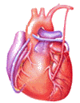
Cardiovascular Block Cardiac Cycle I & II and Heart Sounds and Murmurs
Dr. Ahmad Al-Shafei, MBChB, PhD, MHPE
Associate Professor in Physiology
KSU

Slide 2
Learning outcomes
After reviewing the PowerPoint presentation, lecture notes and associated material, the student should be able to:
Describe the normal cardiac cycle.
Discuss the relationship between the electrical and mechanical events during the cardiac cycle.
State the function of the heart valves.
Compare and contrast left and right ventricular pressures and volumes during the normal cardiac cycle
Define and state the normal values for the End-diastolic volume, end-systolic volume, stroke volume and ejection fraction.
Discuss changes in aortic pressure during the normal cardiac cycle.
Calculate pulse pressure and mean arterial pressure.
Describe the venous pulse waves.
Distinguish between the first and second heart sounds.
Define and classify cardiac murmurs.
Describe the haemodynamic changes associated with aortic stenosis and regurgitation.
Discuss the haemodynamic changes associated with mitral stenosis and regurgitation.

Slide 3
Learning Resources
Textbooks :
Guyton and Hall, Textbook of Medical Physiology; 12th Edition.
Mohrman and Heller, Cardiovascular Physiology; 7th Edition.
Ganong’s Review of Medical Physiology; 24th Edition.
Websites:
http://accessmedicine.mhmedical.com/

Slide 4
The cardiac cycle
The cardiac cycle consists of alternate periods of systole contraction and emptying) and diastole (relaxation and filling).
The atria and ventricles go through separate cycles of systole and diastole.
Contraction occurs as a result of the spread of excitation across the heart, whereas relaxation follows the subsequent repolarization of the cardiac musculature.

Slide 5
Early ventricular diastole
The SAN has not yet reached threshold.
The atrium is still also in diastole.
Because of the continuous inflow of blood from the venous system into the atrium, atrial pressure slightly exceeds ventricular pressure even though both chambers are relaxed.
Because of this pressure differential, the AV valve is open, and blood flows directly from the atrium into the ventricle throughout ventricular diastole.
As a result, the ventricular volume slowly continues to rise even before atrial contraction takes place.
The rate of filling declines as the ventricles become distended.
About 70% of the ventricular filling occurs passively during diastole.
This stage corresponds to the TP interval on the ECG: the interval after ventricular repolarization and before another atrial depolarization.

Slide 6
1
2
3
4
5
6
7
Atrial systole and Late ventricular diastole
120
80
40
0
Pressure
mm Hg
The SA node reaches threshold and fires
Impulse spreads throughout the atria (P wave on the ECG).
Atrial contraction → rise in atrial pressure curve.
More blood is squeezed into the ventricle → rise in ventricular pressure.
Throughout atrial contraction, atrial pressure slightly exceeds ventricular pressure, so the AV valve remains open.
EDV (averages about 135 ml).
140
70
Ventricular
volume, ml
4
heart sounds
a
venous pulse
P
ECG
Q
0 0.5 1.0 s

Slide 7
1
2
3
4
5
6
7
Isovolumetric ventricular contraction
120
80
40
0
The impulse passes through the AV node and specialized conduction system to excite the ventricles → ventricular contraction → ventricular pressure immediately exceeds atrial pressure → The AV valve is closed.
Ventricular pressure must continue to increase before it exceeds aortic pressure to open the aortic valve.
Because no blood enters or leaves the ventricle, the ventricular chamber remains at constant volume, and the muscle fibres remain at constant length.
This period lasts about 0.05 s, until the pressures in the left and right ventricles exceed the pressures in the aorta (80 mm Hg; 10.6 kPa) and pulmonary artery (10 mm Hg) and the aortic and pulmonary valves open.
During isovolumetric contraction, the AV valves bulge into the atria, causing a small but sharp rise in atrial pressure
Pressure
mm Hg
mitral
valve
closes
140
70
Ventricular
volume, ml
4
1
heart sounds
a
venous pulse
R
P
ECG
Q
S
0 0.5 1.0 s

Slide 8
1
2
3
Ventricular ejection
4
5
6
7
aortic
valve
opens
When ventricular pressure exceeds aortic pressure → the aortic valve is forced open → ejection of blood begins.
Ejection is rapid at first, slowing down as systole progresses.
The intraventricular pressure rises to a maximum and then declines somewhat before ventricular systole ends.
Blood is forced into the aorta faster than blood is draining off into the smaller vessels at the other end → rise of aortic pressure curve.
Peak pressures in the left and right ventricles are about 120 and 25 mm Hg, respectively. Late in systole, pressure in the aorta actually exceeds that in the left ventricle, but for a short period momentum keeps the blood moving forward.
Ventricular volume decreases substantially as blood is rapidly pumped out.
ESV (averages about 65 ml)
SV.
120
80
40
0
Pressure
mm Hg
mitral
valve
closes
140
70
Ventricular
volume, ml
4
1
2
a
c
heart sounds
The AV valves are pulled down by the contractions of the ventricular muscle, and atrial pressure drops.
venous pulse
R
P
T
ECG
Q
S
0 0.5 1.0 s

Slide 9
Ventricular repolarization
and onset of ventricular diastole
The T wave on the ECG signifies ventricular repolarization occurring at the end of ventricular systole.
The already falling ventricular pressures drop more rapidly. This is the period of protodiastole, which lasts about 0.04 s.
Protodiastole ends when the momentum of the ejected blood is overcome and the aortic and pulmonary valves close, setting up transient vibrations in the blood and blood vessel walls.
After the valves are closed, pressure continues to drop rapidly during the period of isovolumetric ventricular relaxation.

Slide 10
1
2
3
4
5
6
7
Isovolumetric Ventricular relaxation
aortic
valve
opens
aortic valve
closes
120
80
40
0
Pressure
mm Hg
mitral
valve
closes
When the aortic valve closes, the AV valve is not yet open, because ventricular pressure still exceeds atrial pressure, so all valves are once again closed for a brief period of time and no blood can enter or leave the ventricle.
The muscle fibre length and chamber volume remain constant.
As the ventricle continues to relax → the pressure steadily falls.
140
70
4
1
2
heart sounds
a
c
v
venous pulse
R
P
T
ECG
Q
S

Slide 11
1
2
3
4
5
6
7
Ventricular filling
aortic
valve
opens
aortic valve
closes
120
80
40
0
Blood continues to flow from the pulmonary veins into the left atrium → atrial pressure rises continuously.
When the ventricular pressure falls below the atrial pressure, the AV valve opens, and ventricular filling occurs once again.
It occurs rapidly at first because of the increased atrial pressure.
It then slows down.
The atrial pressure starts to fall.
During late ventricular diastole, when ventricular filling is proceeding very slowly, the SA node fires again, and the cardiac cycle stars over.
Pressure
mm Hg
mitral
valve
closes
mitral valve
opens
140
70
Ventricular
volume, ml
4
1
2
3
heart sounds
a
c
v
venous pulse
R
P
T
P
ECG
Q
S
0 0.5 1.0 s

Slide 12
Cardiac cycle timing
Although the events of the cardiac cycle on the two sides of the heart are similar, they are somewhat asynchronous.
Right atrial systole precedes left atrial systole. Contraction of the right ventricle starts after that of the left. However, since pulmonary arterial pressure is lower than aortic pressure, right ventricular ejection begins before that of the left.
During expiration, the pulmonary and aortic valves close at the same time; but during inspiration, the aortic valve closes slightly before the pulmonary. The slower closure of the pulmonary valve is due to lower impedance of the pulmonary vascular tree.
When measured over a period of minutes, the outputs of the two ventricles are equal, but transient differences in output during the respiratory cycle occur in normal individuals.

Slide 13
Length of systole and diastole
Cardiac muscle has the unique property of contracting and repolarizing faster when the heart rate is high.
The duration of systole decreases from 0.27 s at a heart rate of 65–0.16 s at a rate of 200 beats/min. The reduced time interval is mainly due to a decrease in the duration of systolic ejection.
However, the duration of systole is much more fixed than that of diastole. When the heart rate is increased, diastole is shortened to a much greater degree. For example, at a heart rate of 65, the duration of diastole is 0.62 s, whereas at a heart rate of 200, it is only 0.14 s.
Physiologic and clinical implications of shortened diastole: The heart muscle rests during diastole. Coronary blood flows to the subendocardial portions of the left ventricle only during diastole. Furthermore, most of the ventricular filling occurs in diastole.
At heart rates up to about 180, filling is adequate as long as there is ample venous return, and cardiac output per minute is increased by an increase in rate. However, at very high heart rates, filling may be compromised to such a degree that cardiac output per minute falls.

Slide 14
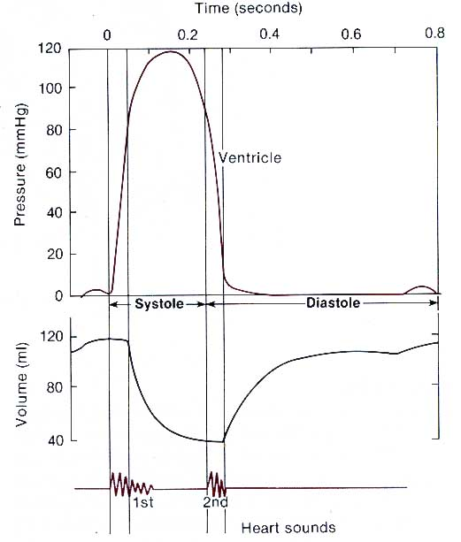
Normal LV pressure and volume

Slide 15
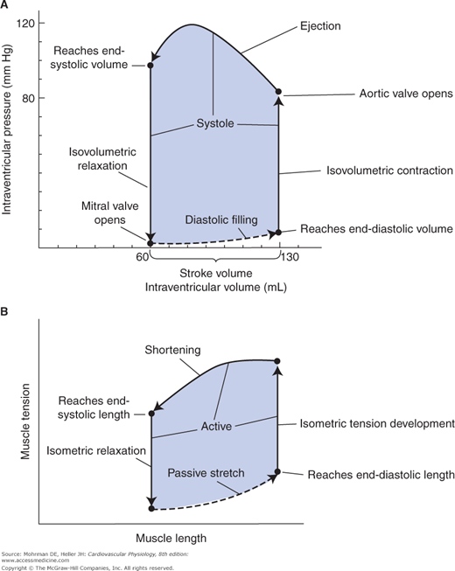
LV Pressure volume relationship in cardiac cycle
(A) Left ventricular pressure–volume cycle, and
(B) corresponding cardiac muscle length–tension cycle.

Slide 16
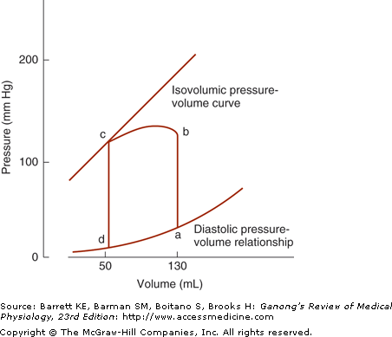
LV Pressure volume relationship in cardiac cycle
Pressure–volume loop of the left ventricle.
During diastole, the ventricle fills and pressure increases from d to a.
Pressure then rises sharply from a to b during isovolumetric contraction and from b to c during ventricular ejection.
At c, the aortic valves close and pressure falls during isovolumetric relaxation from c back to d.

Slide 17
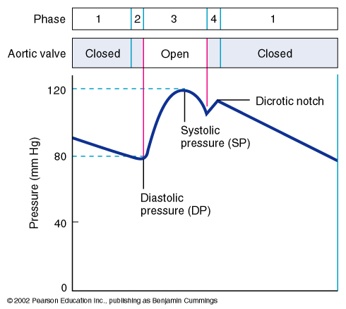
Aortic pressure
Aortic (semilunar) valve
Phase 1 and 2. AORTIC valve
is closed but there is still
flow of blood out of the
aorta; ↓ P( aorta)
Blood flow into the aorta
> blood flow out of the aorta
Phase 3; AORTIC valve
opens.
Flow (into aorta) > Flow (out):
↑ P (aorta)
Due to blood flow to
the systemic circulation.
Dicrotic notch: closure
of the semilunar (aortic)
valve (brief reversal of blood flow)
Arteries are pressure reservoirs.

Slide 18
Systolic and diastolic pressure
Aortic (semilunar) valve
Minimum Aortic Pressure
= Diastolic Pressure
Systolic
Pressure
Maximum Aortic Pressure
= Systolic Pressure
Systolic Pressure (SP)
= 120 mm Hg
Diastolic
Pressure
Diastolic Pressure (SP)
= 80 mm Hg

Slide 19
Pulse pressure
Systolic Pressure (SP)
= 120 mm Hg
Diastolic Pressure (SP)
= 80 mm Hg
Aortic valve
Pulse Pressure (PP)
= SP – DP
= 120 mmHg – 80 mmHg
= 40 mm Hg
Systolic
Pressure (SP)
(120 mmHg)
Diastolic
Pressure (DP)
(40 mmHg)
An increase in pulse pressure
can indicate a hardening of
the arteries. (arteries are pressure reservoirs)

Slide 20
Mean arterial pressure (MAP)
Mean Arterial Pressure (MAP)
does not equal
(SP + DP) / 2
SP
(120 mmHg)
DP
(80 mmHg)
Aortic pressure is closer to
the minimum value for longer
than it is close to the
maximum value.
SP= systolic pressure
DP = diastolic pressure
PP = pulse pressure

Slide 21
Mean arterial pressure (MAP)
Mean Arterial Pressure (MAP)
= 1/3 SP + 2/3 DP
= 1/3 (120 mmHg) + 2/3 (80mmHg)
= 40 mmHg + 53 mmHg
= 93 mmHg
SP
(120 mmHg)
DP
(80 mmHg)
Mean Arterial Pressure (MAP)
= PP/3 + DP
= 40 mmHg/3 + 80 mmHg
= 13 mmHg + 80 mmHg
= 93 mmHg
SP= systolic pressure
DP = diastolic pressure
PP = pulse pressure
MAP is the driving force for blood flow.

Slide 22
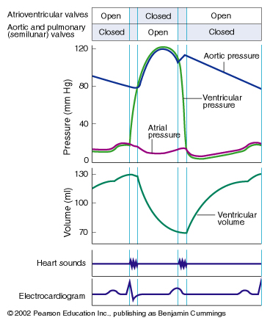
Stroke volume
Stroke Volume (SV)
= EDV – ESV (ml)
SV = the amount of blood
pumped in one heartbeat
End Diastolic Volume (EDV)
Maximum
End Systolic Volume (ESV)
Minimum
↑ contraction force results in
an ↑ SV

Slide 23
Ventricular volumes
End-diastolic volume (EDV): is the volume of blood in each ventricle at the end of diastole. It is about 135 ml.
End-systolic volume (ESV): is the volume of blood in each ventricle at the end of systole. It is about 65 ml.
Stroke volume (SV): is the volume of blood that is pumped by each ventricle per beat. It is equal to the difference between the EDV and ESV. Its is about 70 ml.
Diastolic filling volume (DFV): is the volume of blood which flows from the atrium into a ventricle during diastole. It is equal to the difference between the EDV and the ESV. It is about 70 ml.

Slide 24
Ejection fraction (EF)
Ejection Fraction (EF)
= SV/EDV
EF = the proportion of EDV
pumped in a single beat
End Diastolic Volume (EDV)
End Systolic Volume (ESV)
EF can be a diagnostic
indicator of heart function. Normally, it is about 65%.

Slide 25
Ejection fraction (EF)
EF can be measured by injecting radionuclide-labeled red blood cells and imaging the cardiac blood pool at the end of diastole and the end of systole (equilibrium radionuclide angiocardiography), or by computed tomography.

Slide 26
Cardiac output (CO)
Cardiac output is the blood flow generated by each ventricle per minute (i.e., the blood pumped by each ventricle per minute).
The cardiac output is equal; to the volume of blood pumped by one ventricle per beat times the number of beats per minute:
Thus, Q = SV . HR
Where Q = cardiac output, SV = stroke volume, and HR = heart rate.
•
•

Slide 27
Cardiac output (CO)
The stroke volume for each ventricle averages 70 ml of blood, and a normal heart rate is approximately 70 beats/minute; therefore, the cardiac output at rest is approximately 5 L/min.
The heart rate is under neural control. Cardiac sympathetic efferent activity increases the heart rate, whereas parasympathetic (vagal) efferent impulses decreases heart rate.
The stroke volume varies with the volume of blood in the ventricle at the onset of contraction, changes in the force of ventricular contraction, and the arterial pressure.

Slide 28
Venous return (VR)
The term venous return (VR) refers to the volume of blood entering each atrium per minute.
Cardiac output (co): 5-5.5 l/min
flow rate out of the heart, volume pumped per unit time.
Cardiac output = Heart rate x Stroke volume
Venous return (VR): 5-5.5 l/min
flow rate into the heart.
Venous return = Heart Rate x Diastolic filling volume

Slide 29
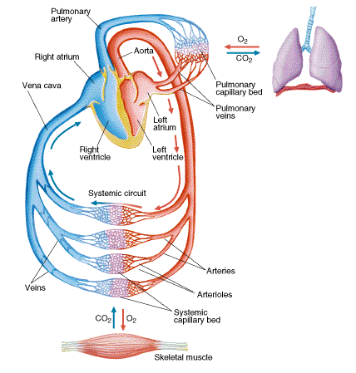
The heart as the central pump
The human heart functions as the central pump in the closed circuit of the CVS.
Thus, the cardiac output should be equal to the rate of venous blood return to the heart from the peripheral vascular beds.

Slide 30
Arterial pulse
Forcing of the blood into the aorta during systole not only moves the blood in the vessels forward but also sets up a pressure wave that travels along the walls of the arteries.
The pressure wave expands the arterial walls as it travels, and the expansion is palpable as the pulse.
The rate at which the wave travels is independent of and much higher than the velocity of blood flow. It is about 4 m/s in the aorta, 8 m/s in the large arteries, and 16 m/s in the small arteries of young adults. Consequently, the pulse is felt in the radial artery at the wrist about 0.1 s after the peak of systolic ejection into the aorta.
With advancing age, the arteries become more rigid, and the pulse wave moves faster.

Slide 31
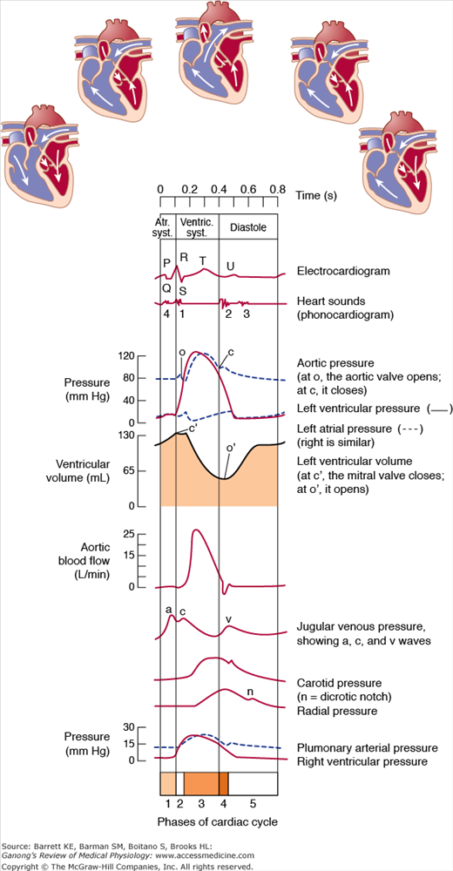

Slide 32
Arterial pulse
The strength of the pulse is determined by the pulse pressure and bears little relation to the mean pressure.
The pulse is weak (“thready”) in shock. It is strong when stroke volume is large; for example, during exercise.
When the pulse pressure is high, the pulse waves may be large enough to be felt or even heard by the individual.
When the aortic valve is incompetent (aortic insufficiency), the pulse is particularly strong, and the force of systolic ejection may be sufficient to make the head nod with each heartbeat. The pulse in aortic insufficiency is called a collapsing, Corrigan, or water-hammer pulse.
The dicrotic notch, a small oscillation on the falling phase of the pulse wave caused by vibrations set up when the aortic valve snaps shut.

Slide 33
Atrial pressure changes
Atrial pressure rises during atrial systole and continues to rise during isovolumetric ventricular contraction when the AV valves bulge into the atria.
When the AV valves are pulled down by the contracting ventricular muscle, pressure falls rapidly and then rises as blood flows into the atria until the AV valves open early in diastole.
The return of the AV valves to their relaxed position also contributes to this pressure rise by reducing atrial capacity. The atrial pressure changes are transmitted to the great veins, producing three characteristic waves in the record of jugular pressure.

Slide 34
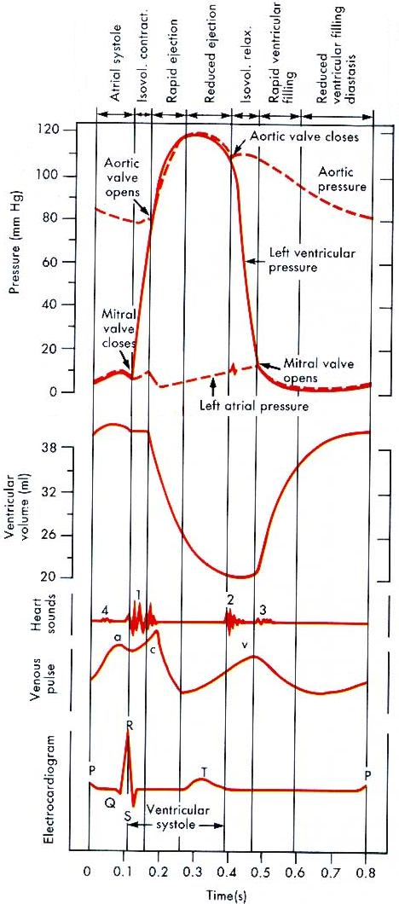
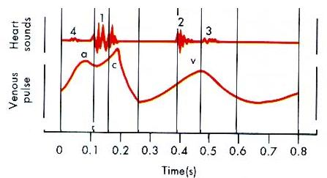
The venous pressure waves and the jugular venous pulse
y
Wave “a” is due to contraction of the atria.
Wave “c” is due to contraction of the ventricles, probably due to bulging of the AV valves back towards the contracted atria.
Wave “v” is due to filling of the atria while the AV valves are closed, opening of the valves allows the pooled blood to enter the ventricles.
All three of these waves appear in the jugular venous pulse.
y descent is due to the fall in atrial pressure associated with opening of the tricuspid valve and rapid right atrial emptying.
Pressures shown on the left figure represent those from the left heart.

Slide 35
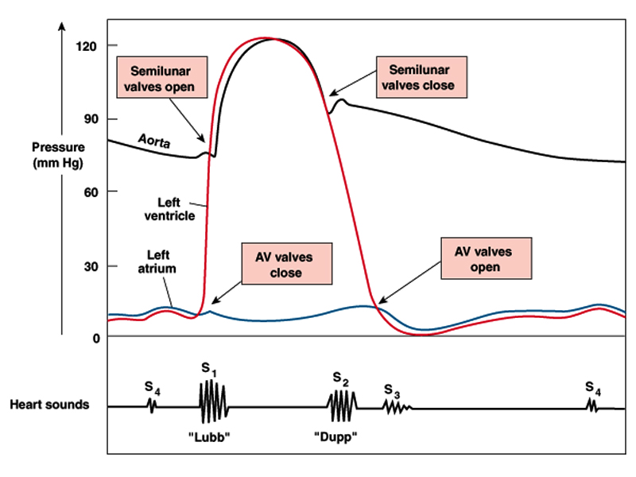
Events of the cardiac cycle and heart sounds

Slide 36
Heart sounds
Normally, only S₁ and S₂ are heard with the stethoscope.
S₃ and S₄ are detectable by phonocardiogram.
Occasionally S₄ is heard in normal individuals.
S₃ is often heard about one third of the way through diastole in children and in many normal young individuals.
Phonocardiogram is a graphic recording of the heart sounds. It involves picking up the sonic vibrations from the heart through a highly sensitive microphone. Such waves are then converted into electrical energy and fed into a galvanometer, where they are recorded on paper.
aortic
pressure
ventricular
pressure
atrial
pressure
ventricular
volume
S₄ S₁ S₂ S₃

Slide 37
Heart sounds
S₁ is a slightly prolonged, low “lub” sound.
It is caused by vibrations set up by the sudden closure of the AV valves at the start of ventricular systole.
S₁ has a duration of about 0.15 s and a frequency of 25–45 Hz.
S₁ is soft when the heart rate is low, because the ventricles are well filled with blood and the leaflets of the AV valves float together before systole.
aortic
pressure
ventricular
pressure
atrial
pressure
ventricular
volume
S₄ S₁ S₂ S₃

Slide 38
Heart sounds
S₂ is a shorter, high-pitched “dup” sound.
S₂ is caused by vibrations associated with closure of the aortic and pulmonary valves just after the end of ventricular systole.
S₂ lasts about 0.12 s, with a frequency of 50 Hz.
S₂ is loud and sharp when the diastolic pressure in the aorta or pulmonary artery is elevated, causing the respective valves to shut briskly at the end of systole.
The interval between aortic and pulmonary valve closure during inspiration is frequently long enough for the second sound to be reduplicated (physiologic splitting of the second sound). Splitting also occurs in various diseases.
aortic
pressure
ventricular
pressure
atrial
pressure
ventricular
volume
S₄ S₁ S₂ S₃

Slide 39
Heart sounds
S₃ is a soft, low-pitched.
S₃ is heard about one third of the way through diastole in many normal young individuals.
S₃ coincides with the period of rapid ventricular filling and occurs during transition between rapid filling and slow filling of ventricle.
It is probably due to vibrations set up by the inrush of blood.
aortic
pressure
ventricular
pressure
atrial
pressure
ventricular
volume
S₄ S₁ S₂ S₃

Slide 40
Heart sounds
S₄ is caused by oscillations of the ventricles during atrial contraction.
aortic
pressure
ventricular
pressure
atrial
pressure
ventricular
volume
S₄ S₁ S₂ S₃

Slide 41
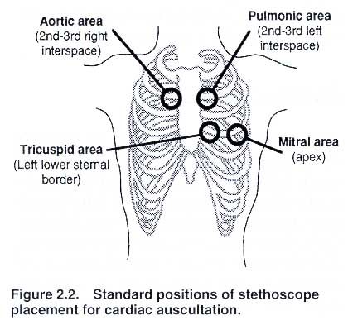
Auscultation of the Heart
Generally the sounds produced by each valves is best heard over a particular region of the chest.

Slide 42
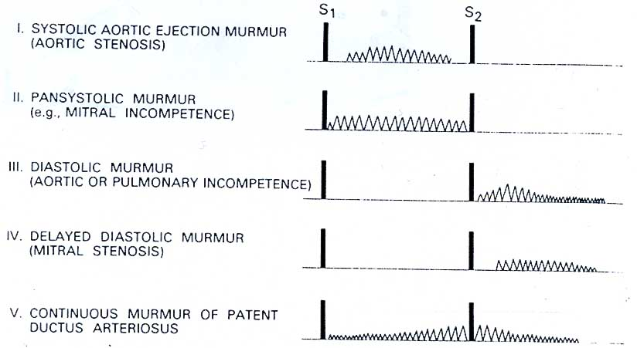
Murmurs
When the orifice of a valve is narrowed (stenosis), blood flow through it is accelerated and turbulent.
When a valve is incompetent, blood flows through it backward (regurgitation or insufficiency), again through a narrow orifice that accelerates flow.
Soft systolic murmurs are also common in individuals, especially children, who have no cardiac disease. Systolic murmurs are also heard in anemic patients as a result of the low viscosity of the blood and associated rapid flow.

Slide 43
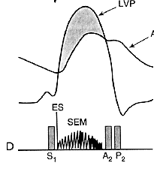
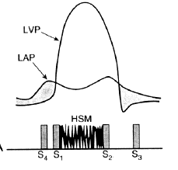
Systolic murmurs
left ventricular
pressure
(1) Ejection systolic murmurs: aortic stenosis, pulmonary stenosis
Characterised by a crescendo-decrescendo contour and a gap between the end of the audible sound and S₂.
AS
aortic
pressure
ES
S₁ S₂
(2) Pansystolic murmur:
mitral or tricuspid regurgitation, VSD
The sound is of reasonably constant intensity throughout the ejection period
left ventricular
pressure
left atrial
pressure
MR
S₄ S₁ S₂ S₃

Slide 44
Diastolic murmurs
(1) Early diastolic murmurs: e.g., the decrescendo murmur of aortic regurgitation.
Best heard with the patient sitting up, leaning forward, at end expiration.
AR
S₁ S₂
(2) Mid diastolic murmurs: e.g., Mitral stenosis.
The murmur is a low-frequency sound and begins early after the early diastolic opening snap (OS).
OS
MS
S₁ S₂

Slide 45
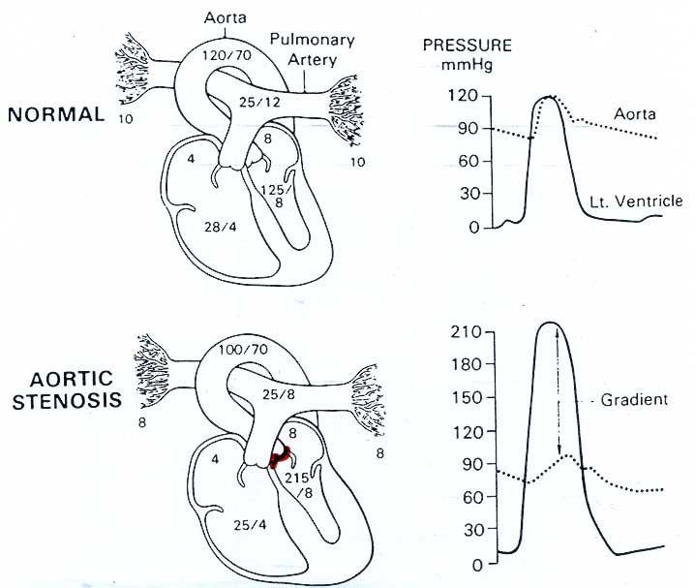
Aortic stenosis (AS)
Narrow orifice slows the rate at which SV is ejected.
Ventricular systolic pressure increases to overcome the increased resistance of the aortic valve.
There is a pressure gradient between the left ventricle and aorta during ejection.
Ejection systolic murmur.
Concentric hypertrophy.

Slide 46
Aortic regurgitation (AR) (Aortic insufficiency)
(aortic incompetence)
The aortic valve does not close properly at the beginning of diastole.
As a result, during diastole there is retrograde flow of blood from the aorta into the ventricle.
The amount of the blood regurgitated into the left ventricle during diastole may be as much as 60-70% of the amount ejected during systole.
Increased left ventricular and aortic systolic pressures.
Decreased aortic diastolic pressure.
Increased aortic pulse pressure.
Diastolic murmur.
AR
S₁ S₂

Slide 47
Mitral stenosis (MS)
A narrowed mitral valve impairs emptying of the left atrium into the left ventricle during diastole..
This generates a pressure gradient between the atrium and ventricle during filling.
Pressure and volume can be dramatically elevated in the left atrium, with little change or a decrease in the left ventricle.
Diastolic murmur.
OS
MS
S₁ S₂

Slide 48
Mitral regurgitation (MR) (Mitral insufficiency)
(Mitral incompetence)
An incompetent mitral valve allows blood to regurgitate from the left ventricle to the left atrium throughout ventricular systole.
Atrial volume and pressures are increased.
Ventricular volumes and pressures are increased during diastole, but there is NO pressure gradient between the atrium and the ventricle.
Systolic murmur.
left ventricular
pressure
left atrial
pressure
MR
S₄ S₁ S₂ S₃

