Slide 1
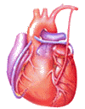
Cardiovascular Block Stroke volume and its regulation Cardiac output Heart failure
Dr. Ahmad Al-Shafei, MBChB, PhD, MHPE
Associate Professor in Physiology
KSU

Slide 2
Learning outcomes
After reviewing the PowerPoint presentation, lecture notes and associated material, the student should be able to:
Discuss the role of the heart as the central pump of the cardiovascular system.
Define cardiac output and cardiac reserve.
Relate venous return to cardiac output.
Discuss regulation of the cardiac pump.
State and describe the determinants of cardiac performance:
Heart rate.
Frequency-force relationship.
Stroke volume.
State and discuss the determinants of stroke volume:
Preload.
Afterload.
Myocardial contractility.

Slide 3
Learning outcomes, continued
Describe how cardiac output is altered according to tissue demands.
Define and give some causes of pathologically low and high cardiac output.
Describe the effects of moderate and severe exercise on heart rate and stroke volume.

Slide 4
Learning outcomes, continued
Define cardiac failure.
Classify cardiac failure.
Describe the causes and pathophysiological consequences of acute cardiac failure.
Discuss how left-sided failure leads to right-sided failure: congestive heart failure.
Describe the compensatory mechanisms in heart failure: Frank/Starling mechanism; sympathetic activation; role of kidneys.
Interpret and draw Starling curves for healthy heart, acute failure, compensated failure.
Discuss fluid retention in cardiac failure.
Compare and contrast compensated and decompensated heart failure.

Slide 5
Learning Resources
Textbooks :
Guyton and Hall, Textbook of Medical Physiology; 12th Edition.
Mohrman and Heller, Cardiovascular Physiology; 7th Edition.
Ganong’s Review of Medical Physiology; 24th Edition.
Websites:
http://accessmedicine.mhmedical.com/

Slide 6
The heart as a pump 1. Cardiac output (CO)
Cardiac output is the blood flow generated by each ventricle per minute (i.e., the blood pumped by each ventricle per minute).
The cardiac output is equal; to the volume of blood pumped by one ventricle per beat times the number of beats per minute:
Thus, Q = SV . HR
Where Q = cardiac output, SV = stroke volume, and HR = heart rate.
•
•

Slide 7
The heart as a pump 1. Cardiac output (CO)
CO is well regulated according to tissue metabolic demands.
Thus, the basic determinant of the cardiac output is the O₂ requirements of body tissues, for their metabolic rates.
Accordingly, if the metabolic rate is increased, the CO and VR are increased to maintain optimal O₂ supply to the active tissues.

Slide 8
Cardiac reserve
The cardiac output at rest is approximately 5 L/min.
The body’s blood volume averages 5 to 5.5 liters.
Thus, each ventricle pumps the equivalent of the entire blood volume each minute.
At this rate, each ventricle would pump ~ 2.5 million liters in just one year.
During exercise, the CO can increase to 20 to 25 liters/min and to as high as 40 liters/min in well trained athletes.
The difference between the resting CO and the maximum volume of blood the heart is capable of pumping per minute is known as the cardiac reserve.

Slide 9
How can cardiac output vary so tremendously depending on the demand of the body?

Slide 10
An overview of cardiac output regulation
CO = SV . HR
The stroke volume for each ventricle averages 70 ml of blood, and a normal heart rate is approximately 70 beats/minute; therefore, the cardiac output at rest is approximately 5 L/min.
The heart rate is under neural control. Cardiac sympathetic efferent activity increases the heart rate, whereas parasympathetic (vagal) efferent impulses decreases heart rate.
The stroke volume varies with the volume of blood in the ventricle at the onset of contraction, changes in the force of ventricular contraction, and the arterial pressure.

Slide 11
The heart as a pump 2. Venous return (VR)
The term venous return (VR) refers to the volume of blood entering each atrium per minute.
Cardiac output (co): 5-5.5 l/min
flow rate out of the heart, volume pumped per unit time.
Cardiac output = Heart rate x Stroke volume
Venous return (VR): 5-5.5 l/min
flow rate into the heart.
Venous return = Heart Rate x Diastolic filling volume

Slide 12
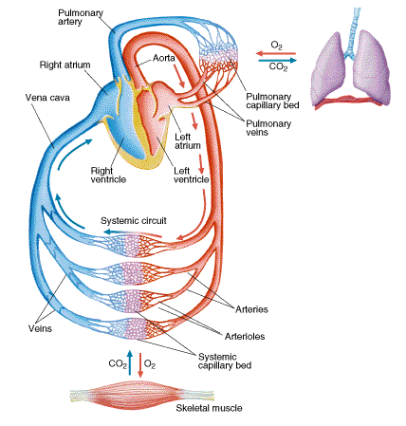
The heart as a pump
3. Coupling of cardiac
and vascular functions
The human heart functions as a hydraulic pump in the closed circuit of the CVS.
Thus, the cardiac output should be equal to the rate of venous blood return to the heart from the peripheral vascular beds.

Slide 13
Regulation
of the cardiac pump
The haemodynamic function of the human heart has two components, namely, to be filled by the venous return (VR) and to produce an outflow (i.e., cardiac output) and pressure.
Accordingly, there are two groups of factors that regulate the haemodynamic function of the heart:
1. Factors affecting the pump ability to eject (i.e., CO)
2. Factors affecting the pump filling (i.e., VR)

Slide 14
Regulation
of the cardiac pump
These factors include:
A- Intrinsic properties of the heart and blood vessels, which provide an autoregulation to the heart pump.
B- Neuro-hormonal factors outside the CVS, which constitute an extrinsic regulation.

Slide 15
Determinants of the cardiac performance
Determinants of the CO

Slide 16
Determinants of the cardiac performance
Determinants of the CO
Stroke
volume
Cardiac
output
Heart
rate

Slide 17
Determinants of the cardiac performance
Determinants of the CO
Preload
(venous return)
Myocardial
Contractility
(Inotropic state)
Cardiac
output
Afterload
(vascular resistance)
Heart rate

Slide 18
Preload
As in skeletal muscle, preload is the load on the muscle in the relaxed state. The preload determines the degree of stretch and the resting length of the muscle before contraction.
Applying preload to muscle does two things:
Causes the muscle to stretch.
Causes the muscle to develop passive tension.
The ventricles of the heart are three dimensional chambers, which get filled with blood from the atria during diastole. Thus, the volume of blood in the ventricle at the end of diastole (end-dastolic volume, EDV) determines the resting length of the ventricle and the degree of its stretch of the myocardial fibers at the end of diastole and constitute the cardiac preload.
Indices of left ventricular preload:
Left ventricular end-diastolic volume (LVEDV).
Left ventricular end-diastolic pressure (LVEDP).

Slide 19
Aftereload
As in skeletal muscle, afterload is the load on the muscle during contraction.
Left ventricular afterload represents the force that the muscle must generate to eject the blood into the aorta.
What is right ventricular after load?
Acceptable indices of afterload on the left ventricle are the following:
Mean aortic pressure:
Hypertension: increased afterload.
Hypotension: decreased afterload.
Peak left ventricular pressure:

Slide 20
Myocardial contractility
Inotropic state
An acceptable definition of contractility would be a change in performance at a given preload.
Acute changes in contractility are due to changes in the intracellular dynamics of calcium.
Drugs that increase contractility usually provide more calcium and at a faster rate to the contractile machinery.
More calcium will activate more cross-bridges and thereby strengthen the heart beat.

Slide 21
Determinants of the cardiac performance
Determinants of the CO
1. Heart rate (HR)

Slide 22
What is the influence of heart rate on myocardial contractility? Frequency- force relationship

Slide 23
Frequency-force relationship
Ca⁺⁺
Ca⁺⁺
Normal
Heart Rate
Fast
Heart Rate
Ca⁺⁺
Ca⁺⁺
Ca⁺⁺
Ca⁺⁺
Increasing heart rate increases contractility.

Slide 24
Frequency-force relationship
The force of contraction of the cardiac muscle is increased when it is more frequently stimulated.
This frequency dependency of force generation in the heart is probably due to accumulation of Ca²⁺ ions within the myocytes as a result of:
The increased in number of depolarizations/min → more frequent plateau phases → more Ca²⁺ entry.
The magnitude of Ca²⁺ current is also increased → increases the intracellular Ca²⁺ stores.
↓
Both effects enhance the release and uptake of Ca²⁺ by the sarcoplasmic reticulum, thus Ca²⁺ availability to the contractile proteins with more force generation through cross-bridge cycling.

Slide 25
Determinants of the cardiac performance
Determinants of the CO
2. Stroke volume (SV)

Slide 26
Determinants of the cardiac performance
Determinants of the CO
Preload
(venous return)
Myocardial
Contractility
(Inotropic state)
Cardiac
output
Afterload
(vascular resistance)
Heart rate

Slide 27
Determinants of the cardiac performance
Determinants of the CO
Determinants of SV
1. Ventricular preload

Slide 28
Stroke volume regulation:
1. Preload:
length tension relationship
Tension
active
passive
L_{o}
Skeletal muscles
Length

Slide 29
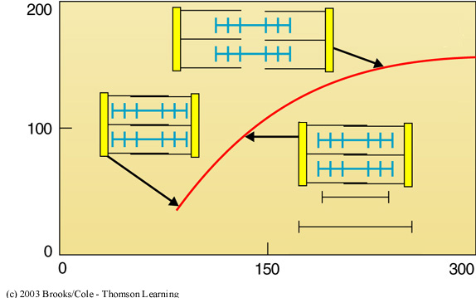
Stroke volume regulation:
1. Preload:
length tension relationship
Stroke volume (ml)
Ventricular end-diastolic volume (ml)

Slide 30
What causes cardiac muscle fibers to vary in length before contraction?
The main determinant of cardiac muscle fiber length is the degree of diastolic filling.
The larger the EDV, the more the heart is stretched → the longer the initial cardiac-fiber length before contraction → greater force on the subsequent cardiac contraction → greater SV.

Slide 31
Mechanism of cardiac
length-tension relationship
1- The larger the EDV, the more the heart is stretched → higher degree of overlap of thick and thin filaments → more cross-bridge interactions between myosin and actin.
2- The cardiac length tension relationship is also enhanced by greater sensitivity to calcium at greater lengths. At any given resting length, a particular calcium concentration produces a greater force of contraction than it manages at a shorter resting length.
3- The cardiac length-tension relationship is further enhanced by increase calcium entry (stretch activated calcium channels) in some species.

Slide 32
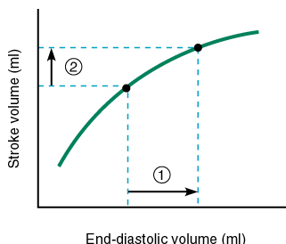
Starling’s Law of the heart
The intrinsic relationship between EDV and SV is known as the Frank-Starling’s Law of the heart
↑ EDV
→ ↑ Force of ventricular contraction
→ ↑ Stroke Volume
→ ↑ Cardiac Output

Slide 33
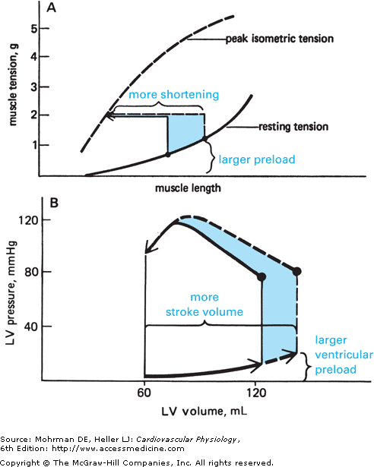
Starling’s Law
of the heart
A: Increasing muscle preload will increase initial muscle fiber length, which increases the extent of shortening during a subsequent contraction with a fixed total load.
B: In the ventricles, Increases in ventricular preload increase both end-diastolic volume and stroke volume almost equally.

Slide 34
Advantages of
Starling’s Law of the heart
1- Equalization of the output between the right and left sides of the heart.
2- Equalization of the output and VR. Adjustment of the output of the heart in response to fluctuations in beat-to-beat variations in venous return.
3- During exercise a larger CO is needed:
Sympathetic activation: → HR
→ VR → EDV → SV

Slide 35
Determinants of the cardiac performance
Determinants of the CO
Determinants of SV
2. Ventricular afterload

Slide 36
Stroke volume regulation:
2. Afterload
Afterload = mean aortic blood pressure
↑ After load → ↓ SV
The heart must respond and compensate to changes of afterload, i.e., cardiac work must increase to maintain the SV constant in the face of an increased afterload.

Slide 37
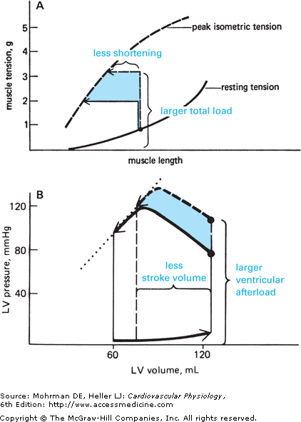
Stroke volume regulation:
2. Afterload
The figure shows the effect of changes in afterload on cardiac muscle shortening:
A: during afterloaded contractions
B: on ventricular stroke volume
In many pathological situations such as hypertension and aortic valve obstruction, ventricular function is adversely influenced by abnormally high ventricular afterload. When this occurs, stroke volume is decreased. Under these conditions, note that stroke volume is decreased because end-systolic volume is increased.

Slide 38
Stroke volume regulation:
2. Afterload
The heart must respond and compensate to changes of afterload, i.e. cardiac work must increase to maintain the SV constant in the face of an increased afterload.
afterload increases
E
D
V
1
4
0
m
l
1
4
0
1
4
0
1
5
0
1
5
0
S
V
7
0
m
l
7
0
6
0
7
0
7
0
E
S
V
7
0
m
l
7
0
8
0
8
0
8
0
L
V
E
S
V
An increase of afterload initially results in
a smaller stroke volume
A rise of end systolic volume

Slide 39
Stroke volume regulation:
2. Afterload
afterload increases
Diastolic filling volume remains constant so that EDV increases
Thus, by Starling’s law stroke work increases and thus restores stroke volume despite the raised afterload

Slide 40
Determinants of the cardiac performance
Determinants of the CO
Determinants of SV
3. Myocardial contractility
Cardiac inotropic state (inotropy)

Slide 41
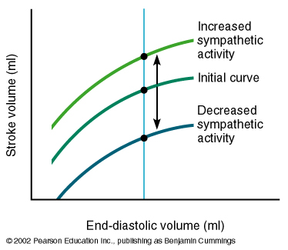
Stroke volume regulation:
3. Myocardial contractility
Cardiac inotropic state (inotropy)
Effect of sympathetic stimulation
inotropic effect of noradrenaline and adrenaline
Sympathetic nerve stimulation increases cardiac contractility.
At rest the heart is under sympathetic tone.
Noradrenaline enhances calcium entry into cardiac cells.
Parasympathetic stimulation has little affect on contractility due to the innervation pattern of the heart.
Increased
ventricular
contractility
Decreased
ventricular
contractility

Slide 42
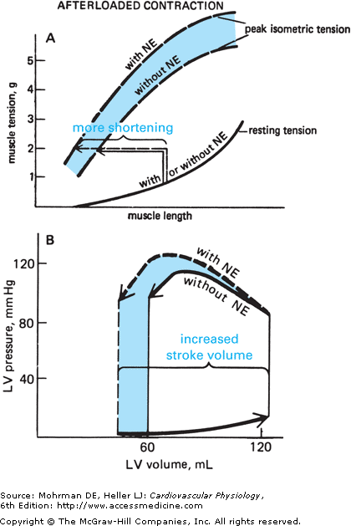
Stroke volume regulation:
3. Myocardial contractility
Sympathetic nerve stimulation increases cardiac contractility.
At rest the heart is under sympathetic tone.
Noradrenaline enhances calcium entry into cardiac cells.
Parasympathetic stimulation has little affect on contractility due to the innervation pattern of the heart.

Slide 43
Inotropic effect
of noradrenaline and adrenaline
Noradrenaline
Adrenaline
Cell
cytosol
ATP
cAMP
Adenylyl
cyclase
↑ Ca²⁺ Permeability
in cardiac
myocytes
Receptor
Increased Contractility
Increased SV
Circulating (hormonal) adrenaline has the same effect.

Slide 44
Inotropic effect
of noradrenaline and adrenaline
Effects of noradrenaile and adrenaline on the size of the plateau current.
Effects of verapamil, nifedipine and diltiazem (Ca²⁺-channel blockers) on the size of the plateau current.

Slide 45
Physiological changes
in cardiac output
During the first 3 hours after meals, the CO is increased to enhance blood flow in the intestinal circulation.
Later months of pregnancy are accompanied by > 30% increase in CO due to increased uterine blood flow.
At environmental temperature above 30 °C, the CO is increased due to increased skin blood flow. Also at low environmental temperature CO is increased due to shivering that increases blood flow to the muscles.
Increased sympathetic activity during anxiety and excitement enhances the CO up to 100%.
Exercise:

Slide 46
Effects of exercise on
heart rate and SV
Moderate Exercise
HR increases to 200% of resting (140 bts/min)
SV increases to 120% (85ml)
CO increases to 240% (12L)
Severe Exercise
HR increases to 300% of resting (200 bts/min)
SV increases to 175% (125ml)
CO increases to 500% (25 L)
In athletes, maximum CO may be 35L or more - can't increase maximum HR beyond 200 bts - hence - SV increases to 175 ml.

Slide 47
Pathological
low or high cardiac output
Causes of low CO:
1- Low VR (e.g., haemorrhage)
2- Reduced contractility (e.g., heart failure)
3- Tachyarrhythmias (e.g., atrial fibrillation and ventricular tachycardia)
4- Marked bradycardia (e.g., complete heart block)
Causes of high CO:
1- Hyperthyroidism: the increase in the CO is due to the high metabolic rate → vasodilatation →↑ CO to 50%+ of control.
2- AV fistulas.
3- Fever.
4- Anaemia.
5- Anexiety.

Slide 48
Regulation of heart rate
0
-50
-100

Slide 49
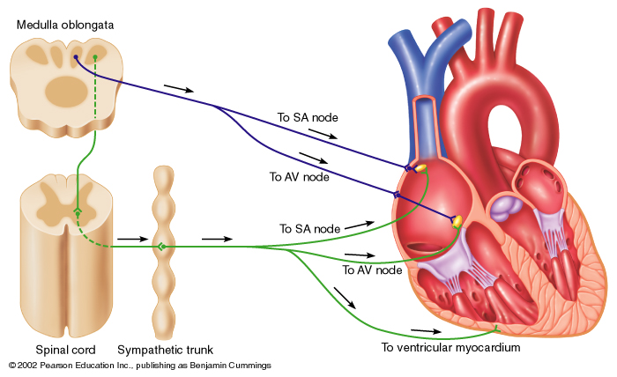
Autonomic nerve supply
to the heart

Slide 50
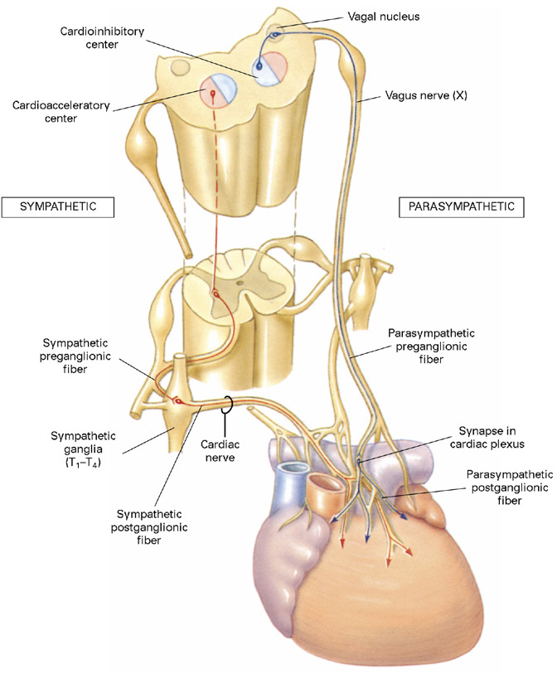

Slide 51
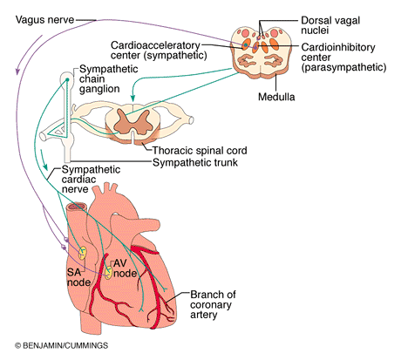
Sympathetic
Noradrenaline
Parasympathetic
Acetylcholine

Slide 52
Neuronal control of the heart
Sympathetic nerves innervate the whole heart.
Sympathetic stimulation increases heart rate, and contractility.
Sympathetic nerves release noradrenaline (adrenaline), which stimulates heart β-receptors.
Parasympathetic nerves innervate the SA and AV nodes, the atria and Purkinje system.
Parasympathetic nerves do not innervate most of the ventricular myocardium.
Parasympathetic stimulation slows the heart but has little inotropic action.
Parasympathetic nerves release ACh that stimulates muscarinic receptors.

Slide 53
The relative level of activity in the two autonomic branches (sympathetic and parasympathetic) to the heart is primarily coordinated by the cardiovascular control center located in the brainstem
↑ sympathetic
↓ parasympathetic
Heart Rate ~ 70 bpm
↓ sympathetic
↑ parasympathetic

Slide 54
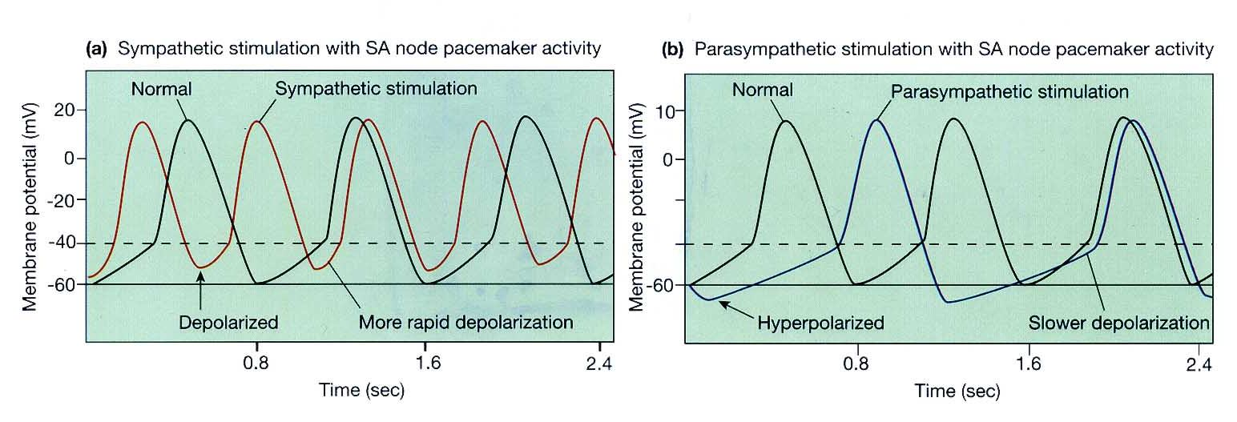
Mechanism of autonomic control of Heart rate
Noradrenaline (NA) released from sympathetic nerve endings and circulating adrenaline act on β₁-adrenergic receptors on the heart and both increase the heart rate:

Slide 55
Mechanism of autonomic control of Heart rate
Mechanisms:
The ß₁-adrenoreceptors on SA node cells are coupled to excitatory G-proteins. This activates the enzyme adenylate cycles → increases cAMP as a second messenger inside the cell
* This results in:
Opening of Na⁺ and Ca²⁺ channels → speed up the rate of depolarization and hence the heart rate.
Decrease in K⁺ permeability by accelerating inactivation of the K⁺ channels. Thus, fewer positive potassium ions leave the cell → the inside of the cell becomes less negative → depolarizing effect.

Slide 56
Mechanism of autonomic control of Heart rate
The net effect is: → swifter drift to threshold → greater frequency of action potential → increase the heart rate.

Slide 57
Mechanism of autonomic control of Heart rate
Acetylcholine (ACh) released from parasympathetic nerves reduces the heart rate.

Slide 58
Mechanism of autonomic control of Heart rate
Mechanisms:
M₂ (muscarinic-2) ACh receptors respond to ACh from the vagus nerve by activating a different G-protein.
This reduces the levels of cAMP in the cell:
→ closure of Na⁺ and Ca²⁺ channels.
→ opening of potassium channels in the cell membrane → hyperpolarises the cell and makes it more difficult to initiate an action potential.
The net effect is: → slower drift to threshold → lesser frequency of action potential → decrease the heart rate.

Slide 59
Heart Failure

Slide 60
Definition
Heart failure is defined as the inability of the heart to pump adequate output for the body metabolism needs.
Thus, the resting CO may be low, normal or even elevated, despite the presence of heart failure as long as this level is inadequate for body organs’ need of blood and O₂.
Manifested mainly by:
Inadequate cardiac output
build-up of blood in veins behind left heart or right heart (increased venous pressure)

Slide 61
Causes
Intrinsic myocardial causes (These result in reduction in ventricular contractility):
myocardial infarction (death of cardiac myocytes due to blockage of the coronary arteries)
Cardiomyopathy
Cardiac arrhythmias: e.g., complete heart block
Extrinsic causes (These make it more difficult to eject blood into aorta):
systemic hypertension
aortic stenosis

Slide 62
Pathophysiological varieties of heart failure
Left vs. right heart failure:
- Since the right and left sides of the heart are two separate pumps, it is possible for one of them to fail independently of the other.
- In left-sided failure, blood pumped normally to the lungs by the RV is not pumped out by the failing LV → blood accumulates in pulmonary circulation increasing the pulmonary capillary pressure → serious filtration of fluid in the lung interstitial space and alveoli (pulmonary oedema).
- In right-sided failure, blood pumped normally to the systemic circulation by the LV is not pumped out by the failing RV → blood accumulates in systemic circulation increasing the systemic capillary pressure → filtration of fluid in the body tissues (systemic oedema).
- Though each side of the heart can undergo failure separately, dysfunction of one side may lead to a sequence of events that make the opposite side also to fail.

Slide 63
Pathophysiological varieties of heart failure
Acute vs. chronic heart failure:
- Sudden serious abnormalities of the heart (e.g., massive infarction, arrhythmias, valve rupture) → acute heart failure → sudden reduction in CO and blood pressure → decreased perfusion of vital organs or pulmonary edema.
- Rapid compensation depends on the sympathetic nervous system and if the patient survives, other adaptation mechanisms operate and chronic heart failure develops.
- Acute failure is usually left-sided.
- Acute left-sided failure is more serious than acute right-sided failure since acute fatal pulmonary edema due to damping of blood in the pulmonary circulation.
- Cardiogenic shock develops following acute failure if the heart became unable to pump enough to even keep tissues alive.

Slide 64
Congestive Heart Failure (CHF); Mechanism
Increased systemic resistance
Increased force of left ventricular contraction
Increased left ventricular oxygen demand
Increased left ventricular hypoxia
Decreased left ventricular contraction
Increased left ventricular end diastolic pressure
Increased left atrial pressure
Pulmonary congestion & pulmonary edema
Increased pulmonary vascular resistance
Right ventricular failure
Decreased oxygen supply
Decreased arterial pressure

Slide 65
Physiological adaptation to CHF
(compensation mechanisms)
Decreased cardiac output (CO) leads to:
1- Decreased firing of carotid sinus baroreceptor → increased sympathetic stimulation:
→ vasoconstriction of arterioles (increased afterload),
→ vasoconstriction of veins (increased preload)
→ increased HR and force of contractility
→ increased CO and increased BP

Slide 66
Physiological adaptation to CHF
(compensation mechanisms)
Decreased cardiac output (CO) also leads to:
2. Decreased renal perfusion → Activation of RAA system: renin is released by JG cells → renin cleaves angiotensinogen to ang I → ACE in lung converts Ang I to Ang II → Ang II causes:
vasoconstriction (increased BP and afterload)
Na⁺/H₂O reabsorption from kidneys → increased plasma volume → increase preload → increase CO → increase BP
aldosterone release from adrenal cortex → reabsorption of Na⁺/H₂O.
Myocyte hypertrophy.
Myocardial fibrosis
3. Decreased effective circulating blood volume → posterior pituitary releases ADH (vasopressin) → increased H₂O reabsorption

Slide 67
Physiological adaptation to CHF
(compensation mechanisms)
These compensatory mechanisms are great if there is acute blood loss, but do not help much with failing heart! Why?
Increased afterload heart has to work against.
Increased preload that failing heart has to pump out.
Retention of salt and water → greater blood volume → peripheral and pulmonary edema

Slide 68
Complications of progressive heart failure
Factors contributing to decompensation
1- Prolonged sympathetic activation to the heart: down regulation of the myocardial adrenergic receptors → ↓ the myocardial adrenergic receptors density and sensitivity to catecholamines. Consequently, the inotropic and chronotropic reponses of the heart cannot be elevated in parallel to increased body requirements.
2- Vasoconstriction of the arterioles (under enhanced sympathetic activity): This increases resistance, thus the cardiac afterload.
3- Hypertrophied heart: → imbalance between the O₂ supply and need → deterioration of the ability to generate force.
4- Excessive salt and water retention:
5- Over-distended ventricle: Has to consume more energy and generate more wall tension to develop the required ejection pressure (Laplace law).

Slide 69
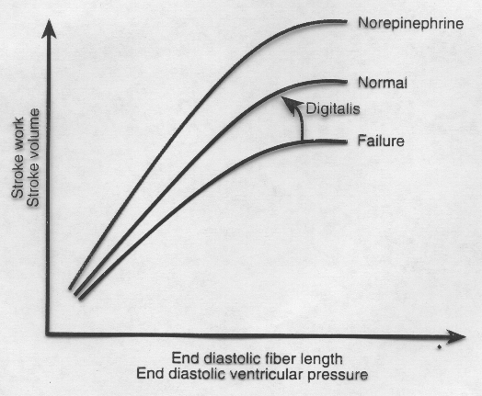
Starling Curve in Heart Failure
EFFECT?
CHANGES IN
CONTRACTILITY

