Slide 1
BLOOD PRESSURE

Slide 2
Definitions
Blood pressure means the pressure exerted by blood on the wall of the arteries.
Unit of Measurement-----mmHg
Normal BP
Systolic-------120 (100—14ommHg)
Diastolic------80 (60– 90mmHg)

Slide 3
Definitions
What is pulse pressure ?
It is the difference between systolic and diastolic blood pressure.
Normal Range----------30 to 60 mmHg

Slide 4
Definitions
What is Mean Arterial Blood Pressure ?
It is the average pressure which drives the blood forward in the tissues ( through blood vessels ) throughout the cardiac cycle.
Mean Arterial B.P
=Diastolic B.P + 1/3 Pulse pressure
= 80+1/3 x 40=93mmHg

Slide 5
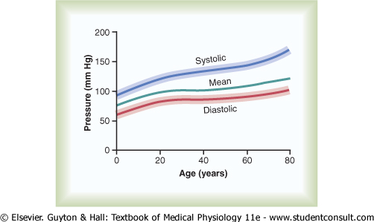

Slide 6
PRACTICAL
BLOOD PRESSURE MEASUREMENT
Normal BP= 120/80 mmHg (In Adults)
Range:
Systolic –100-140mmHg
Diastolic—60-90mmHg
Equipment
Stethoscope
Sphygmomanometer

Slide 7
Factors affecting BP
Age.
Sex
Posture
Exercise
Emotion
Gravity
Sleep
Pregnancy

Slide 8
Precautions
Patient should be physically and mentally relaxed
The subject should lie or sit comfortably for minimum 5 minutes before the recording
Cuff Size should be suitable
The arm should be totally exposed
Cuff should be at the level of the heart.
The cuff should be tied neither very tightly nor loosely around arm.
Don’t keep cuff inflated for too long.

Slide 9
Methods of Measurements
Palpitory
Auscultatory

Slide 10
Palpitory Method
After localizing the brachial pulse
Inflate the BP cuff until a level which is about 20-30 mmHg above the point at which the pulse is no longer palpable.
Now slowly deflate the cuff until the pulse is palpable again.
This is the systolic BP.
In this method only the systolic pressure can be measured, while the diastolic pressure cannot be measured.

Slide 11
Auscultatory Method
The cuff pressure is inflated quickly to a pressure about 30 mm Hg higher than the systolic pressure determined by the Palpitory method. Then the air is let out of the cuff slowly.
At some point the person listening with the stethoscope will begin to hear sounds with each heartbeat. This point marks the systolic pressure.
The sounds are called Korotkoff sounds.

Slide 12
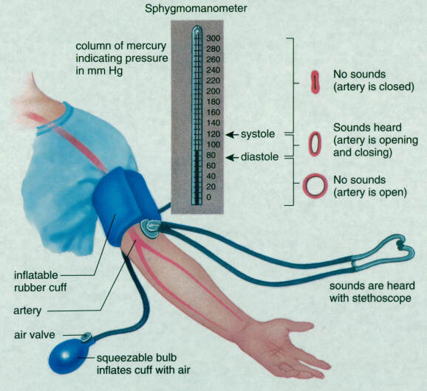
Methods of Measurements

Slide 13
Hypertension:
Mild—140-160/90-100mmHg
Moderate—160-180/100-110mmHg
Severe—180-200/110-120mmHg
Malignant—When Diastolic BP>140mmHg
Blood Pressure should be measured on more than Two occasions to make a diagnosis of high blood pressure.

Slide 14
THANK YOU

