Slide 1
Infective Endocarditis

Slide 2
Infective Endocarditis (IE):
It is an Infection or colonization of endocardium , heart valves , congenital defects by bacteria , rickettsia , fungi.
We can also definite as low grade persistent bacteraemia(bacteraemia is the presence of bacteria in the blood).
Improved surgical technology have reduced the morbidity and mortality (death) of IE.
Advances in antimicrobial therapy
Early recognition and management of complications of IE
Endocarditis, irrespective of the underlying cardiac condition,
is a serious, life-threatening disease that was always fatal in the preantibiotic era1.
1) all affected patients were died before the discovering of antibiotics

Slide 3
More about Infective Endocarditis:
Serious disease
mortality : 30 %
Damage of heart or other organs
Follow dental procedures ( tooth extraction)
Rheumatic heart disease
Congenital heart disease
Numerous comorbid factors, may complicate IE such as
older age and diabetes mellitus
immunosuppressive conditions or therapy
dialysis.

Slide 4
Classification :
Classification of clinical presentation:
Native Valve IE
Prosthetic Valve (implanting valve) IE
Intravenous drug abuse (IVDA) IE
Nosocomial IE (originating in a hospital)
Acute Infective Endocarditis
Affects normal heart valves.
Rapidly destructive.
Metastatic foci
Commonly Staph.
If not treated, usually fatal within 6 weeks.
Subacute Infective Endocarditis
Often affects damaged heart valves.
Indolent( causing little or no pain) nature.
If not treated, usually fatal by one year.

Slide 5
Etiology:
SUSCEPTIBLE PATIENT
BACTEREMIA
Factors affecting severity and outcome :
▪ Bacterial factors: Virulence, no bacteria in the blood.
▪ Host factors:
- Factors increasing susceptibility
Local
• Congenital or rheumatic heart disease
• Prosthetic heart valves
• Other cardiovascular diseases
• Heart surgery
General
• Underlying disease (Diabetes M.)
Drugs
• Iatrogenic: Immunosuppressant treatment, Cytotoxic agent.
• Self-inflicted: Alcoholism, Injected drugs.
- Protective factors: Antimicrobial chemotherapy.

Slide 6
SOURCES OF INFECTION
Dental extraction and other dental procedures
Cardiac surgery ( prosthetic valves)
Intravenous medication
Intravenous Drug addiction
Intracardiac or intravenous catheters
Obstetric or gynaecologic procedures

Slide 7
PREDISPOSING FACTORS:
Cardiac lesions
• Chronic rheumatic valvular disease
• congenital heart disease and defects
• atherosclerosis
• Prosthetic valves
Immediate (about one week after surgery)
Delayed (about one month after surgery)
Distorted shape causes stasis (stoppage of flow of a body fluid)of blood flow and settee of bacteria on the endocardium
Virulent bacteria`, staph. aureus and strep. Pneumoniae can infect normal heart
systemic factors
• Immunosuppressive treatment
• Immune defects ( disease)
• Alcoholism
• Iv. Drug abuse

Slide 8
CAUSATIVE ORGANISMs:
Viridians streptococci
Most common cause of subacute bacterial endocarditis (SBE)
Staphylococcus aureus
Acute endocarditis iv drug
Staphylococcus epidermidis
Prosthetic heart valves
α - hemolytic
produces a polysaccharide (glucagons) which makes it sticky and so adhere to the endocardium
examples : Streptococcus mutans , Streptococcus sanguis
other
Streptococcus faecalis Streptococcus faecium
Streptococcus pneumonia Brucella species
Actinobacillus actinomycetes Rickettsiae
Candida albicans (severe)

Slide 9
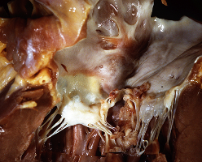
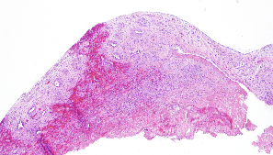
pathologic changes in the endocardium:
fibrin platelet (thrombi) and bacterial colonies attach to heart valve
Break off
(detach) from the valves and become infected emboli
involvement of other organs
( kidney ,brain )
immune comlex is formed (antigen - anti body complex )
glomerular damage
hematuria
Note: the involvement of other distance organs can be:
Directly : bacteremia (hematogenous)
Indirectly : by inducing antigen-anti body reaction
Drug addicts: often there is involvement of tricuspid, pulmonary valves of the right side of the heart. Because they take it intravenously. Increased risk to develop lung emboli and pneumonia

Slide 10
Petechiae
Nonspecific
embolie
Embolic manifestations of endocarditis
Osler’s Nodes
More specific
Often located on extremities or mucous membranes
Painful and erythematous nodules
Located on pulp of fingers and toes
More common in subacute IE
nails
CNS

Slide 11
Pathogenesis:
MORTALITY:
- With antibiotic treatment 30%
OTHER CLINICAL FEATURES: include:
High mortality
Virulence of organism or sever infection
Presence of underlying disease
Elderly
poor prognosis
Candida
Staphylococcus
Gram-negative
Inadequate treatment
Mild and prolonged fever, Malaise , weight loss and weakness
Changing murmurs
Anaemia , leucocytosis
Microscopic haematuria
Splenomegaly
Splinter haemorrhage
Hypergammaglobulinemia
Age young , elderly

Slide 12
ENDOCARDITIIS CAUSES: CONTINUOUS BACTERAEMIA:
There are three clinical patterns of Bacteraemia:
● Transient:
Lasts minutes to hours: following manipulation of infected tissues (Abscess, Furuncle or during a surgical procedure);instrumentation of contaminated mucosal surfaces (Dental Procedures, Cystoscopy or Sigmoidoscopy) and at the onset of bacterial Pneumonia, Arthritis, Osteomyelitis and Meningitis.
● Intermittent:
Commonly occurs with undrained Abscesses.
● Continuous:
Reflects an endovascular infection such as Endocarditis or Endarteritis, Suppurative Thrombophlebitis or an Infected Aneurysm. It also occurs in the first two weeks of Typhoid fever and Brucellosis.

Slide 13
LABORATORY DIAGNOSIS:
- Aerobic.
- Anaerobic.
- Serial Blood Culture (2-3 sets before Antibiotic Therapy):
- Serological Tests:
CFT ( Coxiella Burnetii ).
- Sensitivity Test.
- CBC, ESR and CRP, Complement levels (C3, C4, CH50).
- RF.
- Urinalysis.
- Additional Tests:
Technique For Collection Of Blood For Culture
Blood for culture contaminated by normal skin flora e.g.
- Staphylococcus Epidermidis.
- Diphtheroids.
- propionibacterium (Anaerobic Diphtheroides).
- So first clean the site (Mainly Antecubital Fossa) with Alcohol 70% (leave it for 1-11/2 minutes), Chlorhexidine or Iodine.
Blood culture by Automated Machines e.g. Bactec or Bact alert up to 5 days when signal Positive, the specimen is Gram Stained. So it will be reported to clinician then cultured identified and tested for Antimicrobial Susceptibility.
● Imaging
- Chest x-ray :
Look for Multiple Focal Infiltrates and Calcification of Heart Valves.
- ECG:
Rarely Diagnostic.
Look for evidence of Ischemia, Conduction Delay and Arrhythmias.
- Echocardiography.

Slide 14
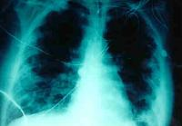
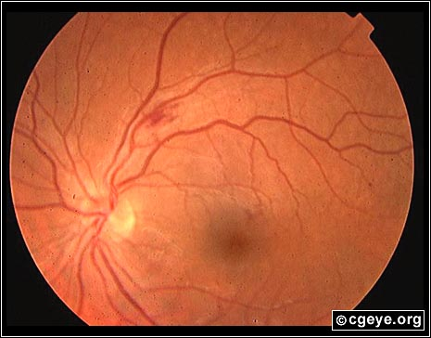
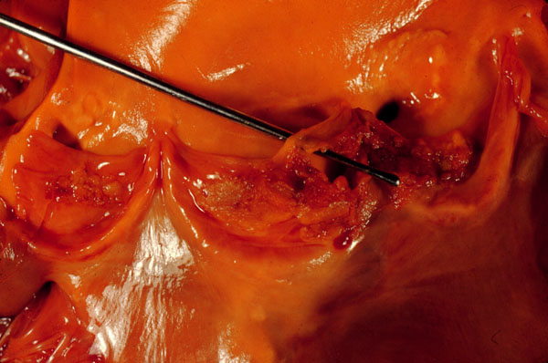
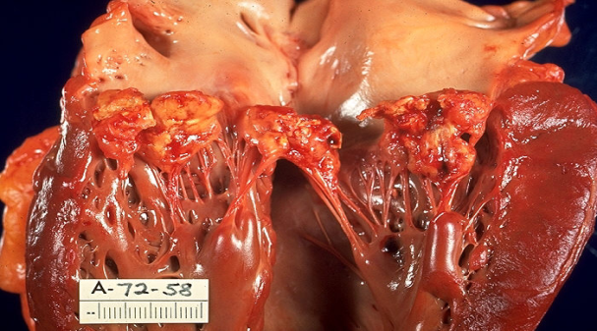
LOCAL SPREAD OF INFECTION
EMBOLIC COMPLICATIONS
- Heart Failure:
- Stroke.
Extensive Valvular Damage.
- Myocardial Infarction:
- Paravalvular Abscess (30-40%):
Fragments of Valvular Vegetation or Vegetation-Induced Stenosis of Coronary Ostia.
Most common in Aortic Valve, IVDA and S. Aureus.
May extend into Adjacent Conduction Tissue causing Arrhythmias.
Higher rates of Embolization and Mortality.
- Ischemic Limbs.
- Hypoxia from Pulmonary Emboli.
- Abdominal Pain (Splenic or Renal Infarction).
Septic Emboli
- Pericarditis.
- Fistulous Intracardiac Connections.
Metastatic Spread Of Infection
- Metastatic abscess:
Kidneys, spleen, brain, soft tissues.
Acute S. Aureus IE with Perforation of the Aortic Valve and Aortic Valve Vegetations.
Acute S. Aureus IE with Mitral Valve Ring Abscess Extending into Myocardium.
- Meningitis and/or encephalitis.
- Vertebral Osteomyelitis.
- Septic Arthritis.

Slide 15
TREATMENT
ANTIMICROBIAL PROPHYLAXIS (PREVENTION)
- Disk Diffusion Test (Not Sufficient).
- MIC, MBC.
- For Susceptible Patients:
- Criteria of antibiotic:
Rheumatic Valvular or Congenital Heart Disease.
Bactericidal.
Parenteral.
High Dose.
Prolonged.
- Before Tooth Extraction, Deep Scaling, Other Operations:
Benzyl Penicillin 2M I.M 30min before 500mg Penicillin V Oral 6 hourly for 2 days afterwards.
■ Viridians streptococci: Benzyl Penicillin by I.V 4MU every 4 hrs for 4 weeks or Penicillin + Gentamicin.
- If Patient is Allergic to Penicillin:
Vancomycin or Erythromycin Lactobionate Ig I.V. 30 min before Operation.
■ Streptococcus faecalis:
Ampicillin + Gentamicin by I.V.
-Recurrence after cure is common in:
Drug Addicts.
Immunodeficient Patients.
- Genitourinary Procedures:
Gentamicin + Ampicillin 30min before Operation.

Slide 16
quiz
1.Alcoholic-addicted-male came to ER with fever. Investigation shows he has leukocytosis and murmur. From the history he had tooth extraction before 3 weeks. What do you think the causative organism?
Viridans Strept. b) Staph. Epidermidis c) Staph. Aureus d) Diphtheroids
2.55-old-farmer came to the hospital with fever, weight loss, petechiae. From the history he had some activity as a shepherd “taking care of sheep”. The gram stain shows –ve. What is the causative agent?
a) Brucella b) Coxiella Burnetii c) Candida Albicans d) Staph. Aureus
3.40-old patient has artificial-heart valve. He had endocarditis. What is the most likely organism?
a) Viridans Strept. b) Staph. Epidermidis c) Staph. Aureus d) Diphtheriods
4.In treatment course of valve inflammation due to endocarditis we should: a) Use antibiotic for long time b) Prescribe high dose c) Use bactericidal antibiotic d) all of the above
5.In management of endocarditis we should measure MIC & MBC. What does MBC mean? a) Lowest concentration of antimicrobial that will inhibit the growth b) Lowest concentration of antimicrobial agent required to kill a particular bacteria
6.What is the best method to confirm diagnose of endocarditis? a) Serological test b) Sensitivity test c) CBC, ESR and CRP d) 2-3 sets of serial Blood Culture
1.A
2.B
3.B
4.D
5.B
6.D

Slide 17
Good luck
Our greatest weakness lies in giving up.
The most certain way to succeed is
always to try just one more time.
Thomas A. Edison
Done by :
Microbiology Team
￼
contact us: microbiology434@gmail.com

