Slide 1
CORONARY CIRCULATION
Physiology Team 434
contact us : physiology434@gmial.com
Color index
Explained in:
-
Only in
Boys’ Slides
Only in
Girls’ Slides
- Important
- Further Explanation

Slide 2
Objectives
Girls’
Boys’

Slide 3
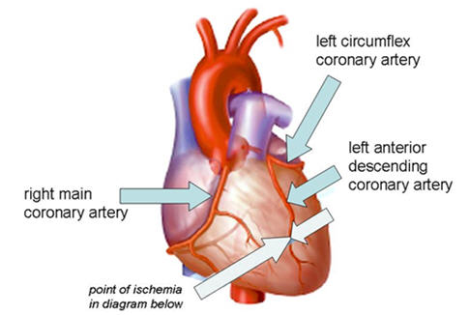
General fact about anatomy of coronary Arteries
The major vessels of the coronary circulation are :
1i- left main coronary that divides into left anterior descending and circumflex branches,
2i- right coronary artery.
The left and right coronary arteries originate at the base of the aorta from openings called the coronary ostia located behind the aortic valve leaflets.

Slide 4
Fact about blood flow in coronary circulation
❖ The right coronary artery has a greater flow in 50% of population.
❖ The left has a greater flow in 20% .
❖ Flow is equal in 30%.
❖ Coronary blood flow at rest in humans = 250 ml/min (5% of cardiac output)
❖ Venous blood: Most of the venous drainage of the heart returns through the coronary sinus
and anterior cardiac veins.(important fact)
❖ At rest the heart extracts 60-70% of oxygen from blood delivered to the heart , is very high
right !! Then why is it high at rest ?
Because , Heart muscle has more mitochondria (40% cell volume) that generate energy for cardiac
contraction by aerobic metabolism.
❖ coronary blood flow increases when more O2 is needed

Slide 5
What is the function of coronary arteries?
1- The coronary arteries supply blood flow to the heart, and when functioning normally, they ensure adequate oxygenation of the myocardium at all levels of cardiac activity.
2- Constriction and dilation of the coronary arteries, governed primarily by local regulatory mechanisms, regulate the amount of blood flow to the myocardium in a manner that matches the amount of oxygen delivered to the myocardium with the myocardial demand for oxygen.

Slide 6
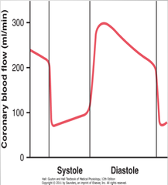
Coronary blood flow during Cardiac cycle
i
From the picture we can see that
coronary flow occurs during diastole
The reason is most of the coronary arteries
Pass through groves in the heart so when the contract it compress the coronary arteries
Note : the coronary filling dependence in aortic pressure
.

Slide 7
Factors Affecting Coronary Blood Flow
In non-diseased coronary vessels, when the cardiac activity and oxygen consumption I , there is an increase in coronary blood flow (active hyperemia) that is nearly proportionate to the in O2 consumption.
1-Autoregulation
heart
organs use this ability
Definition the ability of the tissue to regulate its own blood flow according to its metabolic needs
kidney
i
Liver
many organs Flow is tightly coupled to oxygen demand
This is necessary because the heart has a very high basal oxygen consumption (8-10 ml O2/min/100g)
.
Good autoregulation between 60 and 200 mmHg perfusion pressure helps to maintain normal coronary blood flow whenever coronary perfusion pressure changes due to changes in aortic pressure.

Slide 8
2- Chemical factors:
c. Other chemical factors:
hypoxia, excess CO2, H+, lactic acid
a- Adenosine
b. Nitric oxide
i
An important mediator of active hyperemia and autoregulation. An important coronary vasodilator.
coronary vasodilator.
.

Slide 9
3- Nervous regulation:
1- sympathetic
2- Parasympathetic
lead to two responses
1st -response cause a transits vasoconstriction .mediated by a1-adenoeceptors
2nd-response is immediately after the first
vasodilatation caused by enhanced production of vasodilator metabolites (active hyperemia) due to increased mechanical and metabolic activity of the heart resulting from
b1-adrenoceptors activation of the myocardium.
Causes modest coronary vasodilation (due to the direct effects of released acetylcholine on the coronaries)
If the activation of parasympathetic(over activity) lead to decrease in o2 .
Then the heart will change to intrinsic metabolic mechanisms
i
.
In summary, Sympathetic activation to the heart results in coronary vasodilation and increased coronary flow due to increased metabolic activity (increased heart rate, contractility).

Slide 10
What is the most vulnerable portion of the heart to ischemia?
Because there is no blood flow during systole in the subendocardial portion of the left ventricle, this region is prone to ischemic damage and is the most common site of myocardial infarction.
Blood flow to the left ventricle is decreased in patients with stenotic aortic valves because in aortic stenosis the pressure in the left ventricle must be much higher than that in the aorta to eject blood. Consequently, coronary vessels are severely compressed during systole. These patients are more prone to develop myocardial ischemia.
i
.

Slide 11
O2 consumption by the heart and energy substrate
1-At rest, O2 consumption by beating heart = 9 ml/100 g/min.
During ms.ex increases in myocardial O2 consumption are met by increases in Coronary Blood Flow
O2 consumption by the heart is determined by:
2-Work load: An increase in afterload causes greater increase in O2 consumption than an increase in preload does. This is why angina due to deficient delivery of O2 to the myocardium is more common in aortic stenosis than in aortic regurge.
Contractile state of the myocardium
Intra-myocardial tension.
Heart rate
Heart most burns chemical fuel to generate energy
The chemical fuel is
Fatty acids, ketone bodies, and carbohydrates
And the energy is ATP
The heart use fatty acids as primery source for energy
Fatty acids are the major source of acetyl coenzyme A for the Krebs cycle and of the oxidative production of ATP.
Glycolysis converts glucose to pyruvate and provides a relatively small amount of ATP to the normal adult heart

Slide 12
Risk factors for coronary artery disease
Conventional risk factors
Among persons with CAD, the cardiovascular death rate for African Americans is reported to be particularly high
Race
Family history
Cessation of cigarette smoking constitutes the single most
age
for early heart disease
Men : < 45 women : < 55
Modifiable risk factors
Cigarette smoking
Diabetes mellitus
High blood cholesterol levels
specifically, low-density lipoprotein cholesterol [LDL-C]
Obesity
High blood pressure
Lack of physical activity

Slide 13
Done by:
Abdurrahman Asker
Abdullah Al faleh

