Slide 1
Inborn Errors of Amino Acid Metabolism
(Renal Block)
abbreviations:
Phe-Phenylalanine
Tyr-Tyrosine
Trp- Tryptophan
Leu- Leucine
Ile- Isoleucine
Val- Valine
Met- Methionine
Biochemistry of:
Phenylketonuria (PKU)
Maple Syrup Urine Disease (MSUD)
Albinism
Homocyteinuria
Alkaptonuria

Slide 2
Inborn Errors of aa Metabolism
Caused by enzyme loss or deficiency due to gene loss or gene mutation
Cofactors
Enzyme + Substrate
Product
Excess
Deficient

Slide 3
Phenylketonuria (PKU)
Most common disease of aminoacid metabolism
Due to deficiency of phenylalanine hydroxylase enzyme
Results in hyperphenylalaninemia

Slide 4
The pathway of phenylalanine degradation
Phenylalanine
accumulated
Phenylalanine hydroxylase
Page 1009

Slide 5
Phenylketonuria (PKU)
Conversion of Phe to Tyr requires tetrahydrobiopterin (BH₄)
Even if phenylalanine hydroxylase level is normal
The enzyme will not function without BH₄
Hence Phe is accumulated

Slide 6
Formation, utilization, and regeneration of 5,6,7,8-tetrahydrobiopterin (BH₄) in the phenylalanine hydroxylase reaction
Page 1010
GTP
Dihydrobiopterin
synthetase

Slide 7
Phenylketonuria (PKU)
Classic PKU:
Due to deficiency of phenylalanine hydroxylase
Atypical hyperphenylalaninemia:
Due to deficiency of BH₄
Caused by the deficiency of:
Dihydropteridine reductase
Dihydrobiopterin synthetase
Carbinolamine dehydratase

Slide 8
Characteristics of PKU
In the absence of BH₄, Phe will not be converted to Tyr

Slide 9
Phe accumulated
BH₂
Page 1010

Slide 10
Melanin biosynthesis from tyrosine
No or less
tyrosine
Page 1002
Melanin
No or less melanin
Light skin in PKU patients

Slide 11
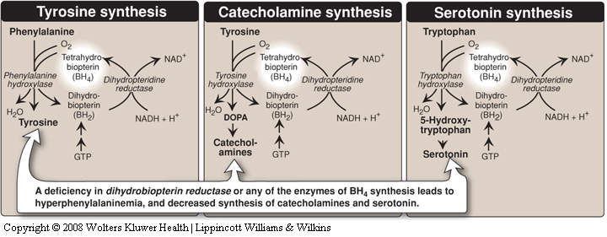
Characteristics of PKU
Tyr will not be converted to catecholamines and Trp will not be converted to serotonin as they require BH₄
Catecholamines and serotonin are neurotransmitters

Slide 12
Characteristics of PKU
CNS symptoms: Mental retardation, failure to walk or talk, seizures, etc.
Hypopigmentation
Deficiency of melanin
Hydroxylation of tyrosine by tyrosinase is inhibited by high phe conc.

Slide 13
Characteristics of PKU
Elevated phenylalanine in tissues, plasma, urine
Phe is degraded to phenyllactate, phenylacetate, and phenylpyruvate
Gives urine a mousy odor

Slide 14
Cause of mousy urine smell in PKU

Slide 15
Characteristics of PKU
Prenatal diagnosis is done by detecting gene mutation in fetus
Neonatal diagnosis in infants is done by measuring blood phe levels
Treatment:
Life long phe-restricted diet

Slide 16
Maple Syrup Urine Disease
Due to deficiency of branched chain α-ketoacid dehydrogenase
The enzyme decarboxylates leucine, isoleucine and valine
These aminoacids accumulate in blood
Symptoms: mental retardation, physical disability, metabolic acidosis, etc.
Maple syrup odor of urine

Slide 17
Maple Syrup Urine Disease
Types:
Classic type: Most common, due to little or no activity of α-ketoacid dehydrogenase
Intermediate and intermittent forms: Some enzyme activity, symptoms are milder
Thiamin-responsive form: High doses of thiamin increases α-ketoacid dehydrogenase activity

Slide 18
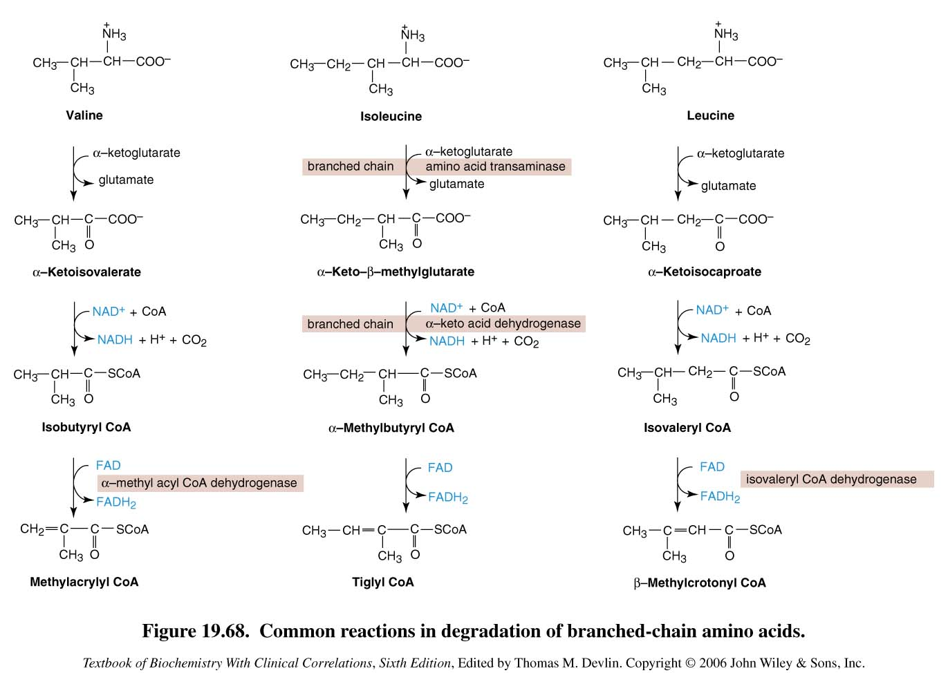
Valine, Isoleucine,
Leucine and their
keto acids
accumulated
Degradation of branched-chain amino acids: valine, isoleucine and leucine. Deficiency of branched chain a-keto acid dehydrogenase leads to MSUD.

Slide 19
Maple Syrup Urine Disease
Treatment:
Limited intake of leucine, isoleucine and valine

Slide 20
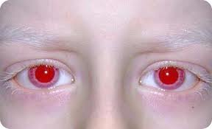
Albinism
A disease of tyrosine metabolism
Tyrosine is involved in melanin production
Melanin is a pigment of hair, skin, eyes
Due to tyrosinase deficiency
Melanin is absent in albino patients
Hair and skin appear white
Vision defects, photophobia

Slide 21
Melanin biosynthesis from tyrosine: Deficiency of tyrosinase leads to albinisim
Tyrosinase
Page 1002
Melanin

Slide 22
Homocystinuria
Due to defects in homocysteine metabolism
Deficiency of cystathionine β-synthase
Converts homocysteine to cystathione
High plasma and urine levels of homocysteine
High plasma homocysteine is a risk factor for atherosclerosis and heart disease
Skeletal abnormalities, osteoporosis, mental retardation, displacement of eye lens

Slide 23
Methionine degradation pathway: Deficiency of cystathione β-synthase leads to homocystinuria / homocysteinemia
Methionine and its
metabolites are
accumulated
Cystathione β-synthase
Cysteine becomes
deficient
Page 1002

Slide 24
Homocystinuria
Treatment:
Oral administration of vitamins B₆, B₁₂ and folate
Vitamin B₆ is a cofactor for cystathionine β-synthase
Methionine-restricted diet

Slide 25
Homocysteinemia
Hyperhomocysteinemia is also associated with:
Neural tube defect (spina bifida)
Vascular disease (atherosclerosis)
Heart disease

Slide 26
Methionine degradation pathway: Deficiency of cystathione β-synthase leads to hyperhomocystinuria / hyperhomocysteinemia
Deficiency of:
Tetrahydrofolate
Methionine synthase
Vitamin B₆, B₁₂
Folic acid
Neural
tube
defect
+
Hyperhomocysteinemia
Cystathione β-synthase
Page 1002

Slide 27
Alkaptonuria
A rare disease of tyrosine degradation
Due to deficiency of homogentisic acid oxidase
Homogentisic acid is accumulated in tissue and cartilage
Homogentisic aciduria: elevated homogentisic acid in urine

Slide 28
Alkaptonuria
Homogentisic acid is oxidized to dark pigment in urine over time
Arthritis, black pigmentation of cartilage and tissue
Usually asymptomatic until adulthood
Restricted intake of tyrosine and phenylalanine reduces homogentisic acid and dark pigmentation

Slide 29
Degradation of tyrosine Deficiency of homogentisic acid oxidase leads to alkaptonuria
Homogentisate oxidase

Slide 30
 | Disease | Enzyme | Aminoacids involved
1 | Phenylketonuria | Phenylalanine hydroxylase | Phenylalanine
2 | Maple syrup urine disease | Branched chain α-ketoacid dehydrogenase | Isoleucine, leucine and valine
3 | Albinism | Tyrosinase | Tyrosine
4 | Homocystinuria | Cystathionine β-synthase | Methionine
5 | Alkaptonuria | Homogentisic acid oxidase | Tyrosine and phenylalanine

