Slide 1
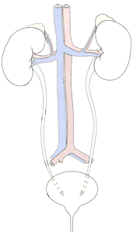
RENAL BLOCK
Pathology Practical I & II
Prof. Ammar Al Rikabi
Dr. Sayed Al Esawy
Dr. Marie Mukhashin
Dr. Shaesta Zaidi
Prepared by:
Head of Pathology Department: Dr. Abdulmalik Al Sheikh

Slide 2
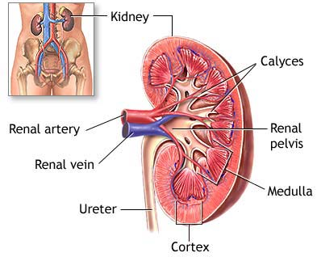
Anatomy of the Kidney
Pathology Dept , KSU
Renal Block

Slide 3
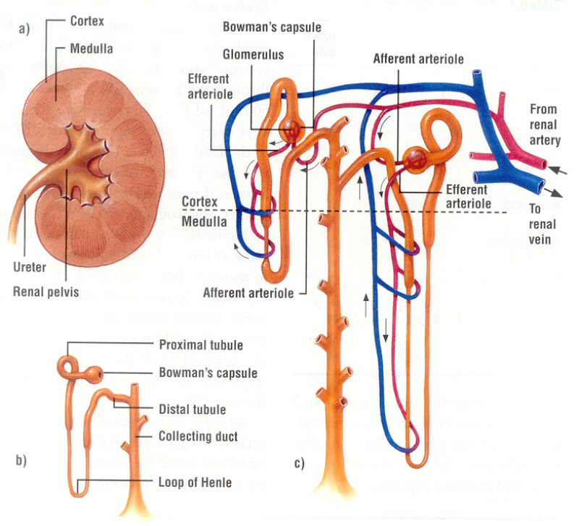
NEPHRON STRUCTURE
Pathology Dept , KSU
Renal Block

Slide 4
KIDNEY ANATOMY : NEPHRONS
Nephron is the functional unit of the kidney.
Each kidney contains about 1,000,000 to 1,300,000 nephrons.
The nephron is composed of glomerulus and renal tubules .
The nephron performs its function by ultra filtration at glomerulus and secretion and reabsorption at renal tubules.
Pathology Dept , KSU
Renal Block

Slide 5
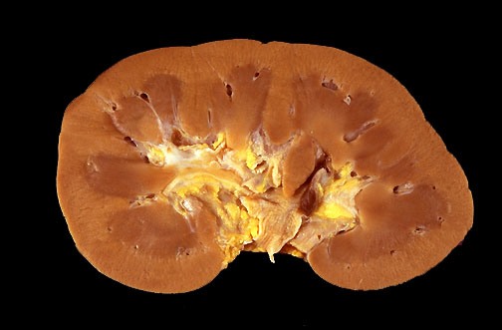
Normal Kidney - Gross
In cross section, this normal adult kidney demonstrates the lighter outer cortex and the darker medulla, with the renal pyramids into which the collecting ducts coalesce and drain into the calyces and central pelvis.
Pathology Dept , KSU
Renal Block

Slide 6
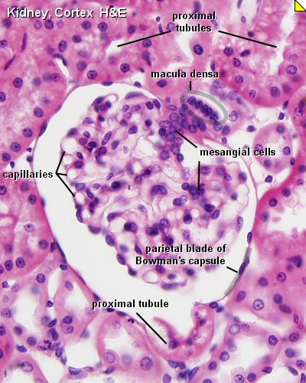
Renal Corpuscle – Normal Histology
Pathology Dept , KSU
Renal Block

Slide 7
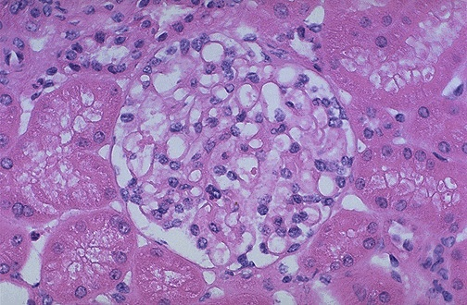
Renal Corpuscle – Normal Histology
Normal glomerulus by light microscopy. The glomerular capillary loops are thin and delicate. Endothelial and mesangial cells are normal in number. The surrounding tubules are normal
Pathology Dept , KSU
Renal Block

Slide 8
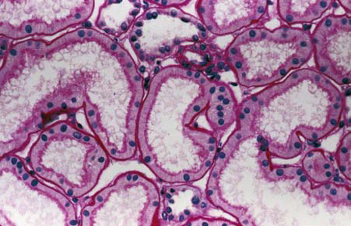
Normal Cortical Tubules
Normal cortical tubules, interstitium, and peritubular capillaries; most of the tubules are proximal, with well-defined brush borders (PAS stain).
Pathology Dept , KSU
Renal Block

Slide 9
ACUTE KIDNEY INJURY
PRACTICAL SESSION : 1
Pathology Dept , KSU
Renal Block

Slide 10
Acute Kidney Injury
Causes:
Pre-renal
(All those that decrease effective blood flow to the kidney)
Low blood volume, low blood pressure, and heart failure.
Renal artery stenosis, and renal vein thrombosis.
Renal ischemia.
Renal:
Glomerulonephritis (GN).
Acute tubular necrosis (ATN).
Acute interstitial nephritis (AIN).
Post-renal:
(is a consequence of urinary tract obstruction)
Benign prostatic hyperplasia.
Kidney stones.
Obstructed urinary catheter.
Bladder stone .
Bladder, ureteral or renal malignancy.
Pathology Dept , KSU
Renal Block

Slide 11
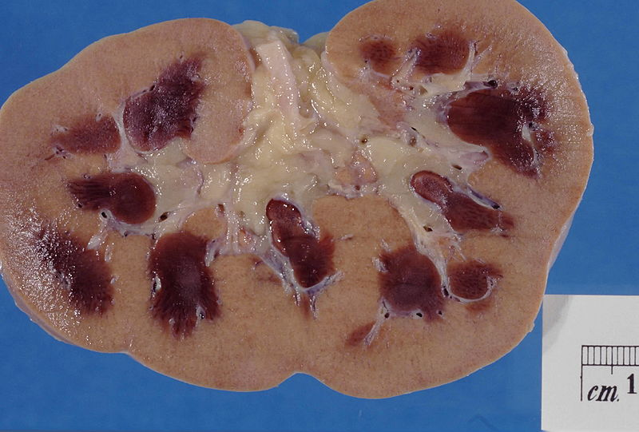
Acute Kidney Injury
Kidney showing marked pallor of the cortex, contrasting to the darker areas of surviving medullary tissue.
Pathology Dept , KSU
Renal Block

Slide 12
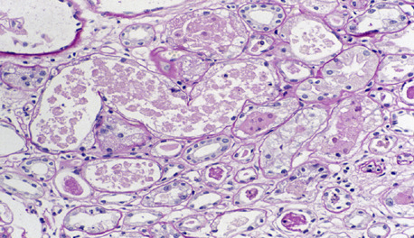
Acute Tubular Necrosis
Acute tubular necrosis is manifest by vacuolated cells and sloughed, necrotic cells in tubular lumina, with some tubules lined by flattened epithelium and some showing frank necrosis
Pathology Dept , KSU
Renal Block

Slide 13
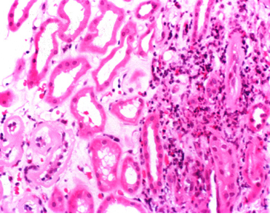
Acute Interstitial Nephritis
There is edema in addition to preexisting mild tubulointerstitial fibrosis .
There is a prominent interstitial eosinophilic component, in addition to lymphocytes and plasma cells
Pathology Dept , KSU
Renal Block

Slide 14
POLYCYSTIC KIDNEY
Pathology Dept , KSU
Renal Block

Slide 15
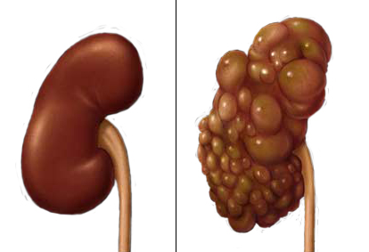
Normal vs Polycystic Kidney
Pathology Dept , KSU
Renal Block

Slide 16
Polycystic kidney – Gross Anatomy
Markedly enlarged kidney and replacement of the renal parenchyma by numerous cysts of variable sizes in entire cortex
Pathology Dept , KSU
Renal Block

Slide 17
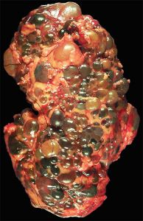
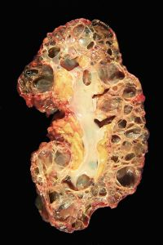
Gross Polycystic kidney and its Cut Section
Massively enlarged kidney disrupted by numerous cysts
Cut surface of the kidney, showing extensive cortical destruction by cysts
Pathology Dept , KSU
Renal Block

Slide 18
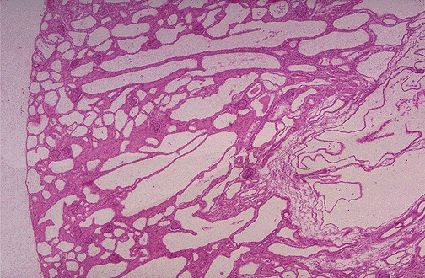
Autosomal dominant Polycystic Kidney Disease
Variable sized cysts fill most of the parenchyma
No glomeruli seen.
COMPLICATIONS: Hypertension, Renal failure

Slide 19
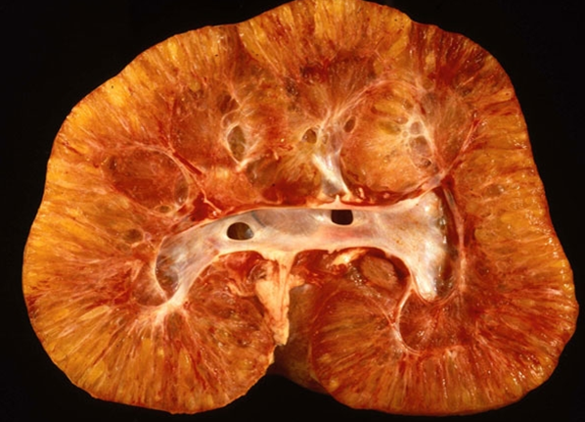
Infantile Polycystic kidney – Gross
Coronal section of an infantile polycystic kidney
Pathology Dept , KSU
Renal Block

Slide 20
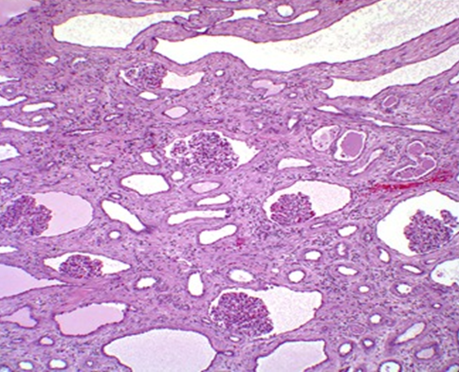
Polycystic kidney – Histopathology
Kidney of child with autosomal dominant PCKD.
a. Coronal section of a polycystic kidney.
b. histology demonstrating glomerular cysts .
Note the normal-sized glomeruli with the enlarged Bowman’s space and tubular cystic changes
Pathology Dept , KSU
Renal Block

Slide 21
INFECTION OF THE URINARY TRACT
PRACTICAL SESSION : 2
Pathology Dept , KSU
Renal Block

Slide 22
ACUTE (POST-STREPTOCOCCAL) GLOMERULONEPHRITIS
Pathology Dept , KSU
Renal Block

Slide 23
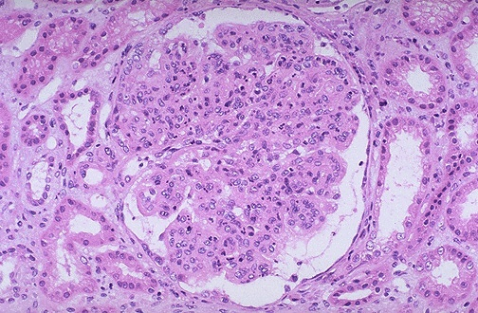
Acute (Post-streptococcal) Glomerulonephritis
This glomerulus is hypercellular and capillary loops are poorly defined. This is a type of proliferative glomerulonephritis known as post-infectious glomerulonephritis
Pathology Dept , KSU
Renal Block

Slide 24
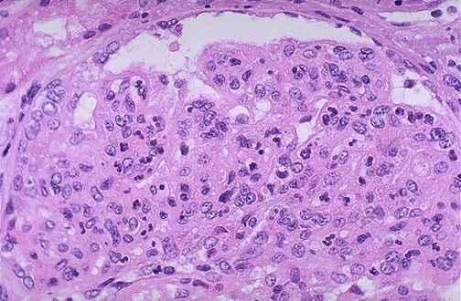
Acute (Post-streptococcal) Glomerulonephritis
The hypercellularity of post-infectious glomerulonephritis is due to increased numbers of epithelial, endothelial, and mesangial cells as well as neutrophils in and around the glomerular capillary loops
Pathology Dept , KSU
Renal Block

Slide 25
Acute (Post-streptococcal) Glomerulonephritis
High power LM of a hypercellular glomerulus; numerous capillaries contain inflammatory cells, mostly neutrophils
Pathology Dept , KSU
Renal Block

Slide 26
Acute (Post-streptococcal) Glomerulonephritis
Section of the kidney shows:
The glomeruli are enlarged, lobulated and hypercellular with obliteration of capsular space.
Cellularity is due to proliferation of endothelial and mesangial cells with some neutrophils.
Many capillaries appear obliterated.
Tubules show degenerative changes.
Pathology Dept , KSU
Renal Block

Slide 27
ACUTE & CHRONIC PYELONEPHRITIS
Pathology Dept , KSU
Renal Block

Slide 28
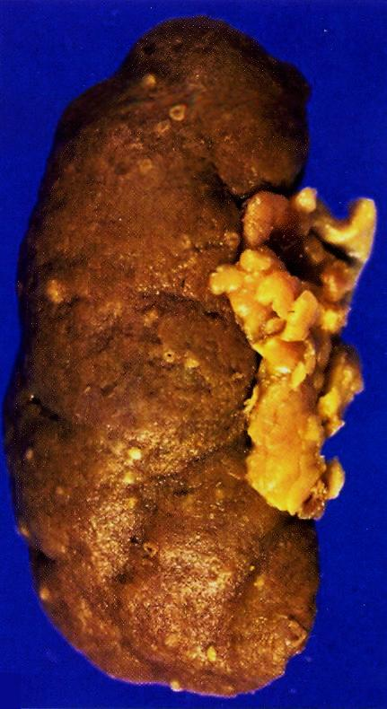
Pyelonephritis with small cortical abscesses
Pyelonephritis with small cortical abscesses
Pathology Dept , KSU
Renal Block

Slide 29
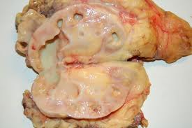
Classic picture of Pyelonephritis
This kidney is bisected to reveal a dilated pelvis and calyxes filled with a yellow-green purulent pus which is consistent with a pyelonephritis. The cortex and medulla are pale and the corticomedullary junction is ill-defined.
No tumors are seen.
Pathology Dept , KSU
Renal Block

Slide 30
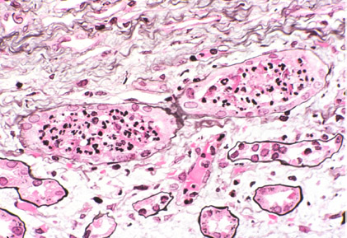
Acute Pyelonephritis - Histopathology
Acute pyelonephritis is diagnosed by intratubular aggregations of polymorphonuclear neutrophils (PMNs). There may be surrounding interstitial inflammation with a mixture of PMNs, lymphocytes,
and plasma cells, but the predominant inflammation is within the tubule
Pathology Dept , KSU
Renal Block

Slide 31
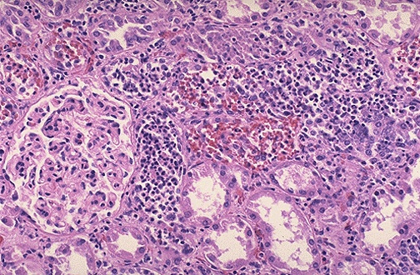
Acute Pyelonephritis - Histopathology
Numerous PMN's are seen filling renal tubules across the center and right of this picture. These leukocytes may form into a cast within the tubule. Casts appearing in the urine originate in the distal renal tubules and collecting ducts
Pathology Dept , KSU
Renal Block

Slide 32
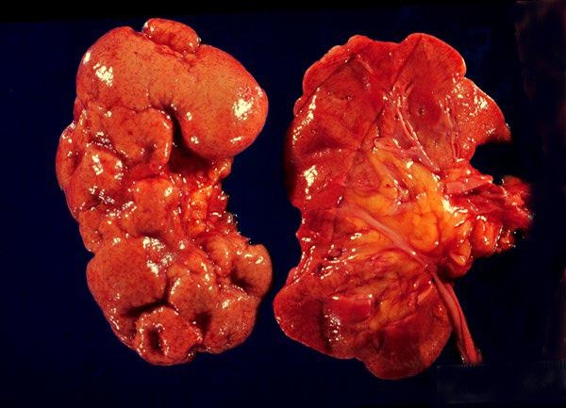
Chronic Pyelonephritis - Gross Pathology
The picture shows slightly atrophic and deformed kidneys
with cortical coarse scars .
Pathology Dept , KSU
Renal Block

Slide 33
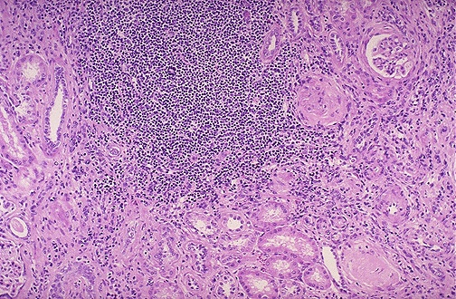
Chronic Pyelonephritis - Histopathology
This is chronic pyelonephritis where a large collection of chronic inflammatory cells . The severity of disease depends upon the amount of remaining functional renal parenchyma
Pathology Dept , KSU
Renal Block

Slide 34
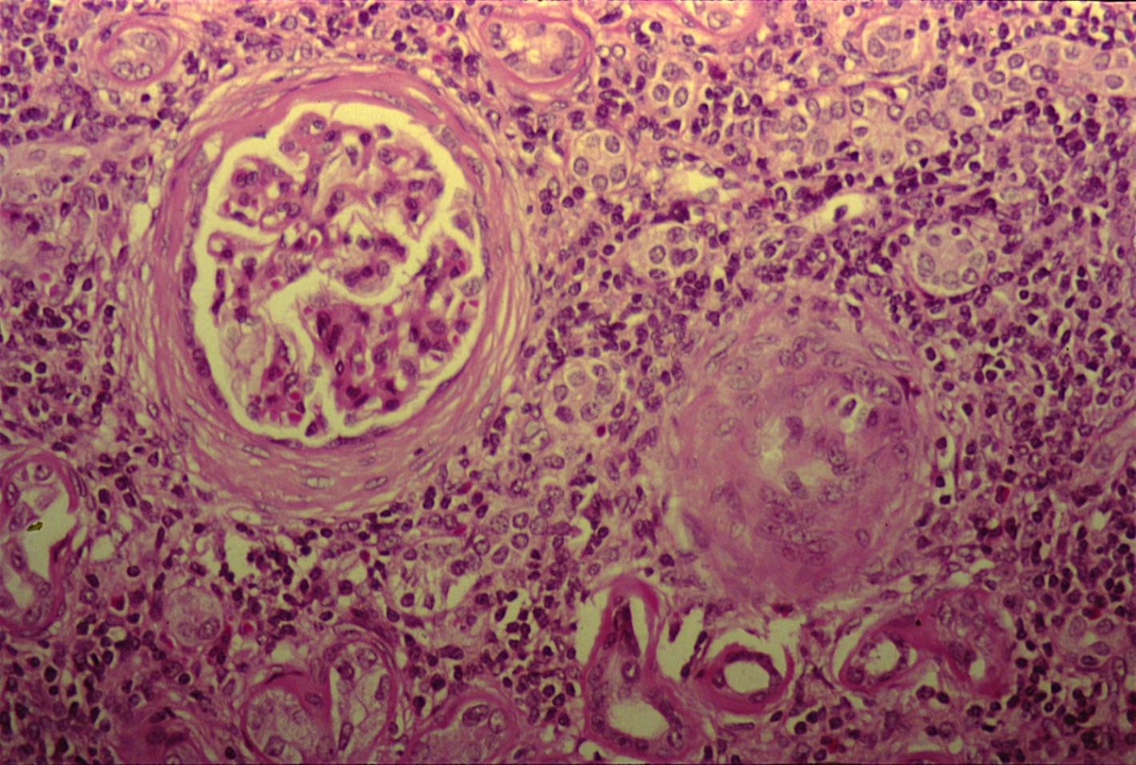
Chronic Pyelonephritis - Histopathology
High power shows periglomerular fibrosis , glomerular sclerosis and hyalinization with marked chronic interstitial inflammation .
Pathology Dept , KSU
Renal Block

Slide 35
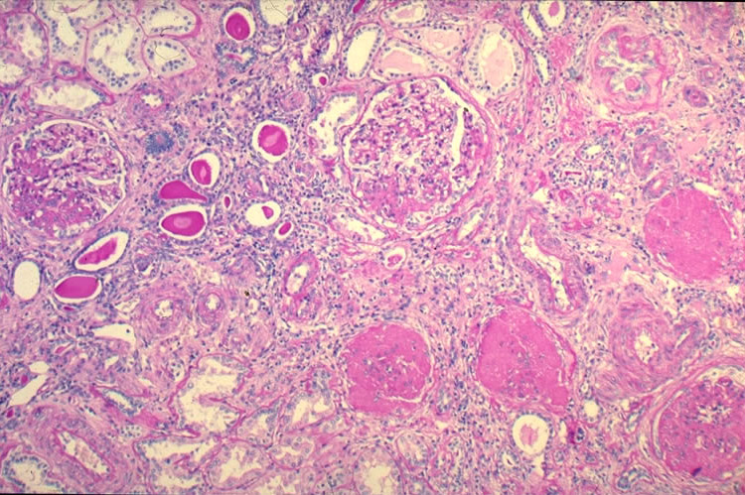
Chronic Pyelonephritis - Histopathology
- Glomeruli show varying degrees of sclerosis & periglomerular fibrosis.
- Tubules show varying degrees of atrophy, Some tubules are dilated and filled with Eosinophilic hyaline casts resembling colloid (thyroidization).
- Interstitial tissue shows chronic inflammatory cells infiltrate and fibrosis.
Pathology Dept , KSU
Renal Block

Slide 36
HYDRONEPHROSIS
Pathology Dept , KSU
Renal Block

Slide 37
Hydronephrosis
The most common causes are:
Foreign bodies like calculi with
obstruction,
Atresia of the urethra,
Benign prostatic hyperplasia ,
Neoplasia of the prostate and
bladder
Spinal cord damage with paralysis of the bladder .
The picture shows markedly dilated renal pelvis and calyces with atrophic and thin renal cortex /parenchyma
Pathology Dept , KSU
Renal Block

Slide 38
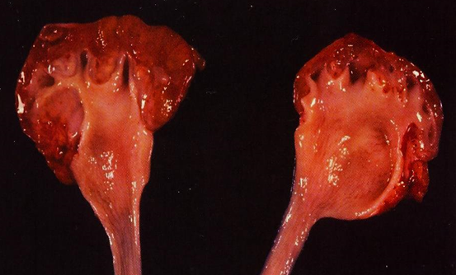
Hydronephrosis
Complications of hydronephrosis
--Urinary tract infection
--Pyelonephritis.
--Renal failure.
Bisected kidney shows markedly dilated renal pelvis and calyces with atrophic and thin renal cortex /parenchyma
Pathology Dept , KSU
Renal Block

Slide 39
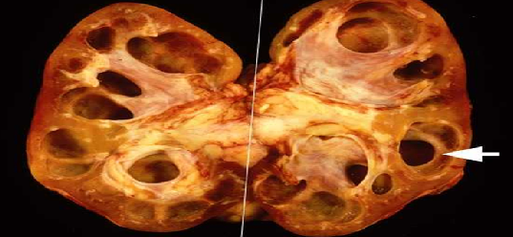
Hydronephrosis
Markedly dilated renal pelvis and calyces with atrophic and thin renal cortex
Pathology Dept , KSU
Renal Block

Slide 40
Nephrotic Syndrome
PRACTICAL SESSION : 2
Pathology Dept , KSU
Renal Block

Slide 41
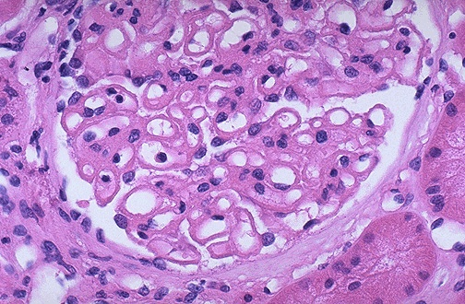
Membranous Glomerulonephritis
Membranous glomerulonephritis ( The common cause of Nephrotic syndrome in adults): the capillary loops are thickened and prominent, but the cellularity is not increased.
Pathology Dept , KSU
Renal Block

Slide 42
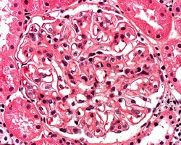
Membranous Glomerulonephritis
Close-up of glomerulus illustrating rigid, uniformly-thickened capillary walls
Pathology Dept , KSU
Renal Block

Slide 43
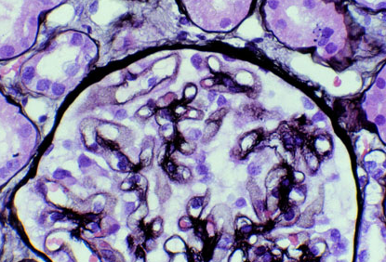
Membranous Glomerulonephritis
The thickened capillary wall shows numerous "holes" in tangential sections, indicating deposits. (Deposits do not take up the silver stain.) Well-developed spikes around the deposits
are not present here.
Pathology Dept , KSU
Renal Block

Slide 44
Nephritic Syndrome (RPGN)
Pathology Dept , KSU
Renal Block

Slide 45
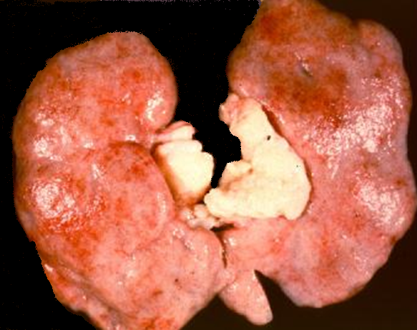
Rapid Progressive Glomerulonephritis (RPGN)
Gross appearance of RPGN - note the flea beaten appearance
Pathology Dept , KSU
Renal Block

Slide 46
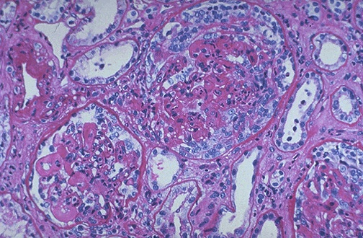
Rapid Progressive Glomerulonephritis (RPGN)
Seen here within the glomeruli are crescents composed of proliferating epithelial cells. Crescentic glomerulonephritis is known as rapidly progressive glomerulonephritis (RPGN) because this disease is very progressive
Pathology Dept , KSU
Renal Block

Slide 47
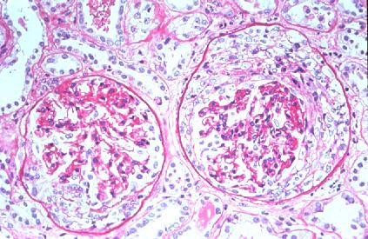
Rapid Progressive Glomerulonephritis (RPGN)
Epithelial cells of Bowman capsule are proliferated . Infiltrating WBCs such as monocytes and macrophages also proliferate compressing the glomerulus, forming a crescent-shaped scar
Pathology Dept , KSU
Renal Block

