Slide 1
Inborn Errors of Amino Acid Metabolism
(Renal Block)
1 Lecture Dr. Ahmed H. Mujamammi
Biochemistry of:
  Phenylketonuria (PKU)
  Maple Syrup Urine Disease (MSUD)
  Albinism
  Homocyteinuria
  Alkaptonuria

Slide 2
Inborn Errors of aa Metabolism
Caused by enzyme loss or deficiency due to gene loss or gene mutation

Slide 3
Phenylketonuria (PKU)
Due to deficiency of phenylalanine hydroxylase enzyme
Most common disease of aa metabolism
Results in hyperphenylalaninemia

Slide 4
Phenylketonuria (PKU)
Classic PKU:
  Due to deficiency of phenylalanine hydroxylase
Conversion of Phe to Tyr requires tetrahydrobiopterin (BH₄)
Even if phenylalanine hydroxylase level is normal
The enzyme will not function without BH₄
Hence Phe is accumulated

Slide 5
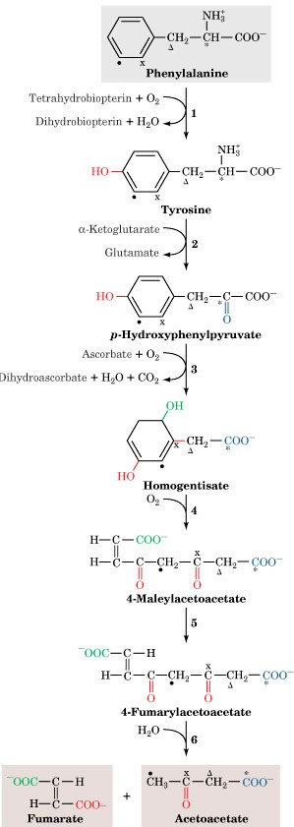
The pathway of phenylalanine degradation
Phenylalanine
accumulated
Phenylalanine hydroxylase
Page 1009

Slide 6
Phenylketonuria (PKU)
  Atypical hyperphenylalaninemia:
  Due to deficiency of BH₄
  Caused by the deficiency of:
    Dihydropteridine reductase
    Dihydrobiopterin synthetase
    Carbinolamine dehydratase

Slide 7
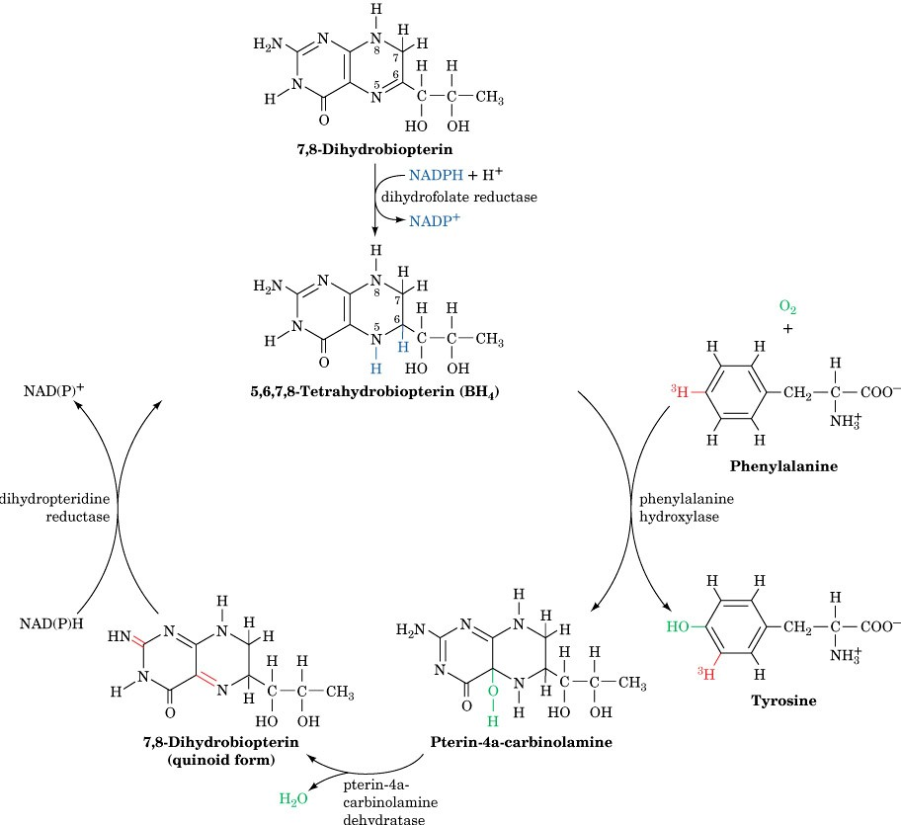
Formation, utilization, and regeneration of 5,6,7,8-tetrahydrobiopterin (BH₄) in the phenylalanine hydroxylase reaction
Page 1010
GTP
Dihydrobiopterin
synthetase

Slide 8
Characteristics of PKU
In the absence of BH₄, Phe will not be converted to Tyr

Slide 9
Phe accumulated
BH₂
Page 1010

Slide 10
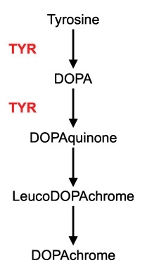
Melanin biosynthesis from tyrosine
No or less
tyrosine
Page 1002
Melanin
No or less melanin
Light skin in PKU patients

Slide 11
Characteristics of PKU
Tyr will not be converted to catecholamine neurotransmitters
Synthesis of catecholamines requires BH₄

Slide 12
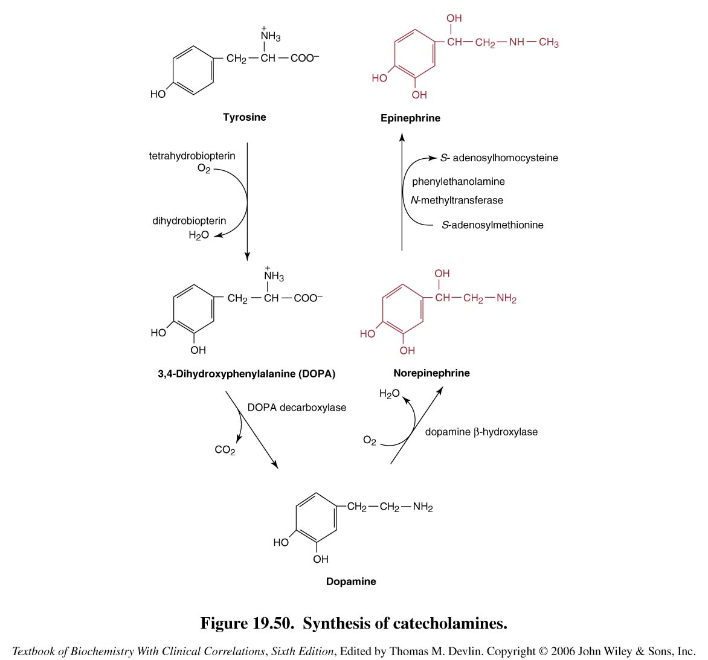

Slide 13
Characteristics of PKU
Trp will not be converted to serotonin (a neurotransmitter) as it requires BH₄

Slide 14
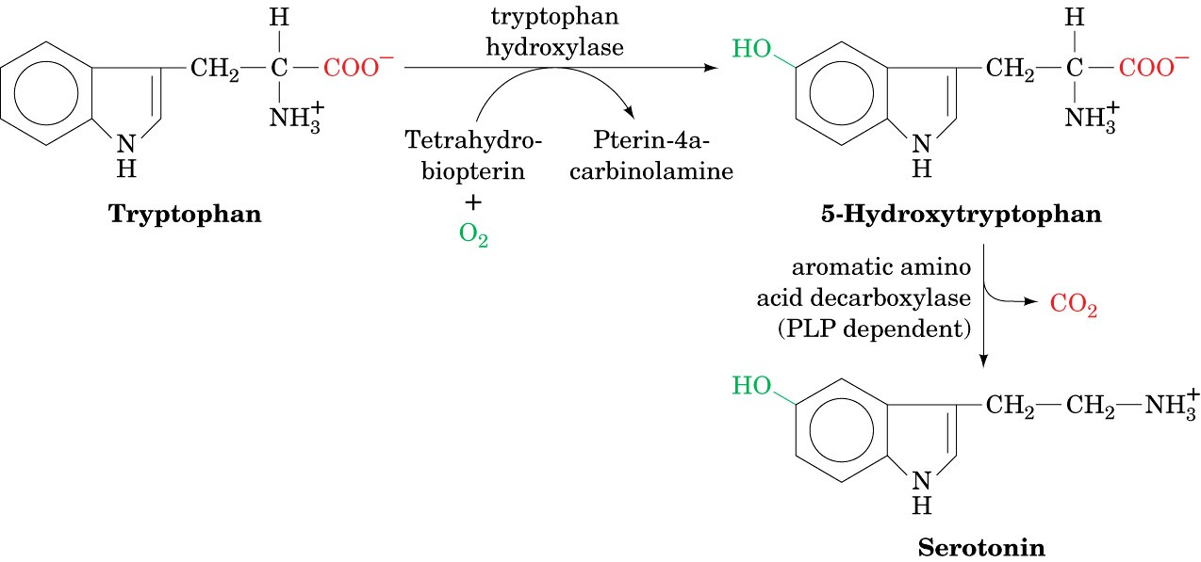
Synthesis of serotonin
Page 1025

Slide 15
Characteristics of PKU
CNS symptoms: Mental retardation, failure to walk or talk, seizures, etc.
Hypopigmentation
  Deficiency of melanin
  Hydroxylation of tyrosine by tyrosinase is inhibited by high phe conc.

Slide 16
Characteristics of PKU
Elevated phenylalanine in tissues, plasma, urine
Phe is degraded to phenyllactate, phenylacetate, and phenylpyruvate
  Gives urine a mousy odor

Slide 17
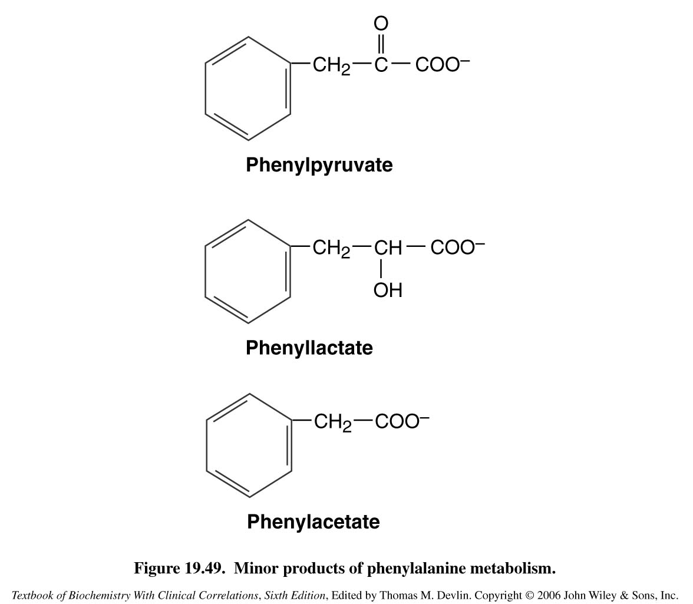
Cause of mousy urine smell in PKU

Slide 18
Characteristics of PKU
Prenatal diagnosis is done by detecting gene mutation in fetus
Neonatal diagnosis in infants is done by measuring blood phe levels
Treatment:
  Life long phe-restricted diet

Slide 19
Maple Syrup Urine Disease
Due to deficiency of branched chain α-ketoacid dehydrogenase
The enzyme decarboxylates leucine, isoleucine and valine
These aa accumulate in blood
Symptoms: mental retardation, physical disability, metabolic acidosis, etc.
Maple syrup odor of urine

Slide 20
Maple Syrup Urine Disease
Types:
  Classic type: Most common, due to little or no activity of α-ketoacid dehydrogenase
  Intermediate and intermittent forms: Some enzyme activity, symptoms are milder
  Thiamin-responsive form: High doses of thiamin increases α-ketoacid dehydrogenase activity

Slide 21
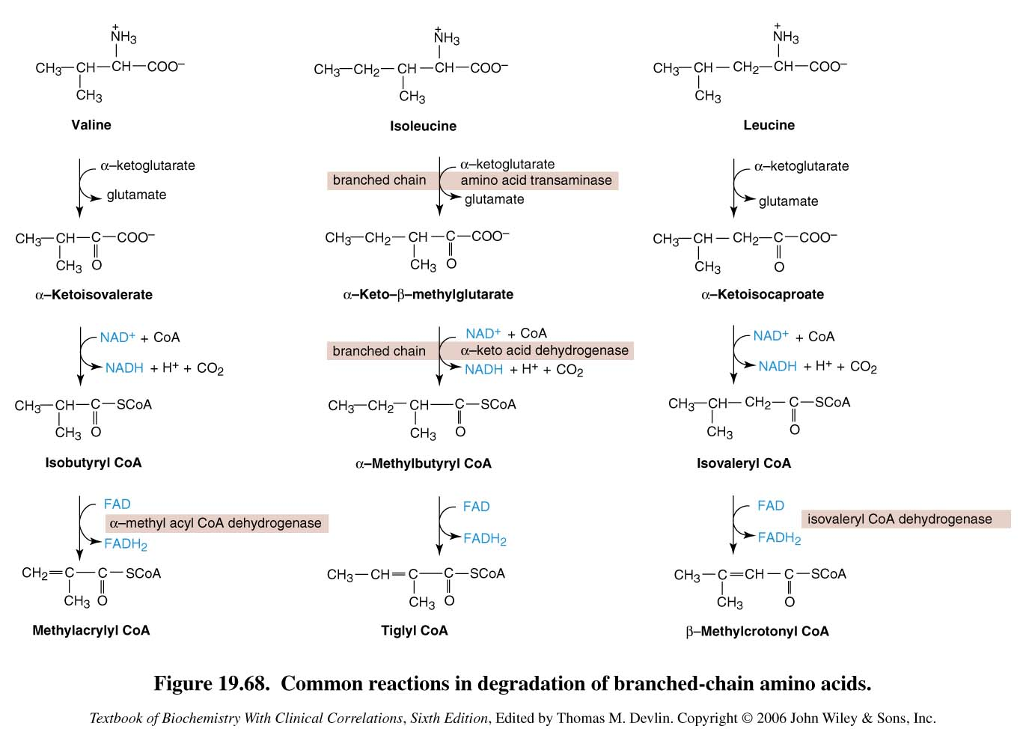
Valine, Isoleucine,
Leucine and their
keto acids
accumulated
Degradation of branched-chain amino acids: valine, isoleucine and leucine.
Deficiency of branched chain a-keto acid dehydrogenase leads to MSUD.

Slide 22
Maple Syrup Urine Disease
Treatment:
Limited intake of leucine, isoleucine and valine

Slide 23

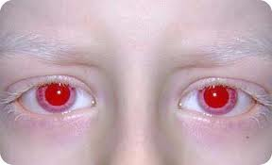
Albinism
A disease of tyrosine metabolism
Tyrosine is involved in melanin production
Melanin is a pigment of hair, skin, eyes
Due to tyrosinase deficiency
Melanin is absent in albino patients
Hair and skin appear white
Vision defects, photophobia

Slide 24
Melanin biosynthesis from tyrosine: Deficiency of tyrosinase leads to albinisim
Tyrosinase
Page 1002
Melanin

Slide 25
Homocystinuria
Due to defects in homocysteine metabolism
Deficiency of cystathionine β-synthase
  Converts homocysteine to cystathione
High plasma and urine levels of homocysteine
High plasma homocysteine is a risk factor for atherosclerosis and heart disease
Skeletal abnormalities, osteoporosis, mental retardation, displacement of eye lens

Slide 26
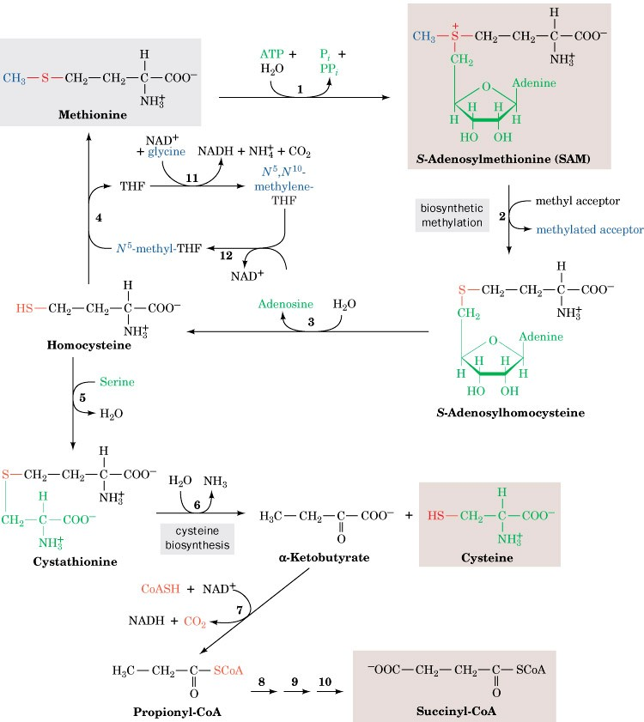
Methionine degradation pathway: Deficiency of cystathione β-synthase leads to homocystinuria / homocysteinemia
Methionine and its
metabolites are
accumulated
Cystathione β-synthase
Cysteine becomes
deficient
Page 1002

Slide 27
Homocystinuria
Treatment:
  Oral administration of vitamins B₆, B₁₂ and folate
  Vitamin B₆ is a cofactor for cystathionine β-synthase
  Methionine-restricted diet

Slide 28
Homocysteinemia
Hyperhomocysteinemia is also associated with:
Neural tube defect (spina bifida)
Vascular disease (atherosclerosis)
Heart disease

Slide 29
Methionine degradation pathway: Deficiency of cystathione β-synthase leads to hyperhomocystinuria / hyperhomocysteinemia
Deficiency of:
Tetrahydrofolate
Methionine synthase
Vitamin B₆, B₁₂
Folic acid
Neural
tube
defect
+
Hyperhomocysteinemia
Cystathione β-synthase
Page 1002

Slide 30
Alkaptonuria
A rare disease of tyrosine degradation
Due to deficiency of homogentisic acid oxidase
Homogentisic acid is accumulated in tissue and cartilage
Homogentisic aciduria: elevated homogentisic acid in urine

Slide 31
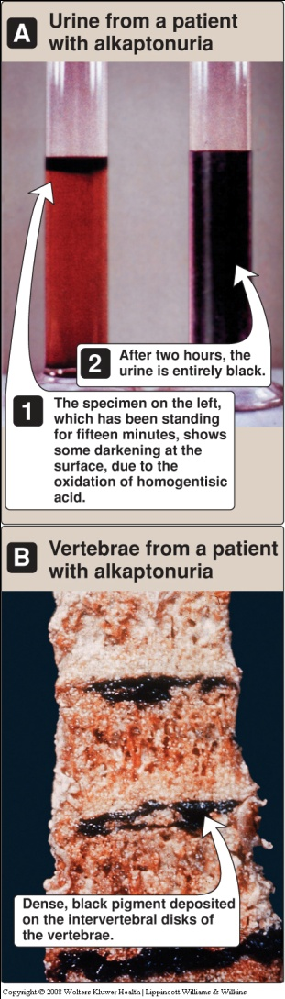
Alkaptonuria
Homogentisic acid is oxidized to dark pigment in urine over time
Arthritis, black pigmentation of cartilage and tissue
Usually asymptomatic until adulthood
Restricted intake of tyrosine and phenylalanine reduces homogentisic acid and dark pigmentation

Slide 32
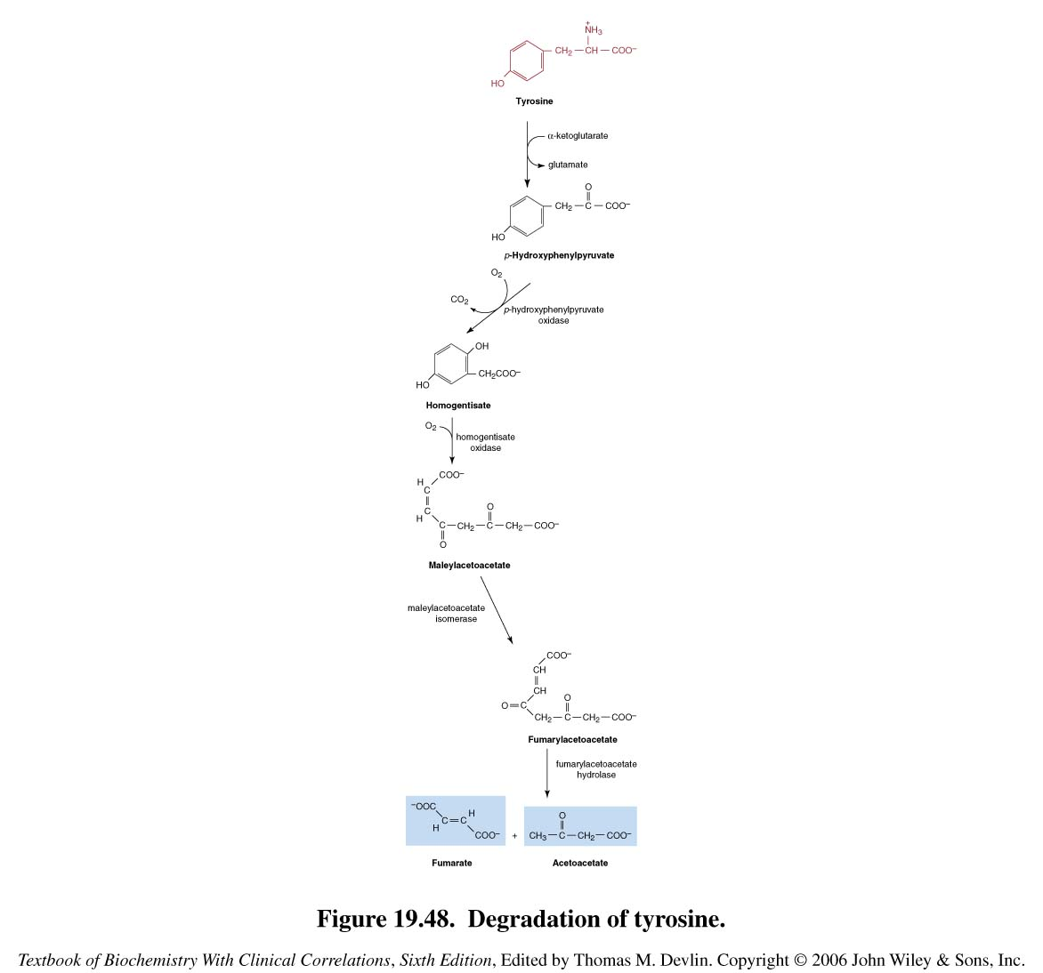
Degradation of tyrosine
Deficiency of homogentisic acid oxidase leads to alkaptonuria
Homogentisate oxidase

