Slide 1
Pathology of the Nephrotic and Nephritic Syndromes. (glomerular diseases)
Dr. tariq aljohani

Slide 2
Objectives:
Recognize the five major renal clinical syndromes.
Describe the main differential pathological diagnosis for each syndrome.
Perform a clinico-pathological correlation.
Describe the patterns of injury of each syndrome.
Notes:
At the end of the activity (2 lectures) the students will be able to:

Slide 3
Ultrastructure of the glomerulus

Slide 4
Clinical Syndromes
1. Nephrotic syndrome = heavy proteinuria = proteins in urine = loss of 3,5 g/day

Slide 5
The glomeruli are normal by LM, but with diffuse effacement of foot processes by EM.
Minimal change disease/ glomerulonephritis.

Slide 6
Minimal change disease. Glomeruli appear unremarkable by light microscopy, and in young patients there is no tubulionterstial fibrosis, as in this patient.

Slide 7
Minimal change disease. Extensive foot process effacement and microvillous transformation of visceral epithelial cells in MCD

Slide 8
MINIMAL CHANGE DISEASE
DIFFUSE EPITHELIAL CELL DISEASE

Slide 9
Pathology of the kidney Glomerular diseases
Diffuse :
all
glomeruli
Global
Focal:
some
glomeruli
Segmental

Slide 10
FSGS. There is sharply defined segmental sclerosis, defined as obliteration of capillary loops and increased matrix, without deposits and with diffuse foot process effacement by EM. Adhesions can also be present.
Focal segmental glomerulosclerosis

Slide 11
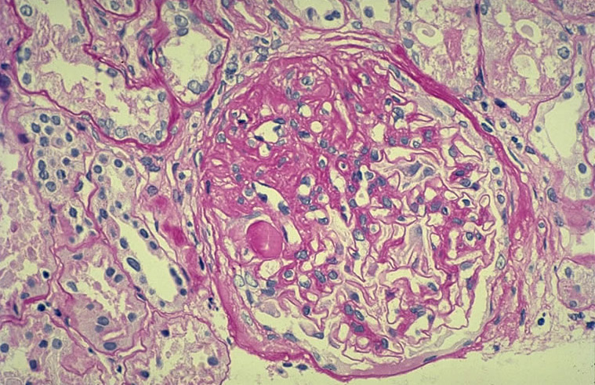
Notes:
Primary or idiopathic FSGS: LM showing characteristic segmental collapse of the tuft (between 9 and 1 o'clock) with adhesion to the capsule and hyaline accumulation (most prominent at 9 o'clock). PAS.

Slide 12
FSGS. The typical segmental sclerotic lesion in FSGS is characterized by increased matrix and obliteration of capillary lumina, frequently with hyalinosis and adhesions, as illustrated here.

Slide 13
Membranous glomerulopathy. There is no evident proliferation by light microscopy, with global subepithelial deposits, which may be visualized by light microscopy by the glomerular basement membrane spike reaction on silver stain.
Membranous glomerulopathy

Slide 15
Membranous glomerulopathy. There are well-developed spikes and holes in tangential sections in stage-2 membranous glomerulopathy.

Slide 16
Membranous glomerulopathy. There is an evenly distributed granular capillary loop pattern of positively in membranous glomerulopathy.

Slide 17
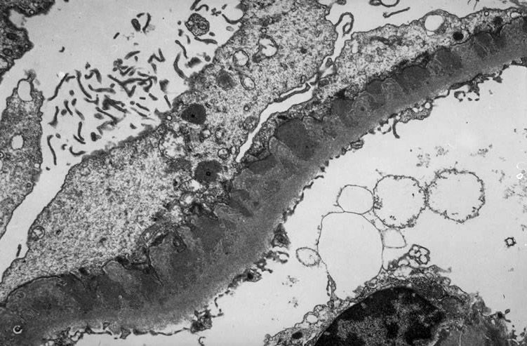
*
*
*
Notes:
Membranous nephropathy. This electron microscopy shows a classical stage II disease. Numerous, sometimes confluent electron dense deposits in the subepithelial space (asterisks)are separated from each other by "spikes" of matrix material (arrows) that extend from the basement membrane toward the epithelial cells. This gives the appearance of the deposits being partially incorporated into the basement membrane.

Slide 18
Diabetic nephropathy. The lesions in diabetic nephropathy are characterized by arteriolar hyalinization, mesangial matrix expansion and glomerular basement thickening.

Slide 19
Diabetic nephropathy. Diabetic nephropathy may manifest either as diffuse mesangial increase, or with nodular glomerulosclerosis as in this case.

Slide 20
Diabetic nephropathy. The lamellated appearance of the Kimmelstiel-Wilson nodule characteristic of the nodular sclerosis form of diabetic nephropathy is shown, along with arteriolar hyalinization and surrounding tubulointerstitial fibrosis.

Slide 21
Amyloidosis. Massive amyloid deposits are present in glomeruli and arterioles.

Slide 22
Amyloidosis. Tubular involvement with amyloid is verified by apple-green birefringence under polarized light.

Slide 23
Amyloidosis. Randomly oriented, 8-10nm fibrils, typical of amyloid within the mesangium.

Slide 24
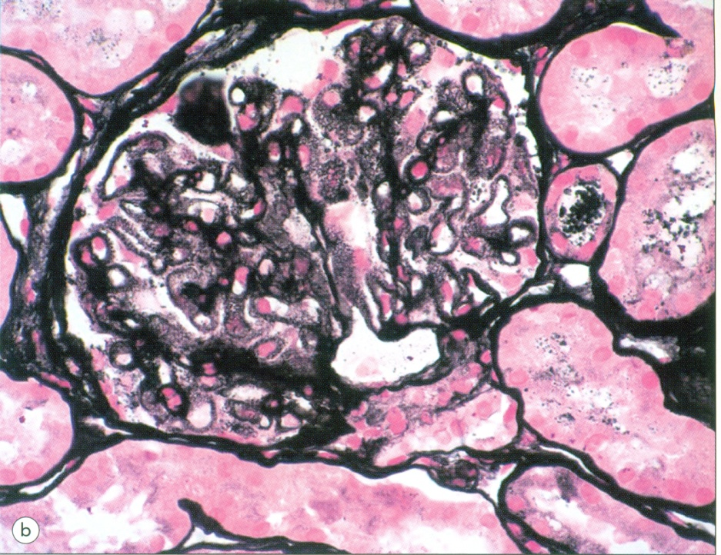
(b) Silver methenamine (jones) stains reveal a spike and dome pattern to be present along the peripheral capillary loops where the wall of the capillaries cut tangentially; there is a moth-eaten appearance of the capillary wall.
Lupus nephritis.
(a) Class V lesion or lupus membranous glomerulopathy. There is diffuse thickening of the peripheral capillary walls associated with an increase in mesangial matrix.

Slide 26
Clinical Syndromes
2. Nephritic syndrome = grossly visible hematuria = red blood cells in urine = red blood cell casts, edema, hypertension, abnormal renal function .

Slide 27
Lecture - 3and 4 Part2
(continued- Nephritic Syndrome)

Slide 35
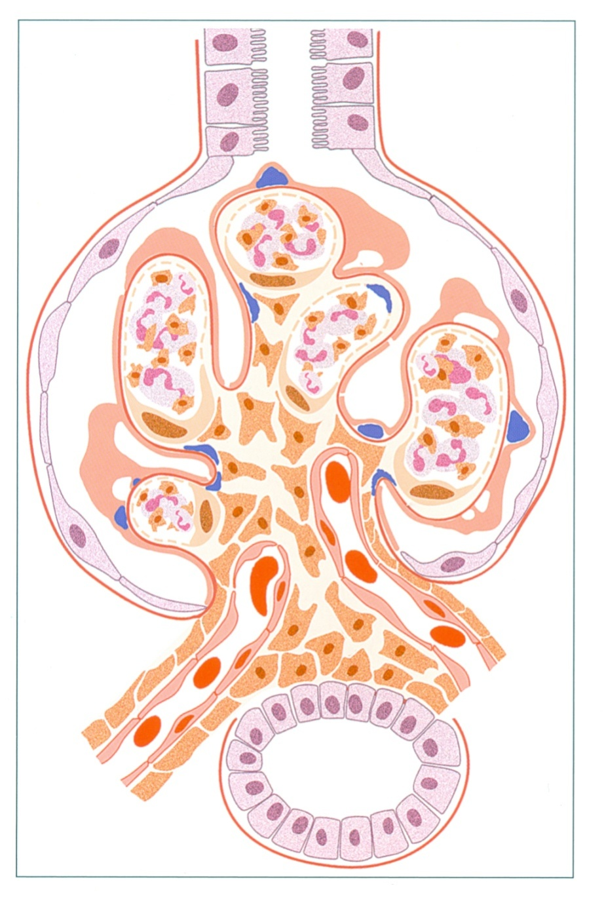
Acute post-infectious glomerulonephritis. There is an exudative proliferation with numerous PMNs and endocapillary proliferation, with scatted mesangial and large hump-shaped sub-epithelial deposits.

Slide 36
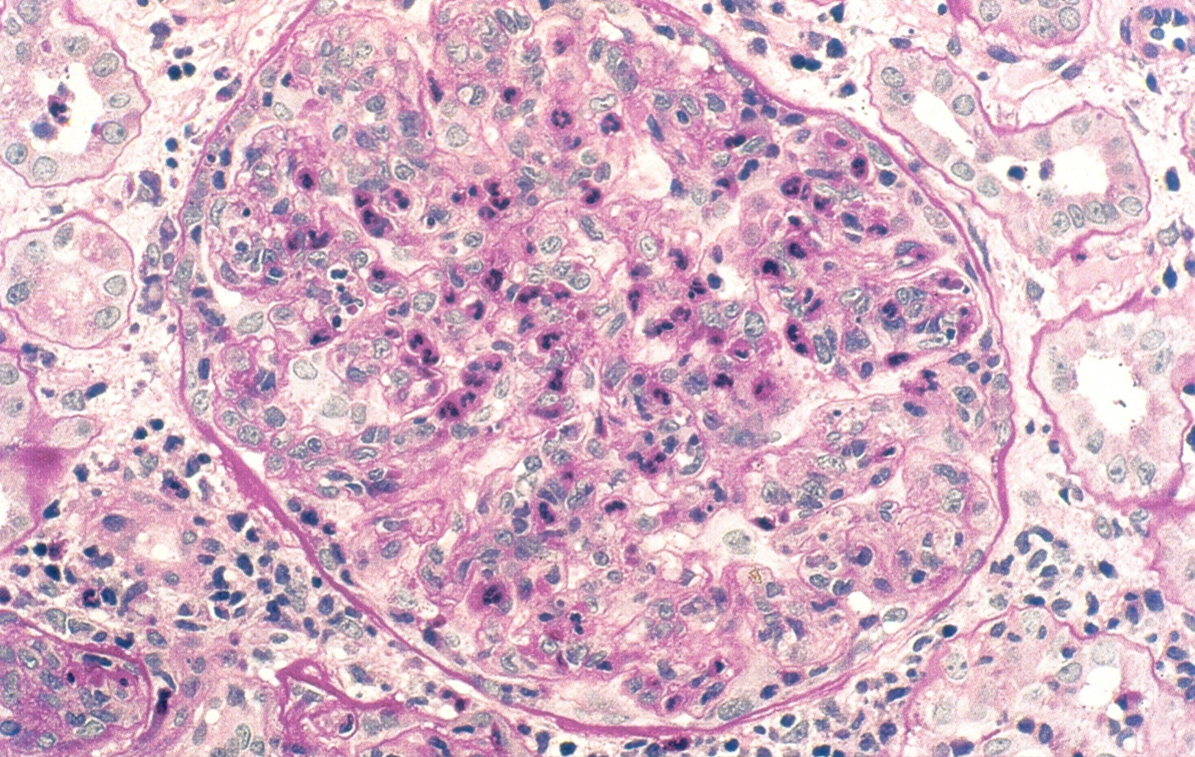
Acute post-infectious glomerulonephritis. There is diffuse, global exudative proliferation with prominent endocapillary proliferation and numerous neutrophils.

Slide 37
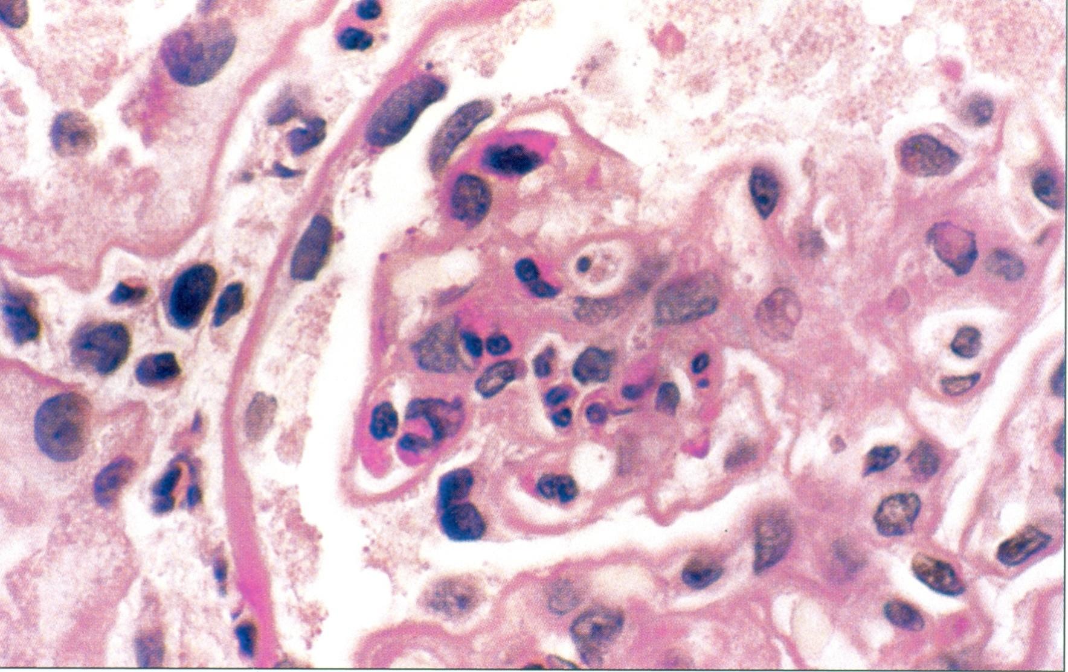
Acute post-infectious glomerulonephritis. Endocapillary proliferation and numerous PMNs both within capillary loops and within the mesangial area are present.

Slide 38
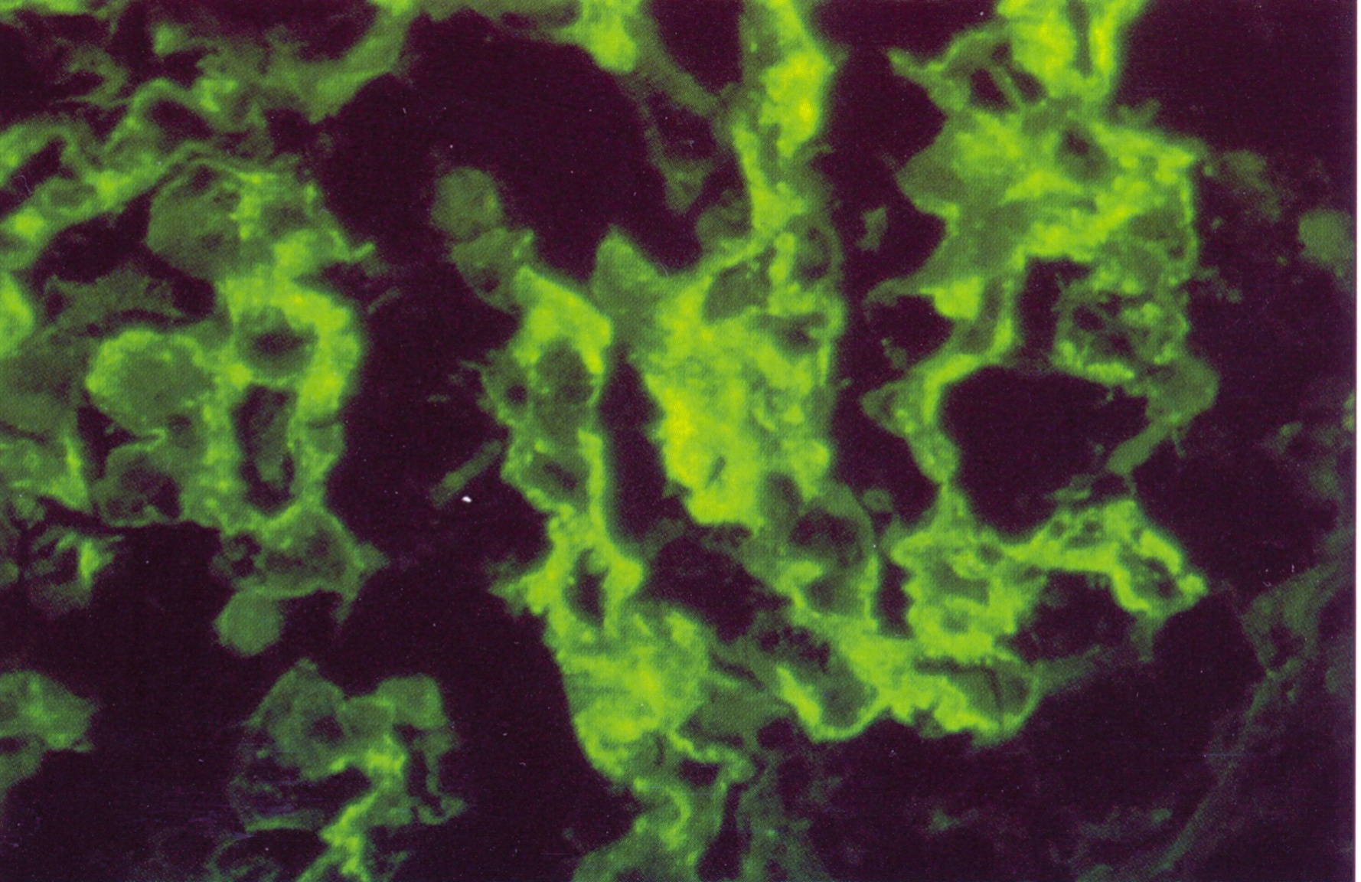
Acute post-infectious glomerulonephritis. A more extensive garland pattern with elongated peripheral loop deposits is illustrated, along with occasional small mesangial deposits.

Slide 39
Clinical Syndromes 4. Rapidly progressive GN = rapid deterioration of renal function

Slide 43
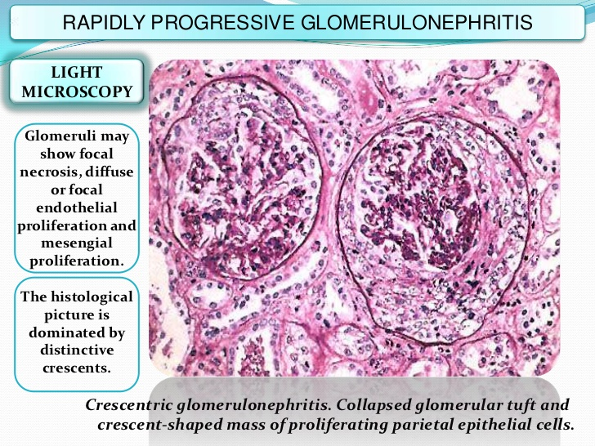

Slide 45
CRESCENTIC GLOMERULONEPHRITIS
Idiopathic or primary crescentic glomerulonephritis:
Type I, anti-GBM disease
Type II, immune complex-mediated
Type III, pauci immune (ANCA-associated)
Vasculitides (ANCA-associated):
microscopic form of polyarteritis nodosa,
Wegener's granulomatosis
Churg-Strauss syndrome
Drug-induced vasculitides
Other primary glomerulonephritides:
post-infectious GN, IgA nephropathy, MPGN, etc.
Systemic diseases (SLE, RA, H-S purpura)

Slide 46
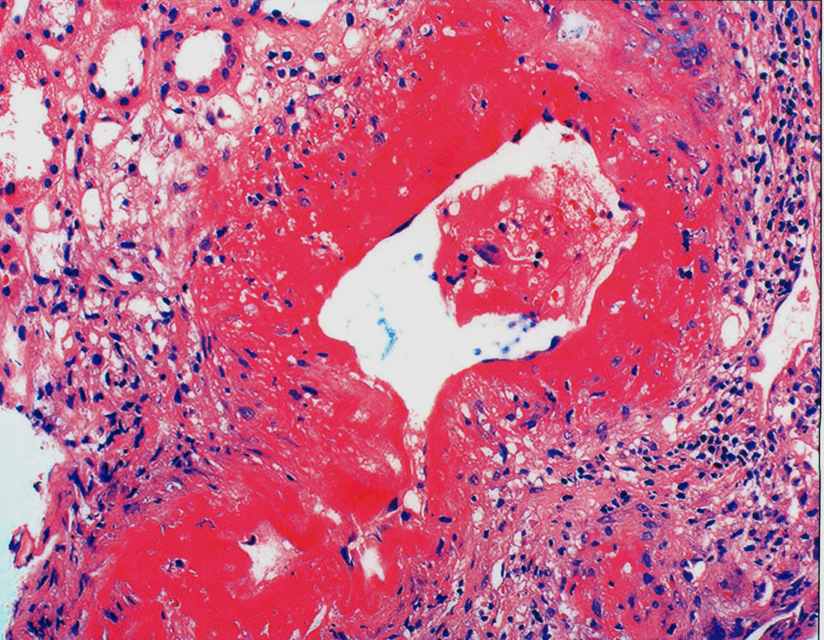
Wegener’s granulomatosis / microscopic polyangiitis. Vessel with transmural necrosis involving the vessels circumferentially with a significant inflammatory infiltrate with mixed polymorphonuclear leukocytes and mononuclear cells.

Slide 47
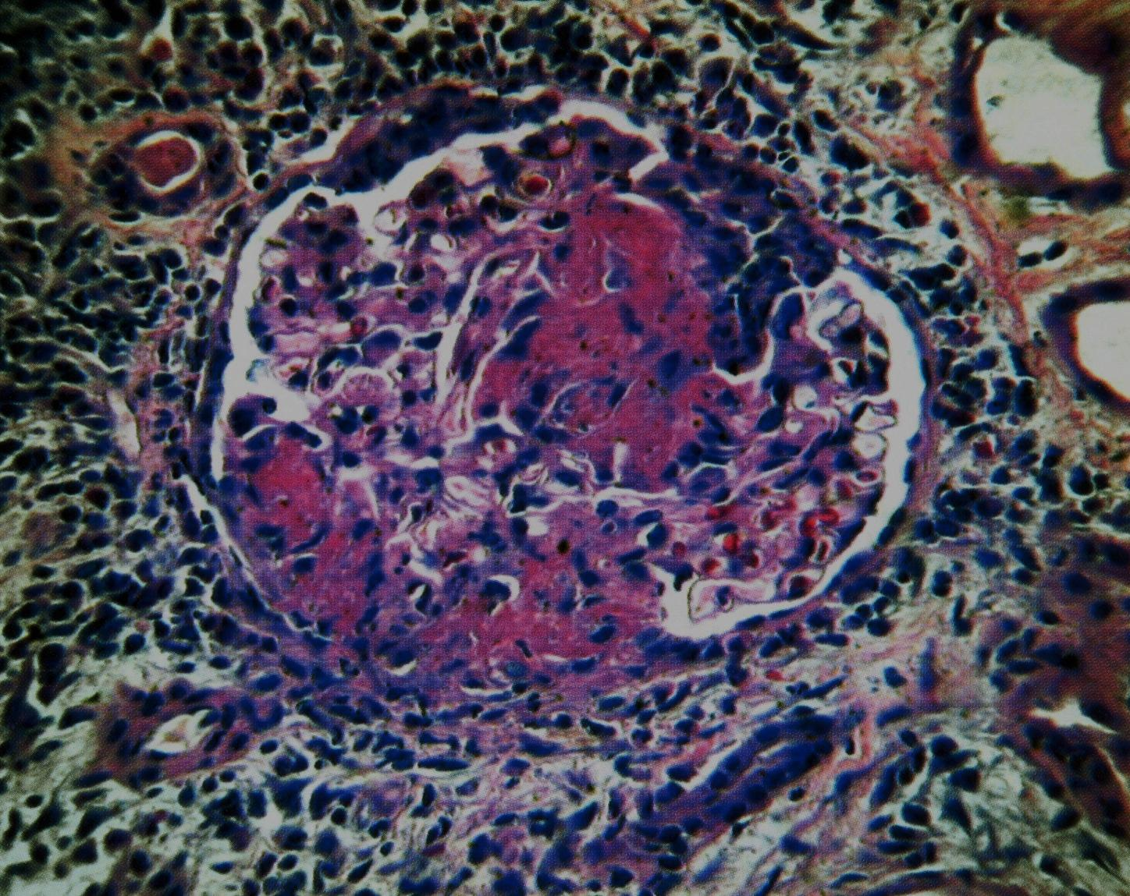
Wegener’s granulomatosis / microscopic polyangiitis. Glomerulus demonstrating focal and segmental necrosis with adhesion to Bowman’s capsule and proliferation of parietal epithelium.

Slide 48
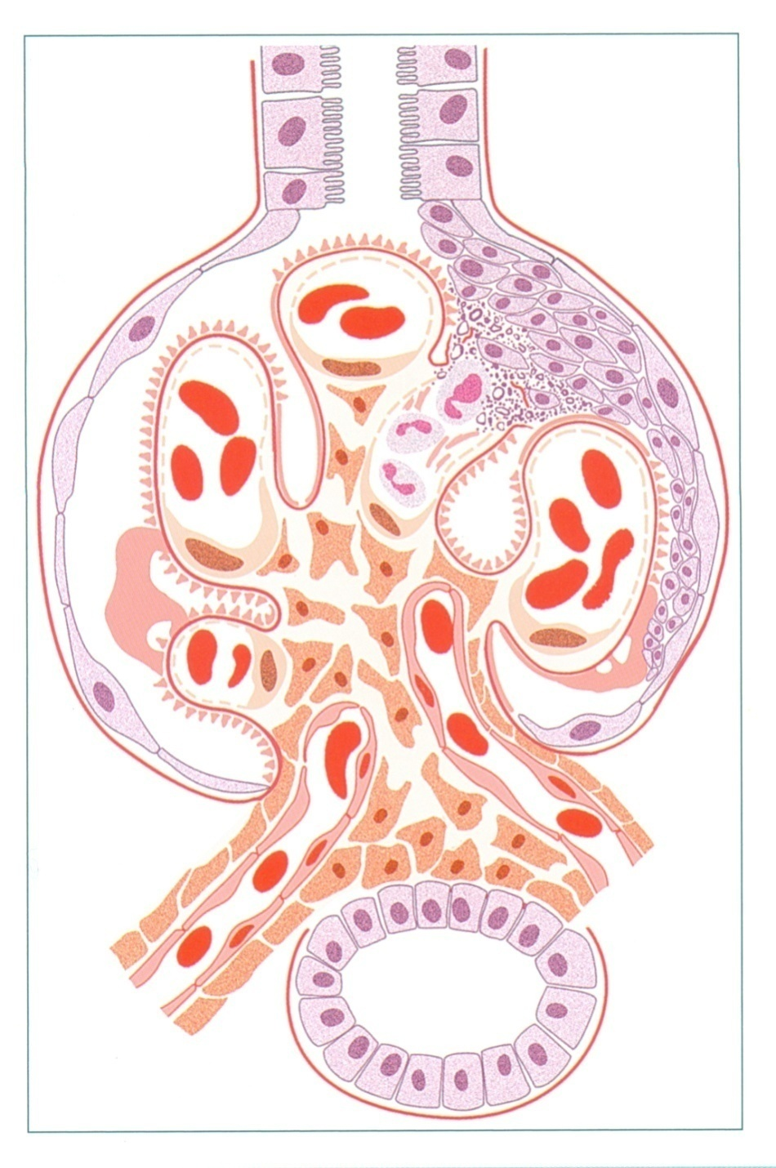
There is segmental necrosis with a break of the glomerular basement membrane, and fibrinoid necrosis and PMNs in the area, with a cellular crescent developing in response to this GBM break.
Anti-GBM-antibody mediated glomerulonephritis (Goodpasture’s Syndrome).

Slide 49
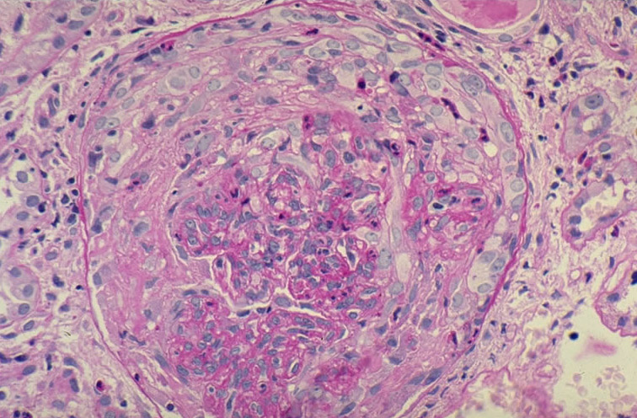
Notes:
Crescentic glomerulonephritis: this image shows details of the cellular composition of the crescent. Notice mostly mononuclear cells (monocytes, epithelioid cells, proliferated parietal epithelial cells from Bowman's capsule, some polymorphonuclear neutrophils) in the crescent and the collapsed, fragmented capillary tuft, as highlighted by the PAS positive basement membranes (center and right). (PAS)

Slide 50
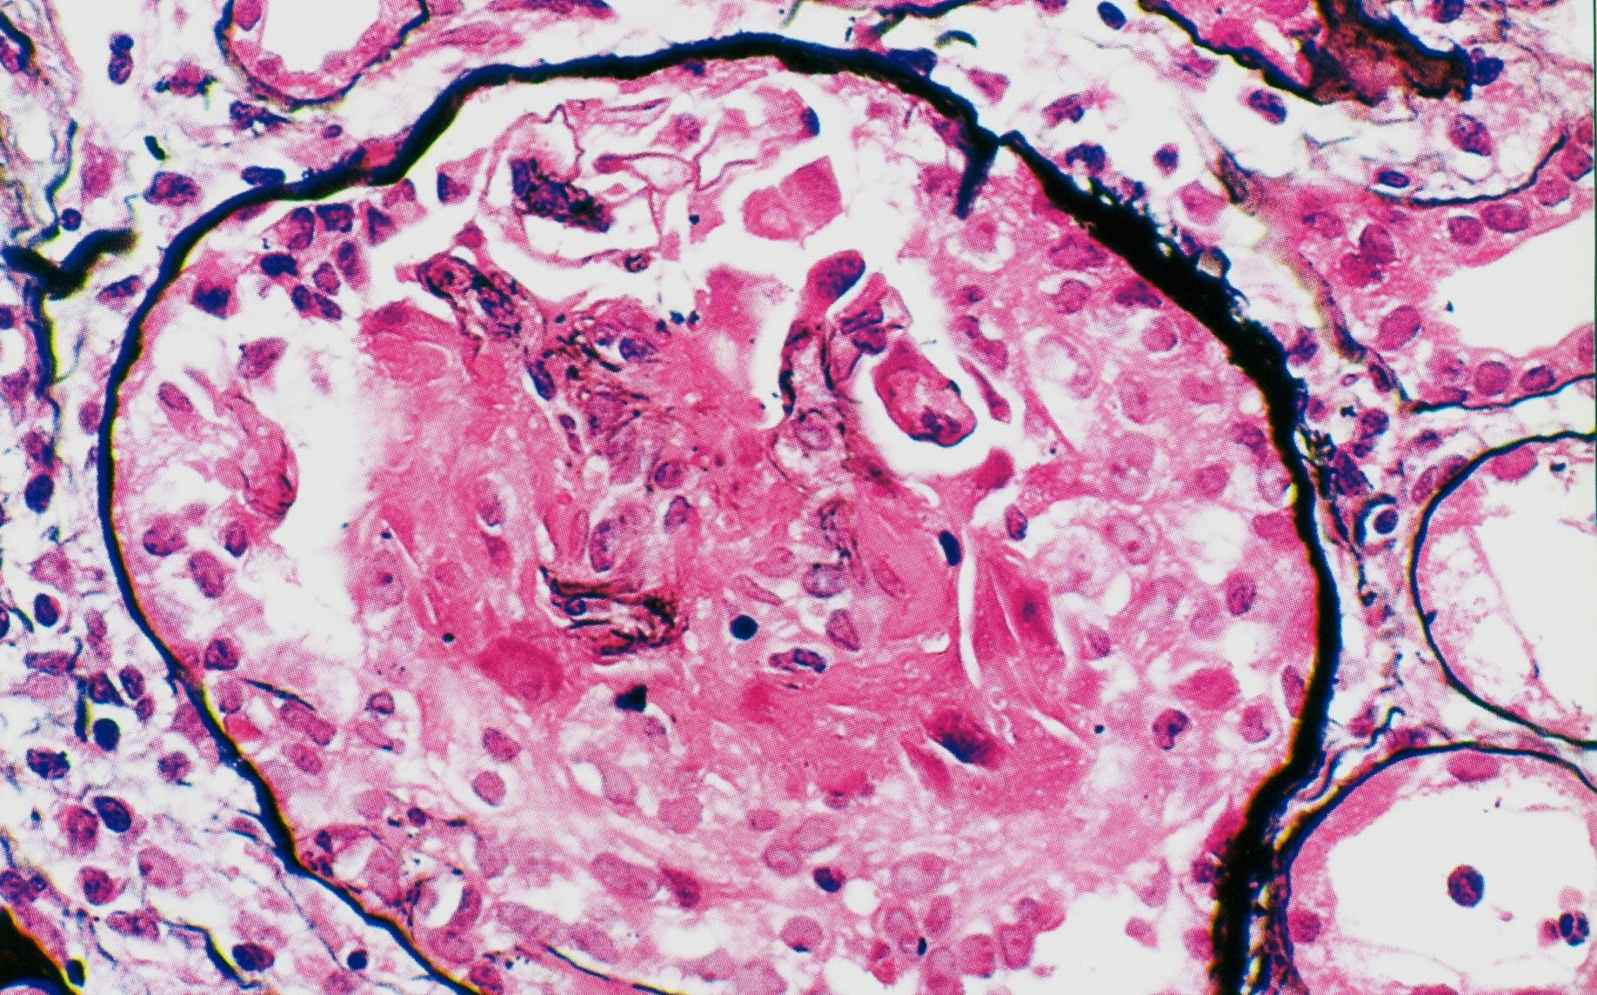
Anti-GBM antibody-mediated glomerulonephritis with karyorrhexis and ruptured fragments of GBM, with a small remaining intact portion of the glomerulus at the top.

Slide 51
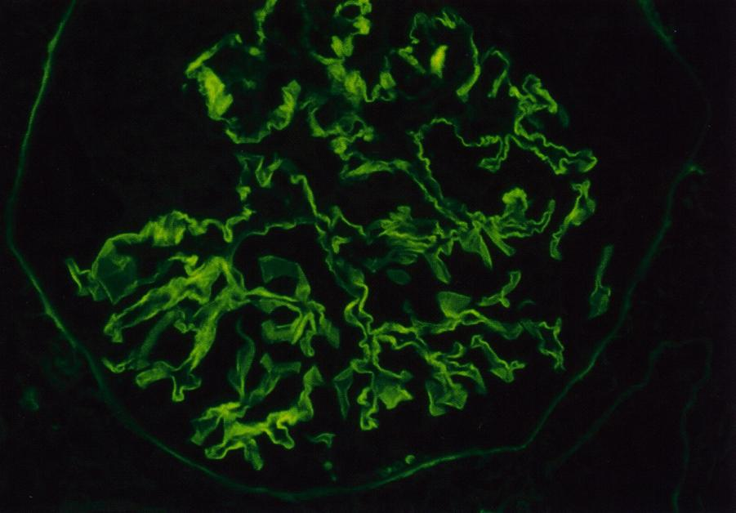
Anti-GBM antibody-mediated glomerulonephritis. Linear glomerular basement membrane staining with lgG is diagnostic of this disease in this setting.

Slide 52
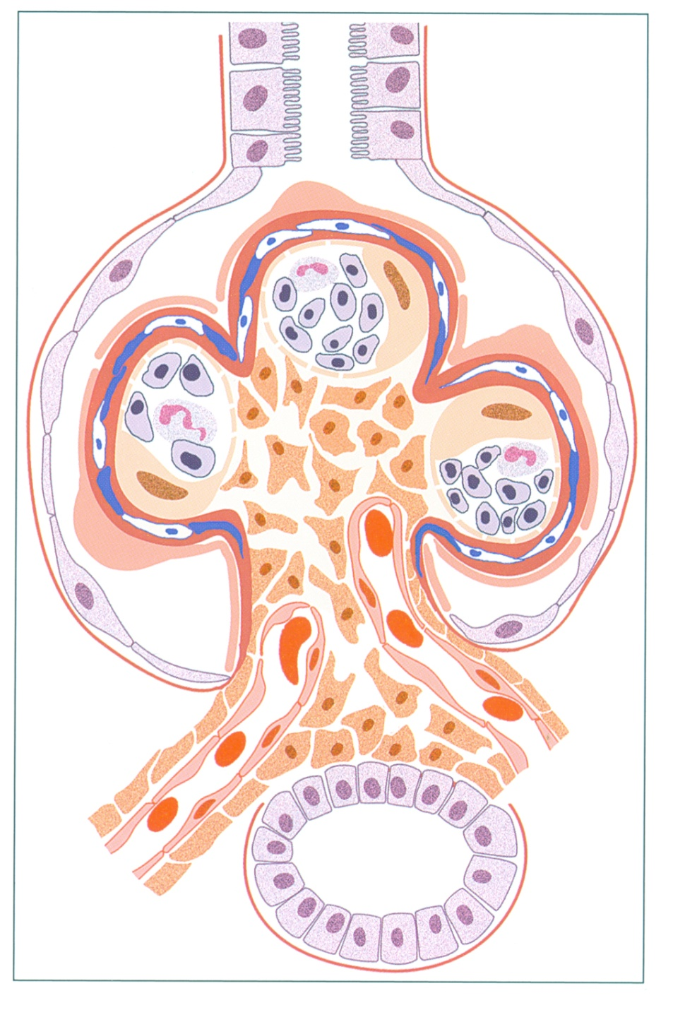
There is endocapillary proliferation and glomerular basement membrane splitting, due to mesangial and subendothelial deposits, with resultant interposition and new basement membrane being laid down, causing the split appearance.
Membranoproliferative glomerulonephritis

Slide 64
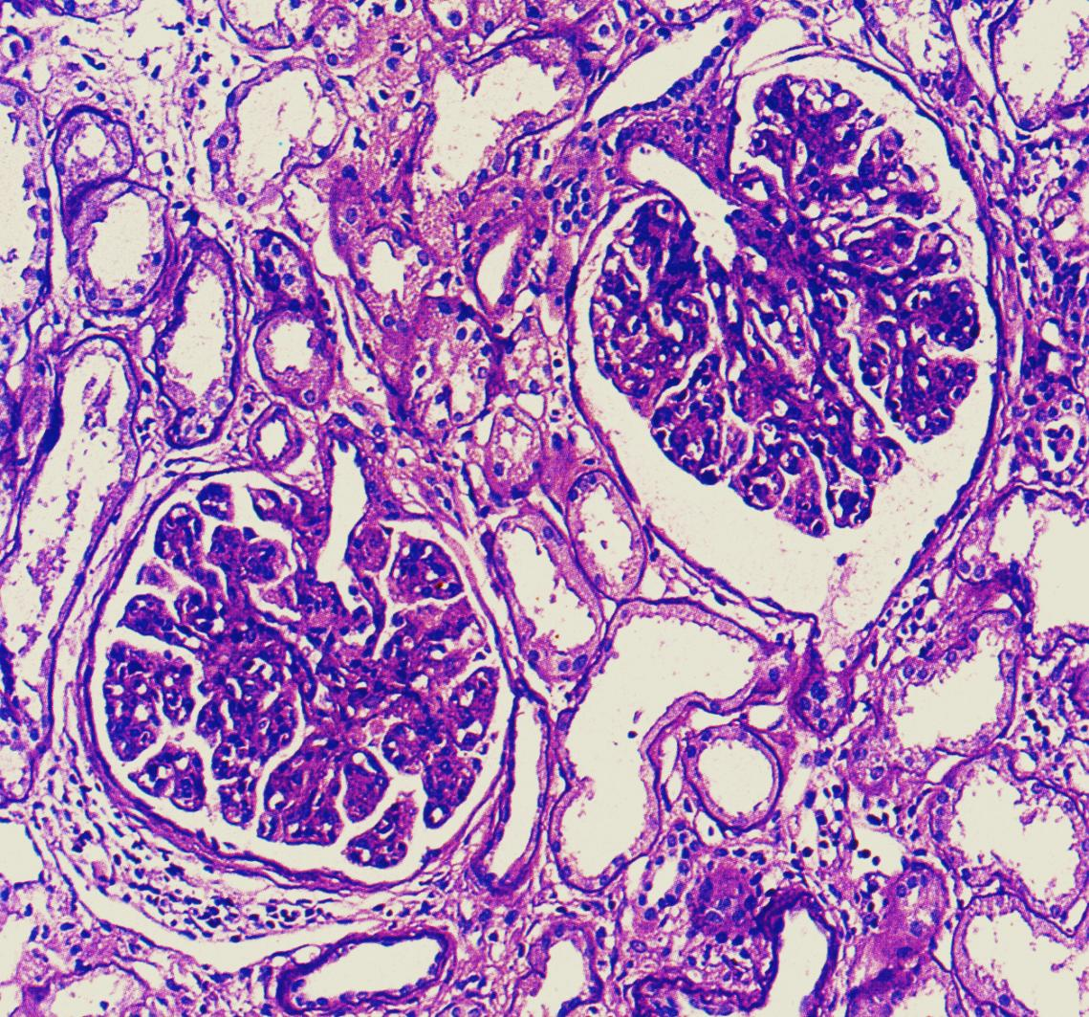
MPGN type I. MPGN is characterized by diffuse endocapillary proliferation, which results in a lobular, uniform appearance of glomeruli.

Slide 65
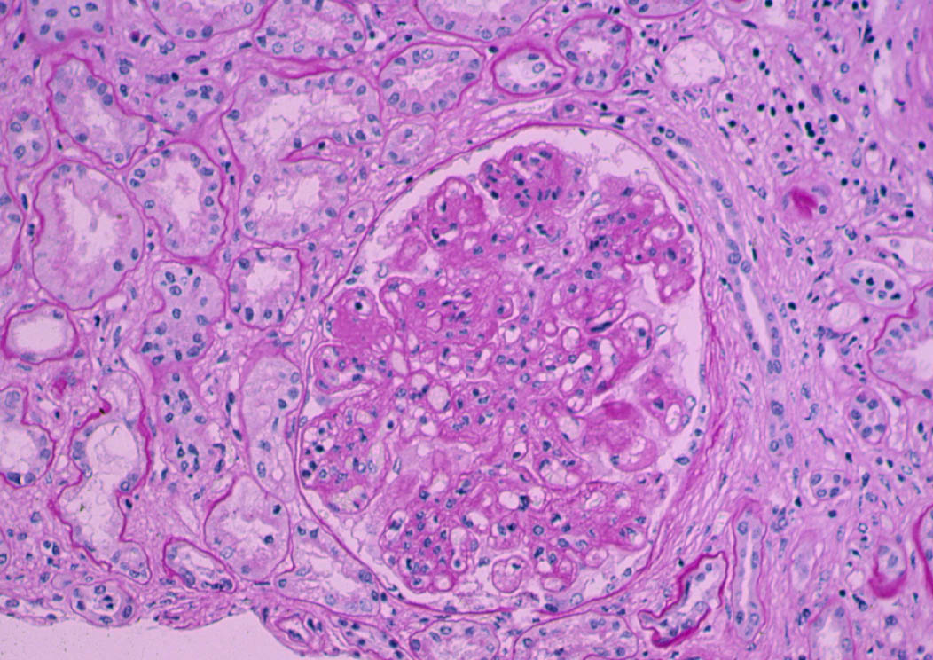
Notes:
Membranoproliferative glomerulonephritis.

Slide 66
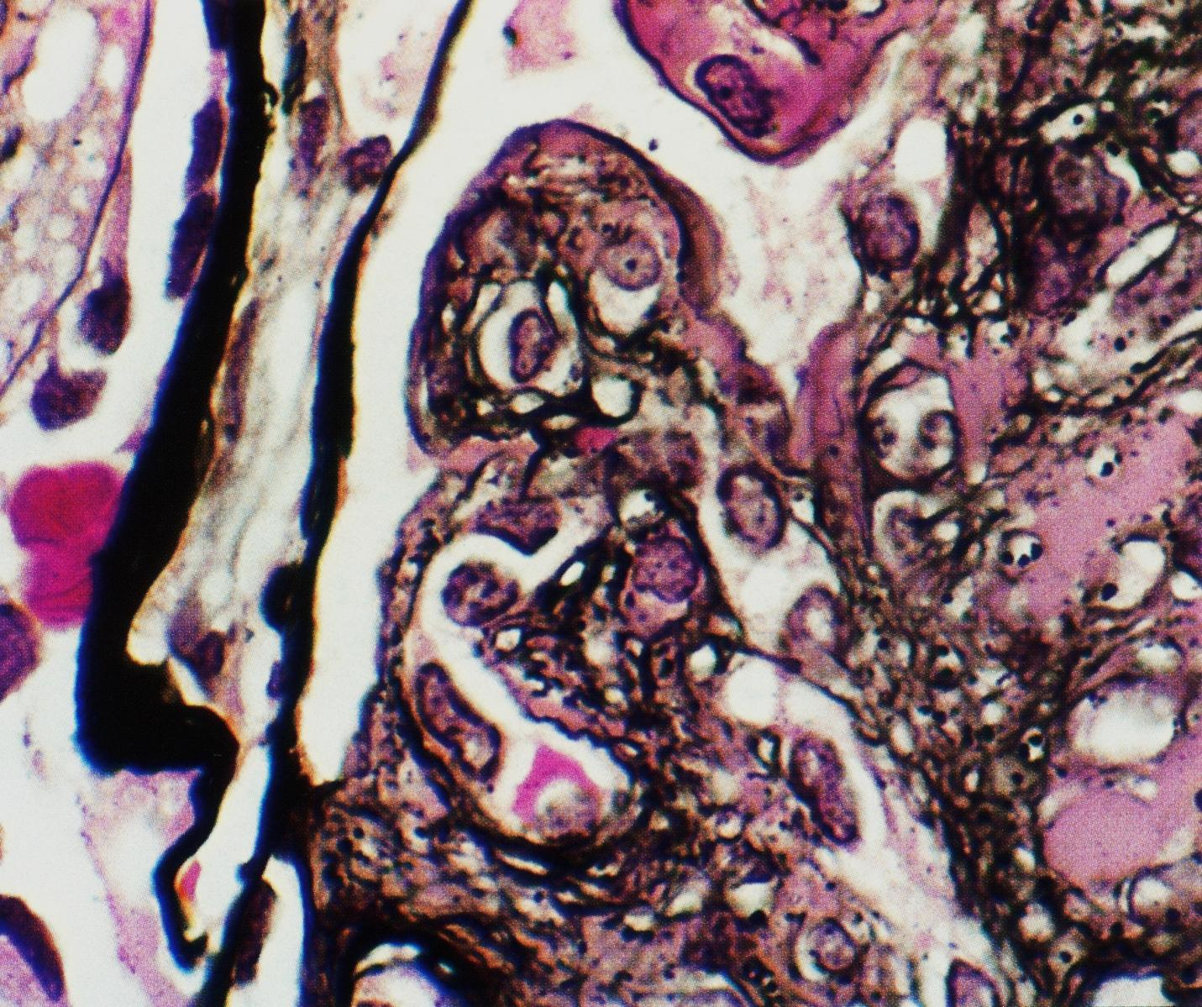
MPGN type I. There is segmental interposition of cells which splitting of peripheral capillary GBM along with subendothelial deposits.

Slide 67
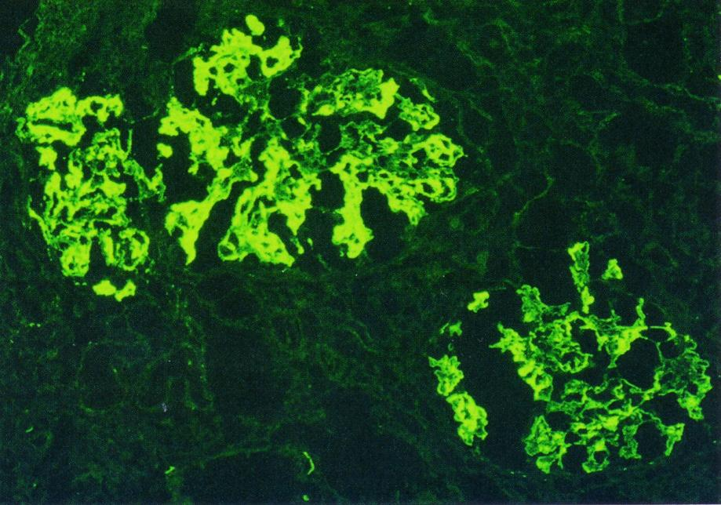
MPGN type I. in addition to IgG, there is often very prominent complement deposition in MPGN with prominent mesangial and coarse, chunky peripheral loop deposits, corresponding to the subendothelial deposits.

Slide 68
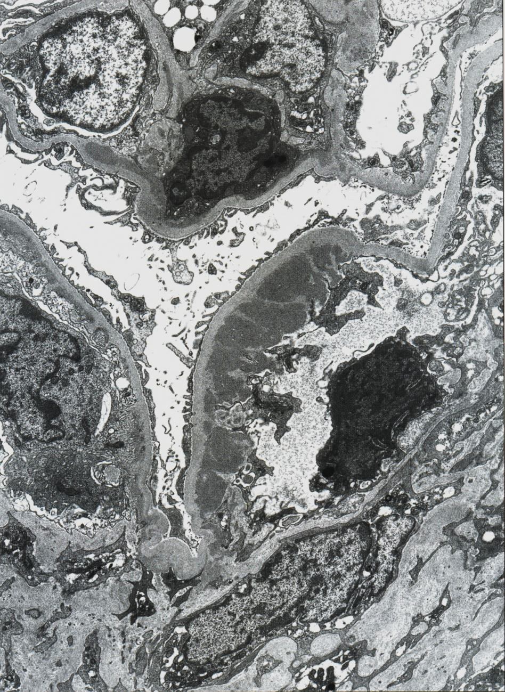
MPGN type I There are massive subendothelial deposits in the right loop, with minimal endocapillary proliferation, and small, silver-like deposits on the left and top loops, with associated proliferation.

Slide 69
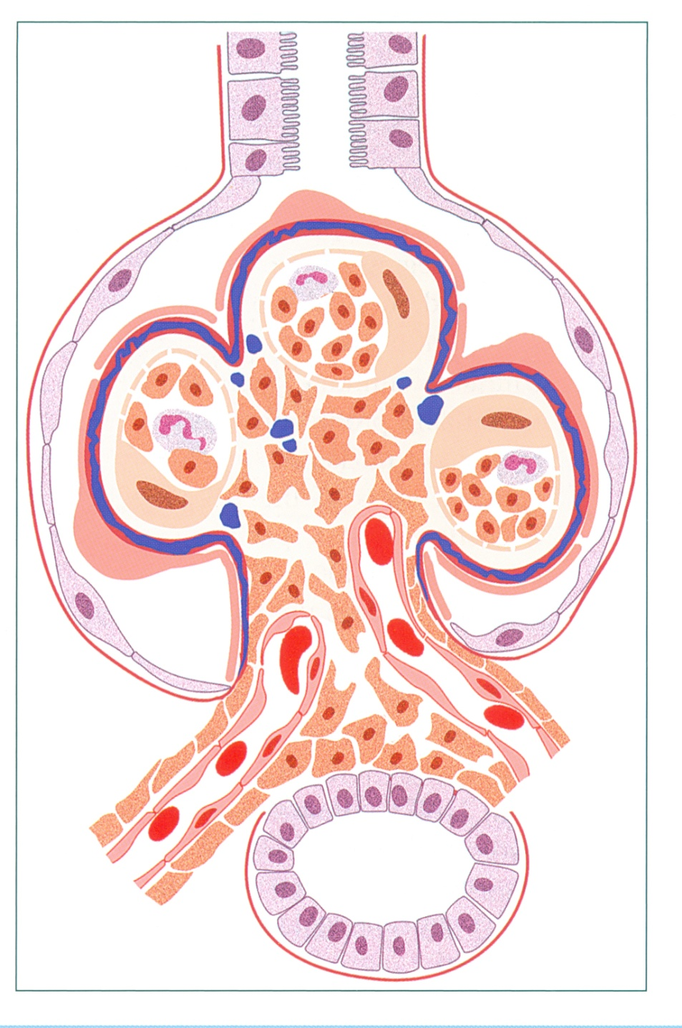
The glomerulus shows a membranoproliferative pattern, with endocapillary proliferation and GBM splitting
Dense deposit disease
(DDD).

Slide 70
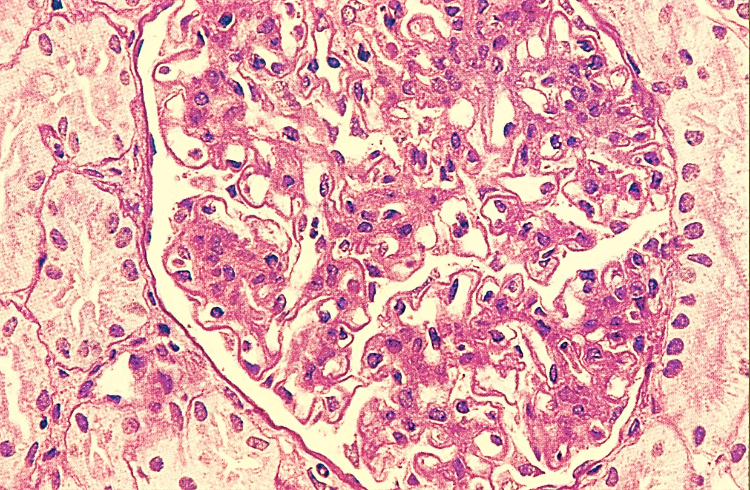
DDD Dense deposit disease has membranoproliferative features by light microscopy, with diffuse, global mesangial and often endocapillary proliferation, and frequent glomerular basement membrane splitting.

Slide 71
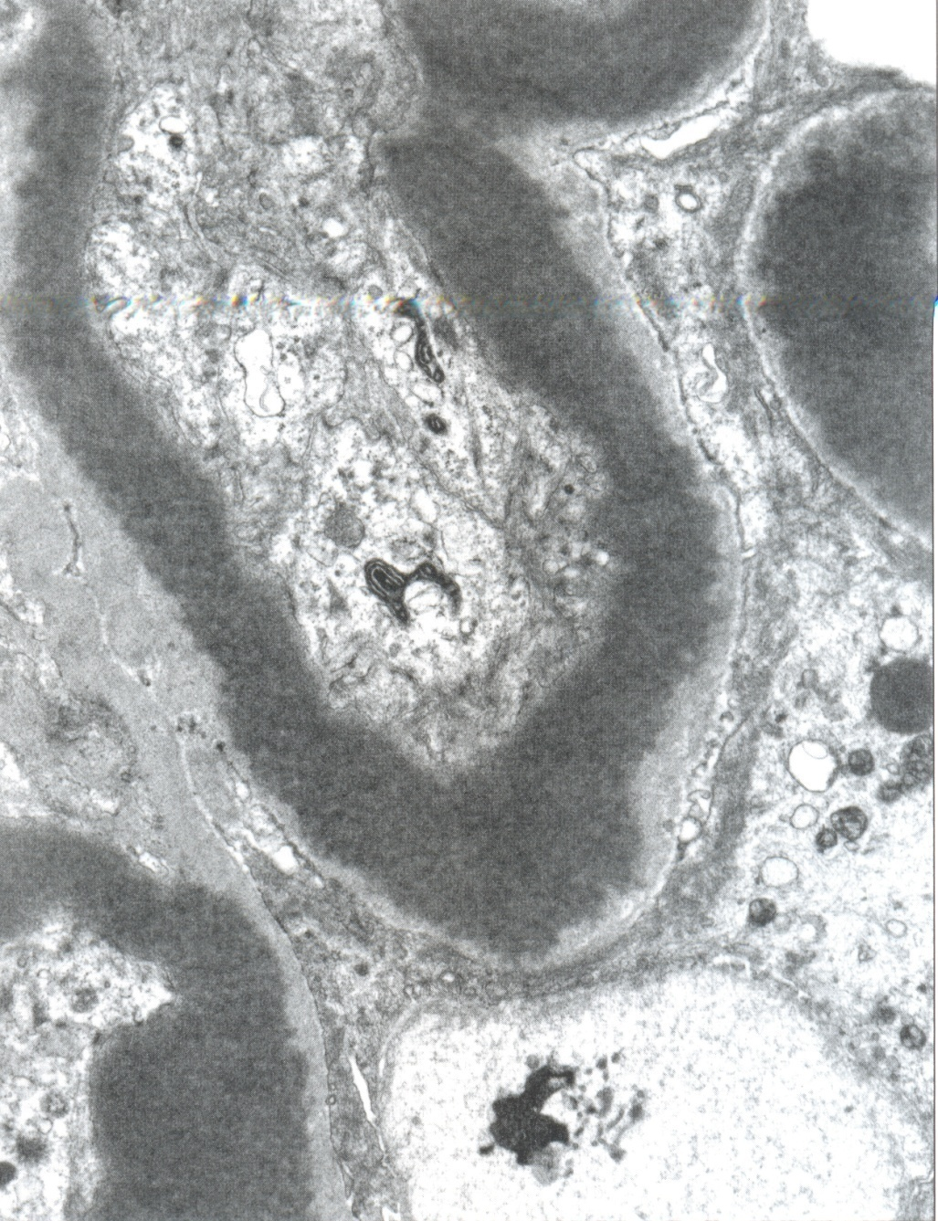
DDD. There is dense transformation of nearly the entire thickness of the glomerular basement membrane, with associated endocapillary proliferation.

Slide 72
Clinical Syndromes
3. Asymptomatic hematuria/proteinuria = microscopic hematuria with red cell casts; proteinuria usually <1 gram/24 hours; normal renal function

Slide 73
ASYMPTOMATIC HEMATURIA/PROTEINURIA
These conditions are characterized morphologically either by focal necrotizing and/or inflammatory lesions of the glomeruli or by basement membrane anomalies that result in greater capillary fragility.

Slide 74
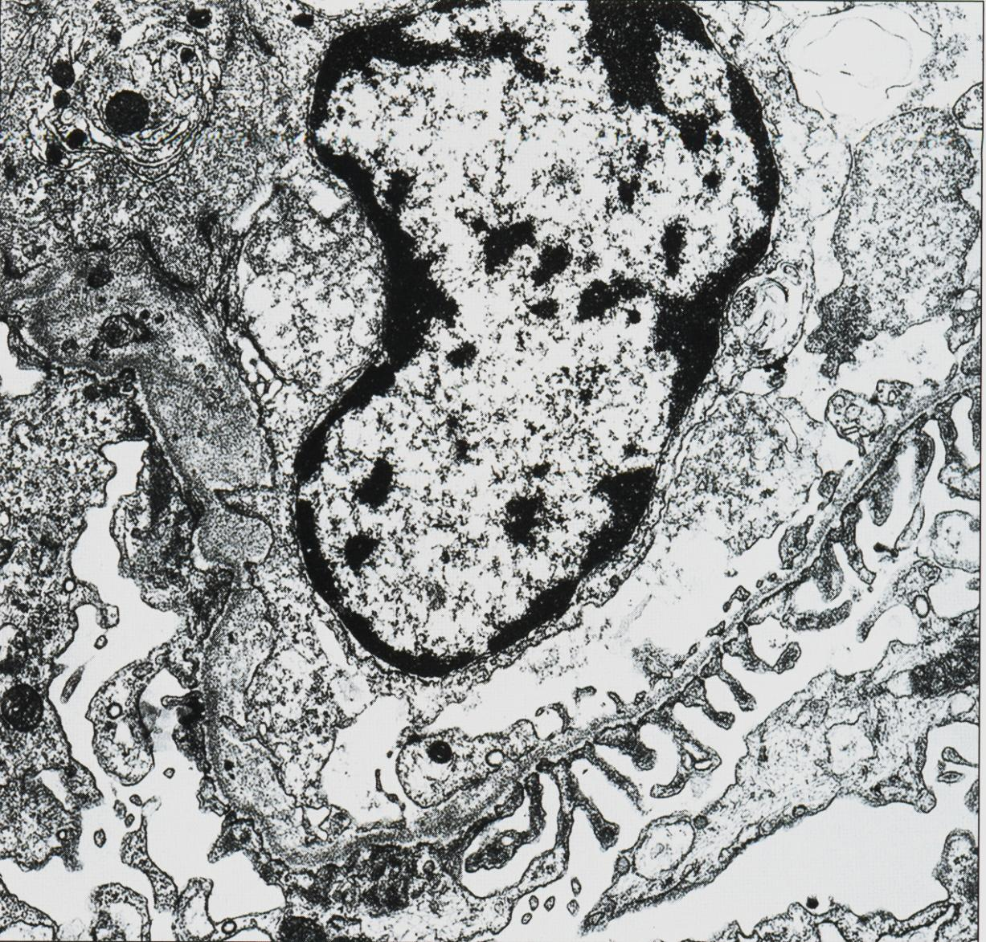
Alport syndrome. Alternating areas of extreme thinning of the glomerular basement membrane (~120 nm) with thick, irregular areas with basket weaving are shown.

Slide 75
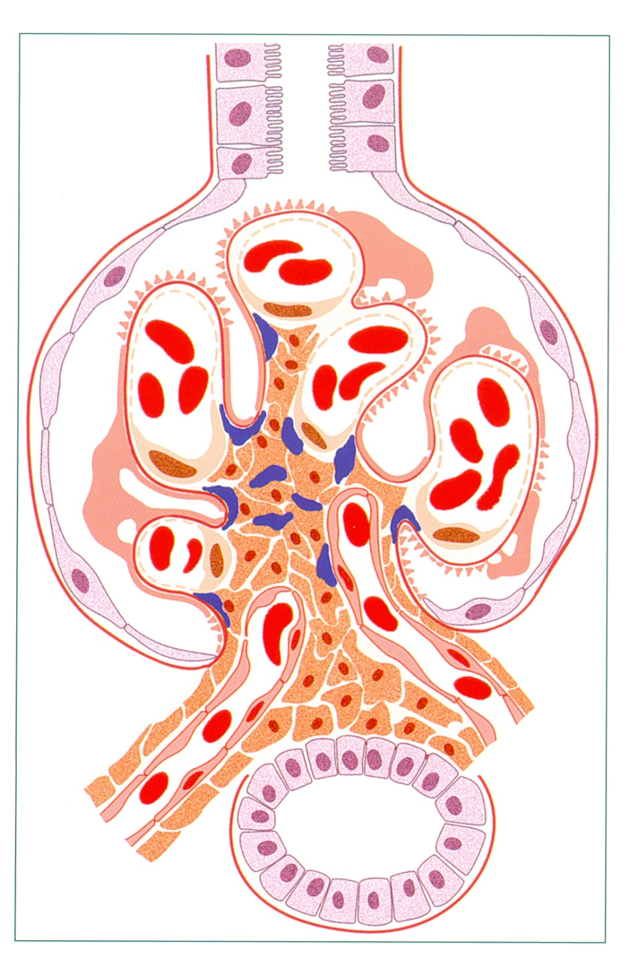
IgA nephropathy. There is mesangial cell and matrix increase, with mesangial deposits.

Slide 76
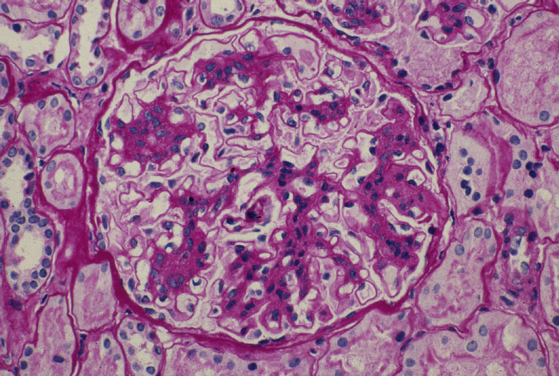
Notes:
Mesangioproliferative glomerulonephritis. There is prominent expansion of the mesangium by matrix and cells.( PAS)

Slide 77
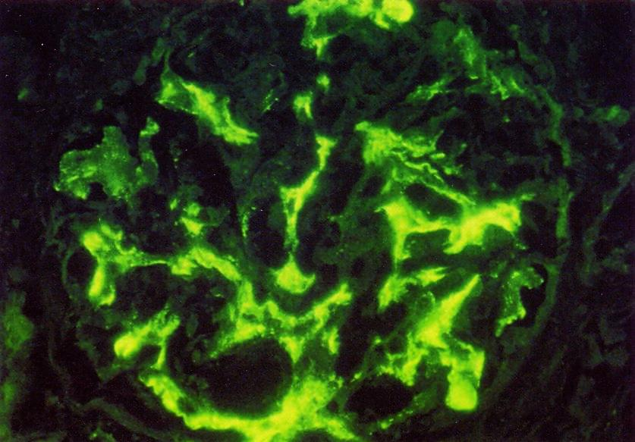
IgA nephropathy. Definitive diagnosis is made by immunofluorescence, showing dominant or codominant staining with IgA in a predominantly mesangial pattern, as shown here.

Slide 78
Clinical Syndromes 5. Chronic renal failure = chronic uremia = end of all renal diseases = end stage renal disease - (ESRD; uremia)

Slide 80
CHRONIC NEPHRITIC SYNDROME
Azotemia
Active urine sediment (variable)
Proteinuria (variable)
Past history of RPGN, nephrotic syndrome, or nephritic syndrome
Hypertension

Slide 81
CHRONIC RENAL FAILURE CHRONIC NEPHRITIC SYNDROME
The structural equivalent of this syndrome is end-stage renal disease, with widespread global glomerular obsolescence (sclerosis), tubular atrophy, interstitial fibrosis, and variable degree of arterial and arteriolar sclerosis. A more precise diagnosis can often be established by immunohistochemical and ultrstructural studies.

Slide 82
END STAGE RENAL DISEASE
Chronic Renal Failure

Slide 83
END STAGE RENAL DISEASE
I. Chronic Renal Failure
A. Extent of the problem; medical costs and ESRD
B. Uremic syndrome - definition
1. Skin manifestations - pruritus, uremic "frost", skin 2. Cardiac manifestations - uremic pericarditis 3. Neurological manifestations - peripheral neuropathy 4. Pulmonary complications - pneumonitis and hemorrhage 5. Hematopoietic manifestations - anemia, bleeding diathesis 6. Skeletal abnormalities - renal osteodystrophy (secondary hyperparathyroidism) 7. Other - metabolic imbalances

Slide 84
END STAGE RENAL DISEASE
Chronic Renal Failure
C. Pathogenesis of uremic syndrome
1. Uremic "Toxins"
II. Treatment of End Stage Renal Disease
A. Supportive therapy
B. Dialysis
C. Renal transplantation

Slide 85
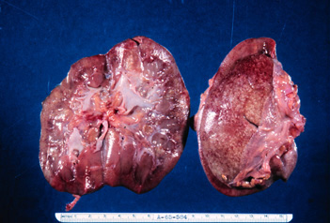
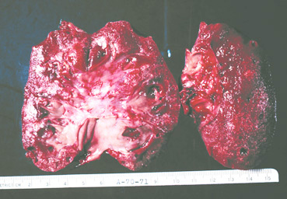
“End stage kidney” of chronic glomerulonephritis. These are severely contracted kidneys each measure about 2 x 3".. Notice the cortices small amount of parenchyma and the finely granular surfaces. Such kidneys are incompatible with life.

Slide 86
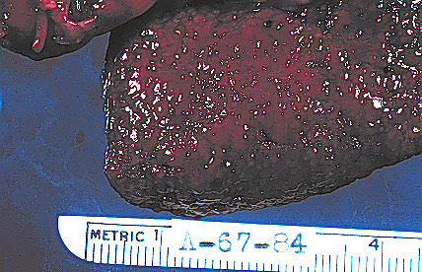
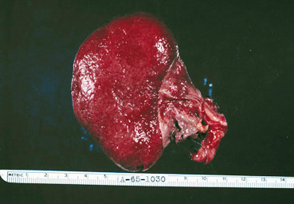
“End stage kidney” of chronic glomerulonephritis. This is the kidney of a 38 year old man who presented with an insidious onset of the three signs of uremia, that is loss of appetite, lethargy, and the laboratory finding of an increased BUN. He had no antecedent history of acute glomerulonephritis.
Extremely contracted and finely granular

Slide 87
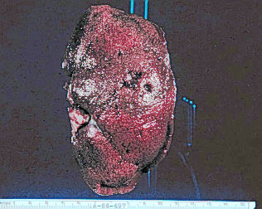
Contracted kidney with a finely granular surface representing another glomerular disease, Kimmelsteil-Wilson disease or diabetic glomerulosclerosis. Grossly is indistinguishable from chronic glomerulonephritis. Notice larger scars rather shallow pits on the surface: these represent chronic pyelonephritis another disease that diabetics are apt to develop.

Slide 88
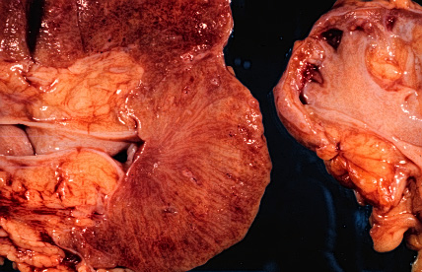
This is a close-up photograph of a cross-section of a kidney with chronic glomerulonephritis. The cortex has largely turned to scar tissue and there is a poor demarcation between cortex and medulla due to the glomerular scarring.

