Slide 1
TUMORS OF THE KIDNEY AND URINARY BLADDER
Dr tariq aljohani

Slide 2
Objectives:
At the end of the lecture the students will be able to:
Recognize the benign tumors of the kidney.
Describe renal cell carcinoma and Wilm’s tumor.
Recognize transitional cell and squamous carcinoma of the urinary bladder.

Slide 3
Benign tumors of the kidney:
1- adenoma
2- angiomyolipoma

Slide 4
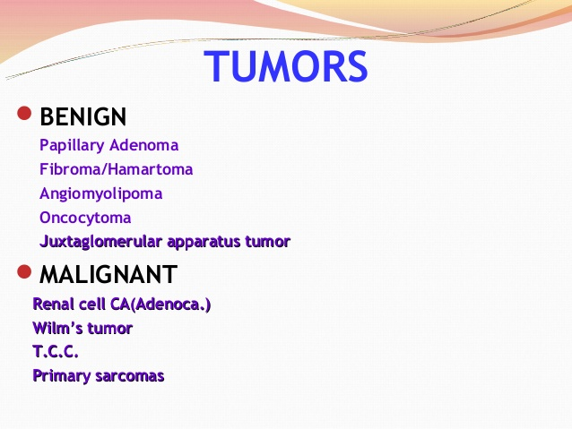

Slide 5
Malignant RENAL NEOPLASMS
Neoplasms of the Renal Parenchyma
Renal cell carcinoma (renal adenocarcinoma; hypernephroma)
Nephroblastoma (Wilms's tumor)
Urothelial tumors

Slide 6
RENAL NEOPLASMS
Gross pathology and histology
Histogenesis
Clinical manifestations
Diagnosis: radiographic imaging
Treatment and prognosis
Pathophysiology

Slide 7
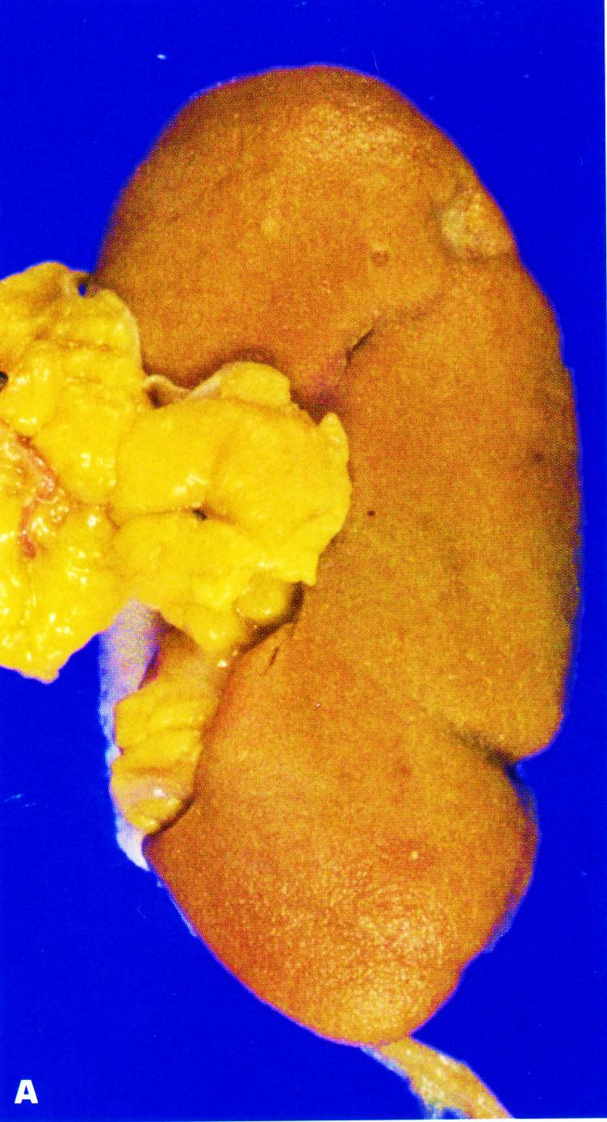
Kidney with ischemic atrophy also bears very small subcapsular adenomas near to each pole.

Slide 8
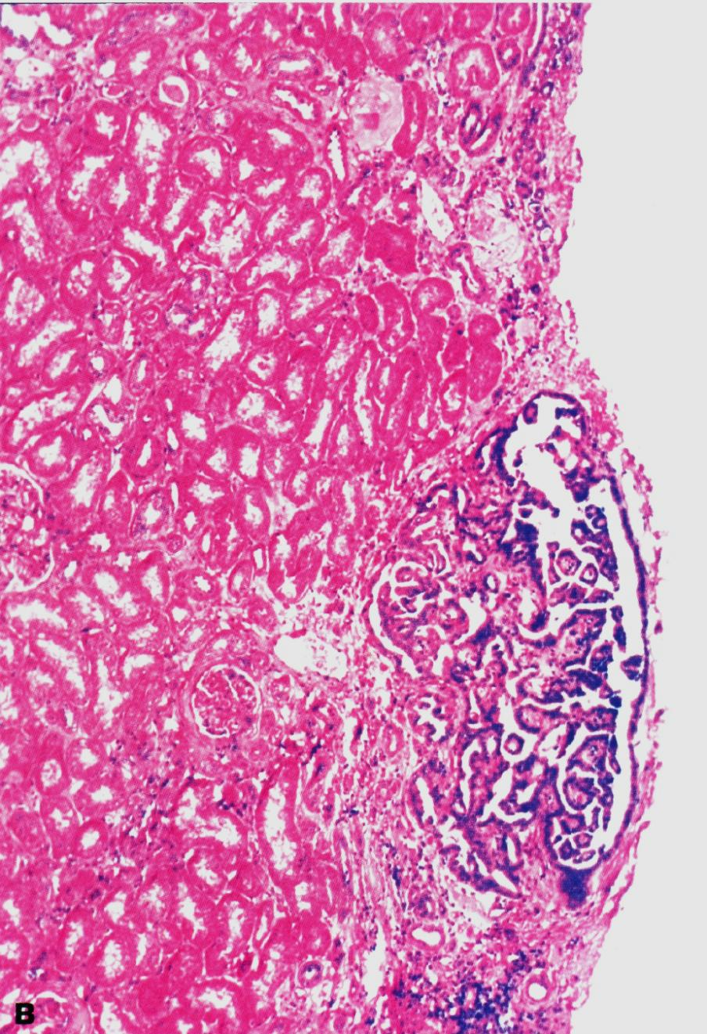
Histology of a subcapsular papillary adenoma shows tubules arranged in a papillary fashion.

Slide 9
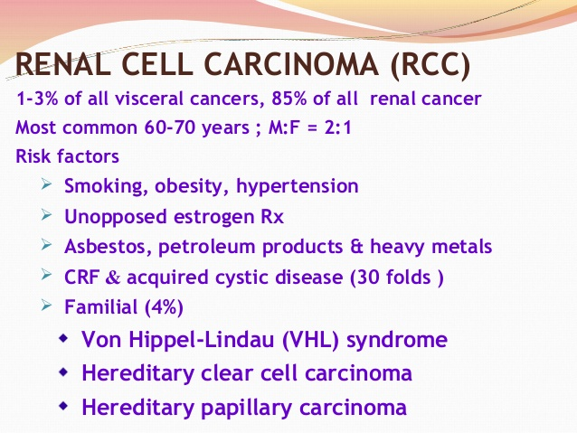

Slide 10
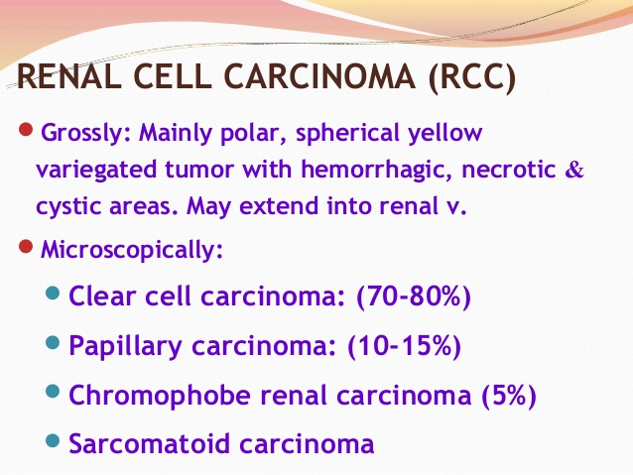

Slide 11
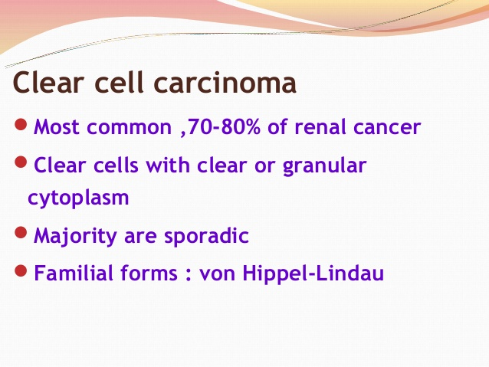

Slide 12
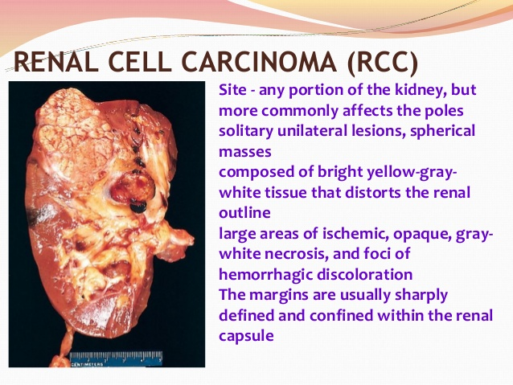

Slide 13
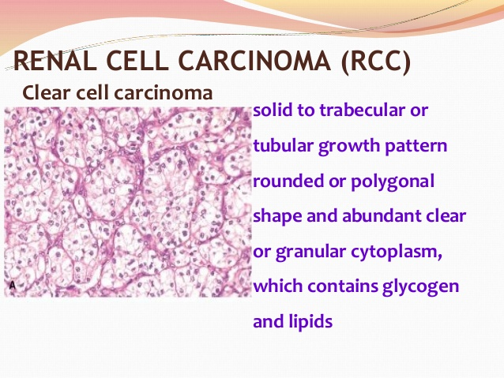

Slide 14
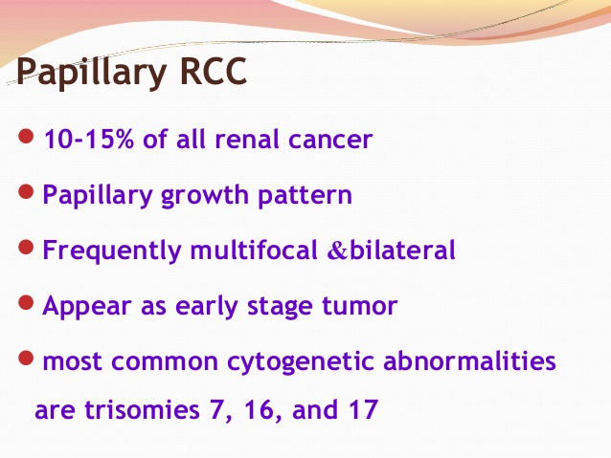

Slide 15
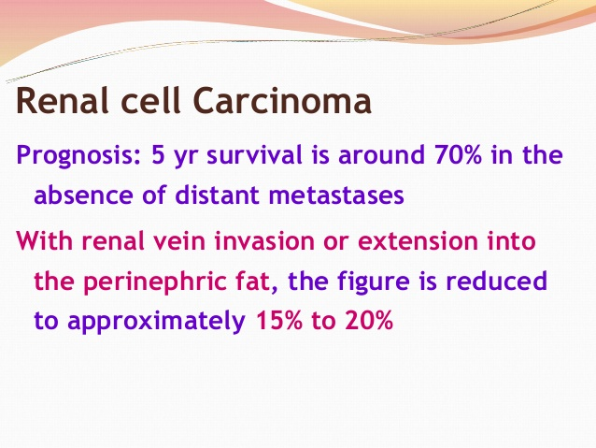

Slide 16
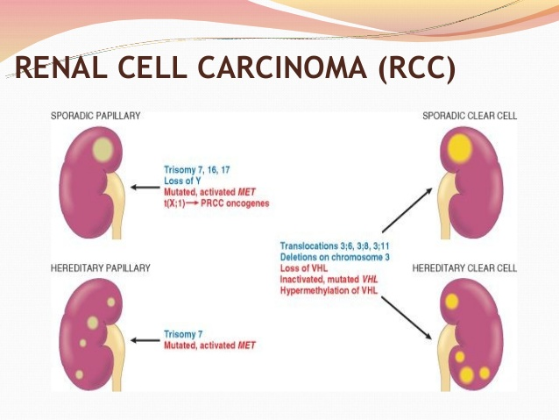

Slide 17
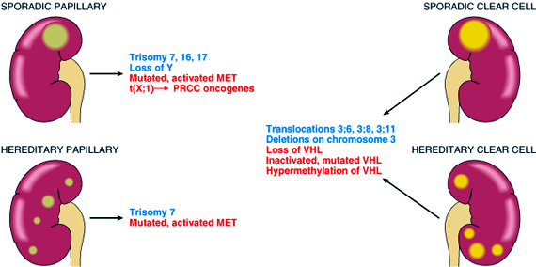
Human renal cell carcinoma

Slide 18
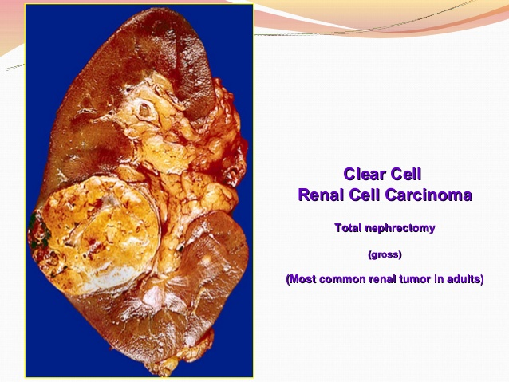

Slide 19
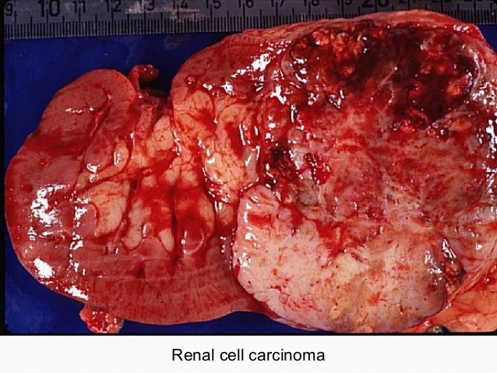

Slide 20
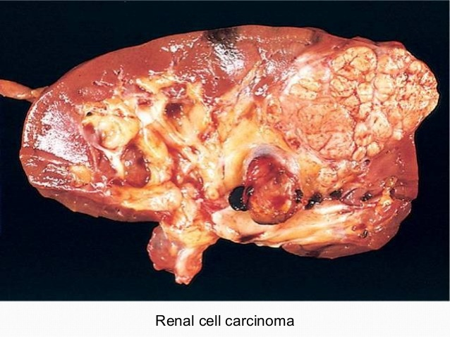

Slide 21
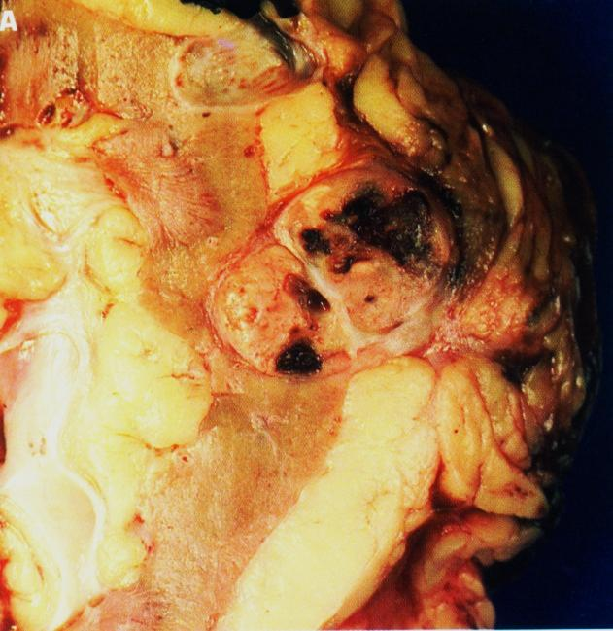
Renal cell carcinoma
Renal cell carcinoma is the most common primary renal tumor in adults and may be occult.

Slide 22
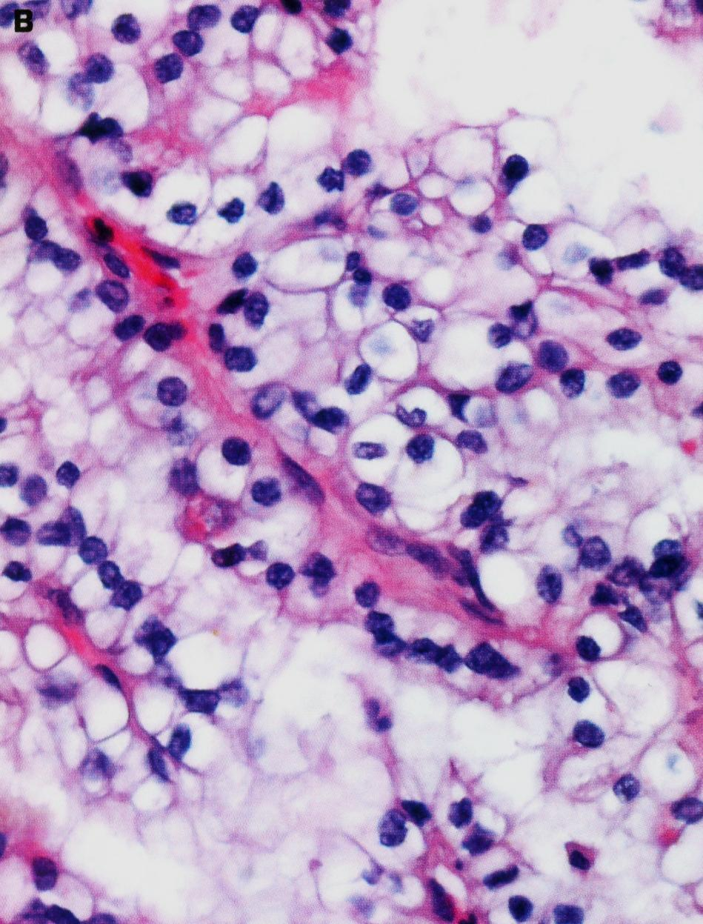
Small clear cell renal cell carcinoma (hypernephroma, Grawitz tumor) is spreading into perirenal adipose tissue.

Slide 23
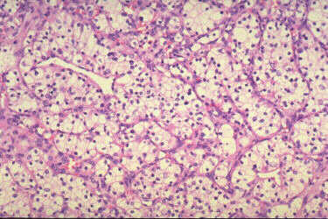
Human renal clear cell carcinoma

Slide 24
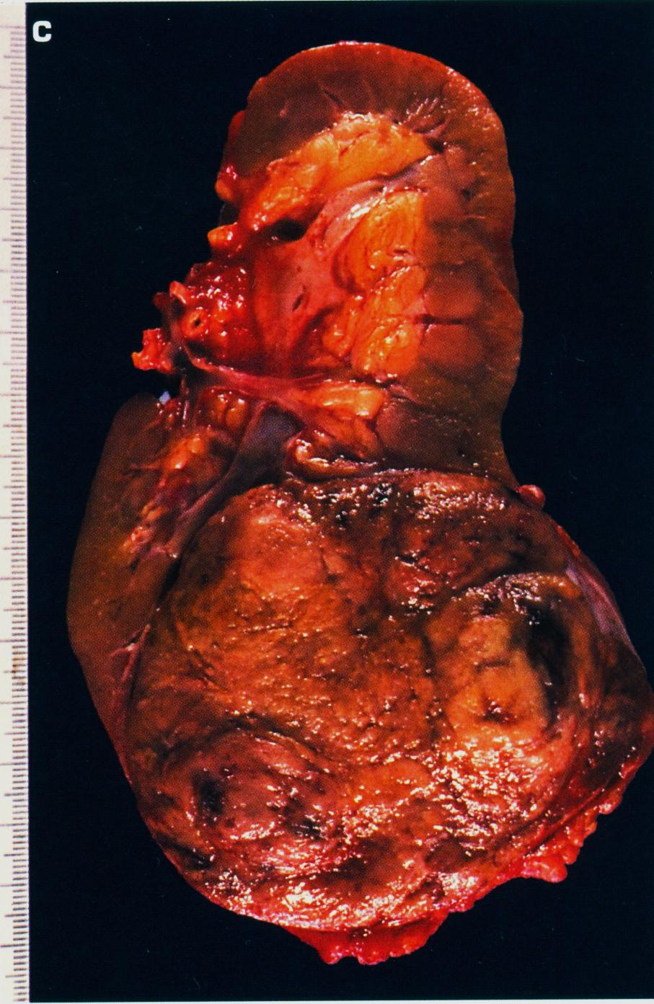
Typical lobulated, whorled, tan-colored cut surface of renal cell carcinoma.

Slide 25
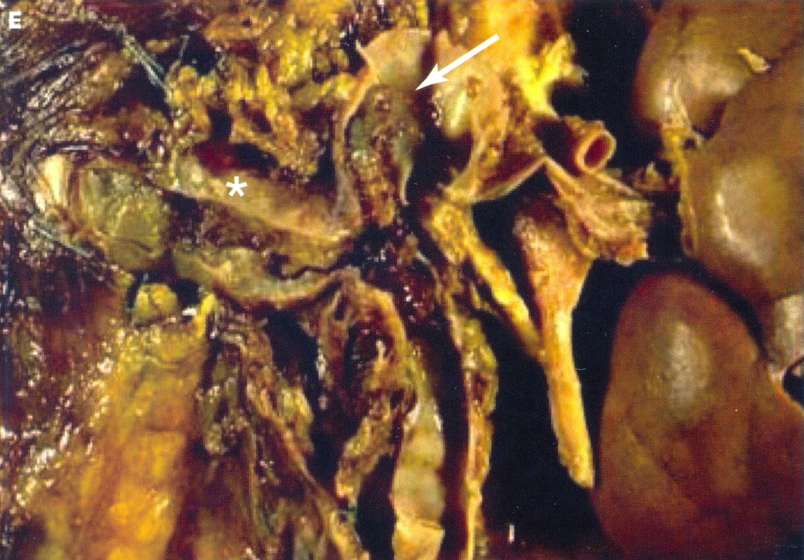
Invasion of the renal vein and inferior vena cava (arrow) by renal cell carcinoma.

Slide 26
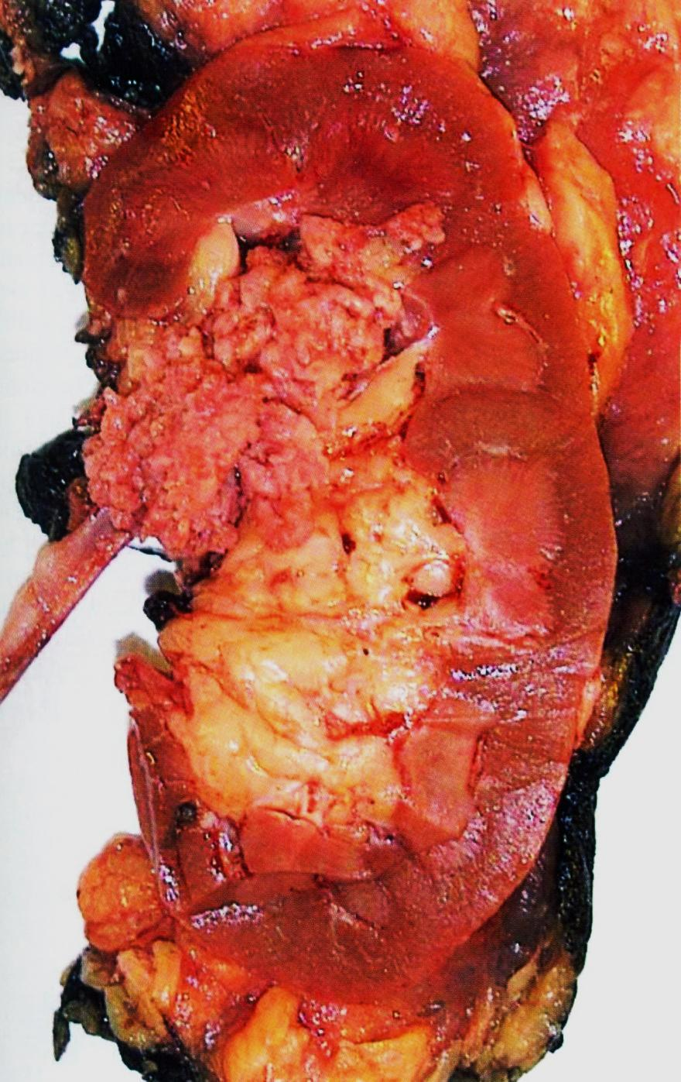
Papillary urothelial (transitional cell) carcinoma of renal pelvis. Note the exophytic, multifronded nature of the tumor.
Transitional cell carcinoma of the renal pelvis.

Slide 27


Slide 28
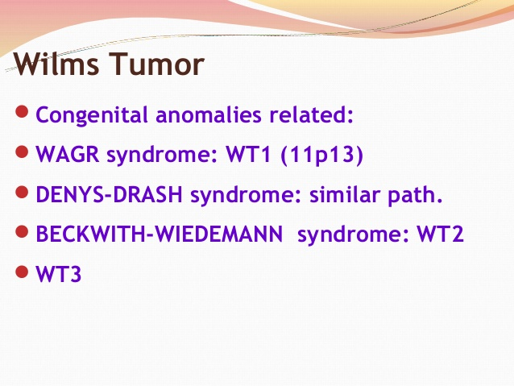

Slide 29
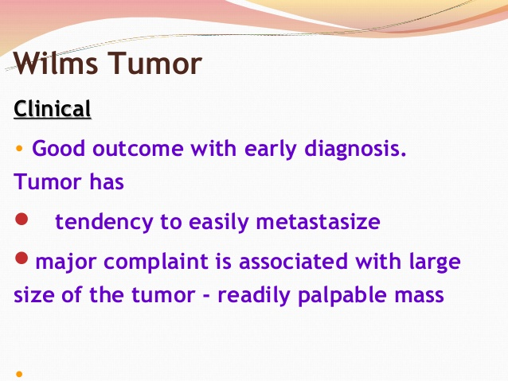

Slide 30
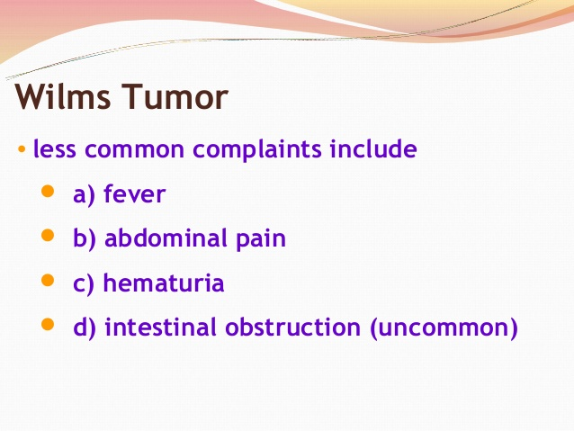

Slide 31
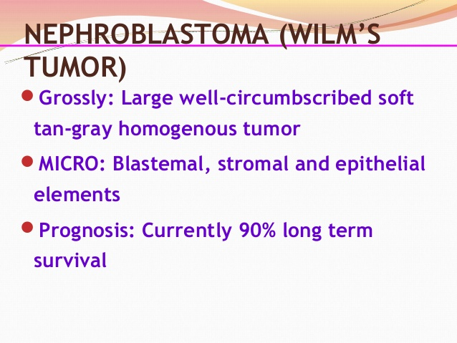

Slide 32
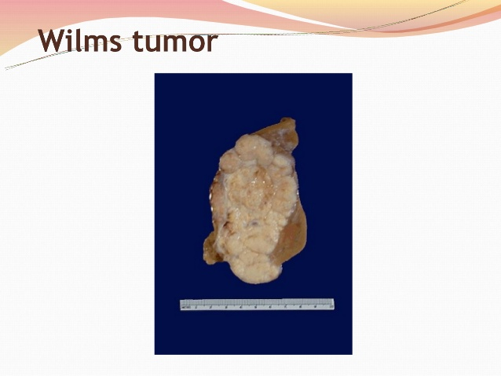

Slide 33
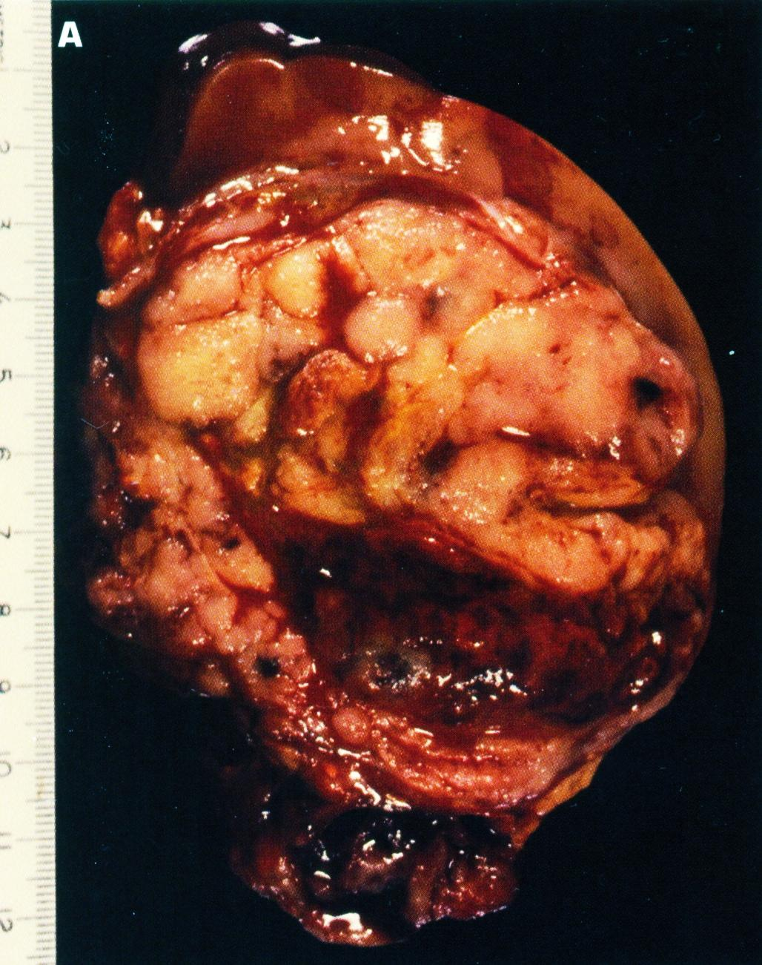
Solid, bulging, fleshy tan-white, partially necrotic tumor has replaced much of the kidney and is encompassed by a thin rim of renal tissue..
Wilms’ tumor (nephroblastoma)

Slide 34
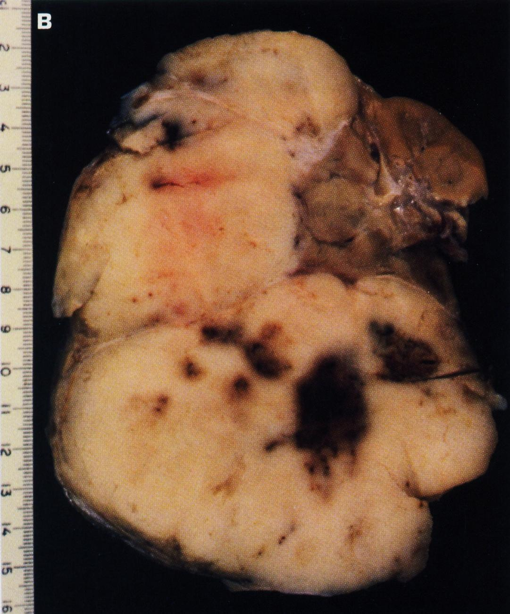
This Wilms’ tumor appears whiter due to formalin fixation and has extended beyond the confines of the kidney

Slide 35
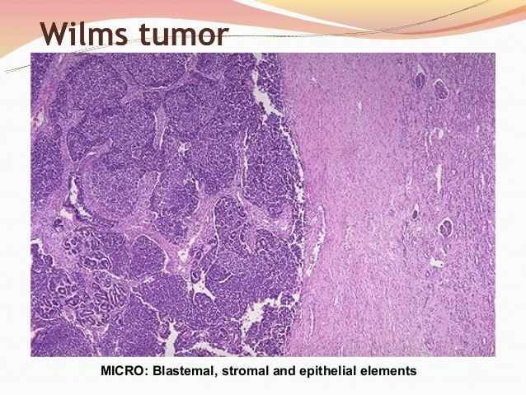

Slide 36
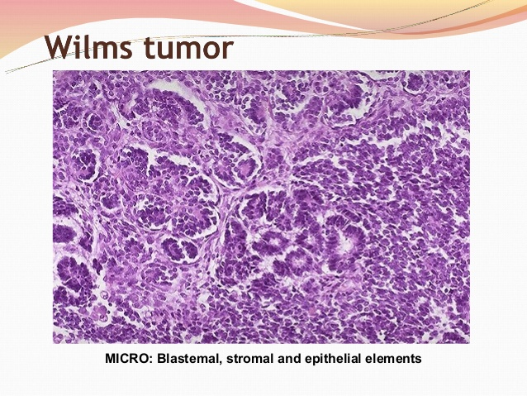

Slide 37
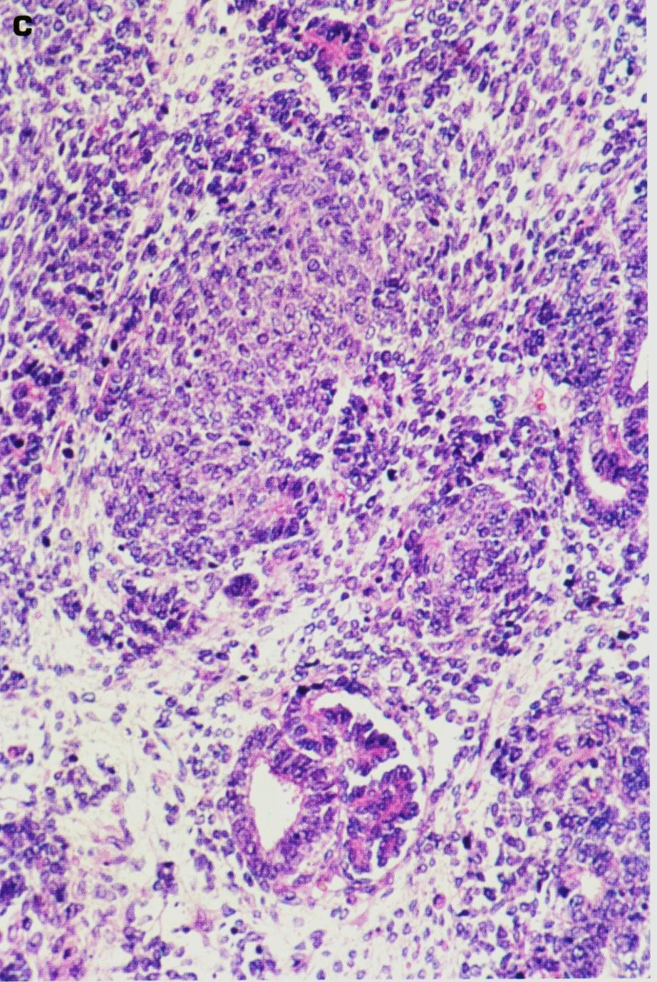
Histology shows hypercellular areas comprising undifferentiated blastema, loose stroma with undifferentiated glomeruloid body.
Wilms’ tumor

Slide 38
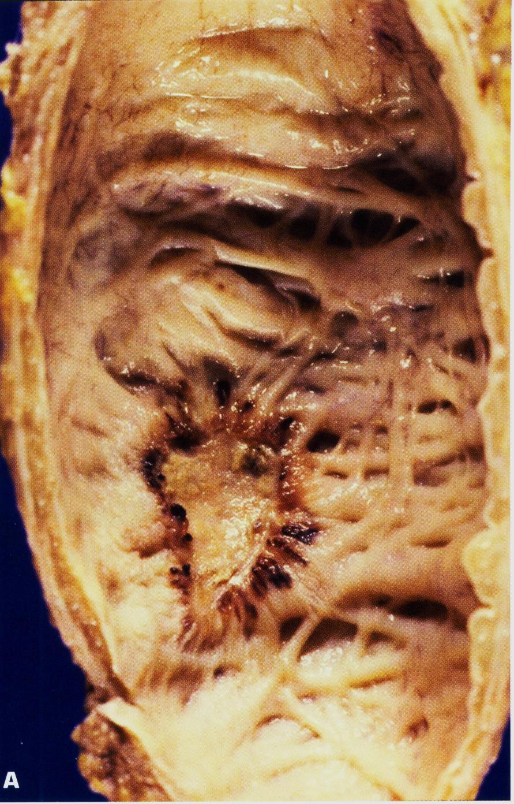
Urothelial (transitional cell) carcinoma in situ of the urinary bladder if untreated, up to 75% of cases go on to invasive cancer.

Slide 39
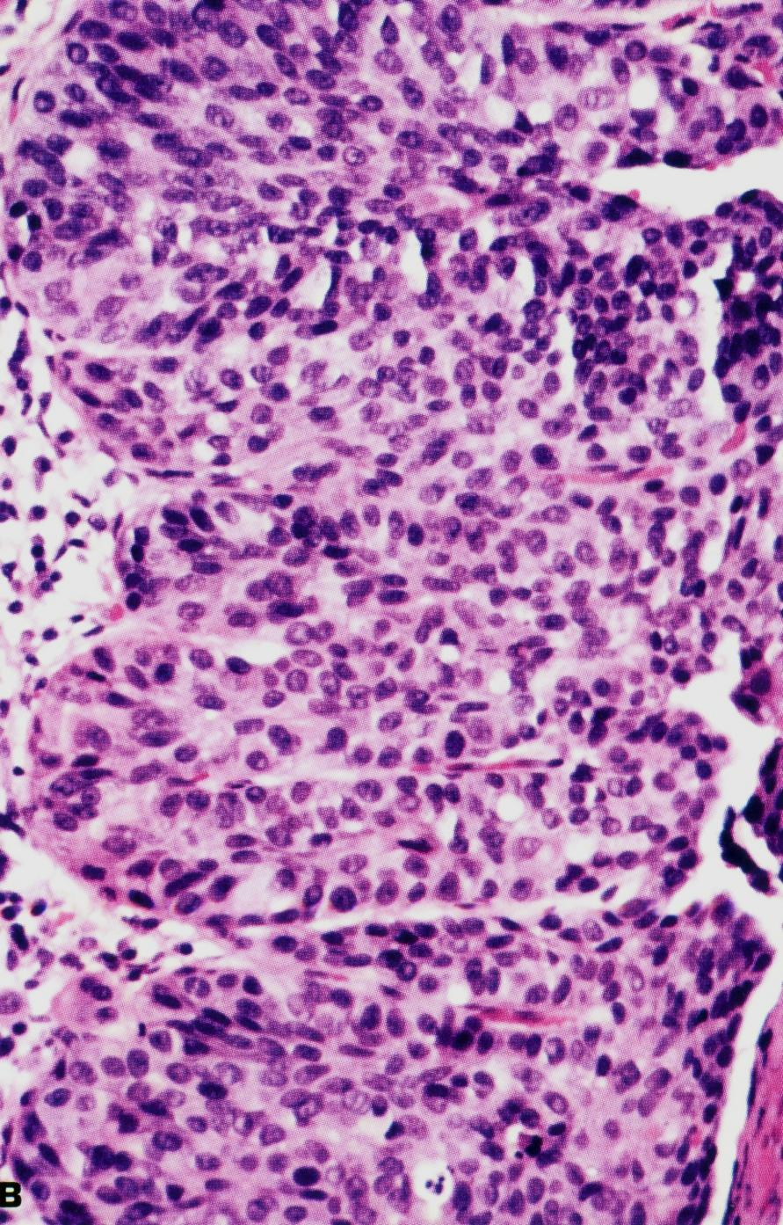
Histology of carcinoma in situ (surface is to the right).

Slide 40
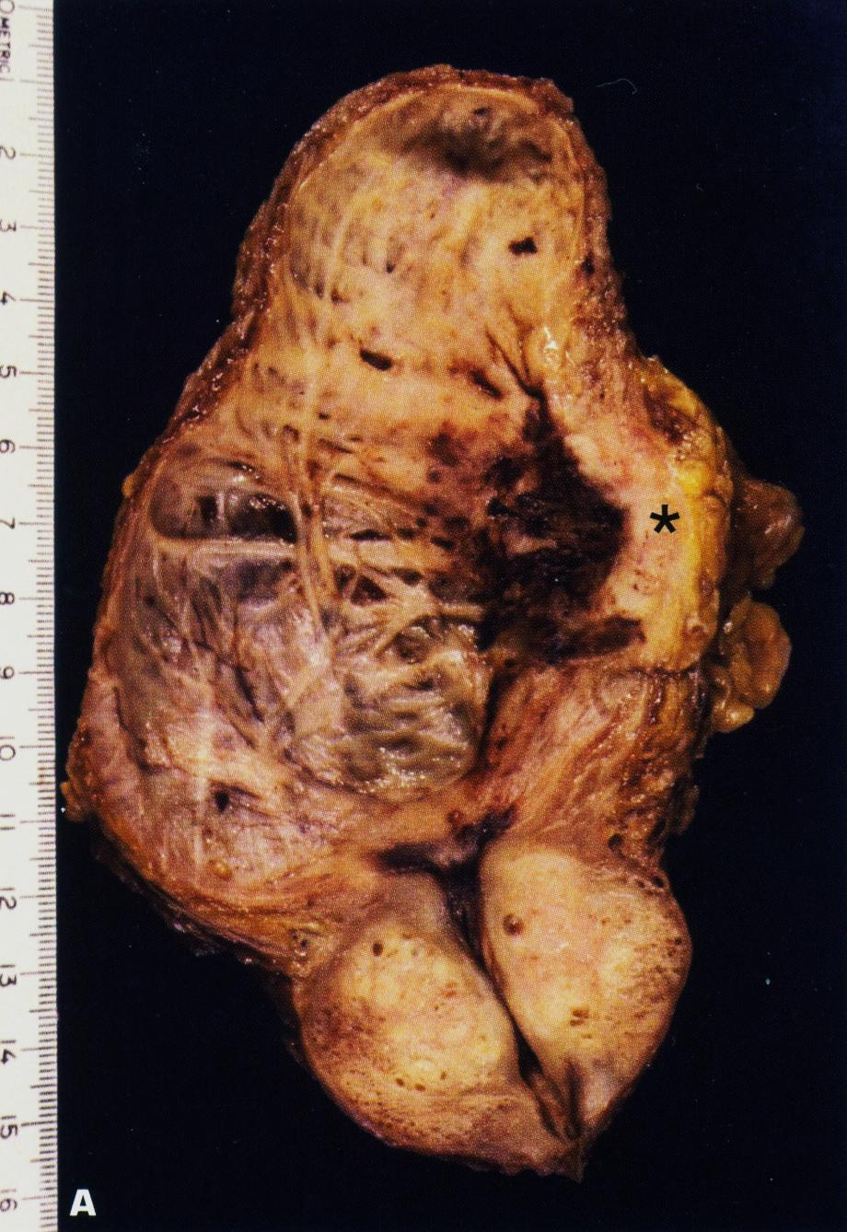
Invasive urothelial carcinoma of the bladder is invading the muscle coat on the right side of the picture.

Slide 41
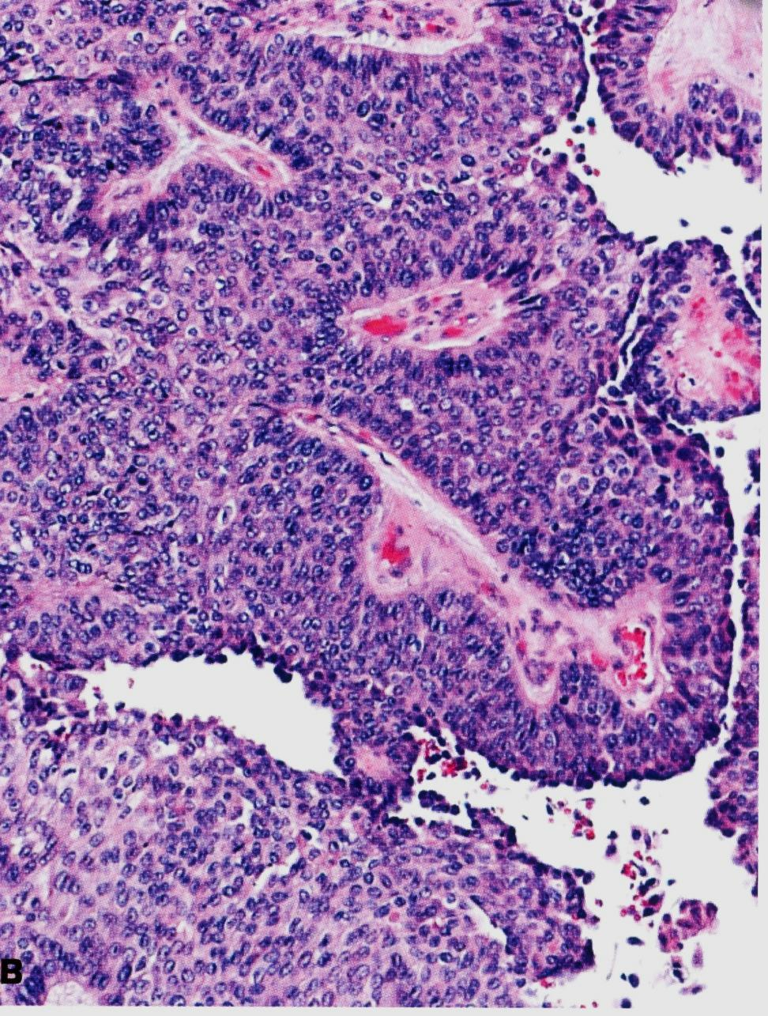
Urothelial carcinoma of bladder.

Slide 42
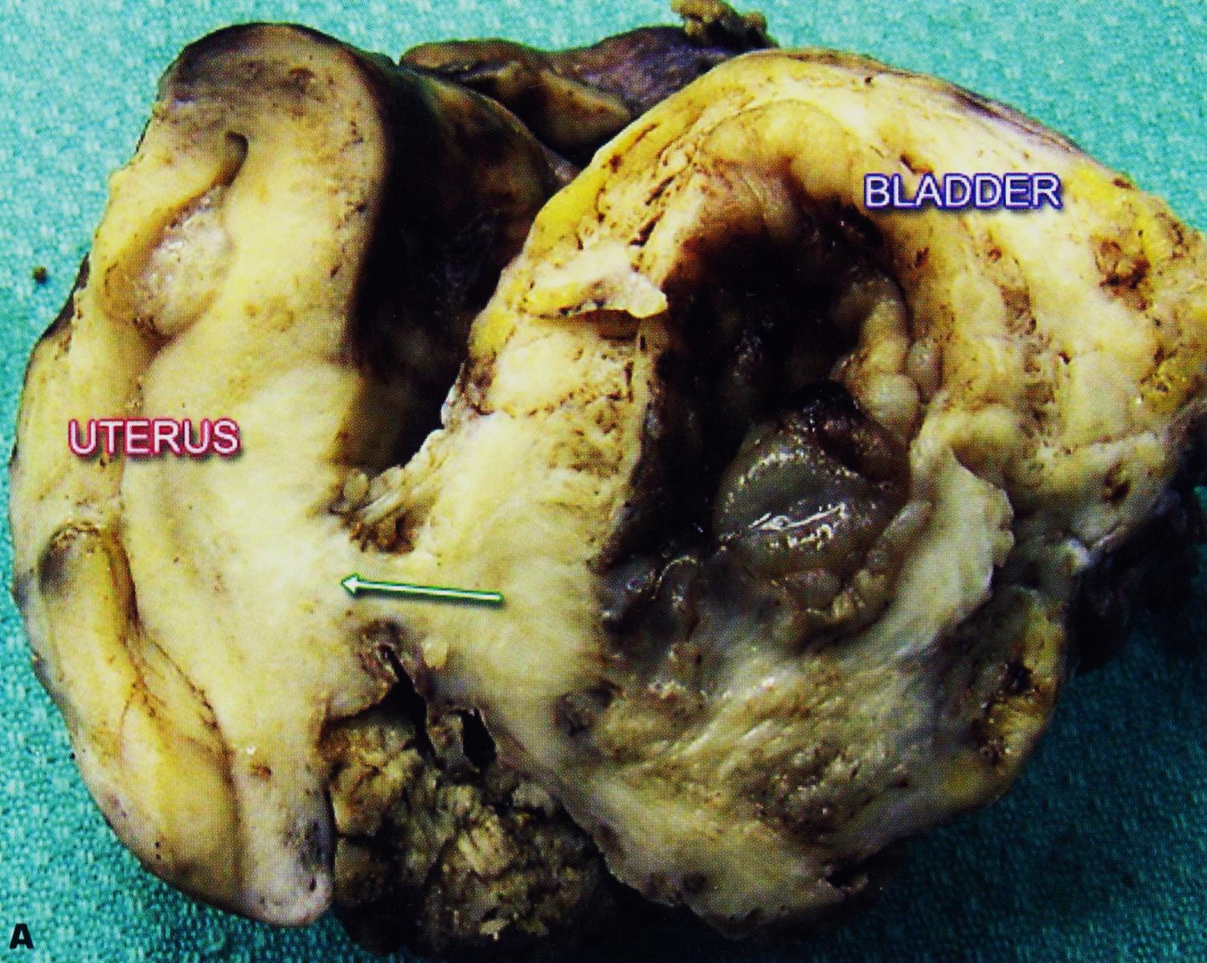
Advanced urothelial cancer of the bladder has spread posteriorly (arrow)to invade the uterus.

Slide 43
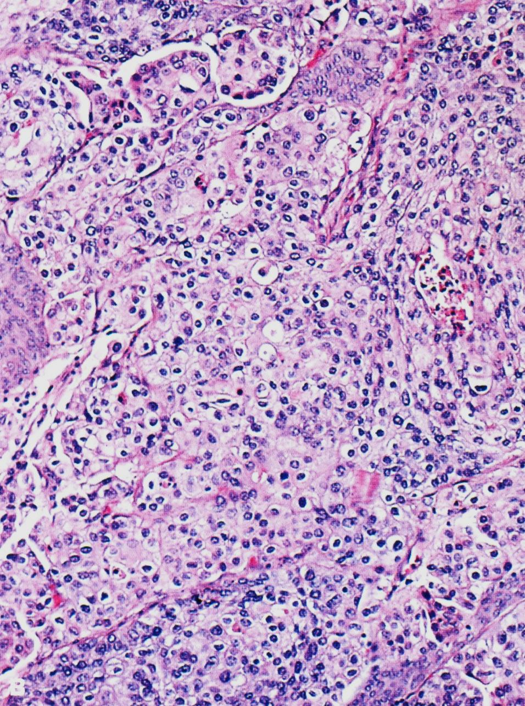
Poorly differentiated urothelial carcinoma.

Slide 44
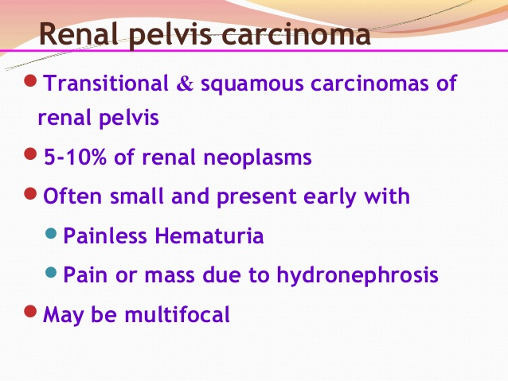

Slide 45
