Slide 1

Diuresis

Slide 2
Objectives
To measure the volume and determine the composition of urine excreted by 4 groups of volunteers, as follows:
  Control.
  Drinking one liter of water.
  Drinking one liter of normal saline.
  Taking lasix (a diuretic) 40 mg.
To explain the mechanisms behind the different data.

Slide 3
Control…..Nothing.
Water….drink 1L water.
Saline…drink 1L saline.
Lasix…..take 20mg lasix.
Cont. M & M
11am
1pm
1:30pm
2pm
2:30pm
3pm
Empty Bladder
(1st sample)
2nd sample
3rd sample
4th sample
5th sample
Empty bladder
Urine volume, osmolality, and pH.

Slide 4
Recording and Analysis of Data
4 | 3 | 2 | 1 | Sample no
11.30am | 11am | 10.30am | 10am | Time
30 | 30 | 30 | 120 | Duration (min)
 |  |  | 102 | Volume (ml)
 |  |  | 0.85 | Flow rate (ml/min)
 |  |  | 132 | Na⁺ Conc. (mmol/L)
 |  |  |  | Total Na⁺excretion (mmol
 |  |  |  | Rate of Na⁺ excretion (μmol/min)
Record the data obtained for each sample in the tables provided.
  Urine volume.
  Osmolality.
  pH.
  [Na⁺]
  [K⁺]
Calculate:
  Flow rate.
  Na excretion.
  Total Na excretion

Slide 5
Calculations
Urine flow rate = Volume/time (ml/min).
Sodium excretion(mmoles) = Na conc. × Volume of Urine
1000
  Urine Na conc. (mmol/L).
  Flow rate (ml/min).
  Volume of Urine (ml)
  Sodium excretion rate (µmol/ml) =Sodium conc.XVolume of Urine
  Time

Slide 6
4 | 3 | 2 | 1 | Sample no
1 pm | 12am | 11am | 10am | Time
60 | 60 | 60 | 120 | Duration (min)
 |  | 58 | 102 | Volume (ml)
 |  | ? | 0.85 | Flow rate (ml/min)
 |  | 107 | 132 | Na⁺ Conc. (mmol/L)
 |  | ? | 13.5 | Total Na⁺excretion (mmol
 |  | ? | 112.2 | Rate of Na⁺ excretion (μmol/min)

Slide 7
Plotting of Data (e.g. drink water )

Slide 10
Explanation of mechanisms
Comparison among the groups

Slide 11
Deprive of H2O
1
Plasma Osmolarity
2
3
Thirst
Stimulates Osmoreceptors in anterior hypothalamus
3
H2O drinking
ADH secretion from posterior pituitary
4
H2O permeability in late distal tubule and collecting duct
5a
Plsma Osmolarity Toward Normal
H2O reabsorption
5b
Urine osmolarity and urine volume
6

Slide 12
m
1
Drink H2O
Plasma Osmolarity and Volume
2
3
Thirst
Inhibits osmoreceptors in anterior hypothalamus
3
ADH secretion from posterior pituitary
H2O drinking
4
H2O permeability in late distal tubule and collecting duct
5a
H2O reabsorption and excretion
Plasma osmolarity toward Normal
5b
Urine Osmolarity and urine volume
6

Slide 13
Dieresis Experiment
Isotonic Saline (0.9%) 1 liter
Volume of E.C.F. Osmolality same (as isotonic saline) ( total solute amount
Stretch on right atrium (volume receptors in right atrium)
ANP (Atrial Natriuretic peptide
Na excretion by Kidneys

Slide 14
ANP Action
Increase in Blood flow to kidneys (due to relaxation of smooth muscles of blood vessels)
Increase in GFR
Increase in Na loss in urine
Decrease in Aldosterone
Decrease in Na reabsorption in DCT (increase in Na loss in urine)

Slide 15
Dieresis experiment
m
1 tab of Lasix (furosemide) (40mg) with 25ml of water
Action starts 1-2 hours and lasts for 4-6 hours (1/2 life of furosemide is 6hr)
Acts on thick asending limb of loop of Henle and blocks the Na-K-2Cl co-transport (called loop diuretic
Na exrection in urine and water excretion (osmotic drag)

Slide 16
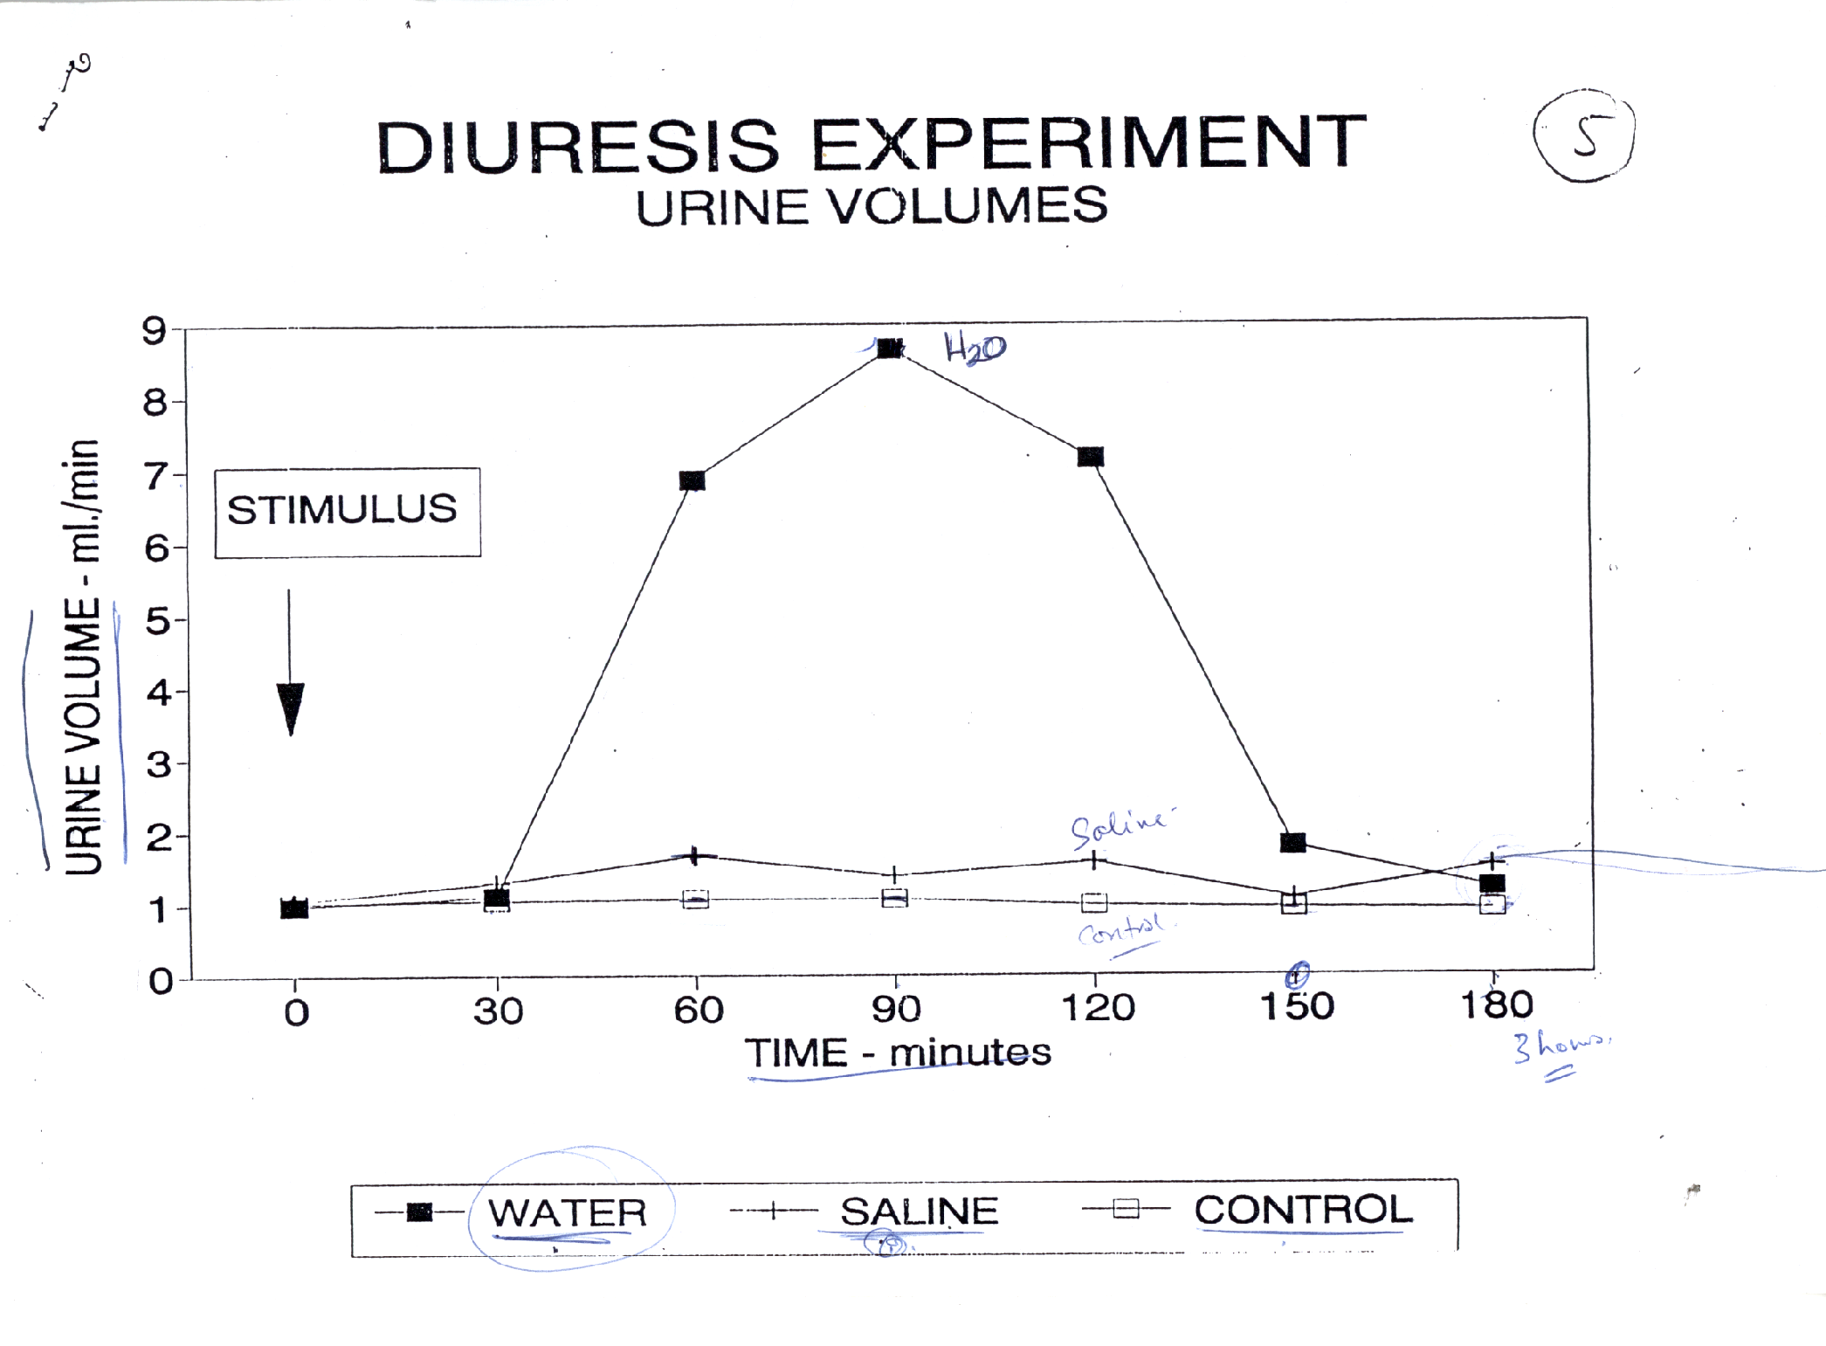

Slide 17
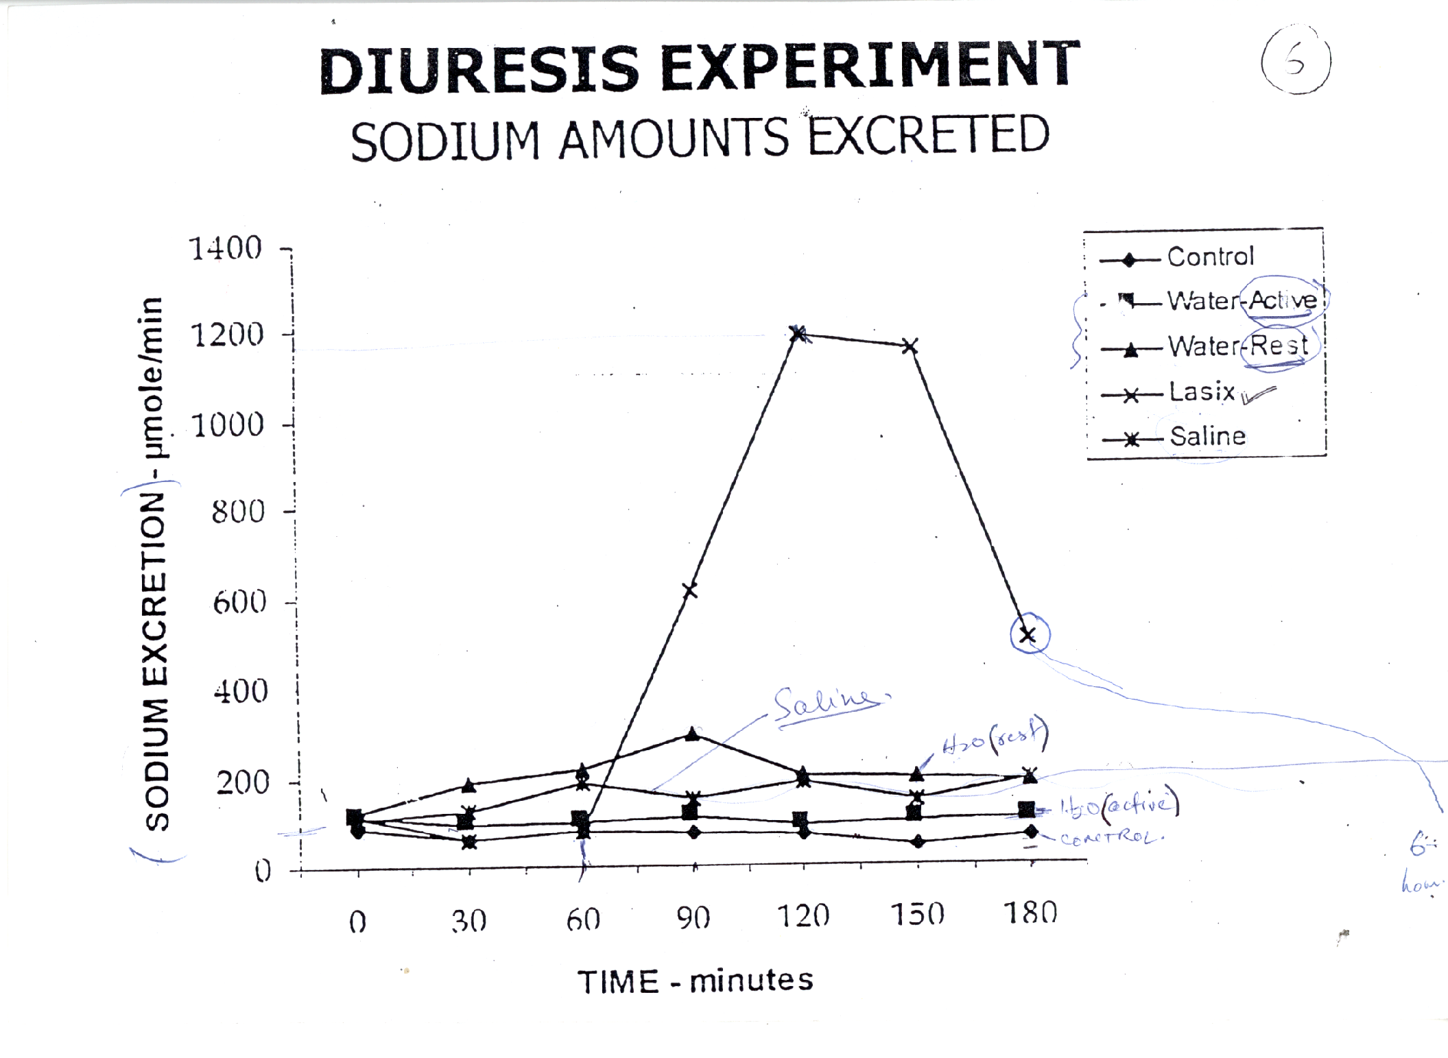

Slide 18
Thank You

