Slide 1
Practical renal block

Slide 2
Q 1
Identify the muscles:
1-
2-
3-
3
2
1

Slide 3
Q 1
Identify the muscles:
1-Psoas major
2- Quadratus lamborum
3- Diaphragm
3
2
1

Slide 4
Q 3
1-The renal artery arises from----------------------------
2-The level of the renal artery is---------------------
3-The renal veins drain into----------
4- The right renal vein is------ ---than the left renal vein

Slide 5
Q 3
1-The renal artery arises from abdominal aorta.
2-The level of the renal artery is L2
3-The renal veins drain into inferior vena cava
4- The right renal vein is shorter than the left renal vein

Slide 6
Q 4
Identify two veins drain into the left renal vein:
1-
2-

Slide 7
Q 4
Identify two veins drain into the left renal vein:
1-left suprarenal vein
2-left gonadal vein

Slide 8
Q 5
The 4 muscles lie behind the kidney are:
1-
2-
3-
4-
3
2
1

Slide 9
Q 5
The 4 muscles lie behind the kidney are:
1-Psoas major M
2-Quadratus lamborum M
3-Transversus abdominis M
4-Diaphragm
3
2
1

Slide 10
Q 6
1
Identify the structures related to the marked areas:
1-
2-
3-
4-
2
3
4

Slide 11
Q 6
1
Identify the structures related to the marked areas:
1- stomach
2-pancreas
3-descending colon
4-Coils of jejunum
2
3
4

Slide 12
Q 7
Identify the structures related to the marked areas:
1-
2-
3-
4-
1
3
2
4

Slide 13
Q 7
Identify the structures related to the marked areas:
1- Liver
2- Second part of the duodenum
3- Right colic flexure
4- Coils of small intestine
1
3
2
4

Slide 14
Q 8
Identify the structures related to the marked areas:
1-
2-
3-
3
2
1

Slide 15
Q 8
Identify the structures related to the marked areas:
1-Psoas Major muscle
2-Quadratus lumborum Muscle
3-Transversus abdominis muscle
2
3
1

Slide 16
Q 9
Identify the structures:
1-
2-
3-
4-
3
1
4
2

Slide 17
Q 9
Identify the structures:
1-Psoas major Muscle
2-Quadratus lumborum Muscle
3-Perirenal fat
4-Pararenal fat
3
1
4
2

Slide 18
Q 10
Identify the marked areas:
1-
2-
3-
4-
1
3
2
4

Slide 19
Q 10
Identify the marked areas:
1-Renal cortex
2- Pyramid in renal medulla
3-Minor Calyx
4-Major Calyx
1
3
2
4

Slide 20
Q 11
The ureter is supplied by:
1-
2-
3-
4-

Slide 21
Q 11
The ureter is supplied by:
1-Renal artery
2-Gonadal artery
3-Common iliac artery
4-Internal iliac artey

Slide 22
Q 13
Identify the labeled areas:
1-
2-
3-
4-
1
1
2
3
4

Slide 23
Q 13
Identify the labeled areas:
1-Ureteric orifice
2- Trigone
3-Internal urethral orifice
4-urethra
1
1
2
3
4

Slide 24
From Med432 and Med433

Slide 26
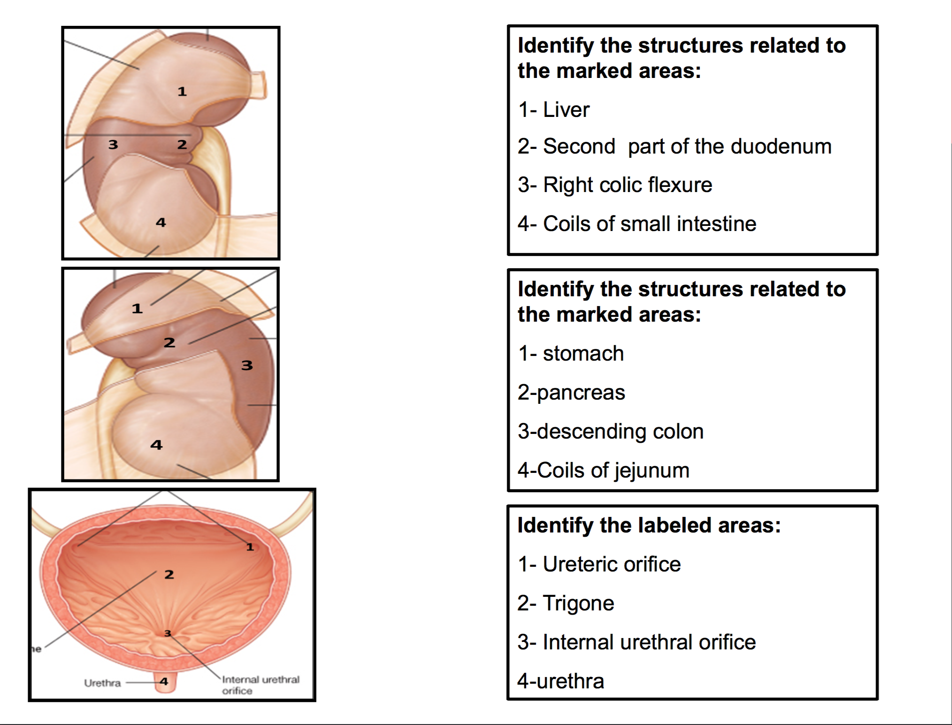

Slide 32
Done by anatomy team 434
1- Abdulrahman Alkaff
2- Abdullah Aljomaiah

