Slide 1
Cell Signaling and Regulation of Metabolism
By
Dr. Reem M. Sallam, MD, PhD
Clinical Chemistry Unit Department of Pathology

Slide 2
Objectives
By the end of this lecture, students are
expected to:
➢Differentiate different steps in signaling pathways
➢Describe the second messenger systems
➢Recognize the function of signaling pathways for
➢Signal transmission
➢Amplification
➢Discuss the role of signaling pathways in regulation and integration of metabolism

Slide 3
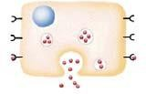
No cell lives in isolation
Cells communicate with each other
Cells send and receive information (signals)
Information is relayed within cell to produce a response

Slide 4
Signaling Process
Recognition of signal
Receptors
Transduction
Change of external signal into intracellular message with amplification and formation of second messenger
Effect
Modification of cell metabolism and function

Slide 5
Signaling Process
Recognition of signal
Receptors
Transduction
Change of external signal into intracellular message with amplification and formation of second messenger
Effect
Modification of cell metabolism and function

Slide 6
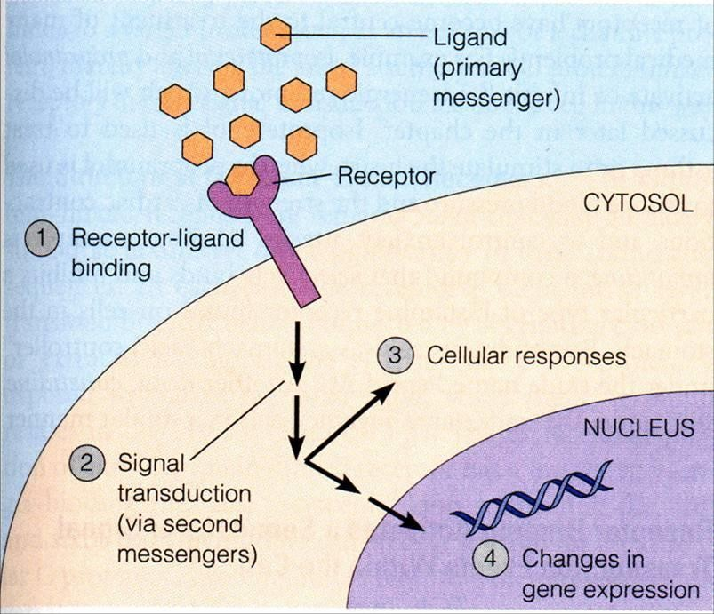
General Signaling Pathway

Slide 7
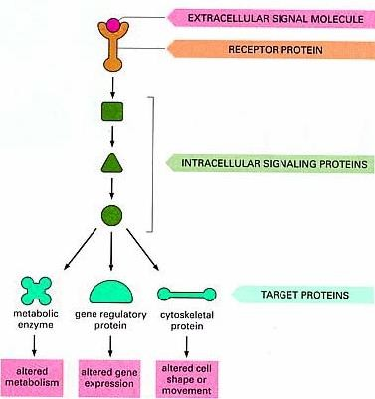
Signaling Cascades

Slide 8
Recognition
Performed by receptors
Ligand will produce response only in cells that have receptors for this particular ligand
Each cell has a specific set of receptors

Slide 9
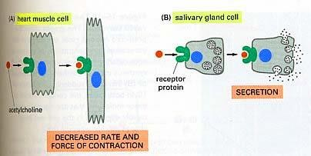
Different Responses to the Same Signaling Molecule
(A) Different Cells

Slide 10
Different Responses to the Same Signaling Molecule
(B) One Cell but, Different Pathways
Hypoglycemia
Glucagon secretion
Hepatocyte: Glucagon/receptor binding
Second messenger: cAMP
Response: Enzyme phosphorylation
P
P
Glycogen synthase
(Inactive form)
Glycogen phosphorylase (Active form)
Inhibition of glycogenesis
Stimulation of glycogenolysis

Slide 11
GTP-Dependant Regulatory Proteins (G-Proteins)
G-Proteins:
Trimeric membrane proteins (αβγ)
G-stimulatory (G_{s}) and G-inhibitory (G_{i})
Binds to GTP/GDP
Forms of G-Proteins
Inactive form Trimeric –bound GDP (αβγ/GDP)
Active form α-bound GTP (α/GTP)
The α-subunit has intrinsic GTPase activity, resulting in hydrolysis of GTP into GDP and inactivation of G-proteins

Slide 12
Signaling Pathways for Regulation of Metabolism
Two important second messenger systems: Adenylyl cyclase system Calcium/phosphatidylinositol system

Slide 13
Adenylyl cyclase
Adenylyl cyclase:
Membrane-bound enzyme
Converts ATP to cAMP
Activation/Inhibition:
Signal: Hormones or neurotransmitters (e.g., Glucagon and epinephrine)
or Toxins
(e.g., Cholera and pertussis toxins)
Receptor: G-protein coupled receptor
Response: Activation/inhibition of protein kinase A (cAMP-dependent protein kinase)

Slide 14
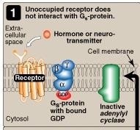
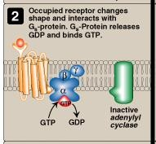
Signal Transduction: Adenylyl Cyclase System
Ligand/Receptor Binding Activation of G_{s}-protein
Resting state: No Signal

Slide 15
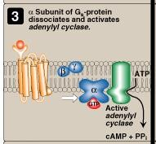
Signal Transduction: Adenylyl Cyclase System
Activation of adenylyl cyclase

Slide 16
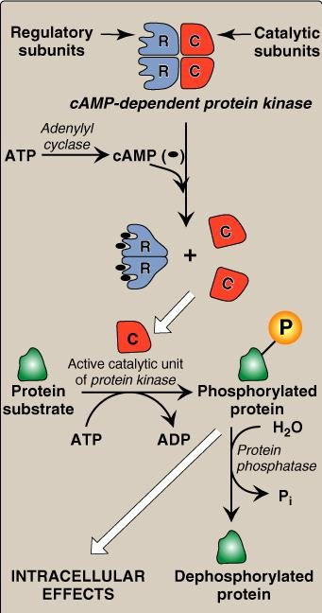
Adenylyl Cyclase System: cAMP-Dependent Protein Kinase (Protein Kinase A)
*
AMP
*Phosphodiesterase

Slide 17
Termination of
Signal (A)
*
AMP
*Phosphodiesterase
•Protein phosphatase
•Phosphodiesterase → ↓cAMP → Inactive protein kinase

Slide 18
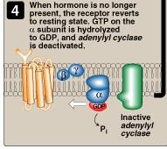
Termination of Signal (B)

Slide 19
Termination of Signal (C)
Х

Slide 20
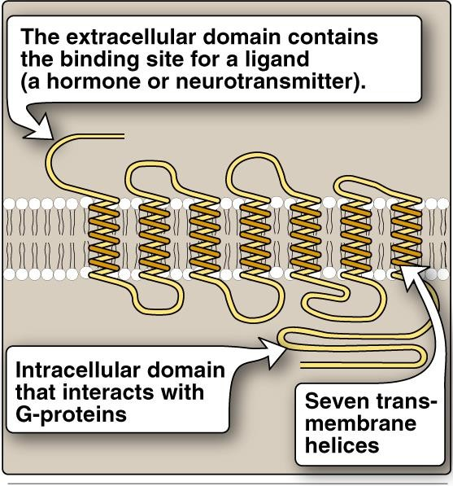
G-Protein Coupled Membrane Receptor

Slide 21
Regulation of Glycogen Metabolism by Glucagon: Effects on Glycogen Synthase and Phosphorylase
Hypoglycemia
Glucagon secretion
Hepatocyte: Glucagon/receptor binding
Second messenger: cAMP
Response: Enzyme phosphorylation
P
P
Glycogen synthase
(Inactive form)
Glycogen phosphorylase (Active form)
Inhibition of glycogenesis
Stimulation of glycogenolysis

Slide 22
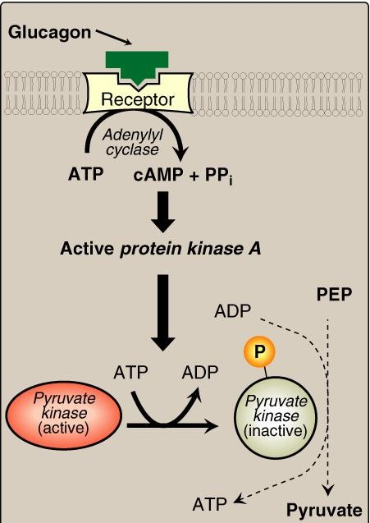
Pyruvate Kinase Regulation: Covalent Modification

Slide 23
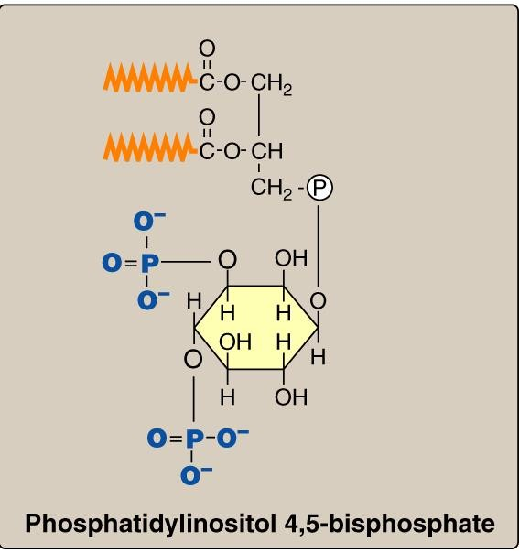
Calcium/Phosphatidylinositol System

Slide 24
Calcium/Phosphatidylinositol System
Diacylglycerol
(DAG)
Phospholipase C
Inositol Trisphosphate
(IP₃)

Slide 25
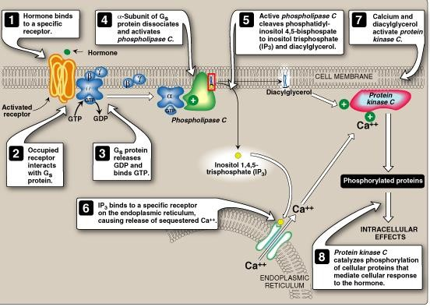
e.g., Antidiuretic hormone (ADH)
Acetylcholine
Intracellular Signaling by Inositol trisphosphate

Slide 26
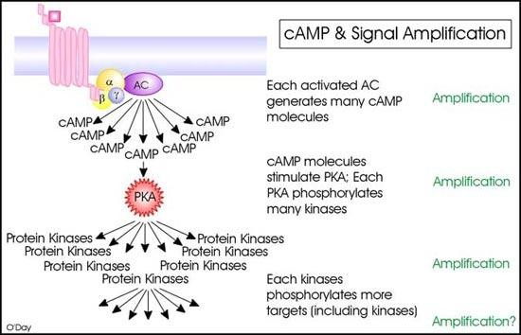
Signal Amplification

Slide 27
Take Home Message
Cell signaling allows
•Signal transmission and amplification
•Regulation of metabolism
•Intercellular communications & coordination of complex biologic functions

