Slide 2
Glucose Metabolism: Glycolysis
By
Reem M. Sallam, M.D.; Ph.D.
Assistant Prof., Clinical Chemistry Unit, Pathology Dept.
College of Medicine, KSU sallam@ksu.edu.sa

Slide 3
Objectives: Glycolysis
By the end of this lecture, students are expected to:
➢Recognize the major regulatory mechanisms for
glycolysis
➢Discuss the unique nature of glycolysis in RBCs
Assess the ATP production in glycolysis (aerobic/anaerobic)
Define pyruvate kinase deficiency hemolytic anemia

Slide 4
Glycolysis: Revision
Major oxidative pathway of glucose
The main reactions of glycolytic pathway
The rate-limiting enzymes/Regulation
ATP production (aerobic/anaerobic)
Pyruvate kinase deficiency hemolytic anemia

Slide 5
Summary: Regulation of Glycolysis
Regulatory Enzymes (Irreversible reactions):
Glucokinase/hexokinase
PFK-1
Pyruvate kinase
Regulatory Mechanisms:
Rapid, short-term:
Allosteric
Covalent modifications Slow, long-term:
Induction/repression
Apply the above mechanisms for each enzyme where applicable

Slide 6
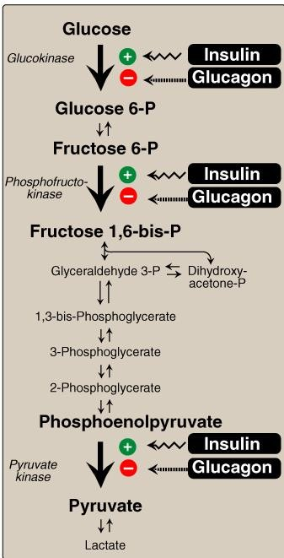
Long-Term Regulation
of Glycolysis
Insulin: Induction
Glucagon: Repression

Slide 7
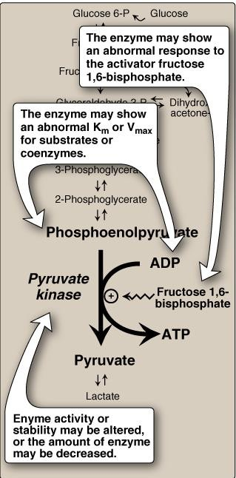
Pyruvate Kinase Deficiency
Hemolytic Anemia
PK Mutation may lead to:
Altered Enz. kinetics
Altered response to activator
Decreased the amount of the
Enz. or its stability

Slide 8
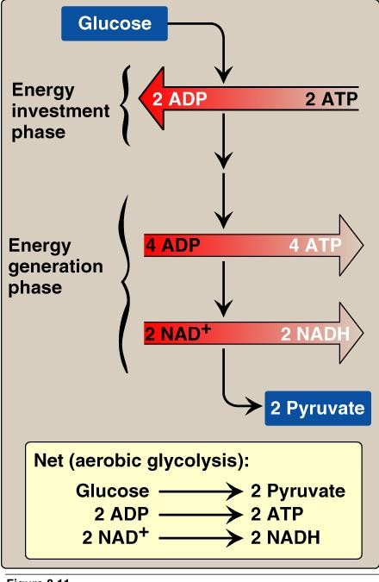
Aerobic Glycolysis:
Total Vs Net ATP Production

Slide 9
Aerobic Glycolysis: ATP Production
ATP Consumed: |  | 2 | ATP
ATP Produced: Substrate-level | 2 X 2 = | 4 | ATP
Oxidative-level | 2 X 3 = | 6 | ATP
Total |  | 10 | ATP
Net: | 10 – 2 = | 8 | ATP

Slide 10
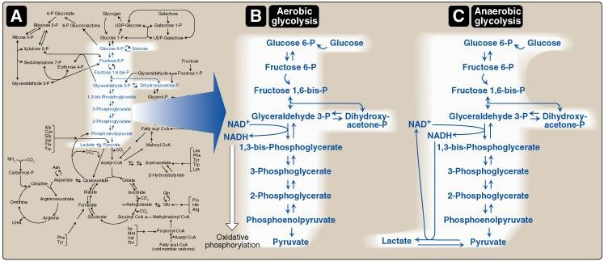
Aerobic Vs Anaerobic Glycolysis

Slide 11
Anaerobic Glycolysis
NADH produced cannot be used by ETC for ATP production
(No O₂ and/or No mitochondria)
Less ATP production, as compared to aerobic glycolysis
Lactate is an obligatory end product, Why?
Because if not formed, All cellular NAD+ will be converted to NADH, with no means to replenish the cellular NAD → Glycolysis stops→ death of the cell

Slide 12
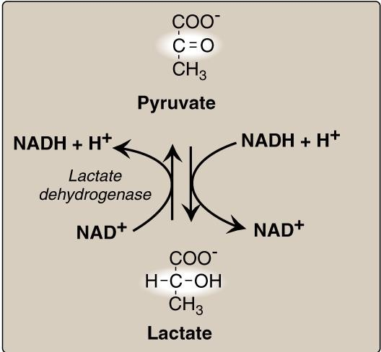
Lactate Dehydrogenase

Slide 13
Anaerobic Glycolysis: ATP Production
ATP Consumed: |  | 2 | ATP
ATP Produced: Substrate-level | 2 X 2 = | 4 | ATP
Oxidative-level | 2 X 3 = | 6 | ATP
Total |  | 4 | ATP
Net: | 4 – 2 = | 2 | ATP

Slide 14
2
Anaerobic Glycolysis
in RBCs: 2,3-BPG Shunt
2
2
2
2
2

Slide 15
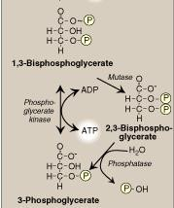
Anaerobic Glycolysis in RBCs:
2,3-BPG Shunt
2
2
2

Slide 16
Glycolysis in RBCs: ATP Production
ATP Consumed:
ATP Produced:
Substrate-level
Oxidative-level
Total
Net:
2 ATP
_{OR} 2 X 2 =
4 ATP
2 ATP
6 ATP
1 X 2 =
2 X 3 =
4 OR 2 ATP
_{OR} 4 – 2 =
2 ATP
0 ATP
2 – 2 =

Slide 17
Glycolysis in RBCs: Summary
End product:
Lactate
No net production or consumption of NADH
Energy yield:
If no 2,3-BPG is formed: If 2,3-BPG shunt occurs:
2 ATP
0 ATP
PK Deficiency hemolytic anemia depends on:
Degree of PK Deficiency Compensation by 2,3-BPG

Slide 18
Take Home Message
➢Glycolysis is a tightly-regulated pathway
PFK-1 is the rate-limiting regulatory enzyme
Glycolysis is mainly a catabolic pathway for ATP production, But it has some anabolic features (amphibolic)
Pyruvate kinase deficiency in RBCs results in
hemolytic anemia

Slide 19
Take Home Message
Net energy produced in:
Aerobic glycolysis:
➢Anaerobic glycolysis:
8 ATP
2 ATP
Net energy produced in glycolysis in RBCs:
➢Without 2,3 BPG synthesis:
➢With 2,3 BPG synthesis:
2 ATP
0 ATP

