Slide 1
بسم الله الرحمن الرحيم

Slide 2
Glucose Metabolism: Gluconeogenesis
By
Reem M. Sallam, MD, PhD
Assistant Prof. , Clinical Chemistry Unit,
Pathology Dept., College of Medicine, KSU

Slide 3
Objectives
The importance of gluconeogenesis as an important pathway for glucose production
The main reactions of gluconeogenesis
The rate-limiting enzymes of gluconeogenesis
Gluconeogensis is an energy-consuming, anabolic pathway

Slide 4
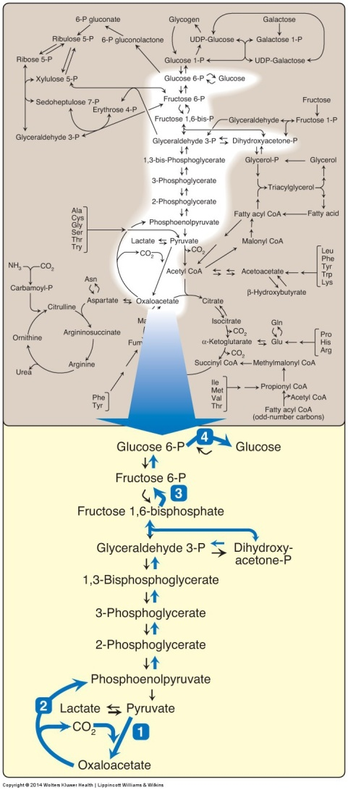
Gluconeogenesis in general metabolism
The gluconeogenesis pathway shown as one of the essential pathways of energy metabolism.

Slide 5
Gluconeogenesis: An Overview
Site: Liver (mainly) and Kidneys
Both mitochondria and Cytosol are involved
Exception: if the substrate is Glycerol: only cytosol
Gluconeogenic substrates:
Glycerol
Lactate and Pyruvate
Glucogenic amino acids

Slide 6
Gluconeogenesis Pathway
4- Dephosphorylation of G-6-P
3- Dephosphorylation of F 1,6-P
2- Formation of PEP
1- Carboxylation of pyruvate

Slide 7
Gluconeogenic Substrates: Glycerol
*GK
Glycerol
Glycerol 3-phosphate
ATP
ADP
NAD+
Glycerol 3-phosphate
dehydrogenase
NADH
Glucose
Dihydroxyacetone phosphate
*GK: Glycerol kinase (present only in liver & kidneys)

Slide 8

Glucogenic Amino Acids
Aspartate (Asp)
Asparagine (Asn)
Glutamate (Glu)
Glutamine (Gln)
Phenylalanine (Phe)
Tyrosine (Tyr)
Methionine (Met)
Valine (Val)

Slide 9
Gluconeogenic Substrates
Lactate
Alanine (Ala)
Glycine (Gly)
Pyruvate
Aspartate (Asp)
Asparagine (Asn)
Glutamate (Glu)
Glutamine (Gln)
Phenylalanine (Phe)
Tyrosine (Tyr)
Methionine (Met)
Valine (Val)

Slide 10
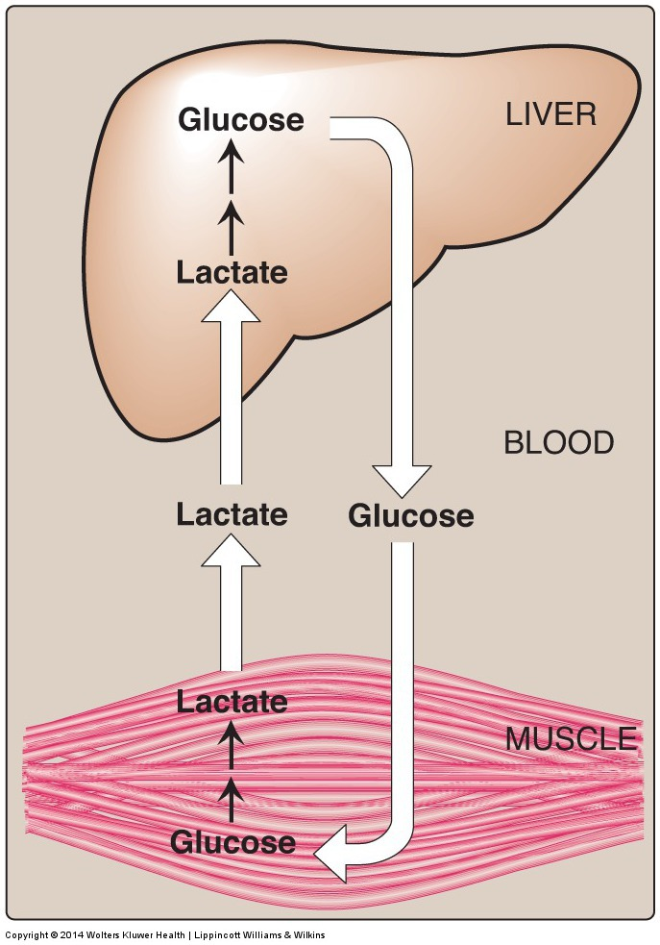
Gluconeogenic Substrates: Lactate
(Cori Cycle)
The inter-tissue Cori cycle.

Slide 11
Pyruvate Carboxylation
Pyruvate Carboxylase
Biotin
Pyruvate
Oxaloacetate
CO₂
ATP
ADP + P_{i}

Slide 12
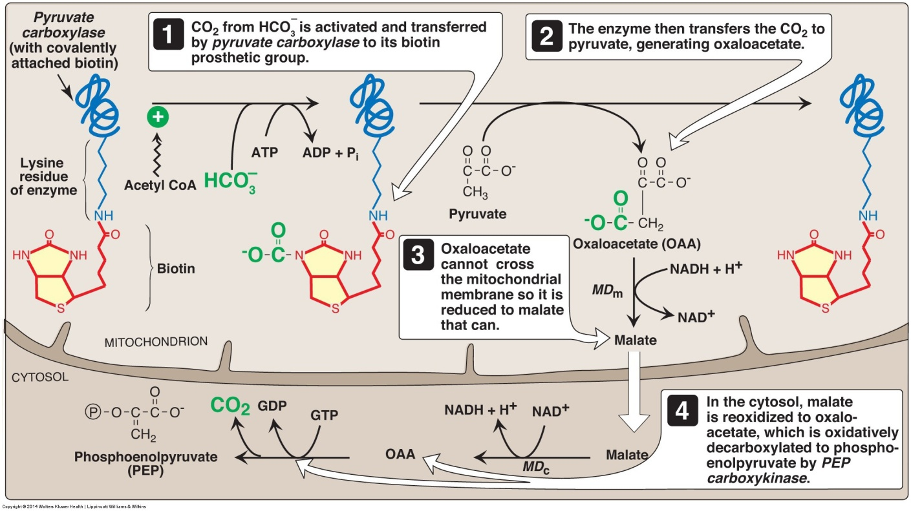
Pruvate Carboxylase and PEP-CK
Fasting:
Acetyl CoA
(From FAO)*
*Fatty
Acid
Oxidation
Pyruvate carboxylase + PEP-CK = Pyruvate kinase

Slide 13
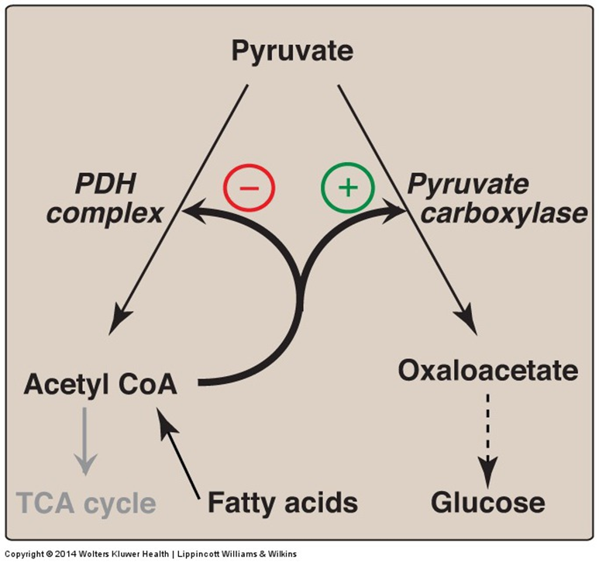
Regulation of Pruvate Carboxylase reaction
Acetyl CoA diverts pyruvate away from oxidation and toward gluconeogenesis

Slide 14
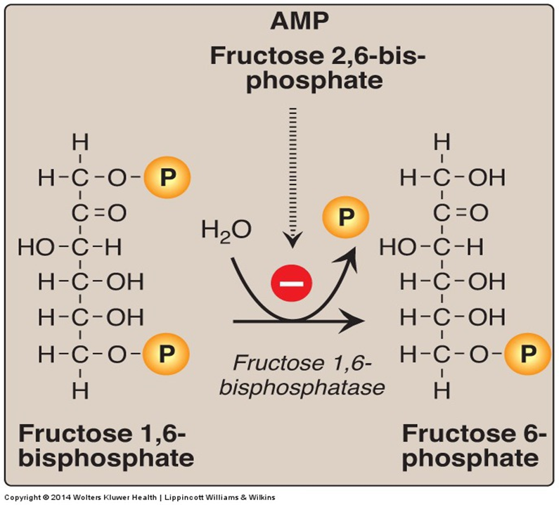
Fructose 1,6-Bisphosphatase
Dephosphorylation of fructose 1,6-bisphosphate.
Fructose 1,6-bisphosphatase = PFK-1

Slide 15
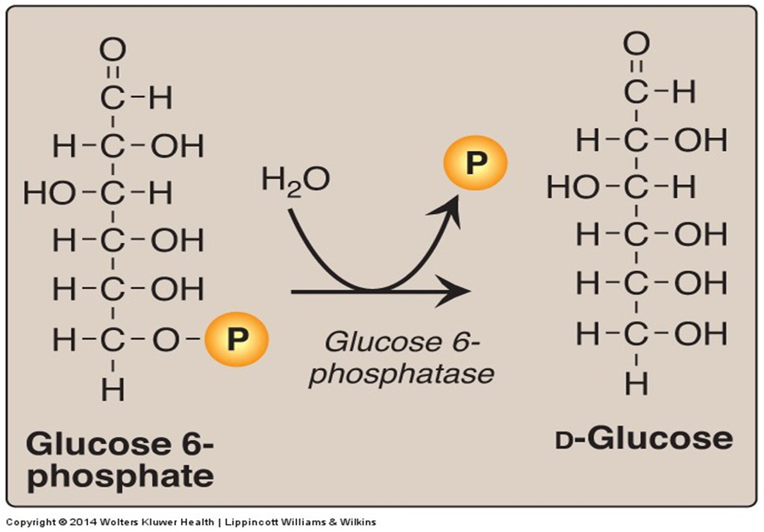
Glucose 6-Phosphatase
Dephosphorylation of glucose 6-phosphate allows release of free glucose from the liver and kidney into blood
Glucose 6-phosphatase = Glucokinase

Slide 16
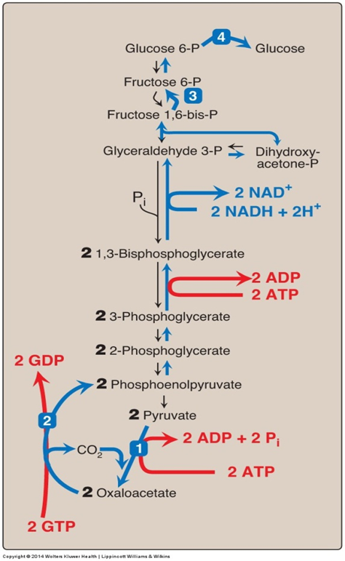
Gluconeogensis:
Energy- Consumed
Six High-Energy Phosphate Bonds From Pyruvate to
Glucose

Slide 17
Gluconeogenesis: Regulation
Reciprocal control
Gluconeogenesis & Glycolysis
Allosteric:
Acetyl CoA Pyruvate carboxylase
AMP or ATP
F 2,6-Bisphosphate
Glucagon ( I/G ratio) stimulates gluconeogenesis
-Allosteric ( F 2,6-Bisphosphate)
- Induction (PEP-CK)
+
-
+
F 1,6-bisphosphatase
-

Slide 18
Take Home Message
Gluconeogenesis:
Synthesis of glucose from noncarbohydrates
Anabolic
Energy-consuming
4 Unique enzymes are required for
reversal of the 3 irreversible reactions
of glycolysis
Both gluconeogenesis & glycolysis are
reciprocally-regulated

