Slide 2
Lipid Compounds of Physiological Significance
By
Reem Sallam, MD, PhD

Slide 3
Objectives
By the end of this lecture, students are expected to:
recognize various functions of lipid compounds
relate lipid metabolism to specific clinical problems
identify examples of lipid compounds of physiological importance
recognize examples of complex lipids, such as:
Phospholipids
Glycolipids
Lipoproteins

Slide 4
Functions of lipid compounds
Major energy source for the body
Structural component of cell membranes
Important regulatory molecules; examples:
Fat-soluble vitamins
Steroid hormones
Prostaglandins
Signaling molecules; e.g. Inositol triphosphate (IP3)

Slide 5
Lipids and Related Clinical Problems
Obesity
Atherosclerosis
Hypertension
Coronary heart diseases

Slide 6
Lipid Compounds
Heterogeneous group
Relatively water-insoluble (Ketone bodies are the exception)
Soluble in non-polar solvents

Slide 7
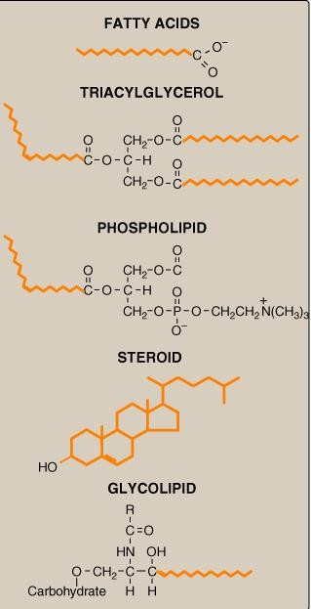
1. Simple Lipids:
Fatty acids
Ketone bodies
Triacylglycerol
Cholesterol
Complex Lipids:
Phospholipids
Lipoproteins
Glycolipids
Lipid Compounds:
Heterogeneous Group

Slide 8
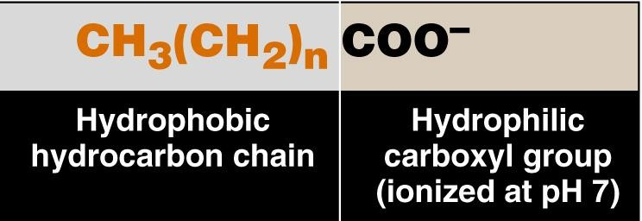
Fatty Acids
Amphipathic: Both hydrophobic & hydrophilic parts

Slide 9
Fatty Acids
Chain length:
o Short-chain & Medium-Chain e.g. Fatty
acids in milk
o Long-Chain e.g. Palmitic acid 16:0
o Very long-chain e.g. Nervonic acid 24:1
Degree of saturation:
o Saturated: No double bonds
o Unsaturated:
o Mono- or poly-unsaturated
o Cis- or trans-form of double bond
Essential fatty acids

Slide 10
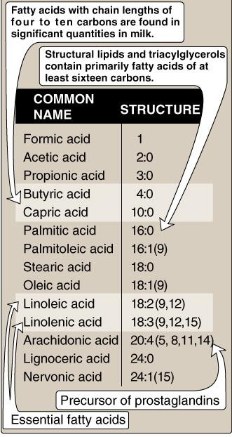
Fatty Acids

Slide 11
Essential Fatty Acids
Linoleic acid, 18:2 (the precursor of arachidonic acid)
Linolenic acid, 18:3
3. The precursor of prostaglandins, Arachidonic acid 20:4, is also considered essential fatty acid if linoleic acid is deficient from diet

Slide 12
Plasma Fatty Acids
Esterified form (~90%):
In triacylglycerol, cholesterol ester, phospholipids (as part of lipoproteins)
Free-form (unesterified) = Free Fatty Acids (FFA):
Transported in association with albumin

Slide 13
Triacylglycerols (TG)
Storage form of lipids in adipose tissue
Constitute ~ 90% of dietary lipids
Composed of glycerol plus 3 fatty acids
Transported in blood: in chylomicrons & in very low density lipoprotein (VLDL)

Slide 14
Ketone Bodies | 1. Water-soluble lipids
_{Acetone} 2. Increase in Diabetic _{Acetoacetate} Ketoacidosis (DKA) β-Hydroxybutyrate

Slide 15
Phospholipids
Glycerophospholipids
Glycerol-containing phospholipids
Phosphatidylcholine (Lecithin)
e.g., Surfactant (Dipalmitoylecithin)
2. Phosphatidyl inositol (signaling molecule)
B. Sphingo-phospholipids:
Sphingosine-containing phospholipids:
e.g., sphingomyelin (Myelin sheath)
(To be discussed with CNS Block)

Slide 16
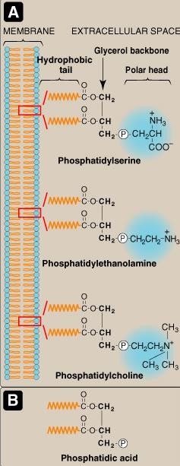
Phospholipids:
A. Glycerophospholipids
e.g. of members:
1. Phosphatidylcholine (Lecithin)
e.g., Surfactant
(Dipalmitoyl lecithin)
Parent Compound Phosphatidic acid

Slide 17
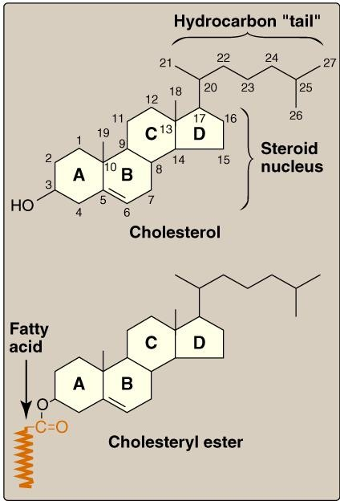
Cholesterol: Structure

Slide 18
Overview and Functions of Cholesterol
Major Sterol of animal tissues
Component of cell membranes
Precursor for:
Bile acids & salts
Vitamin D
Steroid hormones: Mineralocorticoids Glucocorticoids Sex hormones
e.g., Aldosterone
e.g., Cortisol
e.g., Testosterone
Estrogen & progesterone
Abnormally high level in blood (Hypercholesterolemia): Associated with Atherosclerosis & Coronary Artery Disease (CAD)

Slide 19
Lipoprotein Structure
Protein part: Apoproteins or apolipoproteins
Abbreviations: Apo-A, B, C
Functions:
Structural and transport function Enzymatic function
Ligands for receptors
Lipid part:
According to the type of lipoproteins
Different lipid components in various combinations

Slide 20
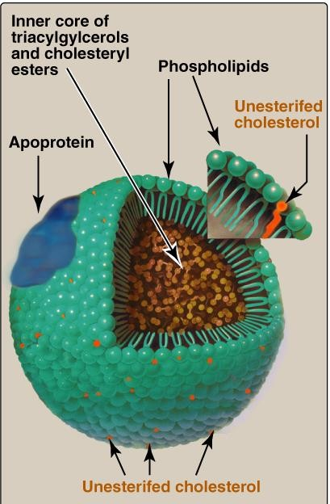
Lipoprotein Structure

Slide 21
Chylomicrons
Very low density
Lipoprotein (VLDL)
Low density
Lipoprotein (LDL)
High density
Lipoprotein (HDL)
Composition of Lipoproteins

Slide 22
Ultracentrifugation of
Lipoproteins

Slide 23
Plasma Lipoproteins
Transport of Triacylglycerol (TG):
Chylomicrons: VLDL:
TG of dietary origin
TG of endogenous synthesis
Transport of Cholesterol :
LDL:
HDL:
Mainly free cholesterol
Mainly esterified cholesterol

Slide 24
Take Home Message
➢Lipids are heterogeneous group of compounds
➢Lipids are relatively water-insoluble
➢Simple lipids:
Fatty Acid, TG, Ketone bodies, Cholesterol
➢Complex lipids:
e.g., Phospholipids, Lipoproteins
➢Lipids have important physiological functions
➢Lipid disorders are the basis for common human
diseases, namely obesity and atherosclerosis

