Slide 1




Dr. Rana Hasanato Associate Professor
Consultant, Head of Clinical Chemistry , Toxicology, POCT
King Saud Medical College and Medical Laboratories

Slide 2
The students should be able to understand &
become familiar with:
General safety rules followed in Biochemistry laboratory
Safety with laboratory equipments
Basic emergency procedures
Biological safety and waste disposal
The basics of spectrophotometer and general equipments to be used in the lab during Biochemistry practical sessions

Slide 4
Lab safety is everyone’s responsibility
Lab safety policy and procedures must be strictly followed

Slide 5


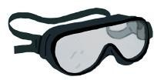
Always use appropriate clothes and personal protective tools (Lab coat, safety goggles, masks, gloves, no open shoes, no eye lenses)

Slide 6




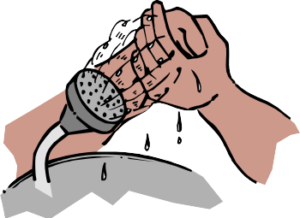
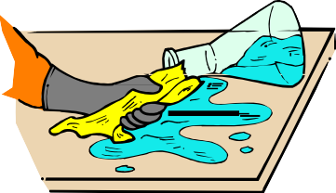
After handling chemicals, always wash your
hands with soap and water.
During lab work, keep your hands away from
your face.
Tie back long hair.

Slide 7


Roll up loose sleeves.
Know the location of the fire extinguisher, fire blanket, eyewash station, and first aid kit.
Keep your work area uncluttered. Take to the
lab station only what is necessary.

Slide 8




It is suggested that you wear
glasses rather than contact lenses.
Never eat or drink during a lab work.

Slide 9




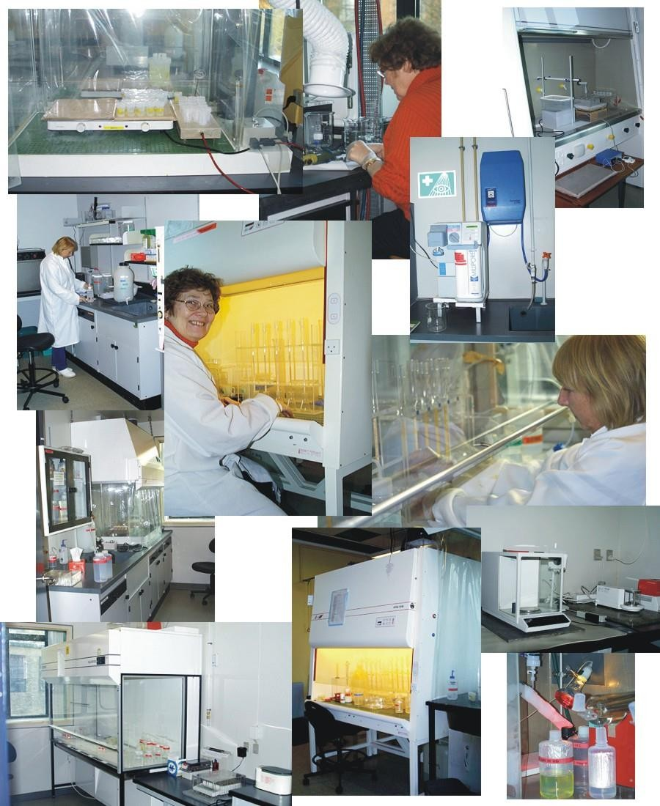
Never use any laboratory equipment unless you are trained & have been authorised to do so
As well as injuring yourself you may cause very costly damage

Slide 10







Lay electrical cords where no one can trip on them.
Be sure your hands and your lab area are dry before using electrical equipment.
Unplug cords by pulling the plug and not the
cord.

Slide 11



Slide 12

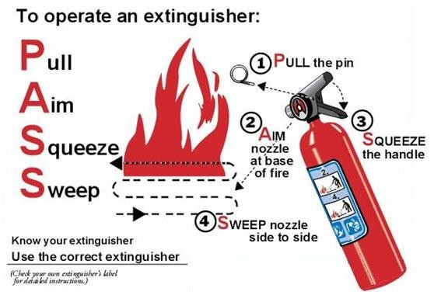

Slide 13


All biological samples are considered
potentially infectious
Should be handled and processed using
strict precautions

Slide 14


For disposal of contaminated waste, use
containers with yellow plastic bags
Regular waste like papers etc go into
containers with black/white plastic bags
All sharp objects such as needles, scalpels and even broken glassware go into yellow- red sharps container

Slide 15


Slide 16

Routine Biochemistry/ STAT Bench
Lab
Endocrinology Lab
Inherited Metabolic Lab
Toxicology Lab
Newborn Screening Lab
Receiving Bench

Slide 17
Cardiac Profile
S. Creatinine
kinase
S. Lactate
dehydrogenase
S. Troponin

Slide 18
Blood urea
Renal Profile
S. Creatinine
S. Electrolytes
(Na, K & Cl)
S. Total proteins
S. Albumin
S. Alanine & Aspartate Aminotransferases(ALT & AST)
Hepatic Profile

Slide 19
S. Triglycerides
Lipid Profile
S. Cholesterol
S. HDL-Cholesterol
S. LDL-Cholesterol
Bone Profile
S. Calcium
S. Phosphorous
S. alkaline Phosphatase
S. Vitamin D

Slide 20
S. Fasting glucose
Glucose (Diabetic) Profile
S. 2 Hours postprandial glucose
S. Random glucose
Glycosylated
hemoglobin

Slide 21
Biochemical laboratory tests are crucial tools
for diagnosis of many human diseases:
Kidney diseases e.g., nephrotic syndrome Liver diseases e.g., hepatitis and jaundice Metabolic diseases e.g., diabetes mellitus Endocrine diseases e.g., Thyrotoxicosis Cancers & malignancy e.g., prostate cancer Inherited diseases e.g., PKU

Slide 22

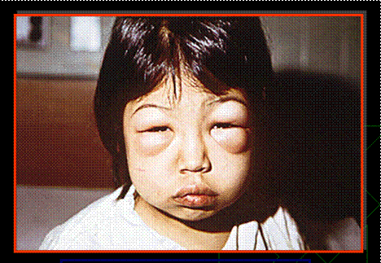

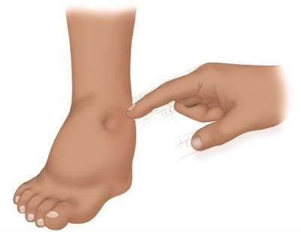

Slide 23


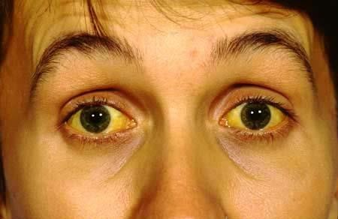

Slide 24




Slide 25

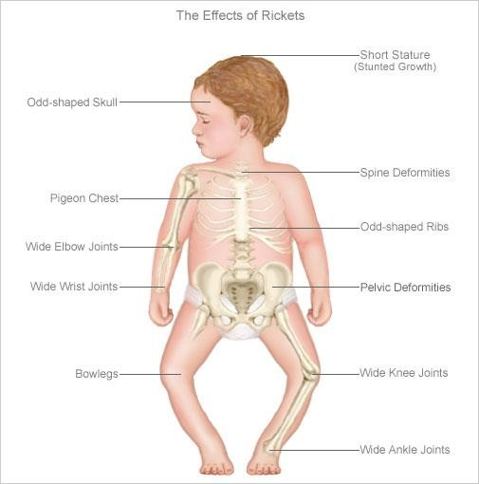
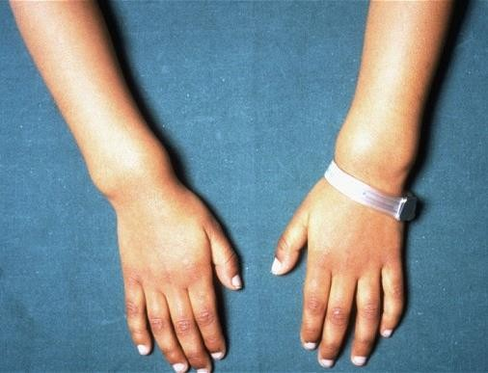

Slide 26
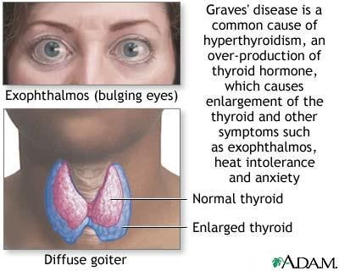
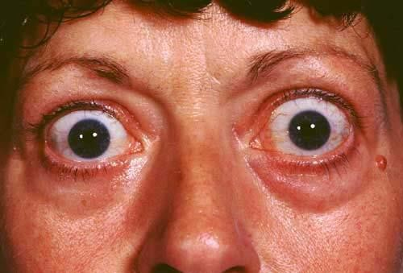
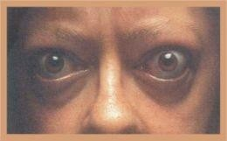

Slide 27
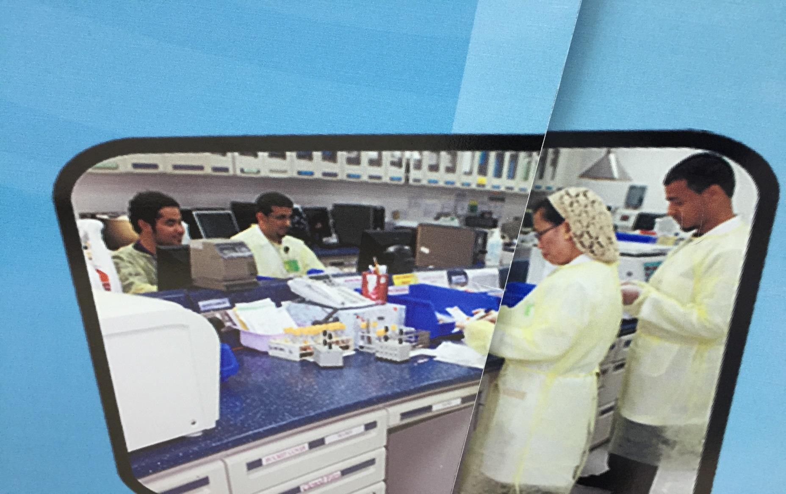

Slide 28
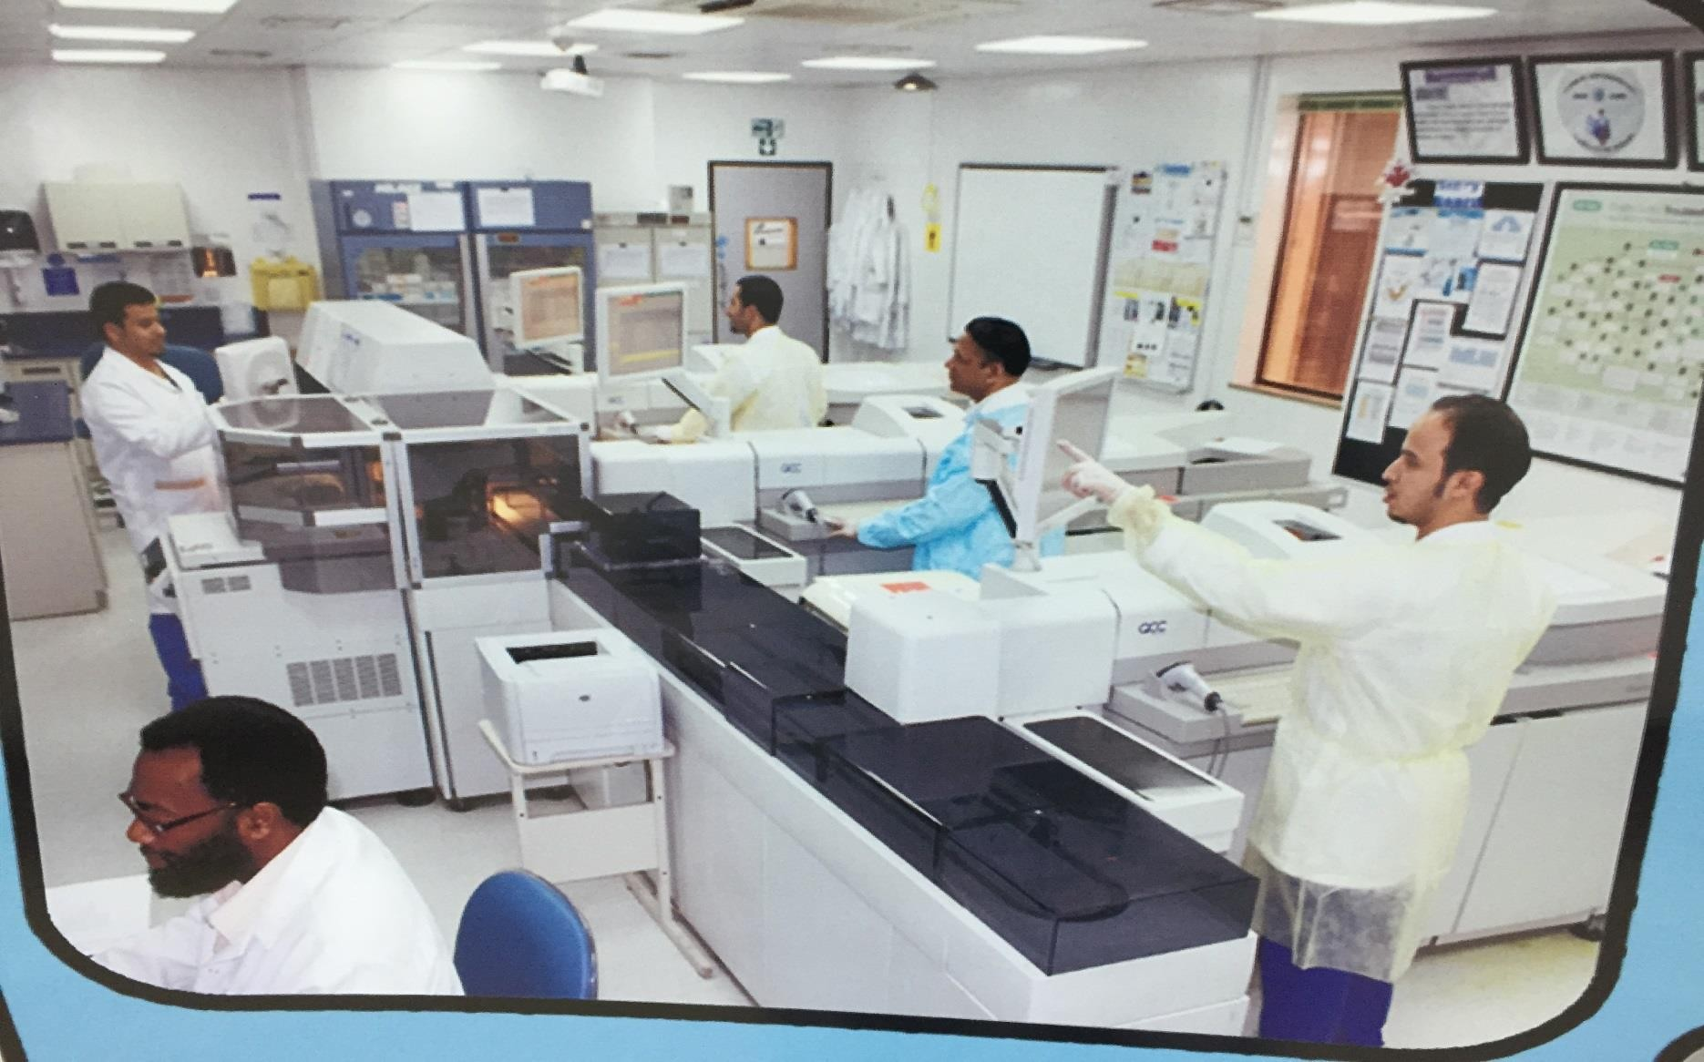

Slide 29
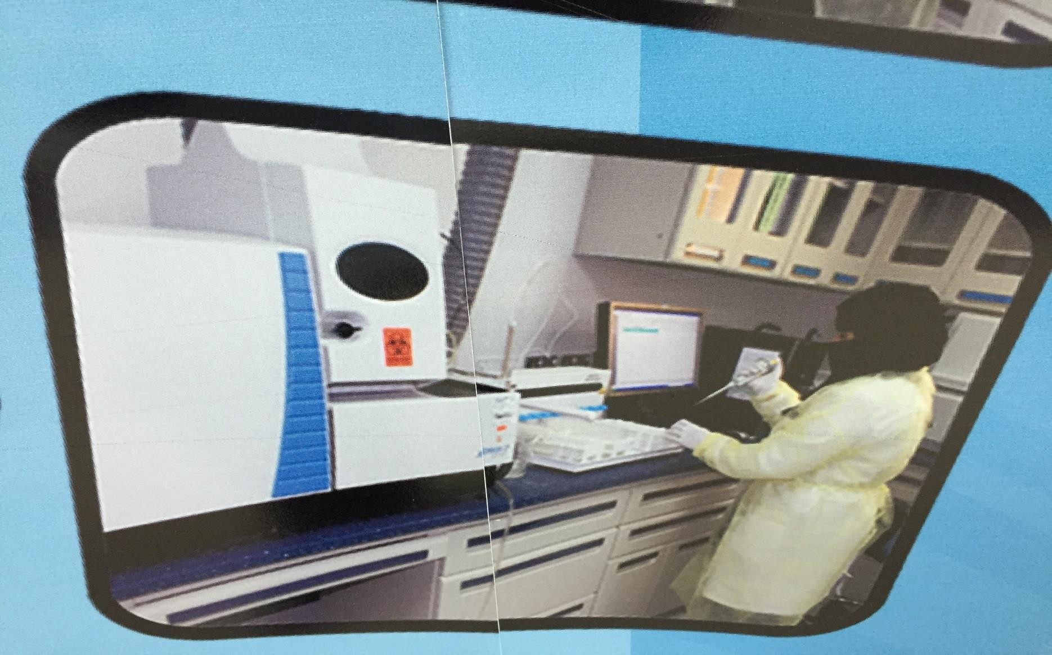

Slide 30
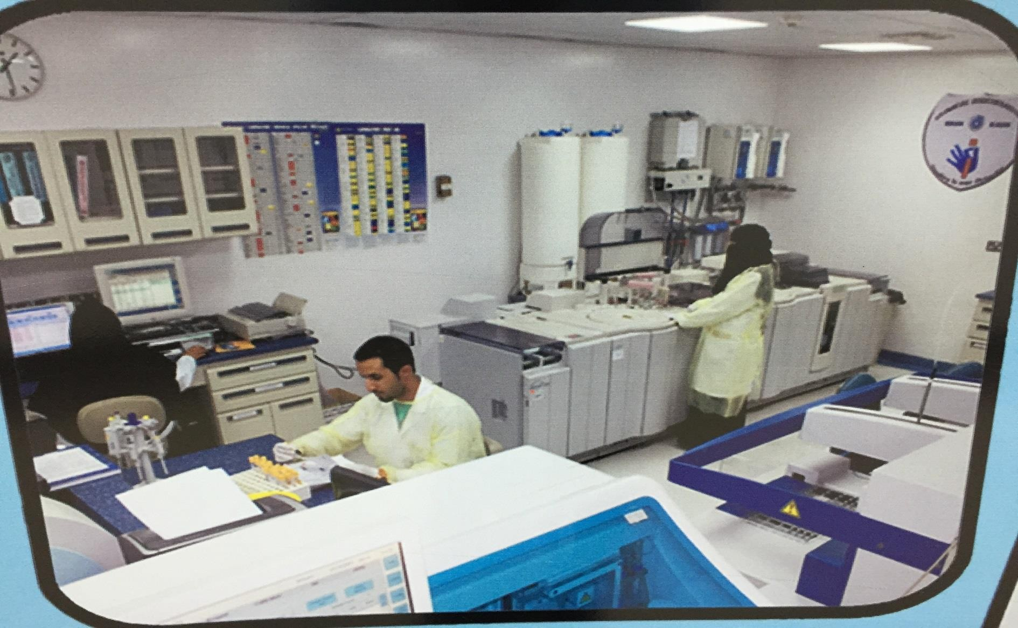

Slide 31

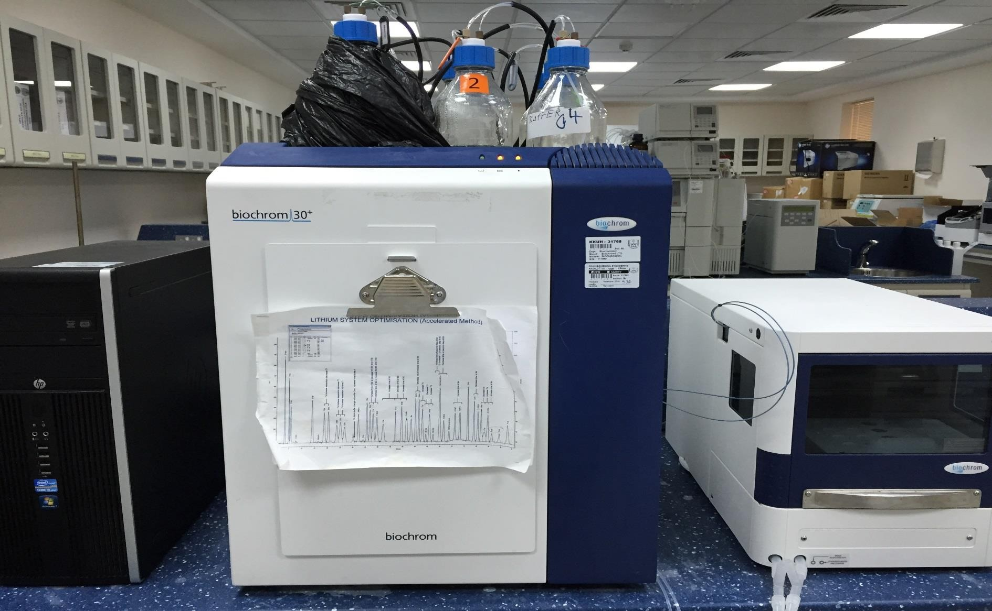

Slide 32
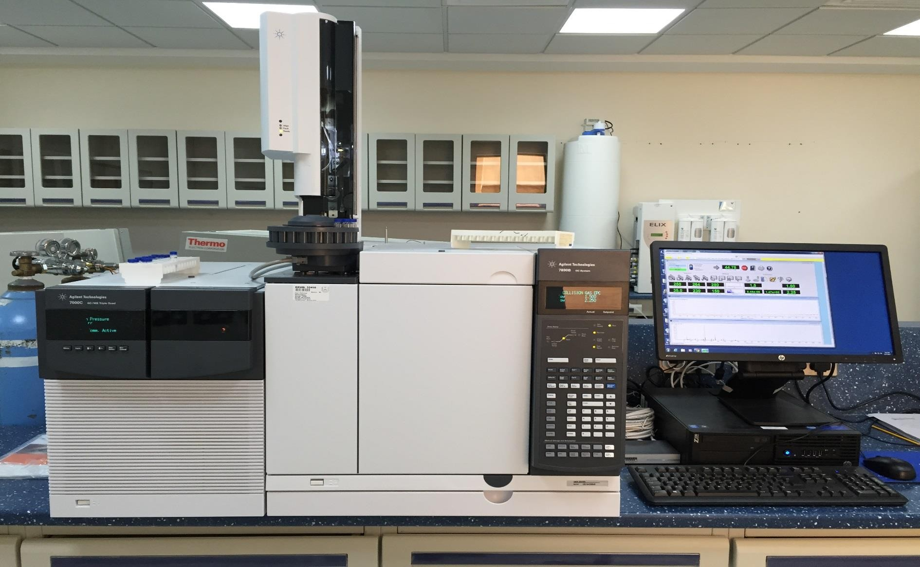

Slide 34

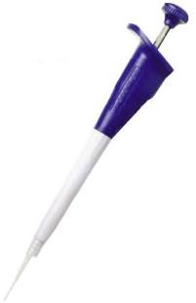
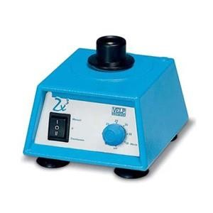
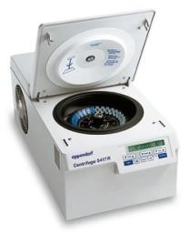
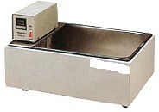
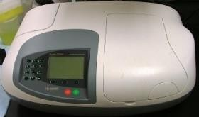
Automatic pipettes
Vortex
Microcentrifuge
Water bath
UV-spectrophotometer

Slide 35

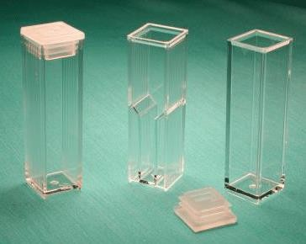
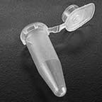
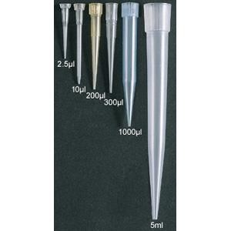
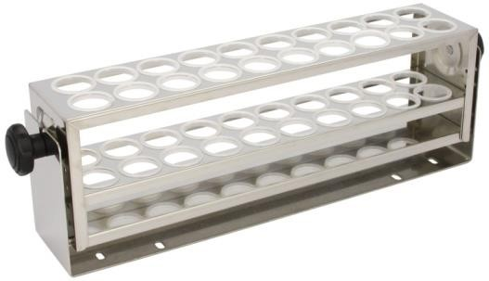
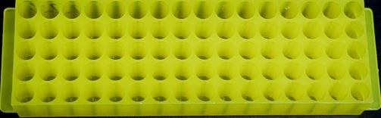
Cuvettes
Eppendorf tube
Tips
Rack- test tube
Rack- eppendorf tube

Slide 36
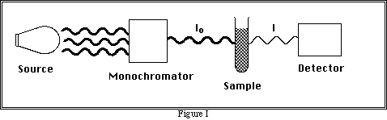
Most of visible spectrophotometers are
composed of:
Light source which works with visible
wavelengths (400-700 nm)
Monochromator filter for choosing desired wavelength
Sample holder (cuvette)
Detector
Meter or recorder

Slide 37

