Slide 1
Introduction to Immunology
&
Lymphoid system
Dr.Amany Ballow
Consultant Immunology
Assistant professor KKUH
General Lab Director MDLAB
PhD, Diploma BSHI,MSC.

Slide 2
Objectives
To know the historical perspective of immunology
To be familiar with the basic terminology and definitions of immunology
Cells of immune response
To understand types of immune responses
To know about the lymphoid system
To understand T and B cell functions

Slide 3
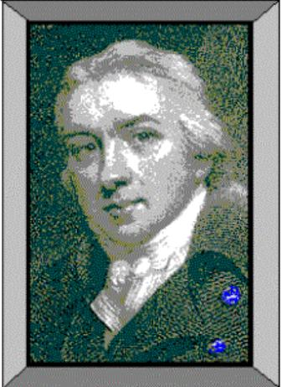
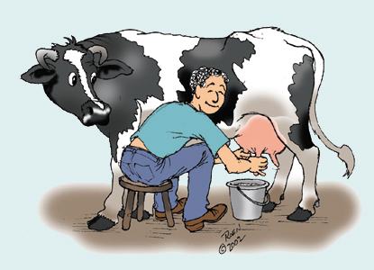
1798 Edward Jenner
Observation:
Milkmaids who contracted cowpox (a mild disease)
were subsequently immune
to small pox

Slide 4
1798 Edward Jenner
Profound results:
(1) Jenner’s technique of inoculating with
cowpox to protect against small pox
spread quickly throughout Europe.
(2) Began the science of Immunology,
the study of the body’s response
to foreign substances.

Slide 5
Louis Pasteur’s Contributions
Determined through studies of cholera in chickens that the virulence of a pathogen weakens with age
  Attenuated – weakened, non-virulent strain whose exposure can confer resistance to disease
Classical experiment
  Heat attenuated anthrax bacillus and subsequent challenge with virulent Bacillus anthracis in sheep

Slide 6
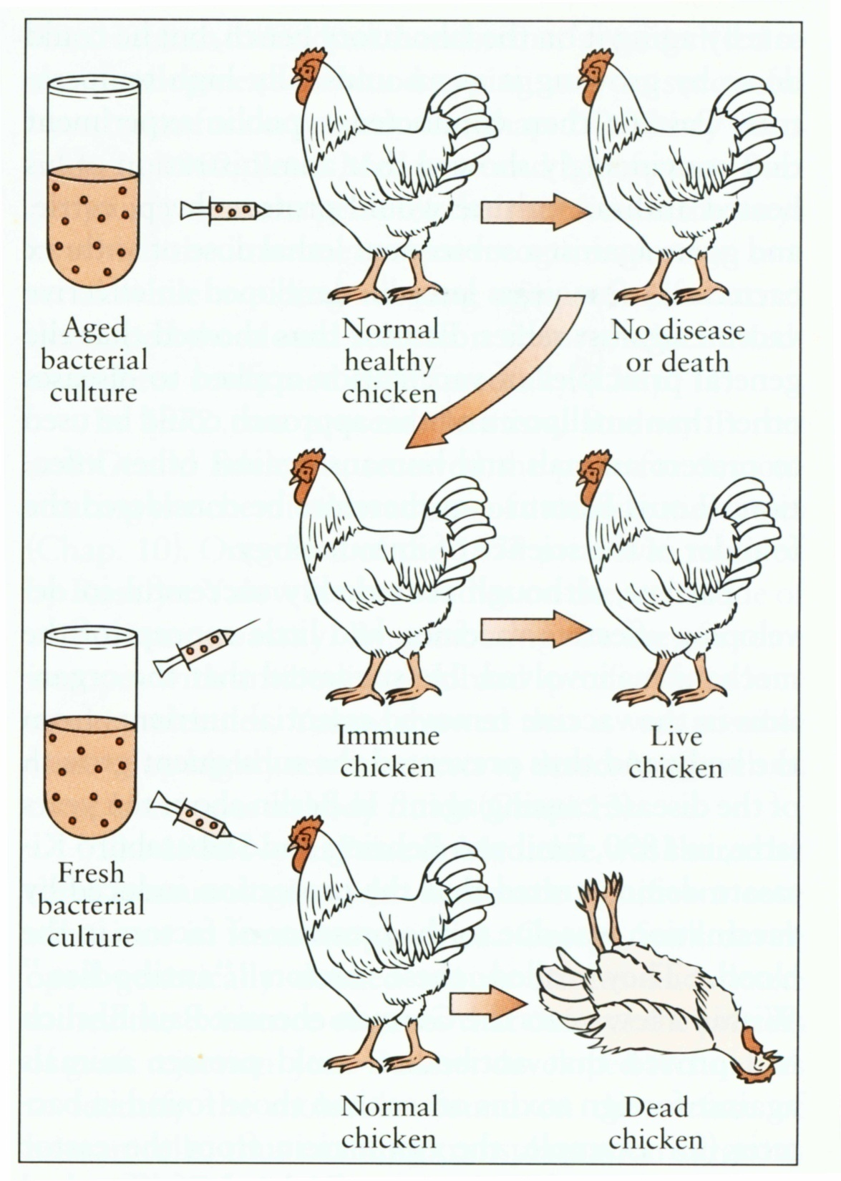
Louis Pasteur
Observation:
Cholera

Slide 7
Definitions
Antigen (Ag):
Any substance (usually foreign) that binds specifically to a component of adaptive immunity.
Allergen:
Noninfectious antigens that induce hypersensitivity reactions, most commonly IgE-mediated type I reactions.
Immunoglobulin (Ig) or Antibodies:
Secreted from plasma cell.
Consists of a heavy or light polypeptide chain.

Slide 8
Where & what are antigens?
Microorganisms & their related products
(proteins, polysaccharides, lipids)
Environmental substances
Drugs
Organs, tissues, cells

Slide 9
Introduction to Immunology
Immune
(Latin- “immunus”)
To be free, exempt
People survived ravages of epidemic diseases when faced with the same disease again
Immunology
The study of mechanisms that humans and other animals use to defend their bodies from invading organisms such as bacteria, viruses, fungi, parasites toxins

Slide 10
Introduction to Immunology
Immunity
refers to protection against infection.
Immune system
is the collection of cells, tissues and molecules that functions to defend us against infectious microbes (bacteria, Virus , parasite Fungus).
Immune response
The reaction of the immune system against foreign substances.

Slide 11
Immune system abnormalities
Defective in immune responses make individuals:
susceptible to infections by Antigen like virus, bacteria, fungi and parasite.
Hypersensitivity due to exposure to Allergen
Allergen :non-infectious antigens that induce hypersensitivity reactions,
most commonly IgE-mediated type I reactions
Autoimmune disease
Transplant rejection
Immune deficiency

Slide 12
Types of Immune response
Innate Immunity
Adaptive Immunity
The cells of innate and adaptive immunity are recruited to sites of infection and injury, and activated to get rid of the infectious agents and dead tissues. This process, called inflammation

Slide 14
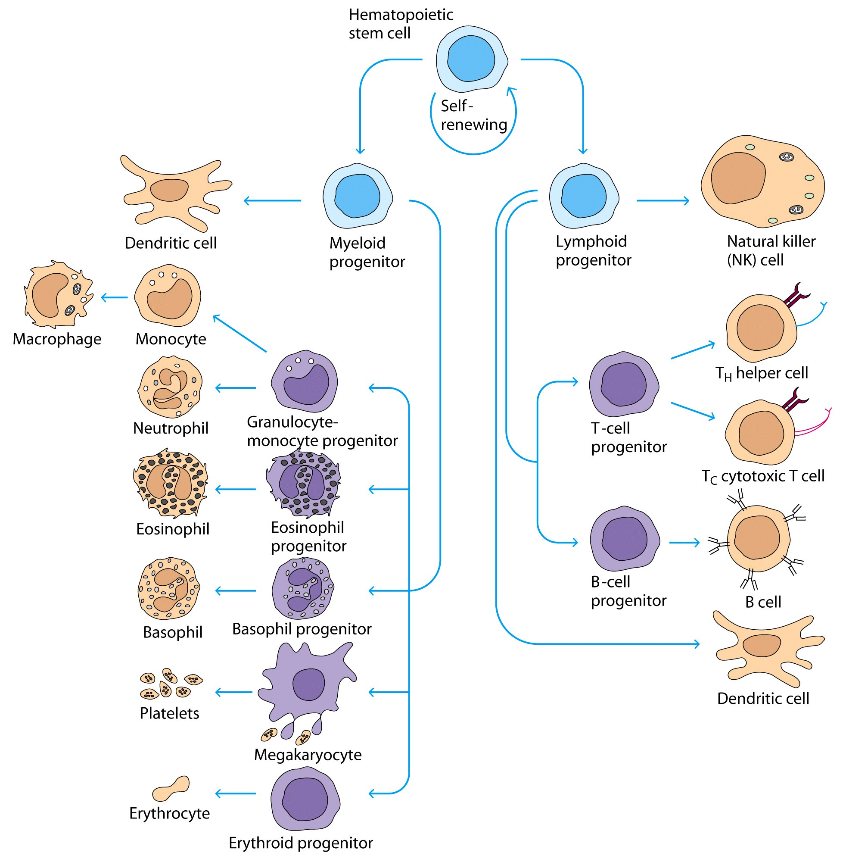

Slide 15
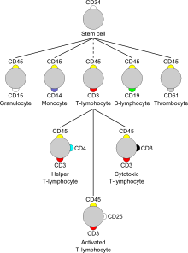
Cellular Markers (CD)

Slide 16
(CD) Cluster of Differentiation
molecule with a CD designation has a characteristic cell surface protein are often associated with the cell’s function.

Slide 17
Innate Immunity
Mediated by cells and proteins that fight against microbes
There are four major components of innate immunity:
Epithelial barriers of the skin, GI tract and respiratory tract, which prevent microbe entry (and have to be breached for a microbe to establish infection, e.g. by cuts and burns)
2. Phagocytic leukocytes (neutrophils and macrophages)
3. Natural killer (NK) cell
4. complement system

Slide 18
Phagocytic leukocytes (Neutrophils & Macrophages)
Neutrophils:
Neutrophils respond rapidly to foreign stimuli and to injury; their reaction is part of acute inflammation.
Macrophages:
When blood monocytes enter tissues, they mature, and are called macrophages. These cells are present under epithelia, connective tissues, and in all organs. this reaction is typical of chronic inflammation.
Macrophages also help to repair damaged tissue

Slide 19
Natural killer cell
Specialized in identifying cells that are infected by a Virus or that have become tumor cell.
They do this by looking for changes in cell surfaces. If natural killer cells find cells with a changed surface, they dissolve them using cytotoxins.

Slide 20
Complement system
The complement system consists of about 20 proteins in normal human serum.
Synthesized mainly in the liver.
Heat labile i.e. it is inactivated at 56ºC for 30 minutes.

Slide 21
Complement function
Chemotaxis
Attract other immune cells from the blood such as macrophages and neutrophils .
Cell lysis
dissolve the cell walls of bacteria which lead to lose fluid, minerals and die.
Fight viruses directly by destroying the virus envelopes, or indirectly by destroying cells infected by viruses
Opsonization
enhancing phagocytosis of antigens
Agglutination
clustering and binding of pathogens together

Slide 22
Adaptive Immunity
Consist of highly specialized cells which has the ability to destroy invading pathogen and toxic molecule .
Includes both humoral immunity and cell-mediated immunity.
highly specific to a specific pathogen
Mediated by T and B lymphocytes following exposure to specific antigen, and characterized by immunological memory
Antigen is any substance that elicit the adaptive immune response.
B- lymphocyte secrets antibodies
T- Lymphocyte secrets cytokines

Slide 23
Adaptive Immunity
Two types:
Humoral Immunity
cellular Immunity

Slide 24
Humoral Immunity
The humoral immune response begins with the recognition of antigens by naïve B cells.
These cells then undergo a process of clonal expansion and differentiation.
The B cell matures into antibody secreting plasma cells, which secrete antibodies.
Antibodies are the effector products of humoral immunity.
As this response declines, a pool of memory cells remains behind.
If the body is re-exposed to the antigen, these memory B- cells will recognize the antigen and respond much more quickly and effectively.

Slide 25
Antibodies
Immunoglobulins (Ig) are grouped into 5 classes:
IgG
IgM
IgA
IgD
IgE
Ig are glycoproteins
They differ in size, amount of CHO and biologic functions after binding to specific antigens

Slide 26
Cellular Immunity
Naïve T cells and their effector products make up the second branch of the adaptive immune system
T cells types.
T-helper CD4
T-cytotoxic CD8
is called into action against pathogens that overcome innate immune defenses.
Components of the adaptive immune system are normally silent; however, when activated, these components “adapt” to the presence of infectious agents by activating, proliferating, and creating potent mechanisms for neutralizing or eliminating the microbes.

Slide 27
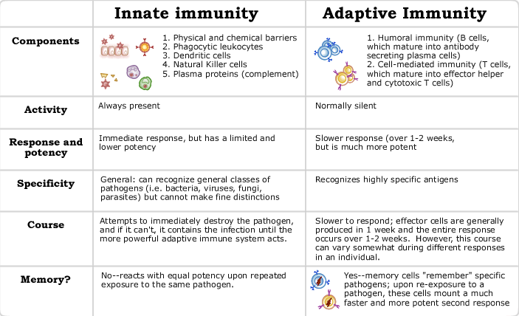

Slide 28
Sumarry
Principle cells of the Immune response
In a previous section, we organized various cell types as participating in innate or adaptive immunity.
Cells of Immune response are reorganized into three functional groups:
Lymphocytes
come from a distinct lineage of stem cells and are responsible for the adaptive response
2. Antigen presenting cells
are capable of bringing antigens to lymphocytes to initiate the adaptive response
3. Effector cells
actually do the killing of microbes once an adaptive response is underway.

Slide 29
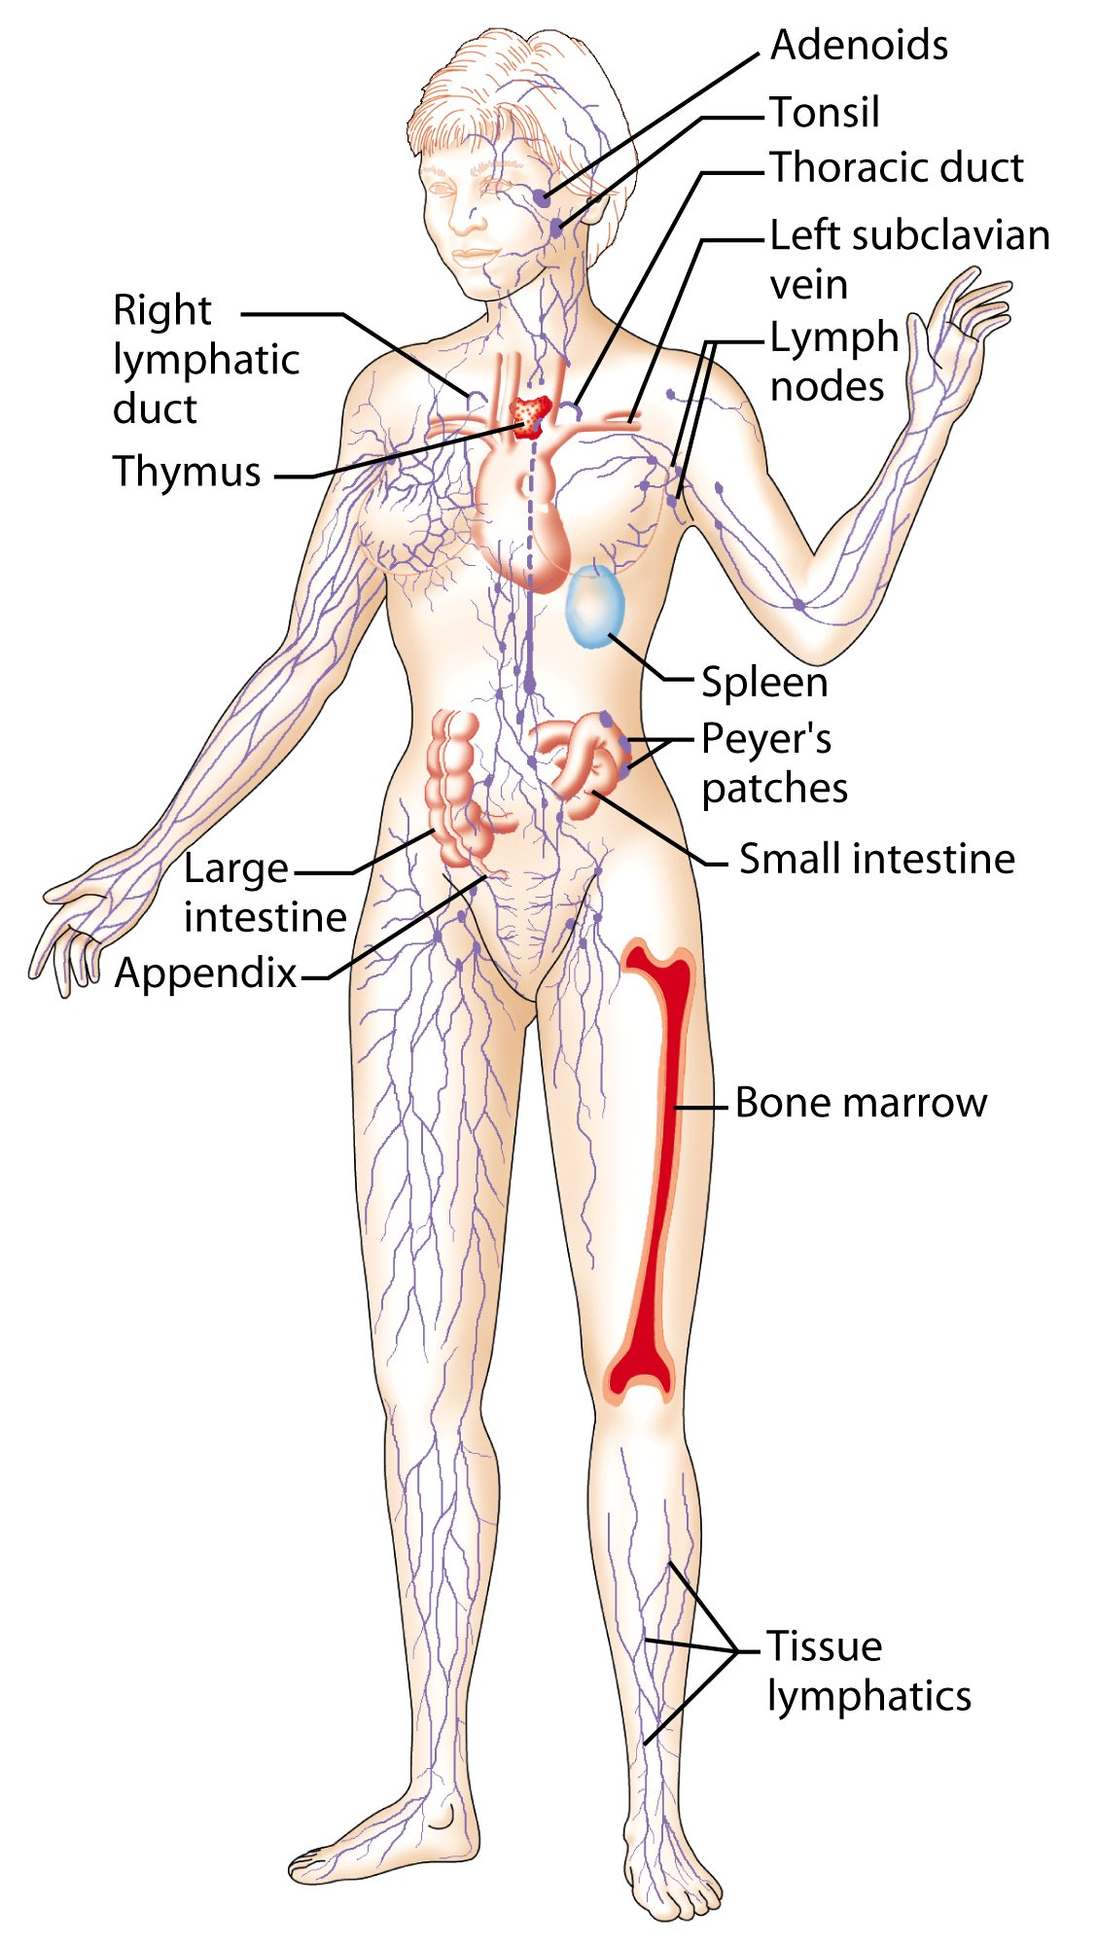
Lymphatic system
&
Immune system

Slide 30
Lymphatic System
Lymphatic system consists of :
lymphatic organs, lymphatic vessels, and the circulating lymph
Primary lymphoid organs
Thymus
Bone marrow
Secondary lymphatic tissues
Spleen
Tonsils
Lymph nodes
MALT (Mucosa Associated Lymphoid Tissue)
Peyer’s patches

Slide 31
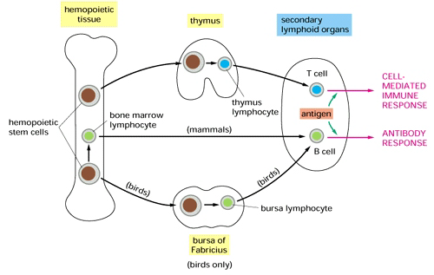
Primary Lymphoid Organs

Slide 32
Lymphoid cells
Lymphoid series comprise of two main lymphocyte populations
T cells & B cells

Slide 33
T-Lymphocyte Differentiation
Originate in Bone Marrow then migrate to Thymus for development.
T cell precursors differentiate into mature T cells in thymus.
Stem cells lack antigen receptors.
All T- Cells have CD3 as a cell marker.
T cell passage take place in thymus and differentiate into T cells expressing either markers (CD4 or CD8).
T-Helper cell CD3/CD4
T-Cytotoxic Cell CD3/CD8

Slide 34
T-Helper cells CD3/CD4
Two types:
T-Helper-1
T-Helper-2
Functions:
T-helper-1
  Help CD8 cells to become activated
  Help macrophages in cell mediated immunity during inflammatory
  response.
  T-helper-2
  Help B cells (CD20) to develop into antibody producing plasma cells

Slide 35
T-Cell Cytotoxic(CD3/CD8)
About 35% of peripheral blood T cells
Perform cytotoxic functions by killing:
virus-infected cells
Tumor
Allograft cells (transplant)

Slide 36
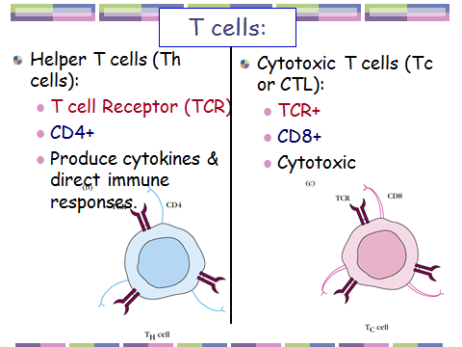

Slide 37
B Lymphocyte CD20 or CD19
Originate
  During embryogenesis – fetal liver
  Migrate to Bone Marrow – final destination
They do not require thymus for maturation

Slide 38
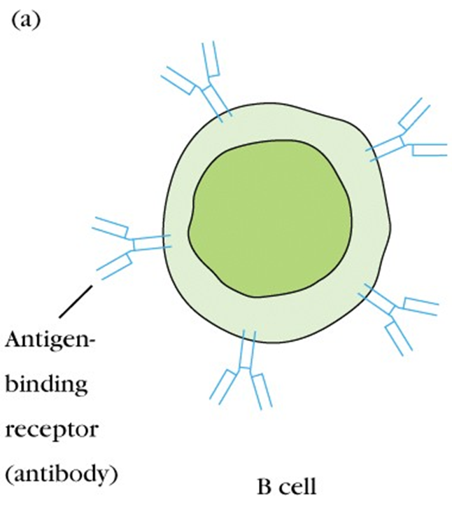
B-Lymphocyte CD20 or CD19
B cells display
surface IgM& IgD both serve as Ag
receptor
Pre B cells are found in Bone Marrow
Mature B cells are found circulating bloodstream

Slide 39
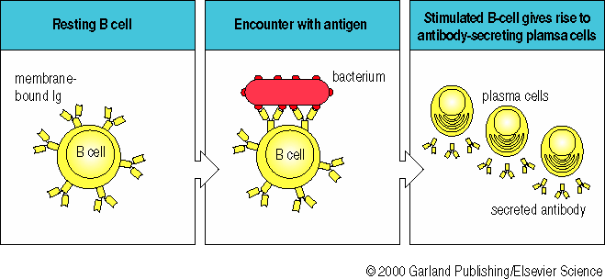
Antibodies

Slide 40
Antibodies
Immunoglobulins (Ig) are grouped into 5 classes:
IgG
IgM
IgA
IgD
IgE
Ig are glycoproteins
They differ in size, amount of CHO and biologic functions after binding to specific antigens

Slide 41
Summary
Normal healthy state is maintained by intact immune response either innate (natural immunity) or adaptive (acquired immunity after exposure to antigens)
Cell mediated immunity and humoral immunity is mediated by T and B lymphocytes respectively
Lymphoid system provides suitable environment for development, maturation and proper functioning of cells of immune system

Slide 42
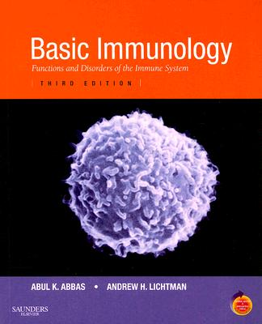
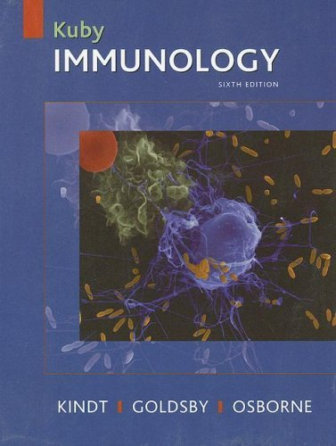
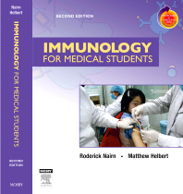
Suggested readings
Immunology for medical students. Nairn &Helbert
Immunology. Kuby
Basic Immunology . Abul Abbas

Slide 43
Thanks

