Slide 1
Natural Defense Mechanisms
Dr. Amany Ballow
Consultant Immunology
Assistant professor KKUH
General Lab Director MDLAB
PhD, Diploma BSHI,MSC.

Slide 2
Objectives
1-First (non-specific immunity) and second (adaptive immunity) lines of defense
2-Complement activation provides protection by killing pathogens
3-Accumulation of inflammatory cells important for clearance of infection
4-Cytokines as mediators regulate inflammation

Slide 3
The main function of the immune system is to protect from infections

Slide 4
Non-specific and specific Immune response

Slide 5
First line of defense
Natural (Innate) Immunity
Physical (skin/ mucous membranes )
Mechanical (Coughing, sneezing, vomiting, action of cilia in trachea)
Biochemical barriers (antimicrobial peptides, lung secretions, mucus, saliva, tears)

Slide 6
Physical
Skin, impermeable to microbes.
Mucous membranes lining the gastrointestinal, genitourinary and respiratory tracts.
Mechanical :
Shedding of outer skin layers.
Coughing and sneezing.
Flushing of urine.
Vomiting.
Cilia in respiratory tract

Slide 7
Natural Innate Immunity
Biochemical barriers
Body secretions contain anti-bacterial substances e.g. saliva, tears and sweat.
Antimicrobial peptides (e.g., defensins, hepcidins)
Normal bacterial flora.
(Compete with pathogenic bacteria for nutrients)

Slide 8
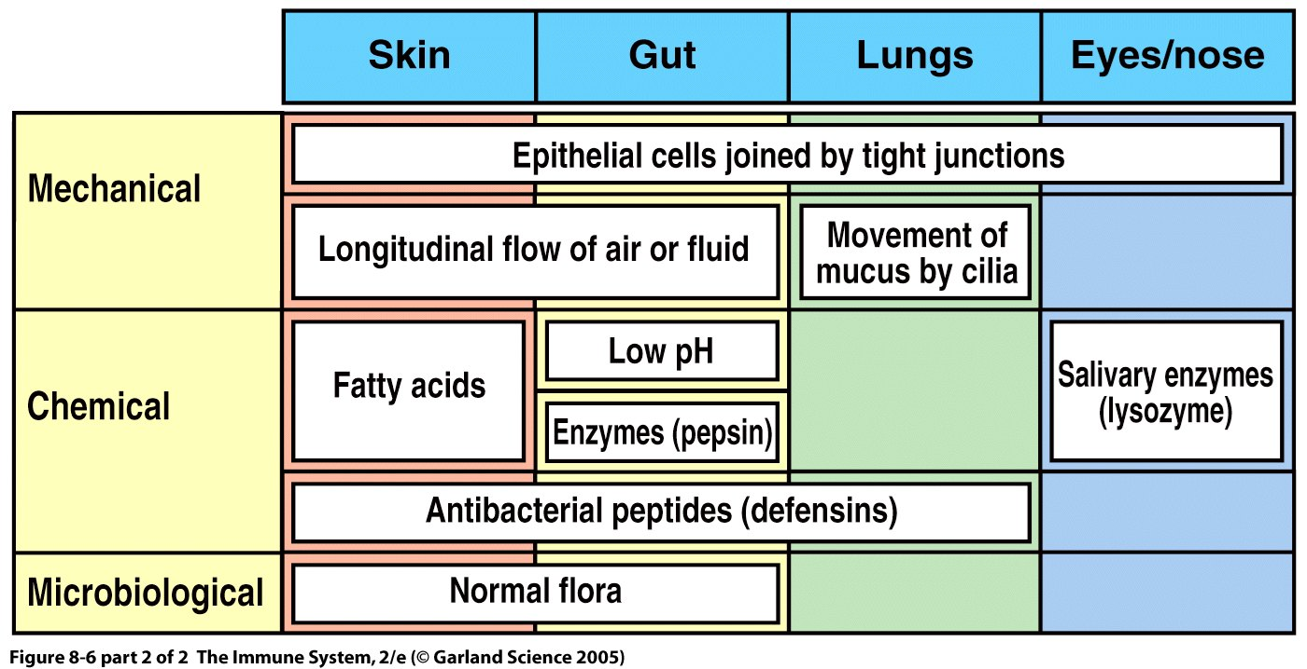
Physiological & chemical mediators

Slide 9
Inflammation
Inflammation is the first response of the immune system to infection or irritation
It consist of a series of vascular & cellular changes that occur in response to various stimuli e.g. infections, injury, radiation
Bacteria possess an array of pro-inflammatory molecules e.g Lipopolysaccharides (LPS)

Slide 10
Inflammation
Function
Prevent and limit infection and further damage
Interact with adaptive immune system
For example Monocytes / Macrophages serve as a link between the adaptive and innate immunity by antigen presenting cells
Prepare the area of injury for healing

Slide 11
Types of Cells attracted to site of infection that mediate inflammation
Monocytes :become macrophages when they leave the blood and enter the tissues.
Neutrophils: (Phagocytic cells)
Eosinophils: (Allergy and Parasitic infections)
Natural Killer cells NK: (Kill tumor cells and virus infected cells)

Slide 12
The Complement system
Consist of a group of serum proteins circulate in blood and tissue fluids in inactive form once they become activated they produce important biological effects that initiate inflammation
> 20 proteins
Many are pro-enzymes
This system plays an important role in Innate & Adaptive immunity.
Initially inactive they are sequentially activated in a cascade
Key protein is C3 which is activated by C3 convertase

Slide 13
The complement system
3 Pathways of activation :
1-Classical
(Requires antigen-antibody binding)
(C1,C4,C2,C3,C5,C6,C7,C8,C9)
2-Lectin
(Activated by mannan binding protein binding manose groups of bacterial carbohydrates)
(C4,C2,C3,C5,C6,C7,C8,C9)
3-Alternative
Activated by bacterial products
C3,C5,C6,C7,C8,C9

Slide 14
Complement

Slide 17
Biological effects of complement activation
1-Anaphylatoxin (C3a, C5a)
- Induce histamine release from mast cells.
- release chemotactic agents.
2-Opsonization: (opsonin, C3b )
- Coating of bacteria enhances phagocytosis
3-Cause direct cell lysis
- Destruction of bacteria.

Slide 18
Bacterial recognition by complement

Slide 19
1-Rolling on vessel wall. 2-Adhesion (attach) 3-Pass through.

Slide 20
Phagocytosis
1-Phagocytic cells (neutrophils & macrophages) at site of infection start the process of phagocytosis 2-The process by which a cell ingests and destroy foreign material

Slide 21
Phagocytosis

Slide 22
Cytokines
Soluble molecules, produced by different cells, that control cell functions e.g. activation or inhibition.
Small proteins (20-25kD) that are released by cells and induce their effects by binding to specific receptors.

Slide 23
Cytokines
Interleukins:
Produced primarily by macrophages and lymphocytes in response to a pathogen.
Many types
Examples:
IL-1, IL-2, IL-3…....
IL-1 inflammation (increases vascular permeability),fever, production of IL-6, local tissue destruction
IL-6 induces fever, acute phase proteins
IL-12 activates NK cells, CD4 T cells

Slide 24
Cytokines
Interferons:
Protects against viral infections
Produced and released by virally infected cells in response to viral infections

Slide 25
Cytokines
Tumor necrosis factor (TNF)
Secreted by macrophages.
Induces fever by acting as an endogenous pyrogen (a substance released from inside the body that produces fever)
Increases synthesis of inflammatory serum proteins

Slide 26
Cytokines
Chemokines:
Class of cytokines with chemoattractant properties
Recruit cells to sites of infection
Interact with specific receptors
Related in amino acid structure
Example: CXC and CC

Slide 27
Summary
Non-specific (innate immunity) acts as a first line of defense against invading pathogens
Innate immunity is an important initial step for generation adaptive immune response
Inflammation is vital for controlling infection and limiting tissue damage

Slide 28
Thank you

