Slide 1
Antibody-mediated Immunity
Dr. Amany Ballow
Consultant Immunology
Assistant professor KKUH
General Lab Director MDLAB
PhD, Diploma BSHI,MSC.

Slide 2
Objectives
To describe B-cells as the mediators of humoral immunity, (antibody-mediated immunity)
2. To describe activation of B-cells which involve:
-Antigen recognition
-T-dependent & T-independent antigens
- Requirement for T-helper cells
3. To explain clonal selection, clonal expansion &
generation of plasma cells & memory cells
4. To describe primary & secondary immune responses
5. To describe the structure & function of Immunoglobulins

Slide 3
Humoral Immunity
Humoral immunity is so named because it involves substances found in the humours or body fluids
The Humoral Immune Response is the aspect of immunity that is mediated by secreted antibodies

Slide 4
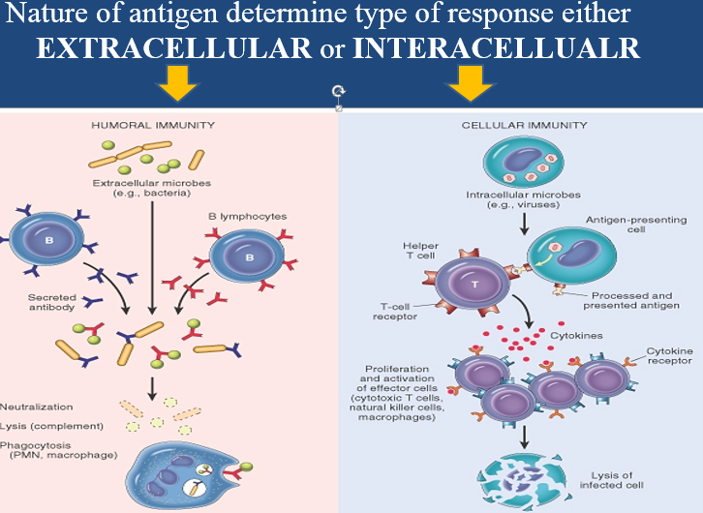

Slide 5
Activation of B cells by antigens
1-T-dependent
- Antibody production by B-cells require T-helper cells
- Macrophages recognize antigen & present it to T-helper cells
- T-helper cells stimulate B-cells specific for that antigen to become plasma cells
- T-dependent antigens are mainly proteins on viruses, bacteria & other foreign materials.

Slide 6
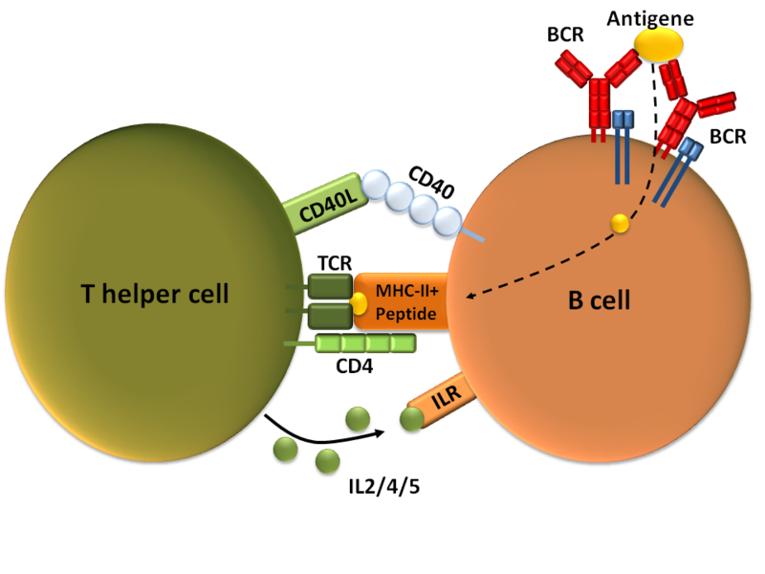

Slide 7
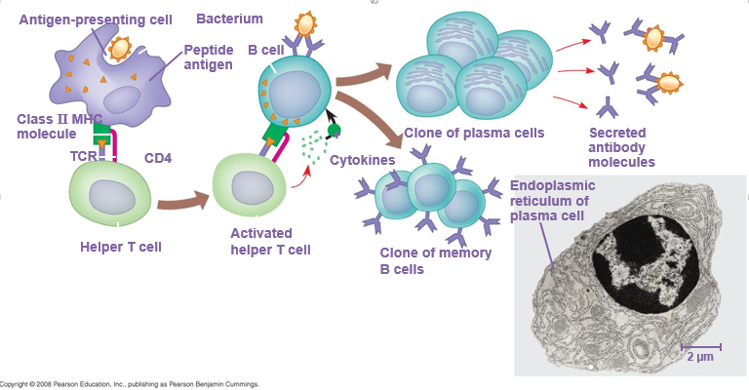

Slide 8
Clonal selection and clonal proliferation

Slide 9
Activation of B-cells by antigens
2-T-independent antigens
B-cells do not require T-helper cells to produce antibody.
Antigens are mainly polysaccharides or lipo-polysaccrides with repeating subunits example :bacterial capsule.
3. Immune responses are weak compared to T-dependent responses.

Slide 10
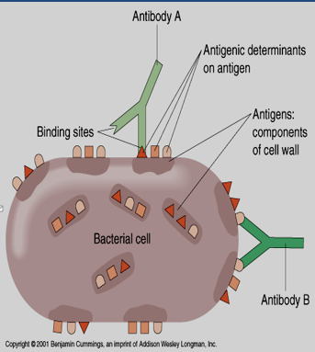
Antigens
Self” versus “non-self”
T cells and B cells removed if they recognize self proteins
Antigens are mostly proteins or polysaccharides
Antigenic determinants (epitopes)
Each bacterial cell has many different epitopes

Slide 11
Antibodies
Antibodies are immunoglobulins (Ig) with specific functions.
Antibodies are found in extracellular fluids (blood plasma, lymph, mucus, etc.) and the surface of B cells.
Antibodies bind to specific sites on antigen surfaces and perform protective functions by different mechanisms.
There is a specific antibody for each antigen stimulate the immune response.

Slide 12
Antibody function

Slide 13
Antibody structure and function
Made up of four polypeptides (amino acid chains).
Two longer and larger (heavy chains ) and the other two shorter and smaller (light chains)
Have the shape of a letter “Y”

Slide 14
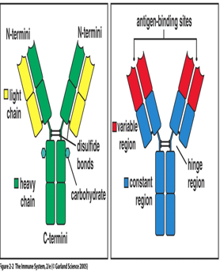
Variable region
has the potential to bind with particular classes of antigens. Once a raw antibody is stimulated to fit to a specific antigen, it can then react with ONLY that antigen .This is known as SINGLE SPECIFICITY
Can fit as precisely as a lock-and-key to an antigen.
Constant regions.
Fc region (stem) - can bind complement

Slide 15
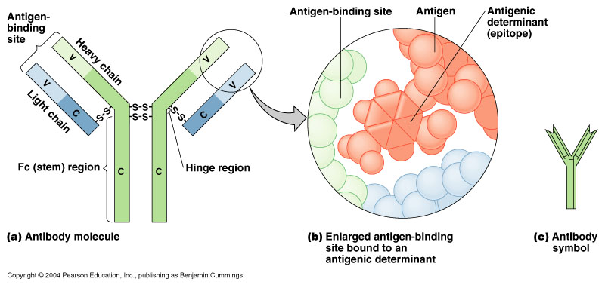

Slide 16
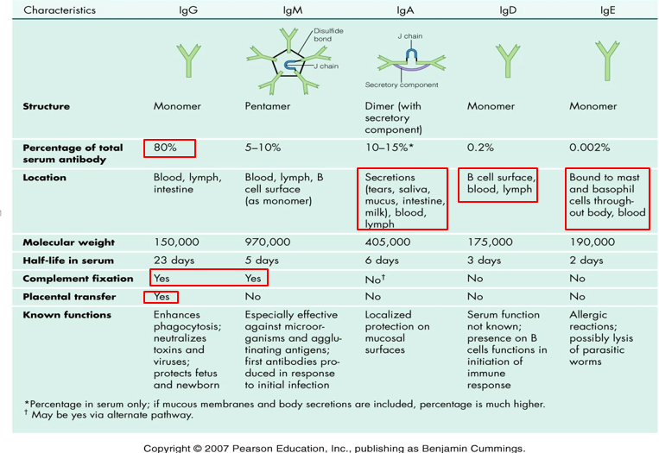

Slide 17
Antibody dependent cell-mediated cytotoxicity
Antibodies coat infecting cell (large parasite usually) - FC facing outwards
NK (lysing ability), Macrophage, neutrophils, and eosinophils have receptors for FC region of antibody
Secretion of lytic enzymes to destroy parasite

Slide 18
Concentration & type of antibody in primary & secondary immune responses

Slide 19
Comparison between primary & secondary responses

Slide 20
Summary
B cells can be activated by antigen to produce antibodies either with the assistance of helper T cells or directly by the antigen itself
Antibodies are made up of two heavy and two light amino acid chains and have a shape of letter “Y”
Different types of antibodies are located at various sites to provide protection by agglutination, precipitation, complement fixation etc.
Secondary humoral immune response is swift and a stronger immune response mediated by IgG class of antibodies because of the memory cells.

