Slide 1
Cell Mediated Immunity (CMI)
Dr. Amany Ballow
Consultant Immunology
Assistant professor KKUH
General Lab Director MDLAB
PhD, Diploma BSHI,MSC.

Slide 2
Objective
To describe antigen recognition by T cells
To describe the pathways involved in processing endogenous and exogenous antigens
To discuss self MHC restriction in Ag presentation to T cells
To describe the induction of cell meditated immunity (Chronic Inflammation)

Slide 3
Immune system

Slide 4
Characteristics of Adaptive Immunity
Antigenic specificity.
Diversity- can recognize > billion different antigens.
Immunological memory
Self vs non-self recognition

Slide 5
Adaptive Immune Response Mediated Predominantly By Cells

Slide 6
Cell Mediated Immunity (CMI)
T cells (lymphocytes) bind to the surface of other cells (Antigen Presenting Cells) that display the antigen and trigger a response.
Mononuclear cell inflammatory process usually associated with chronic inflammations.

Slide 7
Cell-Mediated Immunity

Slide 8
Antigen Presenting cells
Monocytes : Peripheral blood
Macrophages : Tissues
Dendritic cells : Lymphoid tissues
Langerhans cells : Epidermis
B-cells : Lymphoid tissue, blood

Slide 9
Lymphocyte
Macrophages
Lymphocyte

Slide 10
Major Histocompatibility Complex (MHC)
(MHC) proteins were discovered for the first time with when tissue transplantation started
The success of tissue and organ transplantation depends upon the match of donor’s and recipient’s “human leukocyte antigens” (HLA) encoded by HLA genes
Genes for HLA proteins are clustered in the MHC complex located on the short arm of chromosome 6

Slide 11
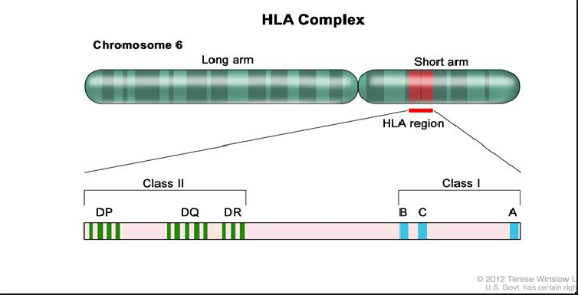

Slide 12
Major Histocompatibility Complex (MHC)
Three genes code for Class I MHC molecules
HLA-A,
HLA-B
HLA-C
HLA-D loci encode for Class II MHC molecules i.e.,
DP
DQ
DR
Each group of MHC consists of several glycoproteins

Slide 13
Major Histocompatibility Complex (MHC)
Each individual has two “haplotypes” i.e., two sets of these genes one paternal and one maternal
MHC Class I molecules are found on the surface of virtually all nucleated cells
MHC Class II molecules are normally present of the surface of antigen presenting cells such as:
Marophages,
Dendritic cells
Langerhans cells of skin
B cells

Slide 14
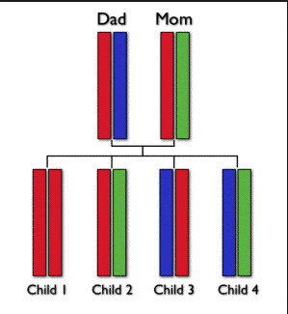

Slide 15
Biologic Importance of MHC
Antigen recognition
T cytotoxic (CD8) cells kill virus infected cells in association with class I MHC proteins
Helper T (CD4) cells recognize antigen in association with class II MHC proteins
This is called MHC restriction
Transplantation
Success of organ transplant is determined by compatibility of the MHC genes

Slide 16
MHC Class I Structure

Slide 17
MHC Class II Structure

Slide 18
Antigen Presentation
Endogenous antigen (Cytoplasm)
Exogenous antigen (Membrane Bound)

Slide 19
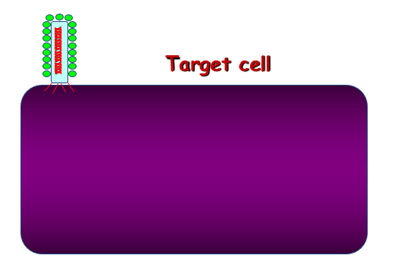
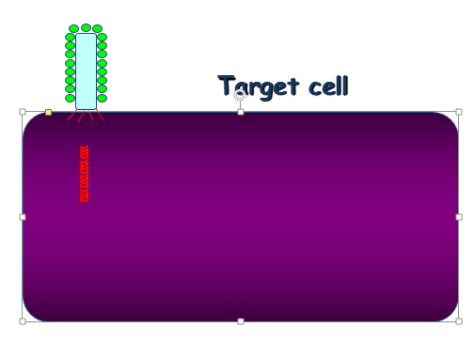
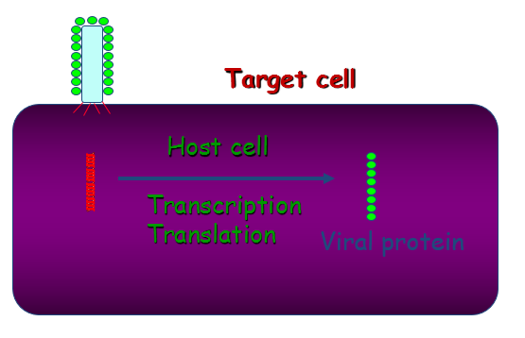
Endogenous Antigen

Slide 20
Exogenous Antigen

Slide 21
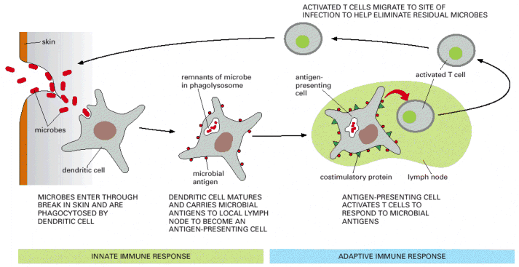
Antigen presenting cell
Dendritic cells and macrophages digest invading microbe and then present the antigen of the microbe to lymphocytes in lymphoid organs

Slide 22
Two signals are required of activation of T cells
Two signals are required to activate T cells
First signal
Class II MHC + antigen – TCR
IL-1, LFA-1 with ICAM
Second signal (Costimulatory signal)
B7 on APC interacts with CD28 on lymphocyte

Slide 24
T lymphocytes ("T cells"): CMI
Subsets include:
CD4+ helper T cells enhance CMI and production of antibodies by B cells
CD8+ cytotoxic T lymphocytes (CTLs) that kill virus-infected and tumor cells

Slide 28
Out come of T helper cell activation
Production of IL-2 and its receptor
IL-2 is also know as T cell growth factor
Proliferation of antigen specific T cells
Effector and regulatory cells are produced along with “memory” cells
IL-2 also stimulates CD8 cytotoxic cells
Production of Interferons
Enhances anti-microbial activity of macrophages

Slide 29
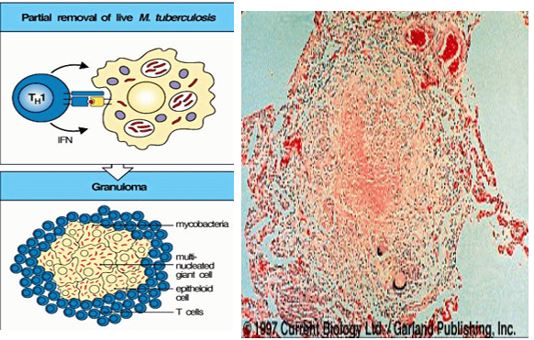
Granuloma Formation(Chronic Inflammation, e.g., TB)

Slide 30
Out come of T helper cell activation
Memory T cells
Respond rapidly for many years after initial exposure to antigen
A large number of memory cells are produced so that the secondary response is greater than the primary
Memory cells live for many years and have the capacity to multiply
They are activated by smaller amount of antigen
They produce greater amounts of interleukins

Slide 31
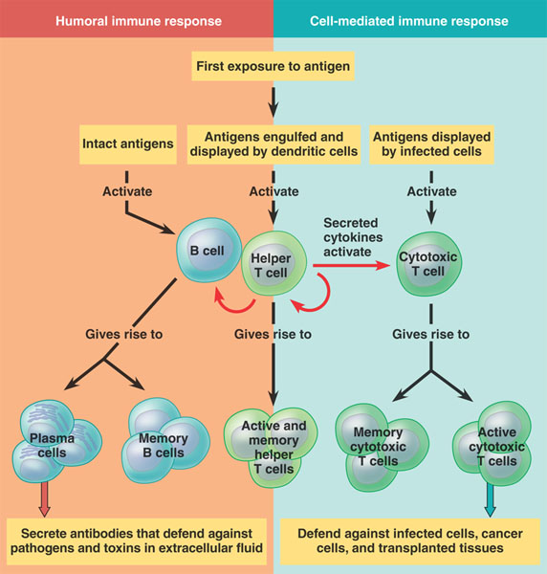

Slide 32
Examples of Cell Mediated Immunity
Delayed type of hypersensitivity (DTH) reaction:
the tuberculin test
Mediated by CD4+ T cells and takes about 72 hours to develop
Contact Sensitivity
Many people develop rashes on their skin following contact with certain chemicals such as nickel, certain dyes, and poison ivy plant
The response takes some 24 hours to occur and like DTH, is triggered by CD4+ T cells

Slide 33
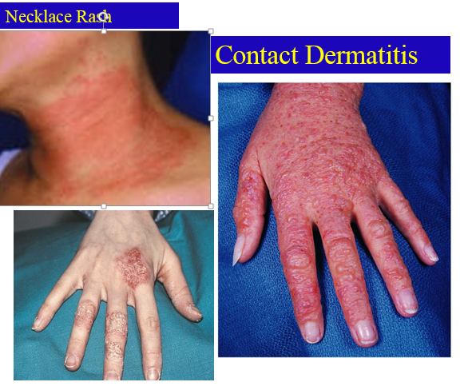

Slide 34
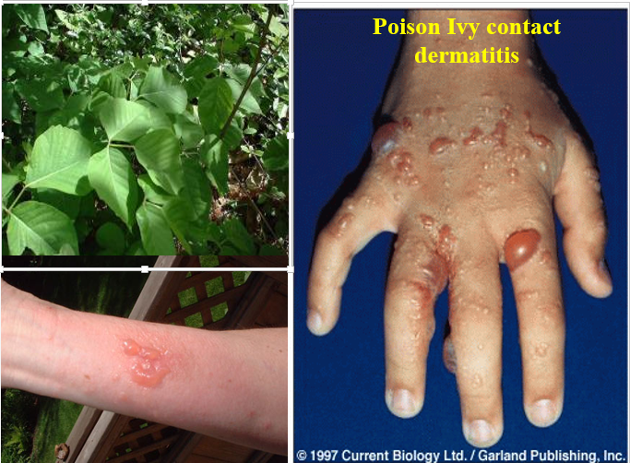

Slide 35
Summary
Cell mediated adaptive immune response is specific and develops after exposure to a pathogen (antigen)
Initial antigen exposure results in generation of memory cells for a stronger and a quicker response against future exposures to the same pathogen
It is usually associated with chronic infections
Antibodies are not involved

