Slide 1




Time Management
Company
LOGO
Learning Skills Course
Dept of medical education
College of Medicine

Slide 2



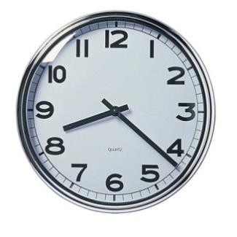
Time Management Skill
LEARNING SKILLS: TIME MANAGEMENT
Objectives of Time Management Skills
By the end of this session, the student will be able to:
Define Time management
Describe the importance of Time management
Identify Characteristics of Time management
Analyze your current effectiveness at Time management
Utilize good Time management techniques
Identify ways to improve your Time management skills
Define strategies to set priorities
Identify stress and procrastination
Identify steps to overcome barriers to effective Time management
Develop a daily time table

Slide 3
Contents
Introduction
Importance of TM
Daily schedules planning
Time wasters
Procrastination
Take home messages

Slide 4

What did you do yesterday?
We need one volunteer on the board. [5 minutes]
Dear colleague, tell us how did you consume your time yesterday [the whole day, bed to bed] ?

Slide 5
Time management important?
Time cannot be bought, stored or stopped - every second that
passes is gone forever and can never be recovered or re-used
"Perhaps the most valuable result of any work is the ability to make yourself do the things that you have to do, when it ought to be done, whether you like it or not."—
Thomas Huxley

Slide 6
؟تقولا ةيمهأب ركفن لا اذامل
لهسأ تويبلاو تارايسلا لثم ةسوململا ءايشلأاب ريكفتلا نإ •
ةميق اهل نلأ كلذو تقولاب ريكفتلا نم
ىظحي لا وهف سملل لباق ريغو يئرم ريغ تقولا نلأ نكلو • كنإف كنم تارهوجم صخش قرس ولف ، يفاكلا مارتحلااب
يف تقولا ةقرس نكلو ةميرجلا نع ةطرشلا ربختو جعزنتس
ةحنج ىتح ربتعت لا ةداعلا

Slide 7
ملسملا ةايح يف تقولا ةيمهأ
ىلص الله لوسر لاق لاق هنع الله يضر لبج نب ذاعم نع • لأسي ىتح ةمايقلا موي دبع امدق لوزت نل " ملسو هيلع الله
:عبرأ نع
هانفأ اميف هرمع نع •
هلابأ اميف هبابش نعو • هقفنأ اميفو هبستكا نيأ نم هلام نعو • " ؟هب لمع اذام هملع نعو •
ىلص الله لوسر لاق لاق امهنع الله يضر سابع نبا نع •
:سانلا نم ريثك امهيف نوبغم ناتمعن " ملسو هيلع الله
“ غارفلاو ةحصلا

Slide 8
Misconceptions ??
•Efficiency and Effectiveness are the same
•To do a job properly, do it yourself
•There's only one right way to do a job
•Time management is a waste of time
•A good time manager lacks creativity

Slide 9

The Basic Rule
Time can't be managed, time is uncontrollable
We can only manage ourselves and our use
of time

Slide 10



- Define high and low periods of attention and
concentration
- Are you morning person" or a "night person“
•
  Sleep is often an activity that learners use as their
time management "bank“
  When they need a few extra hours for studying, they withdraw a few hours of sleep
  You need to have a social life, yet, you need to
have a balance in your life

Slide 11



- If you are spending time at the Laundromat, bring
your psychology notes to study. If you are waiting in
line for tickets to a domestic flight, bring your
biology flashcards to memorize
("Twofer" concept )
  This will allow you to reduce distractions which can
"waste time.“
  Study in shorter time blocks with short breaks
between to avoid fatigue
  While you are taking a break, the brain is still
processing the information

Slide 12
Learners’ basic principles
1- Identify "Best Time" for Studying
2- Study Difficult Subjects First
3- Use Distributed Learning and Practice
4- Make Sure the Surroundings are Conducive to Studying
5- Make Room for Entertainment and Relaxation
6- Make Sure you Have Time to Sleep and Eat Properly
7- Try to Combine Activities

Slide 13

How busy are you?
Because we are not concentrating on the right things
To succeed, we must concentrate on:
  The results to be achieved, not on being busy
2. Setting priorities, which is vital
The aims to ensure that we concentrate our effort on
the high payoff tasks

Slide 14
Plan your time
Everyone has 24 hours each day & 168 hours each
week
We must use this time to eat, sleep, work, relax,
exercise, groom, attend class, and study
It requires planning to get the most from these hours
It requires self-discipline and control until the behavioral
changes becomes an everyday habit
Remember, plans and schedules for managing time are
useless if one does not follow them

Slide 15


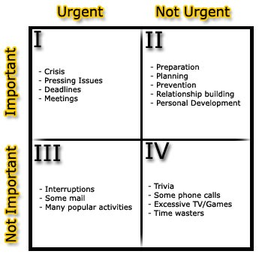
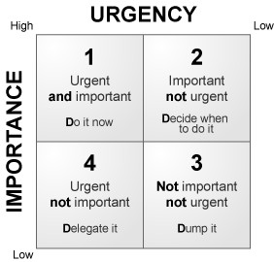
Plan your time – Cont.
People don't plan to fail but a lot of
people do fail to plan."
To Do List:
  Break things down into small steps
  Like a child cleaning his/her room
  Do the ugliest thing first

Slide 16





Plan your time – Cont.
Daily Schedules:
Engagement books
Palm Computers or PPC
A piece of poster board tacked to a wall
3 x 5 index cards
OFinrcset, ypouut ddoewcnideall uopfonthethneecsetsysleit,iesth;eclansesxet s,stweporki,s
cmoenasltsru, cettico.n
_{A}T_{l}h_{lo}e_{w}n _{s}b_{p}lo_{a}c_{c}k_{es}in_{fo}y_{r}ou_{e}r_{ac}s_{h}tud_{h}y_{ou}t_{r}i,m_{e}e_{v}. _{e}S_{n}ch_{½}ed_{h}u_{o}le_{ur}s_{f}tu_{or}dy_{a} fo_{b}r_{us}a_{y}
_{s}ti_{c}m_{h}e_{ed}w_{u}h_{le}en you are most alert and energized.

Slide 17
Effective Scheduling Review
Keep a calendar and include all your activities
•
Keep weekly and daily schedules & review your
schedule daily
Keep a long-term schedule (one yr., four yrs.) and plan
ahead
Take into account the learning style when developing a study schedule. Select the times when you are most alert and the most appropriate place for you to study
When setting up your schedule, organize tasks in order
of priority
Spread work out over a week period. Studying small
amounts daily works better than does cramming
Plan ahead your computer access needs and avoid time
of heavy user traffic

Slide 18

Once scheduling becomes a habit, you will
discover that:
“It is easier to find something to do with extra
time than to find extra time to do something.”

Slide 19

Crisis Management
It can lead to situations such as:
High levels of stress
A disrupted private life
Tiredness
Failure of projects

Slide 20






Assess your task!!
Is the task urgent & important?
yes
Do you need to yes
complete it today?
Take immediate action
No
Allocate time to complete it
Is the task urgent or important?
yes
Does it has a definite deadline?
ye
s
No
No
Set realistic
deadline for it
Is the task
necessary?
yes
Save the task for
quiet time
No
Discard

Slide 21
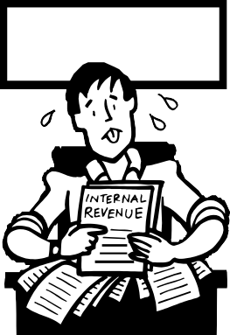

Stress Management
Being more in control of what you do
Being productive, and secure in your daily tasks
Enjoying what you do
Giving your-self more quality time to relax and enjoy life
outside work
Hear me now, Believe me Later…

Slide 22
Common Time Wasters
Interruption
Meetings
Tasks to delegate
Procrastination
Acting with incomplete
information
Dealing with classmates
Crisis management
Unclear communication
Inadequate technical
knowledge
Unclear objectives and
priorities
Lack of planning
Stress and fatigue
Inability to say "No"
Personal disorganization

Slide 23


Procrastination Signs (Thief of Time)
Paralysis by planning where implementation is delayed unnecessarily
Perfectionism which often serves to delay tackling other
problems and not cost-effective to achieve
Boredom
How to tackle
procrastination?
Set deadlines by which goals should be achieved
Hostility to tasks
The Deadline High

Slide 24

Why don't people manage their time?
They don't know about it
They are too lazy to plan
They enjoy the adrenaline buzz of meeting tight
deadlines
They enjoy crisis management
Failing to plan is planning to fail

Slide 25






how long should I study?
The rule-of-thumb in college
To spend two hours studying for every one hour in class each week

Slide 26
Summary
Time can't be managed
We can only manage ourselves and our
use of time
Planning
Urgent v/s Important

Slide 27
Finally
Apply: Time management principles to your real life.
Plan: well your college and home activities.
You may find some difficulties for the application, try to find solutions.
Reflect well on the time management activities as it will be your midterm assignment.

Slide 28

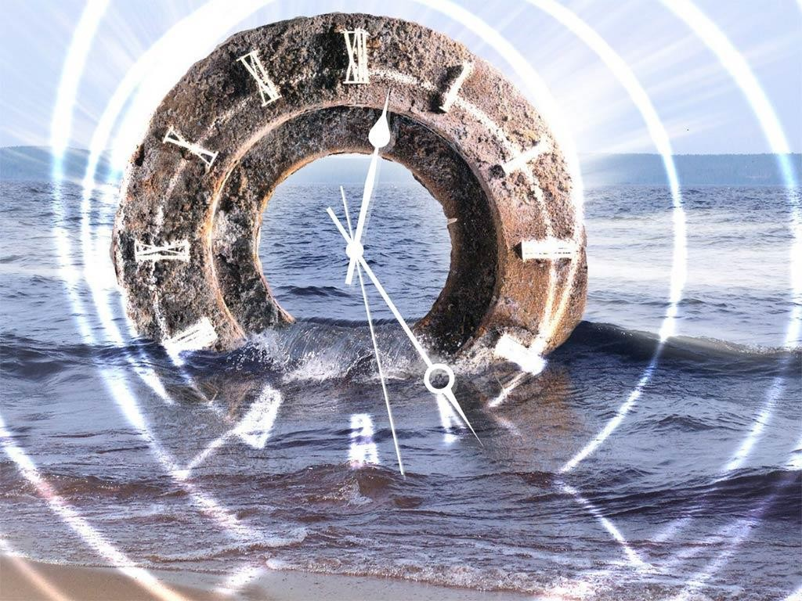
Questions !!
T H A N K
Y O U

