Slide 1
INFLAMMATION AND REPAIR
Lecture 2
Cellular Events in Inflammation
(Foundation Block, Pathology)
Maha Arafah
Associate Professor
Department of Pathology
King Saud University
Email: marafah @hotmail.com
2015
Dr. Maha Arafah

Slide 2
Objectives
Describe the steps involved in extravasation of leukocytes from the blood to the tissues. Know the steps at which selectins and integrins act.
Describe the meaning and utility of chemotaxis. Understand the role that chemokines play in inflammation.
Describe the steps involved in phagocytosis and the role of IgG and C3b as opsonins and receptors.
List the mechanisms of microbial killing.
Know various defects in leukocyte function.

Slide 3
Reference book and the relevant page numbers..
Robbins Basic Pathology 9th edition, pages 34-41

Slide 4
Acute Inflammation CELLULAR EVENTS:
A critical function of inflammation is to deliver leukocytes to the site of injury
and to activate the leukocytes to perform their normal functions in host defense.
WHAT ARE THESE FUNCTION?
Leukocytes ingest offending agents, kill bacteria and other microbes, and get rid of necrotic tissue and foreign substances.
They may induce tissue damage and prolong inflammation, since the leukocyte products that destroy microbes and necrotic tissues can also injure normal host tissues.
LEUKOCYTE EXTRAVASATION

Slide 6
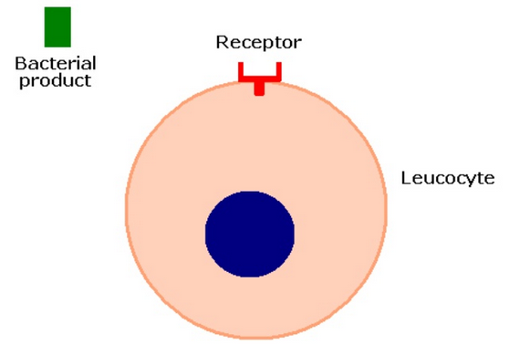

Slide 7
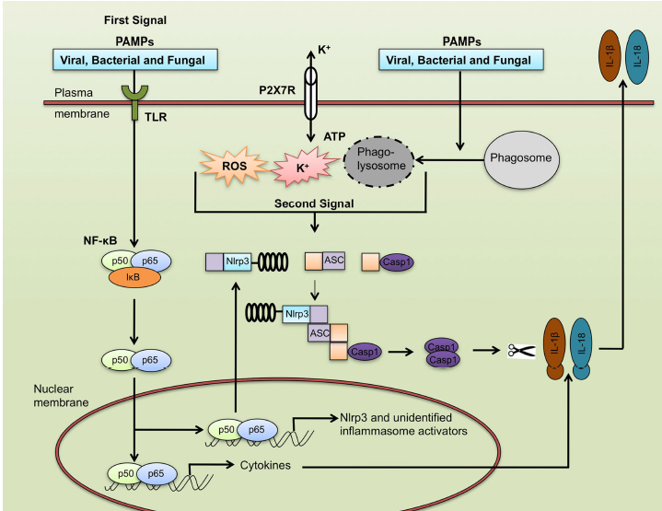
pathogen-associated molecular patterns
LPS
Nod-like receptor inflammasome

Slide 8
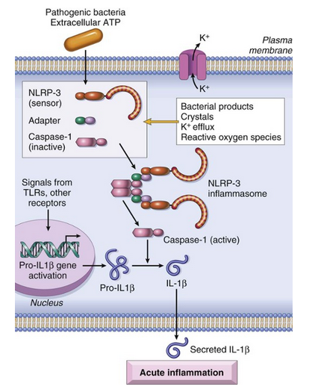
The inflammasome
The inflammasome is a protein complex that recognizes products of dead cells and some microbes and induces the secretion of
biologically active interleukin 1.
The inflammasome consists of a sensor protein (a leucine-rich protein called NLRP3), an adapter, and the enzyme caspase-1, which is converted from an inactive to an active form

Slide 9
Recruitment of leukocytes
A multistep process involving attachment of circulating leukocytes to endothelial cells and their migration through the endothelium (extravasation)
3 steps:
In the lumen:
Margination
rolling
adhesion to endothelium
Vascular endothelium normally does not bind circulating cells
Transmigration across the endothelium (also called diapedesis)
Migration in interstitial tissues toward a chemotactic stimulus

Slide 10
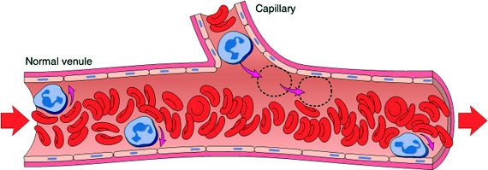
Acute Inflammation CELLULAR EVENTS: LEUKOCYTE EXTRAVASATION AND PHAGOCYTOSIS
Margination

Slide 11
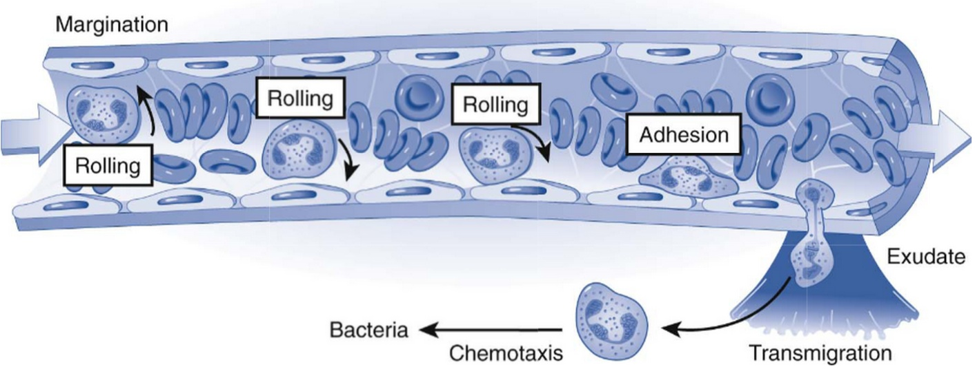

Slide 13
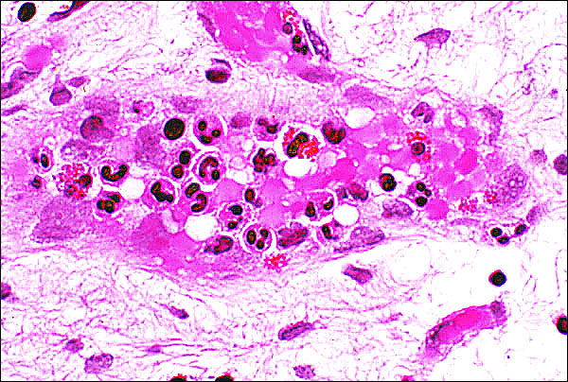
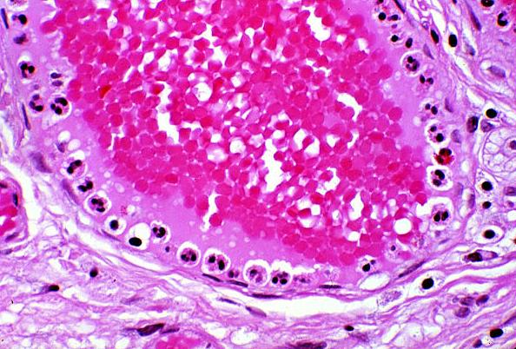
Leukocytes Rolling
Within a Venule
Margination
because blood flow slows early in inflammation (stasis), the endothelium can be lined by white cells
(pavementation)

Slide 14
Notes:
2. LEUKOCYTE INFILTRATION AND PHAGOCYTOSIS
The next phase, which we will now examine, is the migration of WBC
from the circulation to the site of injury.
Leukocyte Exudation
The most striking finding in inflammation under the microscope - what
we call a "pathognomonic" feature - is the presence of leukocytes. The sequence
events in leukocyte infiltration (SLIDE) can be divided into (1) margination, (2)
sticking, (3) emigration and (4) phagocytosis.
In a typical course of inflammatory events, vasodilation, transudation,
and then slowing of circulation occurs as the blood viscosity increases. As stasis
develops, one begins to see the peripheral orientation of leukocytes, principally
neutrophils, along the vascular endothelium (margination). Leukocytes first stick
transiently and then more avidly (sticking). Soon after they migrate through the
vascular wall into the interstitial tissue (emigration).

Slide 15
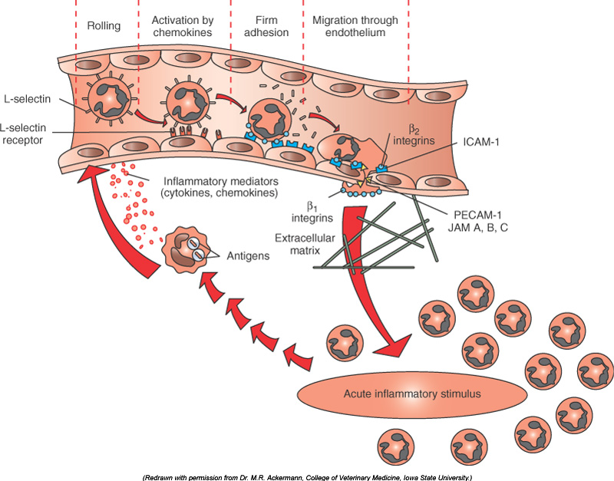
Resident tissue macrophages, mast cells, and endothelial cells respond to injury by secreting the cytokines TNF, IL-1, histamine and chemokines

Slide 16
Leukocyte Adhesion
Mediators such as histamine, thrombin, and platelet activating factor (PAF) stimulate the redistribution of P-selectin from its normal intracellular stores in granules (Weibel-Palade bodies) to the cell surface.
P-selectin
Weibel-Palade bodies are the “glue factory” of endothelial cells, because they synthesize P-selectin, an adhesion molecule for leukocytes, and von Willebrand factor, the adhesion molecule of the platelet

Slide 17
Adhesion Molecules and Receptors
1. Selectins, consist of:
1. E-selectin: confined to endothelium induced by TNF&IL-1
2. P-selectin: present in endothelium and platelets from Weibel-Palade bodies
3. L-selectin: expressed on most leukocyte and endothelium
E-selectin & P-selectin bind to Sialyl-Lewis X glycoprotein and slow the leukocytes

Slide 18
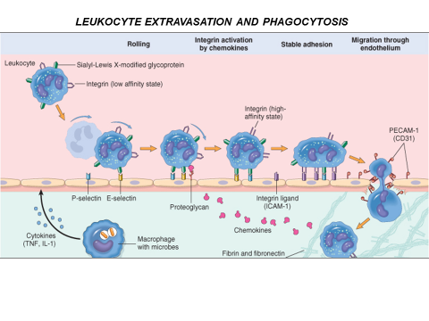
Interleukin-1 (IL-1) and tumor necrosis factor (TNF) stimulate the expression of selectin ligands on the surface of neutrophils (L-selectin) and the expression of selectin molecules on the surface of venular endothelial cells (E-selectin, P-selectin)

Slide 19
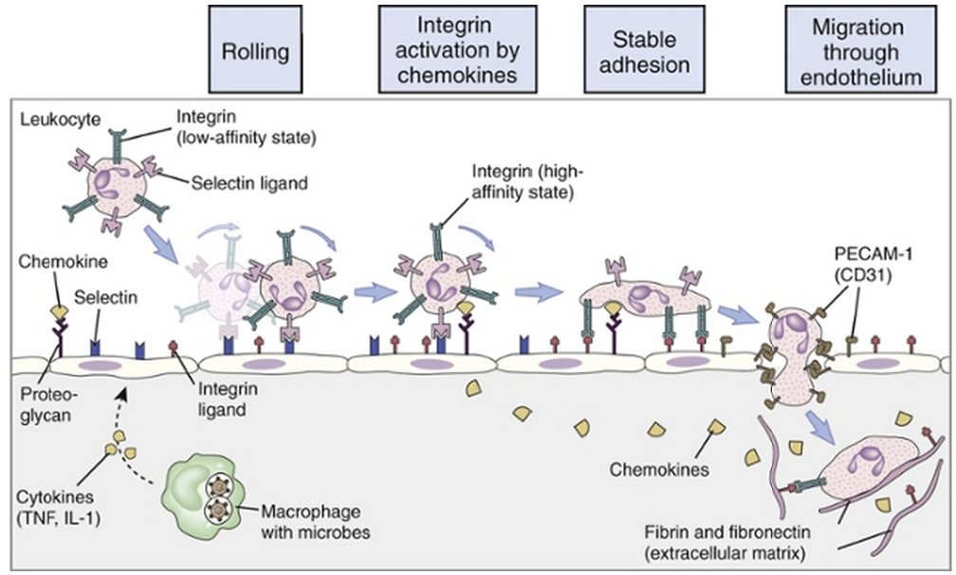
LEUKOCYTE EXTRAVASATION AND PHAGOCYTOSIS

Slide 20
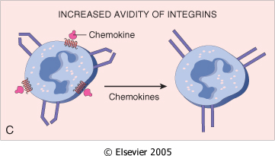
Adhesion Molecules and Receptors
2. Integrins
rolling
are transmembrane heterodimeric glycoproteins, made up of α and β chains expressed on leukocytes and bind to ligands on endothelial cells
Integrins are up regulated on leukocytes by C5a & LTB4 resulting in firm adhesion with vessel wall

Slide 21
Leukocyte Adhesion Deficiency
Autosomal recessive defect of integrins
Two types:
LAD type 1 is a deficiency of β₂-integrin
LAD type 2 is a deficiency of an endothelial cell selectin that normally binds neutrophils.
Clinical findings:
Delayed separation of umbilical cord
Increased circulating neutrophils (leukocytosis due to loss of the marginating pool)
Recurrent bacterial infection that lack pus formation
Poor wound healing

Slide 22
Adhesion Molecules and Receptors
3. The immunoglobulin family molecules :
ICAM-1 (intercellular adhesion molecule 1)
VCAM-1 (vascular cell adhesion molecule 1)
IL-1 and TNF activate intercellular adhesion molecule (ICAM) and vascular cell adhesion molecule (VCAM) on venular endothelial cells.
adhesion to endothelium

Slide 23
Adhesion Molecules and Receptors
4. Mucin-like glycoproteins: PECAM-1
- these glycoproteins are found in the extracellular matrix and on cell surfaces.
Neutrophils moving along the venular endothelium dissolve the venular basement membrane (release type IV collagenase) exposed by previous histamine-mediated endothelial cell contraction and enter the interstitial tissue.
Neutrophils, monocytes, lymphocytes, eosinophils, and basophils all use the same pathway to migrate from the blood into tissues.

Slide 24
Leukocyte Adhesion and Transmigration
Migration of the leukocytes through the endothelium is called:
Transmigration
or Diapedesis
Diapedesis occurs predominantly in the postcapillary venules
BV lumen
Extravascular

Slide 25
Leukocyte Adhesion and Transmigration
The type of emigrating leukocyte varies with the age of the inflammatory response
In most forms of acute inflammation: neutrophils predominate in the inflammatory infiltrate during the first 6 to 24 hours, then are replaced by monocytes in 24 to 48 hours
WHY?

Slide 26
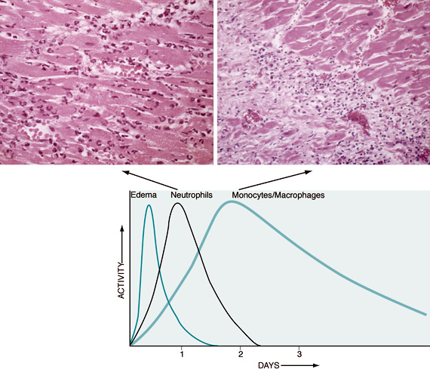
Leukocyte Adhesion and Transmigration
neutrophils are more numerous in the blood, they respond more rapidly to chemokines,
but are short-lived; they undergo
apoptosis and disappear after 24 to 48 hours,
whereas monocytes survive longer.

Slide 27
Leukocyte Adhesion and Transmigration
The type of emigrating leukocyte varies with the type of stimulus:
In viral infections, lymphocytes may be the first cells to arrive
In some hypersensitivity reactions and parasitic infection, eosinophil may be the main cell type
Chronic inflammation lymphocytes plasma cells and macrophages are present

Slide 28
Chemotaxis
After extravasation, leukocytes emigrate in tissues toward the site of injury by a process called chemotaxis, defined as locomotion oriented along a chemical gradient !!!!
Chemoattractants
Neutrophils are attracted by bacterial products, IL-8, C5a & LTB4
Chemokines act on the adherent leukocytes and stimulate the cells to migrate toward the site of injury or infection

Slide 29
Chemotaxis Chemoattractants
Exogenous and endogenous substances
The most common exogenous agents are bacterial products.
Endogenous chemoattractants include several chemical mediators:
components of the complement system, particularly C5a
products of the lipoxygenase pathway, mainly leukotriene B₄ (LTB₄)
cytokines, particularly those of the chemokine family (e.g., IL-8).

Slide 30
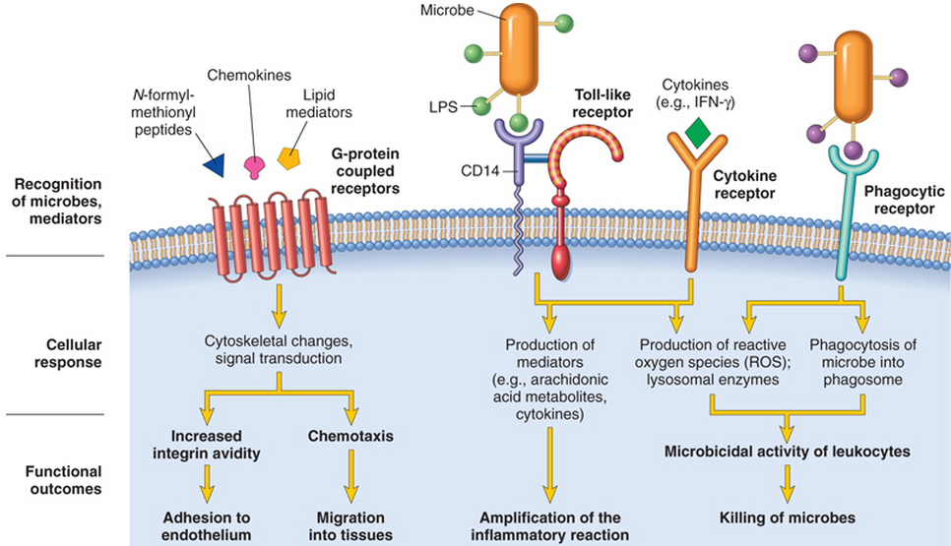
All these chemotactic agents bind to specific seven-transmembrane G-protein-coupled receptors (GPCRs) on the surface of leukocytes.

Slide 31
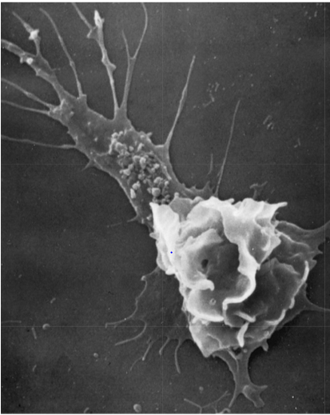
Scanning electron micrograph of a moving leukocyte in culture showing a filopodium and a trailing tail.
The leukocyte moves by extending filopodia that pull the back of the cell in the direction of extension

Slide 32
Leukocyte Activation
Phagocytosis
Intracellular destruction
Liberation of substances that destroy
extracellular microbes and dead tissues
Production of mediators

Slide 33
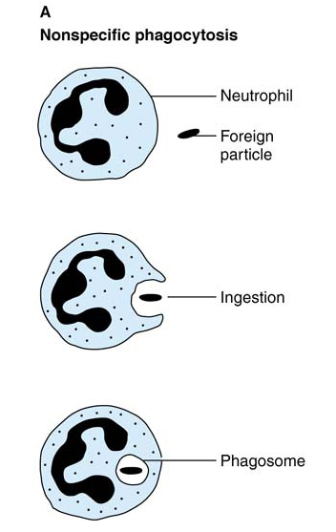
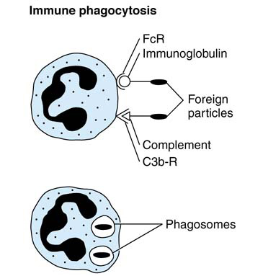
Phagocytosis by neutrophils
Immune phagocytosis is much more efficient than nonspecific phagocytosis

Slide 34
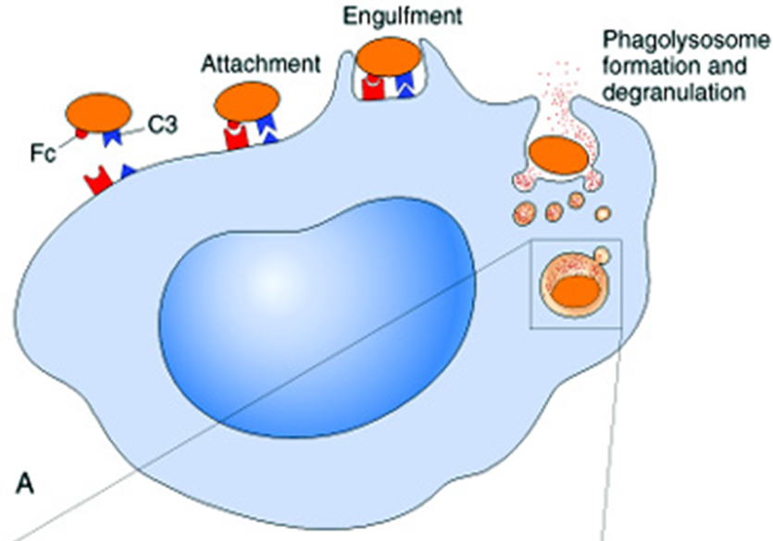
Phagocytosis
Phagocytosis involves three distinct but interrelated steps
Recognition and Attachment of the particle to be ingested by the leukocyte
(2) its Engulfment, with subsequent formation of a phagocytic vacuole
(3) killing or Degradation of the ingested material.

Slide 35
Leukocyte activation (1) Recognition and Attachment (Opsonization)
Is the process of coating a particle, such as a microbe, to target it for phagocytosis
The substances that do this are opsonins.
These substances include:
antibodies (IgG)
complement proteins (C3)
And others: lectins (mannose-binding lectin (MBL), collectins,fibronectin, fibrinogen, and C-reactive protein
These can coat microbes and are recognized by receptors on phagocytes (Fc and C3b receptors).

Slide 36
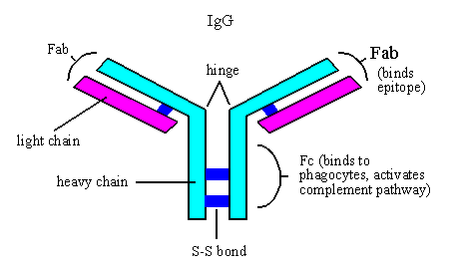

Slide 37
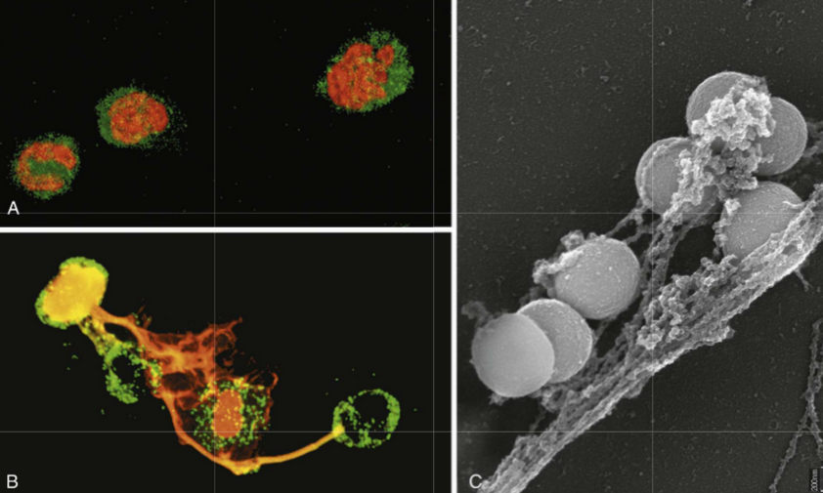
Neutrophil extracellular traps (NETs)
A, Healthy neutrophils with nuclei stained red and cytoplasm green.
B, Release of nuclear material from neutrophils (note that two have lost their nuclei), forming extracellular traps.
C, An electron micrograph of bacteria (staphylococci) trapped in NETs.

Slide 38
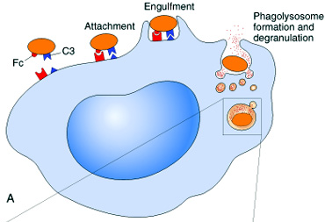
Phagocytosis 2. Engulfment
During engulfment, extensions of the cytoplasm (pseudopods) flow around the particle to be engulfed, eventually resulting in complete enclosure of the particle within a phagosome
The phagocytic vacuole then fuses with a lysosomal granule, resulting in phagolysosome

Slide 39
Defect in phagolysosome formation
Chediak-Higashi Syndrome:
Protein trafficking defect ( microtubule defect)
Autosomal recessive
Lead to impaired phagolysosome formation
Clinical feature:
Increased risk of pyogenic infection
Neutropenia (defect in generation from BM)
Giant granule formation (granules formed cannot move in cytoplasm)
Defective primary hemostasis ( platelet granule are not secreted)
Albinism
Peripheral neuropathy

Slide 40
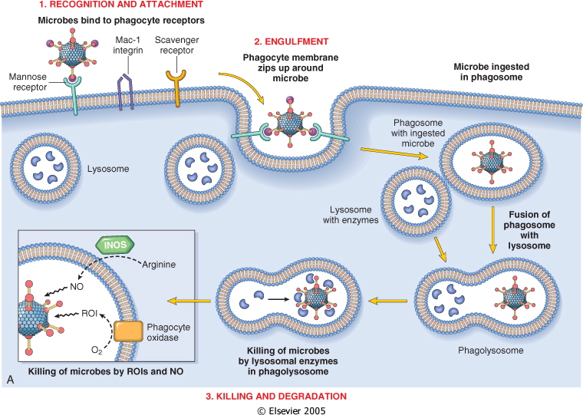

Slide 41
Phagocytosis Killing and Degradation
2 mechanisms for Microbial killing:
1. Oxygen-dependent mechanisms
2. Oxygen-independent mechanisms

Slide 42
Oxygen-Dependent Mechanisms
The H₂O₂-MPO-halide system is the most efficient bactericidal system in neutrophils
_
O2
oxidase
O2
H2O2
MPO
HOCL
SOD

Slide 43
Oxygen-independent mechanisms
through the action of substances in leukocyte granules. These include:
bactericidal permeability increasing protein (BPI
lysozyme
lactoferrin
major basic protein
defensins
In addition, neutrophil granules contain many enzymes, such as elastase, that also contribute to microbial killing

Slide 44
Summary of Phagocytosis

Slide 45
Defects in Leukocyte Function
Defects in leukocyte function, both genetic and acquired, lead to increased vulnerability to infections:
Defects in leukocyte adhesion
Defects in phagolysosome function
Defects in microbicidal activity

Slide 46
Defects in Leukocyte Function
Genetic
Leukocyte adhesion deficiency 1and 2
Chédiak-Higashi syndrome
Protein involved in organelle membrane fusion (no phagolysosomes)
Chronic granulomatous disease
Decreased oxidative burst. 2 types:
A. X-linked: NADPH oxidase (membrane component)
B. Autosomal recessive:
a. NADPH oxidase (cytoplasmic components)
b. Myeloperoxidase deficiency: (absent MPO-H2O2 system) pt. have increased risk of candida infection

Slide 47
Chronic Granulomatous Disease (CGD)
Infection and granuloma formation with catalase positive organisms e.g. S aureus, P cepacia, S marcescens, Norcardia and aspergillus
Nitroblue tetrazolium test (NBT), turn blue if NADPH oxidase can convertO2 to O2-
Remains colorless in CGD (NADPH oxidase)
NBT test is normal in Myeloperoxidase deficiency type

Slide 48
Comparison of Chronic Granulomatous Disease and Myeloperoxidase Deficiency

Slide 49
Defects in Leukocyte Function
Acquired
Thermal injury, diabetes, malignancy, sepsis, immunodeficiencies
Chemotaxis
Hemodialysis, diabetes mellitus
Adhesion
Leukemia, anemia, sepsis, diabetes, neonates, malnutrition
Phagocytosis and microbicidal activity

Slide 50
TAKE HOME MESSAGES:
Several steps are involved in extravasation of leukocytes from the blood to the tissues.
Phagocytosis is important step to get rid of necrotic material and bacteria.
Various defects in leukocyte function are present. These could be genetic defects or acquired.

Slide 51
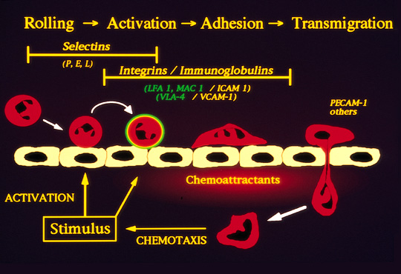
Leukocyte emigration

