Slide 1
Granulomatous Diseases
PRACTICAL
Foundation Block
2015
Pathology Dept, KSU

Slide 2
1- Tuberculosis of the lung
Pathology Dept, KSU
Foundation Block

Slide 3
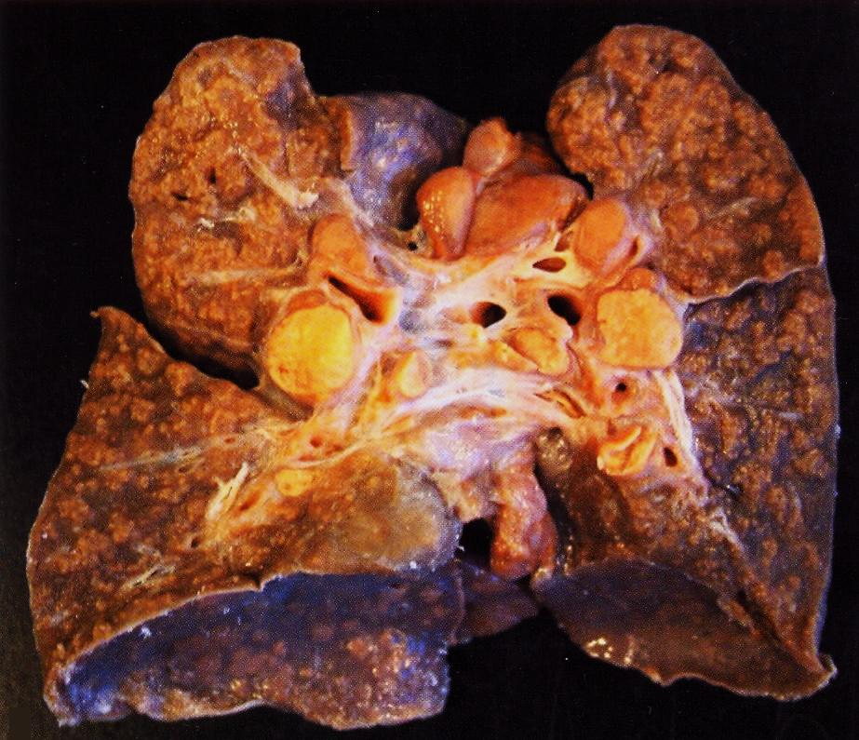
Pulmonary TB – Caseous Necrosis – Gross
The granulomas have areas of caseous necrosis.
Pathology Dept, KSU
Foundation Block

Slide 4
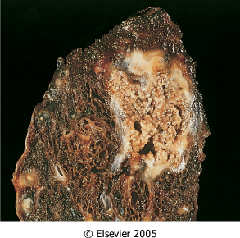
Pulmonary TB – Caseous Necrosis – Gross
Pathology Dept, KSU
Foundation Block

Slide 5
Pulmonary TB - Ghon’s Complex – Gross
Initial (primary) infection with T.B. producing a sub-pleural lesion called
a Ghon’s focus. The early Ghon’s focus together with the lymph node lesion constitute the Ghon’s complex.
The Ghon’s complex is seen here. Primary tuberculosis is the pattern seen with initial infection with tuberculosis in children. Reactivation, or secondary tuberculosis, is more typically seen in adults.
Pathology Dept, KSU
Foundation Block

Slide 6
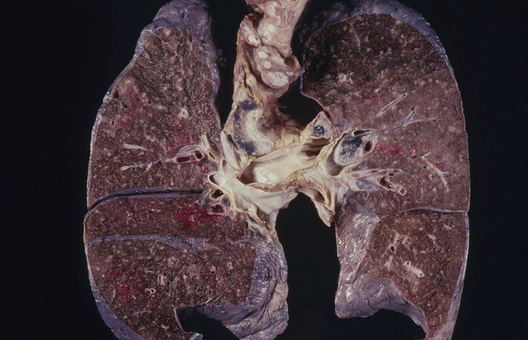
Miliary TB of the Lungs
Miliary TB can occur when TB lung lesions erode pulmonary veins or when extrapulmonary TB lesions erode systemic veins.
This results in hematogenous dissemination of tubercle bacilli producing myriads of 1-2 mm. lesions throughout the body in susceptible hosts.
Miliary spread limited to the lungs can occur following erosion of pulmonary arteries by TB lung lesions.
Pathology Dept, KSU
Foundation Block

Slide 7
Tuberculous Granulomas
Well-defined granulomas are seen here. They have rounded outlines. The one toward the center of the photograph contains several Langhan’s giant cells. Granulomas are composed of transformed macrophages called epithelioid cells along with lymphocytes, occasional PMN's, plasma cells, and fibroblasts
Pathology Dept, KSU
Foundation Block

Slide 8
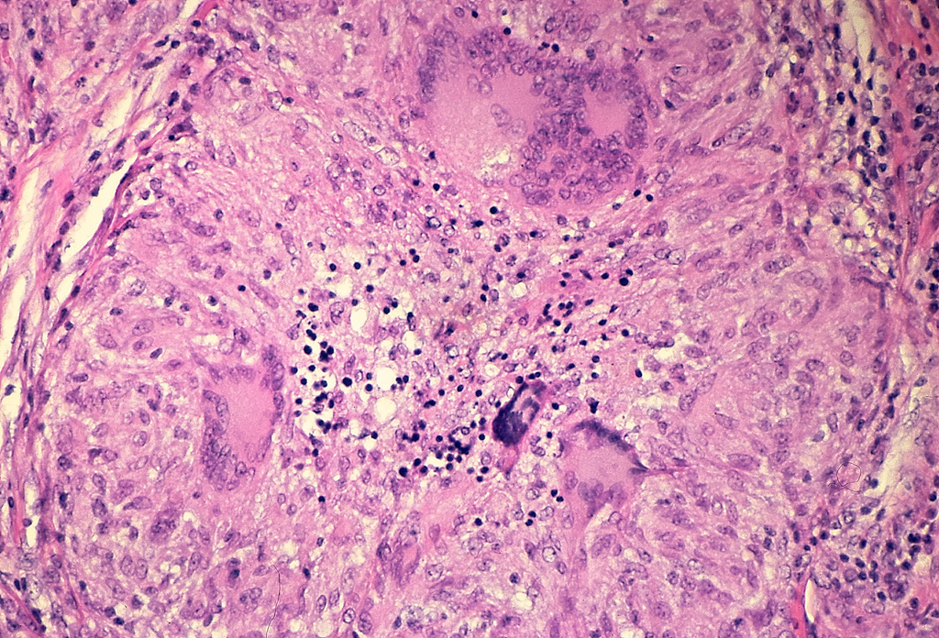
Pulmonary TB - Granuloma with central
early necrosis
The pyknotic nuclei of epithelioid cells in the center of the granuloma (apoptotic bodies) are a precursor of necrosis.
Pathology Dept, KSU
Foundation Block

Slide 9
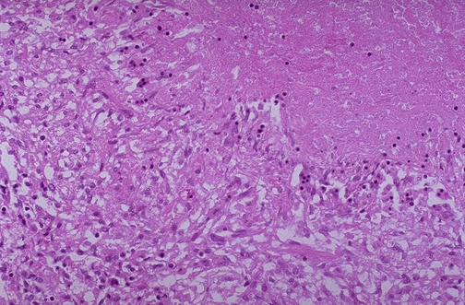
Tuberculous Granulomas
1
2
The edge of a granuloma is shown here at high magnification. At the upper is amorphous pink caseous material [1] composed of the necrotic elements of the granuloma as well as the infectious organisms. This area is ringed by the inflammatory component [2] with epithelioid cells, lymphocytes, and fibroblasts.
Pathology Dept, KSU
Foundation Block

Slide 10
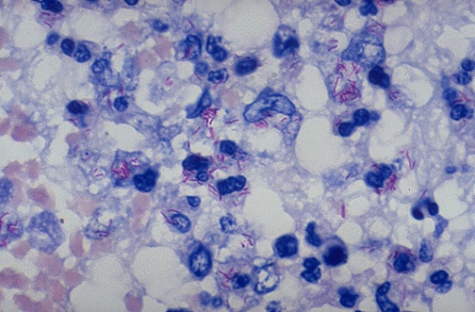
Acid Fast bacilli of Mycobacterium TB in the Lung
A stain for Acid Fast Bacilli is done (AFB stain) to find the mycobacteria . The mycobacteria stain as red rods, as seen here at high magnification.
Pathology Dept, KSU
Foundation Block

Slide 11
2- Tuberculous Lymphadenitis
Pathology Dept, KSU
Foundation Block

Slide 12
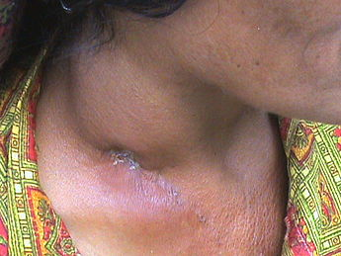
Tuberculous Lymphadenitis - Gross
Pathology Dept, KSU
Foundation Block

Slide 13
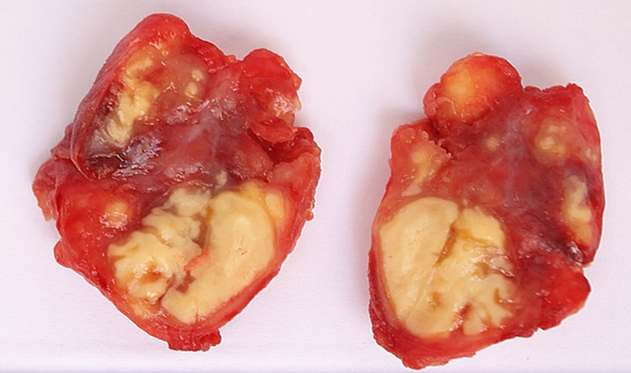
Tuberculous Lymphadenitis – Cut Section
Section of a lymph node with connective tissue capsule and lymphoid tissue
Pathology Dept, KSU
Foundation Block

Slide 14
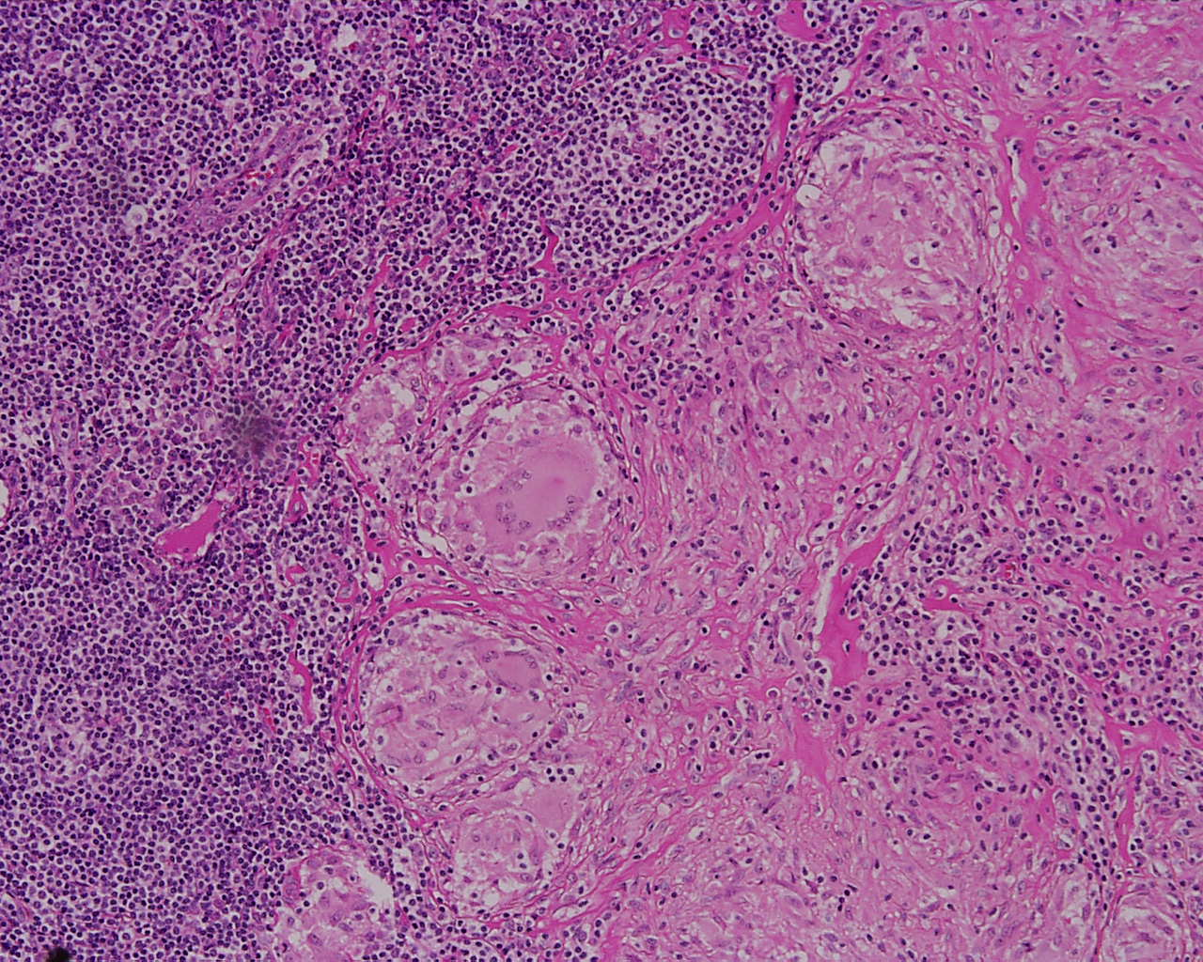
Tuberculous Lymphadenitis
Many round and oval tubercles/ granulomas with or without central caseation that appears structureless, homogenous and pink in colour.
Pathology Dept, KSU
Foundation Block

Slide 15
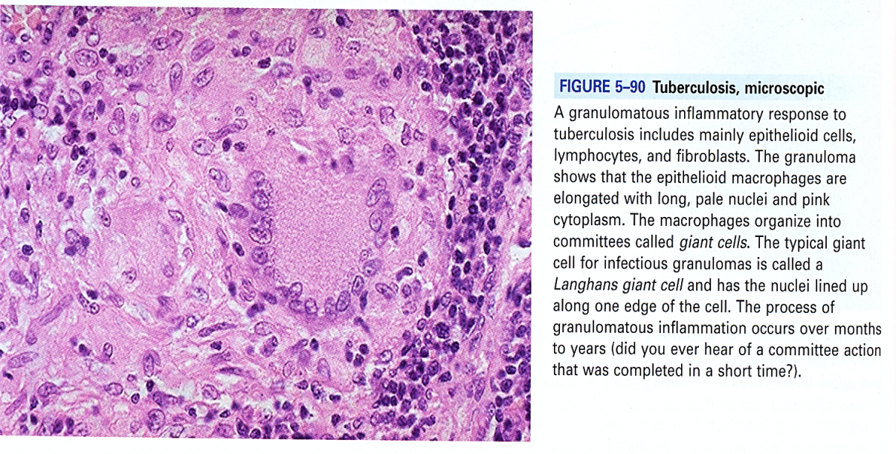
Tuberculous Lymphadenitis
The granulomas consists of epithelioid cells, few langhan’s giant cells (large cell with multiple peripheral nuclei) and peripheral rim of lymphocytes
Pathology Dept, KSU
Foundation Block

Slide 16
3- Bilharzial Granulomas
Pathology Dept, KSU
Foundation Block

Slide 17
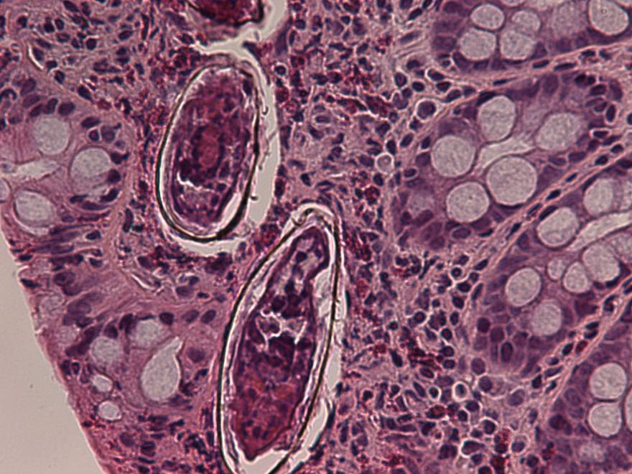
Colonic Bilharziasis - HPF
Colon biopsy of bilharziasis. Fibrosing foreign body granuloma against the miracidium-containing ovum of S. mansoni is observed in the submucosal layer (H&E).
Pathology Dept, KSU
Foundation Block

Slide 18
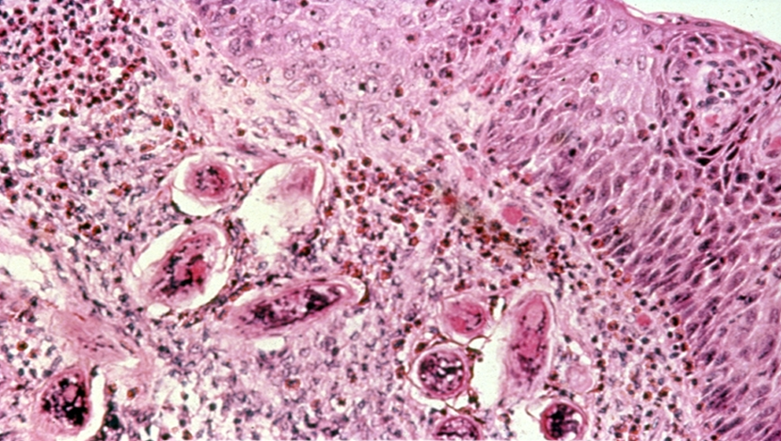
Bilharziasis of the Urinary Bladder
Schistosoma haematobium. Urinary Bladder biopsy showing bilharziasis eggs
Pathology Dept, KSU
Foundation Block

Slide 19
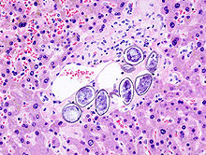
S. japonicum in the Hepatic portal tract
S. japonicum eggs in hepatic portal tract
Pathology Dept, KSU
Foundation Block

Slide 20
4- Cutaneous Leishmaniasis
Pathology Dept, KSU
Foundation Block

Slide 21
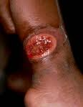
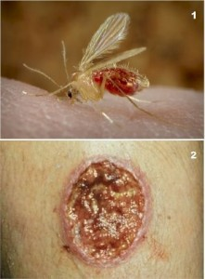
Cutaneous Leishmaniasis
Leishmaniasis is caused by parasitic infection, mainly by parasites of the Leishmania genus which are carried by a blood-sucking insect known as the sandfly.
Pathology Dept, KSU
Foundation Block

Slide 22
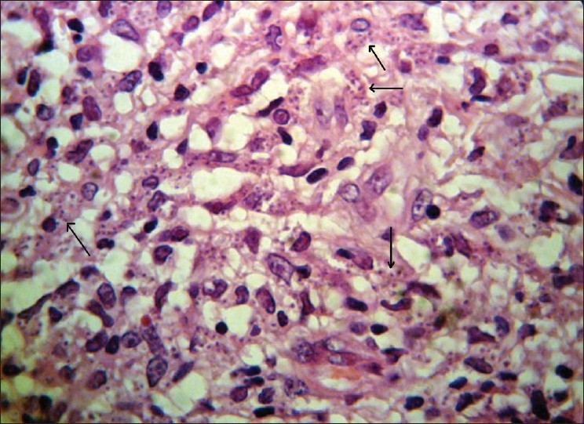
Cutaneous Leishmaniasis
Histological view shows marked cellular infiltration and parasites
(Leishman bodies) within macrophages
Pathology Dept, KSU
Foundation Block

Slide 23
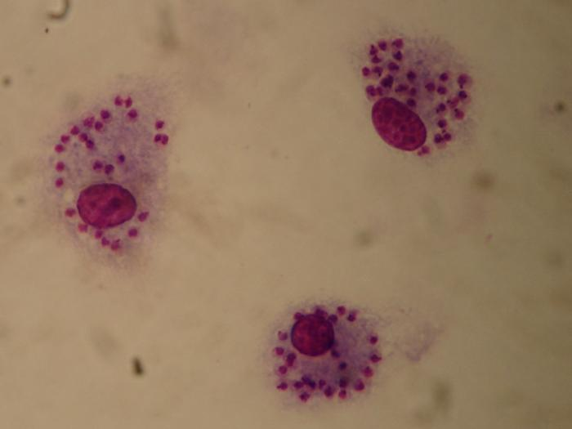
Cutaneous Leishmaniasis
The blood film shows macrophages containing Leishmania amastigotes, each with a prominent kinetoplast (seen as a darkened spot next to the larger nucleus) and no flagella (in contrast with the promastigote form).
Pathology Dept, KSU
Foundation Block

Slide 24
GOOD LUCK

