Slide 1
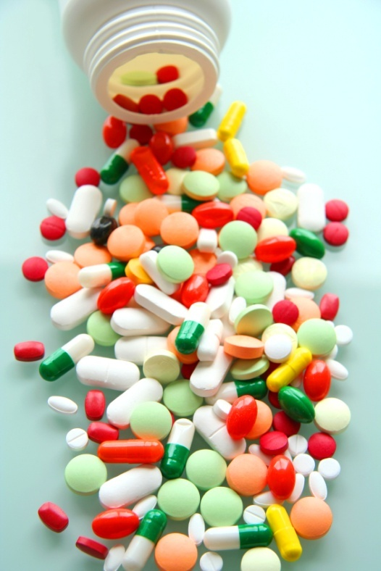
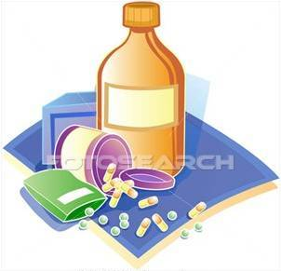
Pharmacodynamics i
Prof. hanan Hagar

Slide 2
Ilos
Identify different targets of drug action
Differentiate between their patterns of action; agonism versus antagonism
Elaborate on drug binding to receptors

Slide 3
What is Pharmacodynamics?
Pharmacodynamics is a branch of pharmacology that deals with the study of the biochemical and physiological effects of drugs and their mechanisms of action.

Slide 4
What are the mechanisms of drug action?
Drugs can produce their actions by:
Binding with biomolecules (Receptor-mediated mechanisms):
Biomolecules = Targets=Receptors
Mostly protein in nature (protein target).
Non receptor-mediated mechanisms Physiochemical properties of drugs.

Slide 5
What are the mechanisms of drug action?
Binding with biomolecules (Targets)
Protein targets for drug binding
Physiological receptors
Enzymes
Ion channels
Carriers
Structural protein

Slide 6
Non receptor–mediated mechanisms
Chemical action
Neutralization of gastric acidity by antacids.
Physical action
Osmotic diuretics.
Purgatives used in treatment of constipation e.g. MgSO4

Slide 7
TARGETS
> Proteins
STRUCTURAL
REGULATORY
ENZYME
CARRIER MOLECULE
ION CHANNEL
RECEPTOR

Slide 8
What are targets for drug binding ?
Drugs
Receptor-mediated
mechanisms
Non receptor-mediated
mechanisms
Drug actions

Slide 9
Receptors
Is a special target macromolecule that binds the drug and mediates its pharmacological actions.
Where?
Cell membrane.
Nucleus.
Cytoplasm.

Slide 10
Enzymes
The drug competes with the natural endogenous substrate for the enzyme.
E.g. Anticholinesterases.
Neostigmine reversibly compete with ACH for cholinesterase at motor end plate (neuromuscular junction.
Organophosphates irreversibly competes with ACH for cholinesterase.

Slide 11
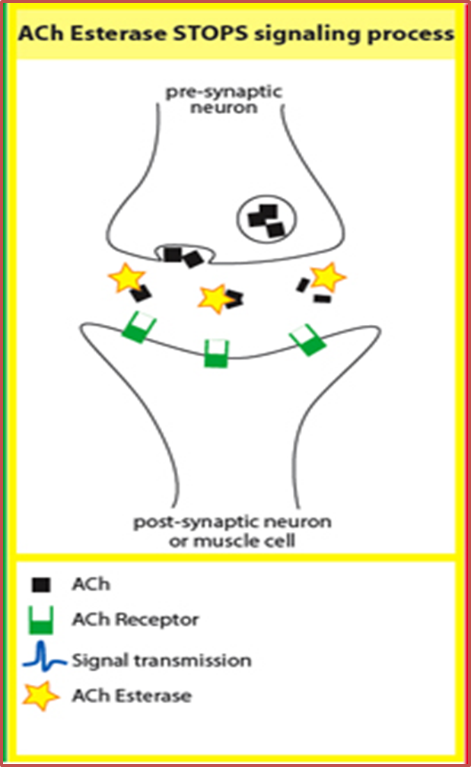

Slide 12
Ion channels
Drugs bind to alter channel function (by blockade or opening).
Channels are responsible for influx or out-flux of ions through cell membranes.
They are activated by alteration in action potential.
e.g. local anesthetics: block Na influx through Na channel in nerve fibers (Na channel blockers).

Slide 13
Ion channels
e.g. Sulfonylurea drugs (antidiabetic drugs): block K⁺ outflux via the K channels in pancreatic beta cells resulting in opening of calcium channels and insulin secretion.

Slide 15
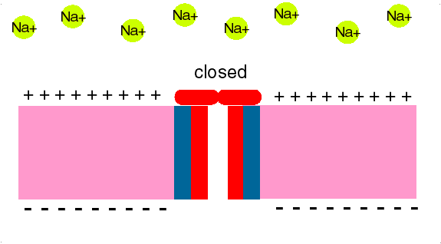
TARGETS
> Proteins
REGULATORY
ION CHANNEL
Local Anesthetics block Na influx through Na channel
in nerve fibers. They are Na channel Blockers.
L.Anaesthesia

Slide 16
Carrier molecules
The drug binds to such molecules altering their transport ability
Responsible for transport of ions and small organic molecules between intracellular compartments, through cell membranes or in extracellular fluids.
e.g., Na+,K+-ATPase inhibitor
Digoxin that block Na efflux via Na pump; used in treatment of heart failure.

Slide 17
Carrier molecules
Digoxin: blocks Na efflux via Na pump; used in treatment of heart failure.
Cocaine: blocks transport or reuptake of catecholamines (dopamine) at synaptic cleft
The dopamine transporter can no longer perform its reuptake function, and thus dopamine accumulates in the synaptic cleft.

Slide 18
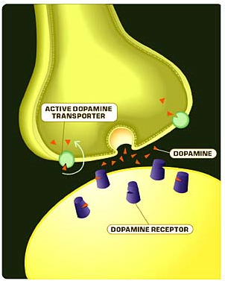
Effect of cocaine

Slide 19
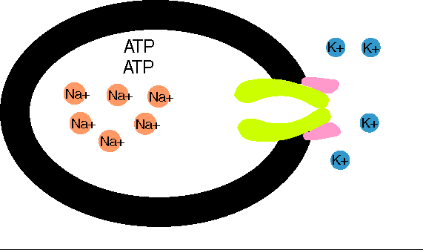
TARGETS
> Proteins
REGULATORY
CARRIER MOLECULE
Digoxin blocks efflux of Na by Na pump
Digoxin
Notes:
19

Slide 20
Structural proteins
e.g. tubulin is target for:
Vincristine
anticancer agent
Colchicine
used in treatment of gout
Tubulin
Structure

Slide 21
Binding Forces between drugs and receptors
Ionic bond.
Van-Dar-Waal.
Hydrogen bond.
Covalent bond.

Slide 22
Affinity
Ability of a drug to combine with the receptor.
D + R D-R complex Effect.
Efficacy (Intrinsic Activity)
Capacity of a drug receptor complex (D-R) to produce an action.
is the maximal response produced by a drug (E max).

Slide 23
Agonist
is a drug that combines with receptor and elicit a response (has affinity and efficacy).
Antagonist
is a drug that combines with a receptor without producing responses. It blocks the action of the agonist (has affinity but no or zero efficacy).
e.g. atropine

Slide 24
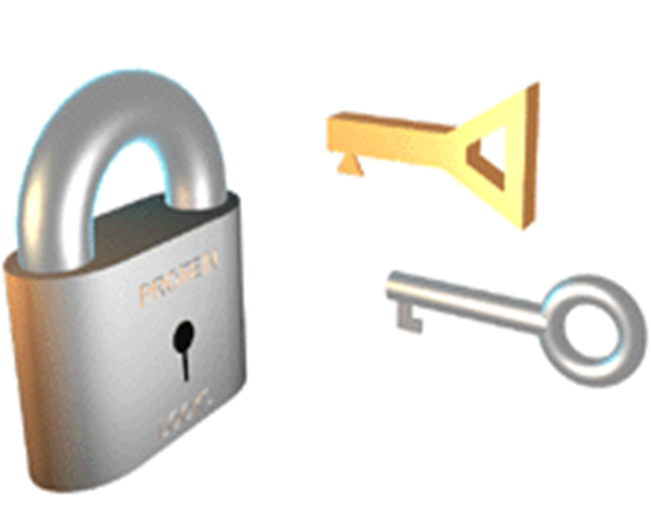
Agonist and Antagonist

Slide 25
Agonist
Full agonist.
Partial agonist.
Full Agonist
A drug that combines with its specific receptor to produce maximal effect by increasing its concentration (affinity & high efficacy).
e.g. acetylcholine (Ach).

Slide 26
Partial Agonist
combines with its receptor & evokes a response as a full agonist but produces submaximal effect regardless of concentration (affinity & partial efficacy).
e.g. pindolol
a beta blocker which is a partial agonist, produces less decrease in heart rate than pure antagonists such as propranolol.

Slide 28
Terms Definitions
Affinity is the capacity of a drug to form a complex with the receptor(DR complex)
Efficacy(Intrinsic activity) the ability of the drug once bound to the receptor to trigger response
The value of intrinsic activity ranges from 0 to 1

Slide 29
Terms Definitions
Affinity is the capacity of a drug to form a complex with the receptor(DR complex)
Full agonist having a full affinity to the receptor and a maximal intrinsic activity (1) e.g. acetylcholine
Partial agonist having a full affinity to the receptor but with low intrinsic activity (<1) e.g. pindolol
Antagonist having full affinity to the receptor but no intrinsic activity(0) e.g. atropine

Slide 30
L
G
U
O
C
O
K
D
PHARMACOLOGY

