Slide 1
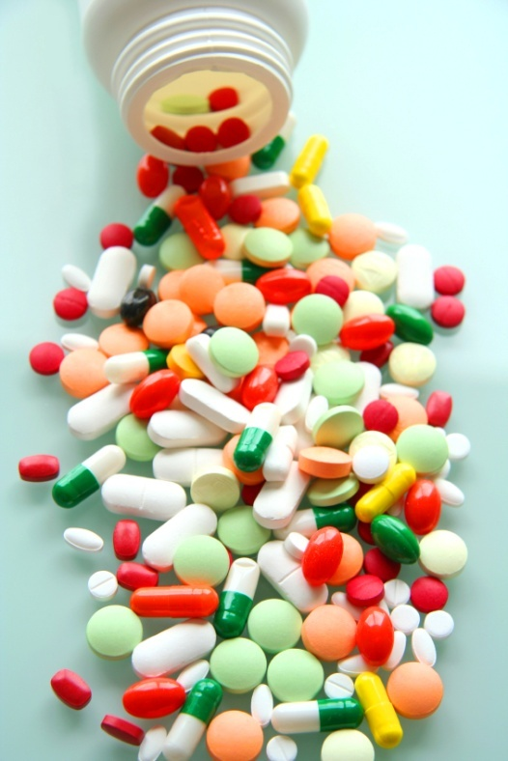
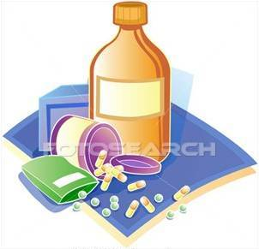
Pharmacodynamics Ii
Quantitative aspects of drugs
Prof. hanan Hagar

Slide 2
Ilos
Determine quantitative aspects of drug receptor binding.
Recognize concentration binding curves.
Identify dose response curves and the therapeutic utility of these curves.
Classify different types of antagonism

Slide 3
QUANTIFY ASPECTS OF DRUG ACTION
Bind
Occupy
Initiate
Activate
D
+
R
D
R
DR*
RESPONSE[R]
Relate concentration [C] of D used (x- axis) to the binding capacity at receptors (y-axis)
Relate concentration [C] of D used (x- axis) to response produced (y-axis)
Concentration-Binding Curve
Dose Response Curves
AFFINITY
EFFICACY
POTENCY

Slide 4
Concentration binding curves
Is a correlation between drug concentration [C] used (x- axis) and drug binding capacity at receptors [B] (y-axis).
i.e. relation between concentration & drug binding

Slide 5
Concentration-Binding curves are used to determine:
B_{max} (the binding capacity)
is the total density of receptors in the tissues.
KD50
is the concentration of drug required to occupy 50% of receptors at equilibrium.
The affinity of drug for receptor
The higher the affinity of D for receptor the lower is the K_{D} i.e. inverse relation

Slide 6
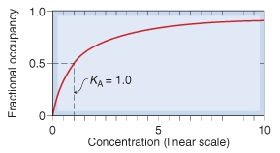
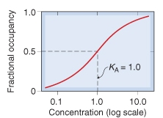
Concentration-Binding Curve
(B_{max}): Total density of receptors in the tissue
K_{D}
K_{D}
(k_{D} )= [C] of D required to occupy 50% of receptors at equilibrium

Slide 7
Dose -response curves
Used to study how response varies with the concentration or dose.
Is a correlation between drug concentration [D] used (x- axis) and drug response [R] (y-axis).
i.e. relation between concentration & Response

Slide 8
TYPES of Dose -response curves
Graded dose-response curve
Quantal dose-response curve (all or none).

Slide 9
Graded Dose-response Curve
Response is gradual
Gradual increase in response by increasing the dose (continuous response).
e.g. blood pressure, heart rate, blood glucose level, cholesterol,…
Curve is usually sigmoid in shape
used to calculate
Emax
EC50
Potency
Efficacy

Slide 10
GRADED DOSE RESPONSE CURVE
Max effect = E_{max}
Effect when all the receptors are occupied by D
100
100
80
As C ↑ response ↑
80
60
% of Maximal Effect
% of Maximal Effect
60
40
40
20
20
0
0
0
200
400
600
800
1
10
100
1000
[C]
EC₅₀
[C]
EC₅₀
C that gives the half-maximal effect

Slide 11
Graded dose-response curves are used to determine:
Maximum Efficacy (Emax): is the maximal biological response produced by a drug.
Median Effective concentration (EC50):
is the concentration of the drug that gives 50% of the maximal response (Emax).
Potency: the concentration of drug required to produce a specified response (50% of the maximal response = EC50).
Potency: is inversely proportional to EC 50.

Slide 12
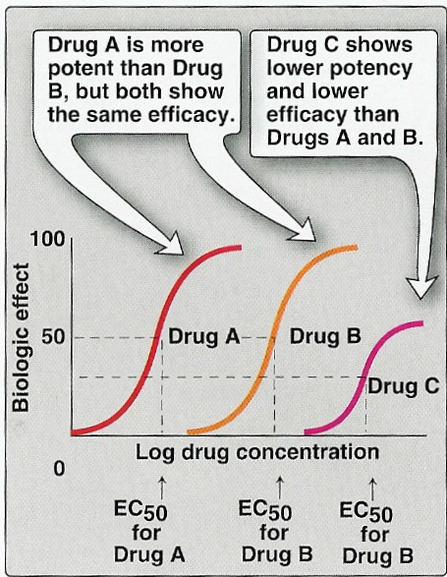

Slide 13
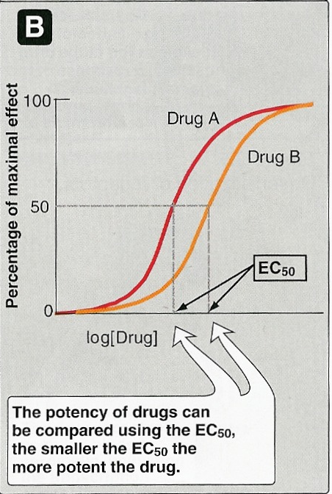

Slide 14
Quantal Dose-response Curve
Relate drug concentration to % percentage of patients responding (all or none response).
The response may be therapeutic response, adverse effect or lethal effect.
e.g. prevention of convulsion, arrhythmias or death.
Used to determine
ED50
TD50 & LD50
Therapeutic index.

Slide 15
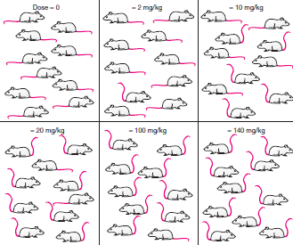
QANTAL DOSE RESPONSE CURVE
All-non responses
* specified therap. response
* adverse response
* lethal outcome
% responding
Dose-frequency relationship

Slide 16
Median Effective Dose (ED50): is a dose of the drug
required to produce a therapeutic effect in 50% of
patients.
Median Toxic Dose (TD50): is the dose of a drug
required to produce toxic effects in 50 % of patients.
Median Lethal Dose (LD50): is the dose of a drug
required to produce death in 50 % of patients.

Slide 17
QANTAL DOSE RESPONSE CURVE: used to determine
100
Lethal Effect
80
Toxic Effect
Therapeutic Effect
60
Predict the safety profile
% subjects responding
40
20
ED₅₀
LD₅₀
TD₅₀
[Dose]
0
1
10
100
1000
1. Median Effective Dose
2.Median toxic dose
3. Median lethal dose
1. 50% of individuals exhibit the specified therapeutic response
2. “ “ “ toxic effects
3. “ “ “ death

Slide 18
Therapeutic Index (TI)
Therapeutic index = LD50
ED50
Is a measure of safety profile
Large value = drug has wide margin of safety
e.g diazepam
Small value a narrow margin of safety e.g. digoxin

Slide 19
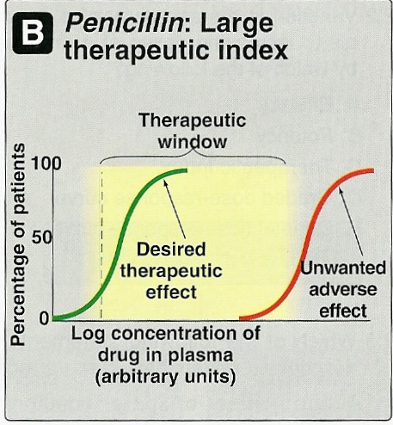

Slide 20
ANTAGONISM
It is the diminution or the complete abolishment of the effect of one drug in the presence of another.
Types
1. Chemical
Two drugs react chemically resulting in loss of activity of active drug.
Dimercaprol reduces heavy metal toxicity [ lead]
2.Physiological
Two drugs possess opposing actions in body, so tend to cancel each other’s effect.
Adrenaline & histamine
3. Pharmacokinetic
The antagonist effectively reduces the concentration of the active drug at the site of action
Phenobarbitone accelerates hepatic metabolism warfarin
4. Pharmacodynamic (Competitive )
Reversible
Irreversible
5. Pharmacodynamic (Non-Competitive)

Slide 21
Antagonism
It is the decrease or the complete abolishment of
the effect of one drug in the presence of another.
Types
Physiological antagonism.
Chemical antagonism.
Pharmacokinetic
Pharmacodynamic antagonism (Receptor-blockade antagonism).
Competitive
- Reversible
- Irreversible
Non-competitive

Slide 22
Antagonist
Types
Physiological antagonist.
Chemical antagonist.
Pharmacokinetic antagonist.
Pharmacodynamic antagonist.

Slide 23
Chemical Antagonism
Simple chemical reaction & loss of activity
No receptor.
e.g. Dimercaprol reduces heavy metal toxicity (as in lead toxicity).
Pharmacokinetic Antagonism
The antagonist effectively reduces the concentration of the active drug at the site of action.
e.g. Phenobarbitone accelerates hepatic metabolism of warfarin

Slide 24
Physiological Antagonism
Two drugs act on different receptors to produce different physiological effects.
e.g. Histamine & Adrenaline
Adrenaline is used in anaphylactic shock to reverse action of histamine.
Adrenaline →
Vasoconstriction (↑ BP) & bronchodilation.
Histamine →
vasodilatation (↓BP) & bronchoconstriction

Slide 25
Pharmacodynamic antagonism
Competitive (reversible)
Two drugs compete for the same receptor.
The antagonist partially or completely prevents the pharmacological effect of agonist.
Antagonist dissociate rapidly from receptor.
Antagonism can be overcome by increasing the concentration of the agonist.
Parallel shift of the curve to the right, without any change in slope or maximum
e.g. acetylcholine and atropine.

Slide 27
Pharmacodynamic antagonism
Competitive (irreversible)
Two drugs compete for the same receptor.
Antagonist forms stable, permanent chemical bond with receptor.
The original response can not be overcome even by increasing the dose of the agonist.
No parallel shift
a decrease in slope and a reduced maximum are obtained.
e.g. phenoxybenzamine and noradrenaline.

Slide 28
COMPETATIVE ANTAGONISM
Antagonist readily dissociate from binding site of agonist to the receptor
Reversible
Antagonism can be overcome by increasing concentration of agonist
Atropine vs Ach
Irreversible
Antagonist form stable, permanent / near permanent chemical bond with receptor.
Inactivation lasts for duration of receptor turnover or its de- novo synthesis → explains its longevity of action
Phenoxybenzamine & Noradrenaline

Slide 29
Pharmacodynamic antagonism
Non-competitive
Antagonist block at some point the chain of events that stimulate the response of agonist.
Agonist and Antagonist can be bound simultaneously.
Antagonism cannot be overcome by increasing concentration of agonist
e.g. verapamil and noradrenaline.

Slide 30
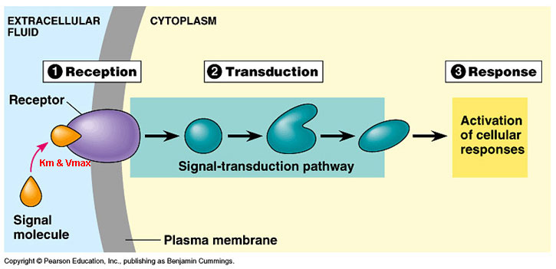
ANTAGONISM
Non-Competitive
Antagonist block at some point the chain of events that ignite the response of agonist
Agonist and Antagonist can be bound simultaneously
Receptor Blockade
Competitive
Reversible
Antagonist prevents binding of agonist to the receptor at the same binding site ( = competes with it at same occupancy site )
Agonist and Antagonist compete
( only one is bound)
Irreversible

Slide 31
Competitive vs Noncompetative Antagonism
Antagonism can be overcomed by increasing concentration of agonist = SURMOUNTABLE
% of Maximal Effect
Agonist + reversible competitive antagonist
100
Agonist
80
Agonist + irreversible competitive antagonist
60
Agonist + non-competitive antagonist
Depression of maximal response +/- rightward shifts ( if some R are spare )
40
20
Verapamil vs noradrenaline
0
[C]
1
10
100
1000
Antagonism cannot be overcome by increasing concentration of agonist

Slide 32
ANTAGONISM
Non-Competitive
Antagonist block at some point the chain of events that ignite the response of agonist
Receptor Blockade
(Competitive)
Agonist and Antagonist can be bound simultaneously
Antagonist prevents binding of agonist to the receptor at the same binding site ( = competes with it at same receptor)
Agonist and Antagonist compete ( only one is bound)
Reversible
Irreversible

Slide 33
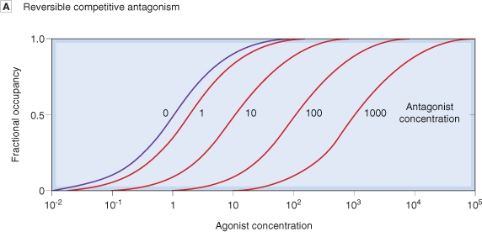
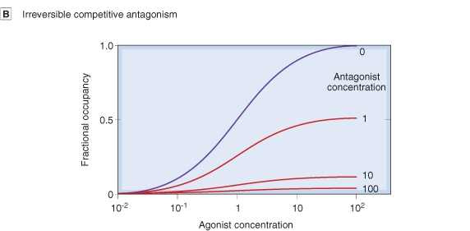
Competitive Antagonism
Reversible
Parallel shift to the right, without any change in slope or maximum
Irreversible
No parallel shift
But both a decrease in slope and a reduced maximum are obtained.

Slide 34
L
G
U
O
C
O
K
D
PHARMACOLOGY

