Slide 1
Pharmacodynamics III
RECEPTOR FAMILIES
Prof. Hanan Hagar ASSO.Prof Osama Yousif

Slide 2
ilos
By the end of this lecture you will be able to :
Classify receptors into their main superfamilies
Recognize their different transduction mechanism
Identify the nature & time frame of their response

Slide 3
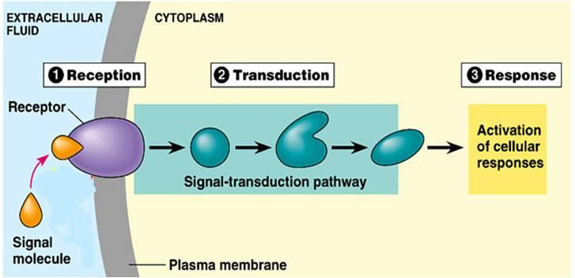
A RECEPTOR
2
3
4
2. Reception
3. Transduction
4. Response
1
1. Recognition

Slide 4
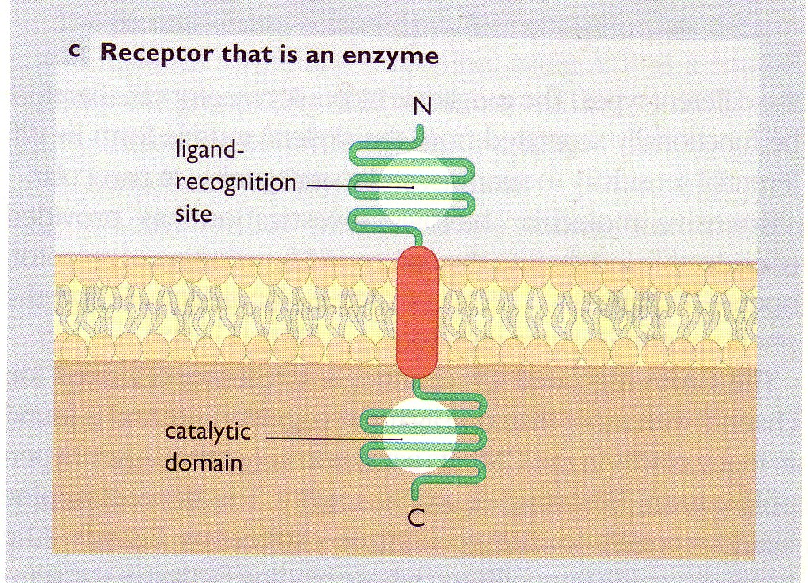
A RECEPTOR structure
Ligand recognition site
Inner catalytic domain
◉
Coupler Transduction

Slide 5
RECEPTOR FAMILIES
Type I (Ion Channel-Linked receptors)
Type II (G-Protein coupled receptors)
Type III (Enzyme-Linked receptors)
Type IV (Receptors linked to gene transcription)

Slide 6
TYPE I : Ion Channel-Linked receptors
Ligand gated ion channels
Ionotropic receptors
Located at cell membrane
Directly activated by ligand binding
Involved in fast synaptic transmission.
Directly related to channels.
Response occurs in milliseconds.
E.g. Nicotinic receptors activated by acetylcholine

Slide 7
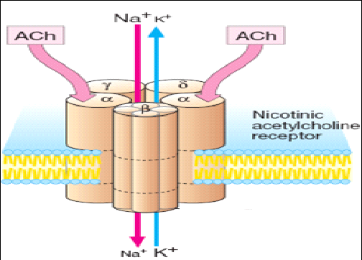
1
Channel-Linked Receptor
Ionotropic Receptor
Ligand-Gated-Ion Channel
e.g. nicotinic acetycholine receptor that is activated by occupancy of a ligand as acetycholine.

Slide 8
Type II: G-Protein coupled receptors
Metabotropic Receptor
The largest family that accounts for many known drug targets
Located at cell membrane
Coupled to G-protein
Response through ion channels or enzymes.
Involved in rapid transduction
Response occurs in seconds.
E.g. Muscarinic receptors of Ach
Adrenergic receptors of Noradrenaline

Slide 9
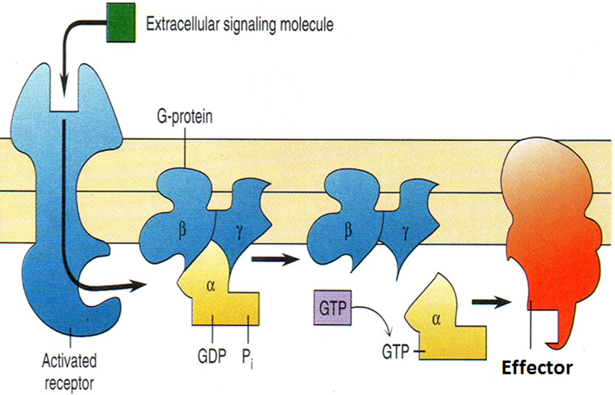
G-Protein
Is composed of 3 subunits [α β γ] &
Guanyle Di-Phosphate [GDP]
◉
Agonist occupancy dissociates [α] subunit so GTP replaces GDP & go to activate effector.
Agonist loss cleaves GTP by GTPase with return of GDP so [α β γ] bind again.

Slide 10
G-protein
GTP-binding regulatory proteins
Regulate guanine nucleotides GDP, GTP.
Comprise of three subunits (αβγ), α subunits possess GTPase activity
Receptors in this family respond to agonists
by promoting the binding of GTP to the G protein alpha ( α ) subunit.
GTP activates the G protein and allows it, in turn, to activate the effector protein.
The G protein remains active until it hydrolyzes the bound GTP to GDP and returns to its ground (inactive) state.

Slide 11
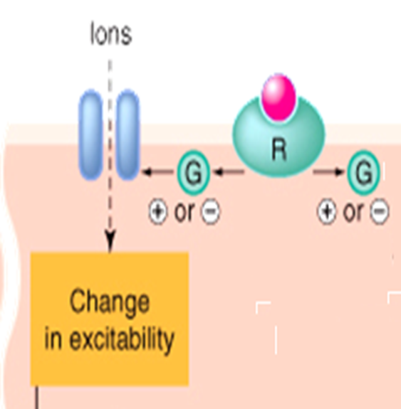
Targets for G-proteins
Ion channels
Muscarinic receptors in heart (K-channel), decrease heart rate.
second messengers
Cyclic AMP system (cAMP)
Inositol phosphate system (IP3+DAG)

Slide 12
Cyclic AMP system (cAMP)
ATP
G Protein
Adenyl cyclase enzyme
cAMP
Phosphorylation of Protein kinase A (PKA)
Activation or inhibitions of ion
channels or enzymes

Slide 13
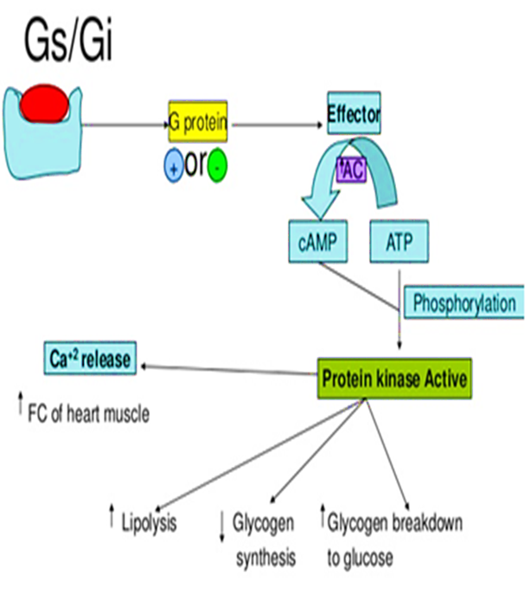
Cyclic AMP system (cAMP)

Slide 14
G-Protein-Coupled Receptor
Adenyle cyclase
R
G-Protein
E
α
β
γ
ATP
ATP
ATP
ATP
3 subunits [α β γ]
◉ + GDP
PKA

Slide 15
?
?
R
Channels
E
α
α
α
P
β
γ
ATP
ATP
ATP
ATP
cAMP
Enzymes
P
PKA
Cytoskeletal Proteins
P

Slide 16
Inositol phosphate system
Phosphoinositol diphosphate (PIP2)
G Protein
Phospholipase C
Diacylglycerol
(DAG)
Inosito triphosphate IP3
Increase intracellular calcium
Protein kinase C (PKC)
Exocrine secretion
Increase heart rate
Smooth muscle contraction
Ion channels
Smooth muscle contraction

Slide 17
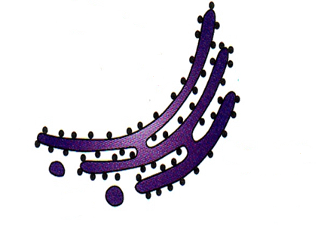
G-Protein-Coupled Receptor
Phospholipase C
E
α
α
PIP₂
DAG
Channels
β
γ

Phosphatidic a
Inositol
↑
P
IP₃
PKC
?
?
Ca⁺⁺
+CaM
CAMPK
P
P
P
Enzymes
P
Cytoskeletal Proteins

Slide 18
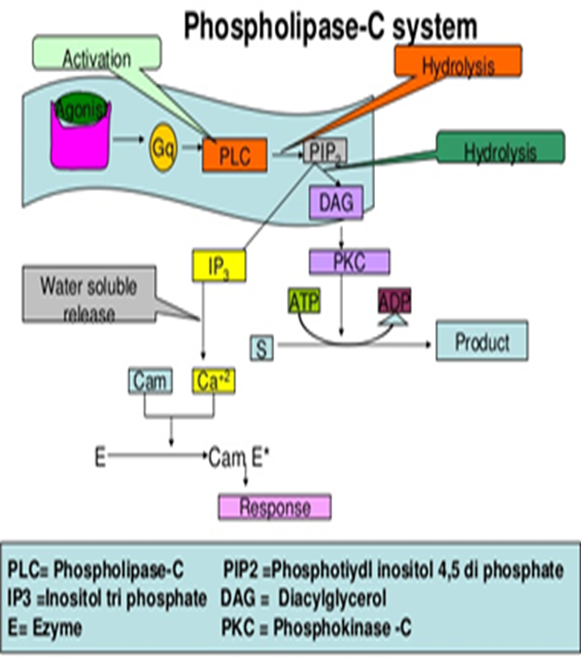

Slide 19
G-Protein-Coupled Receptor
Are the Most Abundant Type
Different Classes of Receptors
Ach R  m Adrenergic R  α & β
Different Receptors Subtypes
m Ach; m₁, m₂, m₃, m₄
β Adrenergic receptors; β₁, β₂ , β₃
Difference in their related G-Protein Classes
Divided according to their α-subunits into G_{s}, G_{i} and G_{q}
G_{s} and G_{i} produce, respective, stimulation and inhibition of AC
G_{q} is linked to activation of PLC-IP₃ -Ca⁺⁺ CaM & PKC

Slide 20
ADRENOCEPTORS
a₁ Adrenoceptors couple to G_{q} to stimulate PLC.
α₂ Adrenoceptors couple to G_{i} to inhibit AC.
β_{1&2} Adrenoceptors couple to G_{s} to stimulate AC
Adr
Adr
Inhibitory Receptor
Stimulatory Receptor
G_{i}
G_{s}
AC
α₂ Adrenoceptor
β Adrenoceptor
+
cAMP
↑cAMP

Slide 21
CHOLINERGIC RECEPTORS
M₁ & M₃ Ach receptors couple to G_{q} to stimulate PLC
M₂ & M₄ Ach receptors couple to G_{i} to inhibit AC
Ach
Adr
Stimulatory Receptor
Stimulatory Receptor
G_{q}
G_{q}
PLC
PLC
M₃ Ach receptor
α₁ Adrenoceptor
+
+
Bronchi
↑Ca ⁺⁺
↑Ca ⁺⁺
Blood Vessel

Slide 22
Type III (Enzyme-Linked receptors)
(Kinase-linked receptor)
Located at cell membrane with intrinsic enzymatic activity
Activation of receptors results in
Activation of protein kinases as tyrosine kinase with phosphorylation of tyrosine residue on their substrates and activation of many intracellular signaling pathways in the cell.
E.g. Insulin receptors

Slide 23
Type III (Enzyme-Linked receptors)
(Kinase-linked receptor)
Involved in response to hormones, growth factors.
Response occurs in minutes to hours.
They control many cellular functions as metabolism and growth.

Slide 24
3
Enzyme-Linked Receptors
Tyrosine Kinase-Linked Receptors
Ligands dimerize receptors
Activated Receptor autophosphorylates
Phosphorylate other proteins that it docks
Phosphorylated docked proteins
Example
Insulin Receptor
RESPONSE

Slide 25
Type IV: Gene transcription receptors
Nuclear receptors
Located intracellularly
Directly related to DNA (Gene transcription).
Activation of receptors either increase or decrease protein synthesis
Response occurs in hours or days and persists longer.
Their natural ligands are lipophylic hormones; steroids, thyroids, estrogen.

Slide 26
Type IV: Gene transcription receptors
They possess an area that recognizes specific DNA sequence in the nucleus which can bind it. This sequence is called a Responsive Element [RE]
This means that the activated receptors are acting as TRANSCRIPTION FACTORS [TF] → expressing or repressing target genes.

Slide 27
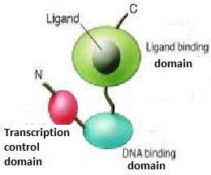
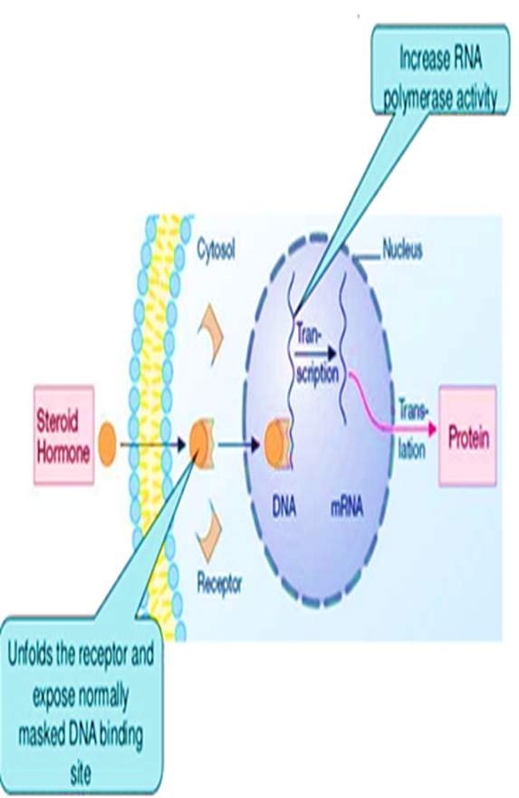
Type IV: Gene transcription receptors
Protein
Translation
Transcription

Slide 28
Type III | Type III | Type II | Type I
Nucleus | Membrane | Membrane | Membrane | Location
Via DNA | Direct | G-Protein | Direct | Coupling
Very slow | slow | fast | Very Fast | Synaptic transmission
Hours or days | minutes | Seconds | milliseconds | Response
Estrogen Steroid receptors | Insulin receptors | Muscarinic receptors | Nicotinic receptors | Examples
DNA | Enzymes | Channels/ enzymes | channels | Effectors

Slide 29
Signaling mechanisms

Slide 30
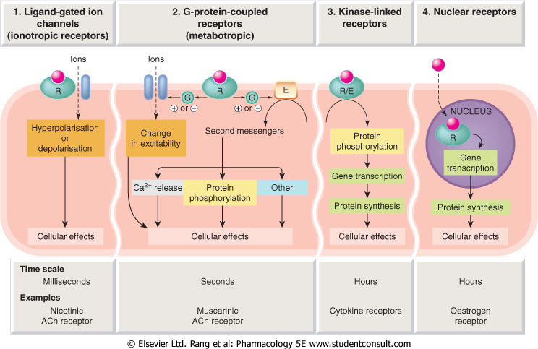
1
2
3
4
Conductance
Cell Signal  
Cell Signal 
Transcription
& Translation
Minutes / Hours
Hours / Days

