Slide 1
Autocrine and Paracrine mediators and their antagonists
Dr.Abdul latif Mahesar
Pharmacology.
2015

Slide 2
Intended learning objectives.
Cell to cell communication
local hormones which play role in communication
Histamine, Eicosanoids ,nitric oxide , Angiotensins, kinins.
their synthesis and role in body functions
Agents which increase or block their functions

Slide 3
HISTAMINE
It is an amine synthesized from an amino acid histidine
Stored in vesicles

Slide 4
Storage Sites
Highest amounts in mast cells
Basophils
Skin
Lung
Intestinal mucosa
Stomach
Brain

Slide 5
Bio synthesis it is synthesized by decrboxylation of amino acid histidine

Slide 6
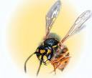
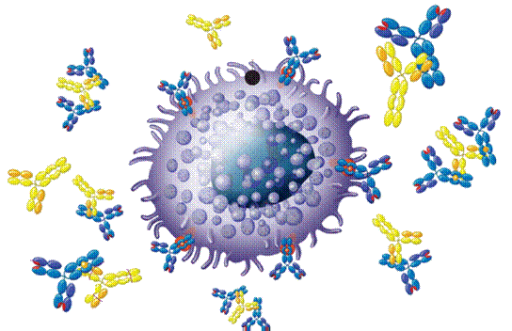
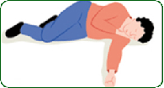
RELEASE
Primary mechanism, during allergic reactions on sensitizing [ IgE antibody interacts with antigen on the surface of mast cells ]
Mast cells get degranulated and release histamine and leads to allergic reactions.
It also has some role in acute inflammation ,on injury it causes local vasodialtion and leakage of plasma ,anti bodies and inflammatory cells.
Its release is modulated by binding to H3 presynaptic receptors

Slide 7
Enzymes as trypsin or drugs such as morphine or other chemicals can also liberate histamine
Tissue injury by trauma or burn

Slide 8
Histamine receptors
Receptor Type | Major Tissue Locations | Major Biologic Effects
H₁ | smooth muscle, endothelial cells | acute allergic responses
H₂ | gastric parietal cells | secretion of gastric acid
H₃ | central nervous system | neurotransmission
H₄ | mast cells, eosinophils, T cells | regulating immune responses

Slide 9
Effects Of Histamine
Pain ,itching,hives
Hypotension, tachycardia, flushing
Headache, visual disturbances, increase
skin temperature
Excessive secretion of gastric acids,diarrhea
Bronchoconstriction, dyspnea,

Slide 10
Histamine receptors antagonists

Slide 11
Physiologic antagonists:its effects can be reduced by physiologic antagonism such as epinephrine which acts on different receptors but produces effects opposite to histamine especially in anaphylaxis.
Specific receptor blockage:
Of Blocking of histamine receptors.
Specific histamine blockers are indicated in particular receptor stimulations.

Slide 12
First generation H1 receptor Blockers.
Diphenhydramine ,
cyclizine ,
promethazine
Second generation H1 receptor blockers
Loratidine
Citrizine

Slide 13
Diphenhydramin
(First generation)
H₁ antagonists ( Blockers )
Has a Sedating effect
Clinical uses :
Insomnia
Motion sickness

Slide 14
Loratadine (Second generation)
H₁ antagonists
Non-sedating effect
Clinical uses
Allergic conditions as :
allergic rhinitis
Conjunctivitis
Urticaria

Slide 15
Cimetidine
H₂ antagonists
Histamine plays an important role in the formation and secrtion of HCl by the activity of H2 receptors. Blocker of H2 receptors inhibit of gastric acid secretion
Used for the treatment of
peptic ulcers

Slide 16
BETAHISTINE
H₃ antagonists
Its effect produced is dilatation of blood vessels in inner ear.
Used in treatment of
vertigo and Balance disturbances.
May produce headache and insomnia.

Slide 17
Eicosanoids These are 20 carbon atom fatty acids.

Slide 18
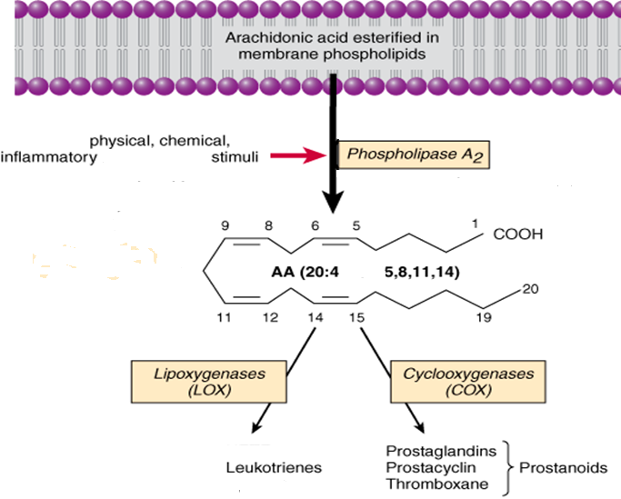

Slide 19
INHIBITORS OF EICOSANOIDS

Slide 21
INHIBITORS OF EICOSANOIDS

Slide 22
Actions of prostaglandins
Causes vasodilatation of vascular smooth muscle cells
Causes inhibition of platelets aggregation
Sensitize neurons to cause pain
Induce labor
Decrease intraocular pressure
Acts on thermoregulatory center of hypothalamus
Acts on kidney to increase glomerular filtration
Acts on parietal cells of stomach to prevent gastric mucosa

Slide 23
Prostaglandin actions.
that stimulate contractility of the uterineand other smooth muscle and have the ability to lower blood pressure, regulate acid secretion of the stomach, regulate body temperature and platelet aggregation, and control inflammation and vascular permeability.
They also affect the action of certainhormones.
First found in semen, they have since been found in cells throughout the body and in menstrual fluid. Prostaglandins are used clinically to control postpartum hemorrhage, to temporarily manage patent ductus arteriosus, and to treat impotence in men
prostaglandin injections into the amniotic sac, an in-hospital procedure, have been used as an abortiontechnique in pregnancies after the 16th week. About 30 minutes after an injection of prostaglandin F_{2α}, contractions begin, andabortion takes place within 19 to 20 hours.
These are also used in induction of labour.

Slide 24
Drugs
Phospholipids
Corticosteroids
Phospholipase A₂
Arachidonic Acid
Zileuton
NSAIDs
Lipoxygenase
Cyclooxygenase
Leukotrienes
Prostaglandins
Prostacyclin
Thromboxane (TXA2)

Slide 25
Comparison in actions between
Prostaglandins
Thromboxane A2

Slide 26
Vascular smooth muscles:
Prostaglandins
Thromboxane A₂
Potent vasoconstrictor.
Potent vasodilators .

Slide 27
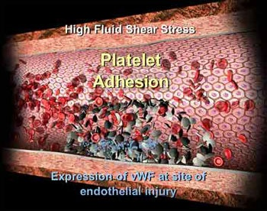
Blood:
TXA2
a potent inducer of platelet aggregation.
Prostaglandins
inhibit platelet aggregation

Slide 28
Inflammation:
Both play important role in inflammatory reactions.

Slide 29
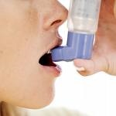
Bronchial smooth muscle:
-Prostaglandins ( bronchorelaxation )
-Thromboxane
(bronchoconstriction)

Slide 30
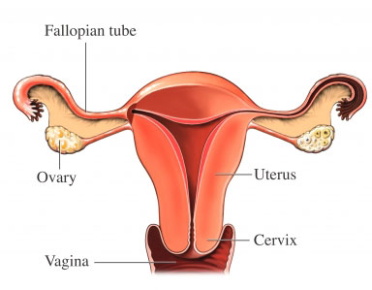
Uterine smooth muscle:
Prostaglandins increase uterine contractions → Menstruation/ Dysmenorrhea/ Labor contractions

Slide 31
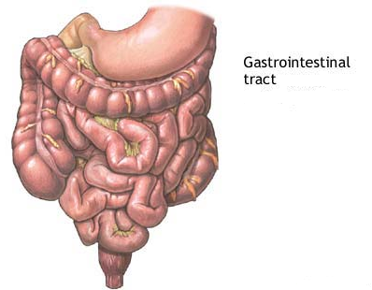
GIT smooth muscle:
- Prostaglandins
GIT
motility

Slide 32
GIT secretions:
Prostaglandins
↓acid secretion
↑ Mucin secretion

Slide 33
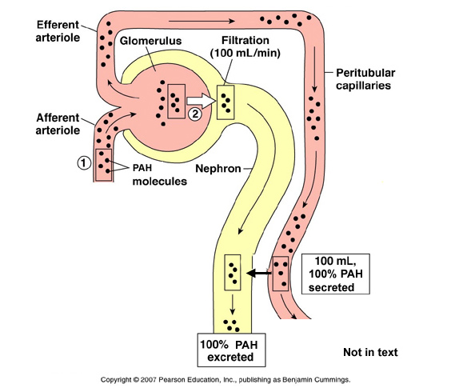
Kideny
Prostaglandins increase renal blood
flow and and may cause diuresis.

Slide 34
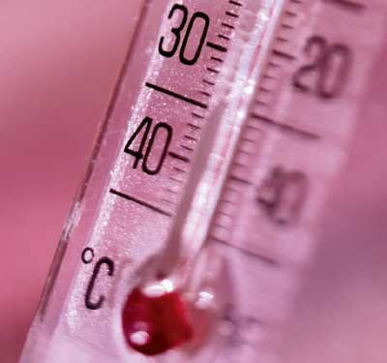
Central and peripheral nervous systems
Fever

Slide 35
Clinical uses of prostaglandins analogs
( Synthetic prostaglandins )

Slide 36
Carboprost
Abortion
Induce abortion in first trimester.

Slide 37
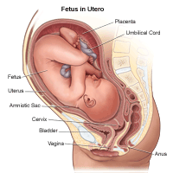
2) Treatment of postpartum haemorrhage
( vasoconstriction + ⬆uterine muscle contraction)

Slide 38
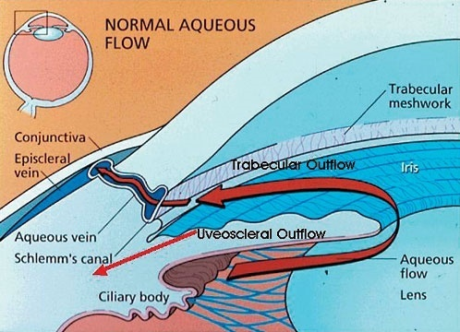
Latanoprost
eye drops /in treatment of open angle glaucoma.
(↓ IOP by enhancing outflow of the aqueous humar)

Slide 39
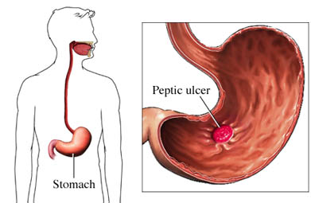
Misoprostol
Treatment of Peptic ulcer

Slide 40
Thank you

