Slide 1

Autonomic Nervous System
The Autonomic Nervous System
Assess Prof. Fawzia Al-Rouq Department of Physiology College of Medicine
King Saud University

Slide 2
LECTUR (1)
Functional Anatomy & Physiology of Autonomic NS

Slide 3
INTRODUCTION

Slide 4

THE NERVOUS SYSTEM
•INTRODUCTION
•The nervous system monitors and controls almost every organ / system through a series of positive and negative feedback loops.
•The Central Nervous System (CNS): Includes the brain
and spinal cord.
•The Peripheral Nervous System (PNS): Formed by neurons & their process present in all the regions of the body.
•It consists of cranial nerves arises from the brain & spinal nerves arising from the spinal cord.
•The peripheral NS is divided into
•Somatic Nervous system
•Autonomic nervous system

Slide 5
OBJECTIVES

Slide 6
Anatomy and physiology of
Autonomic Nervous System
At the end of this lectutre (1)the
student should be able to:-
-appreciate the anatomy of sympathetic& parasympathetic nervous system.
-explain physiological functions of Sympathetic &parasympathetic nerves in head&neck,chest,abdomen and pelvis

Slide 7
FUNCTIONAL ANATOMY OF THE AUTONOMIC NERVOUS SYSTEM

Slide 8
Basic anatomical difference between the motor
pathways of the voluntary somatic nervous system (to skeletal muscles) and those of the autonomic nervous system
Somatic division:
  Cell bodies of motor neurons reside in CNS (brain
or spinal cord)
  Their axons (sheathed in spinal nerves) extend all the way to their skeletal muscles
Autonomic system: chains of two motor
neurons
  1st = preganglionic neuron (in brain or cord)
  2nd = gangionic neuron (cell body in ganglion
outside CNS)
– Slower because lightly or unmyelinated
8

Slide 9
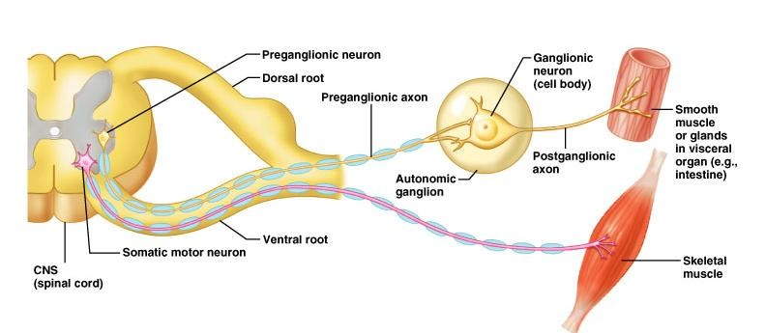
Basic anatomical difference between the motor pathways of the voluntary somatic nervous system (to skeletal muscles) and those of the autonomic nervous system

Slide 10
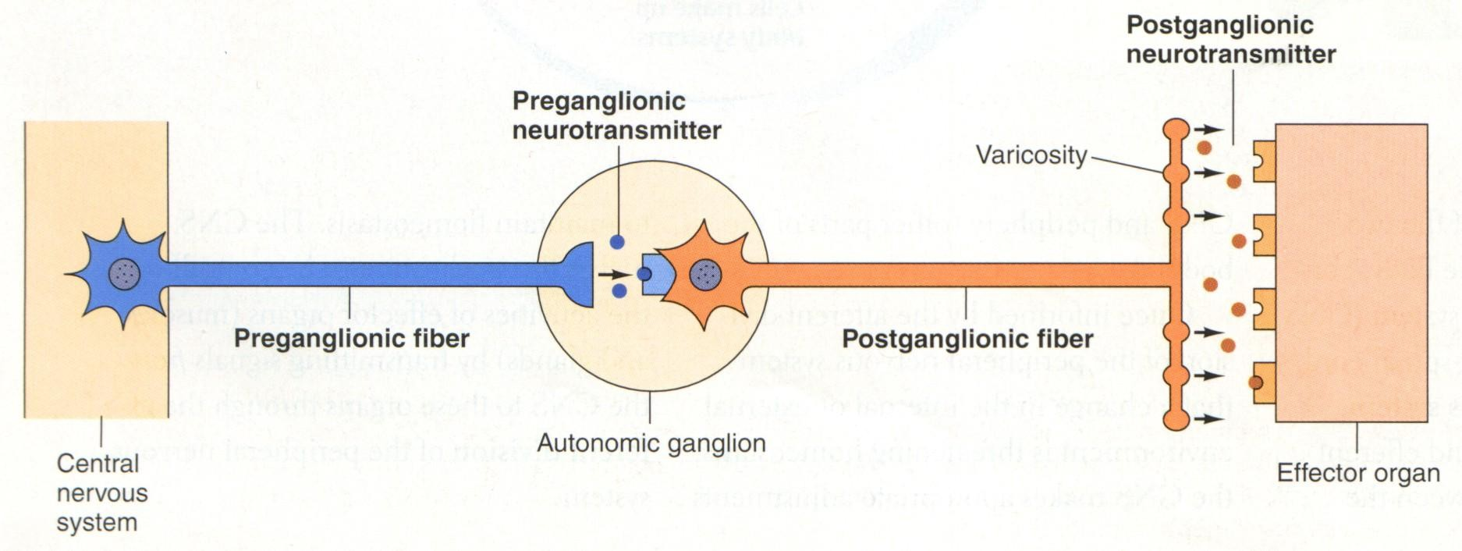
Axon of 1st (preganglionic) neuron leaves CNS to synapse with the 2nd (ganglionic) neuron
Axon of 2nd (ganglionic) neuron extends to the organ it serves
this dorsal root ganglion is sensory
10

Slide 11
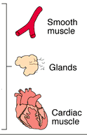
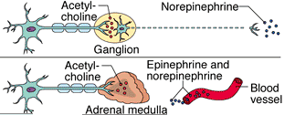
Sympathetic
Innervation of Visceral Targets
Short, lightly myelinated preganglionic neurons
Long, unmyelinated postganglionic neurons
Ganglia close to spinal cord
Spina
l

Slide 12

Parasympathetic
Innervation of Visceral Targets
Ganglia close to or on target organs
Preganglionic neurons - long
Post ganglionic neurons - short

Slide 13

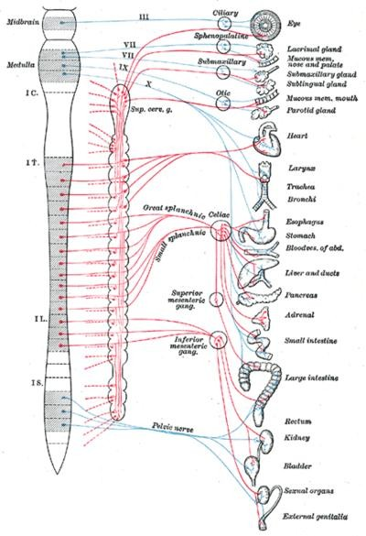
SYMPATHETIC & PARASYMPATHETIC
NERVOUS SYSTEM ORIGIN
Blue= Para symp;
Red symp

Slide 14
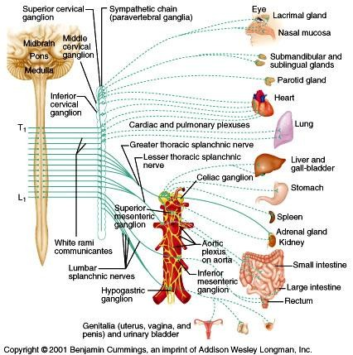
Sympathetic - Origin
Thoracolumbar lateral horns of the spinal segments T1-L2.
Nerve fibers originate between T1 & L2

Slide 15
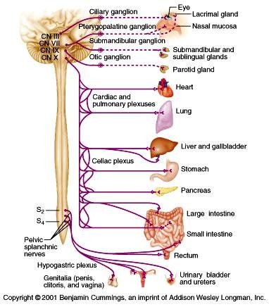
Parasympathetic - Origin
Craniosacral Cell bodies of the motor nuclei of the cranial nerves III, VII, IX and X in the brain stem
Second, third and fourth [S2- S4] sacral segments of the spinal cord
Nerve fibers emerge from
brain &
sacrum cranio-sacral outflow

Slide 16
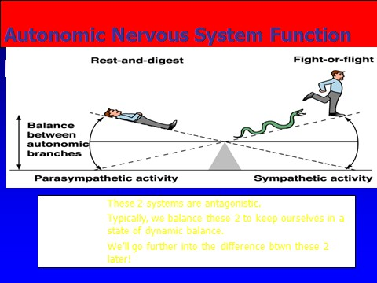
PHYSIOLOGICAL FUNCTIONS OF THE AUTONOMIC NERVOUS SYSTEM

Slide 17

THE AUTONOMIC
NERVOUS SYSTEM
Subdivis ion | Nerves Employed | Location of Ganglia | Chemical Messenger | General Function
Sympath etic | Thoracolum bar | Alongside vertebral column | Norepineph rine | Fight or flight
Parasym pathetic | Craniosacral | On or near an effector organ | Acetylcholi ne | Conservati on of body energy

Slide 18
PHYSIOLOGICAL FUNCTIONS OF THE AUTONOMIC NERVOUS SYSTEM

Slide 19
The Autonomic Nervous System
Structu re | Sympathetic Stimulation | Parasympathetic Stimulation
Iris (eye muscle) | Pupil dilation | Pupil constriction
Salivary Glands | Saliva production reduced | Saliva production increased
Oral/Na sal Mucosa | Mucus production reduced | Mucus production increased
Heart | Heart rate and force increased | Heart rate and force decreased
Lung | Bronchial muscle relaxed | Bronchial muscle contracted

Slide 20
The Autonomic Nervous System
Structure | Sympathetic Stimulation | Parasympathetic Stimulation
Stoma ch | Peristalsis reduced | Gastric juice secreted; motility increased
Small Intes | Motility reduced | Digestion increased
Large Intes | Motility reduced | Secretions and motility increased
Liver | Increased conversion of glycogen to glucose
Kidney | Decreased urine secretion | Increased urine secretion
Adrenal medulla | Norepinephrine and epinephrine secreted
Bladder | Wall relaxed Sphincter closed | Wall contracted Sphincter relaxed

Slide 21




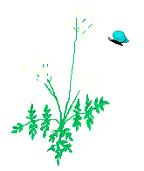
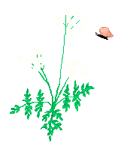

Slide 22
LECTUR (2)
MECHANISM OF ACTIONS
The neurotransmitters &
receptors of Autonomic NS

Slide 23
OBJECTIVES

Slide 24
OBJECTIVES
describe neurotransmitters that can release at pre and post ganglionic of Autonomic NS.
Describe Autonomic NS receptors.

Slide 25
Sympathetic Neurotransmitters
Preganglionic neurons -
Cholinergic = ( release acetylcholine )
Postganglionic neurons:
  release norepinepherine at target organs
  ie. Adrenergic

Slide 26
Parasympathetic Neurotransmitters
Pre & Postganglionic neurons release
acetylcholine = Cholinergic

Slide 27
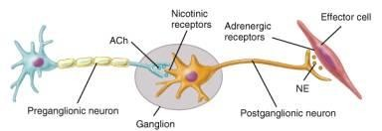
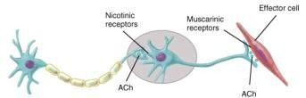
ANS Neurotransmitters: Classified as either cholinergic or adrenergic
neurons based upon the neurotransmitter released
Adrenergic
Cholinergic

Slide 28
Chemical or neural transmitter
All preganglionic fibers release
acetylcholin (Ach).
All parasympathetic postganglionic
release Ach.
All sympathetic postganglionic release noradrenalin except sweat glands & bl vessels to skeletal muscles

Slide 29
RECEPTORS
The
parasympathetic
nervous
system uses only
acetylcholine (ACh) as its neurotransmitter.
The ACh acts on
two types of receptors, the
muscarinic and nicotonic choloinergic receptors.
Most transmissions occur in two stages: When stimulated, the preganglionic nerve releases ACh at the ganglion, which acts on nicotinic receptors of the postganglionic nerve.
The postganglionic nerve then releases ACh to stimulate the muscarinic receptors of the target organ.
The Sympathetic NS Acts on tow types of receptors :
α and β.

Slide 30
ANS Receptors : Classified as either parasympathetic or sympathetic
Adrenergic
Cholinergic

Slide 31
What do the receptors do?
Activation of α receptors leads to smooth muscle contraction
Activation of β₂ receptors leads to smooth muscle relaxation
Activation of β₁ receptors leads to smooth muscle contraction (especially in heart)

