Slide 1
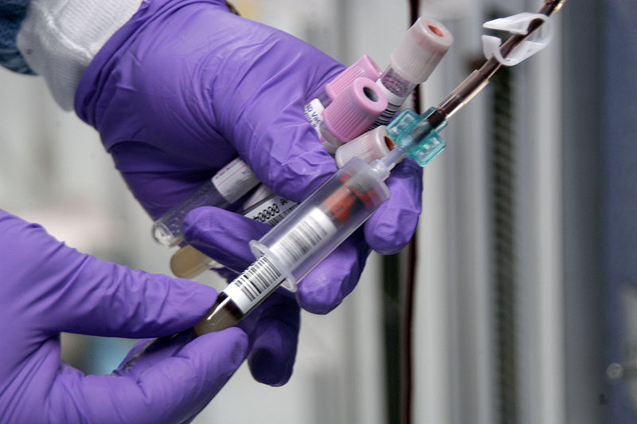
Blood Groups
Clotting Time and Bleeding Time

Slide 2

Aims of the Practical
To determine:
Blood groups.
Clotting time.
Bleeding time.

Slide 3
Objectives
At the end of this lab you should be able to:
Understand and practice the method used in determining blood groups (ABO and Rhesus (Rh) systems).
Determine your own Bleeding and clotting time.
Recognize the importance of bleeding time and clotting time in haemostasis.

Slide 4
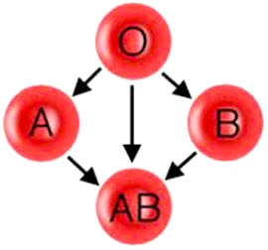
Blood Groups

Slide 5
Blood Groups
ABO System:
  Group A: antigen A on RBC membrane anti B in plasma.
  Group B: Antigen B on RBC membrane Anti A in plasma.
  Group AB: Antigen A and B on RBC membrane NO antibodies in plasma.
  Group O: NO antigen on RBC membrane both Anti A and Anti B in plasma.

Slide 6
Rhesus Blood Group(Rh)
Rhesus antigen D:
Rhesus positive (Rh+ve): Antigen D on RBC (96-98%).
Rhesus negative (Rh-ve): NO Antigen D on RBC (2-4%).

Slide 7
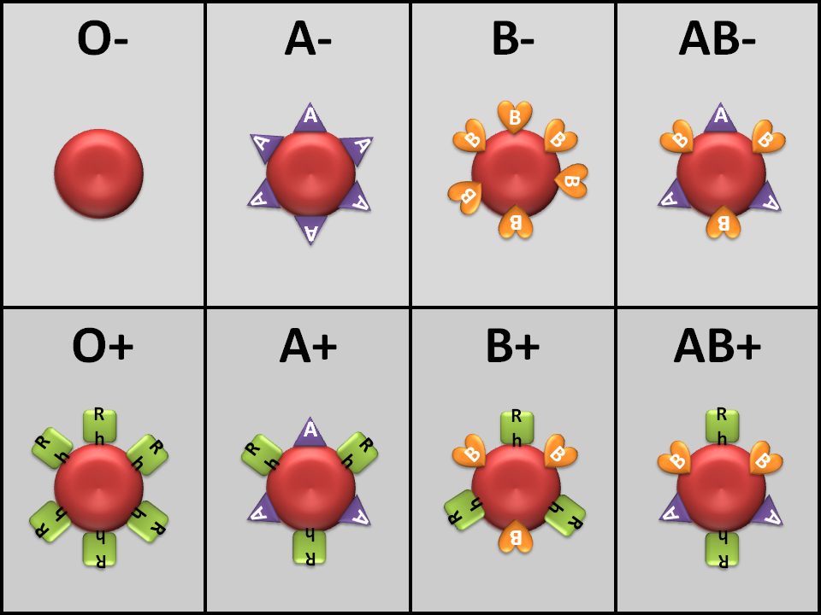
Blood Groups Antigens

Slide 8
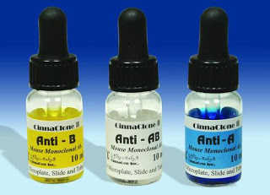
Materials
High titer anti-A, anti-B and anti-D sera.
A grease pencil.
Microscope slides.
Alcohol swab and pricker.

Slide 9
Procedure
Prick a finger and place one drop of blood in each of the compartments A, B and D (these are clearly labeled on the microscope slides provided).
Quickly add a drop of anti-A, anti-B and anti-D-sera to each compartment
Mix the serum with the drop of blood by moving the slides gently for a minute or two, Then examine the mixtures for signs of RBC agglutination or clump formation.

Slide 10
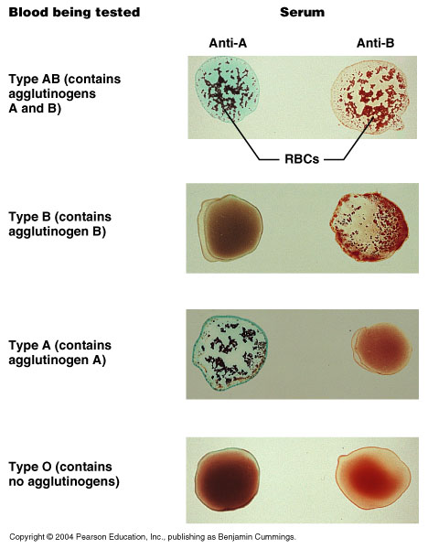

Slide 11
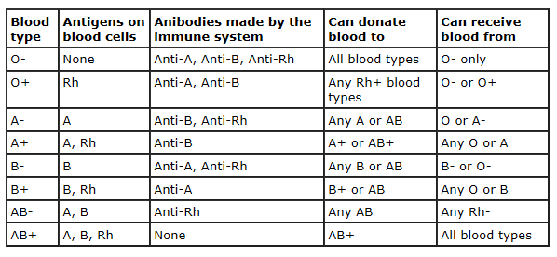
Blood Groups

Slide 12
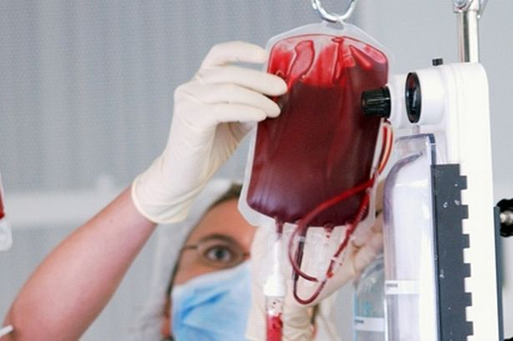
Clinical Applications
Important in the following conditions:
Blood transfusion.
Hemolytic disease of the newborn (HDN).
Blood products.

Slide 13
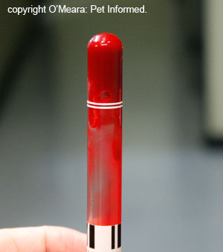
Clotting Time

Slide 14
Clotting Time
The time required for blood to form a clot.
The normal coagulation time in glass tubes is 5 to 15 minutes.
The whole blood clotting time is a rough measure of all intrinsic clotting factors in the absence of tissue factors.
Used in diagnosis of hemophilia.
Its chief application is in monitoring anti-coagulant therapy.

Slide 15
Materials
Capillary tubes of uniform size ( non heparinized)
A petri-dish.
Alcohol swabs.
Cotton wool.
Plasticine.
A water bath set at 37°C.

Slide 16
Procedure
Clean finger with alcohol swap, prick it with lancet and note the time that the prick is made.
Wipe away the first drop of blood. Then while the blood is still flowing freely place one end of a capillary tube in the blood. Holding the tube horizontally let it fill by capillary action, fill more than one tube.
Close the end of the capillary tube with plasticine. Place the tube in the water bath.

Slide 17
Two minutes after making the puncture, break a capillary tube and separate the two halves slowly.
Repeat the procedure at 30 second intervals with the remaining tubes.
When the blood forms a continuous thread-like clot between the broken ends of the tube, the end-point has been reached, note the time.
The time from pricking the finger to the appearance of the clot is the clotting time .

Slide 18
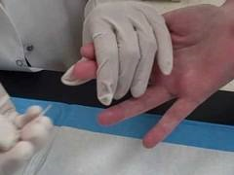
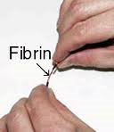

Slide 19
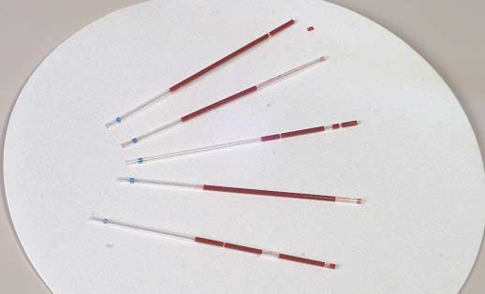

Slide 20
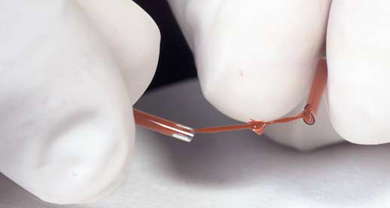

Slide 21
Results
Usually the clotting time measured by this method is in the range 3-6 minutes.
Prolong clotting time seen in deficiencies in the intrinsic coagulation pathway.
Example:
hemophilia due to deficiency of Factor VIII (8).

Slide 22
Clotting Time using Test Tube
Method
Place 2 ml blood into non heparinized test tube incubated in water bath.
Every 30 second invert gentle to check for clot formation.
Time from pricking finger to clot formation is clotting time.
Normally 6-10 min by this method
Measurement of the clotting factors are better used.

Slide 23
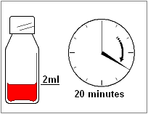
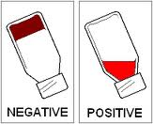
Clotting Time using Test Tube
Method
Clot formed
No Clotting

Slide 24
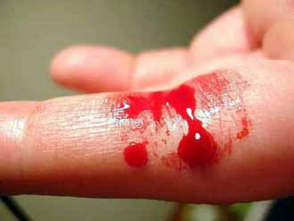
Bleeding Time

Slide 25
Bleeding Time
The time taking for bleeding to stop (time for a platelet plug to form).
Bleeding time is a test of platelet function.
The template bleeding time is used when the test is performed by standard template method.

Slide 26
Materials
Alcohol swabs.
Filter paper.
A stop-watch.
A stylette to prick an ear lobe.

Slide 27
Procedure
Clean the lobe of the ear with an alcohol swab.
When it is dry, make a single puncture with a stylette (about 3mm deep).
Note the time at which the puncture is made.
The skin of the ear should not be touched once the puncture has been made until the experiment is over.

Slide 28
Procedure cont….
Apply a piece of filter paper to the blood-drop every 30 seconds until the bleeding stops.
The bleeding time estimated by this method of a normal subject is within 2-5 minutes.

Slide 29
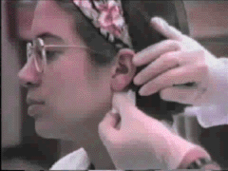
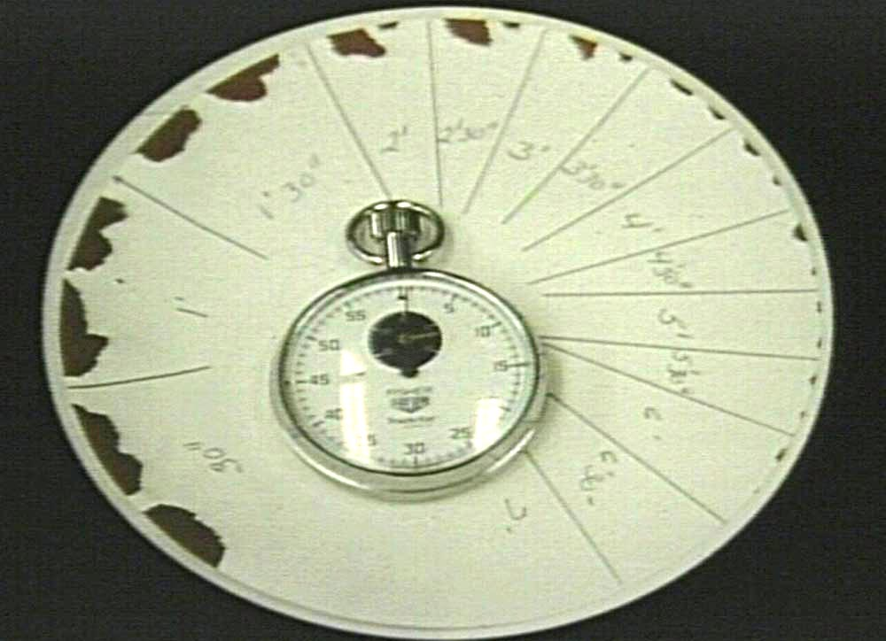
Bleeding Time

Slide 30
The Standardized Template Method
A sphygmomanometer cuff is applied to the subject’s arm and inflated to 40mmHg.
The volar surface is cleaned with 70% alcohol.
A sterile metal template with a linear slit (11mm long) is pressed firmly against the skin.
A scalpel blade, with a guard, is carefully introduced so that it protrudes 1mm through the template slit. An incision, 1mm deep and 9mm long can then be made.

Slide 31
Blood is gently, but completely removed with filter paper at 15 second intervals until the bleeding stops.
Normal bleeding times determined with this method are in the range 2.5-9.5 minutes.

Slide 32
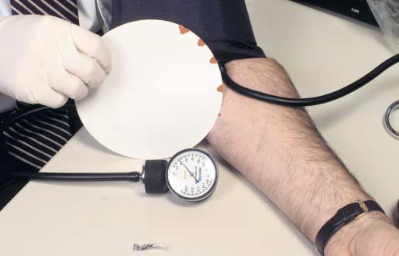
The Standardized Template Method

Slide 33
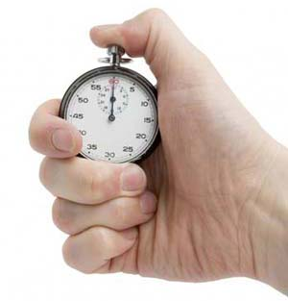
Note:
If the bleeding time exceeds 15 minutes:
- Stop the procedure.
- Apply pressure to stop the bleeding.
- Report as greater than 15 min.

Slide 34
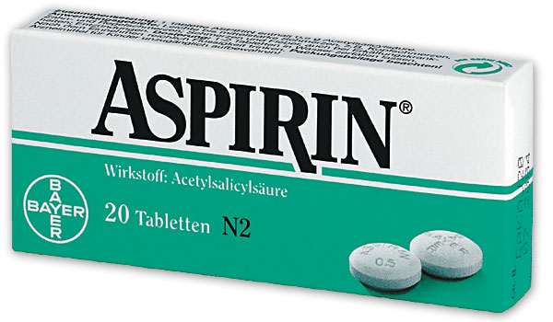
Clinical Application
Bleeding time is prolonged in the following conditions:
Platelet dysfunction.
Blood vessel wall disorders.
Haemophilia.
Von Willebrand Disease.
Thrombocytopenia.
Vitamin K deficiency.
Medications: Aspirin.

Slide 35

Thank you

