Slide 1
بسم الله الرحمن الرحيم

Slide 2
Oxidative Decarboxylation and Krebs Cycle
By
Amr Moustafa , MD PhD
Clinical Chemistry Unit, Pathology Dept.
College of Medicine, King Saud University

Slide 3
Objectives: Oxidative Decarboxylation
By the end of this part of the lecture, students are expected to:
Recognize the various fates of pyruvate
Define the conversion of pyruvate to acetyl CoA
Discuss the major regulatory mechanisms for PDH complex
Recognize the clinical consequence of abnormal oxidative decarboxylation reactions

Slide 4
Objectives: Krebs Cycle
By the end of this part of the lecture, students are expected to:
Recognize the importance of Krebs cycle
Identify various reactions of Krebs cycle
Define the regulatory mechanisms of Krebs cycle
Assess the energy yield of PDH reaction and Krebs cycle’s reactions

Slide 5
Fates of Pyruvate
ALT
Alanine
PLP
αKG
Glutamate
PLP = Pyridoxal Phosphate

Slide 6
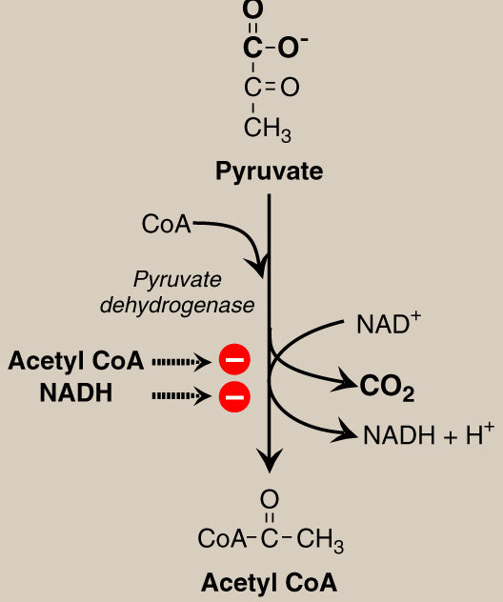
Oxidative Decarboxylation of Pyruvate
Allosteric
Regulation

Slide 7
PDH Complex: Covalent Regulation
Insulin
+
PDH
Insulin
Ca²⁺
Glucagon
-
PDH
+
P
P_{i}
Pyruvate dehydrogenase
complex (active)
Protein Phosphatase
H₂O
Pyruvate dehydrogenase
complex (inactive)
Protein Kinase
ATP
ADP
+
Glucagon

Slide 8
PDH Reaction: Clinical application
Deficiencies of thiamine or niacin can cause serious CNS problems. WHY?
Brain cells are unable to produce sufficient ATP if the PDH complex is inactive.
Wernicke-Korsakoff (encephalopathy-psychosis syndrome) due to thiamine deficiency, may be seen with alcohol abuse.
PDH complex deficiency is the most common biochemical cause of congenital lactic acidosis.

Slide 9
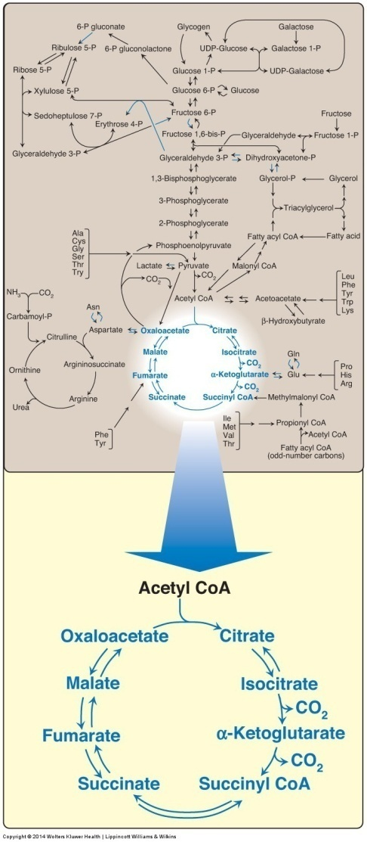
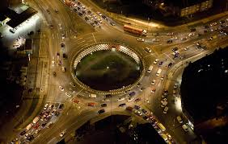
Krebs Cycle
The tricarboxylic acid cycle (Krebs) shown as a part of the essential pathways of energy metabolism.
CoA = coenzyme A

Slide 10
Tricarboxylic Acid Cycle: Krebs Cycle
Final common pathway for oxidation
Exclusively in mitochondria
Major source for ATP
Mainly catabolic with some anabolic features
Synthetic reactions (anabolic features):
Glucose from amino acids
Nonessential amino acids
Fatty acids
Heme

Slide 11
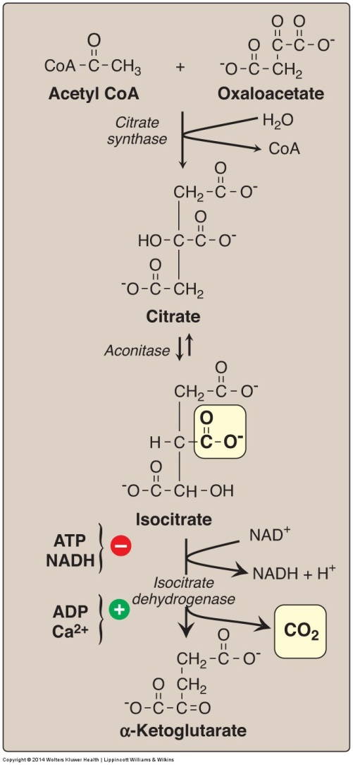
Krebs Cycle Reactions (1)
Formation of α-ketoglutarate from acetyl coenzyme A (CoA) and oxaloacetate. NAD(H) = Nicotinamide adenine dinucleotide

Slide 12
Krebs Cycle Reactions (2)
Succinate Thiokinase
Substrate-Level
Phosphorylation
Formation of malate from α-ketoglutarate.
NAD(H) = nicotinamide adenine dinucleotide; GDP = guanosine diphosphate;
P = phosphate; CoA = coenzyme A; FAD(H₂) = flavin adenine dinucleotide.

Slide 13
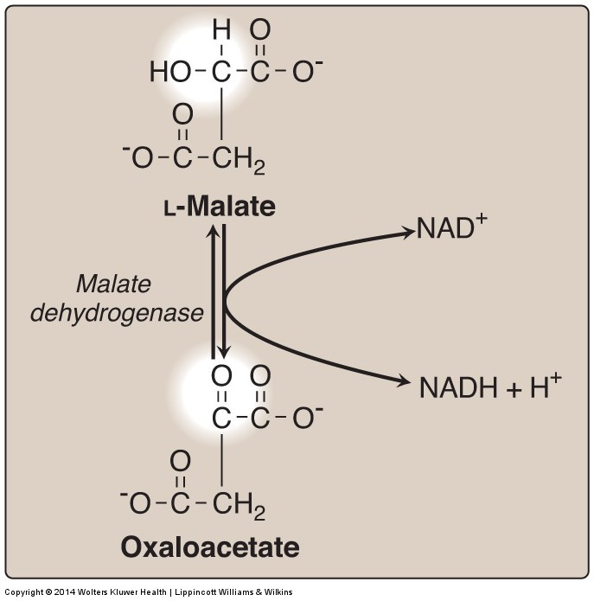
Krebs Cycle Reactions (3)
Formation (regeneration) of oxaloacetate from malate.
NAD(H) = nicotinamide adenine dinucleotide

Slide 14
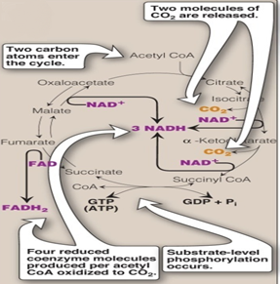
Krebs Cycle: Energy Yield
Number of ATP molecules produced from the oxidation of one molecule of acetyl coenzyme A (CoA) using both substrate-level and oxidative phosphorylation.

Slide 15
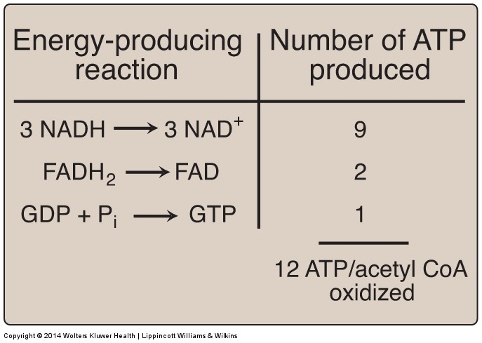
Krebs Cycle: Energy Yield
Number of ATP molecules produced from the oxidation of one molecule of acetyl coenzyme A (CoA) using both substrate-level and oxidative phosphorylation.

Slide 16
Net ATP Production by Complete Glucose Oxidation
Aerobic glycolysis: 8 ATP
Oxidative decarboxylation: 2 X 3 = 6 ATP
Krebs cycle: 2 X 12 = 24 ATP
Net: 38 ATP

Slide 17
Regulation of Oxidative decarboxylation and Krebs cycle
PDH complex and the TCA cycle are both up-regulated in response to a decrease in the ratio of
ATP:ADP
NADH:NAD⁺
TCA cycle activators are:
ADP
Ca²⁺
TCA cycle inhibitors are:
ATP
NADH

Slide 18
Take Home Message
Pyruvate is oxidatively decarboxylated by PDH to acetyl CoA inside the mitochondria
Krebs cycle:
Final common pathway for the oxidation of carbohydrates, fatty acids and amino acids
occurs in the mitochondria
Aerobic
Mainly catabolic, with some anabolic reactions
The complete oxidation of one glucose molecule results in a net production of 38 ATP molecules

Slide 19
Thank you

