Slide 1
بسم الله الرحمن الرحيم

Slide 2
Glucose Metabolism: Gluconeogenesis
By
Amr S. Moustafa, MD, PhD
Assistant Prof. & Consultant, Medical Biochemistry Unit,
Pathology Dept., College of Medicine, KSU
amrsm@ksu.edu.sa

Slide 3
Objectives
The importance of gluconeogenesis as an important pathway for glucose production
The main reactions of gluconeogenesis
The rate-limiting enzymes of gluconeogenesis
Gluconeogensis is an energy-consuming, anabolic pathway

Slide 4
Gluconeogenesis: An Overview
Liver (mainly) and Kidneys
Both mitochondria and Cytosol
Exception: Glycerol, only cytosol
Gluconeogenic substrates:
Glycerol
Lactate and Pyruvate
Glucogenic amino acids

Slide 5
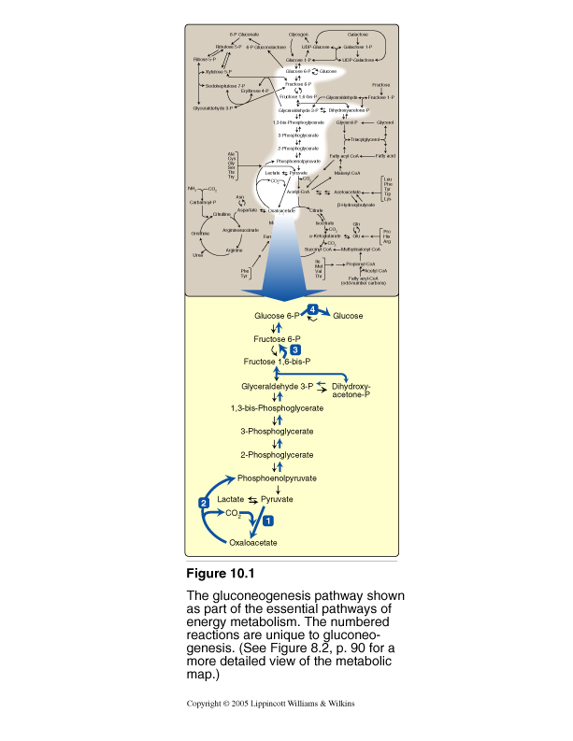
Gluconeogenic Pathway
4. Dephosphorylation of G6P
3. Dephosphorylation of F1,6P
2. Transport of OA
1. Carboxylation of pyruvate

Slide 6
Gluconeogenic Substrates: Glycerol
*GK
Glycerol
Glycerol 3-phosphate
ATP
ADP
NAD+
Glycerol 3-phosphate
dehydrogenase
NADH
Glucose
Dihydroxyacetone phosphate
*GK: Glycerol kinase only in liver & kidneys

Slide 7

Glucogenic Amino Acids
Aspartate (Asp)
Asparagine (Asn)
Glutamate (Glu)
Glutamine (Gln)
Phenylalanine (Phe)
Tyrosine (Tyr)
Methionine (Met)
Valine (Val)

Slide 8
Gluconeogenic
Substrates
Lactate
Amino acids
Pyruvate
Alanine (Ala)
Glycine (Gly)
Aspartate (Asp)
Asparagine (Asn)
Glutamate (Glu)
Glutamine (Gln)
Phenylalanine (Phe)
Tyrosine (Tyr)
Methionine (Met)
Valine (Val)

Slide 9
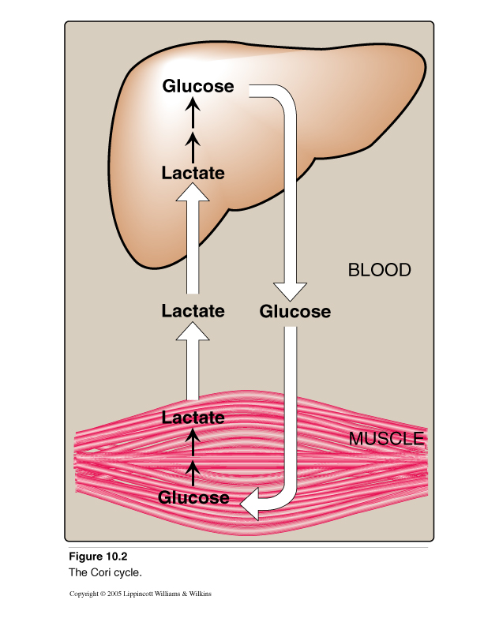
Gluconeogenic Substrates: Lactate
(Cori Cycle)

Slide 10
Gluconeogenic Pathway
Dephosphorylation of G-6-P
Dephosphorylation of F 1,6-P
Transport of OAA
Carboxylation of pyruvate

Slide 11
Carboxylation of Pyruvate in the Mitochondria
Pyruvate Carboxylase
Biotin
Pyruvate
Oxaloacetate
CO₂
ATP
ADP + P_{i}

Slide 12
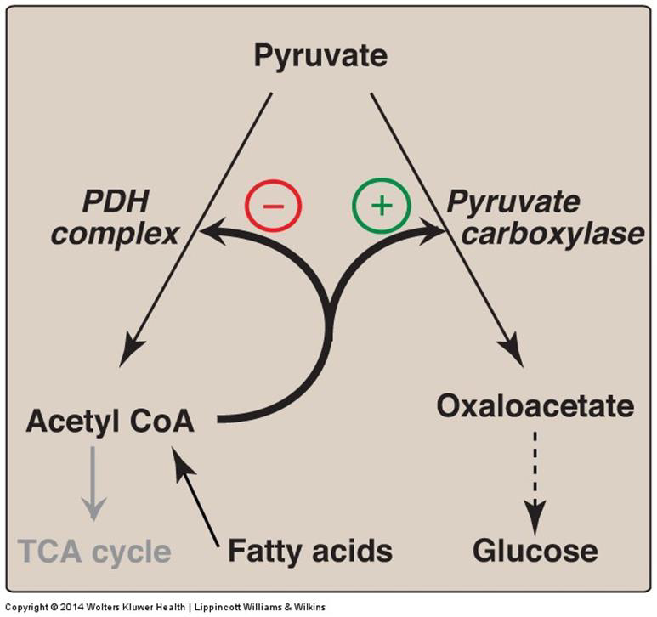
Regulation of Pyruvate Carboxylase
Acetyl CoA diverts
pyruvate away from oxidation and toward gluconeogenesis

Slide 13
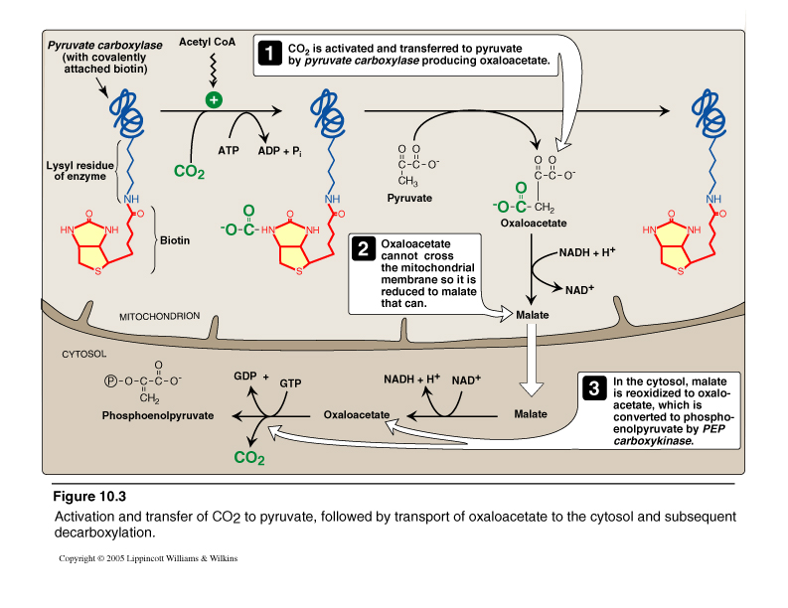
Pruvate Carboxylase and PEP-CK
Fasting:
Acetyl CoA
(From FAO)*
*Fatty Acid
Oxidation
Pyruvate carboxylase + PEP-CK = Pyruvate kinase

Slide 14
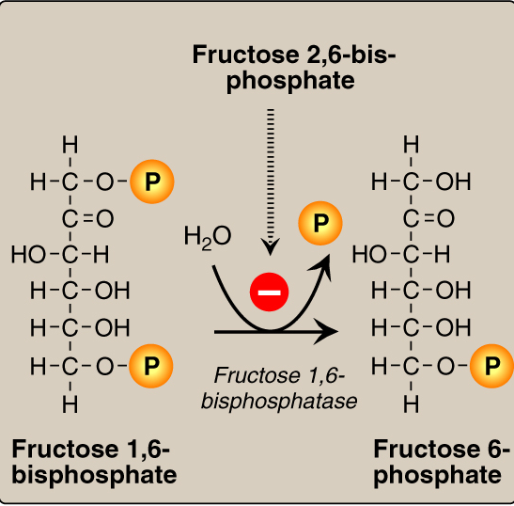
Fructose 1,6-Bisphosphatase
Fructose 1,6-bisphosphatase = PFK-1

Slide 15
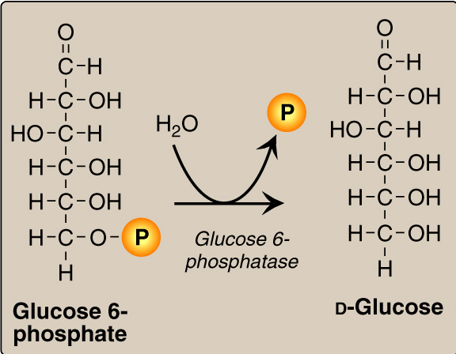
Glucose 6-Phosphatase
Glucose 6-phosphatase = Glucokinase

Slide 16
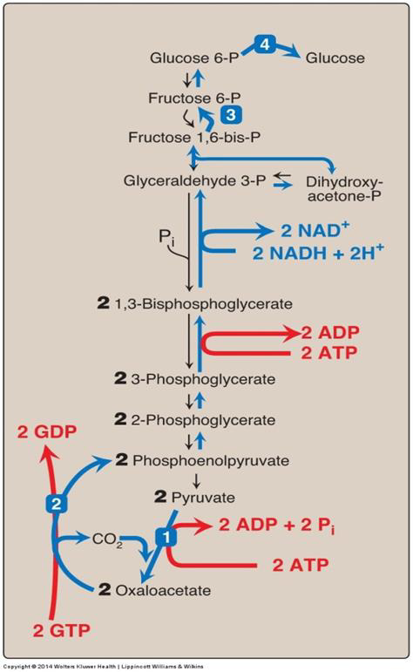
Gluconeogensis:E- Consumed
Six High-Energy
Phosphate Bonds
Are Consumed for
the Conversion of
Pyruvate to Glucose

Slide 17
Gluconeogenesis: Regulation
Reciprocal control of
Gluconeogenesis & Glycolysis
Allosteric regulation:
Acetyl CoA Pyruvate carboxylase
AMP or ATP
F 2,6-Bisphosphate
Glucagon ( I/G ratio)
Allosteric ( F 2,6-Bisphosphate)
Induction (PEP-CK)
+
-
+
F 1,6-bisphosphatase
-

Slide 18
Take Home Message
Gluconeogenesis:
Synthesis of glucose from noncarbohydrates
Anabolic
Energy-consuming
Four unique enzymes are required for
reversal of the 3 irreversible reactions
of glycolysis
Both gluconeogenesis & glycolysis are
reciprocally-regulated

