Slide 1
Enzymes I (Foundation Block)
Dr. Usman Ghani
What are enzymes?
Classification of enzymes and naming
Coenzymes, Cofactors, Isoenzymes
Enzyme activity and specificity
Factors affecting enzyme activity

Slide 2
Enzymes II (Foundation Block)
Enzyme kinetics (Michaelis Menten equation)
Enzyme inhibition and types
Regulation of enzyme activity
Enzymes in clinical diagnosis

Slide 3
What are Enzymes?
Enzymes are biological catalysts that speed up the rate of a reaction without being changed in the reaction
All enzymes are protein in nature
But all proteins are not enzymes
All enzymes have one or more active sites
Some enzymes have both active and regulatory sites
Enzymes bind to their specific substrates in the active site to convert them to product(s)

Slide 4
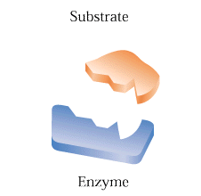
Enzymes

Slide 5
Active site
The region of enzyme where a substrate binds is called active site
Once the substrate is bound, catalysis takes place
All enzymes have one or more active sites

Slide 6
Structure of trypsin enzyme
Page 519

Slide 7
An enzyme with its active site
Page 533

Slide 8
Structure of pepsin enzyme
Page 537

Slide 9
Classification of Enzymes
Enzymes are classified into six types according to the type of reaction catalyzed

Slide 10
Enzyme Classification According to Reaction Type
Page 470

Slide 11
Enzyme nomenclature (Naming)
Enzyme nomenclature is based on the rules given by IUBMB (International Union of Biochemistry and Molecular Biology)
EC 3.4.17.1
EC Class . Subclass . Subsubclass . Enzyme number
EC = Enzyme Commission

Slide 12
Enzyme specificity
Enzymes are highly specific to their substrate
They catalyze only one type of reaction

Slide 13
Enzyme –substrate binding
Two models have been proposed:
Lock and key binding
The enzyme has an active site that fits the exact dimensions of the substrate

Slide 14
An enzyme–substrate complex illustrating both the geometric and the physical complementarity between enzymes and substrates
Page 460

Slide 15
Page 461

Slide 16
Enzyme –substrate binding
Induced-fit binding
After the binding of substrate, the enzyme changes its shape to fit more perfectly with substrate

Slide 17
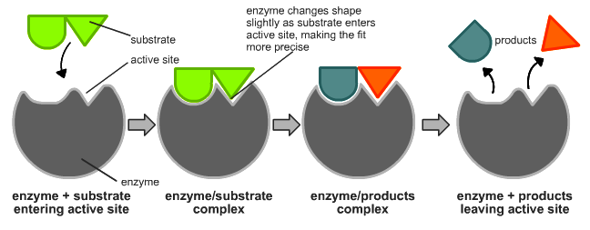
Page 461

Slide 18
Enzyme Activity or Velocity
Velocity is the rate of a reaction catalyzed by an enzyme
Enzyme activity is expressed as:
μmoles of product formed/min/mg enz

Slide 19
Cofactors, Coenzymes, Isoenzymes
Cofactors are small molecules or metal ions such as Cu²⁺, Fe³⁺, Zn²⁺, etc. which help an enzyme to catalyze a reaction
Cofactors may also be organic molecules known as coenzymes such as NAD⁺
Some cofactors are only temporarily associated with an enzyme known as cosubstrates

Slide 20
Cofactors, Coenzymes, Isoenzymes
Some cofactors are permanently associated with an enzyme known as prosthetic groups
An active enzyme-cofactor complex is called a holoenzyme
The inactive form of an enzyme without its cofactor/coenzyme is called an apoenzyme
Isoenzymes catalyze the same chemical reaction but they have slightly different structures

Slide 21
Apoenzyme (inactive) + Cofactor = Holoenzyme (active)
Apoenzyme (inactive) + Coenzyme = Holoenzyme (active)

Slide 22
Ribozymes
Ribozymes are RNA (ribonucleic acid) with enzymatic activity

Slide 23
Zymogens
Zymogens are inactive forms of enzyme
They are activated when needed

Slide 24
How do enzymes work?
In every chemical reaction, the reactants pass through a transition state that has greater energy than that of the reactants or products alone
The difference in energy between the reactants and the transition state is called the activation energy
If the activation energy is available then the reaction can proceed forming products

Slide 25
How do enzymes work?
An enzyme reduces the activation energy required for a reaction
It provides an alternative transition state of lower energy called the enzyme-substrate complex and thus speeds up the reaction
Enzymes decrease the activation energy but they do not cause a change in the free energy (∆G) (available energy)

Slide 26
The effect of a catalyst on the transition state diagram of a reaction.
Page 477

Slide 27
Factors affecting enzyme activity
Effect of temperature
The rate of an enzyme reaction increases with rise in temperature (increase in velocity)
Every enzyme has an optimal temp. for catalyzing a reaction
At high temp. enzymes are denatured and become inactive
In humans most enzymes have an optimal temp. of 37ºC

Slide 28
Factors affecting enzyme activity
Effect of pH
pH changes the ionizable groups in the active site – this affects catalysis
Every enzyme has an optimal pH for catalyzing a reaction
Most enzymes have highest activity between pH 6 and pH 8
Pepsin has highest activity at pH 2

Slide 29
Effect of pH on the initial rate of the reaction catalyzed by most enzymes (the bell-shaped curve)
Page 487

Slide 30
Factors affecting enzyme activity
Effect of [E] and [S]
Enzyme reaction rate is directly proportional to the conc. of enzyme if the substrate concentration [S] is higher than enzyme
The reaction velocity increases initially with increasing [S]
Further addition of substrate has no effect on enzyme velocity (v)
At low [S], the reaction rate is proportional to [S]

Slide 31
Enzyme kinetics
The model of enzyme kinetics was first proposed by Michaelis and Menten in 1913 and later modified by Briggs and Haldane
The Michaelis Menten equation describes the relationship of initial rate of an enzyme reaction to the [S]

Slide 32
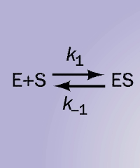

Slide 33
Initial rate of enzyme reaction
Pre-steady state kinetics
When an enzyme is mixed with high [S]
There is an initial short period of time (a few hundred microseconds) in which intermediates of product are formed
This is called pre-steady state reaction

Slide 34
Steady state kinetics
After the initial state, the reaction rate and the conc. of intermediates change slowly with time
This is called steady state reaction
Michaelis-Menten equation measures the initial velocity (v_{o}) of an enzyme reaction

Slide 35
Michaelis Menten Equation
V_{max} [S]
v_{o} = ------------
K_{m} + [S]
[S] = substrate concentration
V_{max} = maximum velocity
K_{m} = Michaelis constant

Slide 36
Plot of the initial velocity v_{o} of a simple Michaelis–Menten reaction versus the substrate concentration [S]
Page 479

Slide 37
K_{m} (Michaelis Constant)
K_{m} is the [S] at which the initial rate is one-half of the maximum rate (½ V_{max})
It is the [S] required to saturate all of the active sites of an enzyme

Slide 38
The K_{m} value of a substrate depends on its affinity with the enzyme
High K_{m} means low affinity with enzyme (more substrate needed to saturate the enzyme)
Low K_{m} means high affinity with enzyme (less substrate needed to saturate the enzyme)

Slide 39
Lineweaver-Burk plot
The Lineweaver-Burk plot is a double-reciprocal plot, obtained by taking reciprocals of the Michaelis Menten equation

Slide 40
Plot of the initial velocity v_{o} of a simple Michaelis–Menten reaction versus the substrate concentration [S]
Page 479

Slide 41
A double reciprocal Lineweaver–Burk plot
Page 480

