Slide 1
ebhc-kt.ksu.edu.sa
Evidence-Based Health Care (EBHC):
The Basics

Slide 2
Aims/Objectives
What is EBM/ EBHC?
Why the sudden interest in EBM/EBHC?
How to do it?
  5 steps
  Step 1- PICO formulation
The way forwards ...

Slide 3


Pause for Thought
For three minutes
Why this session is important?
What is EBM
What are the
    Benefits ??
First alone then 2-3 in group

Slide 4
What Is EBM?
EBM is a style of practice in which doctors manage problems by reference to valid and relevant information.

Slide 5
What Is EBM?
EBM is the conscientious, explicit and judicious use of current best evidence in making decisions about the care of individual patients.
(Sackett, et al 1992)

Slide 6
What Is EBM?
Clinical expertise
Best research evidence
Patient’s values & expectations
(Sackett, et al 1996)

Slide 7
    The patient should be involved in
    all important decisions
    But this is NOT always an easy task!
    And conflicts WILL occur!

Slide 8
No salt?
Lose weight?
Forget it!
Just give me a pill!
I WON’T take that medicine… The side effects are INTOLERABLE!
But doctor, I DO want to have children!
    And conflicts WILL occur!

Slide 9
No salt?
Lose weight?
Forget it!
Just give me a pill!
I WON’T take that medicine… The side effects are INTOLERABLE!
But doctor, I DO want to have children!
Education about current alternatives and risks is often needed… for both the Patient and the Doctor!

Slide 10
Wow…
I never knew that high blood pressure could be so dangerous at my age!
Yes, I’d like to try that new medication!
I’ll discuss those risks with my husband.
Education about current alternatives and risks is often needed… for both the Patient and the Doctor!

Slide 11
EBM, EBCP & EBHC
EBM
EBCP
EBHC

Slide 12
Is It Something New?
The term
Formalization of the process
The systems and technology
X THE ACTIVITIES

Slide 13
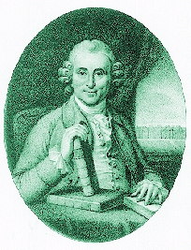
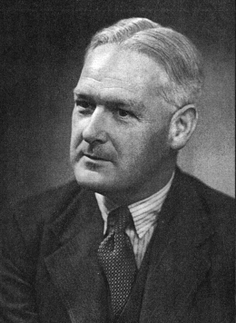

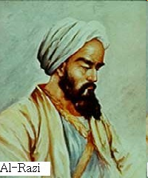
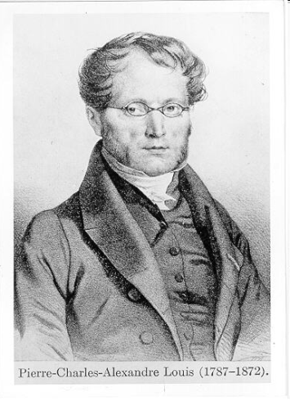
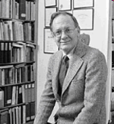

Some milestones in the history of EBM
James Lind
publishes review & clinical trial in
Treatise on Scurvy
Bradford-Hill
publishes Principles of Medical Statistics &
MRC trial of streptomycin
900 AD 1780 1840 1937/48 1967 1970’s
Al-Rhazi
For I once saved one group by it, while I intentionally neglected another group.
By doing that, I wished to reach a conclusion .
Alvan Feinstein
publishes his book
Clinical Judgement
Pierre Louis
Develops his “numerical method” and changes blood letting practice in France
Notes:
13

Slide 14
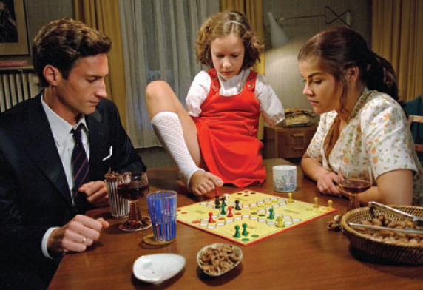
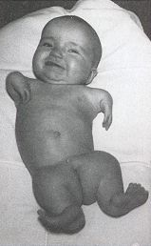
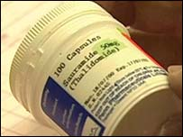
Unexpected Bad Effects

Slide 15

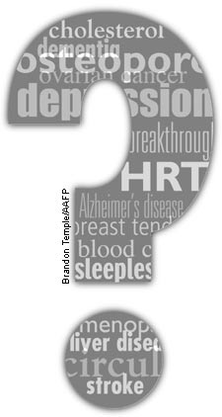
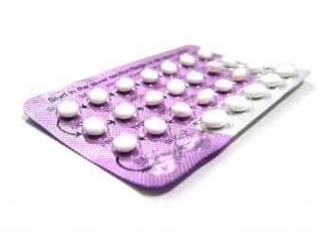
Hoped-For Effects That Don’t Materialise
HRT and heart attacks
Notes:
Evening primrose oil and starflower oil rich in gamma linolenic acid

Slide 16

T
The Cochrane Collaboration Logo
It shows how pooling data reveals the significance of treatment effect

Slide 17
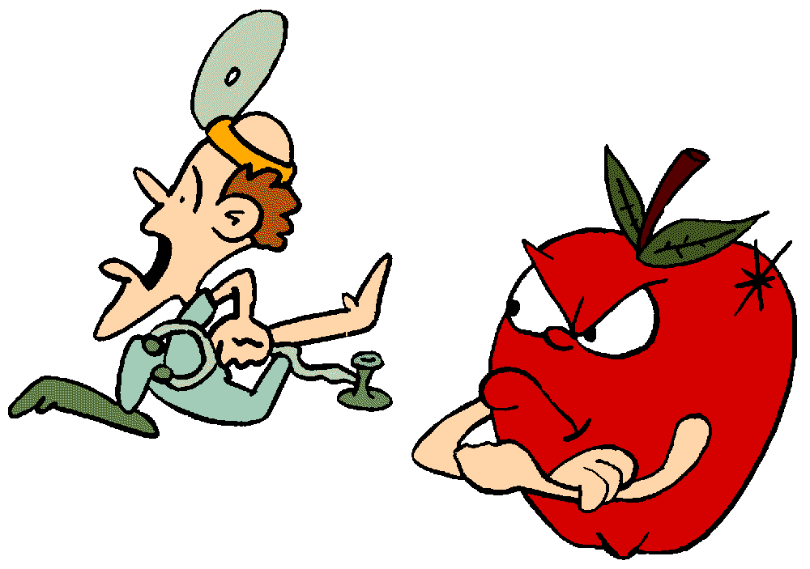

Our daily need for valid information
Diagnosis
Therapy
Prognosis
Prevention

Slide 18
The inadequacy of traditional sources of information
  Textbooks - out of date
  Experts - frequently wrong
  Didactic CME - ineffective
  Medical journals –
    Overwhelming in volume
    Variable in validity

Slide 19
5,000?
per day
Medical Articles Per Year
1,500 per day
95 per day

Slide 20
Where’s the Meat in Clinical Journals?
Top 20 Journals Contributing to ACPJC in 1992
Journal | # articles with abstract | % articles meeting criteria
N Engl J Med | 254 | 16.9
JAMA | 303 | 12.2
Ann Intern Med | 246 | 13.4
Lancet | 410 | 7.3
Arch Intern Med | 262 | 10.3
BMJ | 283 | 8.5
J Intern Med | 157 | 10.8

Slide 21
Our inability to set aside time to find & assimilate the evidence
Notes:
Our inability to:
Afford >seconds/patient to find & assimilate the evidence
Set aside >30 minutes /week for general reading
The slippery zone: the longer the period since graduation, the higher the chance that our knowledge gets out of date.(unless we have a mechanism by which we can check how much of our knowledge is up to date.

Slide 22
Our inability to set aside time to find and assimilate the evidence
Median minutes/week spent reading about ‘my patients’*:
House officers (PGY1): 0 (up to 70%=none)
SHOs (PGY2-4): 20 (up to 15%=none)
Registrars: 45 (up to 40%=none)
Sr. registrars 30 (up to 15%=none)
Consultants Post 1975: 45 (up to 30%=none)
Consultants Pre 1975: 30 (up to 40%=none)
*Self-reports at 17 Grand Rounds (Internal Medicine)

Slide 23
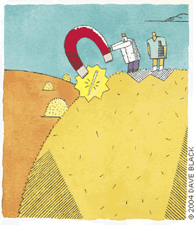
Notes:
Now with the plethora/ huge piles/large databases of CPGs that are available, how can we select the better, dynamic and lively CPGs that are based on science and experience? How can we sift the shaft from the weeds?
We need some guidelines on how to appraise GLs and determine their quality. We need a tool or an instrument that will help us to do this.

Slide 24
5 Steps of EBM: 5 As
Asking
Accessing
Appraising
Applying
Assessing

Slide 25
Now That I Know What I Am Supposed to Do, How Do I Actually Do It?

Slide 26
5 Steps of EBM: 5 As
Asking

Slide 27
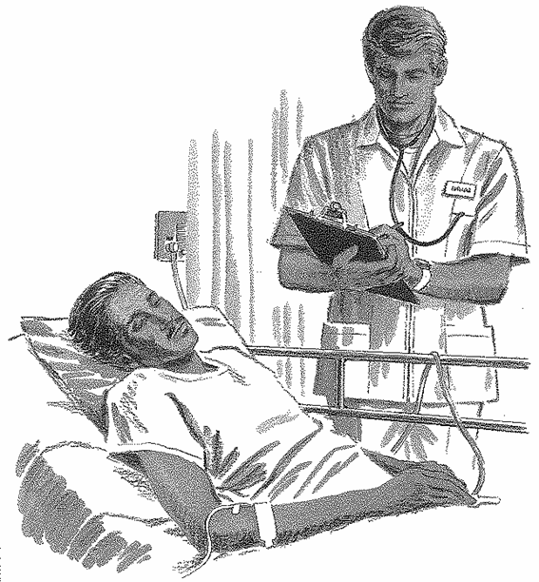
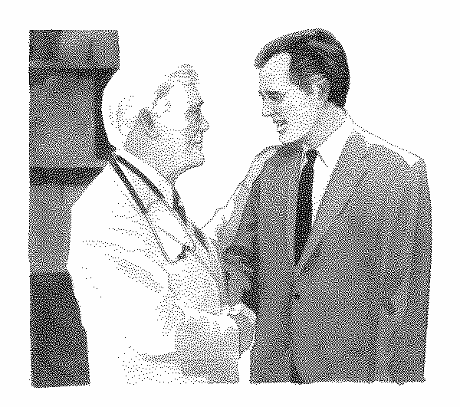
Background and Foreground
Questions

Slide 28

Background and Foreground Qs
Foreground Qs
Background Qs
Novice
Expert
A
B
C
Experience with Condition

Slide 29
Foreground Questions
PICO
1. Patient and/or problem.
2. Intervention/indicator.
3. Comparison intervention (if relevant).
4. Clinical outcomes.

Slide 30
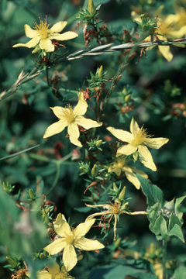
Clinical Scenario
Mrs. FATMA is an educated patient who presents with a complaint of fatigue and loss of interest in her usual activities. She denies any suicidal ideation, and has a normal history and physical examination. After diagnosing her with minor depression, you are preparing to write a prescription for a serotonin specific reuptake inhibitor (SSRI). She asks, what about St. John’s Wort?
You wonder: “Is St. John’s Wort a reasonable choice for this patient?”
Blossom of St. John’s Wort
(Hypericum perforatum)

Slide 31
Clinical Scenario
Patient/problem
Intervention
Comparison intervention
Outcome(s)
Adults with minor depression
St. John’s Wort
SSRI
Relief of symptoms
“In adults with minor depression, is St. John’s Wort or an SSRI more effective at relieving symptoms?”

Slide 32
To formulate clinical questions:
  Population
  Intervention
  Comparison
  Outcome

Slide 33
Why Bother Formulating Qs Clearly?
To focus our scarce learning time on evidence that:
  Is directly relevant to our patient needs.
  Directly addresses our particular knowledge needs.
To suggest high yield search strategies
  PICO
  Study design

Slide 34
Why Bother Formulating Qs Clearly?
To communicate clearly with colleagues when sending or receiving patients in referral
To suggest the forms that useful answers might take
To help learners understand the content of what we teach
Personal satisfaction

Slide 35
5 Steps of EBM: 5 As
Asking
Accessing
Appraising
Applying
Assessing

Slide 36

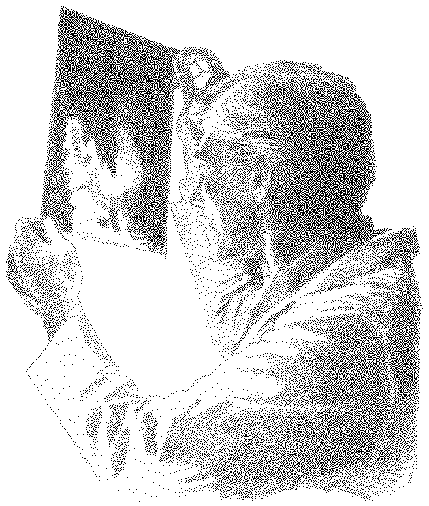
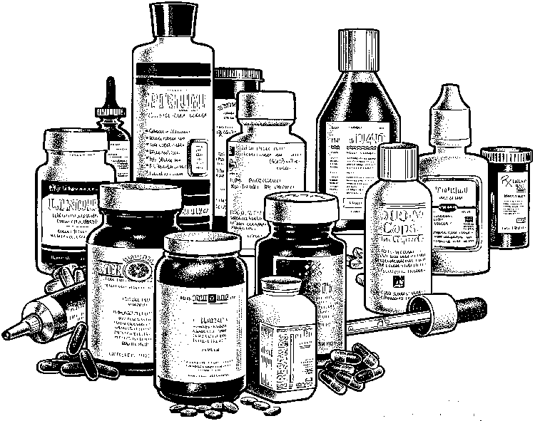
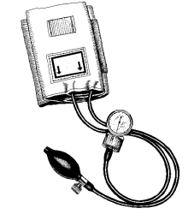
Problems in Posing Answerable Questions
When we‘re puzzled by a patient but don’t know where to start.
Therapy
Diagnosis
Prognosis

Slide 37
Problems in Posing Answerable Questions
When we have trouble articulating the question.

Slide 38
Examples where POE does not confirm DO (surrogate) end points
Disease and intervention | DOE | POE
Ventricular arrhythmia after MI and use of lidocaine prophylaxis
Decreased risk of ventricular arrhythmia
Increase in mortality
Heart failure and use of digoxin
Increase in exercise tolerance
No effect on mortality
Blood lipid lowering and clofibrate
Lowered lipid concentration
Increased non-cardiac mortality

Slide 39
Problems in Posing Answerable Questions
When we have more questions than time.
Prioritize Qs !

Slide 40
The best evidence for different types of question
Level | Treatment | Prognosis | Diagnosis
I | Systematic Review of … | Systematic Review of … | Systematic Review of …
II | Randomised trial | Inception Cohort | Cross sectional
III

Slide 41
Types of Studies
Question | Best study design
Intervention | RCT
Aetiology & risk factors | RCT/ Cohort/ Case-control
Frequency & rate | Cohort / Cross-sectional
Diagnosis | Cross-sectional with random or consecutive sample
Prognosis | Cohort/ survival
Phenomena | Qualitative
In each case, a systematic review of all available studies is better than an individual study

Slide 42
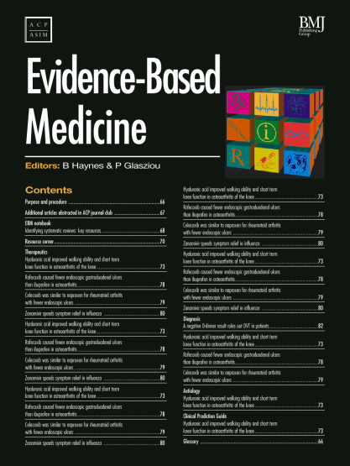
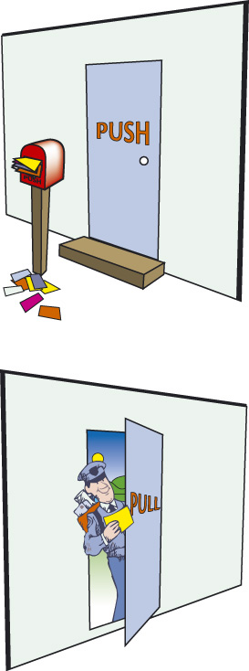
Coping with the overload: three possible things you might try
A. Read an evidence-based
abstraction journal
(and cancel other journals)
B. Keep a logbook of your
own clinical questions
C. Run a case-discussion journal
club with your practice

Slide 43
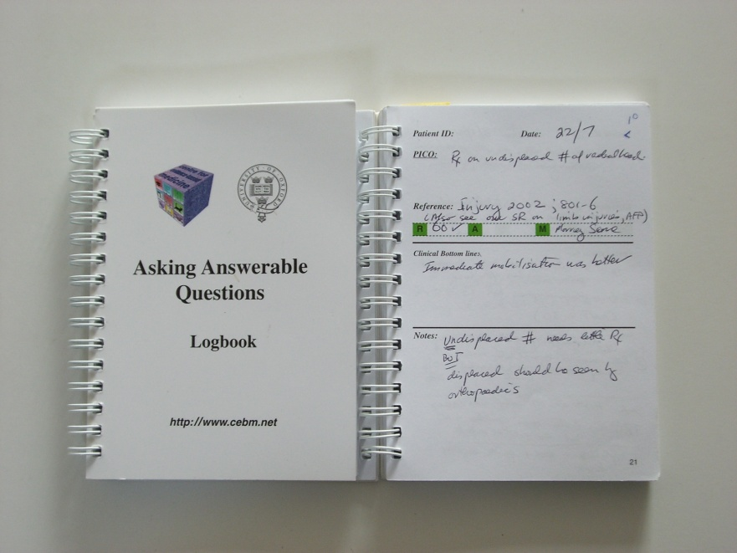

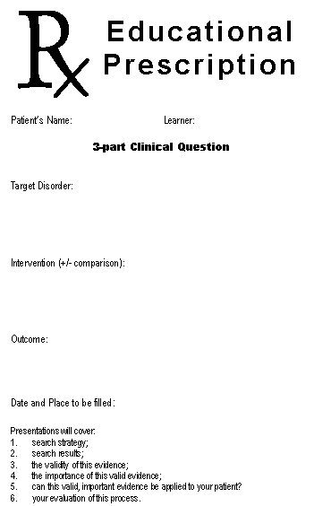
Steps to Improve Your Ability to Ask and Answer Questions
The educational prescription/Logbook.

Slide 44
Steps to Improve Your Ability to Ask and Answer Questions
Create a culture of inquiry
  Inquire, don’t advocate
“What do you think?”
“Should I keep doing this?”
“I wonder whether there is a better way?”

Slide 45
Steps to Improve Your Ability to Ask and Answer Questions
Feel good about not knowing everything.
Only 2% of the medical literature is POEMs

Slide 46




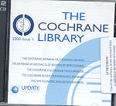
Steps to Improve Your Ability to Ask and Answer Questions
Let someone else do the heavy lifting
Secondary literature:

Slide 47
THANK YOU

