Slide 1
CARCINOGENESIS: THE MOLECULAR BASIS OF CANCER
Slides were taken from Dr. Maram Al-Otaibi,
Department of Pathology
Group B & A1st year- 19th Moharruam 1437
Osamah T. Khojah
0555485892, asd@ksu.edu.sa

Slide 2
Non-lethal genetic damage lies at the heart of carcinogenesis.
Mutation may be acquired by the action of environmental agents, such as chemicals, radiation, or viruses, or it may be inherited in the germ line.
The genetic hypothesis of cancer implies that a tumor mass results from the clonal expansion of a single progenitor cell that has incurred genetic damage (i.e., tumors are monoclonal).

Slide 3
Four classes of normal regulatory genes are involved :
Growth-promoting proto-oncogenes.
Growth-inhibiting tumor suppressor genes.
Genes that regulate apoptosis.
Genes involved in DNA.

Slide 4
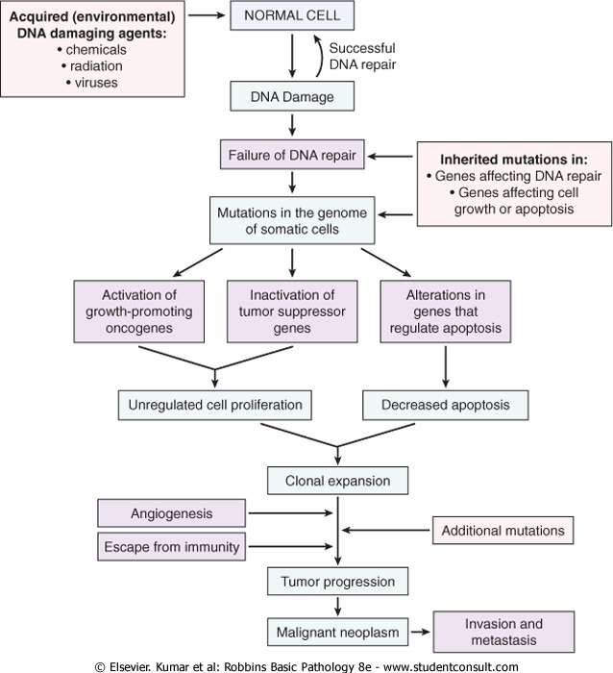

Slide 5
Mutant alleles of proto-oncogenes are called oncogenes.
They are considered dominant because mutation of a single allele can lead to cellular transformation.
Both normal alleles of tumor suppressor genes must be damaged for transformation to occur, referred to as recessive oncogenes.(OK?(.
Genes that regulate apoptosis may be dominant, as are proto-oncogenes, or they may behave as tumor suppressor genes (recessive ).

Slide 6
Tumor Suppressor Genes
Tumor suppressor genes are of 2 types :
1 - promoters genes:
Promoters are the traditional tumor suppressor genes, such as RB or p53.
Mutation of these genes leads to cell transformation by releasing the control on cellular proliferation.
2 - caretakers genes.

Slide 7
Tumor Suppressor Genes
2 - caretakers genes.
Caretaker genes are responsible for processes that ensure the integrity of the genome, such as DNA repair.
Mutation of caretaker genes does not directly transform cells by affecting proliferation or apoptosis.
DNA repair genes affect cell proliferation or survival indirectly by influencing the ability to repair non-lethal damage in other genes, including proto-oncogenes, tumor suppressor genes, and genes that regulate apoptosis.

Slide 8
Carcinogenesis
Carcinogenesis is a multistep process at both the phenotypic and the genetic levels, resulting from the accumulation of multiple mutations.
Malignant neoplasms have several phenotypic attributes, such as excessive growth, local invasiveness, and the ability to form distant metastases.

Slide 9
Tumor progression
Over a period of time, many tumors become more aggressive and acquire greater malignant potential which is not simply represented by an increase in tumor size.
Tumor progression and associated heterogeneity results from multiple mutations that accumulate independently in different tumor cells, generating subclones with different characteristics.

Slide 10
Even though most malignant tumors are monoclonal in origin, by the time they become clinically evident, their constituent cells are extremely heterogeneous.
During progression, tumor cells are subjected to immune and nonimmune selection pressures.
E.g: cells that are highly antigenic are destroyed by host defenses, whereas those with reduced growth factor requirements are positively selected.
A growing tumor tends to be enriched for subclones that are capable of survival, growth, invasion, and metastasis.

Slide 11
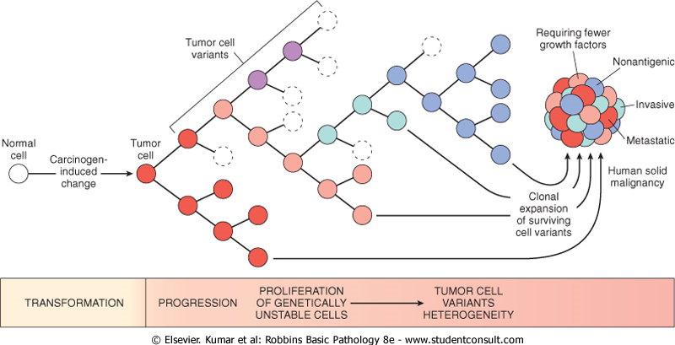

Slide 12
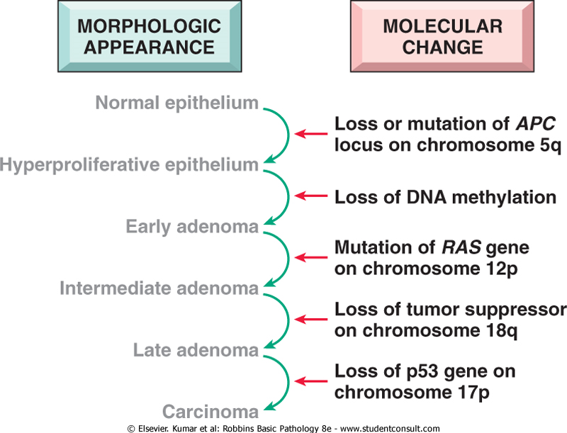

Slide 13
Features of malignent cells
1-Self-sufficiency in growth signals.
2-Insensitivity to growth-inhibitory signals.
3-Evasion of apoptosis.
4-Limitless replicative potential (i.e., overcoming cellular senescence and avoiding mitotic catastrophe).
5-Development of sustained angiogenesis.
6-Ability to invade and metastasize.
7-Genomic instability resulting from defects in DNA repair.

Slide 14
Self-Sufficiency in Growth Signals
Genes that promote autonomous cell growth in cancer cells are called oncogenes.
They are derived by mutations in proto-oncogenes and are characterized by the ability to promote cell growth in the absence of normal growth-promoting signals.
Their products, called oncoproteins, resemble the normal products of proto-oncogenes except that oncoproteins are devoid of important regulatory elements, and their production in the transformed cells does not depend on growth factors or other external signals.

Slide 15
The binding of a growth factor to its specific receptor on the cell membrane causes transient and limited activation of the growth factor receptor.
 activates several signal-transducing proteins on the inner leaflet of the plasma membrane
transmission of the transduced signal across the cytosol to the nucleus via second messengers or a cascade of signal transduction molecules
induction and activation of nuclear regulatory factors that initiate DNA transcription
progression of the cell into the cell cycle, resulting ultimately in cell division

Slide 16
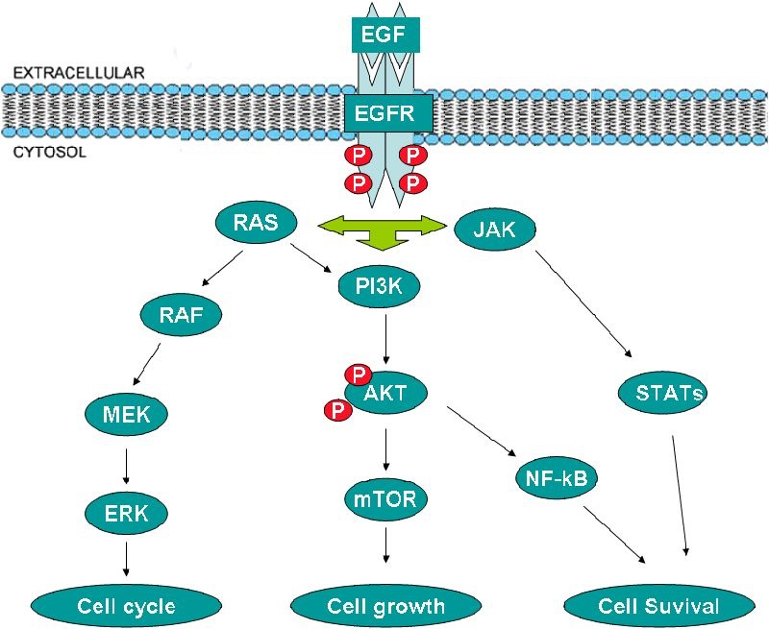

Slide 17
Growth Factors
All normal cells require stimulation by growth factors to undergo proliferation.
Types :
1- Paracrine action:
growth factors are made by one cell type and act on a neighboring cell to stimulate proliferation
2- Autocrine action:
Many cancer cells acquire growth self-sufficiency by acquiring the ability to synthesize the same growth factors to which they are responsive.

Slide 18
Growth Factor Receptors
Mutant receptor proteins deliver continuous mitogenic signals to cells, even in the absence of the growth factor in the environment.
Overexpression of growth factor receptors can render cancer cells hyper-responsive to levels of the growth factor that would not normally trigger proliferation.

Slide 19
E.g:
Overexpression involve the epidermal growth factor (EGF) receptor family. ERBB1.
the EGF receptor, is overexpressed in 80% of squamous cell carcinomas of the lung.
In 50% or more of glioblastomas.
In 80-100% of epithelial tumors of the head and neck.

Slide 20
HER2/NEU (ERBB2), is amplified in 25-30% of breast cancers and adenocarcinomas of the lung, ovary, and salivary glands.
These tumors are exquisitely sensitive to the mitogenic effects of small amounts of growth factors
High level of HER2/NEU protein in breast cancer cells is a poor prognosis.

Slide 21
The significance of HER2/NEU in the pathogenesis of breast cancers is illustrated by the clinical benefit derived from blocking the extracellular domain of this receptor with anti-HER2/NEU antibodies.
Treatment of breast cancer with anti-HER2/NEU antibody (herciptin) proved to be clinically effective .

Slide 22
Signal-Transducing Proteins
These signaling molecules couple growth factor receptors to their nuclear targets.
Many such signaling proteins are associated with the inner leaflet of the plasma membrane, where they receive signals from activated growth factor receptors and transmit them to the nucleus, either through second messengers or through a cascade of phosphorylation and activation of signal transduction molecules.
Two important members in this category are:
1-RAS gene.
2-ABL gene.

Slide 23
RAS is the most commonly mutated proto-oncogene in human tumors.
Approximately 30% of all human tumors contain mutated versions of the RAS gene.
The incidence is even higher in some specific cancers (e.g., colon and pancreatic adenocarcinomas).
RAS is a member of a family of small G proteins that bind guanosine nucleotides (guanosine triphosphate [GTP] and guanosine diphosphate [GDP]).

Slide 24
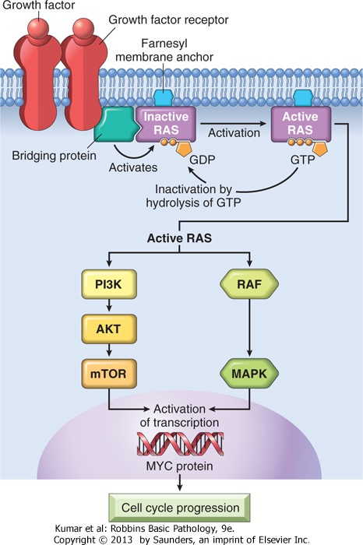

Slide 25
The ABL proto-oncogene has tyrosine kinase activity that is dampened by internal negative regulatory domains.
In chronic myeloid leukemia (CML) and acute lymphocytic leukemias.
When ABL gene is translocated from its normal site on chromosome 9 to chromosome 22, where it fuses with part of the breakpoint cluster region (BCR) gene= Philadelphia (Ph) chromosome .

Slide 26
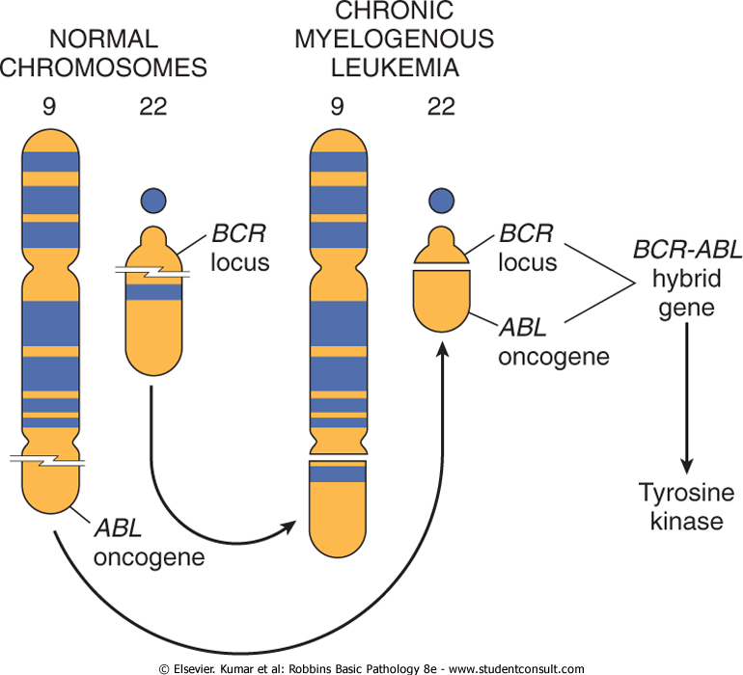

Slide 27
The BCR-ABL hybrid protein has potent, unregulated tyrosine kinase activity, which activates several pathways, including the RAS-RAF cascade.
Normal ABL protein localizes in the nucleus, where its role is to promote apoptosis of cells that suffer DNA damage.
The BCR-ABL gene cannot perform this function, because it is retained in the cytoplasm as a result of abnormal tyrosine kinase activity.

Slide 28
Nuclear Transcription Factors
Growth autonomy may occur as a consequence of mutations affecting genes that regulate transcription of DNA.
MYC, MYB, JUN, FOS, and REL oncogenes, function as transcription factors that regulate the expression of growth-promoting genes, such as cyclins.

Slide 29
the MYC gene is involved most commonly in human tumors.
The MYC proto-oncogene is expressed in virtually all cells, the MYC protein is induced rapidly when quiescent cells receive a signal to divide.
In normal cells, MYC levels decline to near basal level when the cell cycle begins.
In contrast, oncogenic versions of the MYC gene are associated with persistent expression or overexpression, contributing to sustained proliferation.

Slide 30
Dysregulation of the C-MYC gene resulting from a t(8;14) translocation occurs in Burkitt lymphoma, a B-cell tumor.
MYC is also amplified in breast, colon, lung, and many other cancers;
N-MYC and L-MYC genes are amplified in neuroblastomas and small-cell cancers of lung.

Slide 31
Cyclins and Cyclin-Dependent Kinases (CDKs)
Cancers may become autonomous if the genes that drive the cell cycle become dysregulated by mutations or amplification.
Progression of cells through the various phases of the cell cycle is controlled by CDKs.
CDKs are activated by binding to cyclins, so called because of the cyclic nature of their production and degradation.

Slide 32
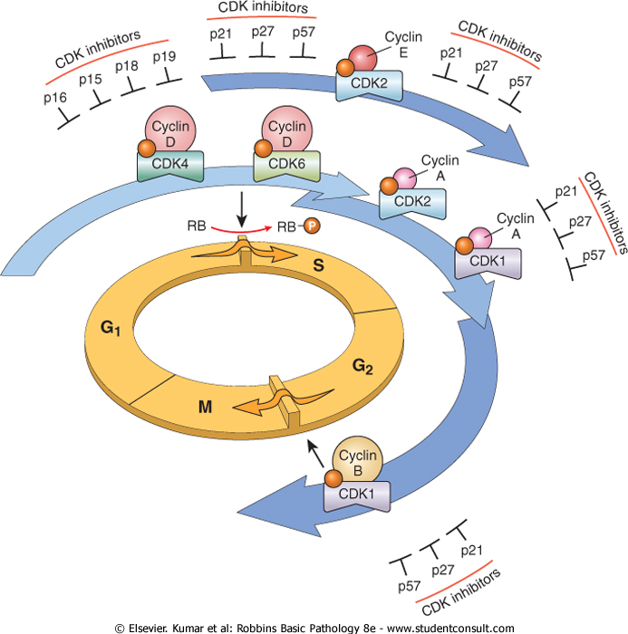

Slide 33
The CDK-cyclin complexes phosphorylate crucial target proteins that drive the cell through the cell cycle.
On completion of this task, cyclin levels decline rapidly.
More than 15 cyclins have been identified; cyclins D, E, A, and B appear sequentially during the cell cycle and bind to one or more CDK.

Slide 34
Mishaps affecting the expression of cyclin D or CDK4 seem to be a common event in neoplastic transformation.
The cyclin D genes are overexpressed in many cancers, including those affecting the breast, esophagus, liver, and a subset of lymphomas.
Amplification of the CDK4 gene occurs in melanomas, sarcomas, and glioblastomas.
Mutations affecting cyclin B and cyclin E and other CDKs also occur, but they are much less frequent than those affecting cyclin D/CDK4.

Slide 35
CDK Inhibitors
Cyclins arouse the CDKs .
CDK inhibitors (CDKIs) silence the CDKs and exert negative control over the cell cycle.
One family of CDKIs, composed of three
proteins:
1- p21 [CDKN1A],
2- p27 [CDKN1B],
3- p57 [CDKN1C],
inhibits the CDKs broadly...

Slide 37
Insensitivity to Growth-Inhibitory Signals
Retinoblastoma (RB) gene, the first and prototypic cancer suppressor gene to be discovered.
Retinoblastoma is an uncommon childhood tumor.
Approximately 60% of retinoblastomas are sporadic, and 40% are familial,
The predisposition to develop the tumor being transmitted as an autosomal dominant trait.
To account for the sporadic and familial occurrence of an identical tumor, Knudson, in 1974, proposed his now famous two-hit hypothesis.

Slide 38
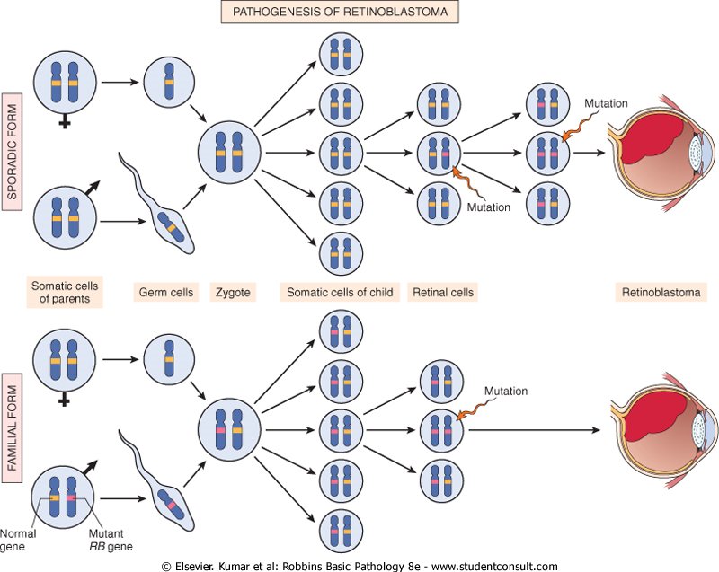

Slide 39
Two mutations (hits): are required to produce retinoblastoma.
These involve the RB gene, located on chromosome 13q14.
Both of the normal alleles of the RB locus must be inactivated (two hits) for the development of retinoblastoma.
In familial cases, children inherit one defective copy of the RB gene in the germ line; the other copy is normal, retinoblastoma develops when the normal RB gene is lost in retinoblasts as a result of somatic mutation.

Slide 41
The RB pathway is important to:
1- Control of cell cycle progression at G₁.
2- Induce cell differentiation.
3- Induce senescence.
Mutations in other genes that control RB phosphorylation can mimic the effect of RB loss, such genes are mutated in many cancers that seem to have normal RB genes.

Slide 42
E.g: mutational activation of CDK4 or overexpression of cyclin D would favor cell proliferation by facilitating RB phosphorylation and inactivation.
Cyclin D is overexpressed in many tumors because of gene amplification or translocation.
Mutational inactivation of CDKIs also would drive the cell cycle by unregulated activation of cyclins and CDKs.

Slide 43
TP53 Gene: Guardian of the Genome
The p53 tumor suppressor gene is one of the most commonly mutated genes in human cancers.
P53 prevents (OK) neoplastic transformation by three interlocking mechanisms:
1-activation of temporary cell cycle arrest (termed quiescence),
2-induction of permanent cell cycle arrest (termed senescence),
3-triggering of programmed cell death (termed apoptosis).

Slide 44
P53 can be viewed as a central monitor of stress, directing the stressed cells toward an appropriate response.
A variety of stresses can trigger the p53 response pathways including: anoxia, inappropriate oncogene expression (e.g., MYC or RAS), damage to the integrity of DNA.

Slide 45
Transforming Growth Factor-β Pathway
TGF-β is a potent inhibitor of proliferation in most normal epithelial, endothelial, and hematopoietic cells.
It regulates cellular processes by binding to a complex composed of TGF-β receptors I and II.
Dimerization of the receptor upon ligand binding leads to a cascade of events that result in: transcriptional activation of CDKIs and suppression of growth-promoting genes such as MYC, CDK2, CDK4, and those encoding cyclins A and E.

Slide 46
Contact Inhibition NF2 and APC
Contact inhibition is abolished in cancer cells allowing them to pile on top of one another.
Cell-cell contacts in many tissues are mediated by homodimeric interactions between transmembrane proteins called cadherins.
E-cadherin mediates cell-cell contact in epithelial layers by mechanism not fully understood.
One mechanism that sustains contact inhibition is mediated by the tumor suppressor gene NF2.

Slide 47
Evasion of Apoptosis
There are 2 distinct programs that activate apoptosis:
1- Extrinsic pathway (death receptor
CD95/Fas).
2- Intrinsic pathway (DNA damage).

Slide 48
Stimulation of either pathway results in activation of a normally inactive protease (caspase-8 or caspase-9), which initiates a proteolytic cascade involving "executioner" caspases that disassemble the cell in orderly fashion.
The cellular remains are then efficiently consumed by the cellular neighbors and professional phagocytes without stimulating inflammation.

Slide 49
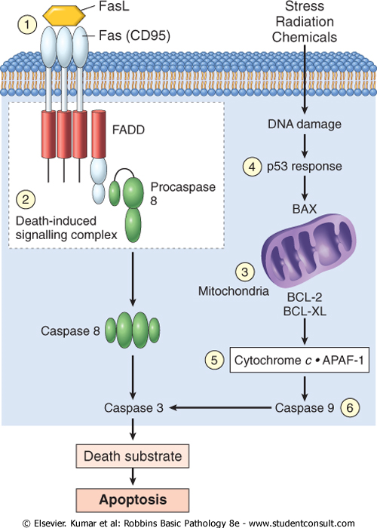

Slide 50
Ability to Invade and Metastasize
The metastatic cascade can be subdivided into two phases: invasion of ECM and vascular
dissemination and homing of tumor cells.

Slide 51
Invasion of Extracellular Matrix (ECM(
Human tissues are organized into a series of compartments separated from each other by two types of ECM: basement membranes and interstitial connective tissue.
each of these components of ECM is composed of: collagens, glycoproteins and proteoglycans.

Slide 52
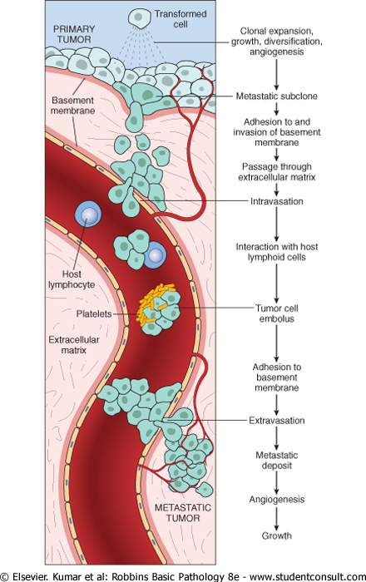

Slide 53
Invasion of the ECM is an active process that requires four steps :
1-Detachment of tumor cells from each other.
2-Degradation of ECM.
3-Attachment to novel ECM components .
4-Migration of tumor cells.

Slide 54
Limitless Replicative Potential
Most normal human cells have a capacity of 60 to 70 doublings.
After this the cells lose the capacity to divide and enter senescence.
This phenomenon is due to progressive shortening of telomeres at the ends of chromosomes.

Slide 55
Development of Sustained Angiogenesis
Tumors cannot enlarge beyond 1-2 mm in diameter unless they are vascularized.
Cancer cells can stimulate neo-angiogenesis during which new vessels sprout from previously existing capillaries or in some cases vasculogenesis in which endothelial cells are recruited from the bone marrow.
Angiogenesis is thus a necessary biologic correlate of neoplasia, both benign and malignant.
Angiogenesis is required not only for continued tumor growth but also for access to the vasculature and hence for metastasis.

Slide 56
Reprogramming Energy Metabolism
Reprogramming of energy metabolism is so common to tumors that it is now considered a hallmark of cancer.
Even in the presence of ample oxygen cancer cells shift their glucose metabolism away from efficient mitochondrial oxidative phosphorylation to glycolysis.
This phenomenon, called the Warburg effect and also known as aerobic glycolysis.

Slide 57
Genomic Instability-Enabler of Malignancy
The importance of DNA repair in maintaining the integrity of the genome is highlighted by several inherited disorders in which genes that encode proteins involved in DNA repair are defective.
Individuals born with such inherited defects in DNA repair proteins are at a greatly increased risk of developing cancer.
Hereditary Non-polyposis Colon Cancer Syndrome (HNPCC syndrome) is characterized by familial carcinomas of the colon affecting predominantly the cecum and proximal colon. It results from defects in genes involved in DNA mismatch repair.

Slide 58
TUMOR IMMUNITY
Immune surveillance to refer to recognition and destruction of newly appearing tumor cells, which are seen as foreign by the host immune system.

Slide 59
Tumor Antigens
2 categories based on their patterns of expression:
1-tumor-specific antigens.
which are present only on tumor cells and not on any normal cells.
2-tumor-associated antigens.
present on tumor cells and also on some normal cells.

