Slide 1
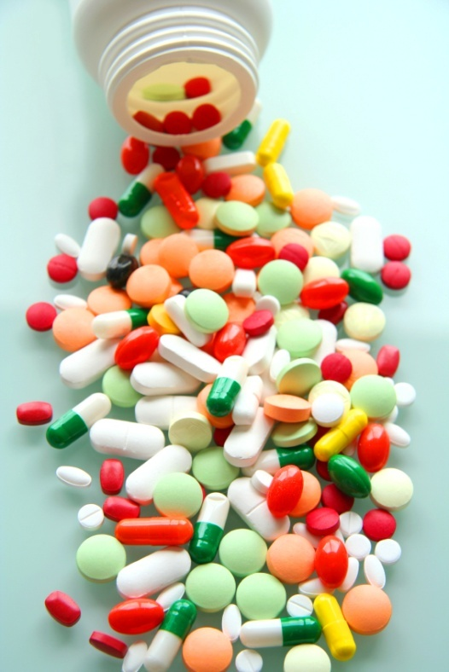
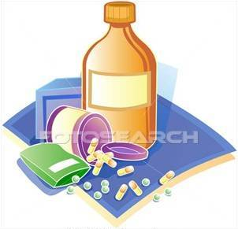
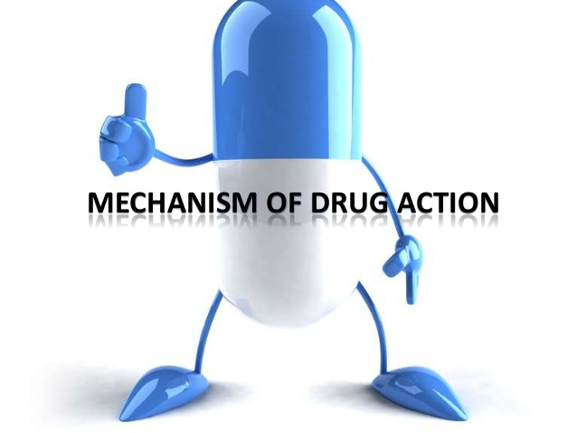
PHARMACdYNAMICS i
Mechanisms of Drug Action

Slide 2
Ilos
Identify different targets of drug action
Differentiate between their patterns of action; agonism versus antagonism
Elaborate on drug binding to receptors

Slide 3
What is Pharmacodynamics?
Principles of drug action
Study of biochemical or physiological effects of drugs and their mechanism of action at cellular and organ level
Activate
Depress
Replace
Irritate
Destroy

Slide 4
Based on the drug target site, the mechanism of action can be classified as:
1-By binding with a biomolecule (Majority)
Mostly protein in nature (protein target)
2-Or not by binding with a biomolecule
By chemical action
Neutralization of acid by antacids
By physical action
Osmosis , purgative effect of MgSO4

Slide 5
TARGETS
> Proteins
STRUCTURAL
REGULATORY
Tubulin is target for:
Vincristine
Colchicine
ENZYME
CARRIER MOLECULE
ION CHANNEL
RECEPTOR
Tubulin
Structure

Slide 6
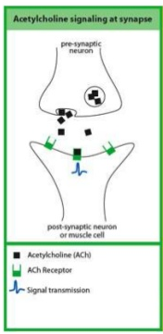
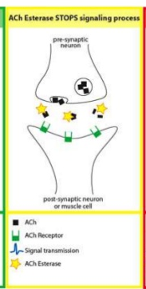
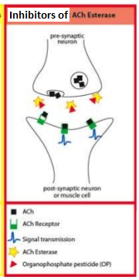
TARGETS
Proteins
REGULATORY
ENZYME
The drug competes with the natural substrate
for the enzyme
REVERSIBLE
Neostigmine reversibly compete with ACH for cholinestrase at motor end plate
IRREVERSIBLE
Organophosphates irreversibly competes with ACH for cholinestrase

Slide 7
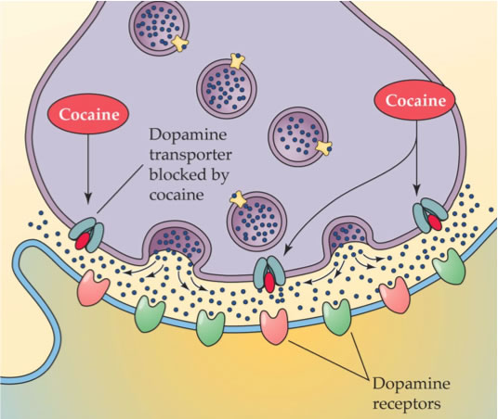
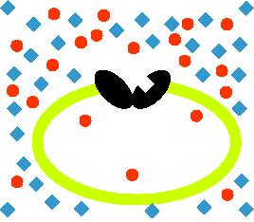
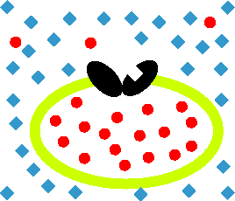
TARGETS
Proteins
REGULATORY
Responsible for transport of ions and small organic molecules between intracellular compartments, through cell membranes or in extracellular fluids.
CARRIER MOLECULE
The drug binds to such molecules altering their transport ability
Cocaine blocks transport of catecholamines at synaptic cleft
Antiporter
Symporter

Slide 8
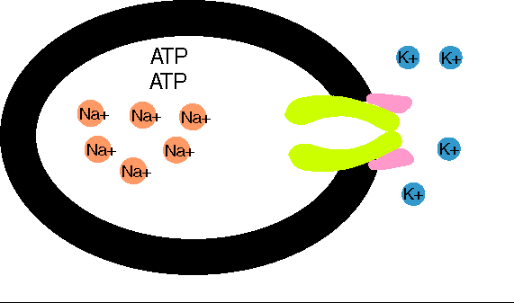
TARGETS
> Proteins
REGULATORY
CARRIER MOLECULE
Digitalis(digoxin) blocks efflux of Na by Na pump
Digitalis
Notes:
8

Slide 9
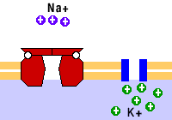
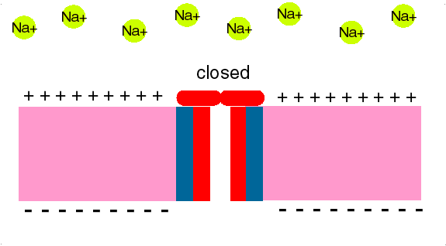
TARGETS
> Proteins
REGULATORY
ION CHANNEL
Responsible for influx or out-flux of ions through cell membranes along their concentration gradients.
They are activated by alteration in action potential and are controlled by gating mechanisms.
Drugs bind to alter channel function by block or modulation
Local Anesthetics block Na influx through Na channel
in nerve fibers. They are Na channel Blockers.
L.Anaesthesia

Slide 10
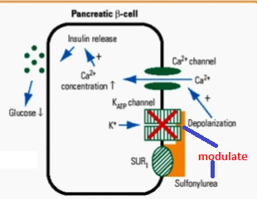
TARGETS
> Proteins
REGULATORY
ION CHANNEL
Sulfonylurea drugs block K⁺ out flux via the K channels in pancreatic cells . They are K Channel Modulator

Slide 11
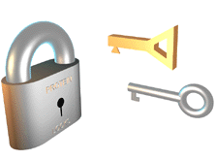
TARGETS
> Proteins
REGULATORY
Responsible for selectively sensing and binding of a stimulus (ligand) and its coupling to a response via a set of signal transduction machinery
RECEPTOR
Drugs bind and alter R signal transduction machinery.
Bind
Occupy
Initiate
Activate
Physiological
RESPONSE
L
L
R
LR*
AFFINITY
EFFICACY
ENDOGENOUS
LIGAND
Agonist
R
Pharmacological
RESPONSE
A
A drug that possesses both affinity and efficacy
A
R
AR*
ACh
DRUGS
Antagonist
A drug that possesses an affinity but no efficacy
B
B
R
NO RESPONSE
Tubocurarine
Analogous to the Key & the lock

Slide 12
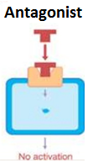
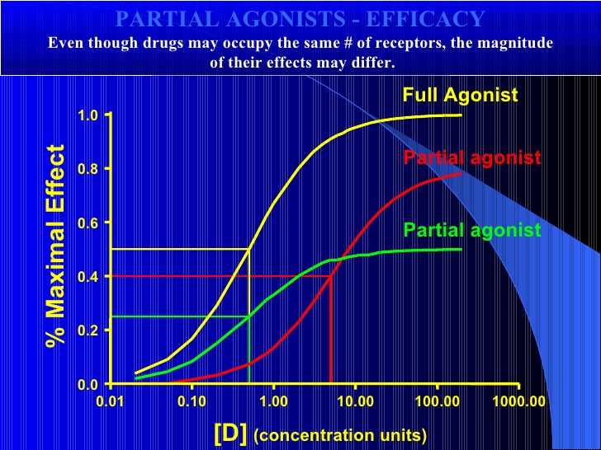
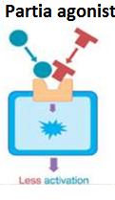
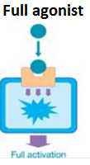
Affinity is the capacity of a drug to form a complex with the receptor(DR complex)
Efficacy(Intrinsic activity) the ability of the drug once bound to the receptor to trigger response
The value of intrinsic activity ranges from 0 to 1
Full agonist having a full affinity to the receptor and a maximal intrinsic activity (1) e.g. acetylcholine
Partial agonist having a full affinity to the receptor but with low intrinsic activity (<1) e.g. pindolol
Antagonist having full affinity to the receptor but no intrinsic activity(0) e.g. atropine

Slide 13
QUANTIFICATION OF DRUG ACTION
Bind
Occupy
Initiate
Activate
D
+
R
D
R
DR*
RESPONSE[R]
Relate concentration [C] of D used (x- axis) to the binding capacity at receptors (y-axis)
Relate concentration [C] of D used (x- axis) to the response produced (y-axis)
Concentration-Binding Curve
Dose Response Curve
AFFINITY
EFFICACY
POTENCY

Slide 14
Concentration-Binding Curve
Bind
Occupy
Initiate
Activate
association rate constant
k₁
D
+
R
D
R
DR*
RESPONSE[R]
k₂
dissociation rate constant
The relationship between drug binding & drug concentration is expressed mathematically by the following equation
B_{max} xC
B = -----------
C+ KD₅₀

Slide 15
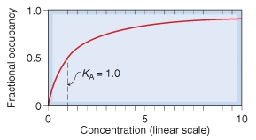
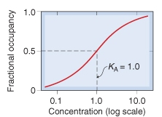
Concentration-Binding Curve
(B_{max}): Total density of receptors in the tissue
K_{D}
K_{D}
(k_{D} ) = [C] of D required to occupy 50% of receptors at equilibrium
Concentration-Binding curves are used to determine:
The binding capacity (B_{max}) → total density of receptors in the tissues.
The affinity of D for receptor
The higher the affinity of D for receptor the lower is the K_{D} i.e. inverse relation
3. Classification of receptors to receptor subtypes

Slide 16
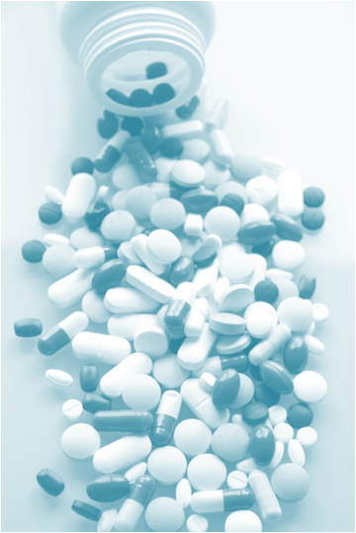
DOSE RESPONSE CURVE
How does response vary with Concentration?
A continuous response
BP, HR, FBG, Cholesterol,…
GRADED DOSE RESPONSE CURVE
An all-or-non response prevention of convulsion, arrhythmias or death…..
Relate C to % of patients eliciting the :
* specified therapeutic response
* adverse response
* lethal outcome
QUANTAL DOSE RESPONSE CURVE

