Slide 1
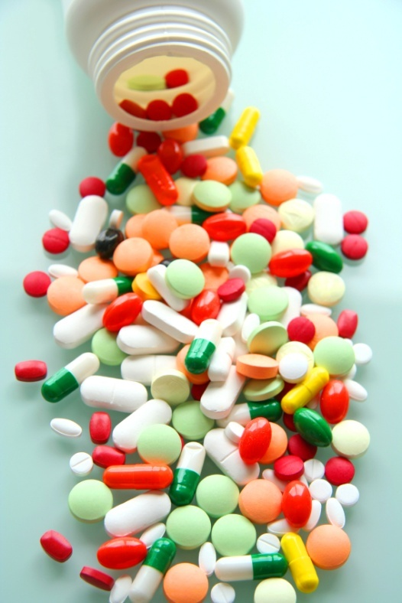
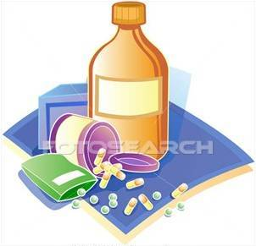
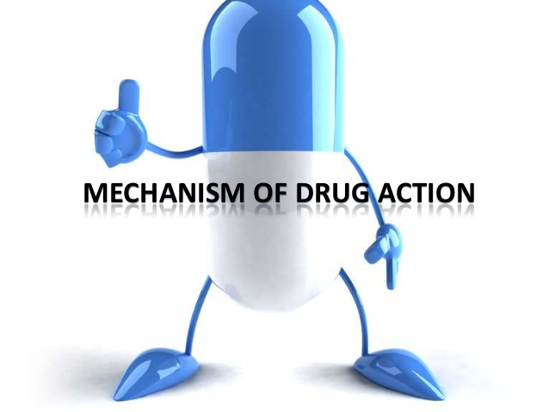
PHARMACdYNAMICS IIi
RECEPTOR FAMILIES

Slide 2
Ilos
Classify receptors into their main families
Recognize their different transduction mechanism
Identify the nature & time frame of their response

Slide 3
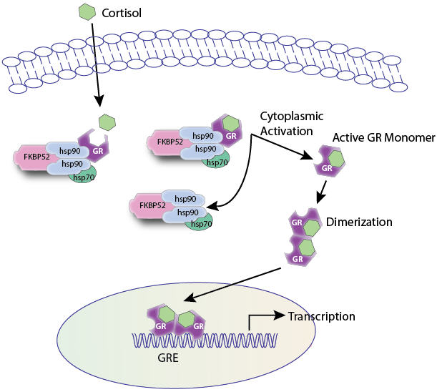
Classification of receptors
Channel-Linked Receptor
G-Protein Coupled Receptors
Enzyme-Linked Receptors
Nuclear Receptors

Slide 4
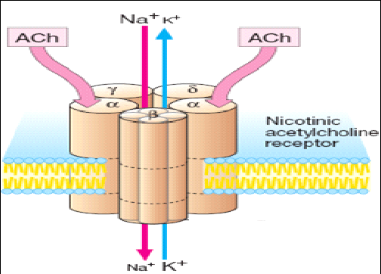
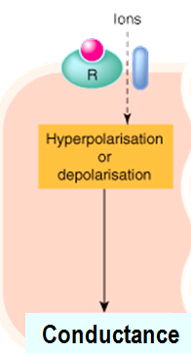
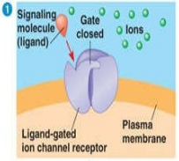
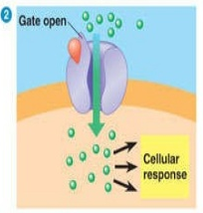
RECEPTOR FAMILIES
Channel- linked receptors
Ionotropic
Involved in fast synaptic neurotransmittion, ligand binding & opening occur in milli seconds
Membrane receptors coupled
directly to ion channels
e.g. nicotinic Ach

Slide 5
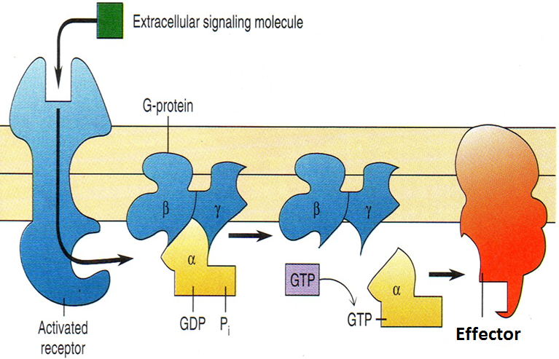
RECEPTOR FAMILIES
G-Protein Coupled Receptors
Membrane receptors, coupled to intracellular effector system via G proteinG protein
The G- protein comprises 3 subunits [αβχ], the α- subunit possesses GTPase activity
When the trimer binds to agonist- occupied receptor , the α-subunit dissociates & is then free to activate an effector

Slide 6
RECEPTOR FAMILIES
G-Protein Coupled Receptors
Activation of the effector is terminated when the bound GTP molecule is hydrolysed , which allows the α-subunit to recombine with βχ .
Receptors for many hormones & slow transmitters(seconds) e.g. mAch & adrenergic receptors
There are several types of G- proteins ,which interact with receptors & control different effectors.

Slide 7
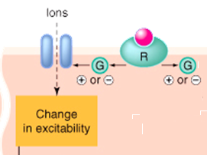
RECEPTOR FAMILIES
Effectors for G-proteins
1-Ion channels
e.g. K+, Ca++thus affecting membrane excitability, transmitter release ,

Slide 8
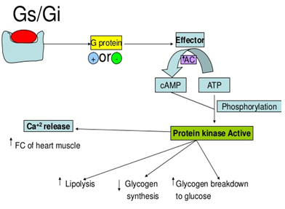
RECEPTOR FAMILIES
Effectors for G-proteins
2-Adenylate cyclase/cAMP

Slide 9
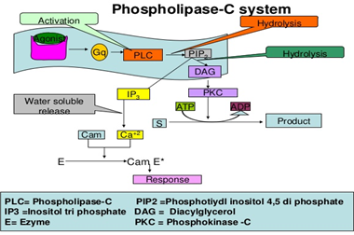
RECEPTOR FAMILIES
effectors for G-proteins
3-Phospholipase C

Slide 10
RECEPTOR FAMILIES
Classes of G protein
Divided according to their α-subunits into G_{s}, G_{i} and G_{q}
G_{s} and G_{i} produce, respective, stimulation and inhibition of AC
G_{q} is linked to activation of Phospholipase C system
Receptors are selective to α subunit & effector with which they couple

Slide 11
ADRENOCEPTORS
a₁ Adrenoceptors couple to G_{q} to stimulate PLC.
α₂ Adrenoceptors couple to G_{i} to inhibit AC.
β_{1&2} Adrenoceptors couple to G_{s} to stimulate AC
Adr
Adr
Inhibitory Receptor
Stimulatory Receptor
G_{i}
G_{s}
AC
α₂ Adrenoceptor
β Adrenoceptor
+
cAMP
↑cAMP

Slide 12
CHOLINERGIC RECEPTORS
M₁ & M₃ Ach receptors couple to G_{q} to stimulate PLC
M₂ & M₄ Ach receptors couple to G_{i} to inhibit AC
Ach
Adr
Stimulatory Receptor
Stimulatory Receptor
G_{q}
G_{q}
PLC
PLC
M₃ Ach receptor
α₁ Adrenoceptor
+
+
Bronchi
↑Ca ⁺⁺
↑Ca ⁺⁺
Blood Vessel

Slide 13
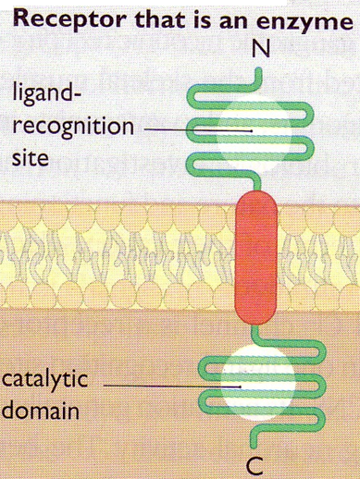
RECEPTOR FAMILIES
Enzyme- linked receptors
The receptors have a large extracellular ligand- binding domain connected via a single α-helix to the intracellular domain
Some have intrinsic tyrosine kinase activity
Receptors for various hormones e.g insulin , growth factors
They are involved mainly in events controlling cell growth & differentiation

Slide 14
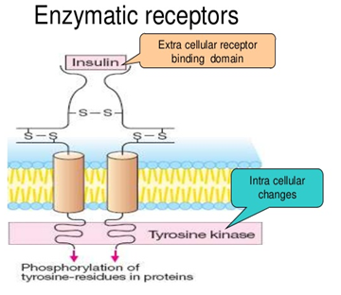
RECEPTOR FAMILIES
Enzyme- linked receptors
Signal transduction involves autophosphorylation of tyrosine residue which acts as acceptor of SH2 domain of various proteins , thereby allowing control of various cell functions.
This usually require many intracellular signaling steps that take time to process (miutes to hours).

Slide 15
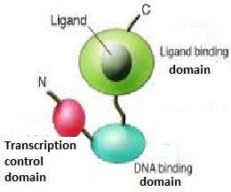
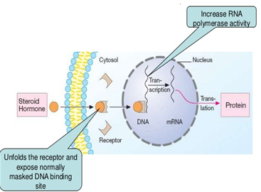
RECEPTOR FAMILIES
Nuclear receptpors
Receptors are intracellular proteins
Receptors consist of a conserved DNA- binding domain attached to variable ligand –binding & transcription control domains.
DNA- binding domain recognizes specific base sequences(response element) , thus promoting or repressing particular genes.

Slide 16
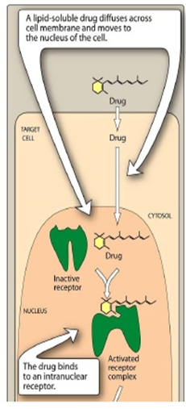
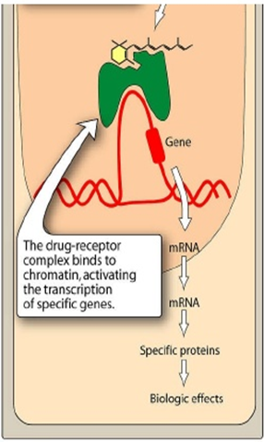
RECEPTOR FAMILIES
Nuclear receptpors
They react as TRANSCRIPTION FACTORS expressing or epressing
target genes.
Effects are produced as a result of protein synthesis , thus they are slow in onset(hours & days).
Pattern of gene activation depends on both cell type & nature of ligands
ligands include steroid hormones , vitamin D & thyroid hormone

Slide 17
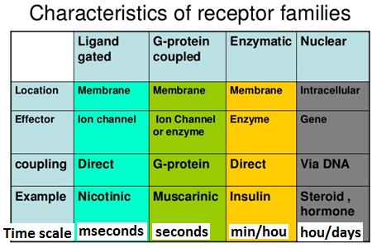
synopsis

