Slide 1



Aerobic & Anaerobic
Metabolism in Muscles
Musculoskeletal Block
1st year
Dec 2015
Dr. Reem M. Sallam

Slide 2

Objectives
Upon completion of this lecture, students should be able to:
Recognize the importance of ATP as
energy source in skeletal muscle.
Understand how skeletal muscle derive
and utilize ATP for energy.
Differentiate between energy metabolism
in red and white muscle fibers.

Slide 3
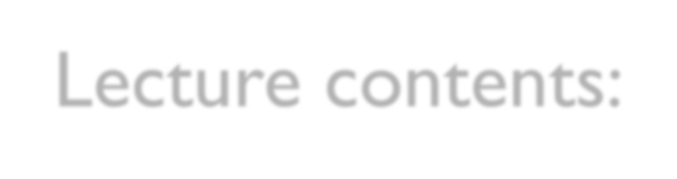
Lecture contents:
Energy requirements and source of energy for
skeletal muscle.
Types of skeletal muscle fibers
Brief account on what is going on in resting muscle
Brief account on what is going on in contracting muscle
Brief account on the Cori’s and glucose-alanine cycles

Slide 4




ENERGY REQUIREMENTS AND SOURCE OF ENERGY FOR SKELETAL MUSCLE

Slide 5
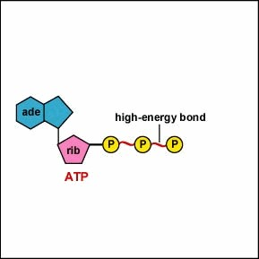

ATP as energy source
The nucleotide coenzyme adenosine triphosphate (ATP) is the most important form of chemical energy stored in cells
Breakdown of ATP into ADP+PO₄ releases energy
This energy is used for all body functions (biosynthesis, membrane transport, muscle contraction, etc.)
Muscles typically store limited amounts of ATP –
enough to power 4-6s of activity
Therefore, resting muscles must have energy stored in other ways.

Slide 6
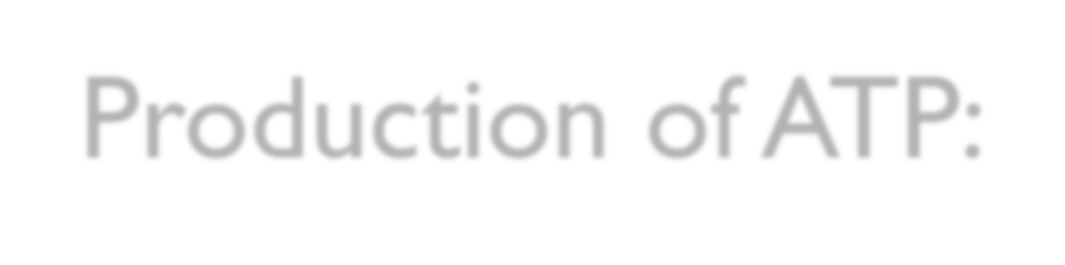
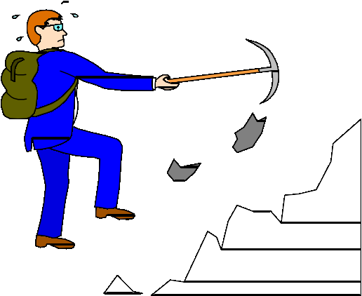
Production of ATP:
Contraction requires huge amounts of ATP
Muscle fibers produce ATP three ways:
Creatine phosphate
Aerobic metabolism
Anaerobic metabolism

Slide 7

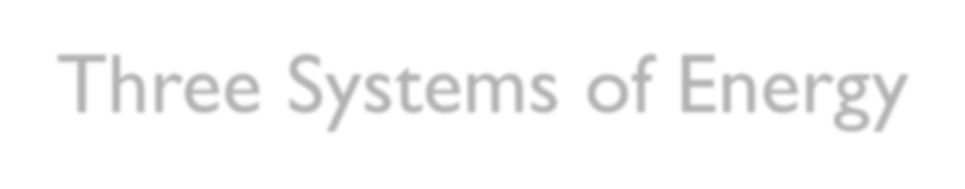


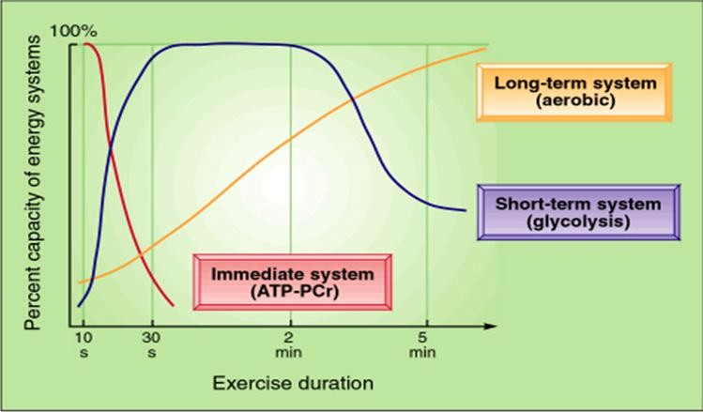
Three Systems of Energy

Slide 8
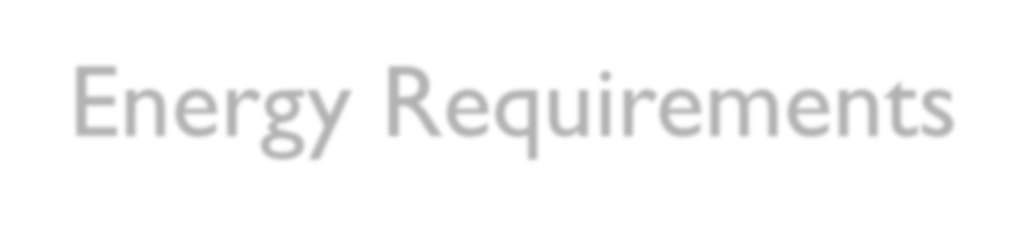
Energy Requirements
The three energy systems often operate
simultaneously during physical activity.
Relative contribution of each system to total energy requirement differs markedly depending on exercise intensity & duration.
Magnitude of energy from anaerobic sources depends on person’s capacity and tolerance for lactic acid accumulation (Athletes are trained so that they will have better tolerance for lactic acid) .
As exercise intensity diminishes and duration extends beyond 4 minutes, energy becomes more dependent on aerobic metabolism.

Slide 9
Energy Metabolism
Aerobic
With oxygen
Source of energy: mainly fatty acids, then carbohydrate
End products: CO₂,
H₂O & ATP
Anaerobic
Without oxygen
Source of energy: Carbohydrate (glycolysis)
End products: Lactate
& ATP

Slide 10

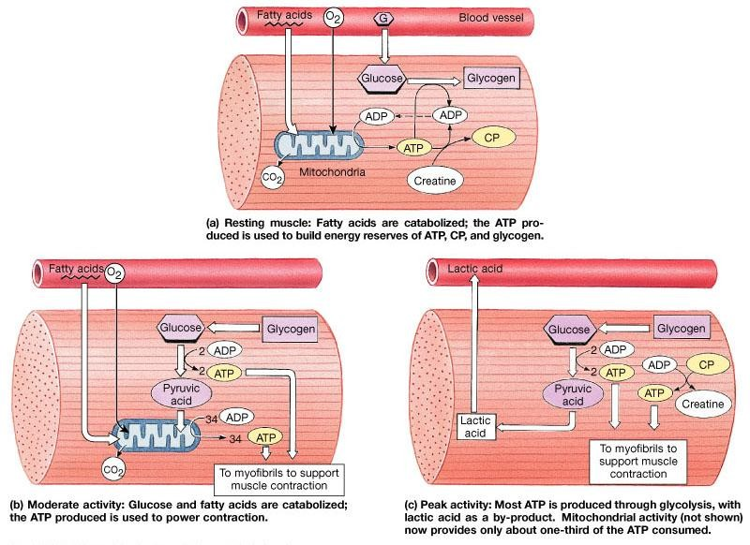
Muscle Metabolism

Slide 11

Muscle Fatigue
Fatigued muscle no longer contracts
due to:
  Build up of lactic acid (low pH of
sarcoplasm)
  Exhaustion of energy resources (↑ ADP &
↓ ATP)
  Ionic imbalance

Slide 12

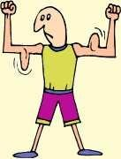

How would a fatigued muscle be able again to contract?
Recovery period: Begins immediately after
activity ends
Oxygen debt (excess post-exercise oxygen consumption)
  Amount of oxygen required during resting
period to restore muscle to normal conditions

Slide 13


TYPES OF SKELETAL
MUSCLE FIBERS

Slide 14

Types of skeletal muscle fibers
Mainly:
◦ Fast fibers (White, Glycolytic)
◦ Slow fibers (Red, Oxidative)

Slide 15

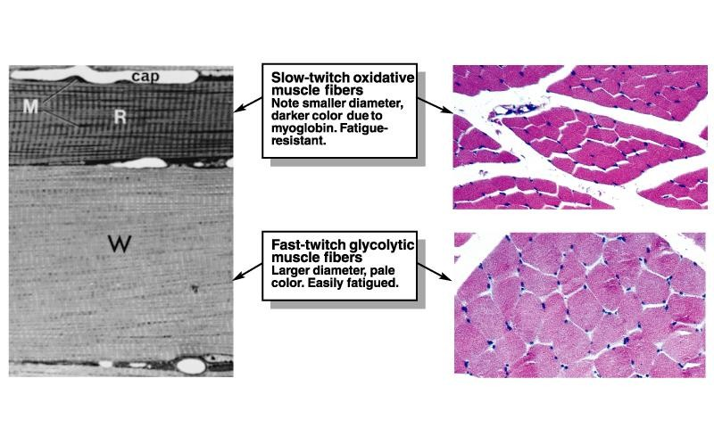
Fast versus Slow Fibers
Type I
Type II

Slide 16
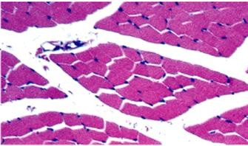

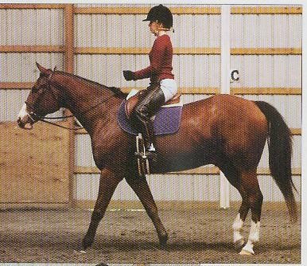
Slow fibers
Half the diameter of fast fibers
Take three times as long to contract after stimulation
Abundant mitochondria
Extensive capillary supply
High concentrations of myoglobin
Can contract for long periods of time
Fatigue resistant
Obtain their ATP mainly from FA β-
oxidation, TCA cycle, and the ETC

Slide 17

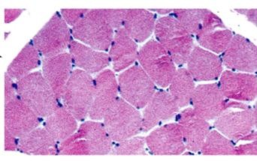
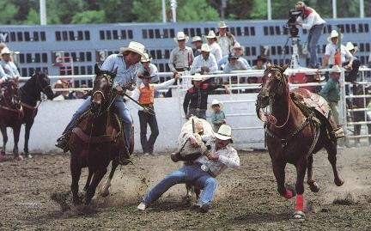
Fast fibers
Large in diameter
Contain densely packed myofibrils
Large glycogen reserves
Relatively few mitochondria
Produce rapid, powerful contractions of
short duration
Easily fatigued
Obtain their ATP mainly from Anaerobic glycolysis

Slide 18








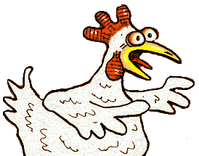

Why do chickens have white breast meat and dark leg meat? Why do migrating ducks have dark breast meat?

Slide 19



WHAT IS GOING ON IN
RESTING MUSCLE?

Slide 20
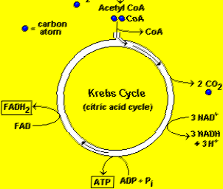
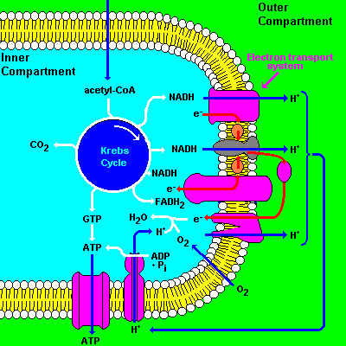
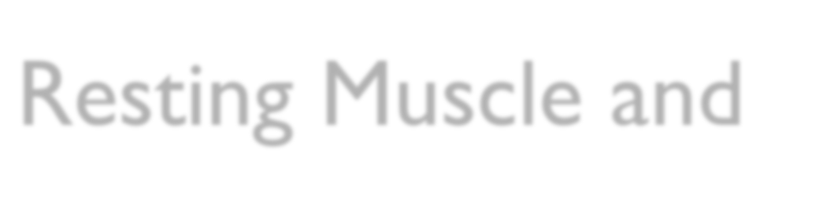
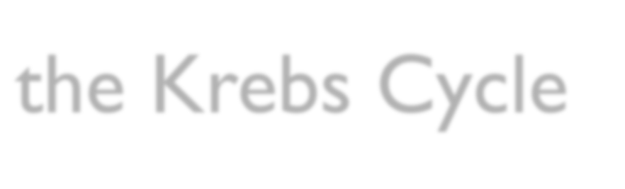
Resting Muscle and
the Krebs Cycle
Resting muscle fibers typically takes up fatty acids from the
blood stream.
Inside the muscle fiber, the FA’s are oxidized (in the mitochondria) to produce Acetyl-CoA & several molecules of NADH and FADH2
Acetyl-CoA will then enter the Krebs cycle (in the mitochondria) →CO₂, ATP, NADH, FADH2, and oxaloacetate
NADH and FADH2 will enter the Electron Transport Chain. (in the inner mitochondrial membrane)→  synthesis of ATP

Slide 21

ATP Use in the Resting Muscle Cell
ATP is necessary for cellular housekeeping duties, e.g.:
  ATP is used for glycogenesis (storage form of
glucose)
  ATP is used to create another energy storage compound called creatine phosphate

Slide 22



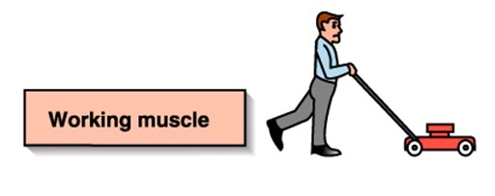
WHAT IS GOING ON IN CONTRACTING MUSCLE?

Slide 23

Working Muscle
As we begin to exercise, we almost immediately
use our stored ATP
For the next 15 seconds or so, we turn to the creatine-phosphate.
This system dominates in events such as the 100m dash or lifting weights.

Slide 24
Working Muscle
After the phosphagen system is depleted, the muscles must find another ATP source.
*The process of anaerobic metabolism can maintain ATP supply for about 45-60s.
Glycogen → Glucose → 2 pyruvic acid (2 ATP + 2 NADH)
2 Pyruvic acid → 2 lactic acid (2 NAD⁺)
Lactic acid diffuses out of muscles →blood → taken by the liver → Glucose (by gluconeogenesis) →blood →  taken by the muscle again
* It usually takes a little time for the respiratory and cardiovascular systems to catch up with the muscles and supply O₂ for aerobic metabolism.

Slide 25


Anaerobic Metabolism, continued…
Anaerobic metabolism is inefficient… Why?
Large amounts of glucose are used for very small ATP returns.
Lactic acid is produced whose presence contributes to
muscle fatigue
Which type of sports uses anaerobic metabolism?
Sports that requires bursts of speed and activity, e.g.,
basketball.

Slide 26


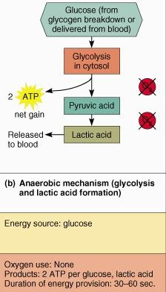
Anaerobic Metabolism in
muscles, summary

Slide 27

Aerobic Metabolism
 Occurs when the respiratory and cardiovascular
systems have “caught up with” the working muscles.
Prior to this, some aerobic respiration will occur thanks to the muscle protein, myoglobin, which binds and stores oxygen.
During rest and light to moderate exercise, aerobic metabolism contributes 95% of the necessary ATP.
Compounds which can be aerobically metabolized
include:
Fatty acids, Pyruvic acid (made via glycolysis), and amino acids.

Slide 28

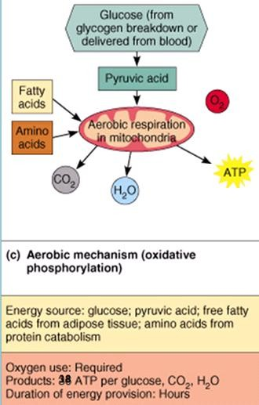
Aerobic Metabolism, summary

Slide 29




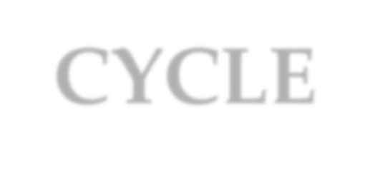
THE CORI CYCLE &
THE ALANINE CYCLE

Slide 30
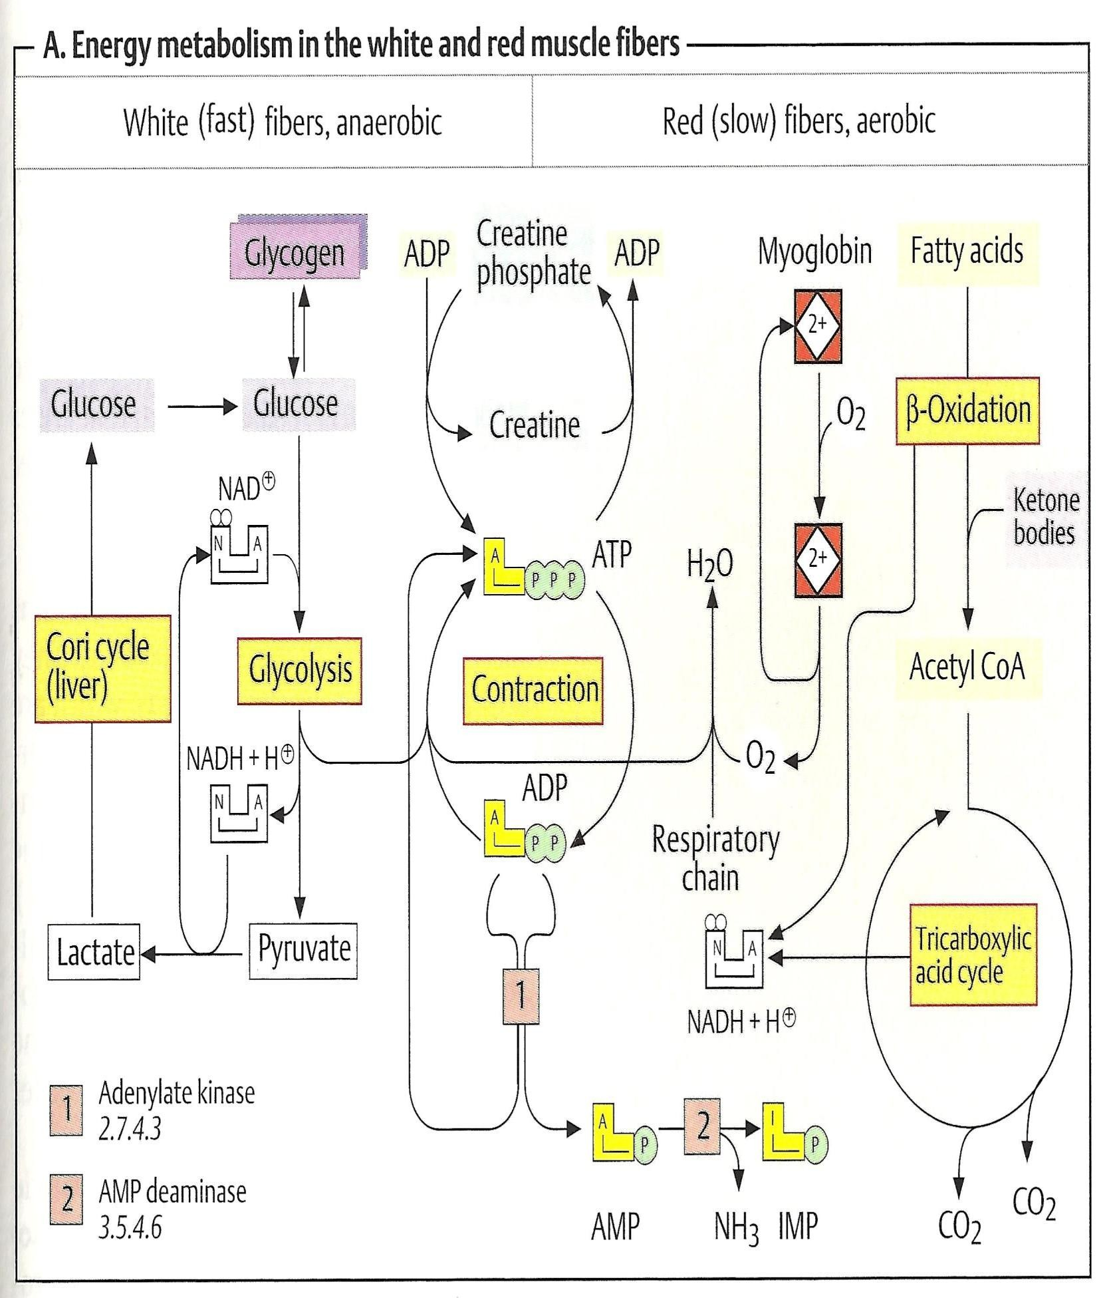

Slide 31
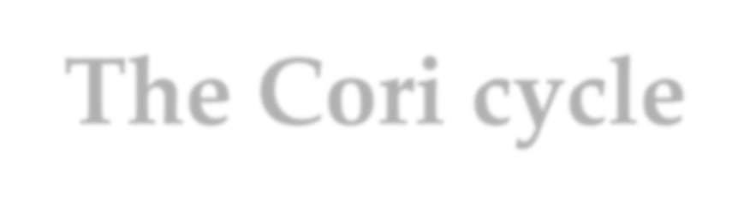
The Cori cycle
Liver converts lactate into
glucose via gluconeogenesis
The newly formed glucose is transported to muscle to be used for energy again

Slide 32
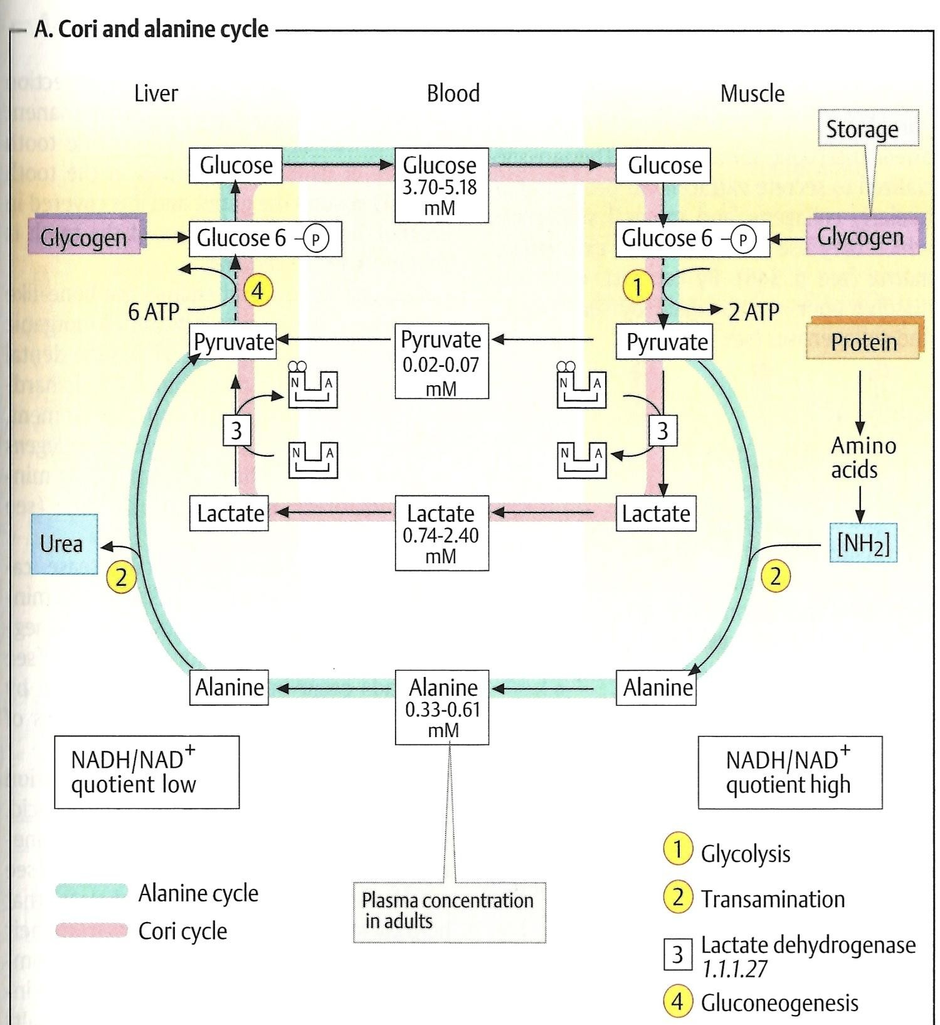

Slide 33
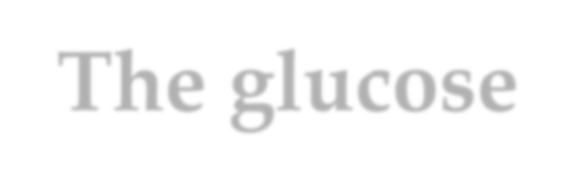

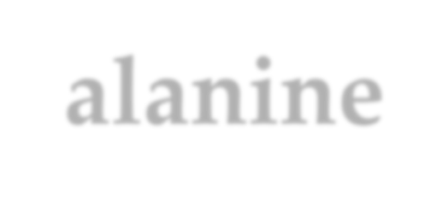
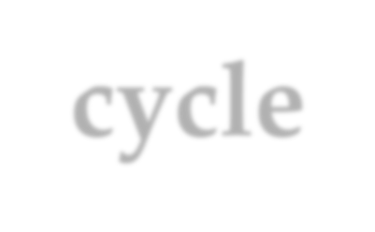
The glucose-alanine cycle
Muscles produce:
  Pyruvate from glycolysis during exercise and NH2 produced from normal protein degradation produce Alanine
Pyruvate + NH₂ → Alanine
This alanine is transported through the blood to liver
Liver converts alanine back to pyruvate
Alanine – NH₂ = Pyruvate
Pyruvate is used in gluconeogenesis
 The newly formed glucose is transported to muscle to
be used for energy again

Slide 34




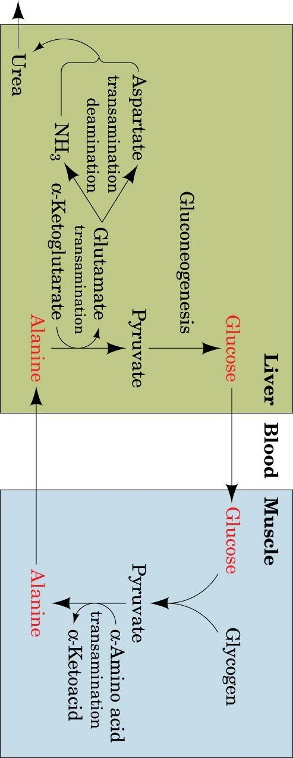



PVaogeet 9B8io8chemistry 3e
© 2004 John Wiley & Sons, Inc.
The glucose–alanine cycle

Slide 35
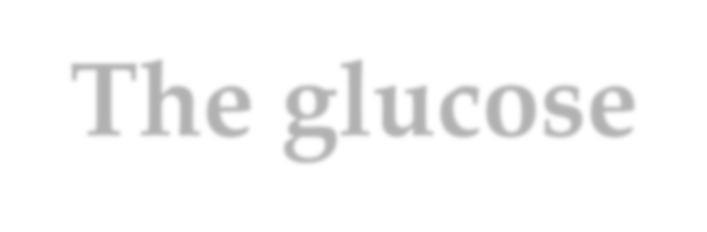

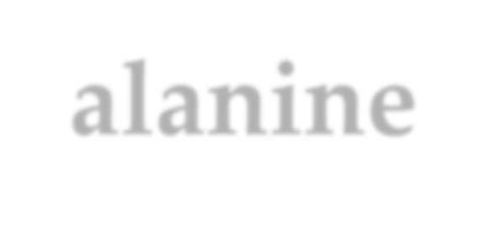
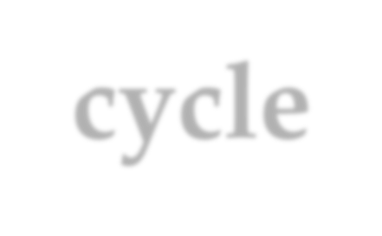
The glucose-alanine cycle
 What happened to NH₂?
Liver converts it to urea for
excretion (urea cycle)

Slide 36

Take home message
There are mainly 2 types of muscle fibers:
  Type I (slow, aerobic, red, rich in mitochondria and myoglobin, mainly generate ATP from fatty acid oxidation, fatigue resistant, involved in endurance activity)
  Type II (fast, glyocolytic, white, mainly generate ATP from anaerobic glycolysis, easily fatigued, used for sports required burst of activity)

Slide 37

Take home message..continued
Muscle metabolism can obtain its energy
through:
  ATP Stores and CP
  Anaerobic metabolism (relatively inefficient, large amounts of glucose are used for very small ATP returns, lactic acid is accumulated,)
  Aerobic (relatively efficient, large amount of ATP produced per each glucose molecule used, requires the presence of O₂ & intact mitochondria)

Slide 38
Take home message..continued
Muscle fatigue is the result of several
factors, e.g.
  Decrease in sarcoplasmic pH (due to ↑ lactic acid)
  Exhaustion of energy sources (↑ ADP & ↓ ATP)
  Ionic imbalance
The glycogen stores in the muscles are rapidly mobilized for ATP production in muscle

Slide 39
Take home message..continued
Glucose-alanine cycle:
  In the muscles, Pyruvate is converted to Alanine by transamination→ Ala is transported through blood to liver→liver converts Ala back to Pyruvate → Pyruvate is converted to glucose (gluconeogenesis)
→ glucose is transported to muscle to be used for energy again

Slide 40
Take home message..continued
Cori’s cycle:
  Lactate produced in exercising muscle is transported to liver→ liver converts lactate back to glucose (gluconeogenesis)
→ glucose is transported to muscle to be
used for energy again

Slide 41









And now, again …
Why do chickens have white breast meat and dark leg meat? Why do migrating ducks have dark breast meat?

Slide 42


THANK YOU ☺

