Slide 1
Nervous system
Peripheral nervous
system
Central nervous
system
Efferent Division
(Motor)
Afferent Division
(Sensory)
Autonomic nervous
system
Somatic system
(skeletal muscles)
Enteric nervous system
Parasympathetic nervous system
Sympathetic nervous system

Slide 2
What are the differences between the somatic and the autonomic nervous system?
Somatic N.S Autonomic N.S
Control skeletal muscles Control internal viscera
Voluntary Involuntary
Somatic nerve is one fiber autonomic nerve is two fibers (Preganglionic &
Postganglionic)

Slide 3
Autonomic nerve
Post-ganglionic fiber
ganglia
Pre-ganglionic fiber
Somatic nerve
One fiber

Slide 4
Division of Autonomic Nervous System
Sympathetic nervous system.
Parasympathetic nervous system.
Enteric nervous system.

Slide 5
Parasympathetic Nervous System
Is a craniosacral outflow

Slide 6
Neurotransmitters
Neurotransmitter in parasympathetic nervous system or cholinergic system is acetylcholine and nerves are called cholinergic nerves

Slide 7
Cholinergic transmission
The release of neurotransmitter Ach from cholinergic nerves include the following steps:
Synthesis of Ach
Storage of Ach in storage vesicles
Release of Ach
Binding of Ach to postsynaptic receptors to give actions

Slide 8
Cholinergic transmission
5) Metabolism by acetyl cholinesterase in synaptic cleft to give choline and acetate.
acetyl cholinesterase
Acetylcholine acetate + choline
6) Recycling of choline

Slide 9
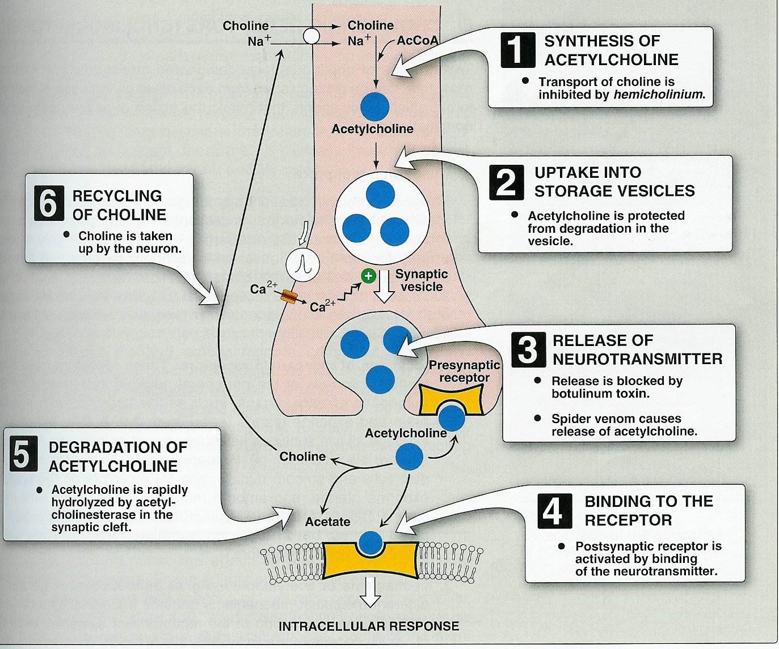
Cholinergic transmission

Slide 10
Cholinergic transmission

