Slide 1
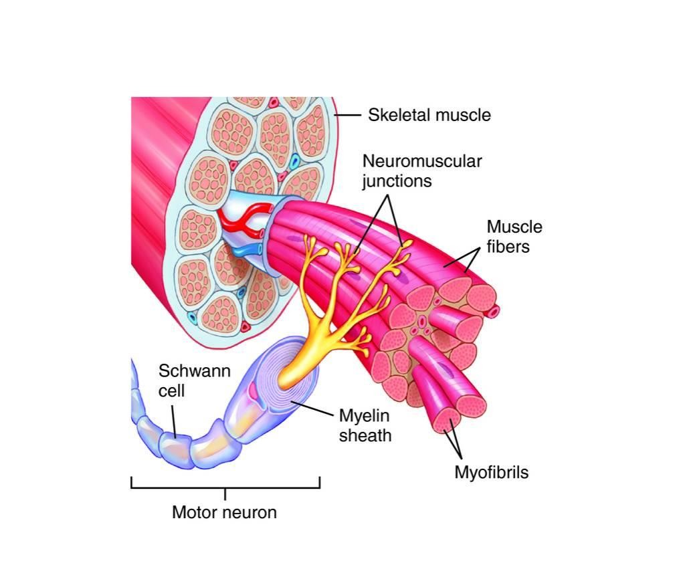
Organization of the Nervous
Systemand Motor unit
BY
Prof.Faten Zakareia Professor of Physiology
Consultant of Neurophysiology Physiology Department College of Medicine
King Saud University

Slide 2
Lecture2:- Organization of the Nervous System and Motor Unit
Objectives:-
At the end of this lecture the student should be able to:-
-Diagnose the organization of the Nervous System
-Appreciate differences between both central nervous system (CNS) & peripheral nervous system (PNS)
Identify motor unit
know the function & recruitment of motor unit
Appreciate effect of motor units number on motor action performance
e

Slide 3
Organization of the Nervous System
The nervous system is divided into the
central nervous system (CNS)
peripheral nervous system (PNS)
1- Central nervous system (CNS)
- It is the part that integrates the sensory information that it receives from diff parts of body , and coordinates the activity of all parts of the body .
It consists of :-
the brain
the spinal cord.
-the brain is protected by the skull, while the spinal cord is protected by the vertebrae, and both are enclosed in the meninges

Slide 4
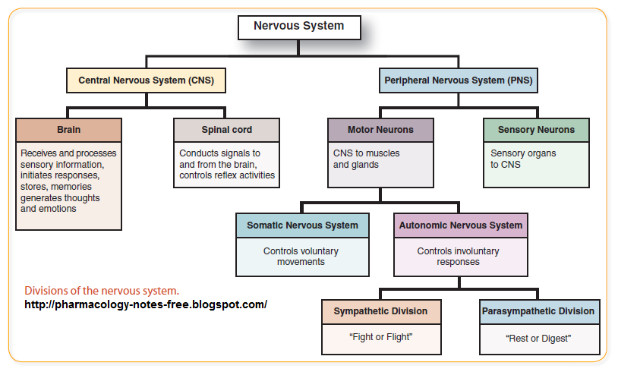

Slide 5
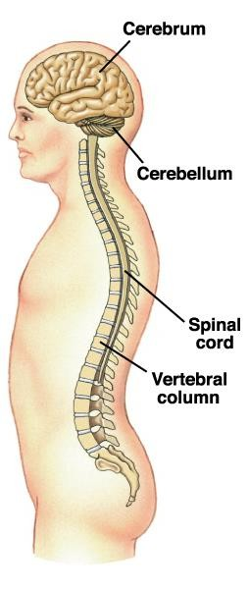
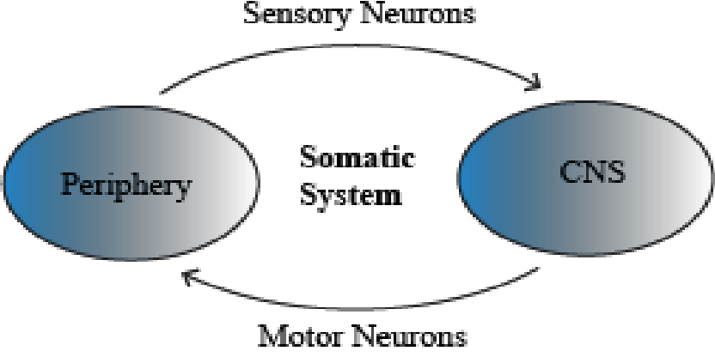

Slide 6
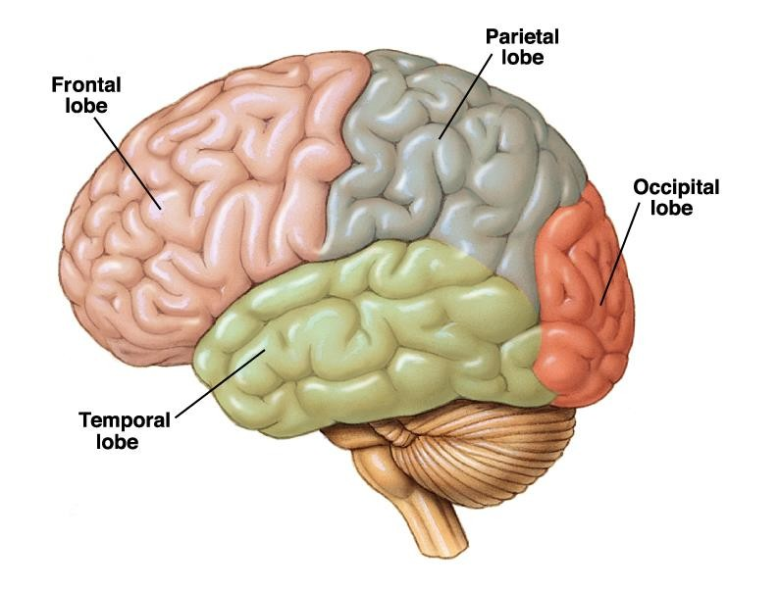
Brain consists of :
- Two cerebral hemispheres connected together by corpus callosum
-Each hemisphere consists of frontal , parietal, temporal & occipital lobes
-Cerebral cortex has sulci & gyri to increase brain surface area
-Deep white matter has groups of
nuclei as basal ganglia and others
-Brain stem
- Cerebellum

Slide 7
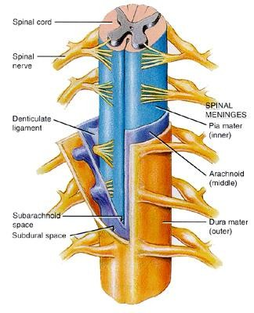
Spinal cord:-
- Consists of H- shape grey matter formed of neurons(nerve cells)
-(dorsal horn has sensory neurons& ventral horn has motor neurons)
- Surrounded by white matter of nerve fibres ( ascending and descending tracts)

Slide 8
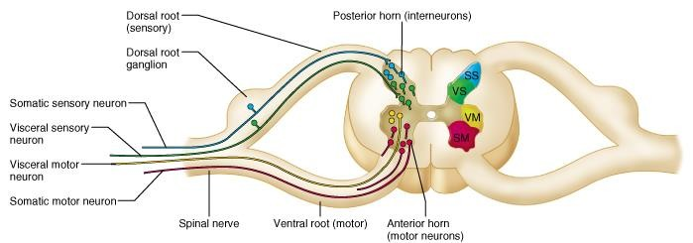

Slide 9
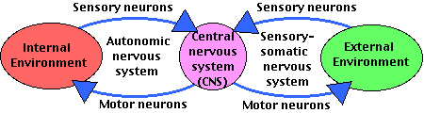
The peripheral nervous system is subdivided
into the :-
1-sensory-somatic nervous system
2- autonomic nervous system

Slide 10
A-Sensory-somatic nervous system
- The actions of the Sensory-Somatic nervous system are largely
voluntary ةيدارا
The Sensory-Somatic Nervous System is concerned with all our conscious awareness of the external environment and all our motor activity to cope with it .
The sensory-somatic system consists of :_-
1-12 pairs of cranial nerves ( control function of head & neck) 2- 31 pairs of spinal nerves.
-All has sensory afferent & motor efferent
•

Slide 11
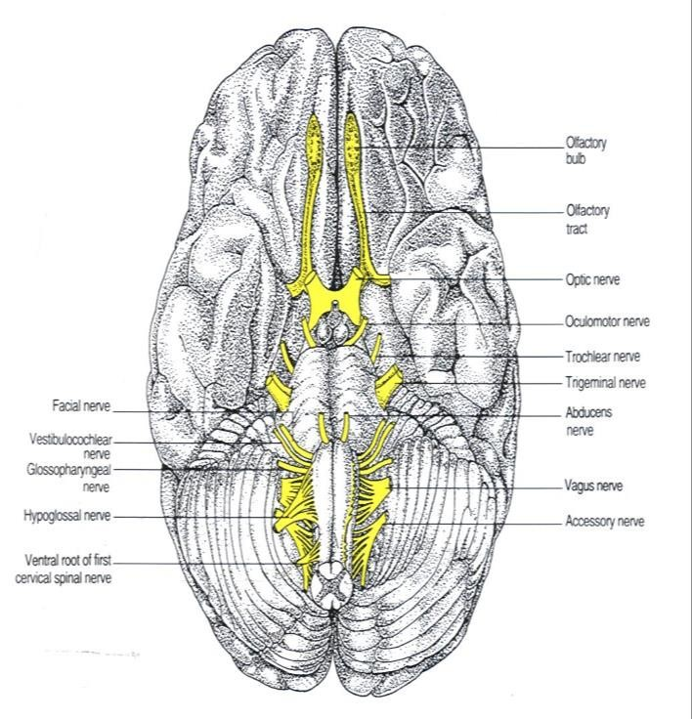
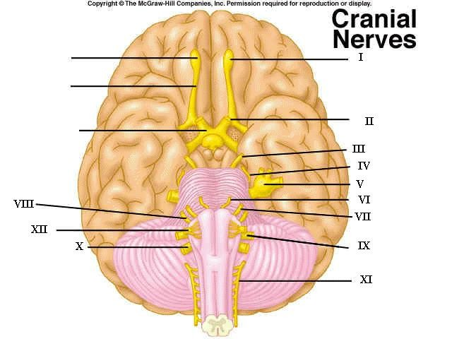
1-CRANIAL NERVES:-
12 PAIR
Ten out of the twelve cranial nerves originate from the brainstem neuclei
-The nuclei of cranial nerves I and II lie in the forebrain and thalamus
-mainly control the functions of all structures of the head & neck with some exceptions.

Slide 12
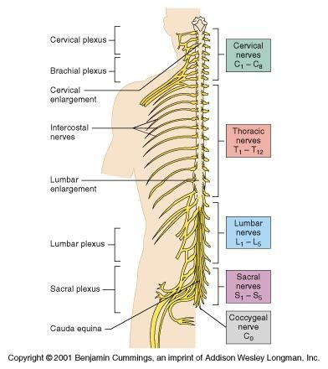
2-SPINAL NERVES:-
- Spinal nerves take their origins from
the spinal cord.
-In humans, there are 31 pairs of spinal nerves: 8 cervical, 12 thoracic, 5
lumbar, 5 sacral and 1 coccygeal.
-They control the functions of all parts
of body except head & neck.
- All of the spinal nerves are "mixed"; that is, they contain both sensory afferents and motor efferent neurons( pass in dorsal & ventral root)

Slide 13
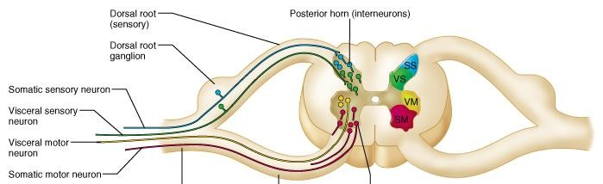
**
The sensory neurons are afferent neurons , running from stimulus receptors to relay SENSORY impulses toward the central nervous system to inform it about all types of sensations.(pain,touch….etc)
The motor neurons are efferent neurons which relay MOTOR impulses away from the central nervous system to periphery ( skeletal muscles , or gland) to take action.( pass in the ventral root)
•

Slide 14
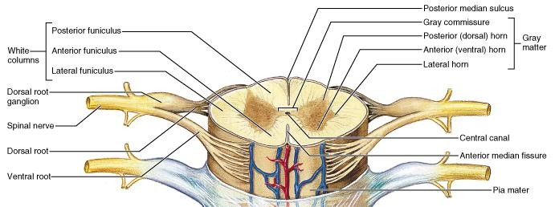

Slide 15
B-The Autonomic Nervous System
The autonomic nervous system consists of neurons that run between the central nervous system (especially the hypothalamus and medulla oblongata) and various internal organs such as the: heart ,lungs ,viscera , glands .
-It is responsible for monitoring conditions in the internal environment and bringing about appropriate changes in them.
-The contraction of both smooth muscle and cardiac muscle is controlled by the autonomic system.
-The actions of the autonomic nervous system are largely involuntary
-The preganglionic neurons, arise in the CNS and run to a ganglion , here they synapse كبشيwith postganglionic neurons, which run to the effector organ (cardiac muscle, smooth muscle, or a gland).
-The autonomic nervous system has two subdivisions :-
sympathetic nervous system
parasympathetic nervous system.

Slide 16
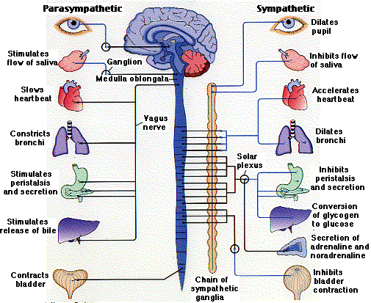

Slide 17
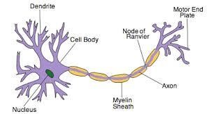
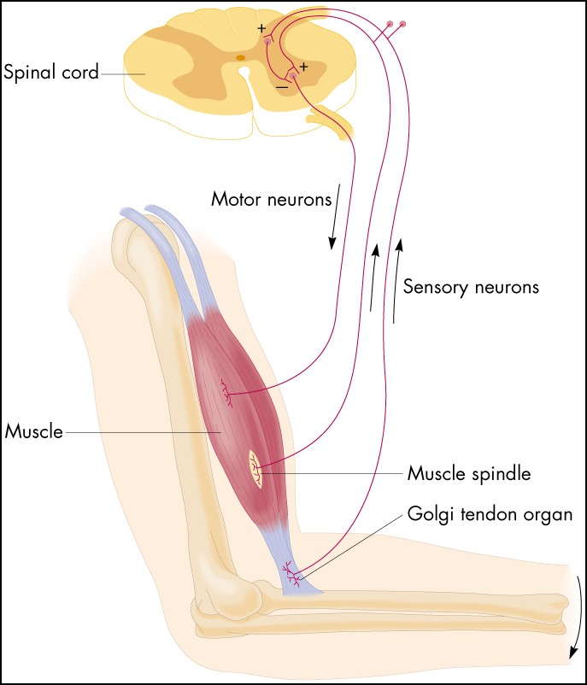
Motor unit
ةيكرح ةدحو

Slide 18
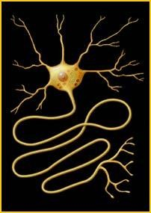
Neuron:-
-Dif// building unit of function of the central nervous
system, Either sensory or motor
Motor neuron is mostly antrior horn cell in the spinal cord supply skeletal muscle ( alpha motor neuton)
Motor neuron parts & function of each part:
Soma (cell body)
Dendrites تابعشتلاcarry nerve impulses from surroundings to the soma
3 Axon hillock زورب at which nerve impulses begin & pass in one direction from soma to the axon ( nerve fiber) then to axon terminal.
4-Axon and axon terminal end on skeletal muscle via neuromuscular junction
-Nerve cell axons are very thin, about 1 micrometer in
diameter, myelinated .
- For many motor neurons the axon is over a meter long, extending from the spinal column to a muscle cell.

Slide 19
-Alpha(α)-motor neuron is an anterior horn cell ( AHCs)
- A nerve is made of a group of axons of motor neurons

Slide 20
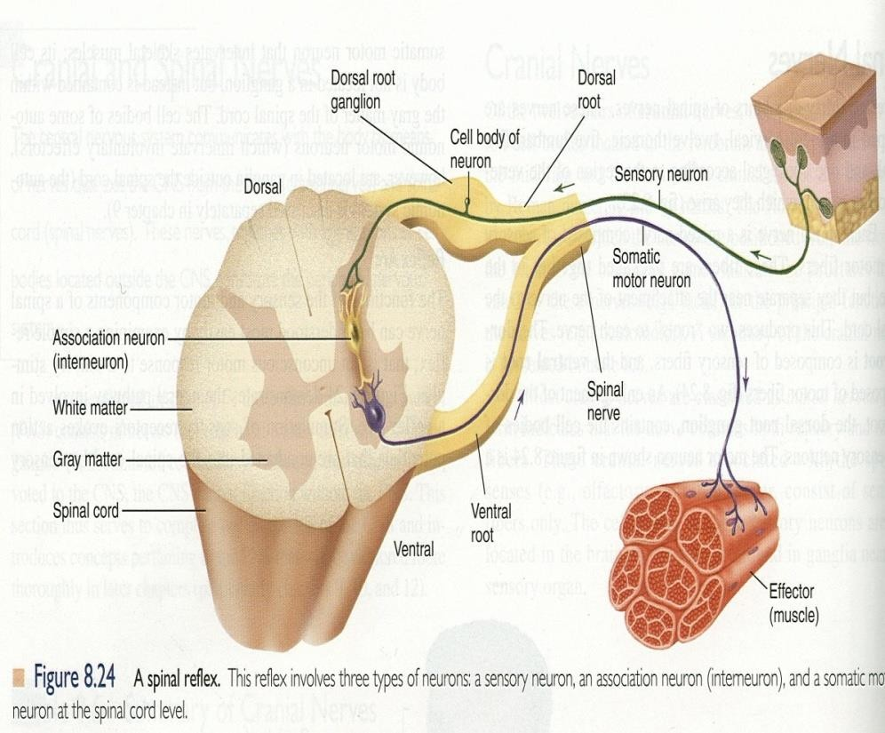
Motor unit
A motor unit is a single alpha -motor neuron and all of the corresponding muscle fibers it innervates ( all skeletal muscle fibers innervated by that motor neuron's axonal terminals.)
-all of these muscle fibers will be of the same type (either fast twitch fibers or slow twitch- ضافتنا).
-When a motor unit is activated, all of its
muscle fibers contract.
-A single muscle is supplied with groups of motor neurons. So Groups of motor units often work together to coordinate the contractions of a single muscle
• ةلضعلا فايللأ يضابقنلاا قفاوتلا
-all of the motor units that subserve ديفتa single muscle are considered a motor unit pool.
•

Slide 21
The number of muscle fibers within each motor unit can vary according to type of muscle movements:
1- Fine precise movements ةقيقدلا تاكرحلا/ need motor units
have small number of muscle fibers
2- Gross movementsةميسجلا تاكرحلا / need motor units have large number of muscle fibers
-Ratio of muscle fibers to motor neurons affects the precision of movement
-Thigh muscles can have a thousand fibers in each motor unit
- A single motor unit for a muscle like the gastrocnemius (calf) muscle (for gross movements) may include 1000-2000 muscle fibers
- A single motor unit for eye muscle controlling eye movements ( fine movements) may trigger fewer than 10 muscle fibers

Slide 22
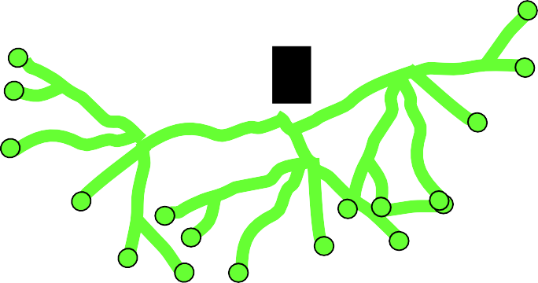
More precise movements
Less precise movements

Slide 23
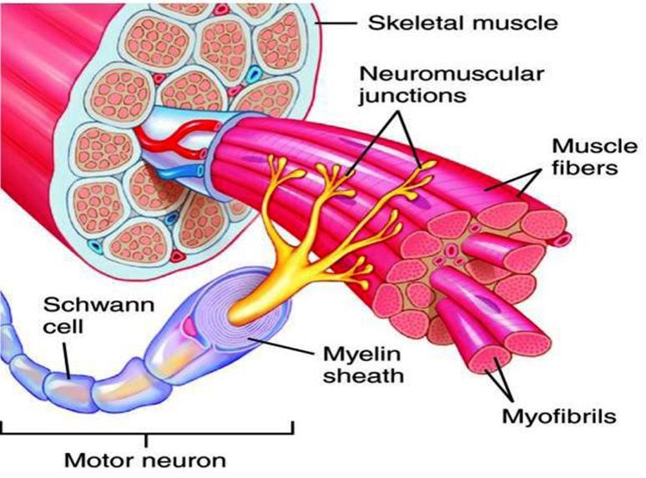
-In general, the number of muscle fibers innervated by a motor unit is a function of a muscle's need for refined precise motion.
-Groups of motor units often work together to help the contractions of a single muscle .
Muscles needed to perform highly precise movements قيقد generally consist of a large number of motor units and few muscle fibers in each motor unit e.g Hand and eye muscles
Less precise movements are carried out by muscles composed of fewer motor units with many fibers per unit e.g Trunk muscles

Slide 24
- The force of muscle contraction The two ways the nervous system increases the muscle contraction force production is through:-
1-Recruitment of new motor units
2- Increasing stimulation
frequency
ةيبصع تاضبن(rate coding).

Slide 25
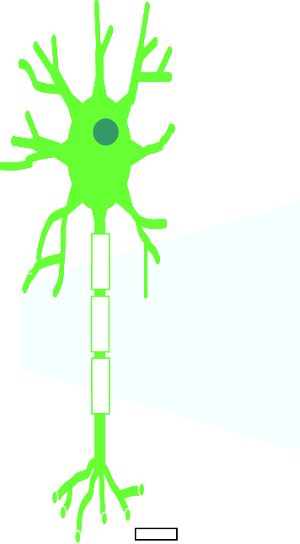
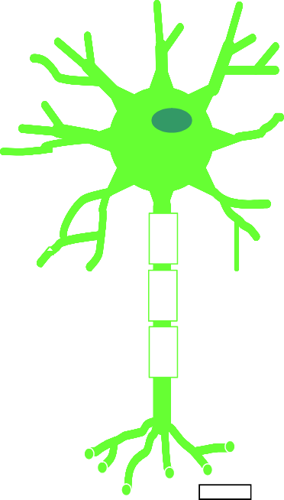
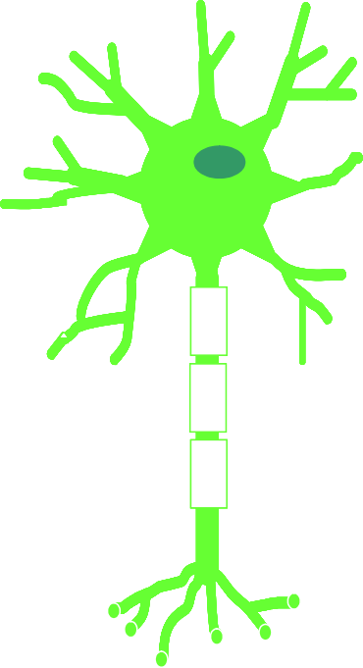
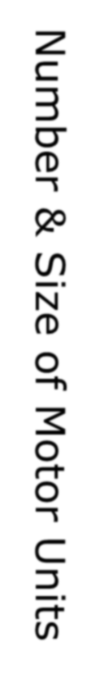
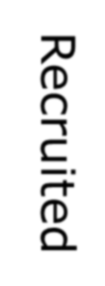



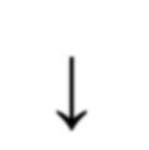

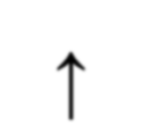


The force produced by a single motor unit is determined by →
(1) the number of muscle fibers in the unit ( size principle) &
(2) the frequency with which the muscle fibers are stimulated by
their innervating axon.
Number & Size of Motor Uni
Recruited
Small motor units
Low stimulus threshold
Larger motor units
Higher stimulus
threshold
Largest motor units
Highest stimulus
threshold
The Size Principle
ts
↓
↑
Amount of Force Required During Movement

Slide 26
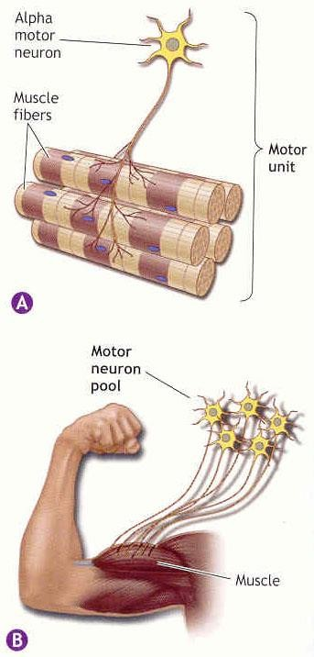
1-Motor unit recruitment
ةيكرحلا تادحولا فيظوت
-Motor unit recruitment is the progressive activation of a muscle by successive recruitment of more (motor units) to accomplish increasing grades of contractile strength ( force).
- All muscles consist of a number of motor units each
one has its own muscle fibers belonging to it.
-When a motor neuron is activated, all of the muscle fibers innervated by this motor neuron are stimulated and contract.
-The activation of one motor neuron (motor unit) will
result in a weak muscle contraction.
-The activation ( multiple motor units)will result in more muscle fibers being activated, and therefore a stronger muscle contraction
-Motor unit recruitment is a measure of how many motor neurons are activated in a particular muscle, and therefore is a measure of how many muscle fibers of that muscle are activated.
-The higher the recruitment of motor units the
stronger the force of muscle contraction

Slide 27
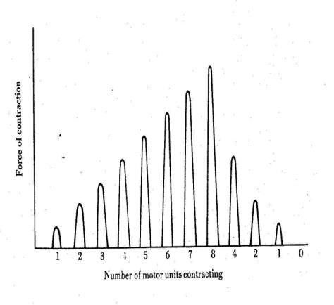
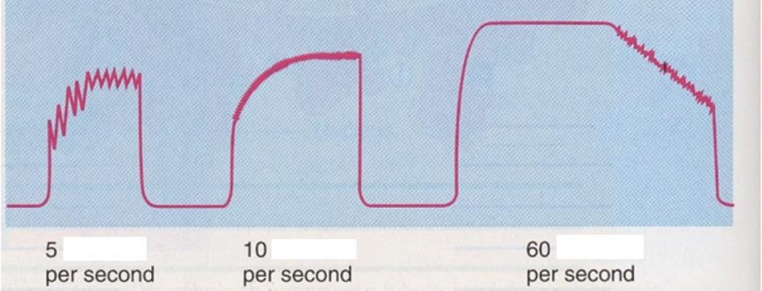
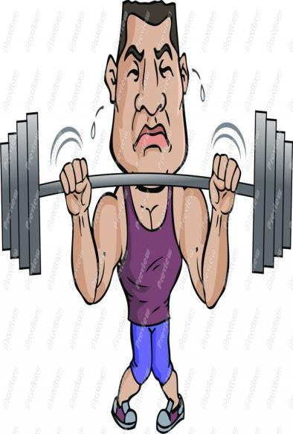
- Motor unit firing rate :_
The rate at which the nerve impulses arrive from motor neurons to muscle fibresand , the rate may vary from:-
Low frequencies firing rate enough to produce a series of single twitch muscle contractions
-When the AHC fires at slow rates , motor unit potentials (MUPs )will be at slow rate & the force of muscle contraction is weak
High frequencies firing rate enough to produce a fused tetanic contraction. جومدم ىصلقت ضابقنا( contraction without relaxation)
-If AHCs fire at very fast rates → fast MUPs → stronger contraction
- In general, the motor unit firing rate ( firing of nerve impulses) of each individual motor unit increases with increasing muscular effort until a maximum rate is reached.

Slide 28

Rate Coding
Increasing stimulation frequency (Motor neuron firing rate of nerve impulses)(rate coding) causes that Active motor units can discharge at higher frequencies to generate greater tensions.
Recruitment vs. rate coding to increase force of contraction:-
-Smaller muscles (ex: first dorsal
interosseous) rely more on rate coding
-Larger muscles of mixed fiber types (ex: deltoid) rely more on recruitment
Increasing frequency of action potentials
resulting in stronger force of
contraction
28

Slide 29
-To test motor unit stimulation, electrodes are placed on the skin and an intramuscular stimulation is applied. After the motor unit is stimulated, its pulse is then recorded by the electrode and displayed as an action potential, known as a motor unit action potential (MUAP).
- In medical electrodiagnostic testing for a patient with muscle
weakness, careful analysis of the motor unit action potential (MUAP) size, shape, and recruitment pattern can help in
distinguishing a myopathy ىلضع ضرمfrom a neuropathy
باصعلاا ىف ضرم

Slide 30
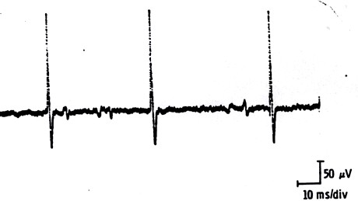
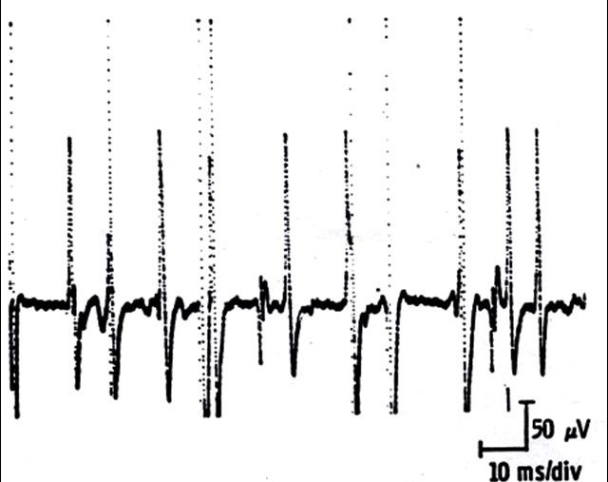
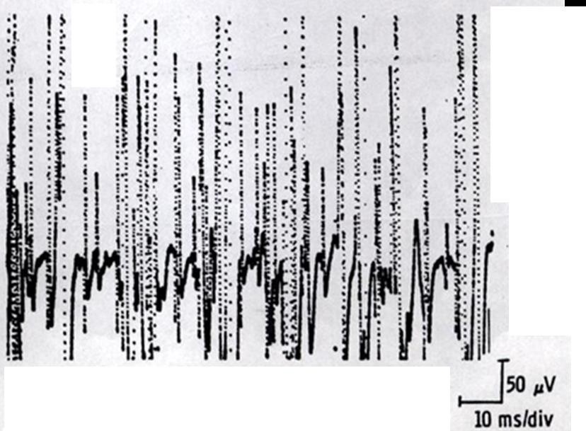
MUPs (2)
During Mild Effort
During Full Voluntary Effort .
There is full recruitment ( you
can not see the baseline )
During Moderate Effort → note recruitment of additional motoneurons

