Slide 1
Applied Nerve & Muscle Physiology : Nerve Conduction Study ( NCS) )and Electromyography ( EMG)

Slide 2
Objectives
Define what is nerve conduction study (NCS) and electromyography ( emg) .
Explain the procedure of NCS using Abductor Pollicicis Brevis muscle .
Define the normal conduction velocity in upper limb and lower limb nerves .
Define the motor unit potentials ( MUPs) and how they are changed in muscle and nervediseases .

Slide 3
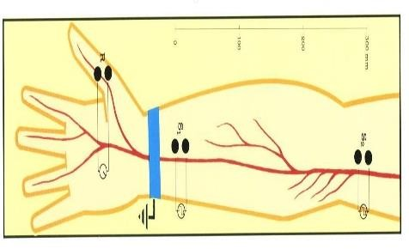
Nerve Conduction Study
( NCS)
A nerve conduction study (NCS) is an electrophysiology test test commonly used to evaluate the function of peripheral nerves of the human body.
It could be motor nerve conduction study ( motor NCS) , sensory nerve conduction study or mixed nerve conduction study .
In this lecture, because of time constraint, only
motor nerve conduction study will be discussed
In the motor test the recorded response is the muscle CMAP ( compound muscle action potential )
3

Slide 4
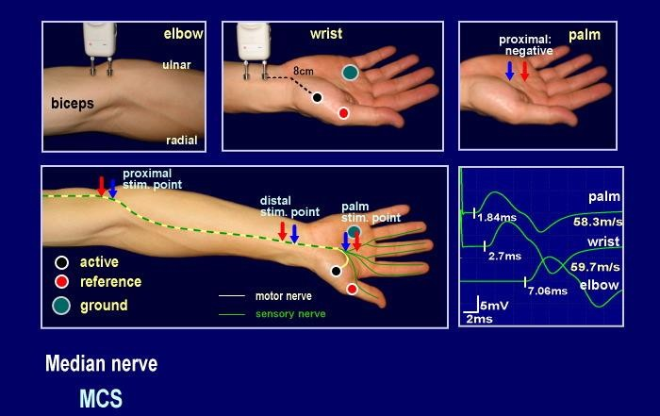
Procedure
An electrical stimulus is applied over a nerve ( e.g., median nerve ) and a recording electrode is place over the muscle suppllied by that motor nerve .
The stimulus is applied at two sites : a
distal site
( wrist ) and a proximal one ( antecubital fossa , elbow) .
The muscle usually chosen in this routine
test is the Abductor Pollicis Brevis
The active recording electrode (G1) is place over the thenar eminence which overlies the muscle .
And the reference recording electrode
(G2) about 3 cm away .
The oscilloscope ( CRO) sweep speed is
4

Slide 5
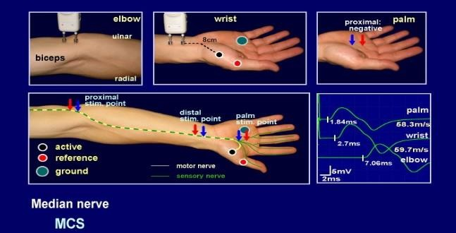
The stimulus duration used is 0.2 ms and stimulus frequency
to 1 / sec.
Apply the stimulus and record the response from stimulation at the wrist .
Store the CMAP ( compound muscle action potential ) in the first channel of the oscilloscope .
Change the stimulating site from wrist to antecubital fossa (
elbow ) .
Stimulate the nerve & record the CMAP for median nerve stimulation at the elbow .

Slide 6






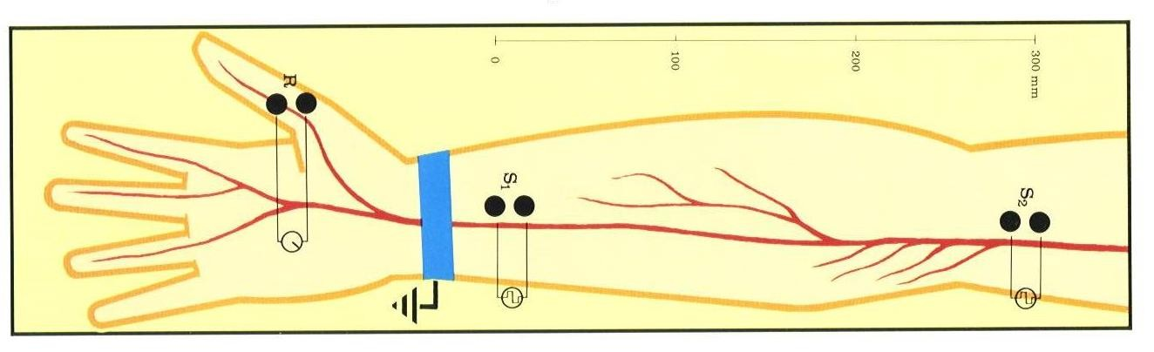
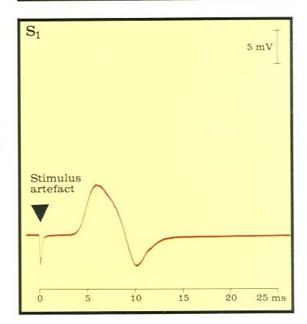
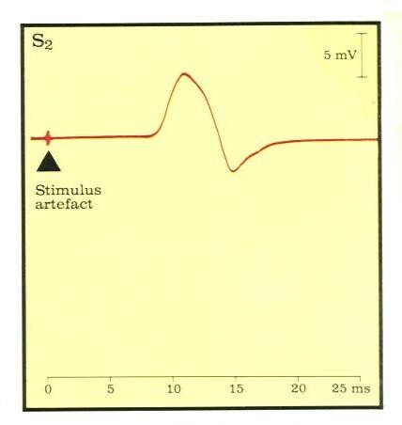

Distance
d = 284 mm
L2 Latency At elbow
L1 Latency At
wrist
= 8.5 ms
6
= 3.5 ms

Slide 7
Measure the distance from elbow to wrist with a measuring tape.
Measure the latency in first CMAP & in the next CAMP.
Enter the distance between the elbow and wrist
• .
7

Slide 8
Motor conduction study: Median nerve

Slide 9
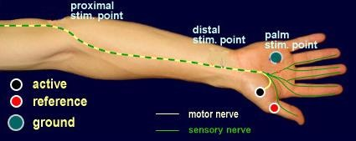

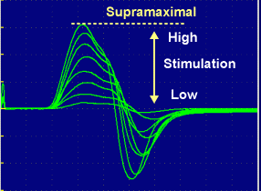

Nerve conduction velocity
D2
_{NCV =} D1-D2
L1-L2
D1
Latency (s) L1
L2

Slide 10
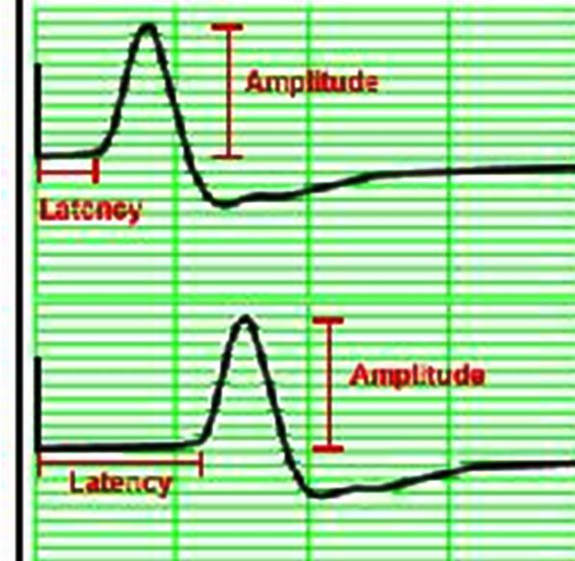
L1
L2

Slide 11
MNCV
MNCV will appear.
It can also be calculated
by formula
MNCV (m/sec)=
Distance (mm)
--------------------------
L2-L1 (ms)
L1 = latency at wrist
L2 = latency at elbow
11

Slide 12
Normal values for conduction velocity
✓In arm
– 50 – 70 m / sec.
✓In leg
– 40 – 60 m / sec.
12

Slide 13
Electromyography ( EMG)

Slide 14
Electromyography (EMG) is a technique for evaluating and recording physiologic properties of muscles at rest and while contracting.
It’s a recording of electrical activity of the muscle by inserting needle electrode in the belly of the muscles ( needle emg ) or by applying the surface electrodes ( surface emg )
The potentials recorded in needle emg are derived from motor units of the muscle, hence known as motor unit potentials (MUPs).
Q: Define what is a “ motor unit ”?
14

Slide 15
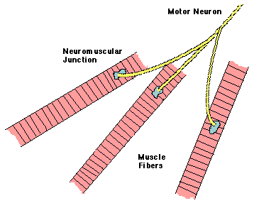
A motor unit is defined as one motor neuron and all of the muscle fibers it innervates.
15

Slide 16
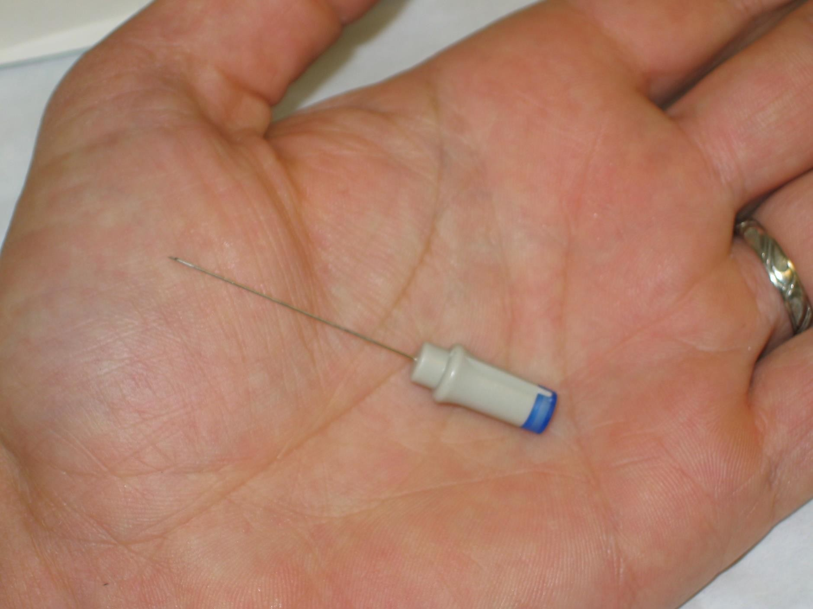
Normal MUPs
Amplitude : 300 μV ( microvolt) – 5 mV ( millivolts) Duration : 3 – 15 ms(milliseconds )
•
•
Electromyography ( EMG)
16

Slide 17
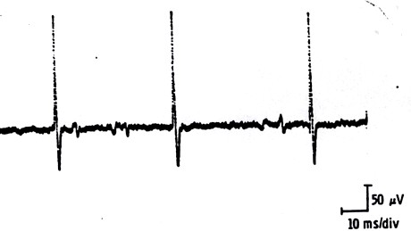
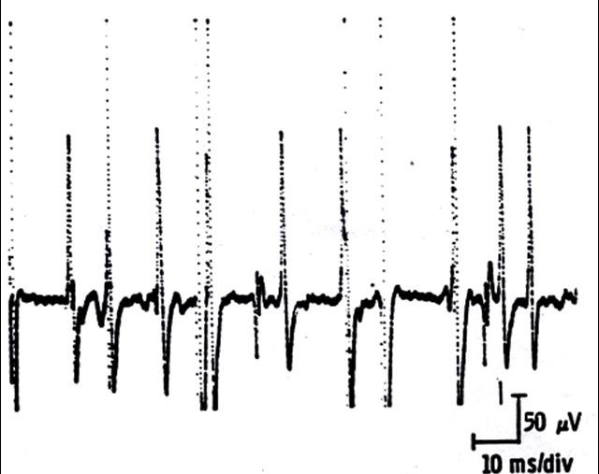
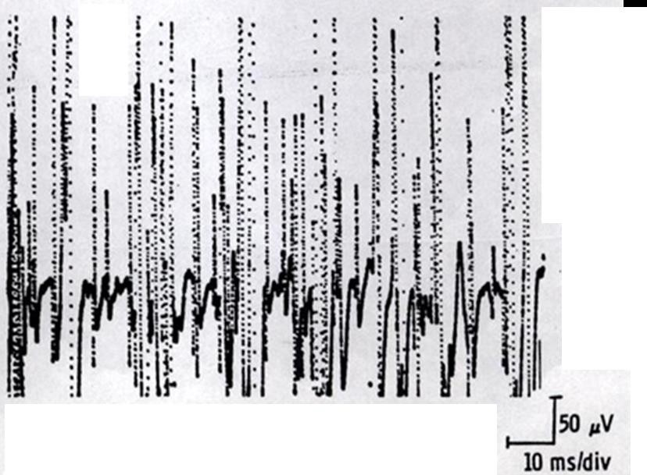
MUPs (2)
During Mild Effort
During Full Voluntary Effort .
There is full recruitment ( you
can not see the baseline )
During Moderate Effort → note recruitment of additional motoneurons

Slide 18
Examples of Abnormalities of MUPs
In nerve diseases : Giant MUPs due to reinnervation > 5 mV
In muscle disease : Small MUPs < 300μV

Slide 19
Clinical Application

Slide 20
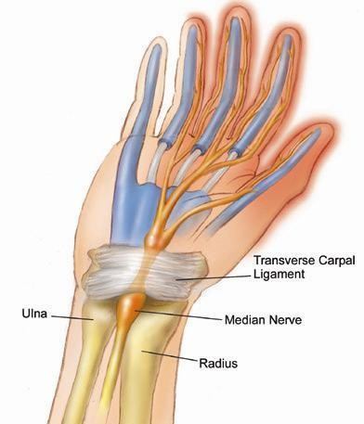
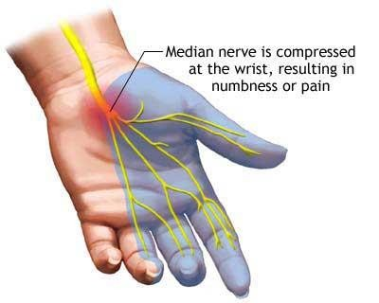
Carpal tunnel syndrome

Slide 21
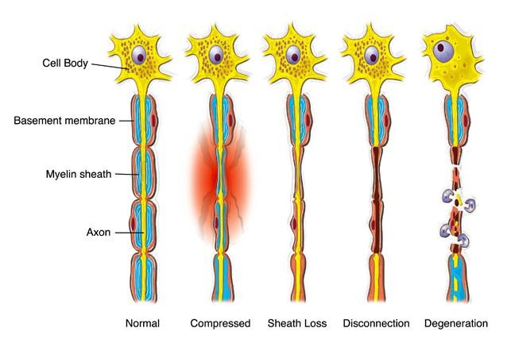
Nerve injury

Slide 22
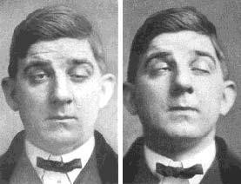
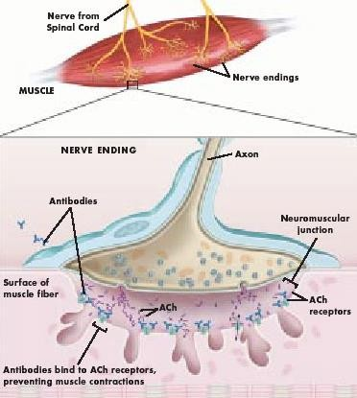
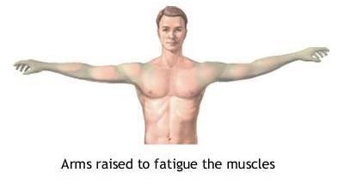
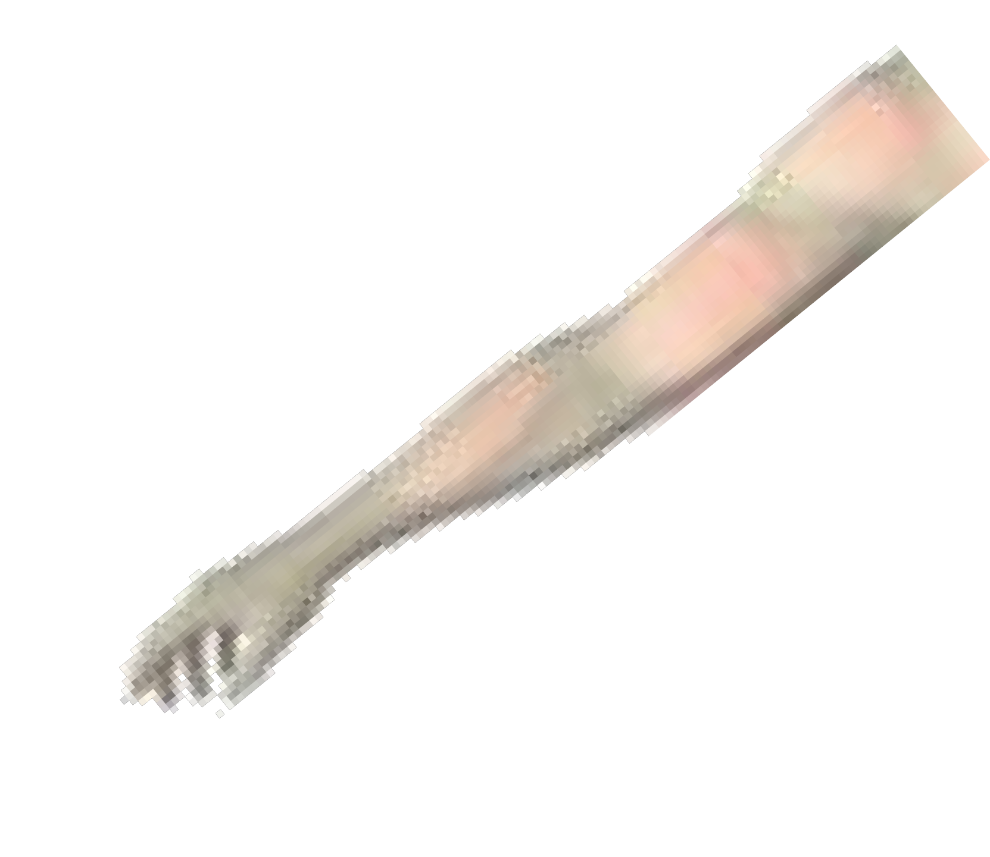
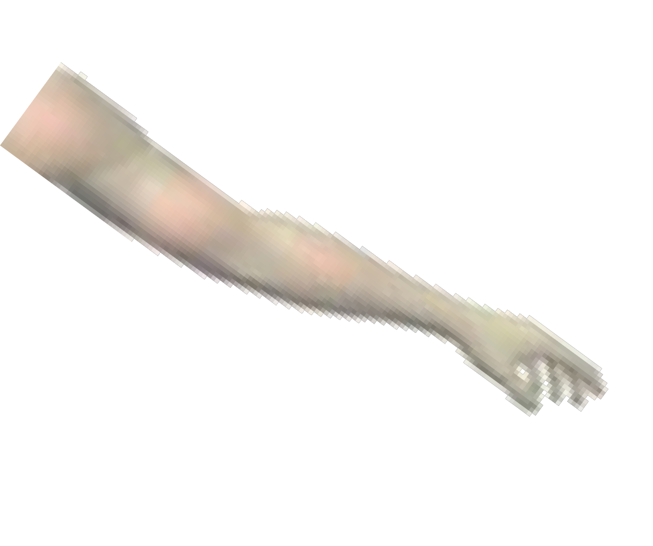
Myasthenia gravis

Slide 23
Thanks

