Slide 1

Physical and Physiological Factors Affecting atheletic Performance
Prof/ FATEN ZAKAREIA
Physiology Department College of medicine KSU

Slide 2
Objectives
1- At the end of this lecture the student should:-
Know the 3 metabolic systems exceedingly important in
understanding the
limits of physical activity
know recovery of the aerobic system after exercise and O2 dept. 3-Understand the Effects of smoking on pulmonary ventilation in exercise &effect of heart disease
Know effect of some drugs on athlets performance
Know the causes and effect of fatigue on sport performance 6- Identify overtraining syndrome
Reference book/ Guyton human physiology

Slide 3
There are 3 metabolic systems exceedingly important in understanding the limits of physical activity.
These are:
Phosphagen system
Glycogen-lactic acid system 3-Aerobic system

Slide 4
Adenosine Triphosphate:-
Adenosine-PO3 ˜ PO3 ˜PO3
-Each one of the last 2 high energy phosphate bonds store 7300 calories , which are used to energize the muscle contractile process.
-removal of one bond converts ATP to ADP then removal of one more forms AMP
-all ATP in muscle is sufficient for only 3 seconds of muscl power.(enough for one half of a 50-meter dash)
-It is essential to form new ATP continuously even during performance of •
short athletic events.

Slide 5
Phosphocreatine-creatine system= Creatine-phsphate system(creatine ˜ Po3)
-Contain high energy phosphate bond has 10300
calories/mole
S0 CP provide enough energy to reconstruct high energy
bond of ATP
-Most muscle cells have 2-4 times as much CP as ATP
-Energy transfer from CP to ATP occurs within a small fraction of a second .Therefore, energy of muscle CP is available for contraction just as stored energy of ATP.

Slide 6
Phosphagen energy system
Phosphagen energy system:- it is formed of combined amounts of cell ATP+CP, together provide maximal muscle power for 8-10 seconds(enough for 100 meter run)
-Energy of phosphagen system is useful for
maximal short bursts of muscle power.

Slide 7
Glycogen-lactic acid system
Anaerobic metabolism( glycolysis):-
-During glycolysis glycogen of the muscle split into glucose
without use of O2
-then each glucose split into:_
2 pyruvic acid + energy to form 4 ATP for each one glucose
molecule.
-then pyruvic acid in the mitochondria in presence of O2 will form more ATP(oxidative stage)

Slide 8
-When there is insufficient O2 most of pyruvic acid converts into lactic acid ,diffuse to blood stream.
-Glycogen-lactic acid system can form ATP molecules( anaerobically)
2.5 times as rapidly as can oxidative mechanism of mitochondria
- Anaerobic Glycolysis can provide large ATP amounts needed for short –moderate periods of muscle contraction( ½ as rapid as phosphagen system)
-Glycogen-lactic acid system provide 1.3-1.6 minutes of maximal
muscle activity (+ 8-10 seconds provided by phosphagen system

Slide 9
Aerobic process:-
Oxidation of foodstuffs glucose, AA,FA in the mitochondrai in presence of O2 produces energy that coverts AMP to ADP to ATP
-supply enerfor unlimited time
(figure 84-1,table 84-1)
 .

Slide 10
Moles of ATP/min
Endurance time
-phosphagen system
8-10 seconds
-Glycogen-lactic acid system 1.3-1.6 minutes
-Aerobic system (unlimited time as long as nutrients last)
-phosphagen system
4 moles
-Glycogen-lactic acid system 2.5 moles
-Aerobic system
1 moles

Slide 11
Recovery of muscle metabolic systems after ecxercise:-
-Energy from CP reconstitute ATP
-Energy from glycogen-lactic acid system reconstitute both CP&ATP
- Energy from oxidative metabolism of aerobic system reconstitute all other
systems(glycogen-lactic acid system & CP&ATP)
-Lactic acid causes fatigue so it is removes in 2 ways:-
(lactic acid system reconstitution means removal)
portion converted into pyruvic acid and oxidated by tissues
remaining is changed into glucose in liver to replinish glycogen stores of muscles

Slide 12
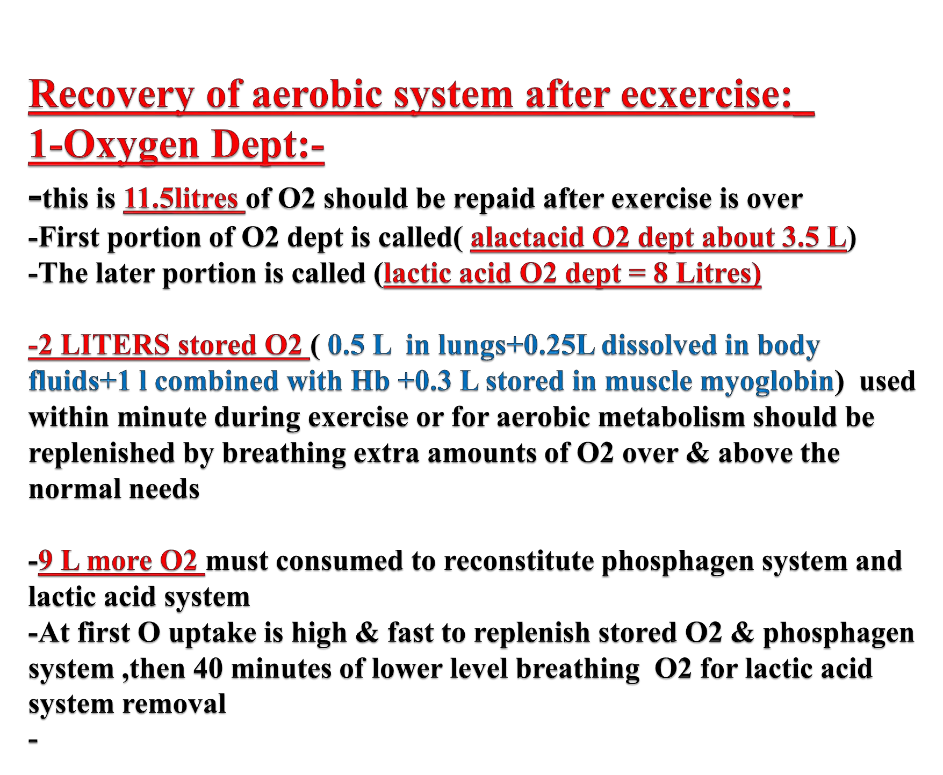

Slide 13
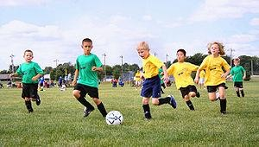
-Recovery of muscle glycogen
-Depletion of glycogen stores by heavy exercise
needs days to be replenished
-On high CHO diet ,recovery occurs in 2 days
-On high fat, high protein all show very little recovery
Message:_
athlet should have high CHO diet before exercise
not to participate in exhausting exercise during 48
hours preceding the event

Slide 14
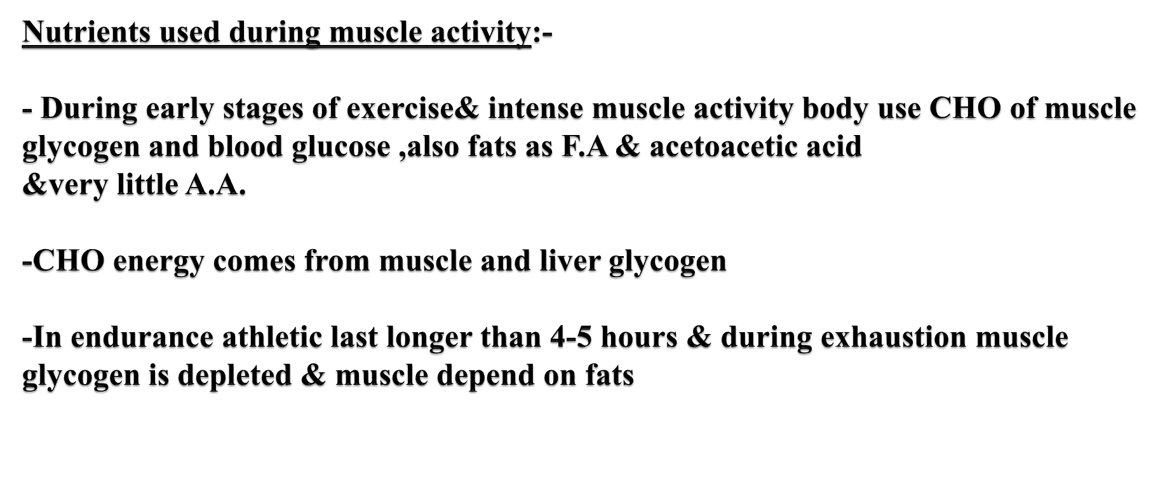
-Glucose solution given to athletes to drink during athletic event supply 30-40% of energy required during prolonged event as marathon race

Slide 15
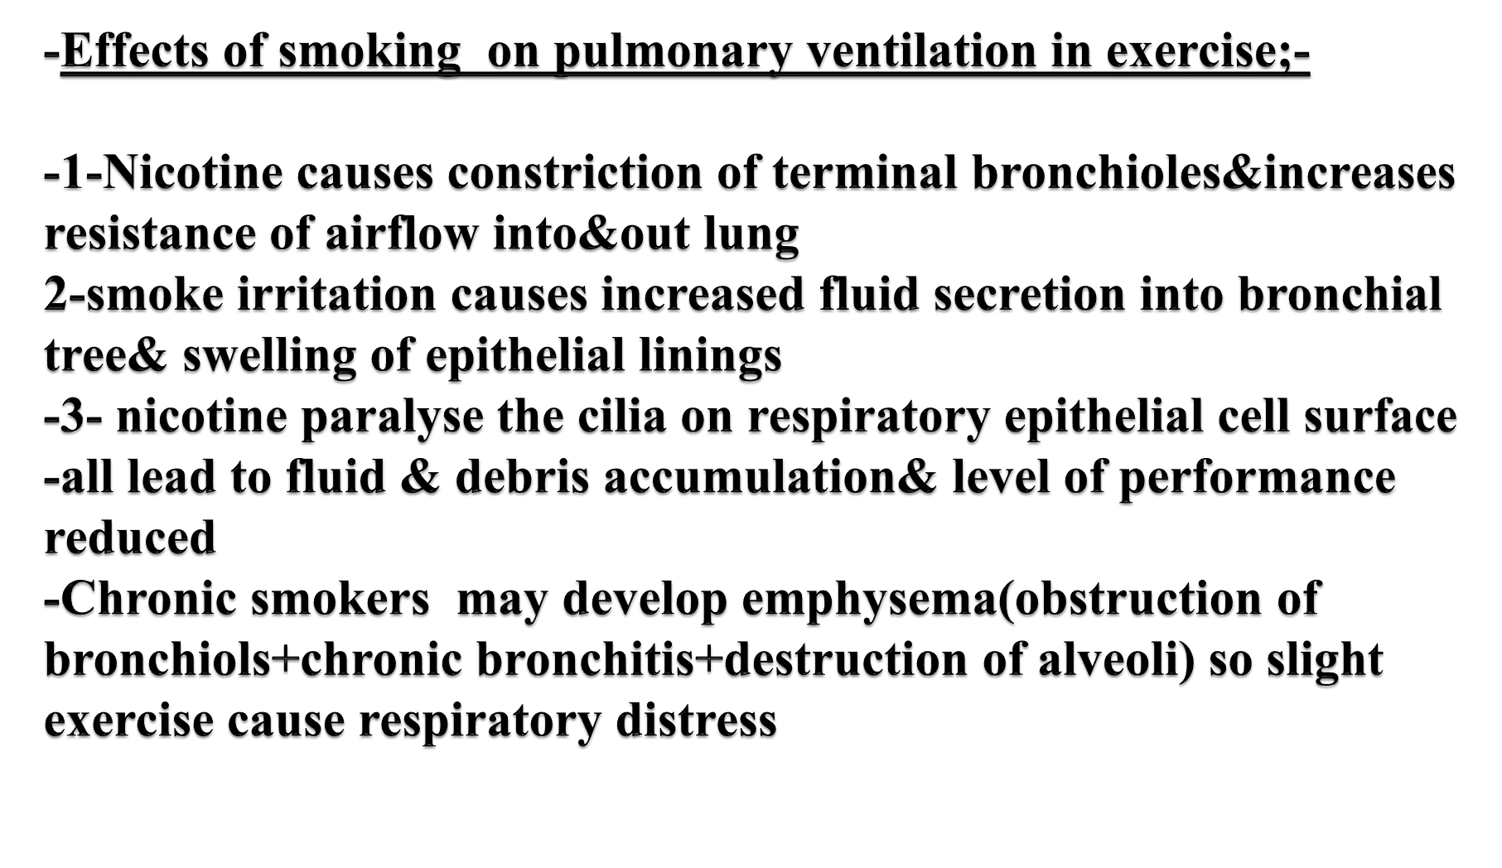

Slide 16
-Effects of heart disease and old age on athletic performance:-
-Cardiac disease reduce C.O& reduce muscle power
-patient withCHF can not climb the bed
Age-There is 50% decrease in C.O between 18-80 years& decrease in breathing capacity,muscle mass & power with age
-Youth are better in sport performance than elderly e.g., a footballer getting old may retire or be a coach

Slide 17
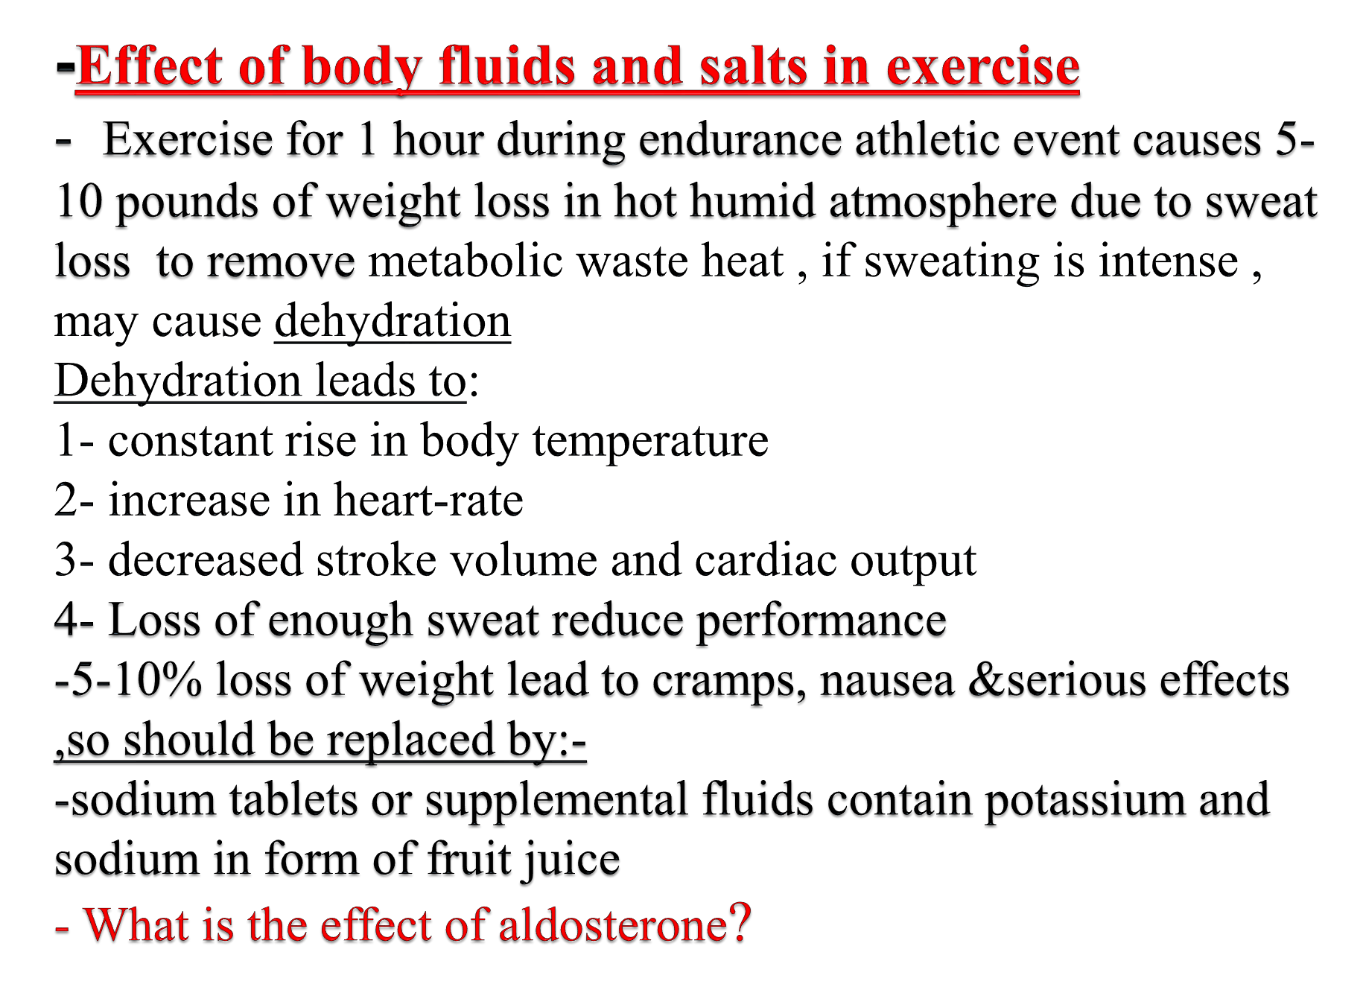
-
-

Slide 18
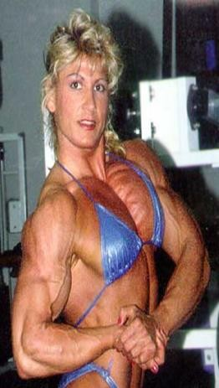
-Drugs and athletes
Caffeine increase athlets performance
Anabolic steroids and androgens ( e.g., Testosterone ) :
These are used by some athletes ( of both sexes ) to increase their muscle mass, allow the athlete to train harder and thereby enhance their physical performance . Their use in sport competitions is illegal
.They have harmful side-effects such as
-raised blood pressure . •
-They increase risk of heart attacks due to hypertension
-In males male sex hormones decrease testicular functions&
decrease natural testosterone
- In women develop facial hair,stoppage of menses,ruddy skin
and bass voice

Slide 19


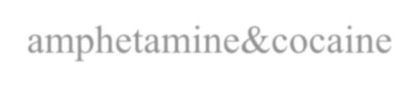

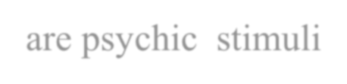


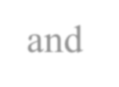


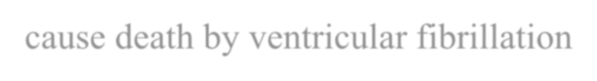
.
-Stimulants
Stimulants increase reaction speed ( i.e., decrease reaction-time ) , reduce perception of pain and raise aggression
They are highly addictive and have side-effects including high blood pressure,
cardiac problems , strokes, and liver disease .
-Narcotic analgesics
These are pain killers which athletes use to mask pain from an injury or overtraining They are also highly addictive and cause withdrawal symptoms when
the athlete stops using them.
- amphetamine&cocaine improve performance but overuse reduce performance they
are psychic stimuli
-reaction of these drugs with epinephrene and norepinephrene secreted during exercise cause death by ventricular fibrillation

Slide 20
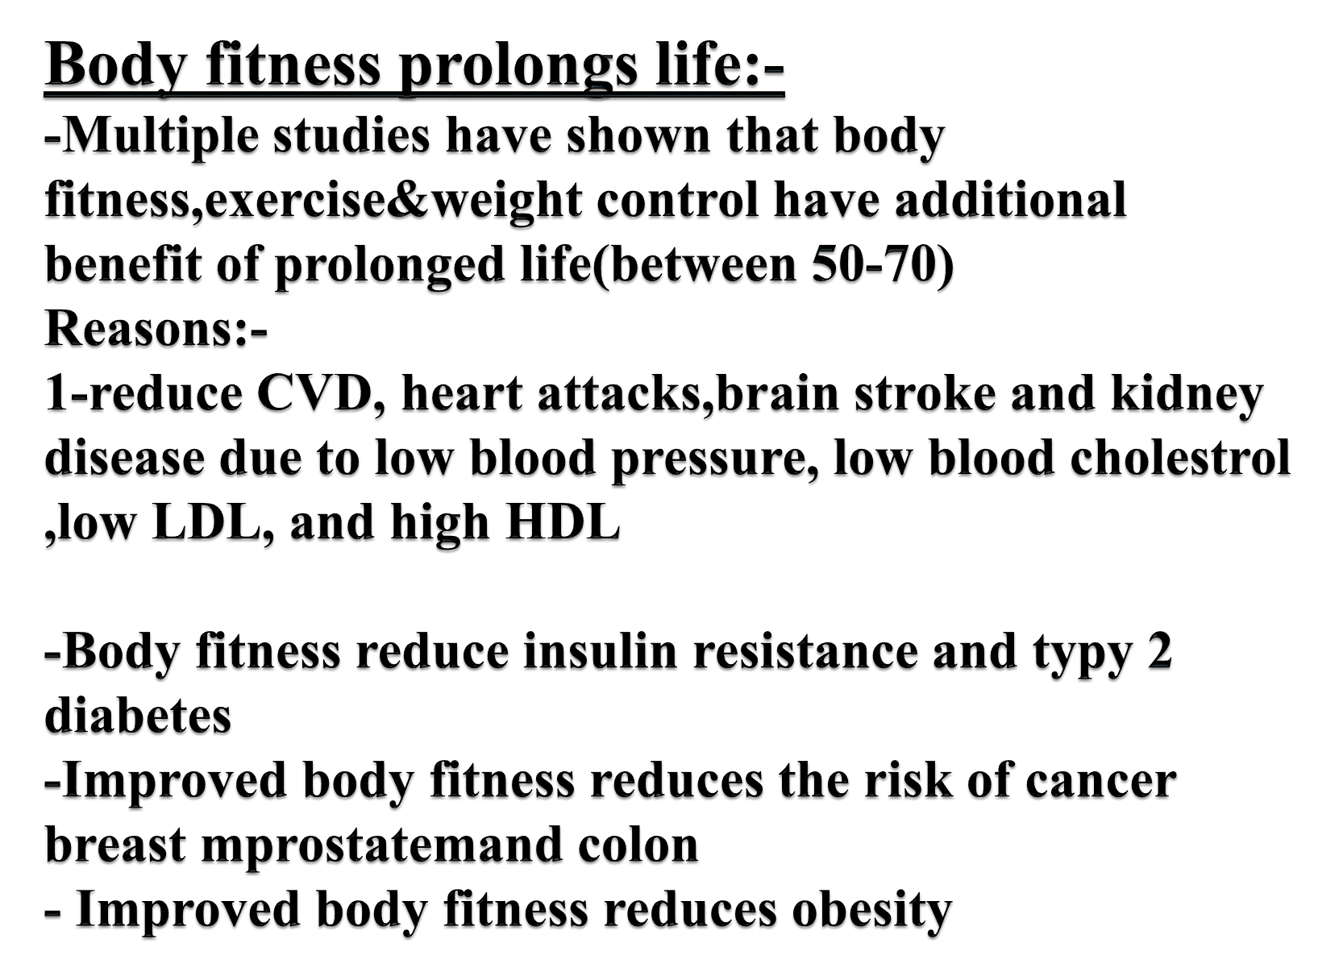
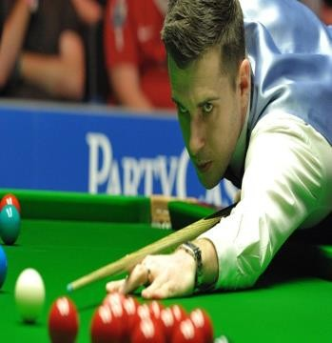

Slide 21
- Glucose Availability
Plasma glucose is maintained by an equal rate of glucose appearance (entry into the blood) and glucose disposal (removal from the blood).
In the healthy individual, rate of appearance and disposal are essentially
equal during exercise of moderate intensity and duration;
However, prolonged , intense exercise can result in a fall in blood
glucose level and the onset of fatigue .
During exercise , rate of glucose appearance depends mainly on the liver ( glycogenloysis & gluconeogenesis ) , and to a lesser extent , on absorption from the gut .
- Oxygen Availability
Which depends upon →
cardiac output (the quantity of blood distributed by the heart ) ,
the ability of the lung to oxygenate the blood ,
arterio-venous (a-v) oxygen difference ( i.e., the ability of the exercising muscle to take up oxygen from blood ).

Slide 22

-Gender
Because of difference between genders of in body build and physical ability , men can perform better than women in contact sports such as boxing , rugby and wrestling .
(ii) Menstruation : women may perform differently at different
times during their monthly menstrual cycle
-Sleep
Sufficient , restful sleep is important for physical and mental
health .
Lack of sleep makes the athlete nervous and irritable , & deteriorates the physical performance
-Disease
Musculoskeletal disease e.g., sprain , disk etc , or
General disease e.g., bronchial asthma , colds , flu , etc affect muscular exercise performance
What is the difference between strain and sprain?.
All may

Slide 23

Muscle fatigue(physical fatigue)
-It is the decline in ability of a muscle to generate force.
It can be a result of vigorous exercise but abnormal fatigue may be caused by barriers to or interference with the different stages of muscle contraction.
Studies in athletes have shown that prolonged and strong contraction of a muscle leads to a state of muscle fatigue
Causes
Glycogen depletion: Studies in athletes gave shown that muscle fatigue increases in direct proportion to the rate of muscle glycogen depletion
Also, lack of ATP and creatine phosphate. When these energy substrates are depleted during exercise, resulting in a lack of intracellular energy sources to fuel contractions & the muscle stops contracting.
Interruption of blood flow through a contracting muscle leads to almost complete muscle fatigue in 1 or more minutes because of loss of nutrient supply and oxygen loss.

Slide 24
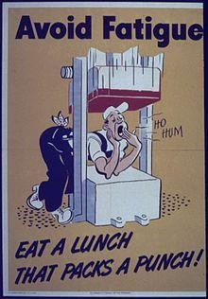
3-Neuromuscular Fatigue ( reduced neurotransmitter release=
reduced Ach release)
Fatigue also can occur at the neuromuscular junction. After prolonged muscle activity ,transmission of nerve signals through the neuromuscular junction diminishes due to diminished acetylcholine vesicles. This prevents the nerve impulse from transmitting through neuromuscular junction to the muscle fiber& diminishes muscle contraction
Some evidence suggests calcium retention within the sarcoplasmic reticulum , may lead to a decrease in calcium available for muscle contraction.
4- Metabolic changes associated with fatigue
Lactic acid accumulation in the muscles often is associated with muscular fatigue. The accumulation of hydrogen ion generated by lactic acid decreases muscle pH and increase intracellular acidity of muscles which impairs the cellular processes that produce energy and muscle contraction, muscle acidity can lower the sensitivity of contractile apparatus to Ca²⁺.
•
.

Slide 25



Slide 26
Overtraining Syndrome
Overtraining can best be defined as the state where the athlete has been
repeatedly stressed by training to the point where rest is no longer adequate to allow for recovery.
-The "overtraining syndrome" is the collection of emotional, behavioral, and
physical symptoms due to overtraining that has persisted for weeks to months
-If sufficient rest is not included in a training program then regeneration cannot occur. If this imbalance between excess training and inadequate rest persists then performance will decline.
-:It may impair an athlete during training or daily work, with signs of
Fatigue which may limit workouts and may be present at rest.
The athlete becomes moody, easily irritated, decreased concentration have altered sleep patterns,
The athlete becomes depressed, or lose the competitive desire 4-Some will report decreased appetite and weight loss.
5-Physical symptoms include persistent muscular soreness, increased frequency of viral illnesses, and increased incidence of injuries.

Slide 27
6-In some, increased cortisol levels (the body's "stress" hormone).
7-A decrease in testosterone 8- Altered immune status
An increase in muscular break down products have also been identified.
The overtraining syndrome is classified as a neuro-endocrine disorder. In which the normal fine balance in the interaction between the autonomic nervous system and the hormonal system is disturbed .
-The treatment for the overtraining syndrome is :-
1- REST .The longer the overtraining has occurred, the more rest required. If the overtraining has only occurred for a short period of time (e.g., 3 - 4 weeks) then
interrupting training for 3 - 5 days is usually sufficient rest
2-Avoiding monotonous training and maintaining adequate nutrition are other recommendations for prevention.

