Slide 1


Muscle adaptation to exercise
By
Prof/Faten zakaria
College of medicine Physiology Dep.

Slide 2

 Strength, power, and endurance of muscles
 Effect of athletic training on muscles and muscle performance
 Muscle hypertrophy
 Fast-twitch and slow-twitch muscle fibers
 Respiration in exercise
 Oxygen consumption and pulmonary ventilation in exercise
 Effect of training on vo₂ max
 Cardiovascular system in exercise
 Work output, oxygen consumption, and cardiac output during exercise
 Effect of training on heart hypertrophy and on cardiac output
 Role of stroke volume and heart rate in increasing the cardiac
output
 Body heat in exercise & heatstroke

Slide 3









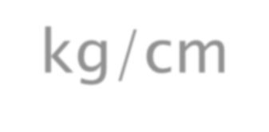










Strength, Power, And Endurance Of Muscles
 Muscles Strength( force) :_Refers to the
amount of force a muscle can produce
 A maximal contractile force, Normally 3 -4
kg/cm² (Size of muscles influence )
 E.g a cross-sectional area 150 cm²
cause
about
maximal contractile strength of
525 kilograms
 Mechanical work of muscle =
 force applied by the muscle X
distance

Slide 4
Muscle Strength
Muscle strength has mechanical & neural components :
Mechanical strength ( force)
-the maximum force a muscle can exert.
This depends upon the muscle cross-sectional area .
So if after a period of training, an athlete increases his muscle size by 50 % , he will also increase the force the muscle can develop by 50%
.
Neurological strength : meaning how many of the anterior horn cells(AHC )motor neurons of the spinal cord supplying that muscle are recruited + frequency of action potentials in them to supply the muscle.
In diseases involving the AHCs ( e.g., poliomyelitis ) the number of active AHCs may
be considerably reduced → decreased muscle performance.
A severely depressed person ( or athlete ) , who lost his motivation , may , unconsciously , recruit less AHCs than normal → decreased performance

Slide 5
Muscle Power
When muscles contract or stretch in moving a load they do work , and energy is transferred from one form to another.
The “ power ” of muscles refers to how quickly the muscles can do this work and transfer the energy.
Work = Force X Distance
Power = Work/Time
The shorter the time used to perform a piece of work , the more power is needed
Hence , if a weightlifter lifts a given weight explosively over a short time ( say 0.5 seconds ) he needs his muscles to produce much more power than if he did that while taking more time (say 3 sec).

Slide 6






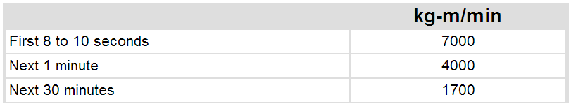

Strength, Power, And Endurance Of Muscles
 Muscles Power : amount of work that the
muscle performs in period of time ( kg-m/min)
 -Power = Work/Time
Guyton & Hall12E

Slide 7




Endurance Of Muscles
 Muscles Endurance: Ability of muscles to sustain repeated contractions against a resistance for period of time.
 depends on glycogen stored in the muscle

Slide 8



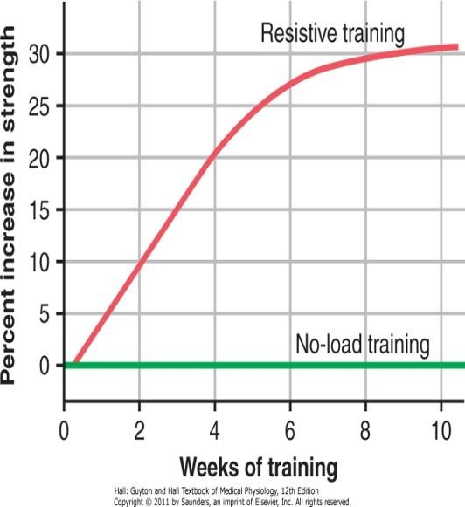
Effect of Training on Muscles and Muscle Performance
 Maximal Resistance Training:
 6 maximal muscle contractions sets against a load X 3 days X one week greatly increase in muscle strength, without muscle fatigue.
 -10 weeks training increase strength 30%
However !!!!
 Muscles function under
no load cause little increase in strength
Approximate effect of optimal resistive exercise training on increase in muscle strength over a training period of 10 weeks.

Slide 9





Muscle Hypertrophy:
 With training muscles hypertrophied 30- 60 %










Due to
diameter of the muscle fibers more than the
number of fibers
Changes in hypertrophied muscle:
myofibrils
120 % in mitochondrial enzymes ATP and phosphocreatine
50 % in stored glycogen
75 -100 % in stored triglyceride oxidation rate 45 %
Increased capability of aerobic and anaerobic
metabolic systems

Slide 10


Muscle Hypertrophy
EXCERCISE hypertrophy is due to increase in contractile protein ( number of actin &myosin filaments in each muscle fibre = muscle cell).
-When number of contractile proteins increases sufficiently, myofibrils split within each muscle fibre to form new myofibrils, so it is mainly great increase in the number of additional myofibrils that causes muscle fiber to hypertrophy.
That is, hypertrophy results primarily from the growth of each muscle cell, rather than an increase in the number of cells.

Slide 11
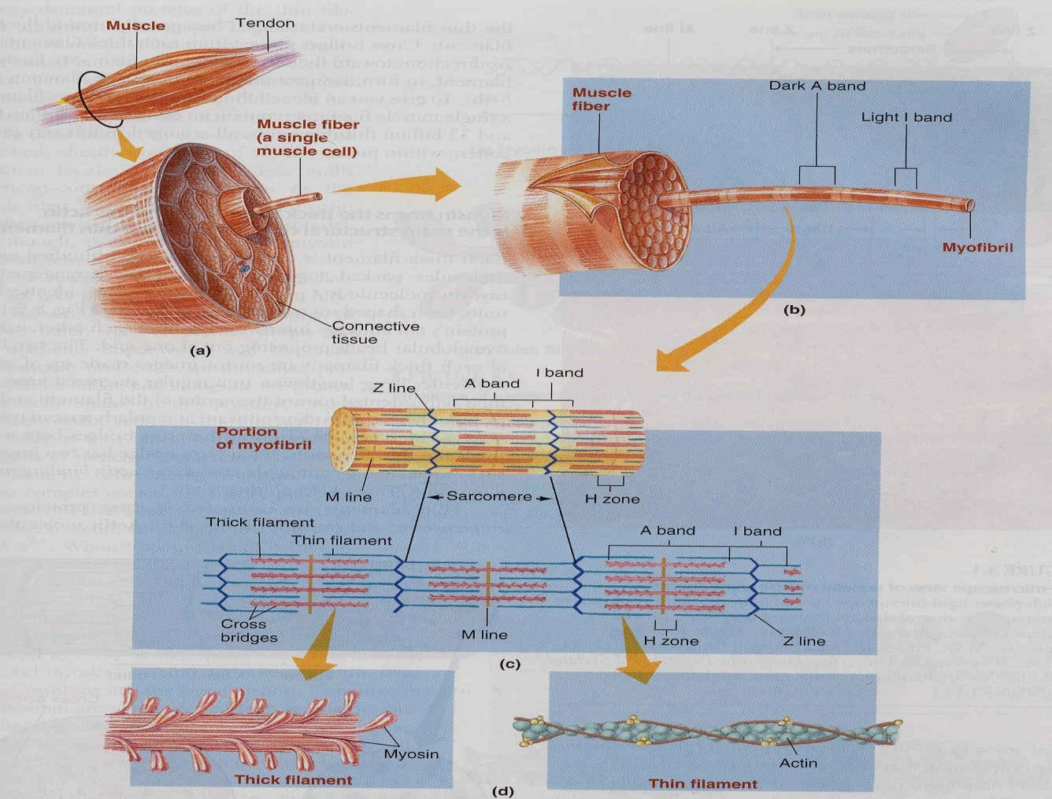

Slide 12
Each muscle is composed of combination of 2 types of muscle fibers but one is usually
dominant
1-Anaerobic ("fast-twitch")
- White muscle fibers( deficient in myoglobin)
-larger in size for strong& powerful contraction
-have extensive sarcoplasmic reticulum for rapid release of calcium
-have a lot of glycolytic enzymes for rapid release of energy
-lower capillarity& few mitochondria because oxidative metabolism is of secondary importance
2-Aerobic ("slow-twitch")
- Red muscle fibers because its high content of myoglobin
-Smaller & innervated with small nerve fibers & they are adapted for prolonged muscle
activity
-have extensive sarcoplasmic reticulum for rapid release of calcium
-have a lot of glycolytic enzymes for rapid release of energy
-Higher capillarity& large number of mitochondria to support high level of oxidative metabolism

Slide 13
Fast-Twitch and Slow-Twitch Muscle Fibers
 fast-twitch fibers: forceful and rapid contraction
E.G gastrocnemius muscle
 slow-twitch muscle: for prolonged muscle activity
E.G leg muscle
fast-twitch fibers deliver power from seconds to a
minute
slow-twitch fibers provide endurance, prolonged
strength of contraction minutes to hours.
!!! differences between the fast-twitch and the slow-
twitch fibers Read
Guyton & Hall: Textbook of Medical Physiology 12E

Slide 14


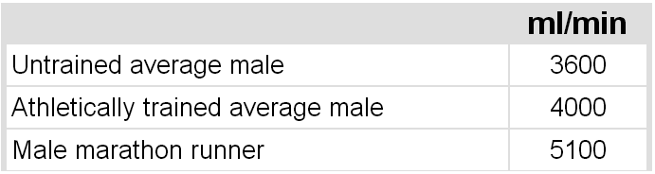
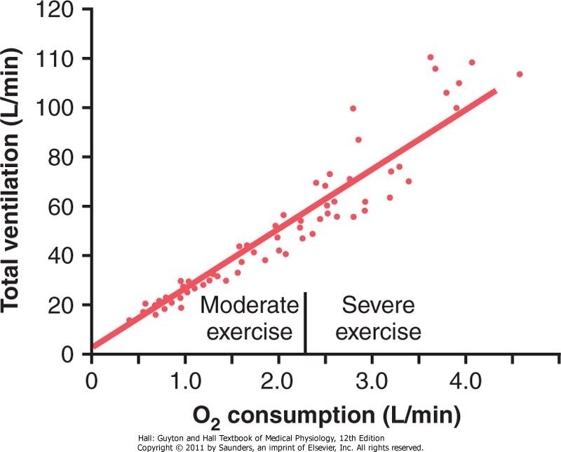
Respiration In Exercise
 Oxygen Consumption VO2 and Pulmonary Ventilation VE in Exercise
 VO2 at rest is about 250 ml/min , However !!! at Maximal efforts
VO2 and VE increase about 20-folds between the resting state and maximal intensity( untrained)
-Maximal breathing capacity of an athlet can reach during maximal exercise 50% more than actual pulmonary ventilation
F Effect of exercise on oxygen consumption and ventilatory rate. (Redrawn from Gray JS: Pulmonary Ventilation and Its Physiological Regulation. Springfield, Ill: Charles C Thomas, 1950.)

Slide 15
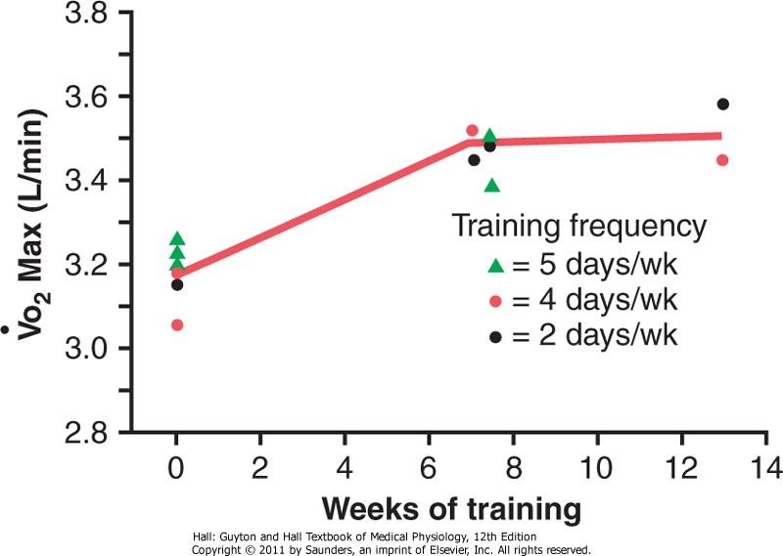
Effect of Training on Vo₂ Max
 Vo₂Max increased only about 10 percent by
training, Moreover other factors !!!
 Chest sizes in relation to body size
 Increase respiratory muscles force of
contraction
Increase in Vo2 Max over a period of 7 to 13 weeks of athletic training. (Redrawn from Fox EL: Sports Physiology. Philadelphia: Saunders College Publishing, 1979.)

Slide 16
O2 diffusion capacityi ncreases 3 folds during exercise than at rest due to:-
increase of lung blood flow in pulmonary capillaries during exercise , this
increases surface area for O2 to diffuse into pulmonary capillaries.
Respiration is stimulated by neurogenic mechanisms due to direct stimulation of respiratory center by nervous signals that also transmitted from brain to muscle to do exercise, sensory signals also transmitted from contracting muscle and moving joints into respiratory center to stimulate respiration , so blood gases during exercise are normal in concentration( no increase in Co2 or decrease in O2 as expected)

Slide 17
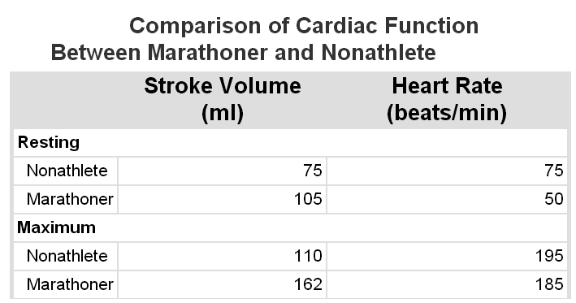
Cardiovascular System in Exercise
 Cardiac output (CO) = stroke volume (SV) X heart rate (HR)
 Muscle blood flow increases 25% folds during sternous exercise
 Work Output, Oxygen Consumption, and Cardiac Output During Exercise
 all these are directly related to one another, muscle work output increases oxygen consumption, and increased oxygen consumption in turn dilates the muscle blood vessels, thus increasing venous return and cardiac output.
 Effect of Training on Heart Hypertrophy and on Cardiac Output:
 Training increase C.O about 40 % greater than untrained persons SO,
 heart chambers of marathoners enlarge about 40 percent in contrast to non trained
 Heart size of marathoner larger than normal person
Guyton & Hall: Textbook of Medical Physiology 12E

Slide 18
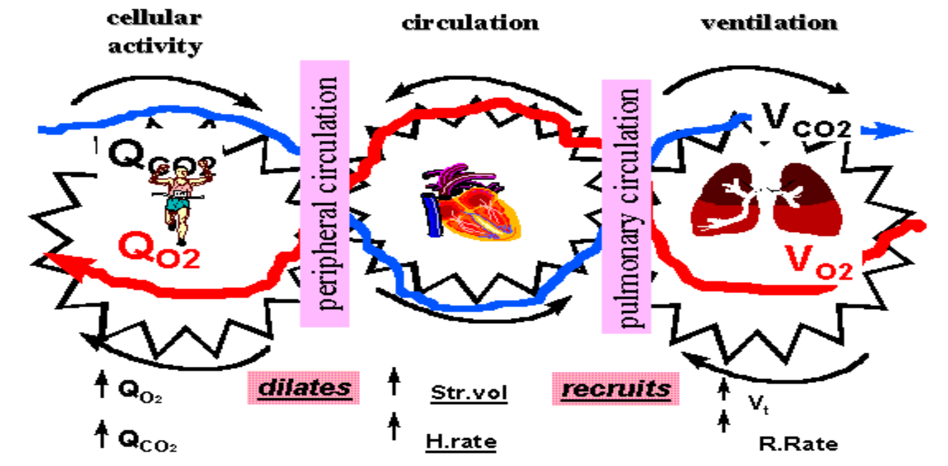
Cardiovascular System in Exercise cont…
 Role of Stroke Volume and Heart Rate in Increasing
the Cardiac Output

Slide 19
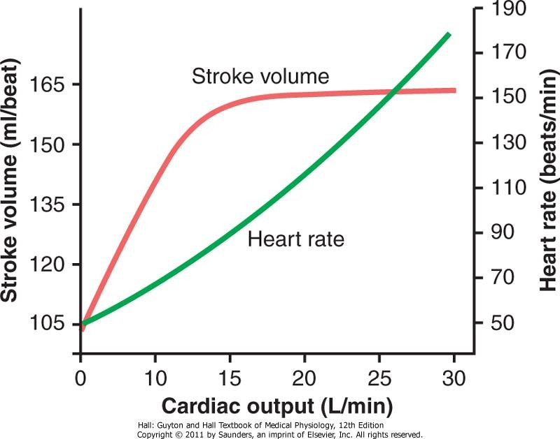
Cardiovascular System in Exercise cont…
the cardiac output increases from its resting level of about 5.5 L/min to 30 L/min.
The stroke volume increases from 105 to 162 milliliters, an increase of about 50 percent
whereas the heart rate increases from 50 to 185 beats/min, an increase of 270 percent.
the heart rate increase a greater proportion of the increase in cardiac output than does the increase in stroke volume
Approximate stroke volume output and heart rate at different levels of cardiac output in a marathon athlete.

Slide 20


Body Heat In Exercise
 Almost all the energy released by the body's metabolism converted into body heat.
 Muscle work use only 20 - 25 % of energy
released from metabolism.
 remainder converted into heat as result of :
 (1) resistance to the movement of the
muscles and joints,
 (2) friction of the blood flowing through the
blood vessels, and
 (3) muscle contractile converted into heat.

Slide 21


Heatstroke
 During endurance training body temperature
rises (37° to 40°C)
 hot and humid conditions body temperature rise (41° to 42°C)
 Consequently, temperature destructive tissue
cells mainly (brain cells) and symptoms are :
 Body weakness, exhaustion, headache,
dizziness, nausea (disgust), sweating,
confusion, uncontrolled unconsciousness.
 And may lead to death
gait, collapse, and

Slide 22


Treatment of heatstroke
The most practical way :
 Remove all clothing
 Maintain a spray of cool water on all surfaces
of the body or continually sponge the body.
 Blow air over the body with a fan.
 Physicians prefer total immersion of the body in water containing a mush of crushed ice if available.

Slide 23
Reference book
Guyton & Hall: Textbook of Medical Physiology 12E

Slide 24

Thank you !

