Slide 1
Purine Degradation & Gout
(Musculoskeletal Block)
1 Lecture Dr. Usman Ghani
Purine degradation pathway
Fate of uric acid in humans
Gout and hyperuricemia:
Biochemistry
Types
Treatment

Slide 2
Purine degradation pathway
The major source of dietary nucleic acids (purines and pyrimidines) is meat
Purine and pyrimidine bases are absorbed by the intestine
The ingested bases are mostly degraded into different products by degradation pathways
These products are then excreted by the body

Slide 3
Dietary
DNA / RNA
Nucleotides
Pancreatic
nucleases
Nucleotidases
Nucleosidases
Free purine
bases + Ribose
Nucleosides
Purine
Degradation
pathway
Free pyrimidine
bases + Ribose
Pyrimidine
Degradation
pathway
Uric acid
Malonyl CoA

Slide 4
Purine degradation pathway
Adenosine and guanosine (purines) are finally degraded to uric acid by:
Purine degradation pathway

Slide 5
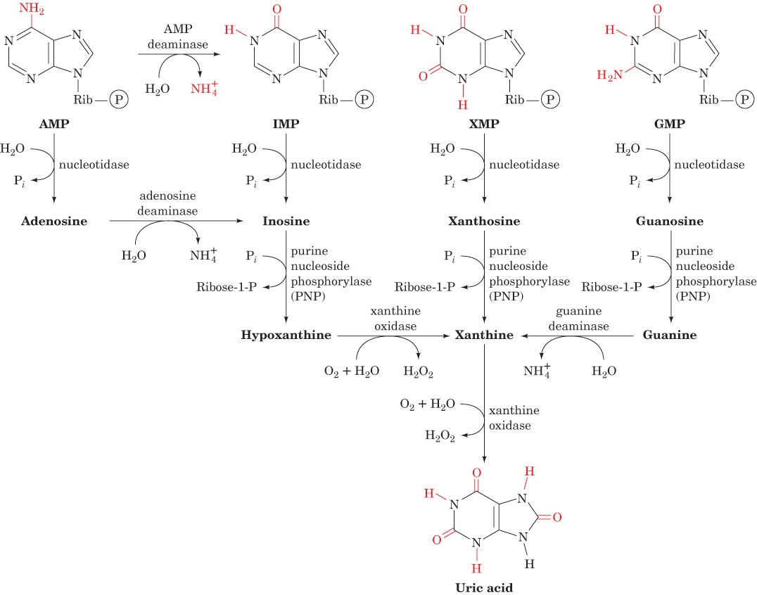
Major pathways of purine catabolism in animals
Page 1093

Slide 6
Fate of uric acid in humans
In humans, primates, birds and reptiles the final product of purine degradation is uric acid
Uric acid is excreted in the urine
Some animals convert uric acid to other products:
Allantoin
Allantoic acid
Urea
Ammonia

Slide 7
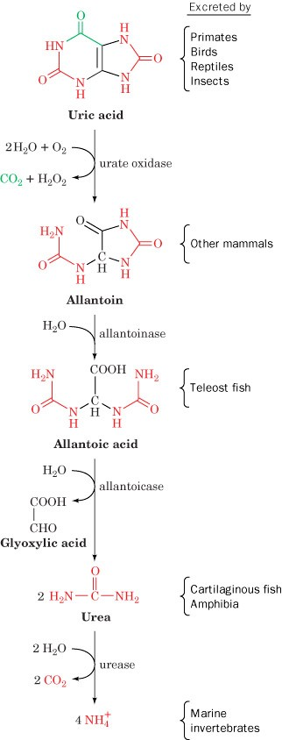
Degradation of uric acid to ammonia in some animals
Page 1097

Slide 8
Fate of uric acid in humans
Uric acid is less soluble in water
Reptiles, insects and birds excrete uric acid as a paste of crystals
To save water
Humans excrete uric acid in urine

Slide 9
Fate of uric acid in humans
Humans do not have enzymes to further degrade uric acid
Excessive production of uric acid causes deposition of uric acid crystals in the joints leading to:
Gout
Hyperuricemia

Slide 10
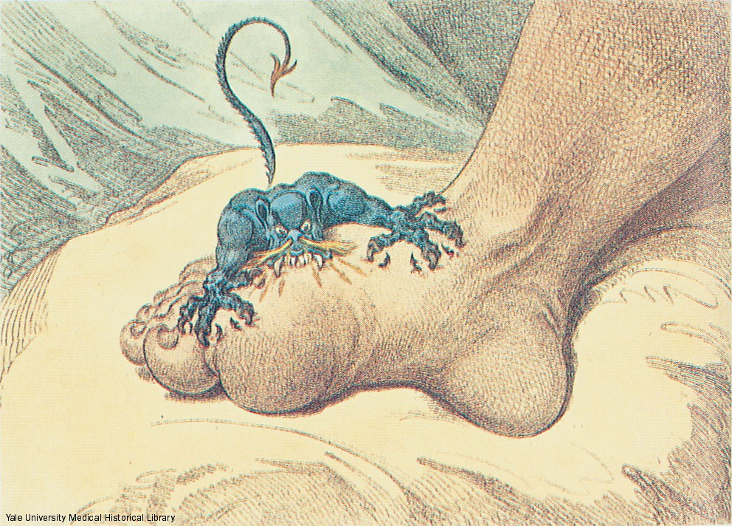
The Gout, a cartoon by James Gilroy (1799)
Page 1097

Slide 11
Gout
Gout is a disease due to high levels of uric acid in body fluids
7.0 mg/dL and above
Uric acid accumulates because of:
Overproduction or
Underexcretion

Slide 12
Gout
Painful arthritic joint inflammation due to deposits of insoluble sodium urate crystals (especially big toe)
Affects 3 per 1000 persons
Sodium urate crystals accumulate in kidneys, ureter, joints leading to chronic gouty arthritis

Slide 13
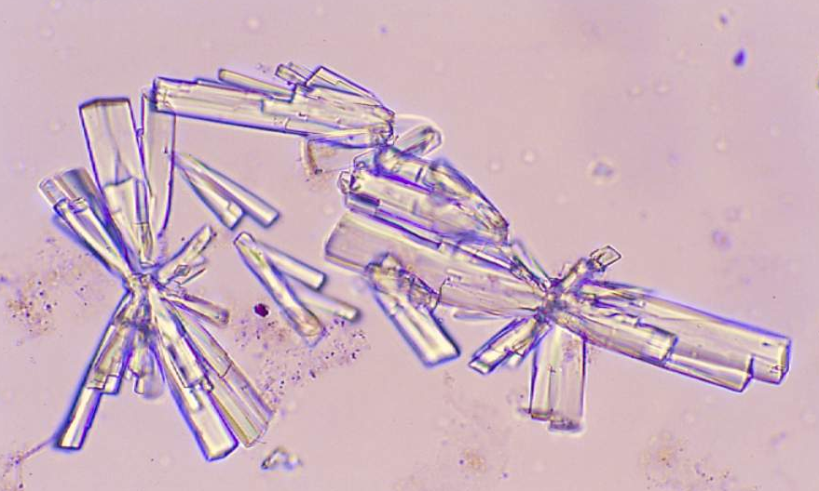
Sodium urate crystals in urine

Slide 14
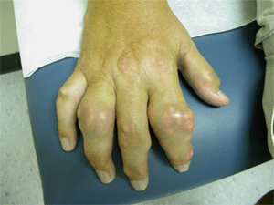

Slide 15
Gout
Inaccurately associated with overeating and drinking
Alcohol used to be contaminated with lead during manufacture and storage
Lead decreases excretion of uric acid from kidneys causing hyperuricemia and gout
Excessive meat comsumption increases uric acid production in some individuals

Slide 16
Gout
Two main causes
Overproduction of uric acid
Underexcretion of uric acid

Slide 17
Primary Gout
Due to overproduction of uric acid
Genetic abnormality in the enzymes of purine degradation
Excessive production and degradation of purine bases (adenine, guanine, hypoxanthine)

Slide 18
Secondary hyperuricemia
A variety of disorders and lifestyles cause secondary hyperuricemia
Underexcretion of uric acid due to chronic renal disease
Chemotherapy
Excessive consumption of purine-rich foods such as meat
Excessive alcohol intake

Slide 19
Secondary hyperuricemia
Hyperuricemia does not always cause gout

Slide 20
Treatment
To reduce pain and inflammation (analgesics, anti-inflammatory drugs)
To increase uric acid excretion (uricosuric agents)
To reduce uric acid production
Xanthine oxidase inhibitors:
Allopurinol
Febuxostat

Slide 21
Major pathways of purine catabolism in animals
Page 1093

