Slide 1
DEVELOPMENT OF SKELETAL & MUSCULAR SYSTEM
Prof. Ahmed Fathalla Ibrahim
Professor of Anatomy
College of Medicine
King Saud University
E-mail: ahmedfathala@gmail.com

Slide 2
OBJECTIVES
At the end of the lecture, students should be able to:
List the different parts of mesoderm and the different divisions of somites.
Differentiate bones according to their embryological origin and mode of ossification.
Describe the ossification of long bones.
Describe the main steps for development of limbs.
Differentiate muscles according to their embryological origin.

Slide 3
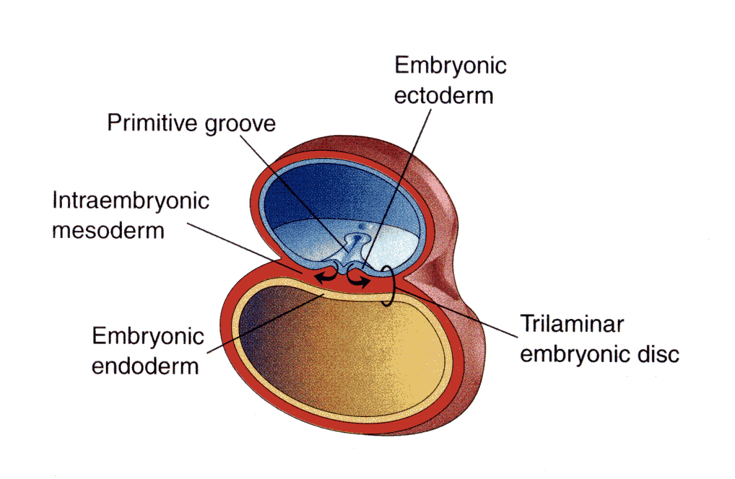
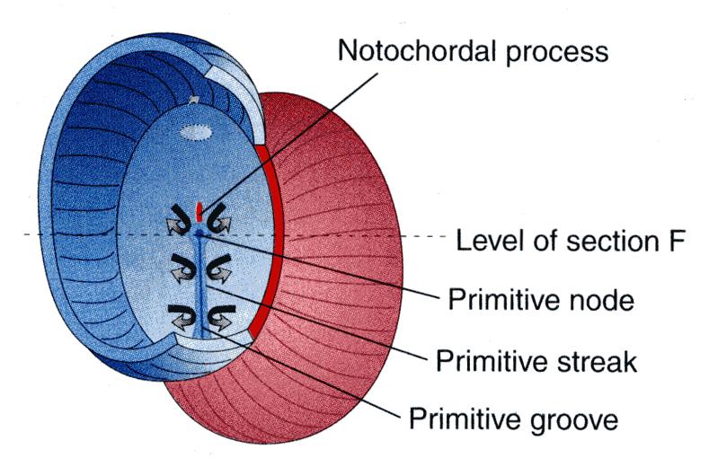
Embryo
Amniotic
cavity
Embryo
Yolk sac

Slide 4
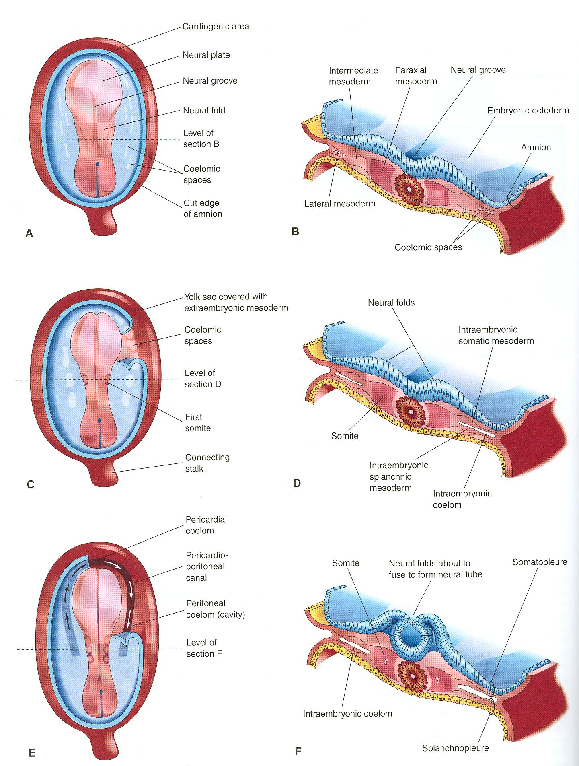
Notochord:
stimulates neural tube
formation
Somatic mesoderm
Splanchnic mesoderm

Slide 5
INTRAEMBRYONIC MESODERM
Proliferates between Ectoderm & Endoderm EXCEPT in the central axis of embryo where NOTOCHORD is found.
Differentiates into 3 parts:
Paraxial mesoderm: on each side of notochord.
Intermediate mesoderm
Lateral mesoderm
Paraxial mesoderm divides into units (somites).
Lateral mesoderm divides by intraembryonic coelom into:
Somatic mesoderm (between ectoderm & coelom).
Splanchnic mesoderm (between endoderm & coelom).

Slide 6
SOMITE
SOMITE
Notochord
Neural tube
Epaxial division:
Muscles of back
(Extensors of VC)
Sclerotome
Sclerotome
Epaxial division:
Muscles of back
(Extensors of VC)
Vertebral column
Ribs & sternum
Myotome
Myotome
Hypaxial division:
Muscles of body wall
Myoblasts migrate
into limb:
Limb muscles
Myoblasts migrate
into limb:
Limb muscles

Slide 7
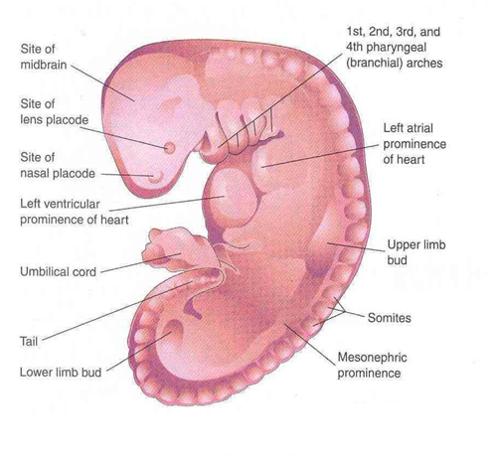
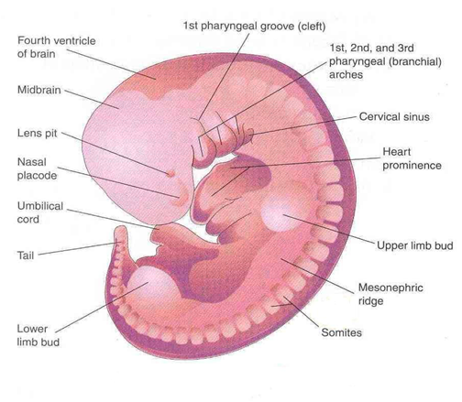
DEVELOPMENT OF LIMBS - 1
The limbs bud appears as an elevation on the ventrolateral body wall resulting from proliferation of mesenchyme of the somatic layer of lateral mesoderm.
Each limb bud is surrounded by an area of ectoderm.
Upper limb buds appear at day 26 opposite the lower cervical segments.
Lower limb buds appear at day 28 opposite the lumbar & sacral segments.
28 DAYS
32 DAYS

Slide 8
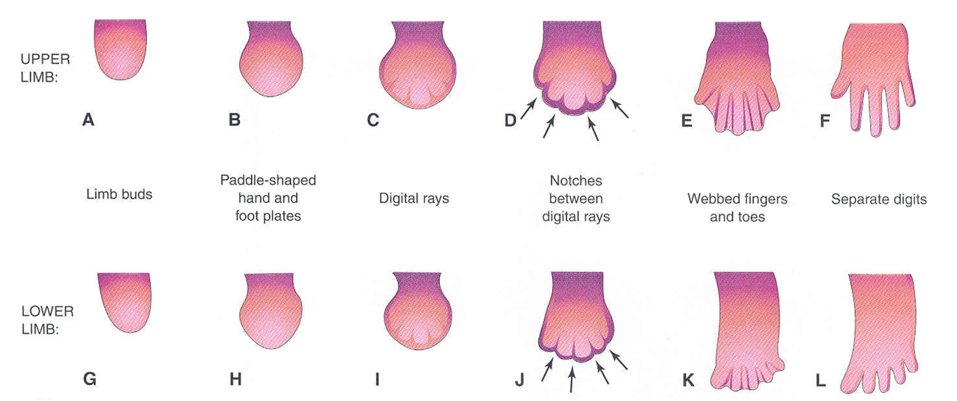
DEVELOPMENT OF LIMBS - 2
A & G: Apical ectodermal ridge: appears at the apex of limb bud and stimulates proliferation of mesenchyme and elongation of limb bud.
B & H: Distal ends of buds flatten into paddle-like hand & foot plates.
C & I: Digital rays: appear as mesenchymal condensations that outline the patterns of digits.
D & J: Mesenchyme between rays disappears to form notches.
E & K: Digits form inside rays, elongate & appear webbed.
F& L: Mesenchyme between digits disappear to separate them.

Slide 9
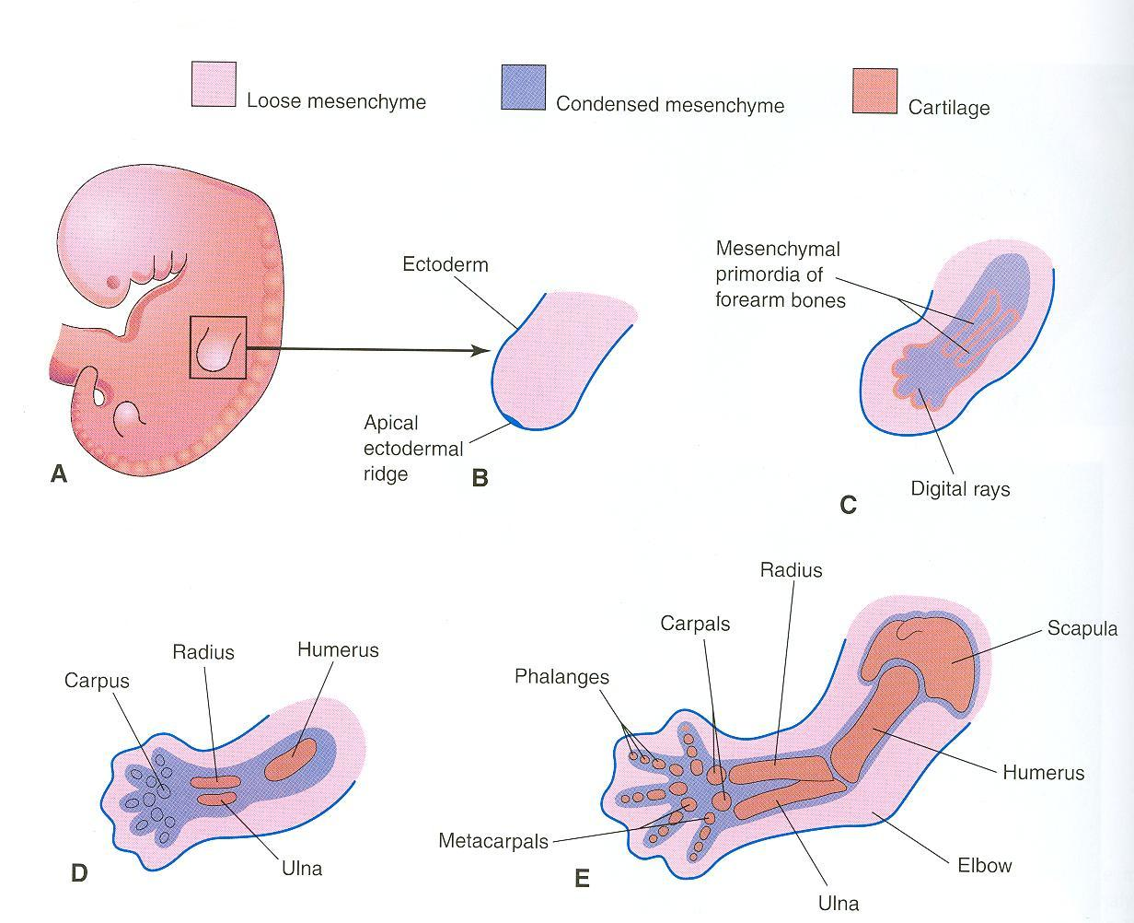
Mesenchyme from somatic layer of lateral mesoderm
Induces growth of mesenchyme & its transformation into cartilage
Cartilage ossifies by:
Endochondral ossification
Myoblasts migrate from myotomes to form:
Muscles of limbs

Slide 10
OSSIFICATION OF LONG BONES
Appearance of
primary ossific
centers: ossification
of diaphysis
Appearance of
secondary ossific
centers: ossification
of epiphysis
Ossification of
epiphseal plate:
Complete union of
epiphysis & diaphysis
Bone in
cartilaginous state
Epiphysis
Epiphyseal
plate of
cartilage
Growth of
bone stops
Diaphysis
Diaphysis
Epiphysis
BIRTH
PUBERTY
Bone increases in length by
proliferation of epiphyseal plate
Bone age is a good index of general maturation. Bone age is determined by:
Appearance of ossific centers in diaphysis & epiphysis (specific for each bone & sex)
Disappearance of epiphyseal plate (specific for each bone & sex)

Slide 11
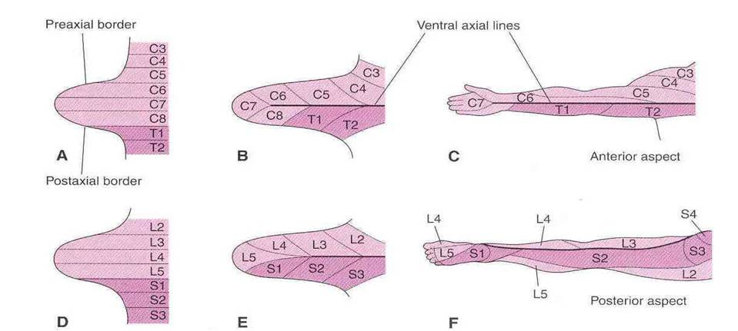
DEVELOPMENT OF LIMBS - 3
Originally, limb buds were at right angle of the trunk with:
-Cranial (preaxial) & caudal (postaxial) borders: radius and tibia are preaxial bones.
-Ventral & dorsal surfaces: flexor muscles are ventral.
During 7th week, adduction of limb buds occurs with 90° rotation:
-In upper limb, rotation occurs laterally: radius is lateral & flexor muscles are anterior.
-In lower limb, rotation occurs medially: tibia is medial & flexor muscles are posterior.

Slide 12
DEVELOPMENT OF CRANIUM (SKULL)
The skull develops from mesoderm around the developing brain.
The skull consists of:
Neurocranium: protective case for brain
Viscerocranium: skeleton of face
Bones of skull ossify either by:
*Endochondral ossification or
*Intramembranous ossification

Slide 13
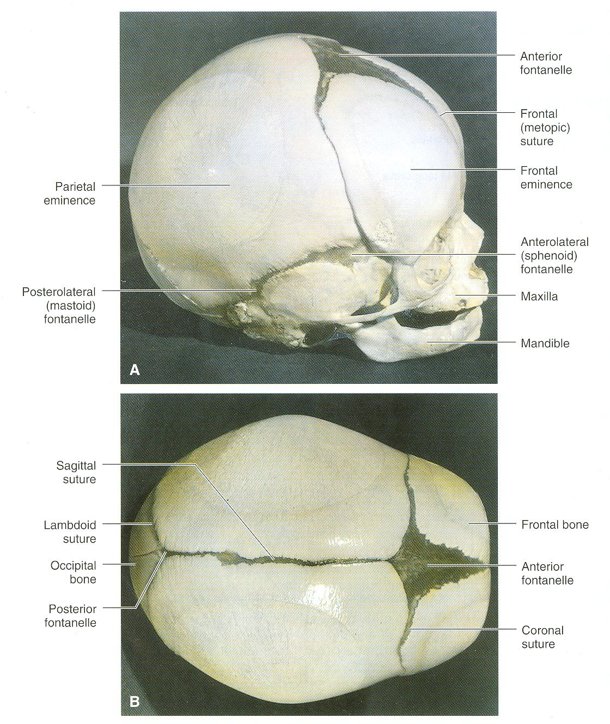
Bones of skull that ossify by
intramembranous ossification:
F = Frontal
P = Parietal
Z = Zygomatic
ST = Squamous temporal
Mand = Mandible
Max = Maxilla
F
P
F
ST
Z
Max
Mand
P
F
F
P

Slide 14
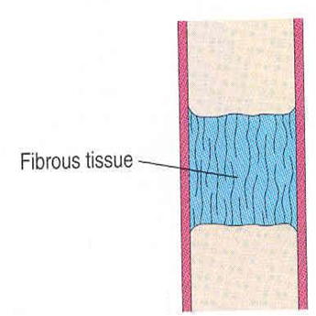
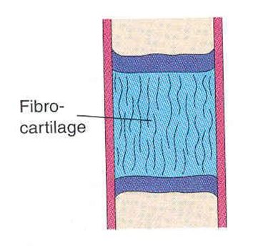
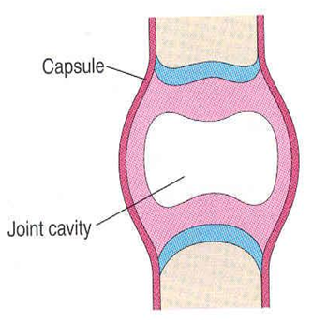
JOINTS
A
B
C
They develop from mesoderm between bones:
A- In fibrous joints: mesoderm differentiates into dense fibrous connective tissue.
B- In cartilaginous joints: mesoderm differentiates into cartilage.
C- In synovial joints: a synovial cavity is formed inside mesoderm; mesoderm differentiates into synovial membrane, capsule & ligaments.

Slide 15
SUMMARY OF DEVELOPMENT OF BONE
All bones develop from MESODERM.
AXIAL SKELETON:
*Vertebrae, ribs & sternum: from sclerotomes of somites (paraxial mesoderm)
*Skull: from mesoderm surrounding the brain
APPENDICULAR SKELETON: from somatic part of lateral mesoderm
All bones ossify by endochondral ossification EXCEPT:
Some bones of skull
Clavicle

Slide 16
SUMMARY OF DEVELOPMENT OF MUSCLES
All muscles develop from MESODERM EXCEPT:
Muscles of iris (eyeball)
Myoepithelial cells of ECTODERM mammary & sweat glands
All skeletal muscles develop from myotomes of paraxial mesoderm EXCEPT: some head & neck muscles from mesoderm of pharyngeal arches

Slide 17
SUMMARY OF DEVELOPMENT OF MUSCLES
Cardiac & smooth muscles develop from lateral mesoderm:
Cardiac muscles from: splanchnic part of lateral mesoderm
Smooth muscles:
*In the wall of viscera from: splanchnic part of lateral mesoderm
* In the wall of blood & lymphatic vessels from: somatic part of lateral mesoderm

Slide 18
SUMMARY OF DEVELOPMENT OF LIMBS
Mesenchyme from somatic layer of lateral mesoderm proliferates to form limb buds.
Apical ectodermal ridge stimulates proliferation & elongation of buds then cartilage formation.
All bones of limbs ossify by endochondral ossification EXCEPT: clavicle.
Muscles of limbs develop from myotomes.
Rotation of limbs occur in opposite direction.
Development of upper limb precedes that of lower limb.

Slide 19
QUESTION 1
Which one of the following group of muscles are derivatives from epaxial division of myotomes?
Muscles of back
Muscles of limbs
Muscles of viscera
Cardiac muscles

Slide 20
QUESTION 2
Which one of the following bones ossifies by intramembranous ossification?
Vertebra
Humerus
Ribs
Mandible

Slide 21
QUESTION 3
Regarding the ossification of long bones, which one of the following statements is correct?
Primary ossific centre appears after birth.
Secondary ossific centre leads into ossification of diaphysis.
Long bones ossify by intramembranous ossification.
When epiphysis unites with diaphysis, growth of bone stops.

Slide 22
QUESTION 4
Which one of the following is the result of rotation of upper limb?
The tibia becomes lateral.
The flexor muscles become posterior.
The ulna becomes medial.
The preaxial digit becomes medial.

Slide 23
THANK YOU

