Slide 2
Myopathies
Pathology

Slide 3
Objectives:
At the end of this lecture, the students should be able to:
Understand the structure of the various types of muscle fibers.
Acquire a basic knowledge of the classification of myopathies and give examples of these disorders.
Understand the meaning of the term muscular dystrophy and have a basic knowledge of the incidence and clinicopathological manifestations of Duchenne's and Becker's muscular dystrophies.
Know the pattern of inheritance of myotonic dystrophy and its clinicopathological presentations.

Slide 4
Contents:
The definition of motor unit and muscle fiber types.
Classification of myopathies.
Muscle atrophy, pathological features and causes.
Neurogenic myopathy: definition, causes and pattern of nerve injury.
Duchenne and Becker Muscular Dystrophy: incidence, Clinicopathological characteristics, with special emphasis on the rule of dystrophin protein.
Myotonic Dystrophy: definition and main Clinicopathological features with special emphasis of inheritance pattern.

Slide 6
Skeletal muscle Fiber types
Depending on the nature of the nerve fiber doing the enervation, the associated skeletal muscle develops into one of two major subpopulations
A single "type I" or "type II" neuron will innervate multiple muscle fibers and these fibers are usually randomly scattered in a "checkerboard pattern" within a circumscribed area within the larger muscle

Slide 7
Skeletal muscle Fiber types
The different fibers can be identified using specific staining techniques:
type I:
"slow twitch“
more dependent on fat catabolism for energy through mitochondrial oxidative phosphorylation
red, refers to this being the dark (red) meat on birds where fiber type grouping in different muscles (e.g., thigh vs. breast meat) is quite pronounced
type II:
"fast twitch“
more dependent on glycogen catabolism for energy through glycolysis
white

Slide 9
MYOPATHY
Myopathy as a term may encompasses a heterogeneous group of disorders, both morphologically and clinically
Recognition of these disorders is important for genetic counseling or appropriate treatment of acquired disease

Slide 10
Myopathies
Diseases that affect skeletal muscle can involve any portion of the motor unit:
primary disorders of the motor neuron or axon
abnormalities of the neuromuscular junction
a wide variety of disorders primarily affecting the skeletal muscle itself (myopathies)

Slide 11
Myopathies
skeletal muscle disease can be divided into:
Neurogenic
Muscular dystrophies
Congenital
inherited mutations of ion channels
inborn errors of metabolism (e.g. glycogen and lipid storage diseases)
mitochondrial abnormalities
Toxic
Thyrotoxic myopathy
Ethanol myopathy
Chloroquine
Inflammatory myopaties
Infectious
Disorders of the neuromuscular junction (e.g. myasthenia gravis)
Notes:
Genetic disorders affecting skeletal muscle include muscular dystrophies, congenital muscular dystrophies, and congenital myopathies. Muscular dystrophies are inherited diseases that result in progressive muscle injury in patients who usually appear normal at birth. Congenital muscular dystrophies are progressive, early-onset diseases. Some are also associated with central nervous system manifestations. Congenital myopathies are a heterogeneous group of inherited diseases that often have a perinatal or early childhood presentation and result in relatively static deficits.

Slide 13
MUSCLE ATROPHY
A non-specific response
Characterized by abnormally small myofibers
The type of fibers affected by the atrophy, their distribution in the muscle, and their specific morphology help identify the etiology of the atrophic changes

Slide 14
MUSCLE ATROPHY
Causes:
Simple disuse, type II fibers
Exogenous glucocorticoids or endogenous hypercortisolism (proximal weakness), type II fibers
Myopathies
Neurogenic atrophy

Slide 16
MUSCLE ATROPHY Neurogenic Atrophy

Slide 17
MUSCLE ATROPHY Neurogenic Atrophy
Neurogenic Atrophy :
Both fiber types
Clustering of myofibers into small groups
Deprived of their normal enervation, skeletal fibers undergo progressive atrophy

Slide 18
MUSCLE ATROPHY Neurogenic Atrophy
Loss of a single neuron will affect all muscle fibers in a motor unit, so that the atrophy tends to be scattered over the field
With re-enervation, adjacent intact neurons engage the neuromuscular junction of the previously de-enervated fibers→ new connection is established → these fibers assume the type of the innervating neuron → whole groups of fibers can eventually fall under the influence of the same neuron, and become the same fiber type (fiber type grouping)

Slide 19
MUSCLE ATROPHY Neurogenic Atrophy
In that setting, if the relevant enervating neuron now becomes injured, rather large coalescent groups of fibers are cut off from the trophic stimulation and wither away (grouped atrophy), a hallmark of recurrent neurogenic atrophy

Slide 22
MUSCULAR DYSTROPHY
A heterogeneous group of inherited disorders
Often presenting in childhood
Characterized by progressive degeneration of muscle fibers leading to muscle weakness and wasting
Histologically, in advanced cases muscle fibers are replaced by fibrofatty tissue
This distinguishes dystrophies from myopathies, which also present with muscle weakness

Slide 23
Dystrophin
Dystrophin is a large protein (427 kD) that is expressed in a wide variety of tissues, including muscles of all types, brain, and peripheral nerves
Dystrophin attaches portions of the sarcomere to the cell membrane, maintaining the structural and functional integrity of skeletal and cardiac myocytes
The dystrophin gene (Xp21) spans (∼1% of the total X chromosome), making it one of the largest in the human genome; its enormous size is a probable explanation for its particular vulnerability to mutation

Slide 24
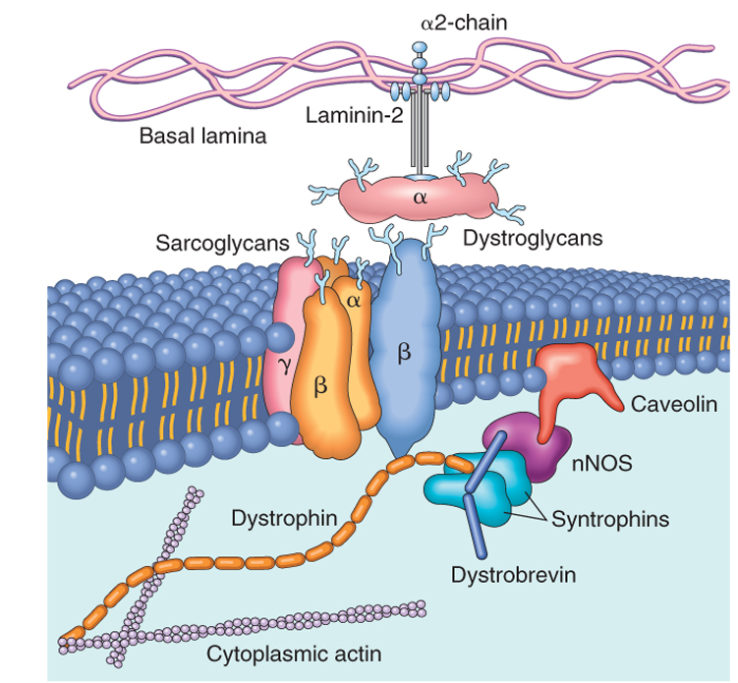
The

Slide 25
Duchenne and Becker Muscular Dystrophy
X-Linked Muscular Dystrophy
The two most common forms of muscular dystrophy
DMD is the most severe and the most common form of muscular dystrophy, with an incidence of about 1 per 3500 live male births
DMD becomes clinically evident by age of 5, →progressive weakness leading to wheelchair dependence by age 10 to 12 years →death by the early 20s
Although the same gene is involved in both BMD and DMD, BMD is less common and much less severe

Slide 26
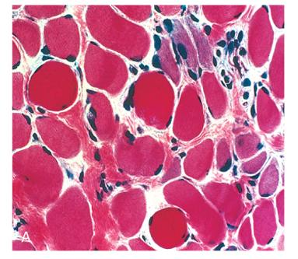

Slide 27
Duchenne and Becker Muscular Dystrophy
Morphology:
The histologic features of DMD and BMD are similar
Marked variation in muscle fiber size (atrophy and hypertrophy)
Range of degenerative changes (fiber necrosis)
Regeneration, including sarcoplasmic basophilia, nuclear enlargement, and nucleolar prominence
Connective tissue is increased
Abnormal staining for dystrophin
Extensive fiber loss and adipose tissue infiltration

Slide 28
Dystrophin
Deletions appear to represent a large proportion of the genetic abnormalities, with frame shift and point mutations accounting for the rest
Approximately two-thirds of the cases are familial, with the remainder representing new mutations
In affected families, females are carriers; they are clinically asymptomatic but often have elevated serum creatine kinase and can show mild histologic abnormalities on muscle biopsy

Slide 29
Pathogenesis
DMD and BMD are caused by abnormalities in the dystrophin gene
The role of dystrophin in transferring the force of contraction to connective tissue has been proposed as the basis for the myocyte degeneration that occurs with dystrophin defects, or with changes in other proteins that interact with dystrophin

Slide 30
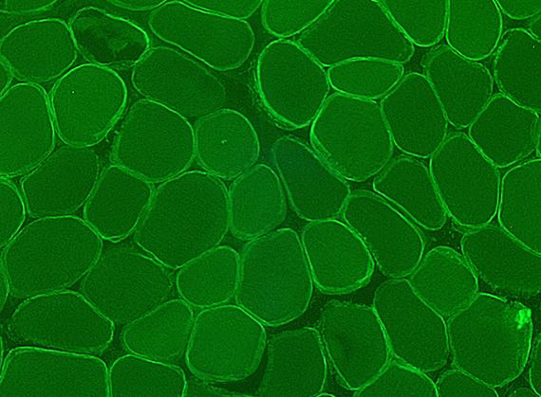
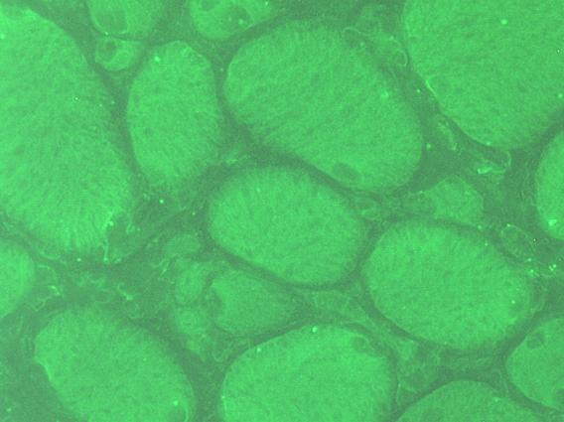

Slide 31
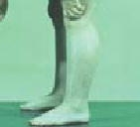
Clinical Features
Boys with DMD:
Normal at birth, and early motor milestones are met on time
Walking is often delayed
Weakness begins in the pelvic girdle muscles and then extends to the shoulder girdle
Enlargement of the calf muscles associated with weakness, a phenomenon termed pseudohypertrophy, is an important clinical finding
The increased muscle bulk is caused initially by an increase in the size of the muscle fibers and then, as the muscle atrophies, by an increase in fat and connective tissue
Pathologic changes are also found in the heart, and patients may develop heart failure or arrhythmias

Slide 32
Clinical Features
Cognitive impairment seems to be a component of the disease and is severe enough in some patients to be considered mental retardation
Serum creatine kinase is elevated during the first decade of life but returns to normal in the later stages of the disease, as muscle mass decreases
Death results from respiratory insufficiency, pulmonary infection, and cardiac decompensation

Slide 33
BMD
Boys with BMD develop symptoms at a later age than those with DMD. The onset occurs in later childhood or in adolescence, and it is accompanied by a generally slower and more variable rate of progression
Although cardiac disease is frequently seen in these patients, many have a nearly normal life span

Slide 35
Inflammatory Myopathies
Inflammatory myopathies make up a heterogeneous group of rare disorders characterized by immune-mediated muscle injury and inflammation
Based on the clinical, morphologic, and immunologic features, three disorders:
Polymyositis
Dermatomyositis
Inclusion body myositis

Slide 36
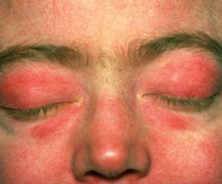

Slide 37
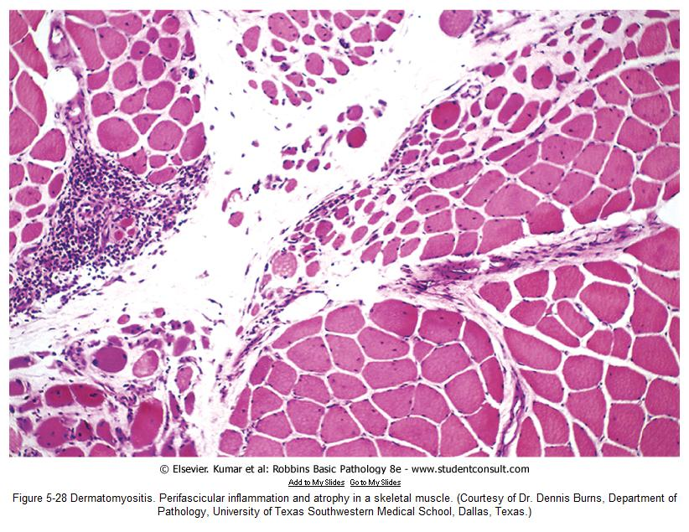

Slide 39
Homework
Define Myotonia?
What is the inheritance and the mutation pattern that characterize myotonic dystrophy?
What is the clinical presentation of myotonic dystrophy?
Source: Robbins basic pathology, 9th edition

