Slide 1
NSAIDs
Epidemiology
NSAIDs amounts for 3.8 of all prescriptions
A significant quantity is sold over the counter(OTC)
Use increases with age
Age>65 years, 10-15% use NSAIDS (90% of all NSAIDs prescriptions)
NSAIDs is the most prominent risk for gastric ulceration, hemorrhage and perforation
The prevalence of NSAID-induced ulcers is 10 to 30%

Slide 2
ILos
To focus on the general mechanism of action of NSAIDs
To outline the common pharmacodynamic effects and ADRs of NSAIDs
To classify NSAIDs on basis of their specifity to COX enzyme
To detail on the phramacokinetic properties and pharmacodynamic effects of slected NSAIDs

Slide 3
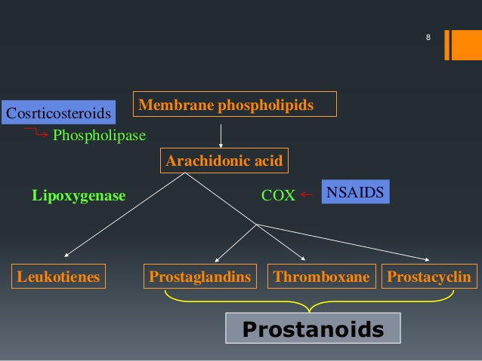
MECHANISM OF ACTION OF NSAIDS
NSAIDs inhibit cyclo oxygenase enzyme

Slide 4
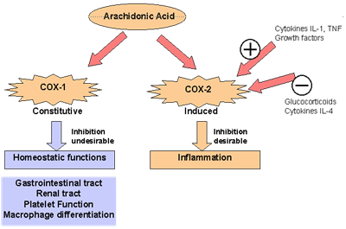
COX isoforms
COX3 is found in the brain

Slide 5
Classification of NSAIDs
Nonselective COX-1/COX-2
Inhibitors
Aspirin,Diclofenac
Selective COX-2
Inhibitors
Coxibs
Preferential COX2 inhibitors
Meloxicam
COX3 inhibitors
Paracetamol

Slide 6
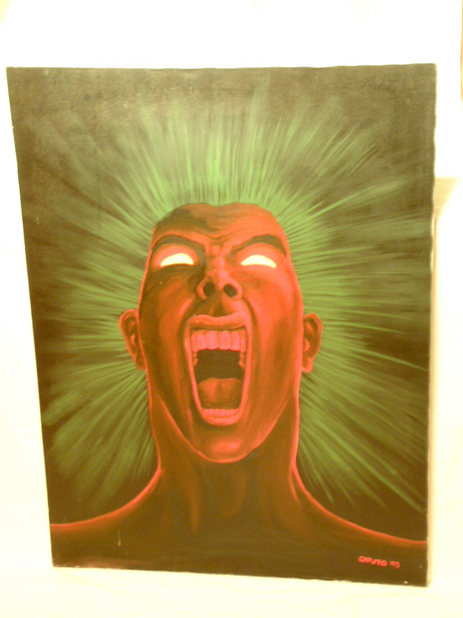
PGS
Nociceptors at nerve endings
PAIN
Inflammatory factors
-
NSAIDs
+
Bradykinin
Histamine
Pharmacodynamic effects
1-analgesic

Slide 7
2-Antipyretic
Pyrogens
PGs
NSAIDs
Thermoregulatory centre
-
Set point↑
Heat production↑
Heat dissipation ↓
Fever

Slide 8
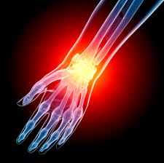
3-Anti-inflammatory
-
NSAIDs
PGs
Inflammatory factors
+
Symptoms of inflammation
Bradikinin
Histamin
Serotonin
Red , Heat , Swelling, Pain

Slide 9
Clinical uses
Fever
Headache, Migraine,
Dental pain, Dysmenorrhea
Common cold
Rheumatoid arthritis / myositis

Slide 10
adrs
GIT upsets ( nausea, vomiting)
GIT bleeding & ulceration
Bleeding
Hypersensitivity reaction
Inhibition of uterine contraction
Salt & water retention

Slide 11
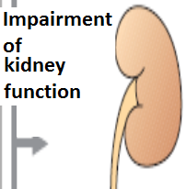
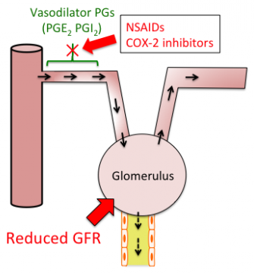
adrs
NSAIDs cause hemodynamically- mediated acute renal failure

Slide 12
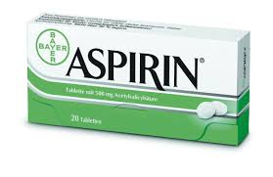
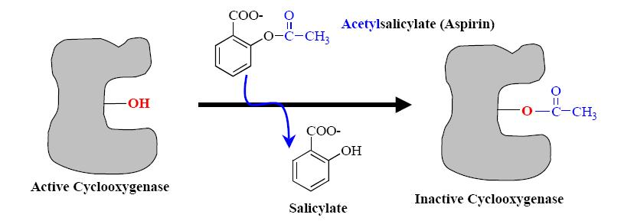
Mechaism of action
Aspirin inhibits COX irreversibly

Slide 13
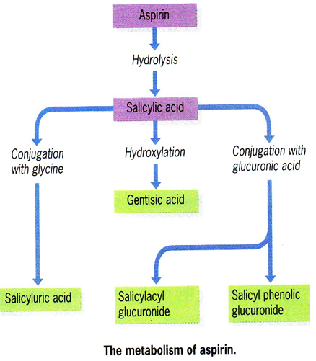
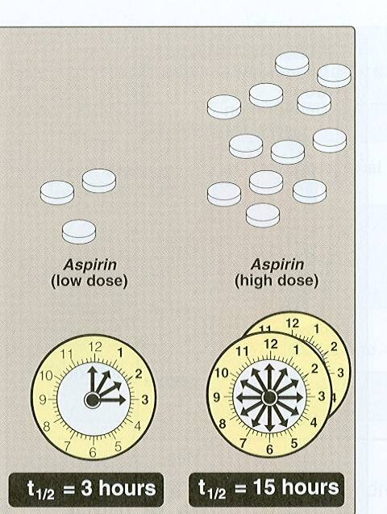
Pharmacokinetics
Metabolized by hydrolysis and then conjugation
Why a high dose has a long plasma half- life?

Slide 14
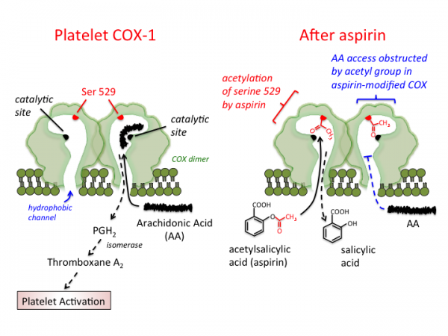
Clinical uses
Acute rheumatic fever
Reducing the risk of myocardial infarction (cardioprotective)
Prevention of pre-eclampsia
Chronic use of small doses ,
reduce the incidence of colon cancer

Slide 15
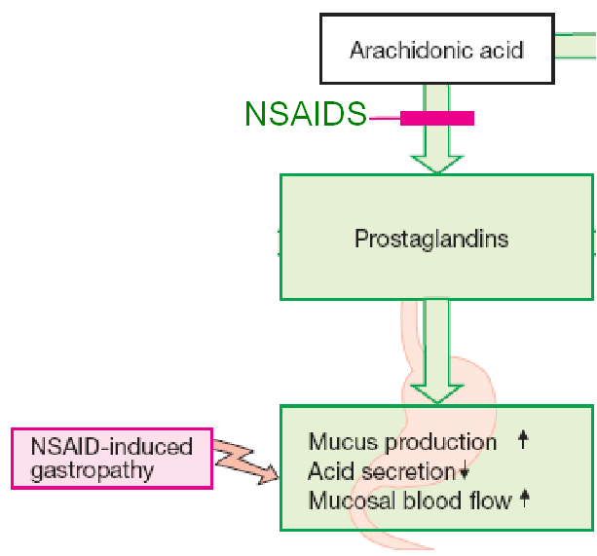
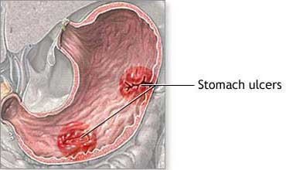
Adrs at clinical doses
Hypersensitivity
Acute Gouty arthritis
Reye's syndrome
Impaired haemostasis
GIT side effects, dyspepsia, nausea, vomiting
Mucosal damage→ hemorrhage

Slide 16
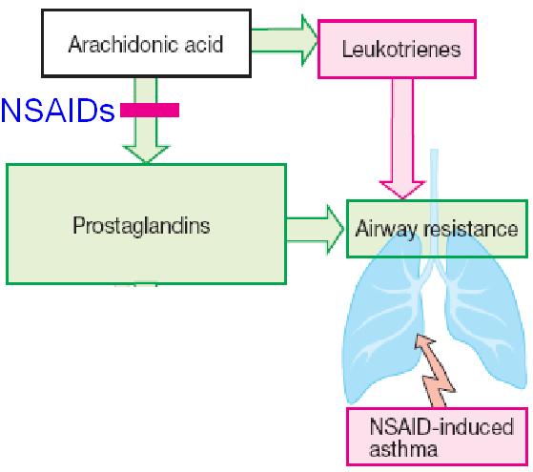
adrs
Bronchospasm in aspirin- sensitive asthmatics

Slide 17
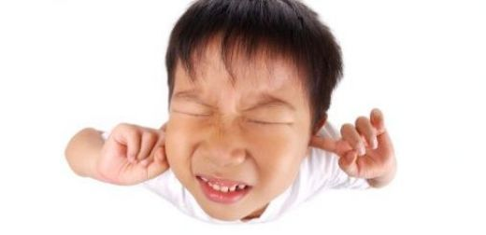
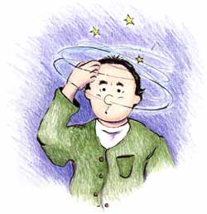
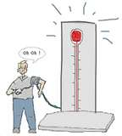
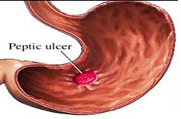
ADRS at overdose
Salicylism ( ringing of ear , vertigo)
Hyperthermia
Gastric ulceration & bleeding

Slide 18
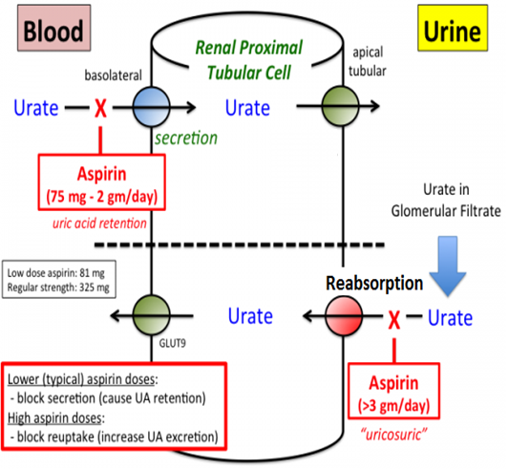
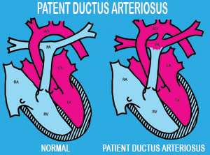
contraindications
Peptic ulcer
Pregnancy
Hemophilic
patients
Patients taking
anticoagulants
Children with
viral infections
Gout ( small doses )

Slide 19
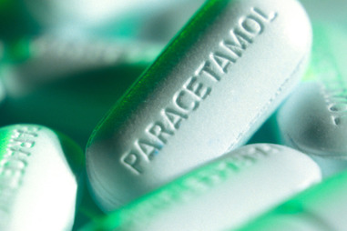
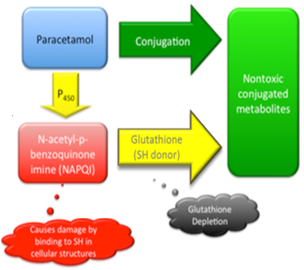
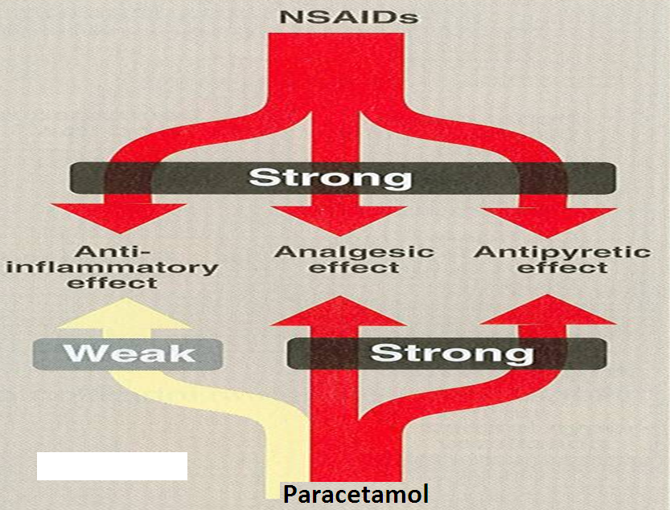
mm
Weak anti-inflammatory effect
Given orally , well absorbed.
t½=2-4h
Metabolized by conjugation at therapeutic doses

Slide 20
Clinical uses
Commonly used analgesic antipyretic
instead of aspirin in cases of:-
Peptic or gastric ulcers
Bleeding tendency
Allergy to aspirin
Viral infections in children
Pregnancy

Slide 21
ADRS
Mainly on liver due to
its active metabolite
Therapeutic doses
elevate liver enzymes
In large doses it is metabolized into N- acetyl-p-benzoquinone imine, which causes liver damage.
Treatment of toxicity of paracetamol is by N- acetylcysteine to neutralize the toxic metabolite

Slide 22
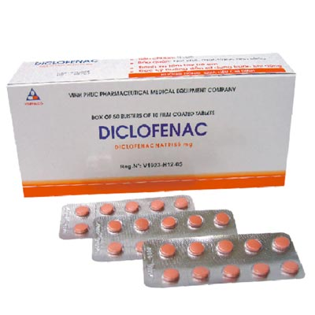
Clinical uses
Analgesic
Antipyretic
Anti-inflammatory
Acute gouty arthritis
Locally to prevent post-ophthalmic inflammation

Slide 23
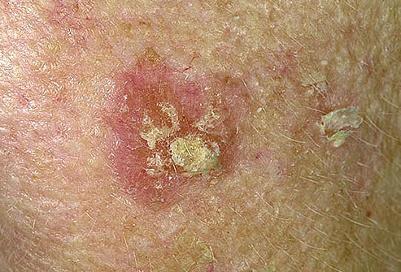
preparations
Diclofenac with misoprostol decreases upper gastrointestinal ulceration ,but results in diarrhea.
Diclofenac with omeprazole to prevent recurrent bleeding
0.1% ophthalmic preparation for postoperative ophthalmic inflammation.
A topical gel 3% for solar keratoses.
Rectal suppository as analgesic
Oral mouth wash.
Intramuscular preparations

Slide 24
Selective COX-2 inhibitors
Potent anti-inflammatory
Antipyretic & analgesic
Lower incidence of gastric upset
No effect on platelet aggregation ( COX-1)

Slide 25
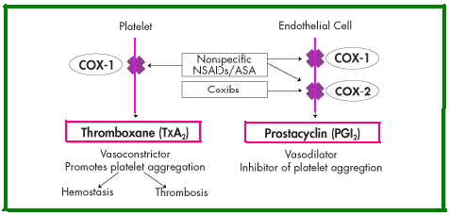
General ADRs
Renal toxicity
Dyspepsia & heartburn
Allergy
Cardiovascular ( do not offer the cardioprotective effects of non-selective group).

Slide 26
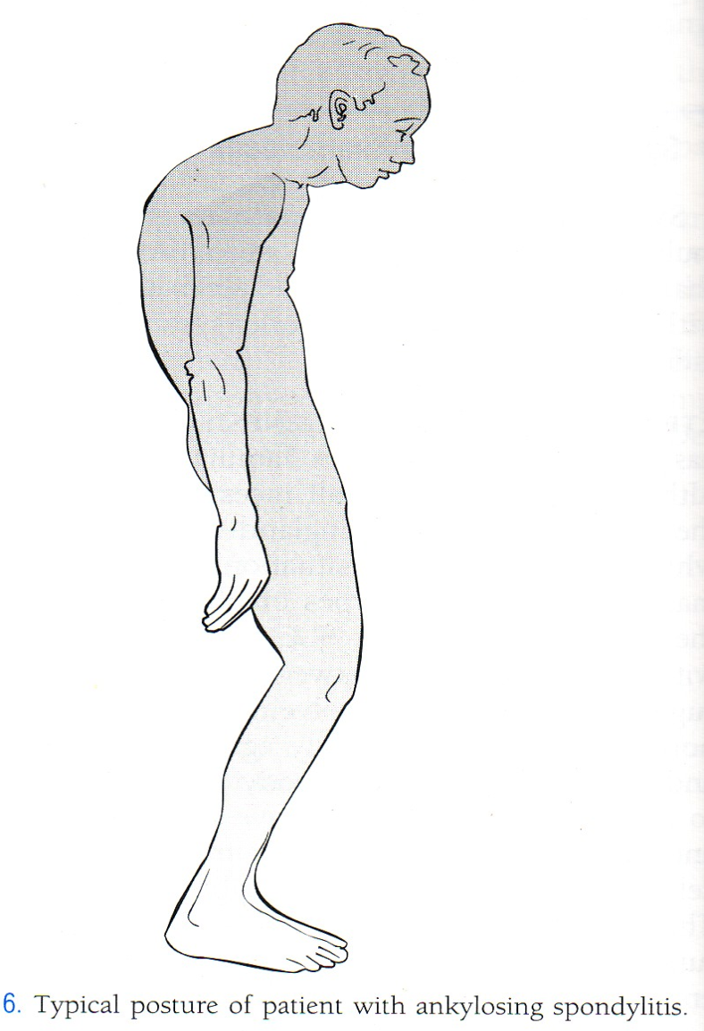
GENERAL CLINICAL USES
Short-term use in postoperative patients
Acute gouty arthritis
Acute musculoskeletal pain
Ankylosing spondylitis

Slide 27
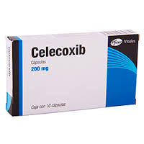
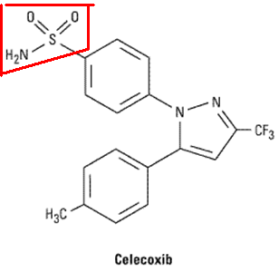
Half-life 11 hours
Food decrease its absorption
Highly bound to plasma proteins
Should not be prescribed to patients who are hypersensitive to sulphonamides

