Slide 1
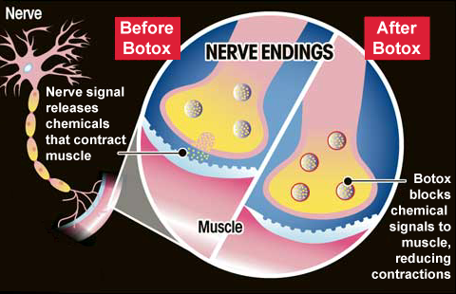
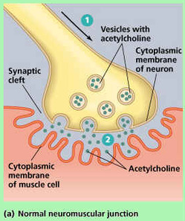
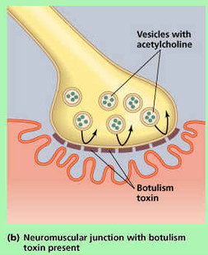
Direct Cholinomimetics
Amanita muscaria
Muscarine
What is botox?
Botulinum toxin
A toxin produced by Clostridium botulinum

Slide 2
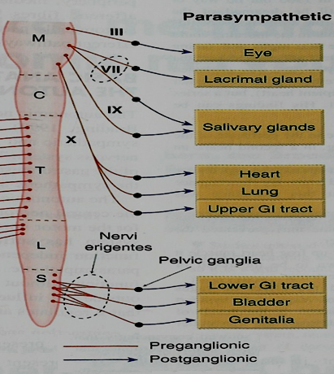
Direct Cholinomimetics
ILOS
To identify the mechanism of action of direct acting acetylcholine receptor stimulants
To discuss the pharmacokinetic aspects and pharmacodynamic effects of direct cholinomimetics
To outline the therapeutic uses and toxicity of direct cholinergic agonists

Slide 3
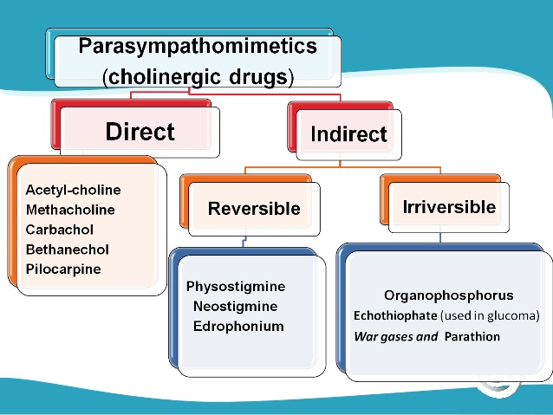
Direct Cholinergic Agonists
Classification of cholinergic agonists

Slide 4
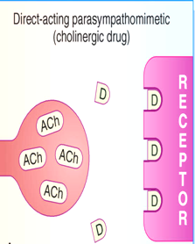
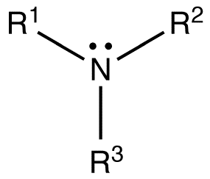
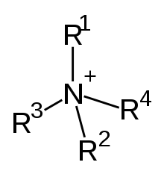
Direct Cholinergic Agonists
Produce primarily effect by activation of muscarinic or nicotinic receptors
Classification according to chemical structure
pilocarpine,
nicotine ,
lobeline
Tertiary cholinomimetics
acetylcholine ,
methacholine,
carbachol,
bethanechol
Quaternary group

Slide 5
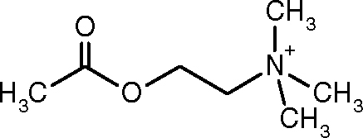
Pharmacokinetics
Acetylcholine low lipid- solubility
Poorly absorbed poorly distributed in the CNS
Hydrolyzed in the GIT , not active by the oral route
Ach is very sensitive to hydrolysis by cholinesterases
Methacholine is 3 times more resistant to hydrolysis
Carbachol & bethanechol are completely resistant to hydrolysis

Slide 6
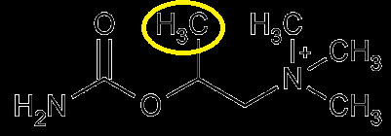
Pharmacokinetics
Presence of a methyl group on bethanechol reduces its potency at nicotinic junction.
Tertiary cholinomimetics are well absorbed from most sites of administration
Nicotine, lipid –soluble, absorbed across the skin.
Muscarinic quaternary amines , less completely absorbed from the GIT but still toxic when ingested in mushroom.
Excretion by kidney, clearance of tertiary amines can be enhanced by acidification of urine

Slide 7
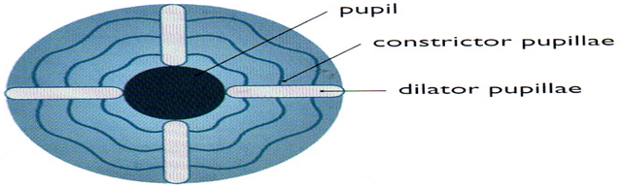
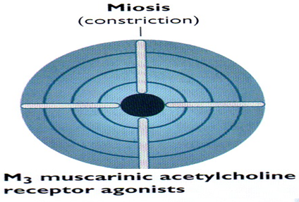
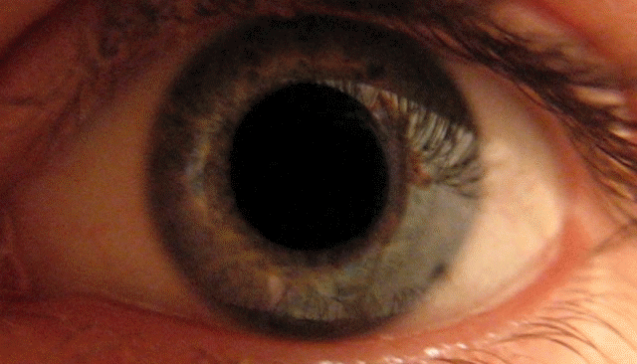
Direct Cholinergic Agonists
Direct Cholinergic Agonists
Direct Cholinergic Agonists
Pharmacodynamic effects
1-Eye
The parasympathetic innervates the constrictor pupillae , runs cirumferentially in the iris
Constrictor pupillae is important for adjusting the pupil in response to change in light intensity & regulating the intraocular pressure

Slide 8
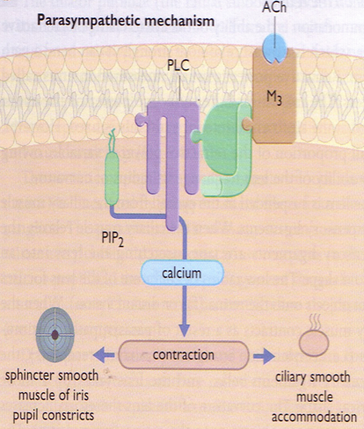
Pharmacodynamic effects
1-Eye
Parasympathetic activation contracts the ciliary muscle
Contraction of ciliary muscle pulls the ciliary body forward & inward , relaxing the tension on the suspensory ligaments of the lens

Slide 9
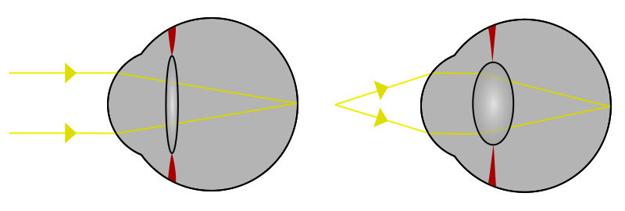
Pharmacodynamic effects
1-Eye
When the ciliary muscle contracts, the lens bulge more →↓focal length, this parasympathetic reflex is essential to accommodate for near vision

Slide 10
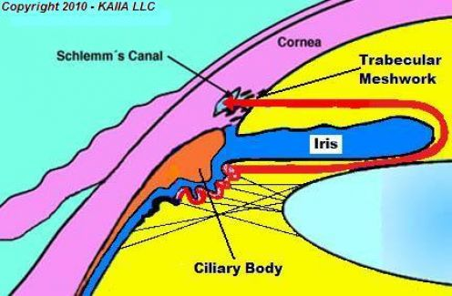
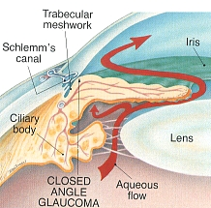
Pharmacodynamic effects
Aqueous humour secreted
by the cells of the epithelium
covering the ciliary body , is
removed continuously by drainage
into the canal of Schlemm
In some people drainage of aqueous humour is impeded when the iris is dilated → folding of the iris tissue occludes the drainage angle →↑intraocular pressure

Slide 11
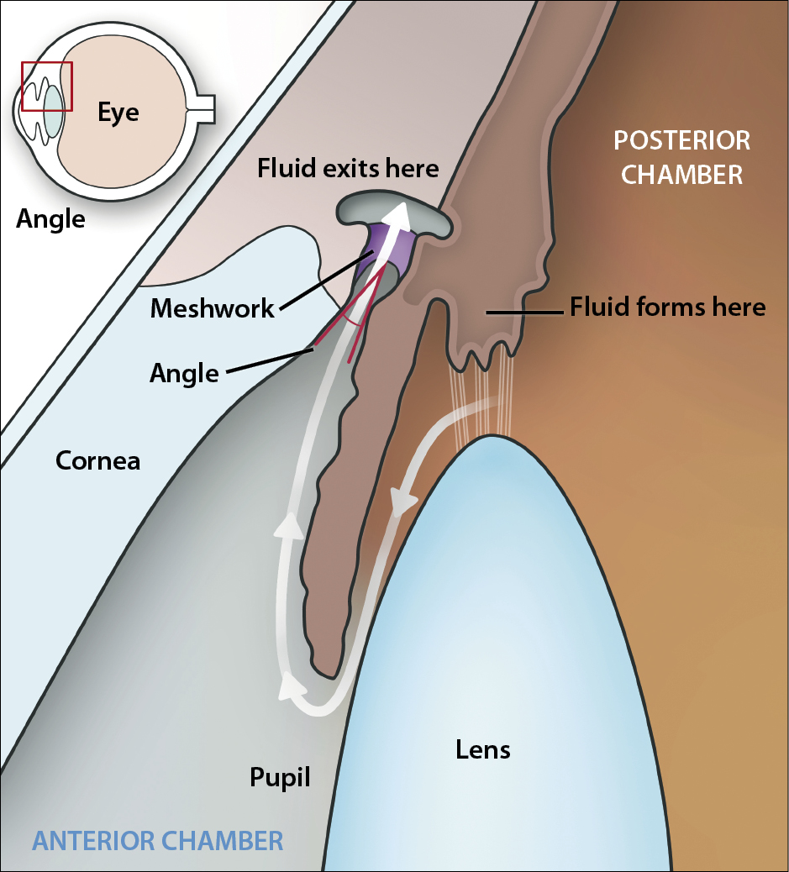
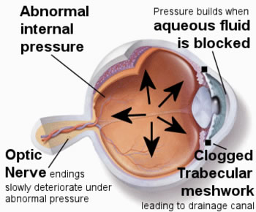
Pharmacodynamic effects
Activation of constrictor pupillae →↓ intraocular pressure in these individuals
Also ↑tension in the ciliary body allow drainage
Normal intraocular pressure is 10-15mmHg above atmospheric pressure . Abnormally raised pressure →retinal detachment

Slide 12
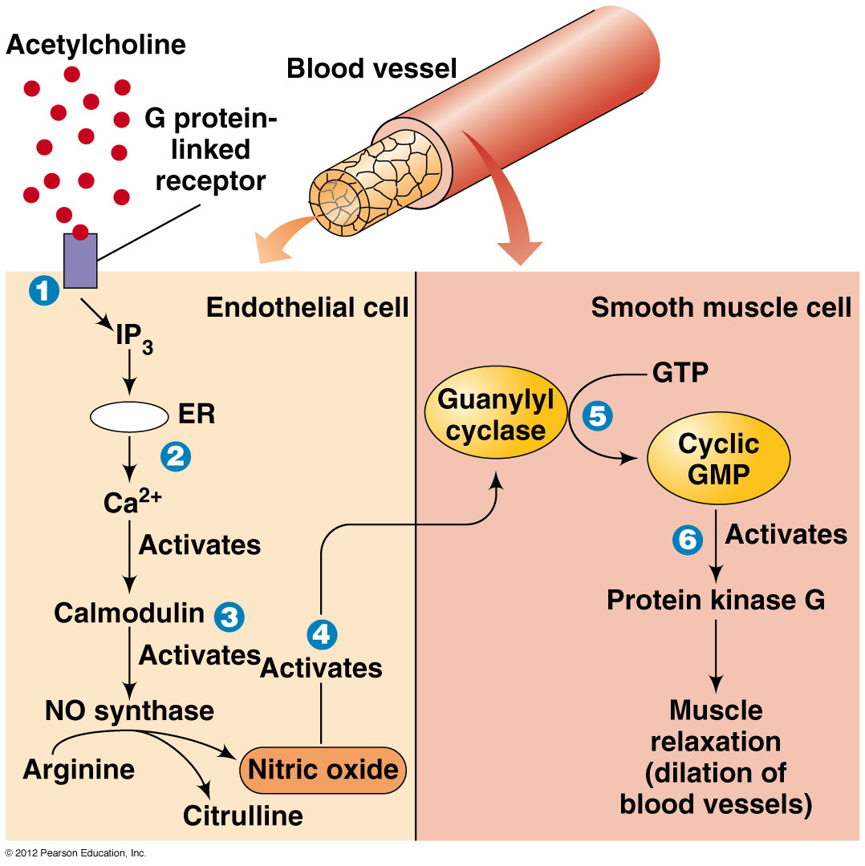
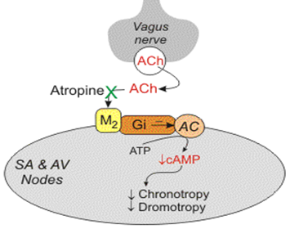
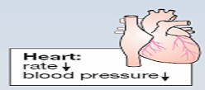
Pharmacodynamic effects
2-Cardiovascular effect
Ventricle has sparse parasympathetic innervations
Cardiac slowing , ↓CO→↓force of contraction of the atrium
Vasodilation occurs , effect not associted with muscarinic innervations
BP: Hypotension is opposed by reflex sympathetic discharge

Slide 13
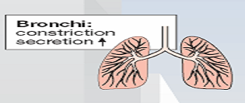
Pharmacodynamic effects
3-Respiratory system
Muscarinic stimulants contract smooth muscles of bronchial tree
↑Glandular secretion, may cause symptoms in individuals with asthma

Slide 14
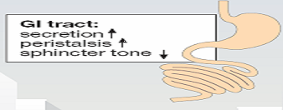
Pharmacodynamic effects
4-GIT:-
↑Secretion of gastric glands
↑Peristaltic movement
Sphincters relaxed.

Slide 15
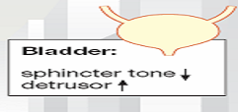
Pharmacodynamic effects
5-Genitourinary tract:-
Stimulate muscles of bladder & relax sphincters promoting voiding
Human uterus is not sensitive to muscarinic agonists
6-Miscellaneous secretory glands:-
Stimulate secretion of sweat , lacrimal, nasopharyngeal glands

Slide 16
Pharmacodynamic effects
7-CNS:-
Both muscarinic & nicotinic receptors are found in the CNS
Nicotine & lobeline
alerting action
High level of nicotine convulsions & coma

Slide 17
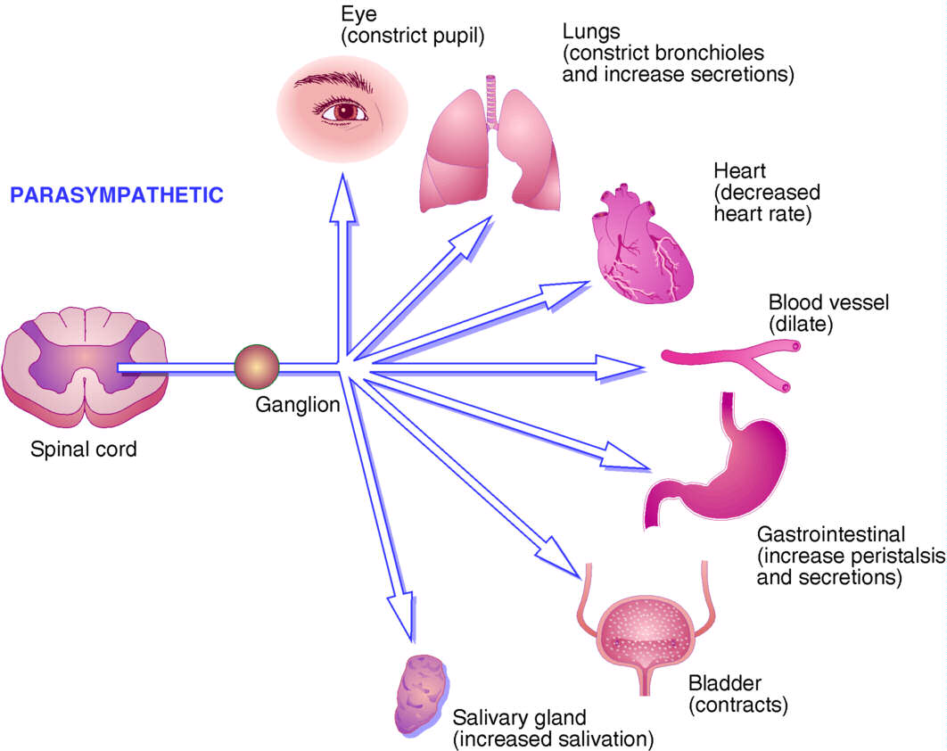
inDirect Cholinomimetics
ILOS
To identify the mechanism of action of indirect acting acetylcholine receptor stimulants
To discuss the pharmacokinetic aspects and pharmacodynamic effects of indirect cholinomimetics
To outline the therapeutic uses and toxicity of indirect cholinergic agonists
To highlight the therapy of cholinergic toxicity

Slide 18
Indirectly –acting cholinoceptor stimulants:-
1-Simple alcohol bearing a quaternary ammonium groups
edrophonium
2-Carbamic acid esters of alcohols bearing quaternary amine
neostigmine
Or Carbamic acid esters of alcohols bearing tertiary amine
physostigmine
Most of the organophosphates are highly lipid soluble except ecothiopate
3-Organophosphates

Slide 19
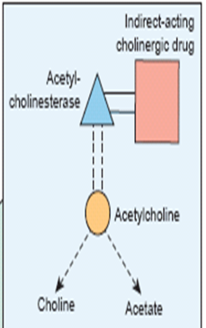
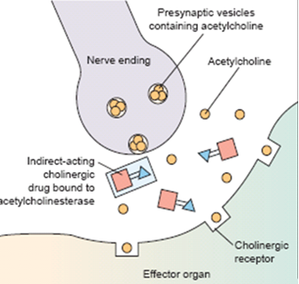
Mechanism of action
↓Aetylcholinesterase→↑level of endogenous Ach.

Slide 20
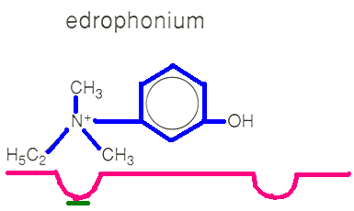
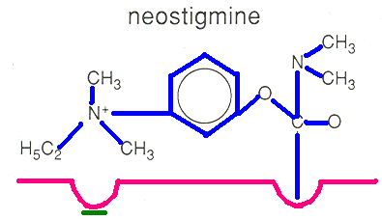
Mechanism of action
Bind reversibly by electrostatic forces to the active site, preventing access of Ach , enzyme-inhibitor complex is short lived’2-10min’
Edrophonium
Carbamate esters
Physostigmine(non-polar), neostigmine, pyridostigmine
Form covalent bond, more resistant to hydrolysis’ 0.5-6hr’

Slide 21
Mechanism of action
Organophosphates
Phosphorylate enzyme ,hydrolysis very slow ‘hundreds of hours’.
Due to the long duration they are called irreversible inhibitors
Pralidoxime is used as cholinesterase regenerator for organic phosphate poisoning

Slide 22
Muscarinic receptors
Pharmacological actions | Locations | Receptor
CNS excitation Gastric acid secretion | CNS gastric parietal cells | M1 Excitatory
Cardiac inhibition (Bradycardia) | Heart | M2 Inhibitory
Secretion of glands Smooth muscle contraction Vasodilatation (via nitric oxide) | Exocrine glands Smooth muscles (GIT, urinary tract, bronchial muscles) Vascular endothelium | M3 Excitatory
memory, arousal, attention and analgesia | CNS | M4 & M5

Slide 23
Cholinergic or parasympathetic receptors
Muscarinic receptors Peripheral cholinoceptors | Nicotinic receptors Central cholinoceptors
Excitatory or inhibitory | Almost excitatory
On all peripheral organs innervated by postganglionic parasympathetic fibers | Autonomic ganglia Nn sympathetic & parasympathetic stimulation
Heart (bradycardia, M2) exocrine glands (secretion, M3) | Adrenal medulla Nn release of catecholamines (adrenaline & noradrenaline)
Smooth muscles (contraction, M3) (GIT, urinary tract, bronchial muscles, uterus) | Skeletal muscles Nm contraction

Slide 24
Muscarinic actions of Ach
Cholinergic actions | Organs
Contraction of circular muscle of iris (miosis)(M3) Contraction of ciliary muscles for near vision (M3) Decrease in intraocular pressure (IOP) | Eye
bradycardia ( decrease in heart rate ) (M2) Release of NO (EDRF) | Heart endothelium
Constriction of bronchial smooth muscles Increase in bronchial secretion M3 | Lung
Increase in motility (peristalsis) Increase in secretion Relaxation of sphincter -defecation M3 | GIT
Contraction of muscles Relaxation of sphincter M3 Urination | Urinary bladder
Increase of secretions of exocrine glands sweat, saliva, lacrimal, bronchial, intestinal secretions M3 | Exocrine glands

Slide 25
Pilocarpine | Bethanechol | Carbachol | ACh
Tertiary non polar | Quaternary Polar | Quaternary Polar | Quaternary Polar | Chemistry
Complete | better absorbed than Ach | better absorbed than Ach | NOT | Absorption
NOT metabolized by cholinesterase |  |  | metabolized by cholinesterase | Metabolism by cholinesterase
Longer (++) | Longer (++) | Longer (++) | Very short | Duration
oral, eye drops | Oral S.C. | Oral, eye drops S.C. | I.V. eye drops | administration

Slide 26
direct Cholinomimetic
Cevimeline M | Pilocarpine | Bethanechol M | Carbachol M,N | ACh M, N
Muscarinic | Muscarinic | Muscarinic | Muscarinic Nicotinic | Muscarinic Nicotinic | Receptors
+++ | +++ | +++ | +++ | +++ | Muscarinic
Exocrine glands | More on eye, exocrine glands | GIT, Urinary bladder | Eye, GIT Urinary bladder | NOT | Selectivity
NO | NO | NO | +++ | +++ | Nicotinic
Sjogren's syndrome | Glaucoma Xerostomia | Paralytic ileus Urinary retention | Glaucoma | NO | Uses

