Slide 1
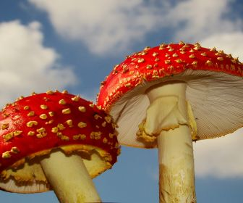
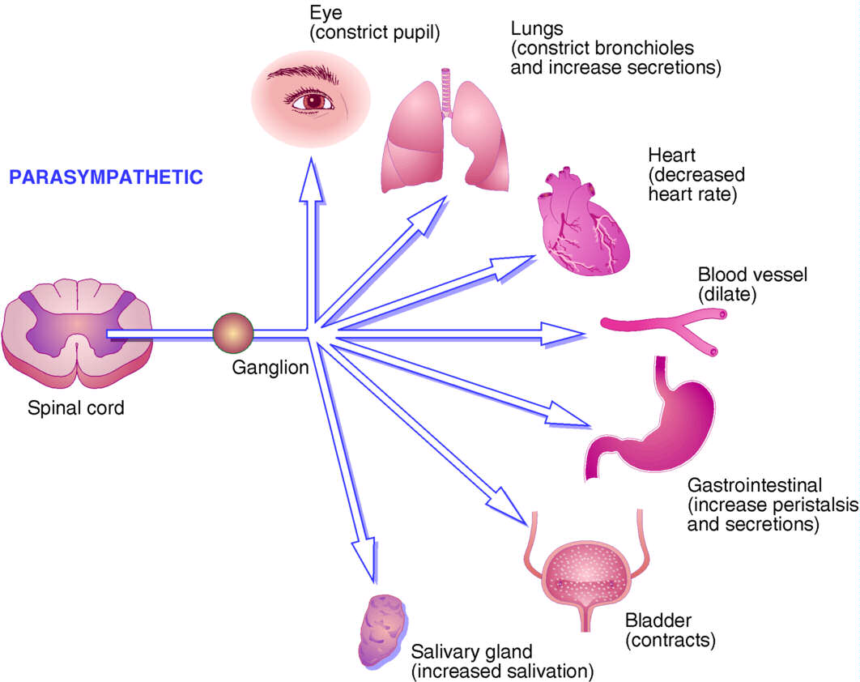
inDirect Cholinomimetics
ILOS
To identify the mechanism of action of indirect acting acetylcholine receptor stimulants
To discuss the pharmacokinetic aspects and pharmacodynamic effects of indirect cholinomimetics
To outline the therapeutic uses and toxicity of indirect cholinergic agonists
To highlight the therapy of cholinergic toxicity

Slide 2
Indirectly –acting cholinoceptor stimulants:-
1-Simple alcohol bearing a quaternary ammonium groups
edrophonium
2-Carbamic acid esters of alcohols bearing quaternary amine
neostigmine
Or Carbamic acid esters of alcohols bearing tertiary amine
physostigmine
Most of the organophosphates are highly lipid soluble except ecothiopate
3-Organophosphates

Slide 3
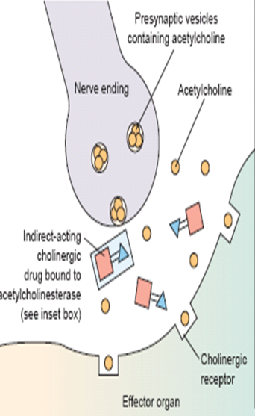
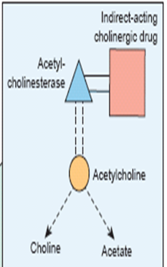
Mechanism of action
↓Aetylcholinesterase→↑level of endogenous Ach.

Slide 4
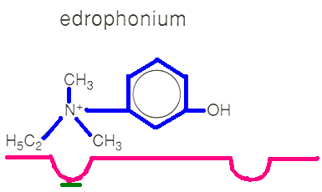
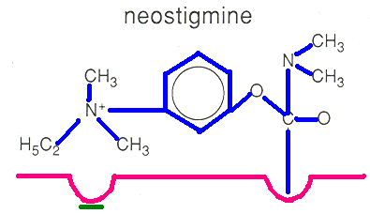
Mechanism of action
Bind reversibly by electrostatic forces to the active site, preventing access of Ach , enzyme-inhibitor complex is short lived’2-10min’
Edrophonium
Carbamate esters
Physostigmine(non-polar), neostigmine, pyridostigmine
Form covalent bond, more resistant to hydrolysis’ 0.5-6hr’

Slide 5
Mechanism of action
Organophosphates
Phosphorylate enzyme ,hydrolysis very slow ‘hundreds of hours’.
Due to the long duration they are called irreversible inhibitors
Pralidoxime is used as cholinesterase regenerator for organic phosphate poisoning

Slide 6
Pharmacokinetics
Absorption of quaternary ammonium salts is poor (ionized)
Distribution in the CNS is negligible
Physostigmine well absorbed can be used topically in the eye
Carbamates are relatively stable in aqueous solution, but can be metabolized by esterases
Organophosphates , well absorbed from the skin , lung, gut & conjunctiva except ecothiopate, (less stable in aqueous solution)

Slide 7
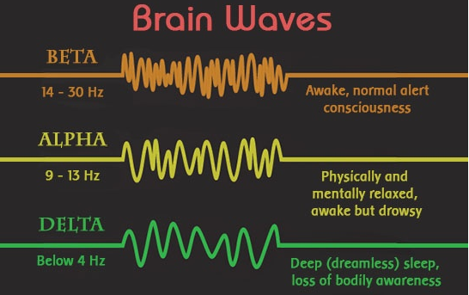
Pharmacodynamic effects
Primary effect is to potentiate the action of endogenous Ach
1-CNS
In low concentration:- The high lipid-soluble inhibitors cause diffuse activation of EEG→ alerting response(ß wave)
↑Concentration →generalized convulsions followed by coma & respiratory arrest

Slide 8
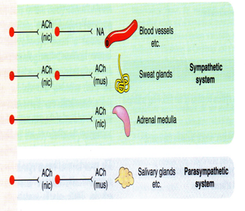
Pharmacodynamic effects
2-CVS
Activation in both sympathetic & parassympathetic ganglia & neuroeffector junction
In the heart effects of parasympathetic limb predominate, ↓HR, ↓conduction velocity through AV node, ↓atrial contractility, ↓CO. Modest change in Bp.

Slide 9
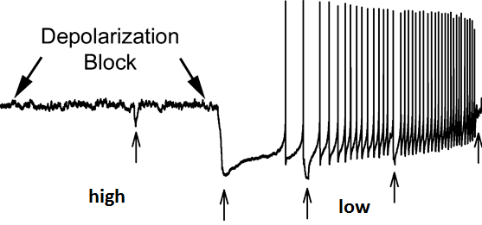
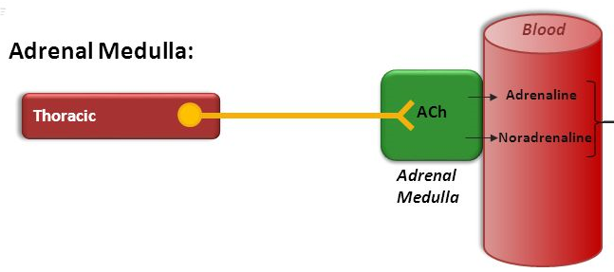
Pharmacodynamic effects
3-Neuromuscular junction
Low concentration → Intensify the effect of endogenous Ach ↑ force of contraction
High concentration →fibrillation of muscle fibers, membrane depolarization becomes sustained → depolarization block
Adrenal medulla
Release of catecholamines

Slide 10
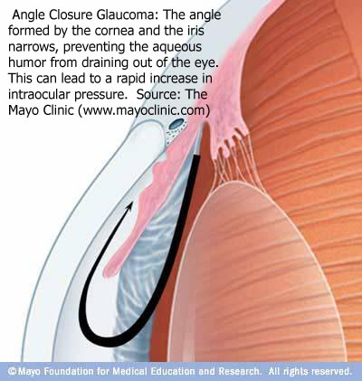
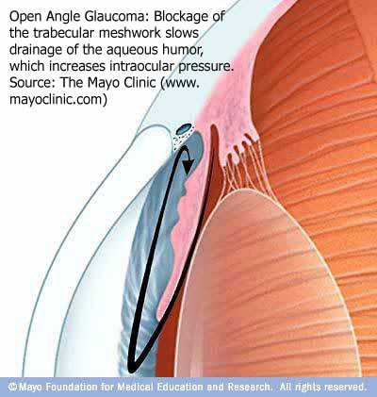
Clinical Uses
1-The Eye
Glaucoma
1- Primary
A- Angle closure
B- Open angle
2- Secondary
caused by trauma, inflammation, surgical procedures

Slide 11
Clinical Uses
Acute angle closure
Medical emergency , initially treated by drugs
Surgery for permanent correction [irridectomy]
Muscarinic stimulants ↓intraocular pressure by 1-facilitating outflow of aqueous humor
2-↓rate of its secretion
Direct stimulants
Methacholine,carbachol,pilocarpine
Indirect stimulants
physostigmine, ecothiopate

Slide 12
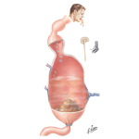
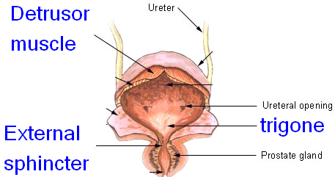
Direct Cholinergic Agonists
Clinical Uses
2-GIT & Urinary tract
Postoperative ileus “atony or paralysis of the stomach following surgery
Postoperative urinary retention
Bethanechol & neostigmine
Xerostomia → Pilocarpine

Slide 13
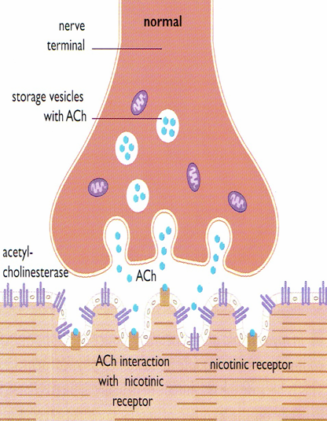
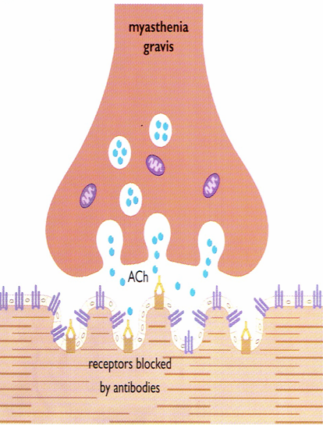
Clinical Uses
3-Neuromuscular junction:-
Myasthenia gravis
Autoimmune disease
Production of antibodies→ ↓no. of functioning nicotinic receptors at endplate

Slide 14
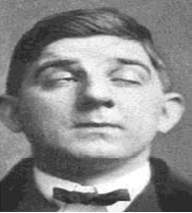
Clinical Uses
Myasthenia gravis
→Weakness ,fatigue affecting muscles of hand ,head, neck , extremities
→Ptosis, diplopia, difficulty of speaking & swallowing.
Treatment with cholinesterase inhibitors+ immunosupressants

Slide 15
Myasthenia gravis
Edrophonium is used as(1) test for diagnosis . An improvement in muscle strength last for 5min is noted. It is also used(2) to assess the adequacy of treatment with the longer –acting cholinesterase inhibitors
In case of excessive amount of cholinesterase inhibitor, a patient becomes weak because of depolarization block + symtoms of muscarinic stimulation.
If a patient improves with a dose of edrophonium, an increase in cholinesterase inhibitor is indicated

Slide 16
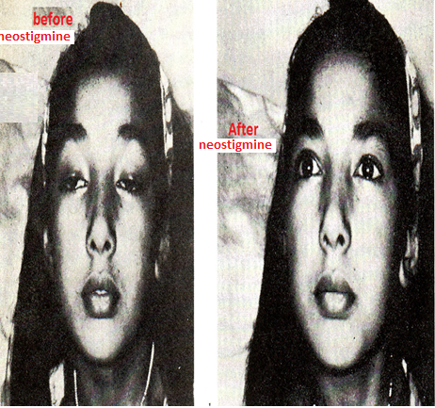
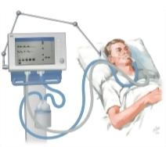
Myasthenia gravis
Severe myasthenia [myasthenia crisis], requires mechanical ventilation
Excess drug therapy [cholinergic crisis]
Chronic long term therapy→ neostigmine, pyridostigmine, ambenonium. Muscarinic side effects can be controlled by antimuscarinics

Slide 17
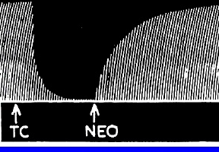
Clinical Uses
4-To reverse pharmacological paralysis produced in case of anaesthetic adjunct (neostigmine versus DTC).
5-Heart:- for treatment of supraventricular tachycardia, edrophonium potentates the effect of Ach at AV node →slow AV conduction & ventricular rate.
6-Antimuscarinic drug intoxication:- atropine overdose is toxic in children → severe muscarinic block
Blockade is competitive , overdose can be overcome by ↑ amount of endogenous Ach.
Physostigmine is used because it crosses the BBB , reverses central & peripheral signs.

Slide 18
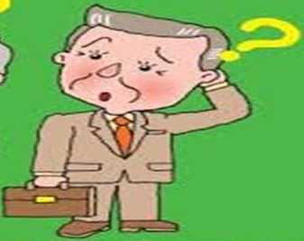
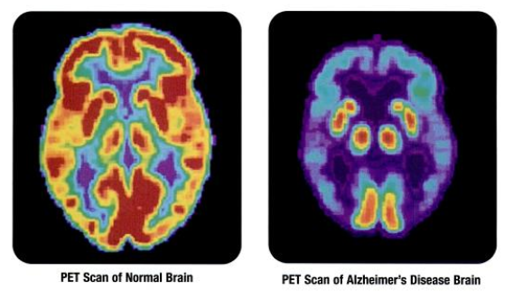
Clinical Uses
Alzheimer’s Disease
Characterized by loss of cholinergic neurons in the basal forebrain nuclei.
Thus cholinesterase inhibitors are used to treat AD
Donepezil, is not hepatotoxic
Used for treatment of dementia of AD
Taken orally

Slide 19
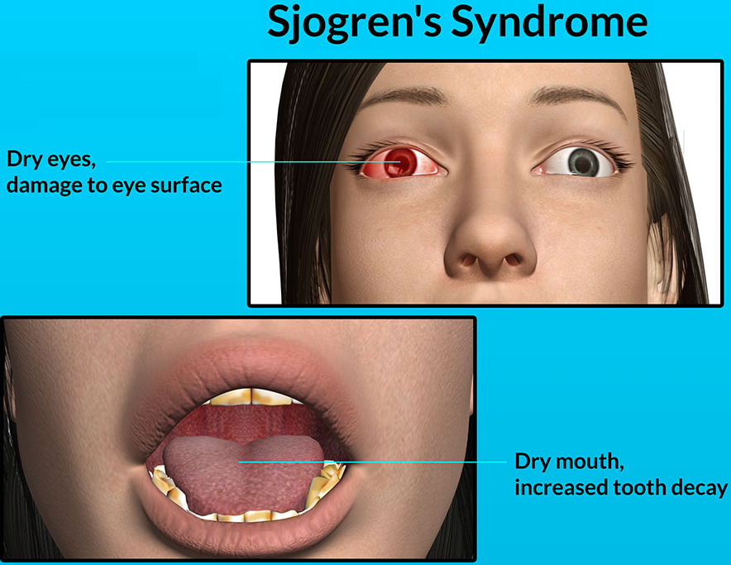
Sjogren's Syndrome
Sjogren's Syndrome is an autoimmune disease. characterized by the abnormal production of antibodies directed to the lacrimal and salivary glands→ eye and mouth dryness.
Cevimeline is a direct muscarinic agonist with particular effect on M3 receptors.
By activating the M3 receptors cevimeline stimulates secretion by the salivary & lacrimal glands thereby alleviating dry mouth & dry eye
Rapidly absorbed after oral administration and excreted unchanged in urine

Slide 20
Toxicity
A-Directly- acting muscarinic stimulants:- nausea, vomiting ,diarrhoea, salivation, cutaneous vasodilatation bronchial constriction
B-Directly- acting nicotinic stimulants:-
I] Acute toxicity
1- CNS stimulant action, convulsions , coma , respiratory arrest
2-Skeletal muscle endplate depolarization →depolarization block & respiratory paralysis
3-Hypertension & cardiac arrhythmias

Slide 21
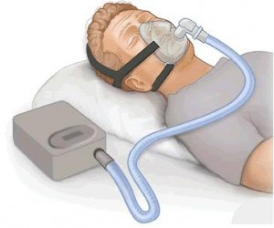
Toxicity
Treatment of symptoms:-
Muscarinic excess→ atropine
CNS stimulation → central anticonvulsants e.g. diazepam
Neuromuscular block → mechanical respiration

Slide 22
ii-Chronic nicotinic toxicity
30% of deaths due to cancer & coronary heart disease are due to smoking
Nicotine contributes to ↑risk of vascular diseases, sudden coronary death, ↑ulcer
C- Cholinesterase inhibitors:-
Organophosphates are used as pesticides ,veterinary vermifuge
Dominant initial signs of muscarinic excess, miosis, salivation, sweating , bronchial constriction, V,D,
CNS involvement follows accompanied by peripheral nicotinic effects
No cigarettes / day

Slide 23
Therapy of cholinesterse toxicity
1- Maintenance of vital signs , respiration may be impaired
2-Decontamination to prevent further absorption, removal of cloth, washing of skin
Parenteral atropine in large doses. Pralidoxime[PAM][oxime] often

Slide 24
Contraindications
  Bronchial asthma
  Peptic ulcer
  Angina pectoris
  Urinary incontinence
  Intestinal obstruction

Slide 25
Muscarinic actions
Cholinergic actions | Organs
Contraction of circular muscle of iris (miosis)(M3) Contraction of ciliary muscles for near vision (M3) Decrease in intraocular pressure | Eye
bradycardia ( heart rate ) (M2) Release of NO (EDRF) | Heart endothelium
Constriction of bronchial smooth muscles Increase bronchial secretion M3 | Lung
Increased motility (peristalsis) Increased secretion Relaxation of sphincter M3 | GIT
Contraction of muscles Relaxation of sphincter M3 | Urinary bladder
Increase of sweat, saliva, lacrimal, bronchial, intestinal secretions M3 | Exocrine glands

Slide 26
Carbamate esters
Uses | Kinetics | Actions | Drug
Myasthenia gravis treatment Paralytic ileus Urinary retention Curare toxicity | 0.5-6 hr polar | Nicotinic & muscarinic M, N | Neostigmine
Glaucoma atropine toxicity | 0.5-2hr Lipid soluble | Nicotinic muscarinic M, N, CNS | Physostigmine
Myasthenia gravis treatment | 3-6 polar | Nicotinic & muscarinic M, N | Pyridostigmine
Myasthenia gravis treatment | 4-8 polar | Nicotinic & muscarinic M, N | Ambenonium

Slide 27
Indirect Cholinomimetic
Diagnosis of Myasthenia gravis | Very Short 5-15 min, Polar | Edrophonium M, N
Myasthenia gravis treatment Paralytic ileus Urinary retention curare toxicity | Short 0.5-2hr polar | Neostigmine M, N
Glaucoma atropine toxicity | Short 0.5-2hr Lipid soluble | Physostigmine M,N, CNS
Myasthenia gravis treatment | Short 3-6, polar | Ambenonium Pyridostigmine M, N
Glaucoma. | Long 100hr, polar | Ecothiophate M, N
dementia of Alzheimer’s disease |  | Donepezil M, N

