Slide 1
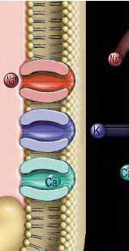
Resting Membrane Potential (RMP)
TEXTBOOK OF MEDICAL PHYSIOLOGY
GUYTON & HALL 12TH EDITION
UNIT II CHAPTER 5
Dr.Mohammed Alotaibi
Department of Physiology
College of Medicine
King Saud University

Slide 2
LECTURE OBJECTIVES
By the end of this lecture, you should be able to:
• Recognise the excitable tissues and their properties.
• Recognise and describe the forces acting on ions.
• Know how membrane potential is measured electrically.
• Recognise and apply Nernst equation to calculate equilibrium potential.
• Explain the origin of RMP and how it is created.

Slide 3
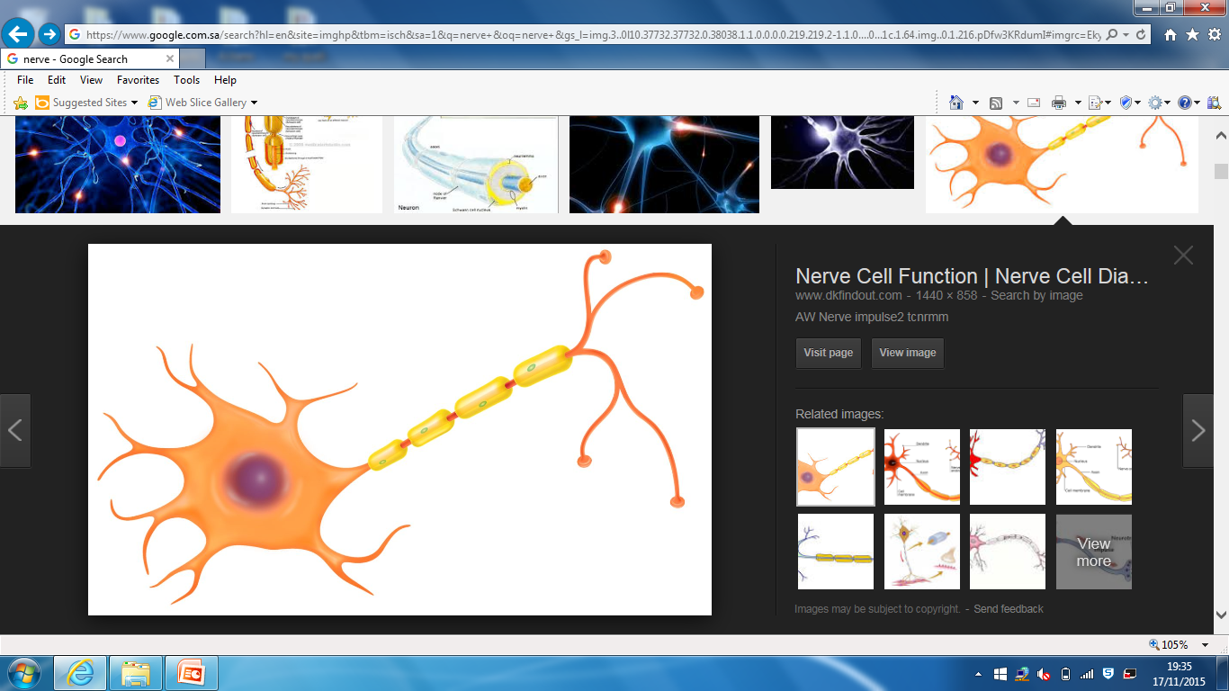
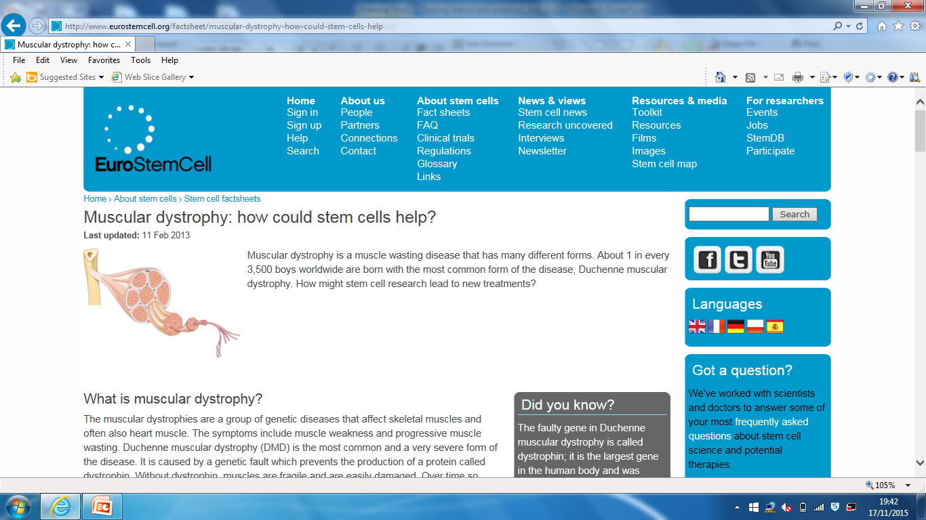
What are Excitable tissues?
What property do excitable tissues have that makethem different from other body tissues ?
Their membrane acts as an electric capacitor storing opposite charges on the opposite sides of the membrane.

Slide 4
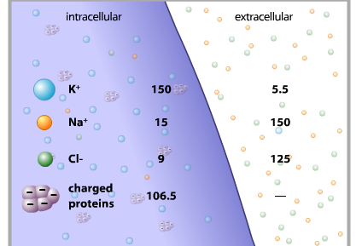
Ion Concentration
140
4
14
142

Slide 5
K⁺
Na⁺
Cl⁻
Na⁺
Na⁺
Cl⁻
Na⁺
Na⁺
Cl⁻
Na⁺
Cl⁻
+
+
K⁺
Cl⁻
+
_
+
Cl⁻
_
Proteins⁻
_
Na⁺
K⁺
Na⁺
Cl⁻
Na⁺
K⁺
K⁺
Cl⁻
K⁺
Cl⁻
Proteins⁻
Na⁺
+
K⁺
K⁺
_
+
Na⁺
_
Cl⁻
Proteins⁻
K⁺
K⁺
Na⁺
K⁺
Cl⁻
Proteins⁻
Na⁺
K⁺
_
+
K⁺
Proteins⁻
K⁺
K⁺
3Na⁺
+
_
K⁺
Proteins⁻
Na⁺
Proteins⁻
K⁺
Na⁺/K⁺ ATPase Pump
K⁺
K⁺
K⁺
K⁺
2K⁺
+
_
Proteins⁻
K⁺
K⁺
K⁺
_
Cl⁻
_
+
K⁺
Na⁺
+
Cl⁻
_
_
Na⁺
+
+
Na⁺
+
Cl⁻
Na⁺
K⁺
Cl⁻
Na⁺
K⁺
Cl⁻
Na⁺
Cl⁻
Na⁺

Slide 6
RESTING MEMBRANE POTENTIAL
Given:
Concentration of ions inside and outside the cell as shown
Only K⁺ can diffuse across the cell membrane
100 K⁺
100 Na⁺
K⁺
100 A⁻
100 A⁻
100 Na⁺
140 mM/L K⁺
Concentration ∆
4 mM/L K⁺
99 K⁺
Concentration ∆
Electrical ∆
1 K⁺
Electrical ∆
A⁻
_
A⁻
+
100 A⁻
_
100 A⁻
+
Equilibrium Potential

Slide 7
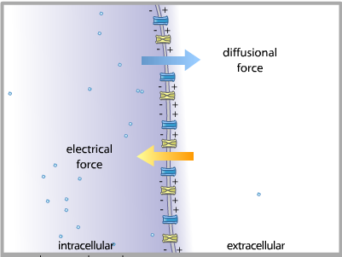
Opposing Forces Acting on Ions
- Only electrolytes are important because they are electrically charged.
- Oxygen, Carbon dioxide ?
K⁺
K⁺
K⁺
K⁺

Slide 8
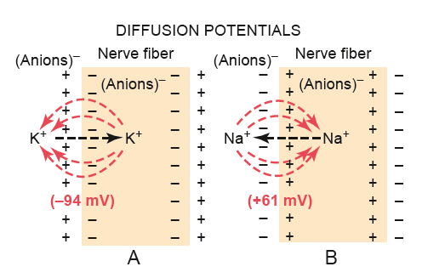
NERNST EQUATION
Nernst calculated the level of concentration potential of ions across the membrane that prevent net diffusion of ions to inside or outside
Nernst made a hypothesis which said that if we suppose that
(1) The ECF and ICF contained ONLY potassium ion
(2) And that the cell-membrane was freely permeable to K+
→ Then K+ will diffuse down its concentration gradient ( via the K+ leak channels ) from inside the cell to outside , carrying with it +ve charges to the outside
The Potassium Nernst ( Equilibrium ) Potential

Slide 9
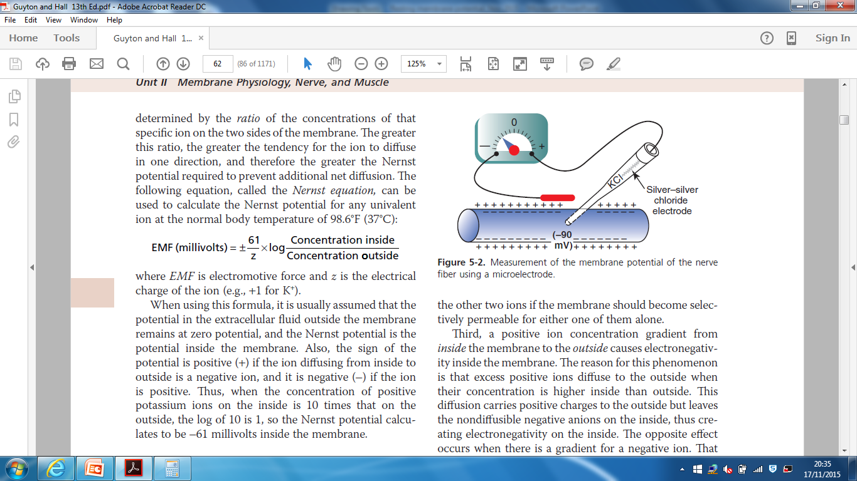
*When this electrical gradient ( electrical force ) , which tends to keep K+ inside equals (=), the concentration gradient (which tends to push K+ outside ) → there will be no net K+ movement across the membrane .
The RMP in that case is called:-
Nernst Potential for K+ (or K+ Equilibrium or Diffusion Potential)
EMF (mV) = -61 log K+ Conc. Inside = -94 mV K+
Conc outside

Slide 10
Nernst made a hypothesis which said that if we suppose that:-
(1) the ECF and ICF contained ONLY sodium ions
(2) and that the cell membrane was freely permeable to Na+
→ Then Na+ will diffuse down its concentration gradient to the Inside of the cell, carrying with it +ve charges , and progressively decreasing the negativity inside the cell.
When this electrical gradient ( force ) , which tends to drive (PUSH) Na+ outside equals = the concentration gradient ( which tends to push Na+ in ) → there will be no Na+ movement across the membrane .
Nernst Potential for Na+ ( or Na+ Equilibrium or Diffusion Potential ) = +61 mV
The Sodium Nernst ( Equilibrium ) Potential

Slide 11
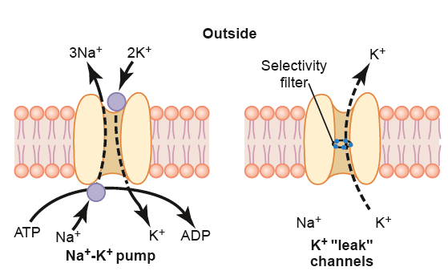
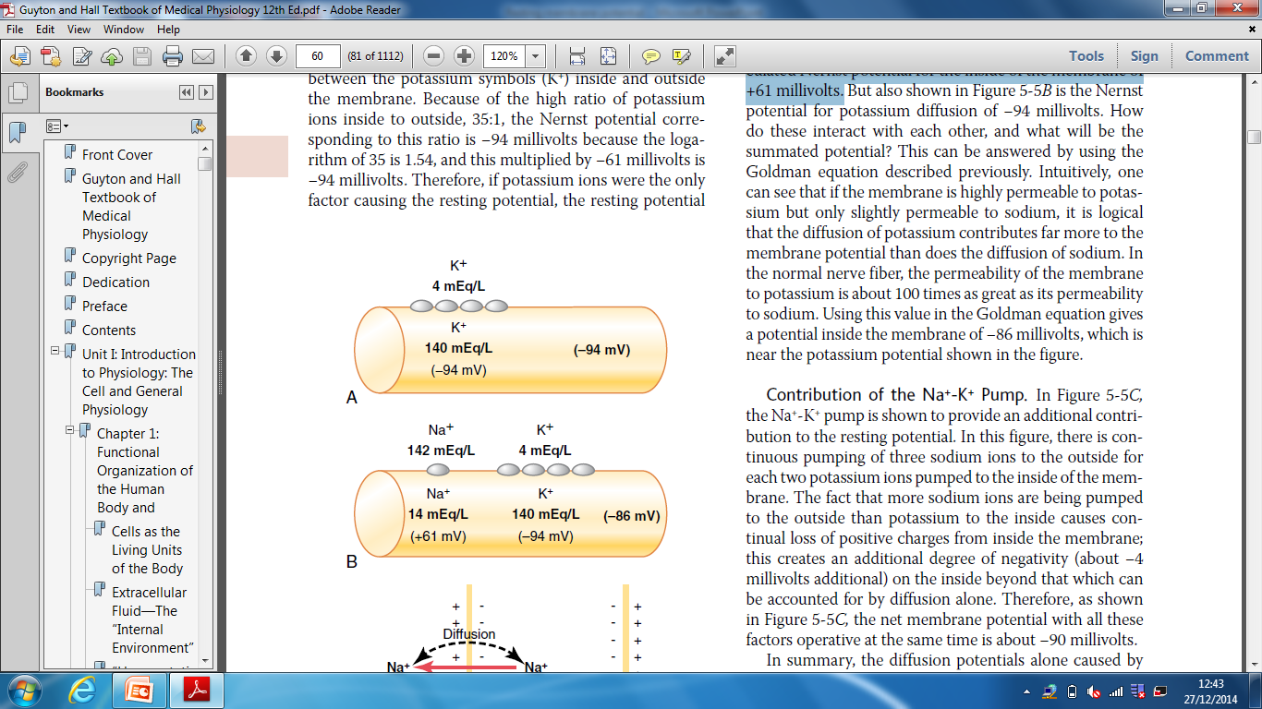
Origin of RMP:
1- Contribution of K diffusion potential:-
K+ leak channels → more K+ diffuses to outside than Na+ to inside
Outside
The ratio of potassium ions from inside to outside the membrane is 35, and this gives a calculated Nernst potential for the inside of the membrane of -94 millivolts.

Slide 12
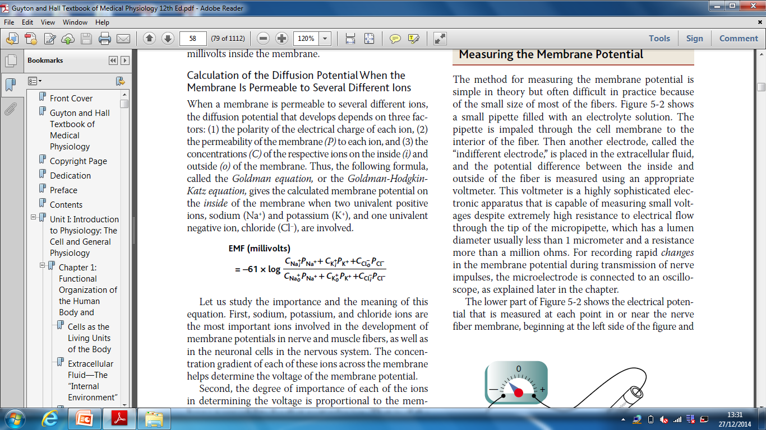
2- Contribution of Na diffusion potential:-
•Na leak channels:- have very slight permeability to Na ions from outside to inside.
The ratio of sodium ions from inside to outside the membrane is 0.1, and this gives a calculated Nernst potential for the inside of the membrane of +61 millivolts.
Using this value in the Goldman equation gives a potential inside the membrane of −86 millivolts,

Slide 13
3- Contribution of Na/K PUMP:-
- This is a powerful electrogenic pump on the cell membrane.
- It pumps 3 Na to outside & 2 K to inside, causing → net loss of +ve ions ,loss of + ve charge from inside , create negativity about - 4mV inside
Outside

Slide 14
So NET MEMBRANE POTENTIAL will be :-
Diffusion potential (caused by K & Na diffusion) + Electrogenic Na/K pump
(-86 mV ) + (- 4mV) = -90 mV
4- Effect of Large intracellular anions(negative ions) (proteins , sulphates & phosphates ), very low effect.

Slide 15
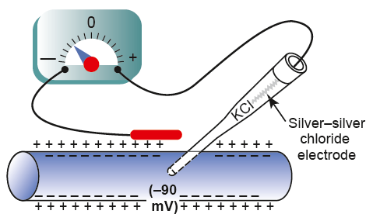
Measuring Membrane Potential
•VOLTMETER
To measure very small membrane potential difference between inside & outside as resting membrane potential . How?
• A small filled pipette (microelectrode) containing electrolyte solution is inserted inside the nerve fiber & another electrode is placed in the outside & membrane potential difference between inside & outside is measured using the voltmeter
All excitable cells exhibit an electrical potential (voltage) called resting cell membrane potential (-70 to -90mV)

Slide 16
